Slide 1
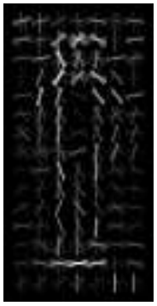
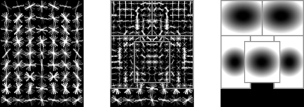
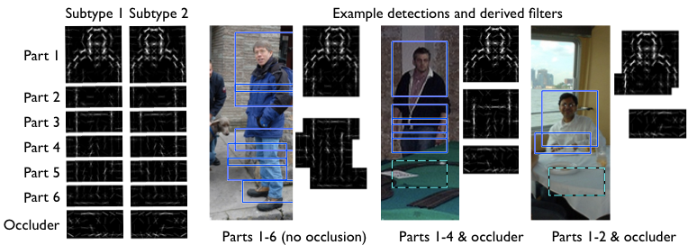
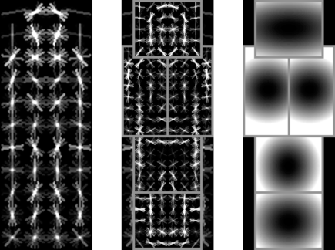
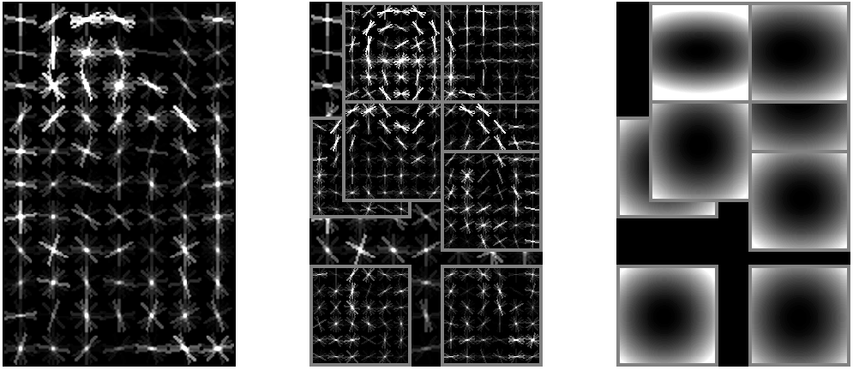
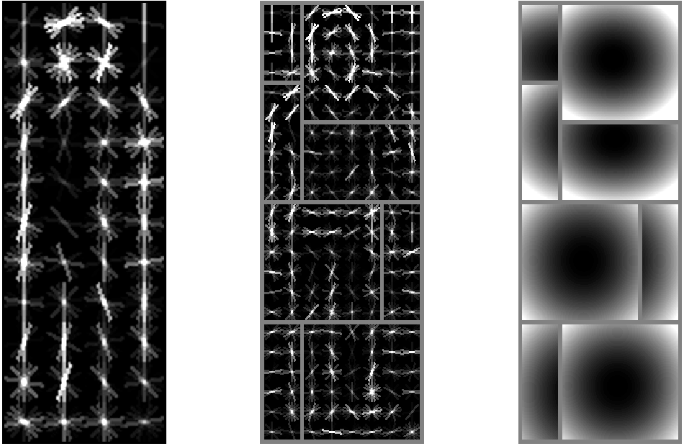
Deformable Part Models (DPM)
Felzenswalb, Girshick, McAllester & Ramanan (2010)
Slides drawn from a tutorial By R. Girshick
Part 1: modeling
Part 2: learning
AP 12% 27% 36% 45% 49%
2005 2008 2009 2010 2011
Person detection performance on PASCAL VOC 2007

Slide 2
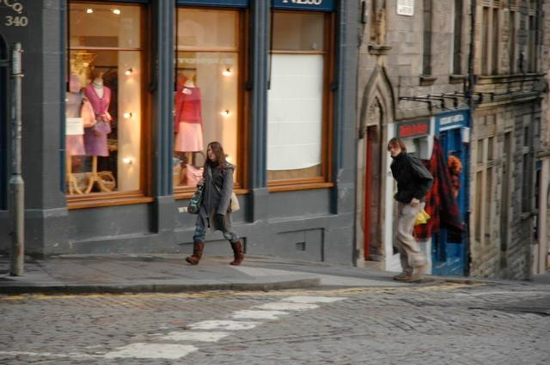
The Dalal & Triggs detector
Image pyramid

Slide 3
The Dalal & Triggs detector
Compute HOG of the whole image at multiple resolutions
Image pyramid
HOG feature pyramid

Slide 4
The Dalal & Triggs detector
Compute HOG of the whole image at multiple resolutions
Score every window of the feature pyramid
How much does the window at p look like a pedestrian?
p
w
Image pyramid
HOG feature pyramid

Slide 5
The Dalal & Triggs detector
Compute HOG of the whole image at multiple resolutions
Score every window of the feature pyramid
Apply non-maximal suppression
p
w
Image pyramid
HOG feature pyramid

Slide 6
Detection
number of locations p ~ 250,000 per image
p

Slide 7
Detection
number of locations p ~ 250,000 per image
test set has ~ 5000 images
>> 1.3x10⁹ windows to classify
p

Slide 8
Detection
number of locations p ~ 250,000 per image
test set has ~ 5000 images
>> 1.3x10⁹ windows to classify
typically only ~ 1,000 true positive locations
p

Slide 9
Detection
number of locations p ~ 250,000 per image
test set has ~ 5000 images
>> 1.3x10⁹ windows to classify
typically only ~ 1,000 true positive locations
p
Extremely unbalanced binary classification

Slide 10
Detection
number of locations p ~ 250,000 per image
test set has ~ 5000 images
>> 1.3x10⁹ windows to classify
typically only ~ 1,000 true positive locations
p
Learn w as a Support Vector Machine
(SVM)
w
Extremely unbalanced binary classification

Slide 11
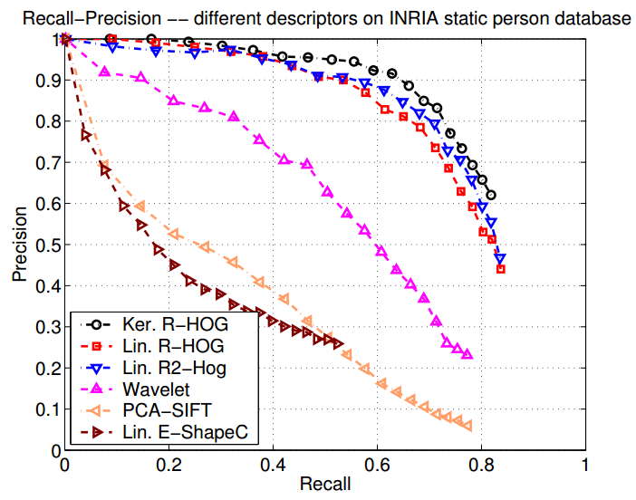
Dalal & Triggs detector on INRIA pedestrians
AP = 75%
Very good
Declare victory and go home?

Slide 12
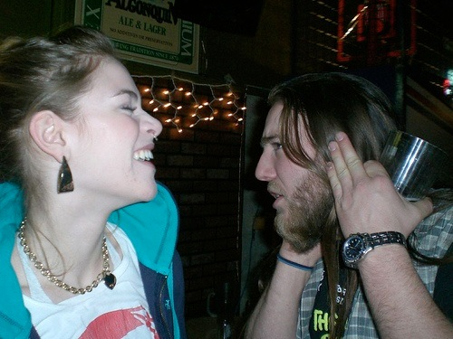
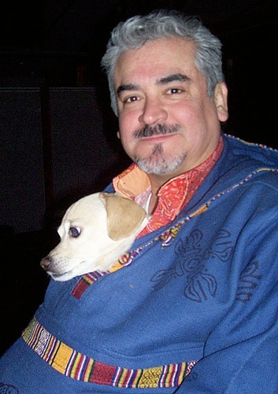
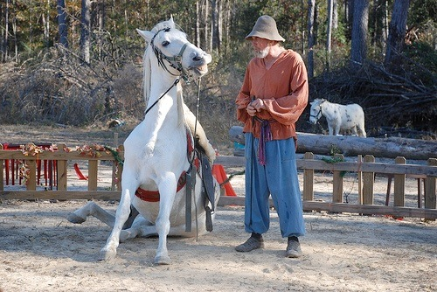
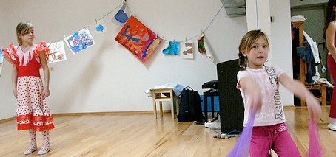
Dalal & Triggs on PASCAL VOC 2007
AP = 12%
(using my implementation)

Slide 13
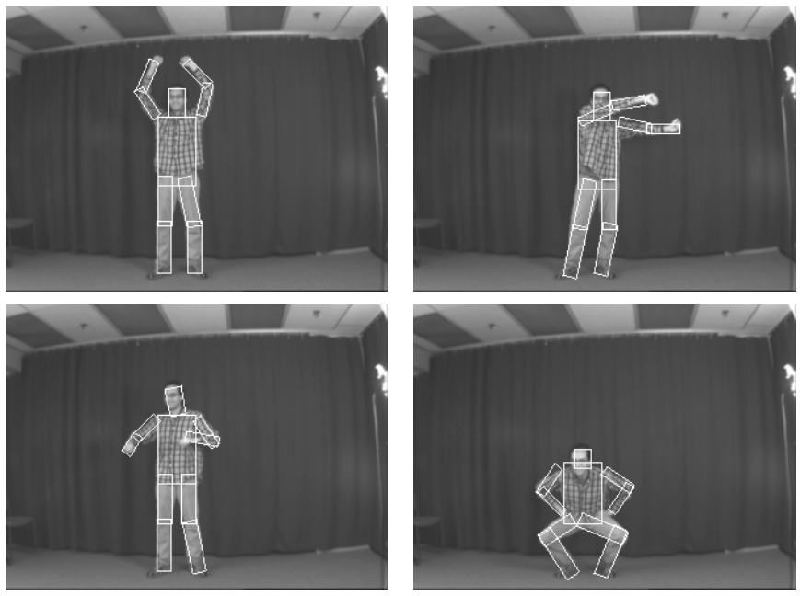
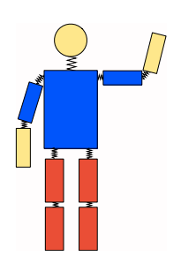
How can we do better?
Revisit an old idea: part-based models
“pictorial structures”
Combine with modern features and machine learning
Fischler & Elschlager ’73
Felzenszwalb & Huttenlocher ’00
- Pictorial structures
- Weak appearance models
- Non-discriminative training

Slide 14
DPM key idea
Port the success of Dalal & Triggs
into a part-based model
=
+
DPM
D&T
PS

Slide 15
Example DPM (most basic version)
Root
Deformation
costs
Root filter
Part filters

Slide 16
Recall the Dalal & Triggs detector
p
Image pyramid
HOG feature pyramid
HOG feature pyramid
Linear filter / sliding-window detector
SVM training to learn parameters w

Slide 17
DPM = D&T + parts
p0
z
root
Image pyramid
HOG feature pyramid
[FMR CVPR’08]
[FGMR PAMI’10]
Add parts to the Dalal & Triggs detector
HOG features
Linear filters / sliding-window detector
Discriminative training

Slide 18
Sliding window detection with DPM
p0
z
root
Image pyramid
HOG feature pyramid
Filter scores
Spring costs

Slide 19
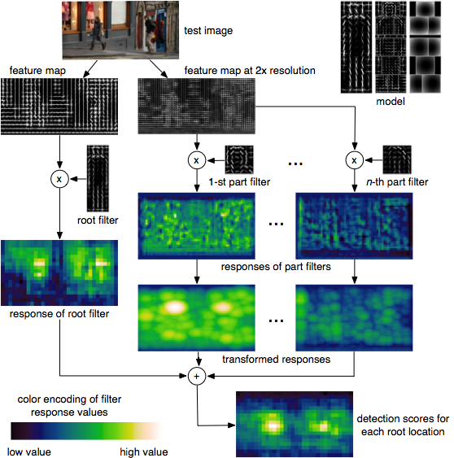
DPM detection
Notes:
For now, suppose we magically have a model...how do we detect?
5 minute break

Slide 20
DPM detection
Root scale Part scale
repeat for each level in pyramid
Notes:
For now, suppose we magically have a model...how do we detect?
5 minute break

Slide 21
DPM detection
Notes:
For now, suppose we magically have a model...how do we detect?
5 minute break

Slide 22
DPM detection
Notes:
For now, suppose we magically have a model...how do we detect?
5 minute break

Slide 23
DPM detection
Generalized distance transform
Felzenszwalb & Huttenlocher ‘00
Notes:
For now, suppose we magically have a model...how do we detect?
5 minute break

Slide 24
DPM detection
Notes:
For now, suppose we magically have a model...how do we detect?
5 minute break

Slide 25
DPM detection
All that’s left: combine evidence
Notes:
For now, suppose we magically have a model...how do we detect?
5 minute break

Slide 26
DPM detection
downsample
downsample
Notes:
For now, suppose we magically have a model...how do we detect?
5 minute break

Slide 27
Person detection progress
Progress bar:
AP 12% 27% 36% 45% 49%
2005 2008 2009 2010 2011

Slide 28
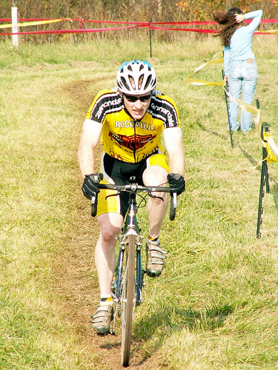
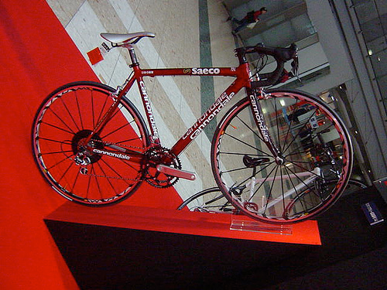
One DPM is not enough: What are the parts?

Slide 29
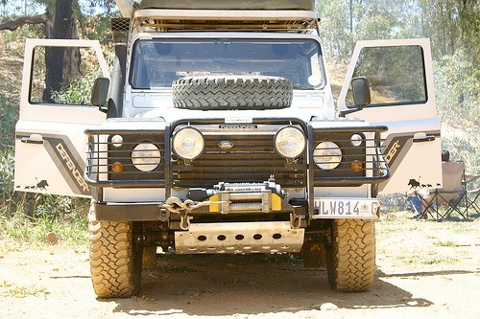
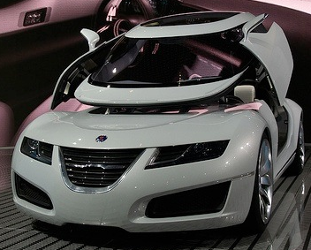
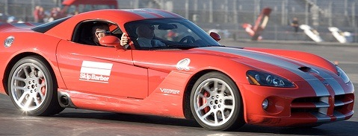
Aspect soup
General philosophy: enrich models to better represent the data

Slide 30
Mixture models
Data driven: aspect, occlusion modes, subclasses
Progress bar:
AP 12% 27% 36% 45% 49%
2005 2008 2009 2010 2011

Slide 31
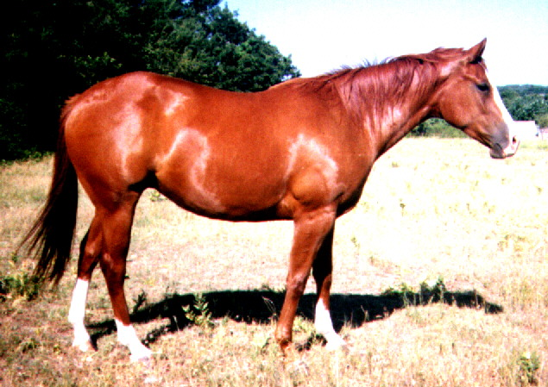
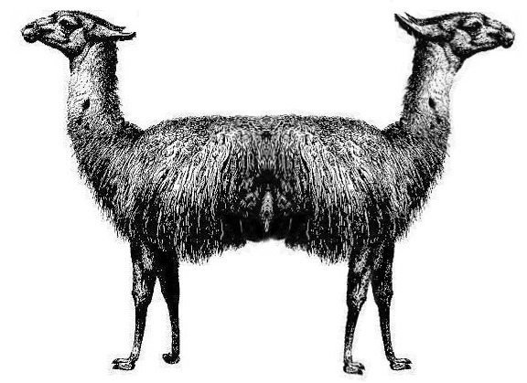
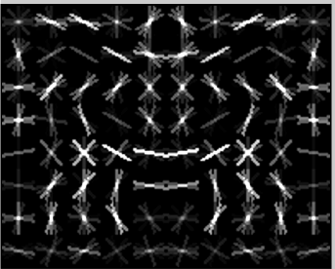
Pushmi–pullyu?
Good generalization properties on Doctor Dolittle’s farm
( + ) / 2 =
This was supposed to
detect horses

Slide 32
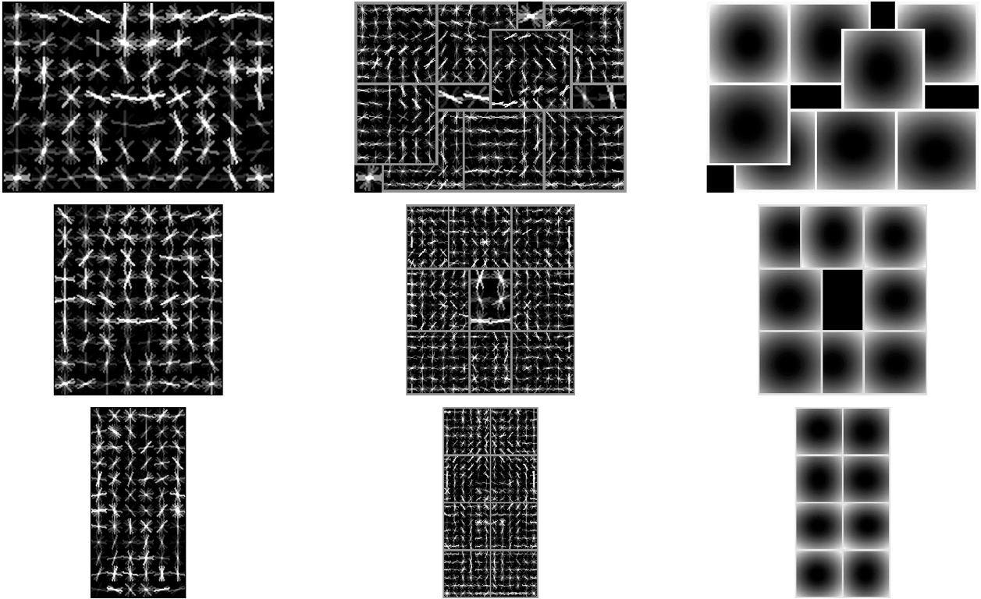
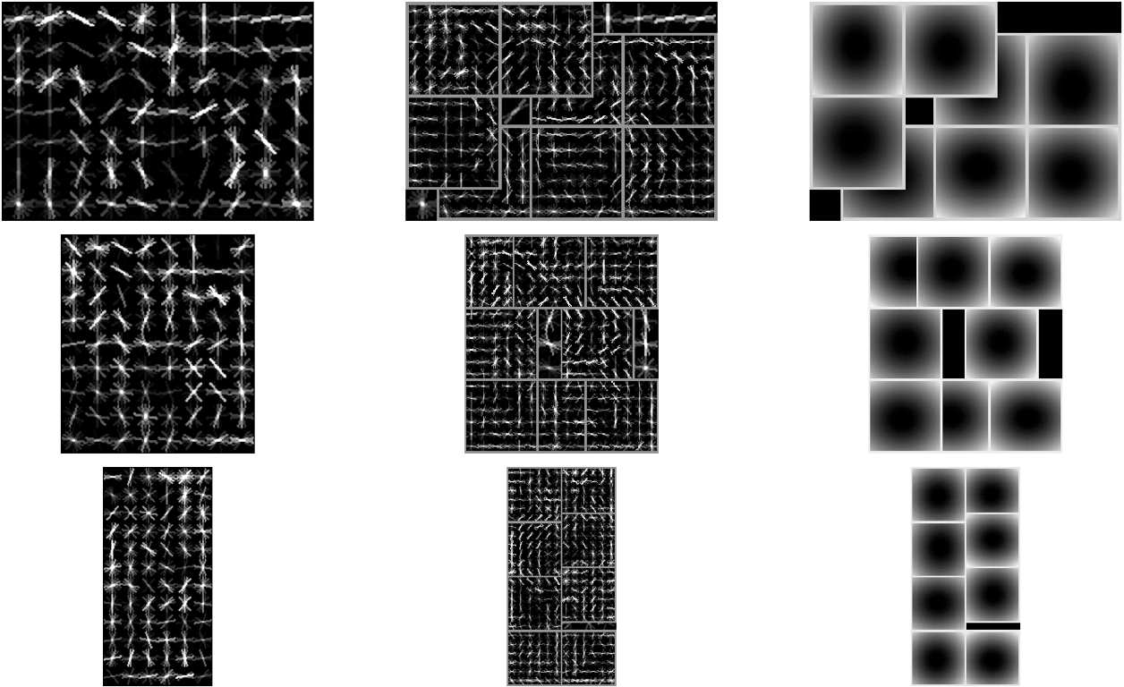
Latent orientation
Unsupervised left/right orientation discovery
horse AP
0.42
0.47
0.57
Progress bar:
AP 12% 27% 36% 45% 49%
2005 2008 2009 2010 2011

Slide 33
Summary of results
[DT’05]
AP 0.12
[FMR’08]
AP 0.27
[FGMR’10]
AP 0.36
[GFM voc-release5]
AP 0.45
[Girshick, Felzenszwalb, McAllester ’11]
AP 0.49
Object detection with grammar models
Code at www.cs.berkeley.edu/~rbg/voc-release5

Slide 34
Part 2: DPM parameter learning
given fixed model structure
?
?
?
?
?
?
?
?
?
?
?
?
component 1
component 2

Slide 35
Part 2: DPM parameter learning
given fixed model structure
training images y
?
?
?
?
?
?
+1
?
?
?
?
?
?
component 1
component 2

Slide 36
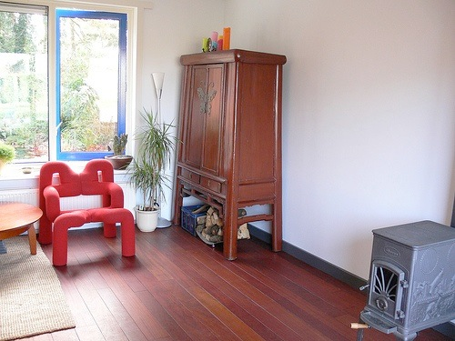
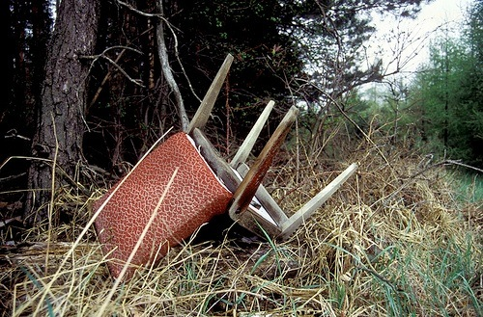
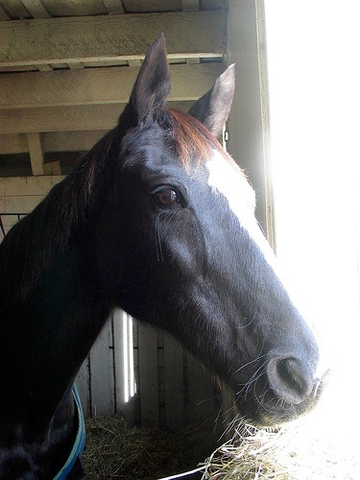
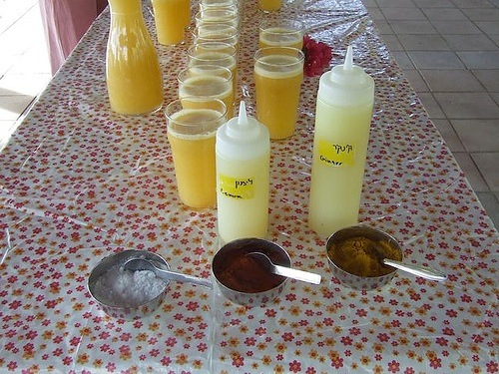
Part 2: DPM parameter learning
given fixed model structure
training images y
?
?
?
?
?
?
+1
?
?
?
?
?
?
component 1
component 2
-1

Slide 37
Part 2: DPM parameter learning
given fixed model structure
training images y
?
?
?
?
?
?
+1
?
?
?
?
?
?
component 1
component 2
Parameters to learn:
– biases (per component)
– deformation costs (per part)
– filter weights
-1

Slide 38
Linear parameterization of sliding window score
Filter scores
Spring costs
Filter scores
Spring costs

Slide 39
Positive examples (y = +1)
x specifies an image and bounding box
person
We want
to score >= +1
includes all z with more than 70% overlap with ground truth

Slide 40
Positive examples (y = +1)
x specifies an image and bounding box
person
We want
At least one
configuration
scores high
to score >= +1
includes all z with more than 70% overlap with ground truth

Slide 41
Negative examples (y = -1)
x specifies an image and a HOG pyramid location p0
p0
z
We want
to score <= -1
restricts the root to p0 and allows any placement of the other filters

Slide 42
Negative examples (y = -1)
x specifies an image and a HOG pyramid location p0
p0
z
We want
All configurations
score low
to score <= -1
restricts the root to p0 and allows any placement of the other filters

Slide 43
Typical dataset
300 – 8,000 positive examples
500 million to 1 billion negative examples
(not including latent configurations!)
Large-scale optimization!

Slide 44
How we learn parameters: latent SVM

Slide 45
How we learn parameters: latent SVM
P: set of positive examples
N: set of negative examples

Slide 46
Latent SVM and Multiple Instance Learning via MI-SVM
Latent SVM is mathematically equivalent to MI-SVM
(Andrews et al. NIPS 2003)
Latent SVM can be written as a latent structural SVM
(Yu and Joachims ICML 2009)
– natural optimization algorithm is concave-convex procedure
– similar to, but not exactly the same as, coordinate descent
z1
xi1
z3
xi3
z2
xi2
latent labels for xi
bag of instances for xi

Slide 47
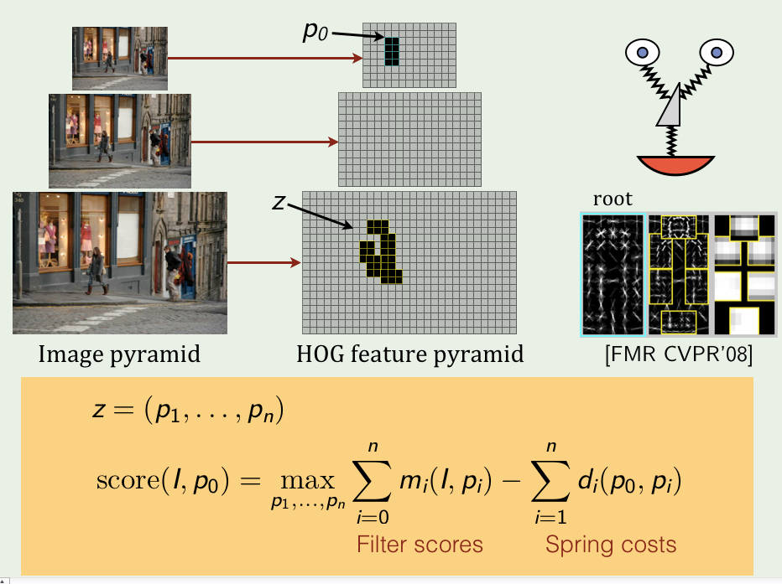
Step 1
This is just detection:
We know how to do this!

Slide 48
Step 2
Convex!

Slide 49
Step 2
Convex!
Similar to a structural SVM

Slide 50
Step 2
Convex!
Similar to a structural SVM
But, recall 500 million to 1 billion negative examples!

Slide 51
Step 2
Convex!
Similar to a structural SVM
But, recall 500 million to 1 billion negative examples!
Can be solved by a working set method
– “bootstrapping”
– “data mining” / “hard negative mining”
– “constraint generation”
– requires a bit of engineering to make this fast

Slide 52
What about the model structure?
Given fixed model structure
training images y
?
?
?
?
?
?
+1
?
?
?
?
?
?
component 1
component 2
Model structure
– # components
– # parts per component
– root and part filter shapes
– part anchor locations
-1

Slide 53
Learning model structure
1a. Split positives by aspect ratio
1b. Warp to common size
1c. Train Dalal & Triggs model for each aspect ratio on its own

Slide 54
Learning model structure
2a. Use D&T filters as initial w for LSVM training
Merge components
2b. Train with latent SVM
Root filter placement and component choice are latent

Slide 55
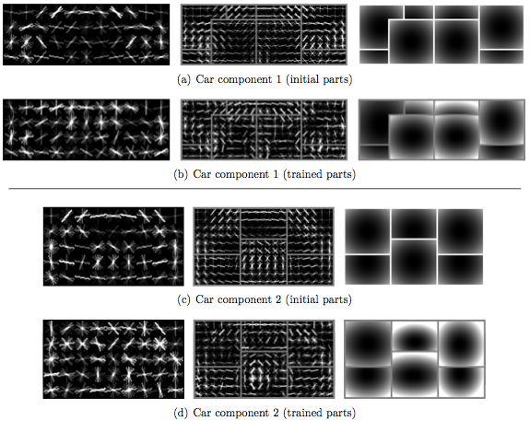
Learning model structure
3a. Add parts to cover high-energy areas of root filters
3b. Continue training model with LSVM

Slide 56
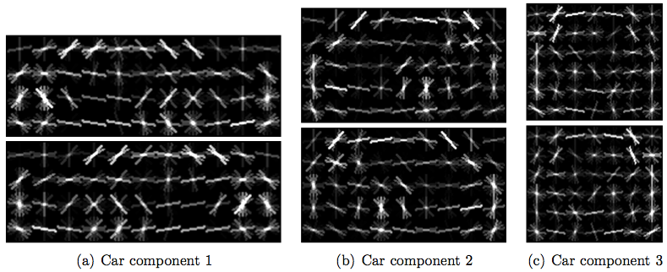
Learning model structure
without orientation clustering
with orientation clustering

Slide 57
Learning model structure
In summary
– repeated application of LSVM training to models of increasing complexity
– structure learning involves many heuristics — still a wide open problem!

