Slide 1
Scene Understanding from RGB-D Images
Object Detection, Semantic and Instance Segmentation
Pose Estimation
Saurabh Gupta, Ross Girshick, Pablo Arbeláez, Jitendra Malik
UC Berkeley

Slide 2
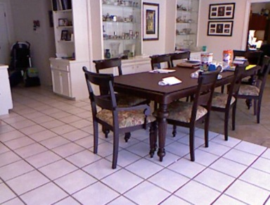
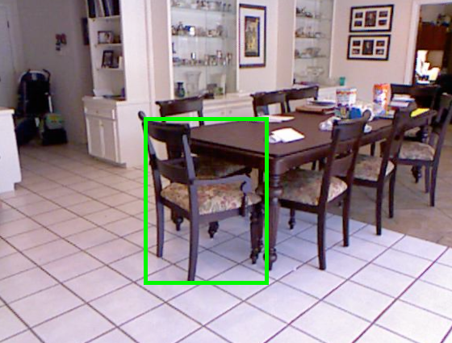
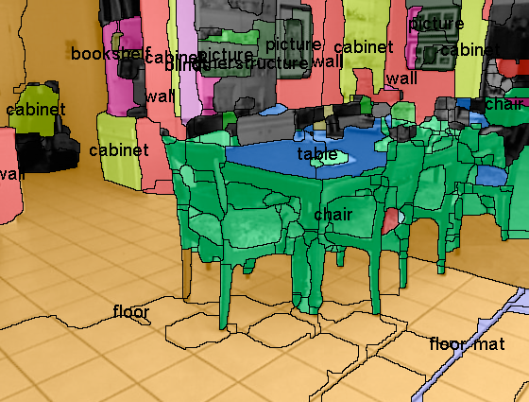
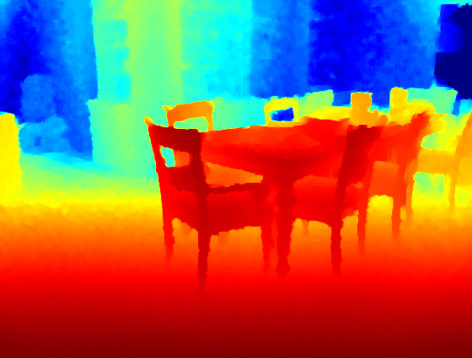
Scene Understanding
Motivation
Object Detection
Semantic Segm.
Good first steps
But we want to know much more
Instance Segmentation
Object Parsing
Sub categorization
How to manipulate/grasp?
Material Properties
Pose

Slide 3
Detailed 3D Understanding
Instance Segmentation
Object Parsing
Pose
How to manipulate/grasp?
Sub categorization
Material Properties
All these tasks are related, doing one will help the other

Slide 4
Detailed 3D Understanding
Instance Segmentation
Object Parsing
Pose
How to manipulate/grasp?
3D Model
Sub categorization
Material Properties
All these tasks are related, doing one will help the other
Estimating the 3D model explains all of these

Slide 5
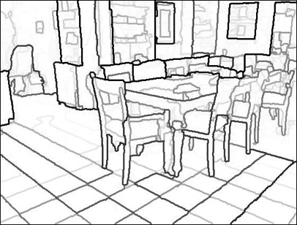
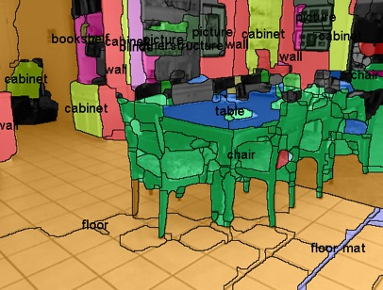
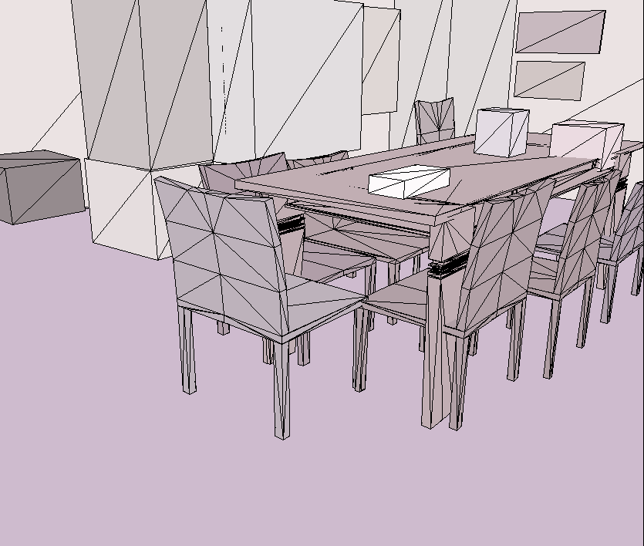
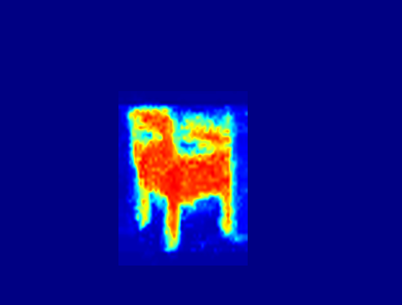
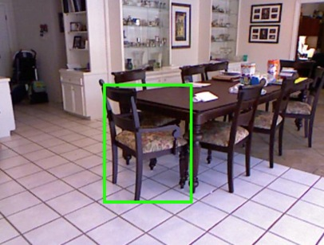
Overview
Input
Re-organization
Recognition
Detailed 3D Understanding
Contour Detection
Semantic Segm.
Color and Depth
Image Pair
Instance Segm.
Object Detection
Region Proposal
Generation
Pose Estimation

Slide 6
Object Detection, Segmentation and Pose Estimation for RGB-D Images
S. Gupta, P. Arbeláez and J. Malik Perceptual Organization and Recognition of Indoor Scenes from RGB-D Images, CVPR 2013 (oral)
S. Gupta, R. B. Girshick, P. Arbeláez, and J. Malik Object Detection and Segmentation using Semantically Rich Image and Depth Features ECCV 2014
S. Gupta, P. Arbeláez, R. B. Girshick, and J. Malik Indoor Scene Understanding with RGB-D Images: Bottom-up Segmentation, Object Detection and Semantic Segmentation IJCV 2014
S. Gupta, P. Arbeláez, R. B. Girshick, and J. Malik Aligning 3D Models to RGB-D Images of Cluttered Scenes CVPR 2015, available on arXiv

Slide 7
Overview
Input
Re-organization
Recognition
Detailed 3D Understanding
Contour Detection
Semantic Segm.
Color and Depth
Image Pair
Instance Segm.
Object Detection
Region Proposal
Generation
Pose Estimation

Slide 8
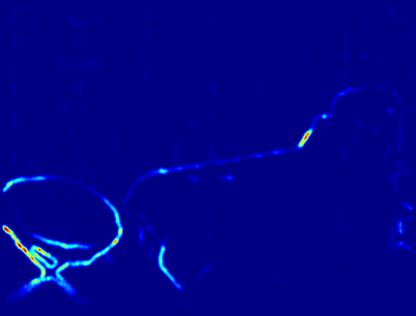
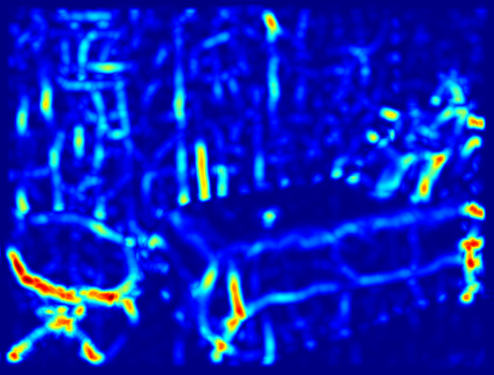
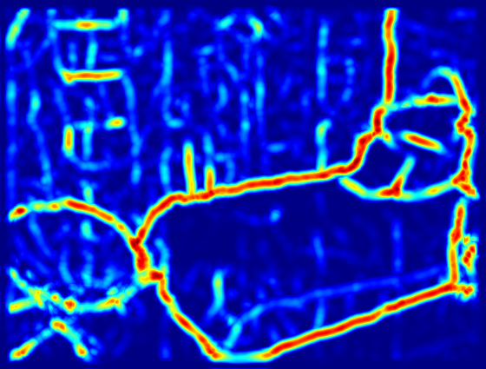
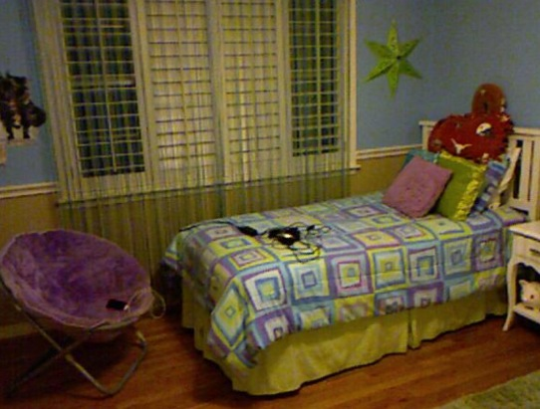
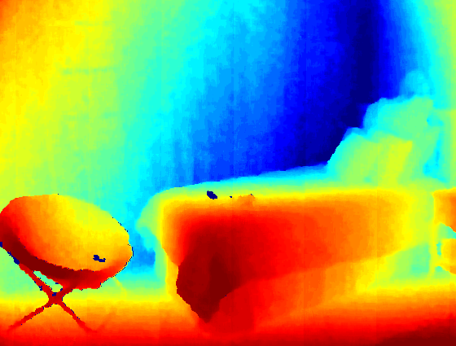
Local Gradients on Depth Images
Depth Gradient,
DG
Convex
Normal Gradient,
NG+
Concave
Normal Gradient,
NG-
Input Depth Image
Multi-scale Local Gradients from Depth Images
Important to differentiate between convex and concave normal gradients

Slide 9
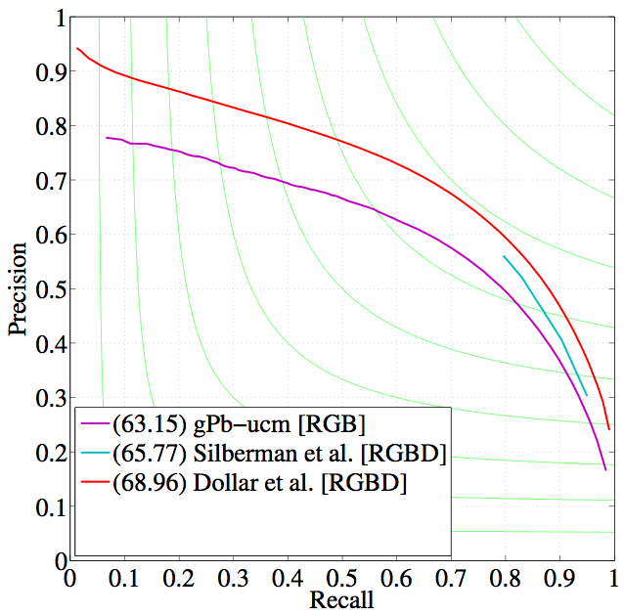
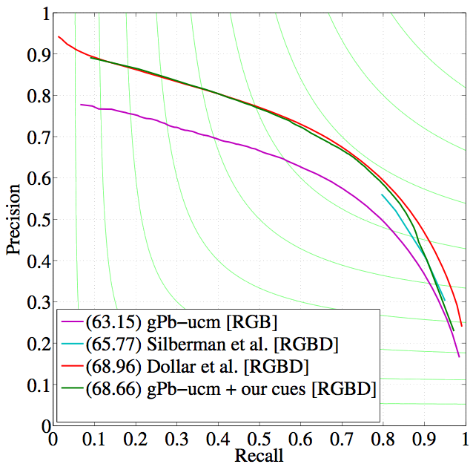
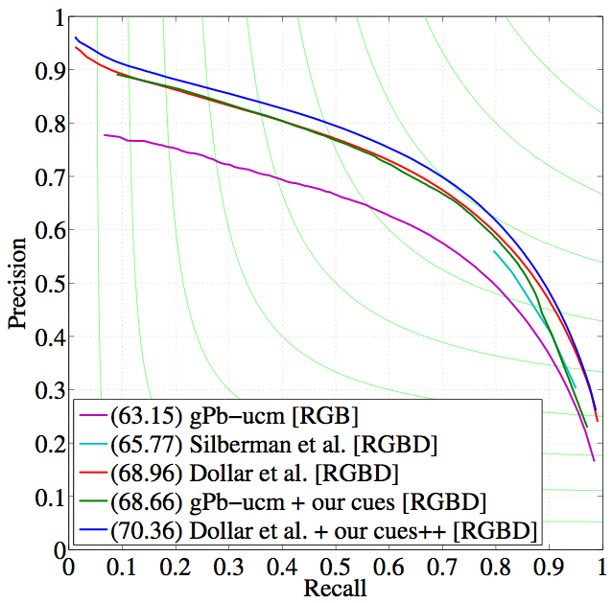
Using Local Gradients for Contour Detection
Use with gPb-UCM
Use with Dollar et al.’s structured edges
Method |  | max F
gPb-UCM | RGB | 63.15
Silberman et al. | RGB-D | 65.77
Dollar et al. | RGB-D | 68.96
Our (gPb-UCM + our cues) | RGB-D | 68.66
Our (Dollar et al. + our cues++) | RGB-D | 70.36
Arbeláez et al. Contour Detection and Hierarchical Image Segmentation, PAMI 2011
P. Dollar and L. Zitnick Structured Forests for fast edge detection, ICCV 2013
S. Gupta, P Arbeláez, J. Malik Perceptual Organization and Recognition in Indoor RGB-D Images, CVPR 2013
S. Gupta, R. Girshick, P Arbeláez, J. Malik , Object Detection and Segmentation using Semantically Rich Image and Depth Features, ECCV 2014

Slide 10
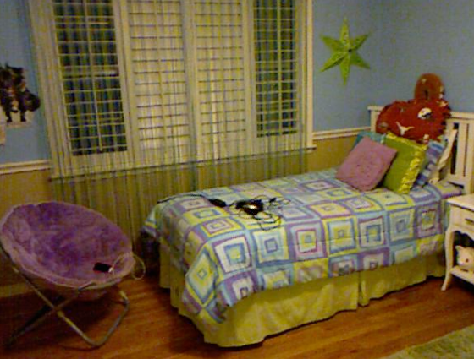
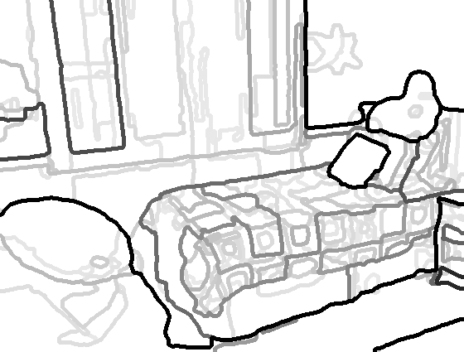
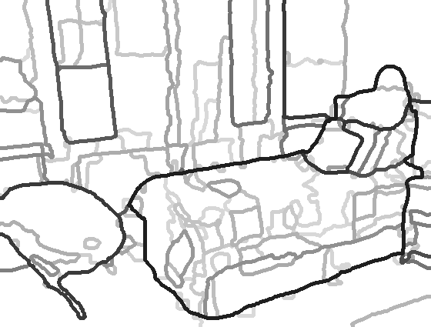
Results
Less distracted by albedo
Higher Recall
RGB
gPb-UCM(RGB)
Higher Precision
More Complete Objects
D
This Work (RGB-D)

Slide 11
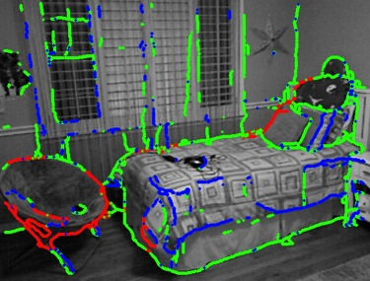
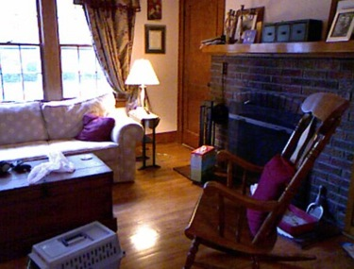
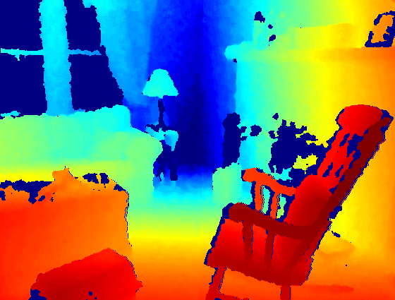
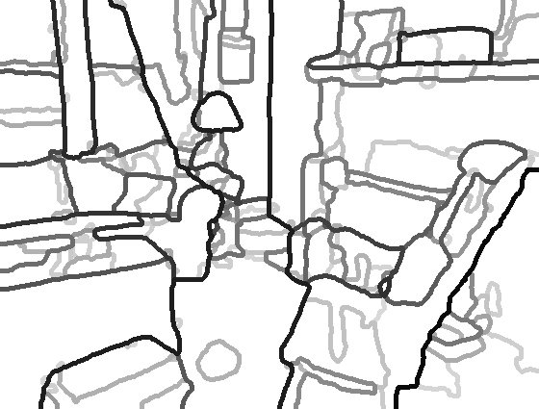
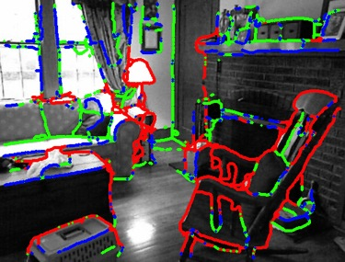
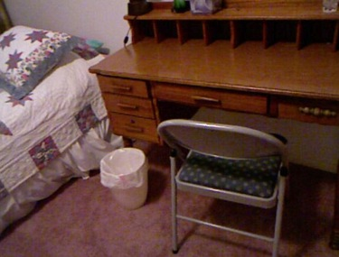
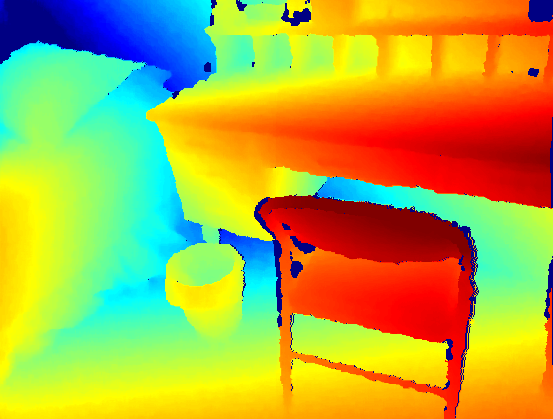
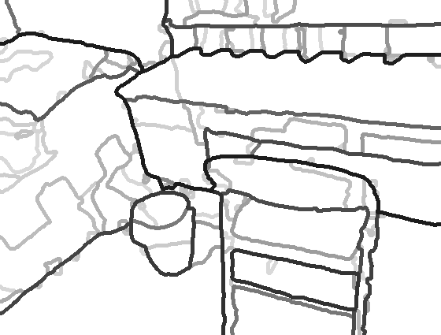
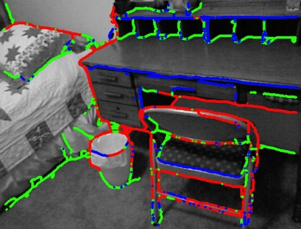
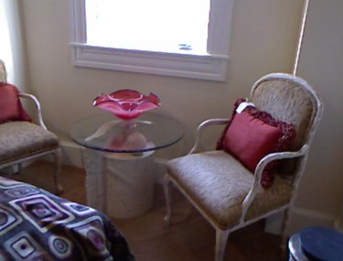
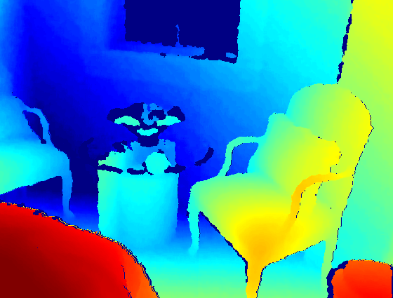
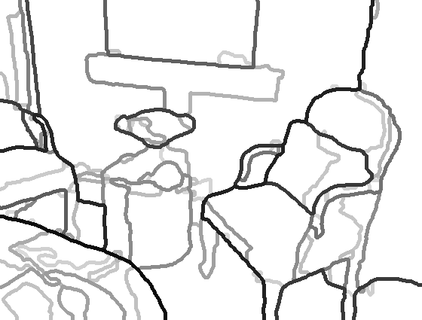
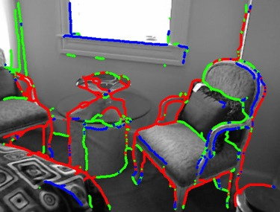
Results
RGB
Depth
Contours
Contour Labels
Depth
Discontinuities
(Red)
Convex
Normal
Discontinuities
(Blue)
Concave
Normal
Discontinuities
(Green)

Slide 12
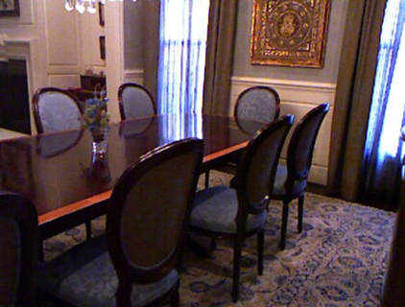
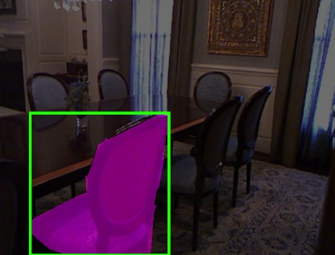
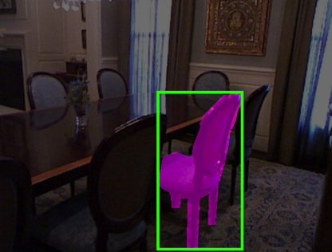
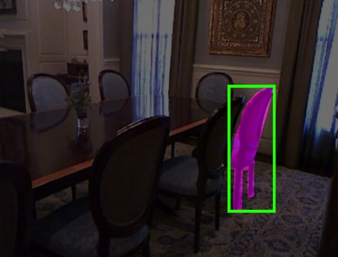
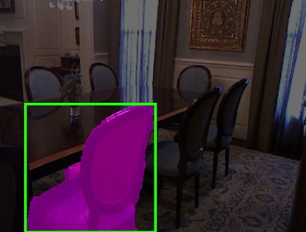
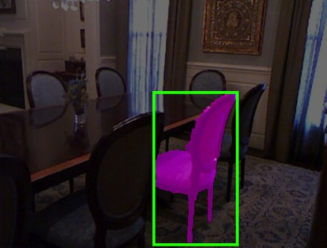
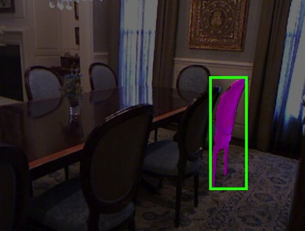
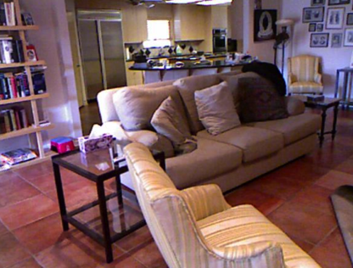
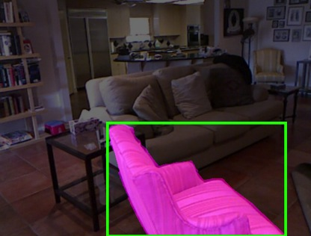
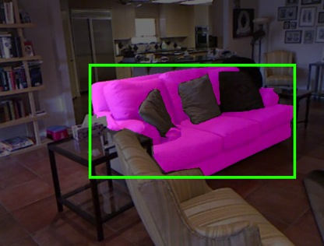
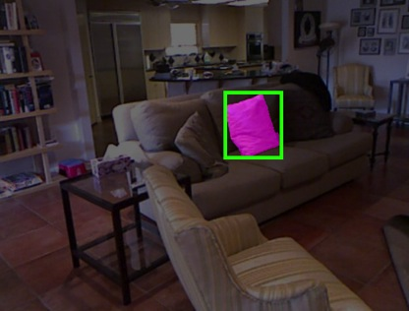
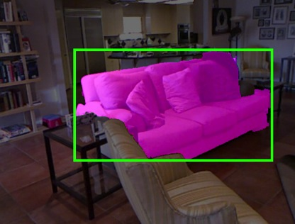
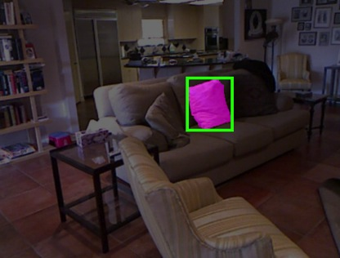
Examples
GT Mask
Best Proposal
@500
GT Mask
Best Proposal
@500

Slide 13
Overview
Input
Re-organization
Recognition
Detailed 3D Understanding
Contour Detection
Semantic Segm.
Color and Depth
Image Pair
Instance Segm.
Object Detection
Region Proposal
Generation
Pose Estimation

Slide 14
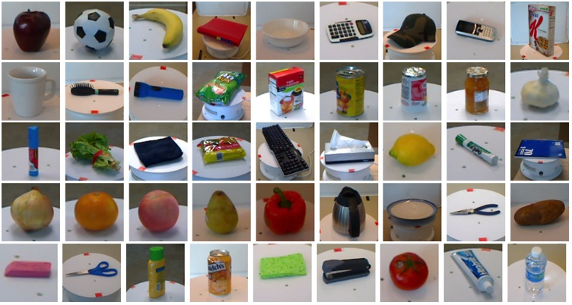
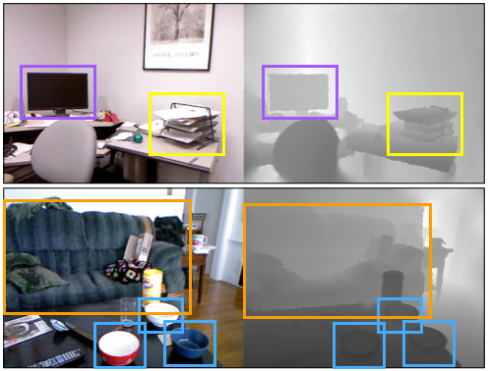
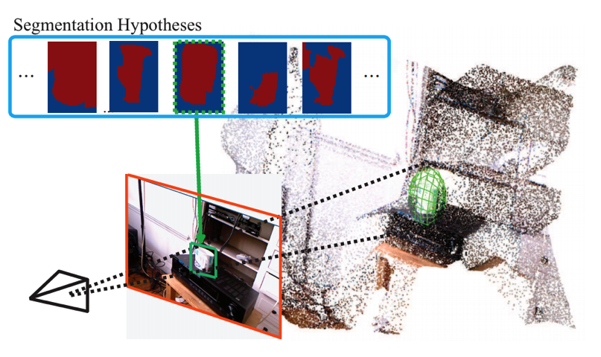
Object Detection
Related Work [RGB-D, Robotics]
Lai et al. ICRA 2011, A Large-Scale Hierarchical Multi-View RGB-D Object Dataset: RGB-D DPM, but instances and small table-top objects
Tang et al. ICRA 2012, A Textured Object Recognition Pipeline for Color and Depth Image Data: Appearance matching, geometric verification
Janoch et al. ICCV-W 2011, A Category-Level 3-D Object Dataset: Putting the Kinect to Work, Absolute size based pruning and re-scoring with DPMs
Kim et al. CVPR 2013, Accurate Localization of 3D Objects from RGB-D Data using Segmentation Hypotheses, Extension to DPMs to model deformations in 3D

Slide 15
State of the Art in RGB Recognition
(Slide from D. Hoiem)

Slide 16
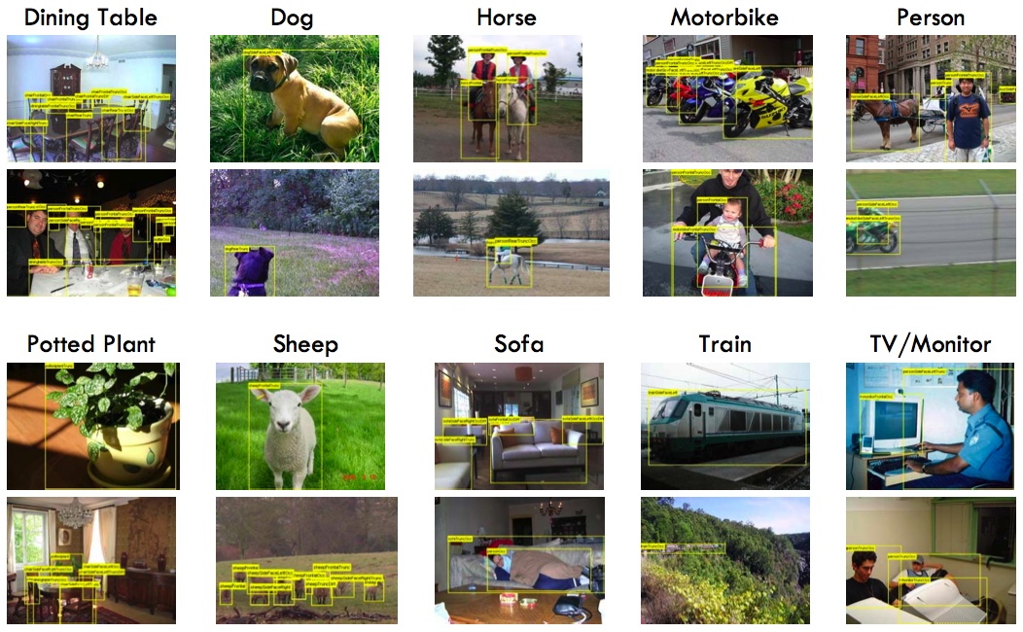
PASCAL Visual Object Challenge
(Everingham et al)

Slide 17
R-CNN: Regions with CNN features Girshick, Donahue, Darrell & Malik (CVPR 2014)
Extract region
proposals (~2k / image)
Input
image
Compute CNN
features
Classify regions
(linear SVM)
CNN features are inspired by the
architecture of the visual system

Slide 18
CNN Features ?
Convolutional Neural Network
Train on a large dataset
How to learn features for RGB-D Images ??
Generic representation useful for for a variety of tasks
LeCun et al., Backpropagation applied to handwritten zip code recognition. Neural Computation (1989)
Krizhevsky et al., ImageNet classification with deep convolutional neural networks. In NIPS (2012)

Slide 19
Object Detection in RGB-D images
Key Insights
Depth Images are image-like enough to use Convolutional Neural Network models
Geocentric embedding into Horizontal Disparity, Height Above Ground, and Angle with Gravity (HHA) works better than just raw disparity
Synthetic depth data can help

Slide 20
Object Detection
Test Set
 | mean | bath tub | bed | book shelf | box | chair | counter | desk | door | dresser | garbage bin | lamp | monitor | night stand | pillow | sink | sofa | table | television | toilet
RGB DPM | 9 | 1 | 28 | 9 | 0 | 8 | 7 | 1 | 3 | 1 | 7 | 22 | 10 | 9 | 4 | 6 | 9 | 6 | 6 | 34
RGBD DPM | 24 | 19 | 56 | 18 | 1 | 24 | 24 | 6 | 10 | 16 | 27 | 27 | 35 | 33 | 21 | 23 | 34 | 17 | 20 | 45
RGB RCNN | 22 | 17 | 45 | 28 | 1 | 26 | 30 | 10 | 16 | 19 | 16 | 28 | 32 | 17 | 11 | 17 | 29 | 13 | 27 | 44
Our | 39 | 36 | 71 | 35 | 4 | 47 | 47 | 15 | 23 | 39 | 44 | 38 | 53 | 41 | 42 | 44 | 52 | 22 | 38 | 48

Slide 21
Object Detection
For Semantic Segmentation
Use output from object detectors to compute additional features for superpixels
Feature Computation
1. Highest scoring detection
2. Use as features for the superpixel
detection score
overlap
difference in mean depth of superpixel and detection
non-linear combinations

Slide 22
Object Detection
For Semantic Segmentation (Performance)
40 Class Task
Scene Surfaces - Floors, walls, ceiling, windows, doors, ...
Furniture - Beds, chairs, sofa, table, desks, ...
Objects - Pillow, books, bottles, ...
Ground Truth 40 Class
 | Silberman et al. ECCV 12 | Ren et al. CVPR 12 | Gupta et al. CVPR 13 | Gupta et al. (13) + RGB-D DPM | Gupta et al. (13) + Our Obj Det.
fwavacc | 38.2 | 37.6 | 43.4 | 45.2 | 47
avacc | 19 | 20.5 | 24.3 | 27.3 | 28.6
mean (maxIU) | - | 21.4 | 27.9 | 29.6 | 31.3
pixacc | 54.6 | 49.3 | 57.9 | 59 | 60.3
obj avg | 18.4 | 21.1 | 26.4 | 31.1 | 35.1
Silberman et al., ECCV12, Indoor segmentation and support inference from RGBD images.
Ren et al., CVPR12, RGB-(D) scene labeling: Features and algorithms
Gupta et al., CVPR13, Perceptual Organization and Recognition of Indoor Scenes from RGB-D Images.

Slide 23
Overview
Input
Re-organization
Recognition
Detailed 3D Understanding
Contour Detection
Semantic Segm.
Color and Depth
Image Pair
Instance Segm.
Object Detection
Region Proposal
Generation
Pose Estimation

Slide 24
Instance Segmentation
Task
Detect and segment objects
Hariharan et al., ECCV14, Simultaneous Localization and Detection

Slide 25
Instance Segmentation
Method
-
-
-
-
Box CNN
Chair
-
-
-
-
Classifier
Region CNN

Slide 26
Instance Segmentation

Slide 27
Instance Segmentation
For Semantic Segmentation (Performance)
40 class task
 | Silberman et al. ECCV 12 | Ren et al. CVPR 12 | Gupta et al. CVPR 13 | Gupta et al. (13) + RGB-D DPM | Gupta et al. (13) + Our Obj Det. | + Instance Segm.
fwavacc | 38.2 | 37.6 | 43.4 | 45.2 | 47 | 47.74
avacc | 19 | 20.5 | 24.3 | 27.3 | 28.6 | 29.71
mean (maxIU) | - | 21.4 | 27.9 | 29.6 | 31.3 | 32.90
pixacc | 54.6 | 49.3 | 57.9 | 59 | 60.3 | 62.24
obj avg | 18.4 | 21.1 | 26.4 | 31.1 | 35.1 | 37.50

Slide 28
Pose Estimation
[ECCV 14]
Instance
Segmentation
Estimate
Coarse Pose
Align to data
Input
3D reasoning by initial 2D processing and then ‘lifting’ to 3D
Learning from synthetic data and generalizing to real data
Starting with weak annotation (instance segmentation) able to produce a much richer output
Search over scale, placement and sub-type to minimize
re-projection error
3 layer CNN on normal images trained on synthetic data
28
[ECCV 14] Learning rich features from RGB-D images for object detection and segmentation. In ECCV 14.
Notes:
To solve this grand problem, we proceed in steps. First we study re-organization or bottom-up grouping problems. We consider 2 problems here contour detection and region proposal generation. We then start studying semantic problems that of semantic segmentaion and object detection.
Most of this is work that I have already done over the last 3 years. The underlying theme in all this work is the observation that depth image are more than just images and require new techniques to be developed to fully utilize the information available from them, and the talk will focus on how techniques for analysis of depth images differ from those that have so far been developed for RGB images in the vision literature, and I will show how the techniques that I have developed for analysis of depth images achieve state-of-the-art performance on all of the 4 tasks that i have studied so far.
After describing my approach for solving these 4 problems, I will go on to describe how we can use the representation developed so far to move towards complete 3D understanding of the scene, and I will describe work on 2 such problems - instance segmentation and pose estimation and propose a plan for the next 2 years towards fulfilling the goal of complete 3D understanding of the scene.
%% Here is an overview of the talk. We start with a color and depth image pair as obtained from a Microsoft Kinect. We first study the problems of Re-organization, where we contour detection, amodal completion (which is the problem of completing surfaces behind occluders), and generation of bottom-up region candidates from RGB-D image pairs. We then go on to investigate semantic problems and study the classical problems of semantic segmentation and object detection for RGB-D images, and how information from object detectors can be used to improve the performance on the semantic segmentation task. Finally, where I want to go with this is to obtain a rich 3D understanding of the given scene from a single RGB-D image pair, and will show preliminary results on instance segmentation and pose estimation and propose a plan for subsequent steps.

Slide 29
Coarse Pose Estimation
Train on synthetic data (pose aligned CAD models [Wu et al.] rendered in scales and positions they occur in scenes)
Input representation
HHA (depth, height above ground, angle with gravity) images don’t have azimuth information
Normal Images
Desirable to be robust to occlusion
Depth images are ‘simpler’, so we use a shallow network
Use a shallow 3 layer fully convolutional network (average pooling to predict)
Wu et al. 3D ShapeNets for 2.5D Object Recognition and Next-Best-View Prediction. In arXiv 14
29
Notes:
To solve this grand problem, we proceed in steps. First we study re-organization or bottom-up grouping problems. We consider 2 problems here contour detection and region proposal generation. We then start studying semantic problems that of semantic segmentaion and object detection.
Most of this is work that I have already done over the last 3 years. The underlying theme in all this work is the observation that depth image are more than just images and require new techniques to be developed to fully utilize the information available from them, and the talk will focus on how techniques for analysis of depth images differ from those that have so far been developed for RGB images in the vision literature, and I will show how the techniques that I have developed for analysis of depth images achieve state-of-the-art performance on all of the 4 tasks that i have studied so far.
After describing my approach for solving these 4 problems, I will go on to describe how we can use the representation developed so far to move towards complete 3D understanding of the scene, and I will describe work on 2 such problems - instance segmentation and pose estimation and propose a plan for the next 2 years towards fulfilling the goal of complete 3D understanding of the scene.
%% Here is an overview of the talk. We start with a color and depth image pair as obtained from a Microsoft Kinect. We first study the problems of Re-organization, where we contour detection, amodal completion (which is the problem of completing surfaces behind occluders), and generation of bottom-up region candidates from RGB-D image pairs. We then go on to investigate semantic problems and study the classical problems of semantic segmentation and object detection for RGB-D images, and how information from object detectors can be used to improve the performance on the semantic segmentation task. Finally, where I want to go with this is to obtain a rich 3D understanding of the given scene from a single RGB-D image pair, and will show preliminary results on instance segmentation and pose estimation and propose a plan for subsequent steps.

Slide 30
Coarse Pose Estimation
Test on Synthetic Data
30
Notes:
To solve this grand problem, we proceed in steps. First we study re-organization or bottom-up grouping problems. We consider 2 problems here contour detection and region proposal generation. We then start studying semantic problems that of semantic segmentaion and object detection.
Most of this is work that I have already done over the last 3 years. The underlying theme in all this work is the observation that depth image are more than just images and require new techniques to be developed to fully utilize the information available from them, and the talk will focus on how techniques for analysis of depth images differ from those that have so far been developed for RGB images in the vision literature, and I will show how the techniques that I have developed for analysis of depth images achieve state-of-the-art performance on all of the 4 tasks that i have studied so far.
After describing my approach for solving these 4 problems, I will go on to describe how we can use the representation developed so far to move towards complete 3D understanding of the scene, and I will describe work on 2 such problems - instance segmentation and pose estimation and propose a plan for the next 2 years towards fulfilling the goal of complete 3D understanding of the scene.
%% Here is an overview of the talk. We start with a color and depth image pair as obtained from a Microsoft Kinect. We first study the problems of Re-organization, where we contour detection, amodal completion (which is the problem of completing surfaces behind occluders), and generation of bottom-up region candidates from RGB-D image pairs. We then go on to investigate semantic problems and study the classical problems of semantic segmentation and object detection for RGB-D images, and how information from object detectors can be used to improve the performance on the semantic segmentation task. Finally, where I want to go with this is to obtain a rich 3D understanding of the given scene from a single RGB-D image pair, and will show preliminary results on instance segmentation and pose estimation and propose a plan for subsequent steps.

Slide 31
Coarse Pose Estimation
Test on Real Data
31
Notes:
To solve this grand problem, we proceed in steps. First we study re-organization or bottom-up grouping problems. We consider 2 problems here contour detection and region proposal generation. We then start studying semantic problems that of semantic segmentaion and object detection.
Most of this is work that I have already done over the last 3 years. The underlying theme in all this work is the observation that depth image are more than just images and require new techniques to be developed to fully utilize the information available from them, and the talk will focus on how techniques for analysis of depth images differ from those that have so far been developed for RGB images in the vision literature, and I will show how the techniques that I have developed for analysis of depth images achieve state-of-the-art performance on all of the 4 tasks that i have studied so far.
After describing my approach for solving these 4 problems, I will go on to describe how we can use the representation developed so far to move towards complete 3D understanding of the scene, and I will describe work on 2 such problems - instance segmentation and pose estimation and propose a plan for the next 2 years towards fulfilling the goal of complete 3D understanding of the scene.
%% Here is an overview of the talk. We start with a color and depth image pair as obtained from a Microsoft Kinect. We first study the problems of Re-organization, where we contour detection, amodal completion (which is the problem of completing surfaces behind occluders), and generation of bottom-up region candidates from RGB-D image pairs. We then go on to investigate semantic problems and study the classical problems of semantic segmentation and object detection for RGB-D images, and how information from object detectors can be used to improve the performance on the semantic segmentation task. Finally, where I want to go with this is to obtain a rich 3D understanding of the given scene from a single RGB-D image pair, and will show preliminary results on instance segmentation and pose estimation and propose a plan for subsequent steps.

Slide 32
Overview
Input
Re-organization
Recognition
Detailed 3D Understanding
Contour Detection
Semantic Segm.
Color and Depth
Image Pair
Instance Segm.
Object Detection
Region Proposal
Generation
Pose Estimation

Slide 33
Detailed 3D Understanding
Motivation
Object Detection
Semantic Segm.
Good first steps
But not enough for a robot to manipulate objects
Instance Segmentation
Object Parsing
Sub categorization
How to manipulate/grasp?
Material Properties
Pose

Slide 34
Detailed 3D Understanding
Instance Segmentation
Object Parsing
Pose
How to manipulate/grasp?
3D Model
Sub categorization
Material Properties
All these tasks are related, doing one will help the other
Estimating the 3D model explains all of these

Slide 35
Current Work / Preliminary Results
3D Model Estimation
Start with a model M, at scale s, an initial pose estimate R
Iterative Closest Point (ICP) to optimize for R, t (that aligns best to data)
Render model, use visible points, run ICP between these points, and points in the segmentation mask, re-estimate R, t, repeat
Pick best model M*, scale s* and pose R*, t* based on fit to the data
Works reasonably well even though
Inaccurate models
Imperfect segmentation masks
35
Notes:
To solve this grand problem, we proceed in steps. First we study re-organization or bottom-up grouping problems. We consider 2 problems here contour detection and region proposal generation. We then start studying semantic problems that of semantic segmentaion and object detection.
Most of this is work that I have already done over the last 3 years. The underlying theme in all this work is the observation that depth image are more than just images and require new techniques to be developed to fully utilize the information available from them, and the talk will focus on how techniques for analysis of depth images differ from those that have so far been developed for RGB images in the vision literature, and I will show how the techniques that I have developed for analysis of depth images achieve state-of-the-art performance on all of the 4 tasks that i have studied so far.
After describing my approach for solving these 4 problems, I will go on to describe how we can use the representation developed so far to move towards complete 3D understanding of the scene, and I will describe work on 2 such problems - instance segmentation and pose estimation and propose a plan for the next 2 years towards fulfilling the goal of complete 3D understanding of the scene.
%% Here is an overview of the talk. We start with a color and depth image pair as obtained from a Microsoft Kinect. We first study the problems of Re-organization, where we contour detection, amodal completion (which is the problem of completing surfaces behind occluders), and generation of bottom-up region candidates from RGB-D image pairs. We then go on to investigate semantic problems and study the classical problems of semantic segmentation and object detection for RGB-D images, and how information from object detectors can be used to improve the performance on the semantic segmentation task. Finally, where I want to go with this is to obtain a rich 3D understanding of the given scene from a single RGB-D image pair, and will show preliminary results on instance segmentation and pose estimation and propose a plan for subsequent steps.

Slide 36
3D Model Estimation Results

Slide 39
3D Model Estimation
For 3D Detection
Put a 3D box around the 3D extent of the object
3D All (AP) | mean | bed | chair | sofa | table | toilet
Sliding Shapes | 39.6 | 33.5 | 29.0 | 34.5 | 33.8 | 67.3
Our - 3D Box on Instance Segm. | 48.4 | 74.7 | 18.6 | 50.3 | 28.6 | 69.7
Our - 3D Box on Model | 58.5 | 73.4 | 44.2 | 57.2 | 33.4 | 84.5
3D Clean (AP) | mean | bed | chair | sofa | table | toilet
Sliding Shapes | 64.6 | 71.2 | 78.7 | 41.0 | 42.8 | 89.1
Our - 3D Box on Instance Segm. | 66.1 | 90.9 | 45.9 | 68.2 | 25.5 | 100
Our - 3D Box on Model | 71.1 | 82.9 | 72.5 | 75.3 | 24.6 | 100
[Sliding Shapes] S. Song and J. Xiao Sliding shapes for 3D object detection in depth images. In ECCV 14.
[arXiv 15] S. Gupta et al. Inferring 3D Object Pose in RGB-D Images In arXiv 15.
39
Notes:
To solve this grand problem, we proceed in steps. First we study re-organization or bottom-up grouping problems. We consider 2 problems here contour detection and region proposal generation. We then start studying semantic problems that of semantic segmentaion and object detection.
Most of this is work that I have already done over the last 3 years. The underlying theme in all this work is the observation that depth image are more than just images and require new techniques to be developed to fully utilize the information available from them, and the talk will focus on how techniques for analysis of depth images differ from those that have so far been developed for RGB images in the vision literature, and I will show how the techniques that I have developed for analysis of depth images achieve state-of-the-art performance on all of the 4 tasks that i have studied so far.
After describing my approach for solving these 4 problems, I will go on to describe how we can use the representation developed so far to move towards complete 3D understanding of the scene, and I will describe work on 2 such problems - instance segmentation and pose estimation and propose a plan for the next 2 years towards fulfilling the goal of complete 3D understanding of the scene.
%% Here is an overview of the talk. We start with a color and depth image pair as obtained from a Microsoft Kinect. We first study the problems of Re-organization, where we contour detection, amodal completion (which is the problem of completing surfaces behind occluders), and generation of bottom-up region candidates from RGB-D image pairs. We then go on to investigate semantic problems and study the classical problems of semantic segmentation and object detection for RGB-D images, and how information from object detectors can be used to improve the performance on the semantic segmentation task. Finally, where I want to go with this is to obtain a rich 3D understanding of the given scene from a single RGB-D image pair, and will show preliminary results on instance segmentation and pose estimation and propose a plan for subsequent steps.

Slide 40
3D Model Estimation
Results
AP^{m}
Prediction is an explicit placement of a model.
Pixels in intersection correct only when within some distance of the ground truth depth value
40
Notes:
To solve this grand problem, we proceed in steps. First we study re-organization or bottom-up grouping problems. We consider 2 problems here contour detection and region proposal generation. We then start studying semantic problems that of semantic segmentaion and object detection.
Most of this is work that I have already done over the last 3 years. The underlying theme in all this work is the observation that depth image are more than just images and require new techniques to be developed to fully utilize the information available from them, and the talk will focus on how techniques for analysis of depth images differ from those that have so far been developed for RGB images in the vision literature, and I will show how the techniques that I have developed for analysis of depth images achieve state-of-the-art performance on all of the 4 tasks that i have studied so far.
After describing my approach for solving these 4 problems, I will go on to describe how we can use the representation developed so far to move towards complete 3D understanding of the scene, and I will describe work on 2 such problems - instance segmentation and pose estimation and propose a plan for the next 2 years towards fulfilling the goal of complete 3D understanding of the scene.
%% Here is an overview of the talk. We start with a color and depth image pair as obtained from a Microsoft Kinect. We first study the problems of Re-organization, where we contour detection, amodal completion (which is the problem of completing surfaces behind occluders), and generation of bottom-up region candidates from RGB-D image pairs. We then go on to investigate semantic problems and study the classical problems of semantic segmentation and object detection for RGB-D images, and how information from object detectors can be used to improve the performance on the semantic segmentation task. Finally, where I want to go with this is to obtain a rich 3D understanding of the given scene from a single RGB-D image pair, and will show preliminary results on instance segmentation and pose estimation and propose a plan for subsequent steps.

Slide 41
Future Work
3D Object Context
Toilet in a bedroom
Chair overlapping with Table
Different chairs in a dinning set
41
Notes:
To solve this grand problem, we proceed in steps. First we study re-organization or bottom-up grouping problems. We consider 2 problems here contour detection and region proposal generation. We then start studying semantic problems that of semantic segmentaion and object detection.
Most of this is work that I have already done over the last 3 years. The underlying theme in all this work is the observation that depth image are more than just images and require new techniques to be developed to fully utilize the information available from them, and the talk will focus on how techniques for analysis of depth images differ from those that have so far been developed for RGB images in the vision literature, and I will show how the techniques that I have developed for analysis of depth images achieve state-of-the-art performance on all of the 4 tasks that i have studied so far.
After describing my approach for solving these 4 problems, I will go on to describe how we can use the representation developed so far to move towards complete 3D understanding of the scene, and I will describe work on 2 such problems - instance segmentation and pose estimation and propose a plan for the next 2 years towards fulfilling the goal of complete 3D understanding of the scene.
%% Here is an overview of the talk. We start with a color and depth image pair as obtained from a Microsoft Kinect. We first study the problems of Re-organization, where we contour detection, amodal completion (which is the problem of completing surfaces behind occluders), and generation of bottom-up region candidates from RGB-D image pairs. We then go on to investigate semantic problems and study the classical problems of semantic segmentation and object detection for RGB-D images, and how information from object detectors can be used to improve the performance on the semantic segmentation task. Finally, where I want to go with this is to obtain a rich 3D understanding of the given scene from a single RGB-D image pair, and will show preliminary results on instance segmentation and pose estimation and propose a plan for subsequent steps.

Slide 42
Future Work
More Data
Current RGB-D datasets are really small
Algorithms far from saturation
Dataset | # Training Images
NYUD2 | 0.8K
PASCAL | 12K
MS COCO | 120K
ImageNet | 1000 K
# Training Images | AP^{b} | AP^{r}
381 | 36.3 | 31.3
795 | 41.2 | 37.5
More Richly Annotated Data
Realistic CAD models
New metrics and corresponding annotations for detailed tasks like
pose estimation
part labelling
model placement
Real high-fidelity models acquired using Kinect Fusion
Looking forward to new dataset from Princeton + Intel
42
Notes:
To solve this grand problem, we proceed in steps. First we study re-organization or bottom-up grouping problems. We consider 2 problems here contour detection and region proposal generation. We then start studying semantic problems that of semantic segmentaion and object detection.
Most of this is work that I have already done over the last 3 years. The underlying theme in all this work is the observation that depth image are more than just images and require new techniques to be developed to fully utilize the information available from them, and the talk will focus on how techniques for analysis of depth images differ from those that have so far been developed for RGB images in the vision literature, and I will show how the techniques that I have developed for analysis of depth images achieve state-of-the-art performance on all of the 4 tasks that i have studied so far.
After describing my approach for solving these 4 problems, I will go on to describe how we can use the representation developed so far to move towards complete 3D understanding of the scene, and I will describe work on 2 such problems - instance segmentation and pose estimation and propose a plan for the next 2 years towards fulfilling the goal of complete 3D understanding of the scene.
%% Here is an overview of the talk. We start with a color and depth image pair as obtained from a Microsoft Kinect. We first study the problems of Re-organization, where we contour detection, amodal completion (which is the problem of completing surfaces behind occluders), and generation of bottom-up region candidates from RGB-D image pairs. We then go on to investigate semantic problems and study the classical problems of semantic segmentation and object detection for RGB-D images, and how information from object detectors can be used to improve the performance on the semantic segmentation task. Finally, where I want to go with this is to obtain a rich 3D understanding of the given scene from a single RGB-D image pair, and will show preliminary results on instance segmentation and pose estimation and propose a plan for subsequent steps.

Slide 43
Overview
Input
Re-organization
Recognition
Detailed 3D Understanding
Contour Detection
Semantic Segm.
Color and Depth
Image Pair
Instance Segm.
Object Detection
Region Proposal
Generation
Thank You
(most) source code online already
Pose Estimation

