Slide 1

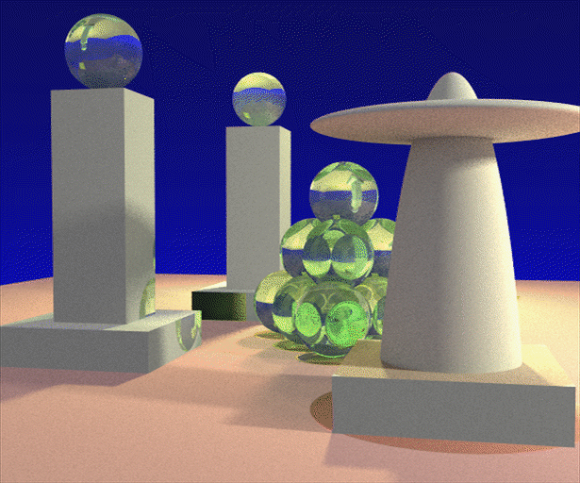

Advanced Computer Graphics
(Spring 2013)
CS 283, Lecture 21:
Physical Simulation Basics
Ravi Ramamoorthi
http://inst.eecs.berkeley.edu/~cs283/sp13
Most slides courtesy James O’Brien from CS294-13 Fall 2009

Slide 2
Outline
Rigid bodies: basic physics
Simple springs
Stress and Strain
Numerical Discretization (next time)

Slide 3
A Rigid Body

Slide 4
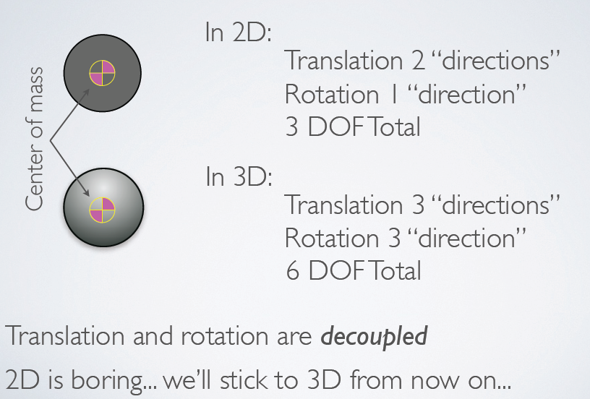
Degrees of Freedom

Slide 5
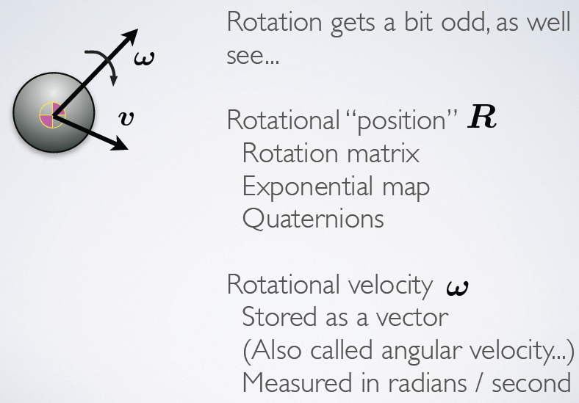
Translational and Rotational Motion

Slide 6
Rotational Motion

Slide 7
Angular Momentum and Inertia Tensor

Slide 8
Inertia Tensor

Slide 9
Rotational Motion 1

Slide 10
Rotational Motion 2

Slide 11
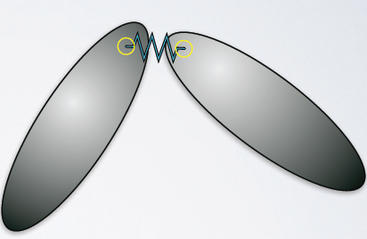
Constraints
How to keep objects together?
Simplest to use springs to attach
Basically a penalty method
Spring strength may need to be very large
Leading to numerical stiffness, small time steps
Many ways around this, still subject of research

Slide 12
Constraints
Articulation constraints
  Spring trick is an example of a full coordinate method
    Better constraint methods exist
  Reduced coordinate methods use DOFs in kinematic skeleton for simulation: More complex to explain
Collisions
  Penalty methods can also be used for collisions
  Again, better approaches exist, topic of research

Slide 13
Outline
Rigid bodies: basic physics
Simple springs
Stress and Strain
Numerical Discretization (next time)

Slide 14
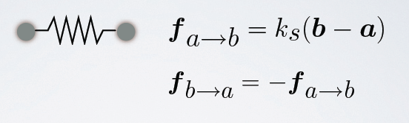
Simple Spring
Ideal zero-length spring
Force pulls points together
Strength proportional to distance

Slide 15
A Simple Spring

Slide 16
A Simple Spring

Slide 17
Non-Zero length springs

Slide 18
Damping

Slide 19
Damping

Slide 20
Spring Constants

Slide 21
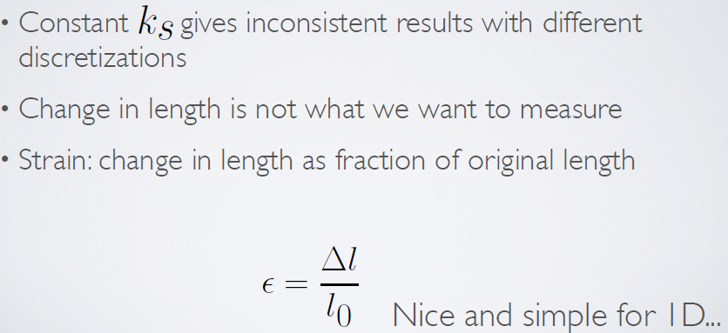
Spring Constants

Slide 22
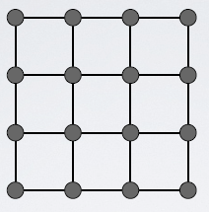
Structures from Springs
Sheets
Blocks
Others

Slide 23
Structures from Springs
They behave like what they are

Slide 24
Structures from Springs
They behave like what they are

Slide 25
Structures from Springs
They behave like what they are

Slide 26
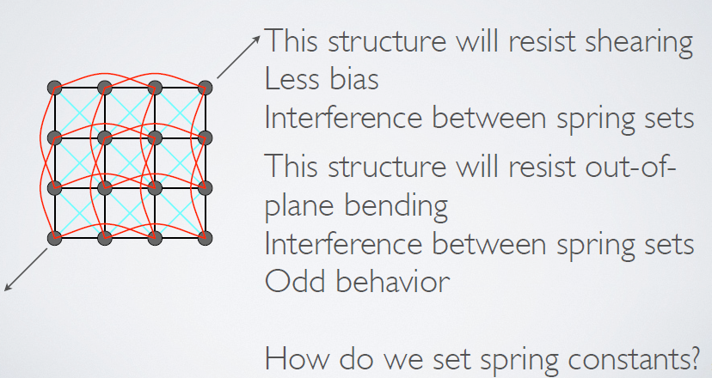
Structures from Springs
They behave like what they are

Slide 27
Edge Springs

Slide 28
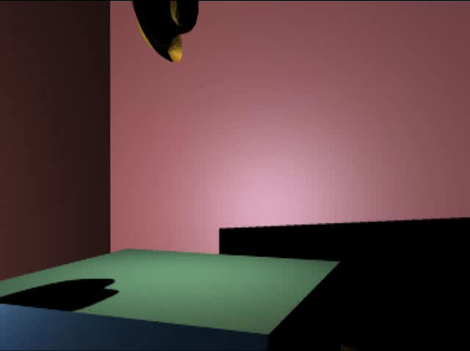
Example: Thin Material

Slide 29
Finite Element Method Setup
Lagrangian Formulation
  Where in space did this material move to
  Commonly used for solid materials
Eulerian Formulation
  What material is at this location in space
  Commonly used for fluids

Slide 30
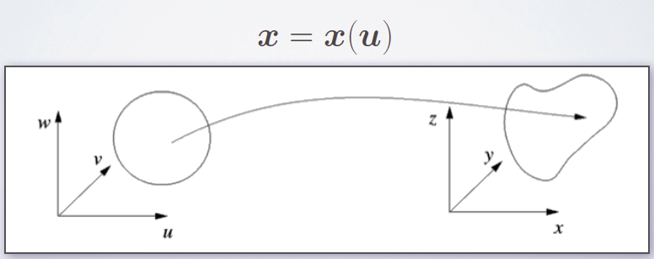
Lagrangian Formulation
Lagrangian Formulation
  Where in space did this material move to
  Commonly used for solid materials

Slide 31
Lagrangian Formulation

Slide 32
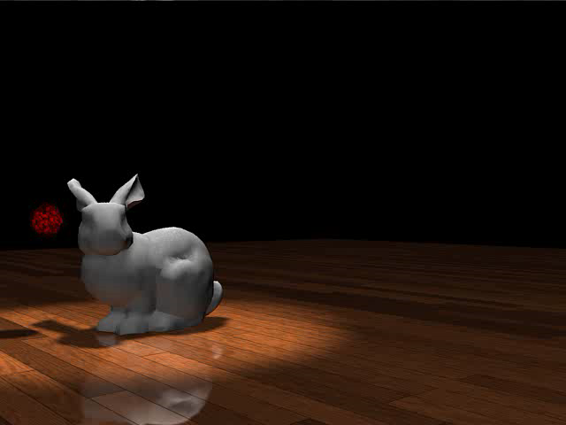
Example

Slide 33
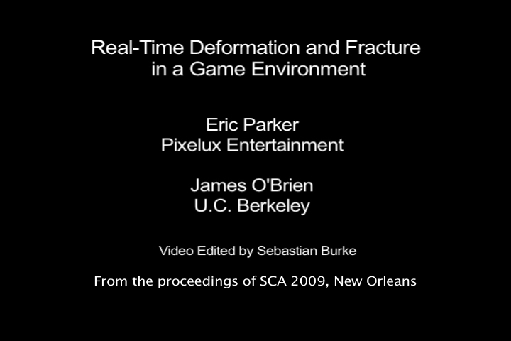
Example

Slide 34
Outline
Rigid bodies: basic physics
Simple springs
Stress and Strain
Numerical Discretization (next time)

Slide 35
Strain
Strain measures deformation
Purely geometric
Example: simple strain in a bar

Slide 36
Measuring Strain

Slide 37
Measuring Strain

Slide 38
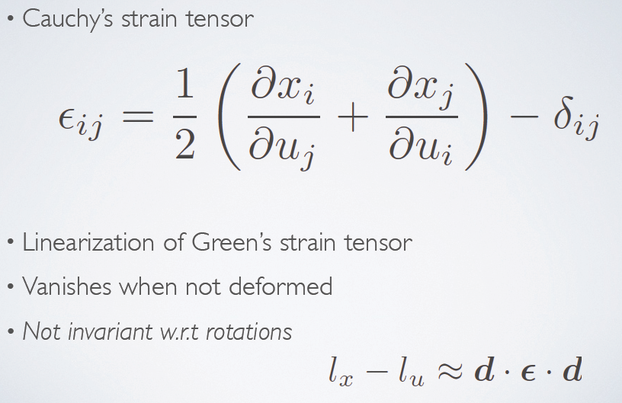
Cauchy’s Strain Tensor

Slide 39
Strain Rate

Slide 40
Strain Rate

Slide 41
Stress

Slide 42
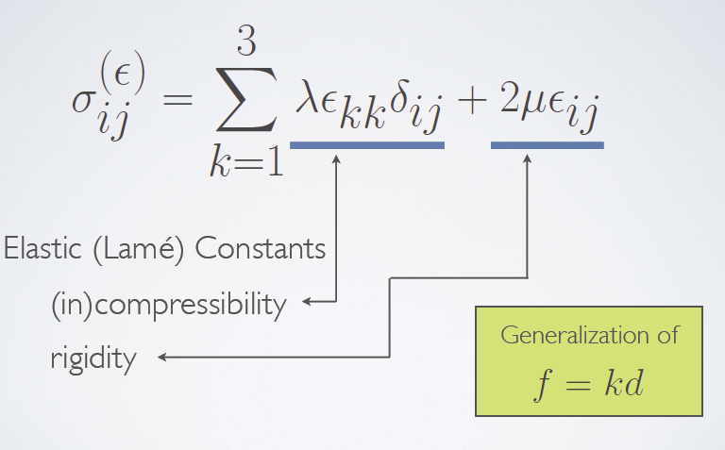
Stress due to Strain

Slide 43
Stress due to Rate

Slide 44
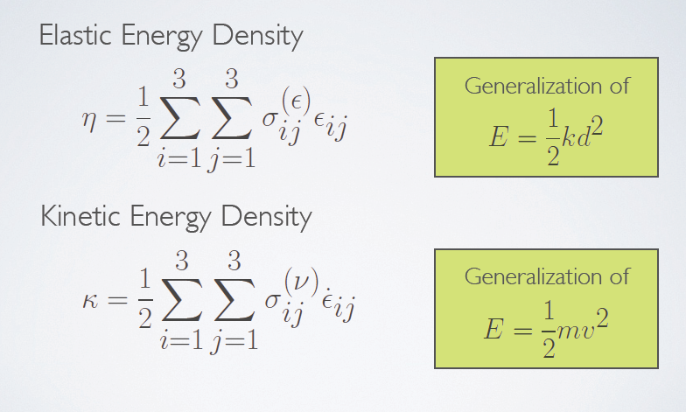
Energy Potentials

Slide 45
Outline
Rigid bodies: basic physics
Simple springs
Stress and Strain
Numerical Discretization (next time)

