Slide 1
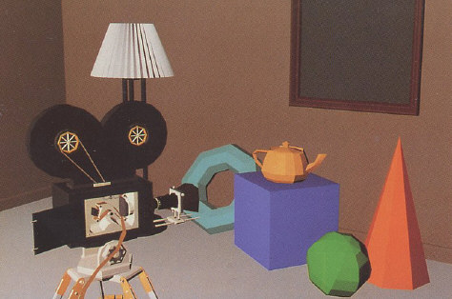
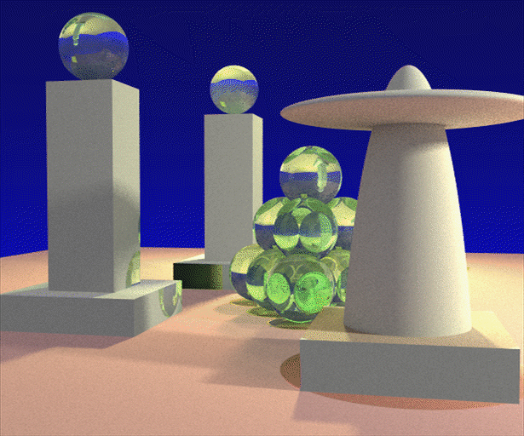

Advanced Computer Graphics
(Spring 2013)
CS 283, Lecture 24
Computational Imaging and Photography
Ravi Ramamoorthi
http://inst.eecs.berkeley.edu/~cs283/sp13
Many slides courtesy Ramesh Raskar, SIGGRAPH 2008 course

Slide 2
Computational Imaging
Digital cameras now commonplace
Can we use computation for better images
  Many novel capabilities relative to film
And new ways of processing images
Is this computer graphics, optics, or image proc?
  All of the above; many rendering ideas apply
  Application shift. Computer aided design to movies/games to photography (big market)
Brief lecture. Subject of whole conference ICCP
  Industry: Light Field cameras, Google glass, …

Slide 3
Outline
Image formation, basic lens-based camera
Light Field camera
Coded aperture depth of field
Flutter shutter (coded aperture shutter)
Many many more old, new innovations

Slide 4
How do we see the world?
Let’s design a camera
  Idea 1: put a piece of film in front of an object
  Do we get a reasonable image?
Slide by Steve Seitz

Slide 5
Pinhole camera
Add a barrier to block off most of the rays
  This reduces blurring
  The opening known as the aperture
  How does this transform the image?
Slide by Steve Seitz
Notes:
It gets inverted

Slide 6
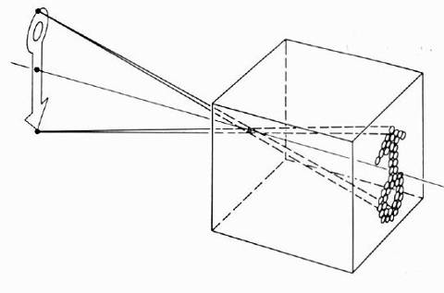
Pinhole camera model
Pinhole model:
  Captures pencil of rays – all rays through a single point
  The point is called Center of Projection (COP)
  The image is formed on the Image Plane
  Effective focal length f is distance from COP to Image Plane
Slide by Steve Seitz

Slide 7
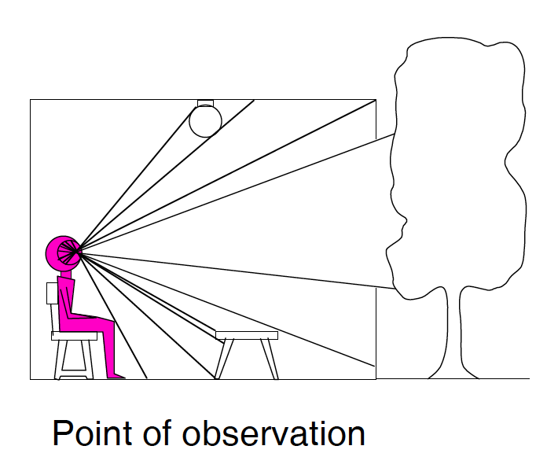
Dimensionality Reduction Machine (3D to 2D)
3D world
2D image
What have we lost?
  Angles
  Distances (lengths)
Figures © Stephen E. Palmer, 2002

Slide 8
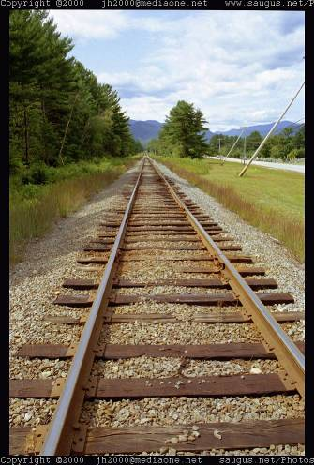
Funny things happen…

Slide 9
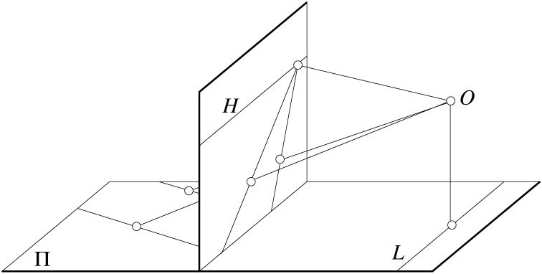
Parallel lines aren’t…
Figure by David Forsyth

Slide 10
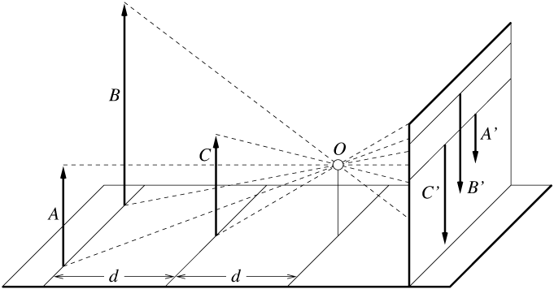
Lengths can’t be trusted...
A’
C’
B’
Figure by David Forsyth

Slide 11

…but humans adapt!
Müller-Lyer Illusion
We don’t make measurements in the image plane
http://www.michaelbach.de/ot/sze_muelue/index.html

Slide 12
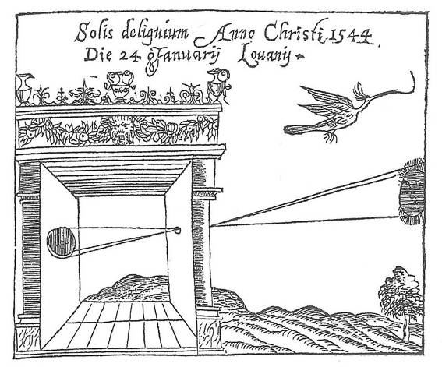
Camera Obscura
Camera Obscura, Gemma Frisius, 1558
The first camera
  Known to Aristotle
  Depth of the room is the effective focal length

Slide 13
From Pinhole to Lenses
Computer graphics assumes pinhole model
But making aperture narrow limits light
Making aperture large causes blurriness
Real cameras have lenses to collect more light, and focus it on the image plane
(Kolb et al. 95 simulates lens effects rendering)

Slide 14
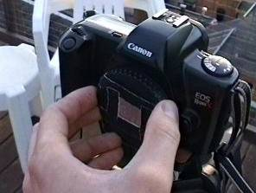
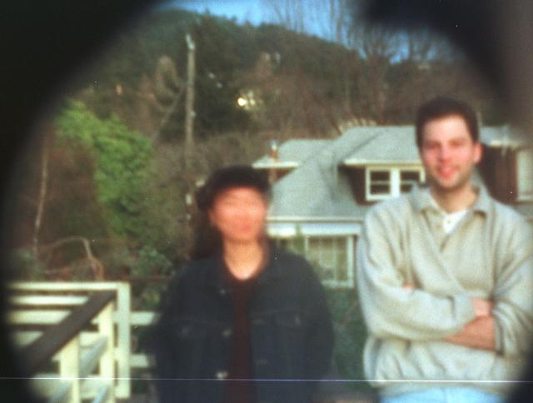
Home-made pinhole camera
Why so
blurry?
http://www.debevec.org/Pinhole/

Slide 15
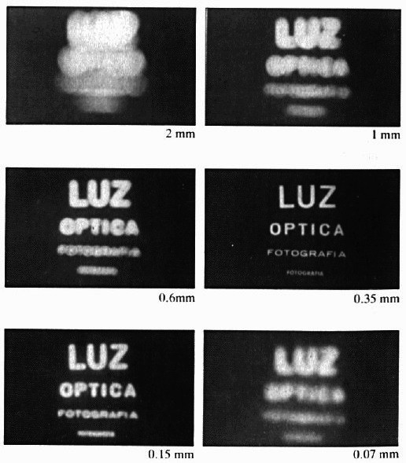
Shrinking the aperture
Less light gets through
Why not make the aperture as small as possible?
  Less light gets through
  Diffraction effects…
Slide by Steve Seitz

Slide 16
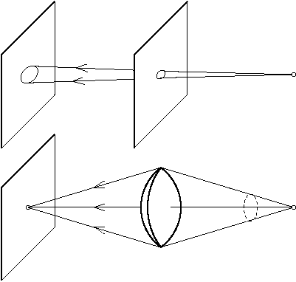
The reason for lenses
Slide by Steve Seitz

Slide 17
Focus and Defocus
“circle of
confusion”
A lens focuses light onto the film
  There is a specific distance at which objects are “in focus”
    other points project to a “circle of confusion” in the image
  Changing the shape/separation of lens changes this distance
Slide by Steve Seitz

Slide 18
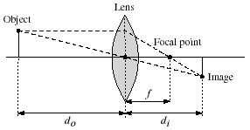
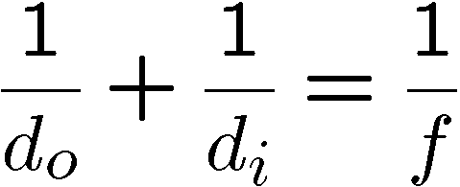
Thin lenses
Thin lens equation:
  Any object point satisfying this equation is in focus
  What is the shape of the focus region?
  How can we change the focus region?
  Thin lens applet: http://www.phy.ntnu.edu.tw/java/Lens/lens_e.html (by Fu-Kwun Hwang )
Slide by Steve Seitz

Slide 19
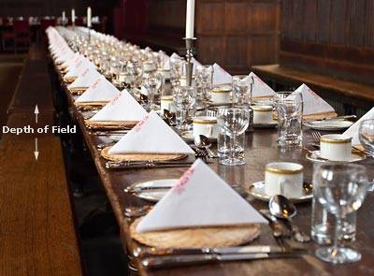
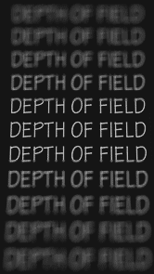
Depth of Field
http://www.cambridgeincolour.com/tutorials/depth-of-field.htm

Slide 20
Outline
Image formation, basic lens-based camera
Light Field camera
Coded aperture depth of field
Flutter shutter (coded aperture shutter)
Many many more old, new innovations

Slide 21
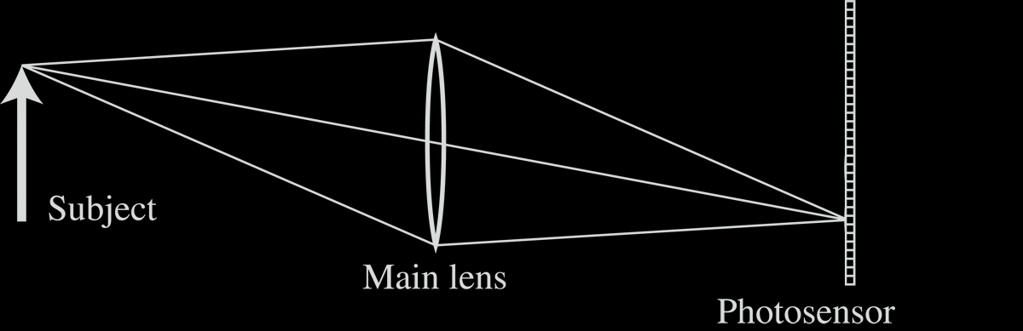
Light Field Inside a Camera
Notes:
21

Slide 22
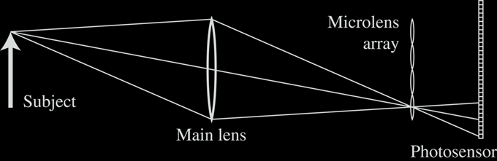
Lenslet-based Light Field camera
Light Field Inside a Camera
[Adelson and Wang, 1992, Ng et al. 2005 ]
Notes:
22

Slide 23
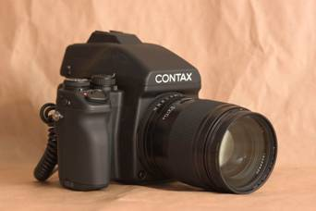
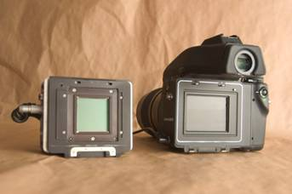
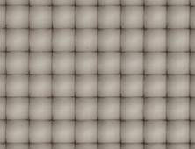
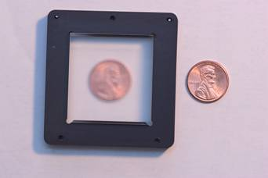
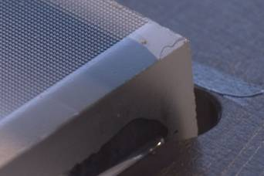
Stanford Plenoptic Camera [Ng et al 2005]
Contax medium format camera
Kodak 16-megapixel sensor
Adaptive Optics microlens array
125μ square-sided microlenses
4000 × 4000 pixels ÷ 292 × 292 lenses = 14 × 14 pixels per lens
Notes:
23

Slide 24
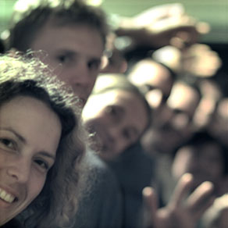
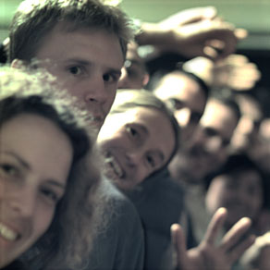
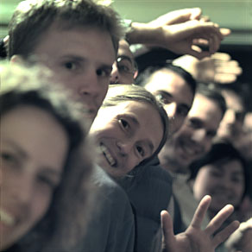
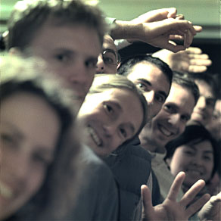

Digital Refocusing
[Ng et al 2005]
Notes:
24

Slide 25
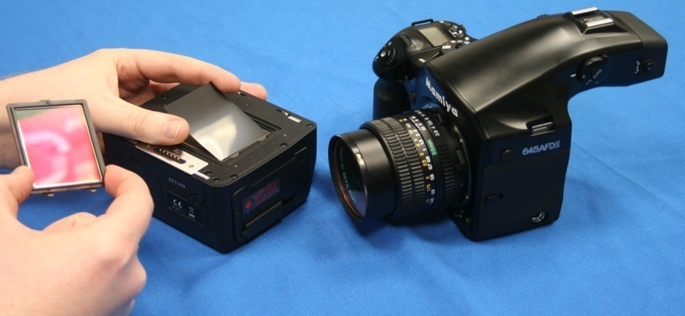
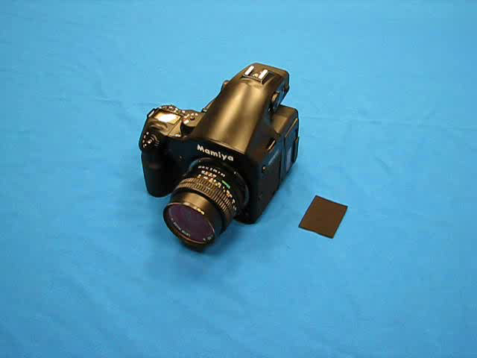
Mask based Light Field Camera
Mask
Sensor
[Veeraraghavan, Raskar, Agrawal, Tumblin, Mohan, Siggraph 2007 ]
Notes:
25

Slide 26


Cosine Mask Used
Mask Tile
1/f₀

Slide 27


Captured 2D Photo
Encoding due to Mask
[Veeraraghavan, Raskar, Agrawal, Tumblin, Mohan, Siggraph 2007 ]
Notes:
27

Slide 28

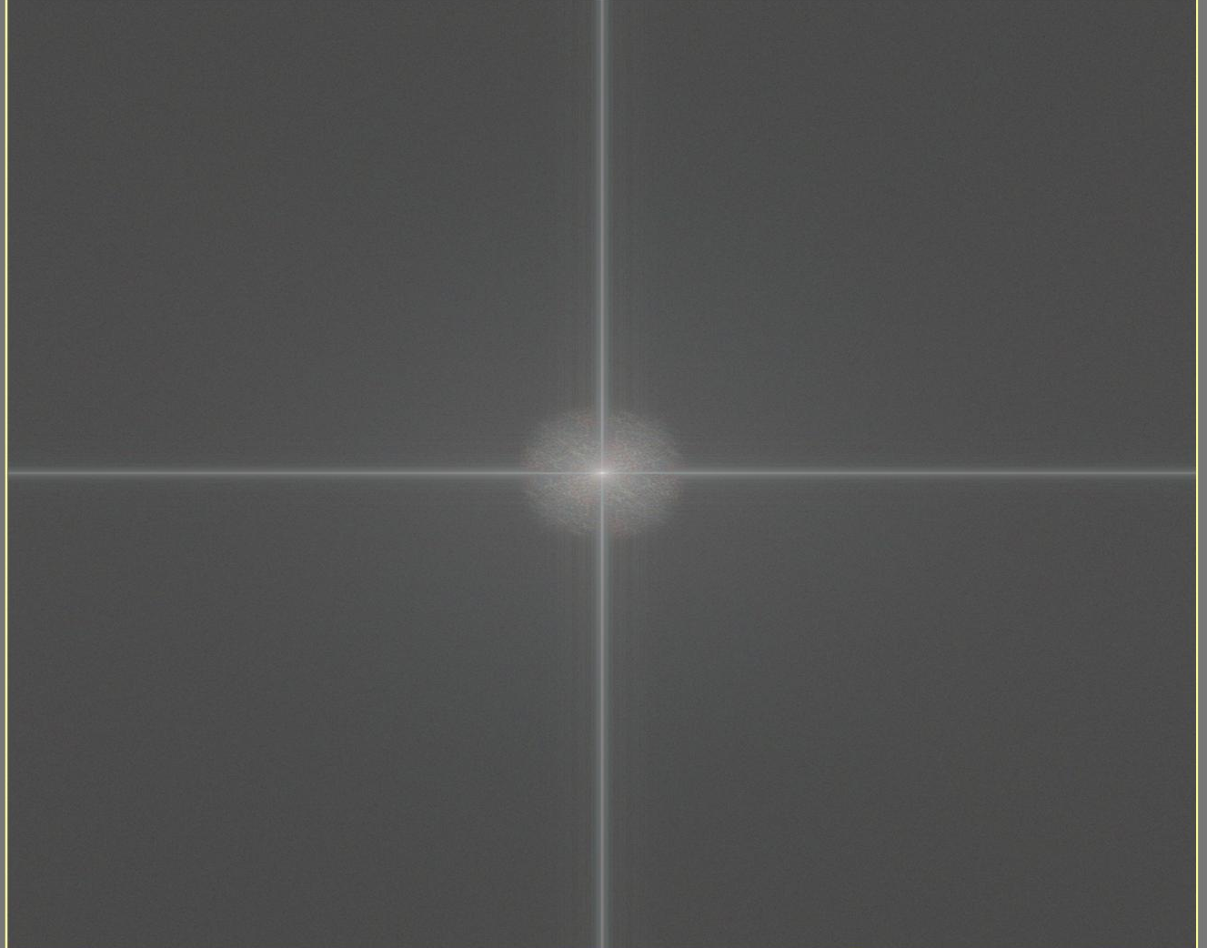
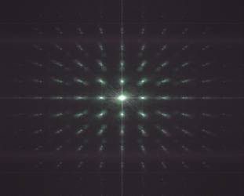
2D FFT
Traditional Camera Photo
Magnitude of 2D FFT
2D FFT
Heterodyne Camera Photo
Magnitude of 2D FFT
Notes:
28

Slide 29
Outline
Image formation, basic lens-based camera
Light Field camera
Coded aperture depth of field
Flutter shutter (coded aperture shutter)
Many many more old, new innovations

Slide 30
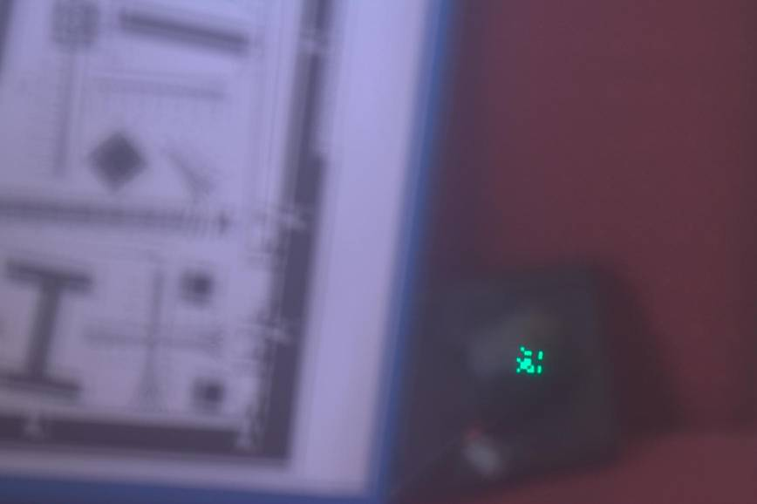
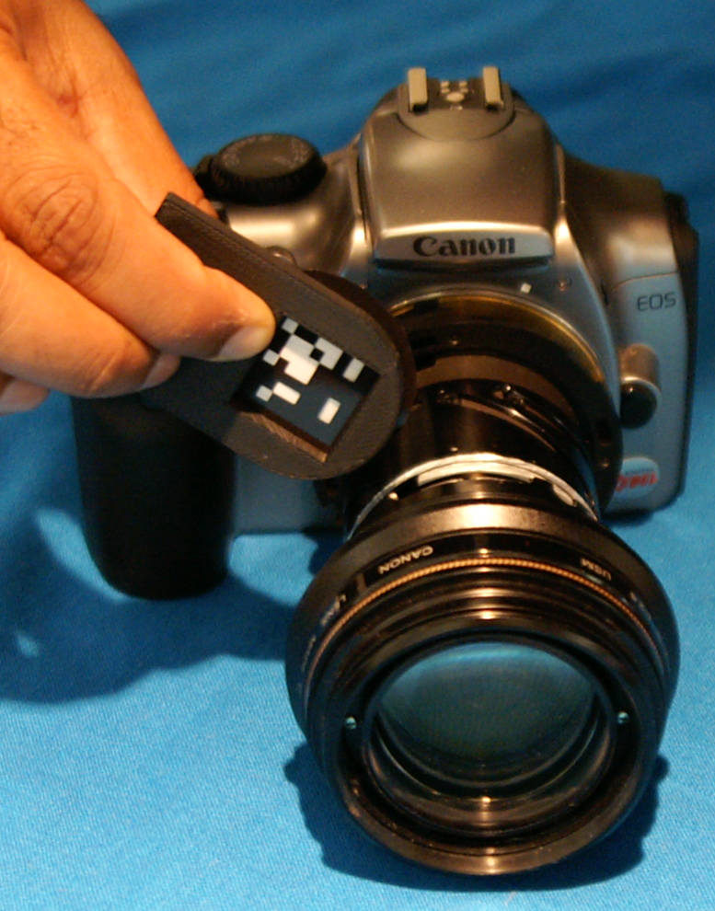
Engineering the PSF when you cannot capture Lightfield
Out of Focus Photo: Coded Aperture
Notes:
30

Slide 31
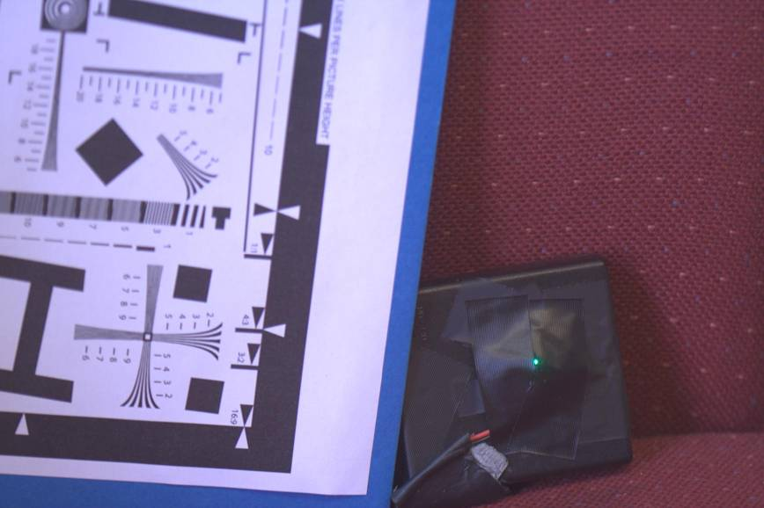
2D Photo
LED
In Focus Photo
Notes:
31

Slide 32

Out of Focus Photo: Open Aperture
Notes:
32

Slide 33
Out of Focus Photo: Coded Aperture
Notes:
33

Slide 34
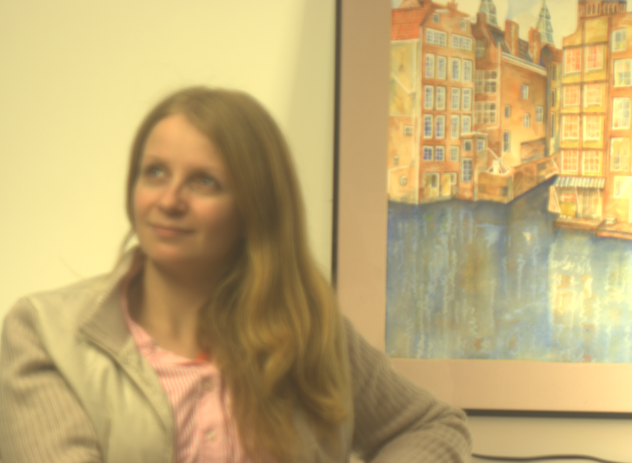
Captured Blurred Photo
[Veeraraghavan, Raskar, Agrawal, Tumblin, Mohan, Siggraph 2007 ]
Notes:
34
Reversibly encode all the information in this otherwise blurred photo

Slide 35

Refocused on Person
Increase DoF +
large aperture
Notes:
35
The glint out of focus shows the unusual pattern.

Slide 36
Outline
Image formation, basic lens-based camera
Light Field camera
Coded aperture depth of field
Flutter shutter (coded aperture shutter)
Many many more old, new innovations

Slide 37
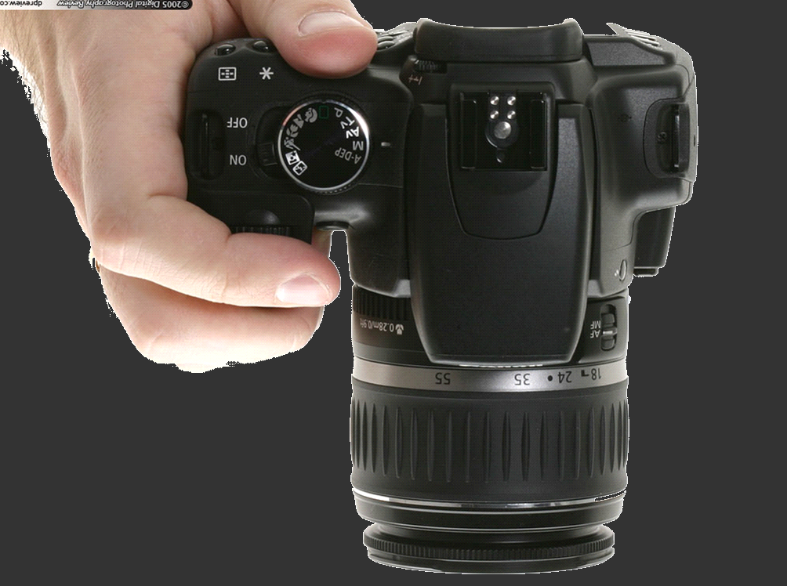






















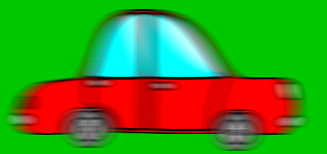



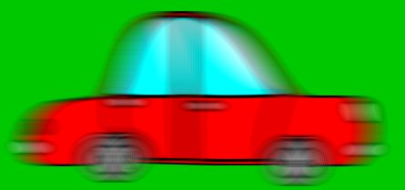
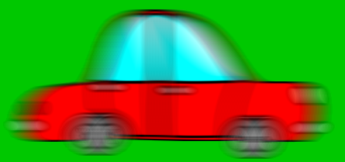
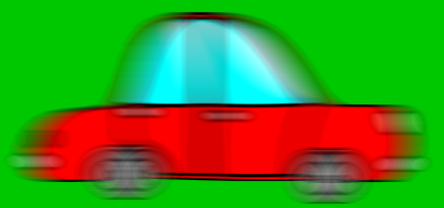
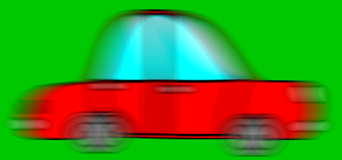







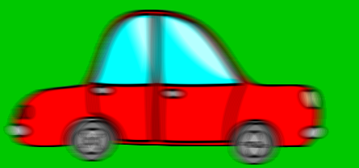
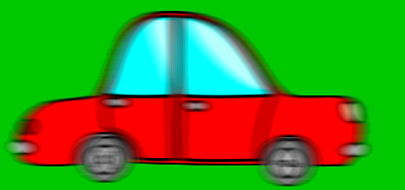
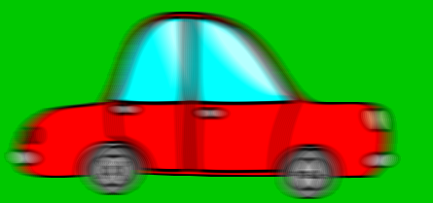




Traditional Camera
Shutter is OPEN
Notes:
How blurring happens in traditional camera

Slide 38


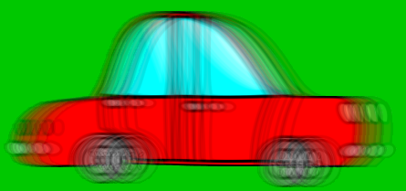
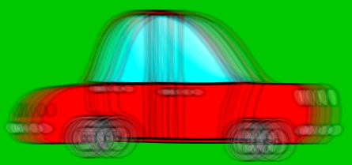






Our Camera
Flutter Shutter
Notes:
And in flutter shutter camera

Slide 39
Shutter is OPEN and CLOSED

Slide 40
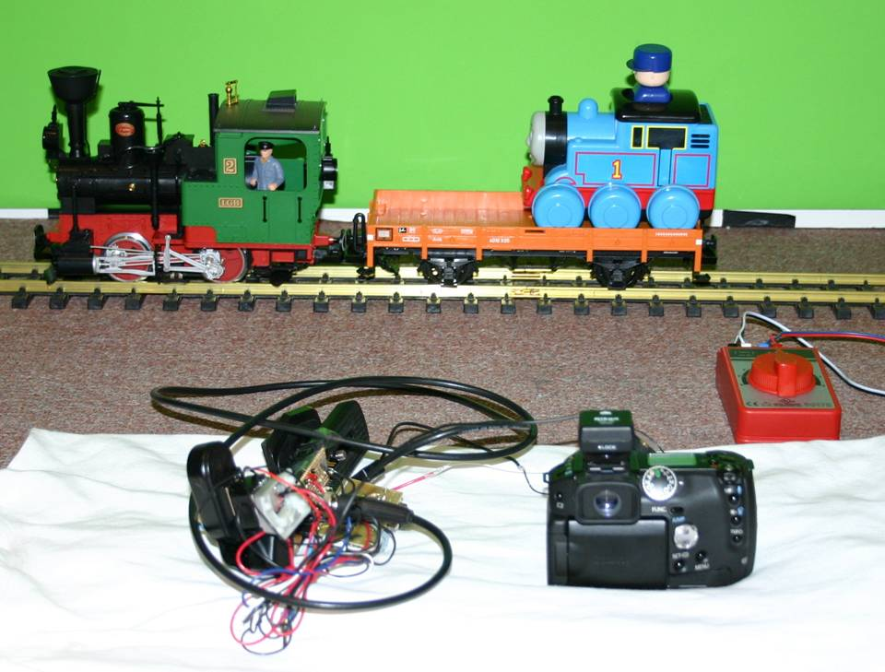
Lab Setup

Slide 41

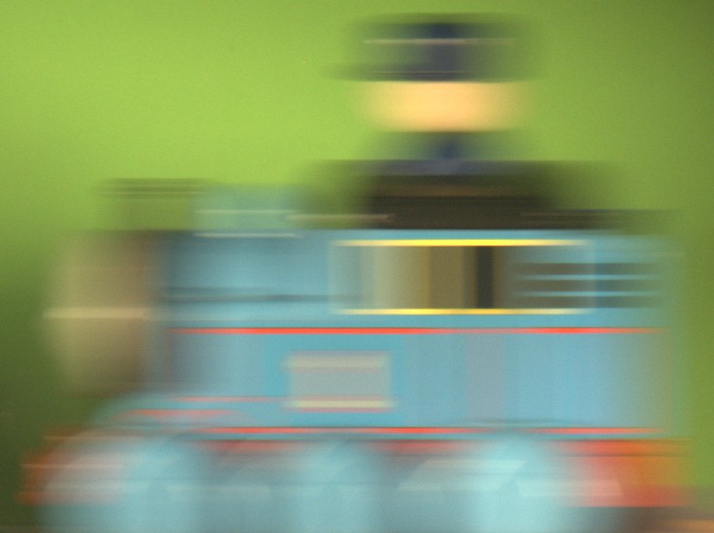
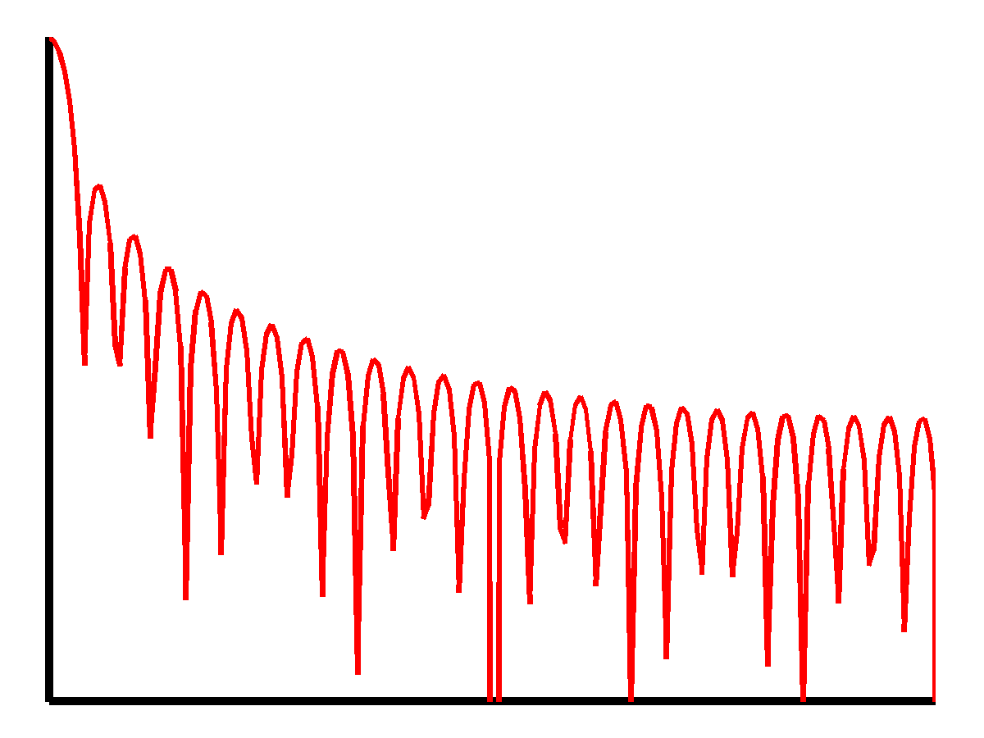
Blurring
==
Convolution
Sync Function
Traditional Camera: Box Filter
Notes:
How is the blurred image formed? It’s a convolution with box filter

Slide 42
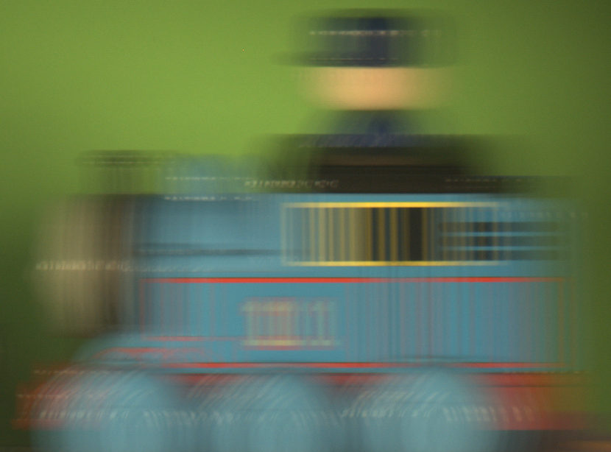

Preserves High Frequencies!!!
Flutter Shutter: Coded Filter
Notes:
Coded exposure makes the filter broadband

Slide 43
Comparison

Slide 44




Inverse Filter stable
Inverse Filter Unstable

Slide 45




Notes:
Deblurring using the single photo. Blur is 60 pixels

Slide 46

Input Image

Slide 47


Rectified Crop
Deblurred Result
Notes:
Result: Blur is 235 pixels, all text can be read

