Slide 1
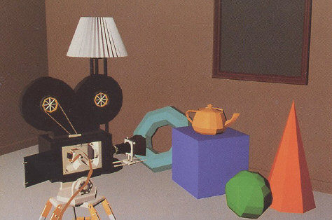
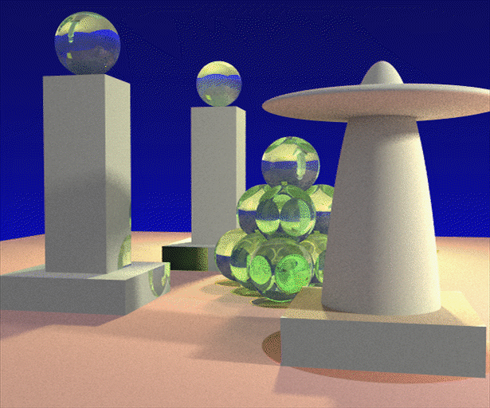
Advanced Computer Graphics (Spring 2013)
CS 283, Lecture 9: Global Illumination
Ravi Ramamoorthi
http://inst.eecs.berkeley.edu/~cs283/sp13
Some images courtesy Henrik Jensen
Some slide ideas courtesy Pat Hanrahan

Slide 2
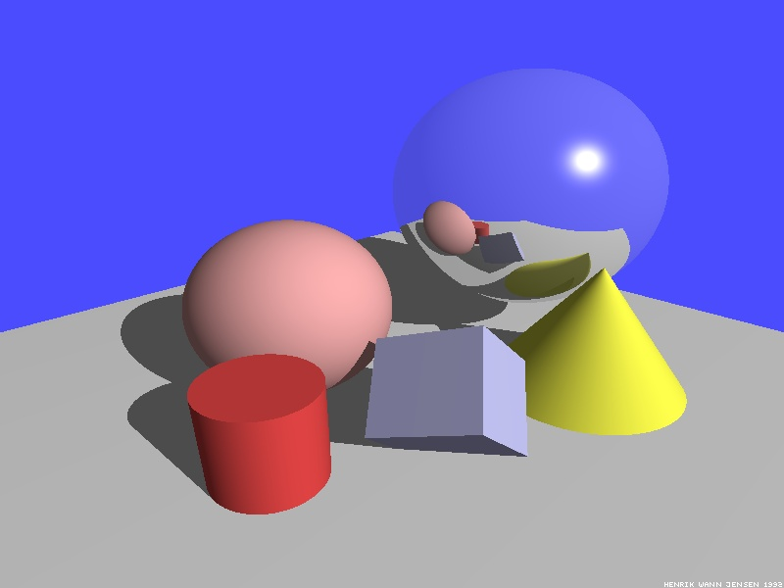
Illumination Models
So far considered mainly local illumination
Light directly from light sources to surface
No shadows (cast shadows are a global effect)
Global Illumination: multiple bounces (indirect light)
Hard and soft shadows
Reflections/refractions (already seen in ray tracing)
Diffuse and glossy interreflections (radiosity, caustics)
Some images courtesy Henrik Wann Jensen

Slide 3
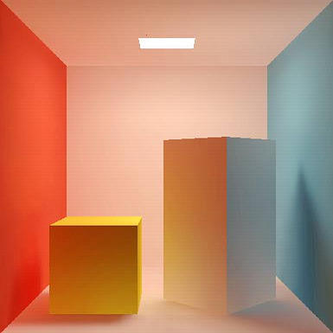
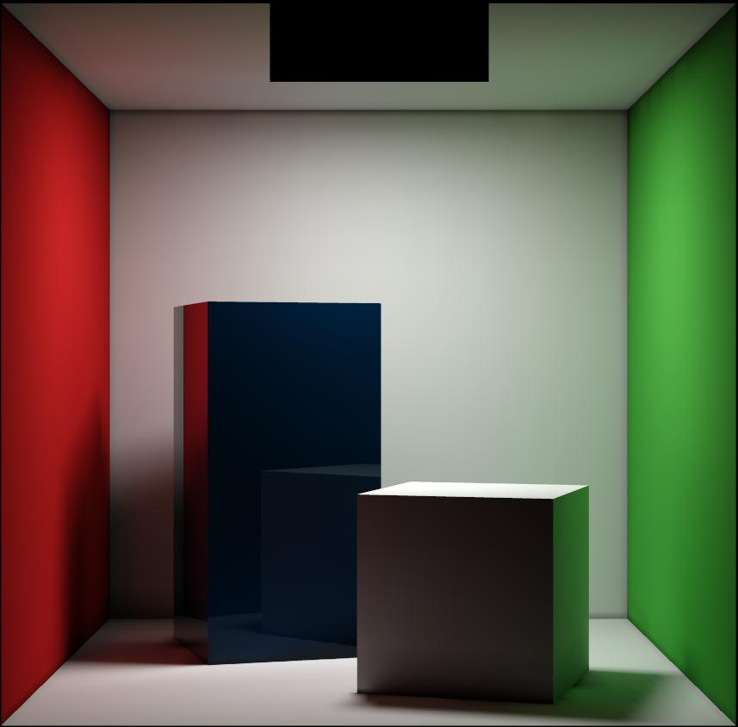
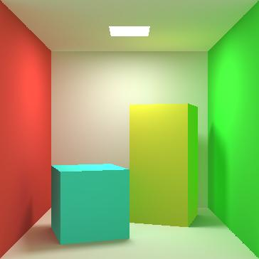
Diffuse Interreflection
Diffuse interreflection, color bleeding [Cornell Box]

Slide 4
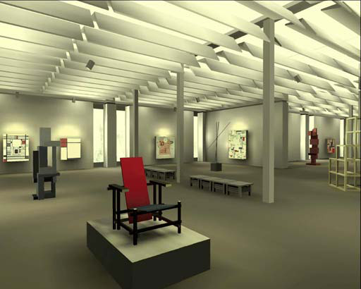
Radiosity

Slide 5
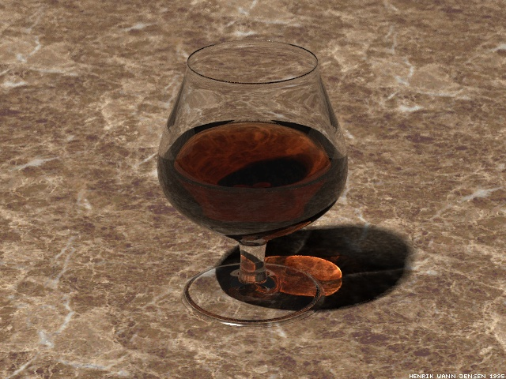
Caustics
Caustics: Focusing through specular surface
Major research effort in 80s, 90s till today

Slide 6
Overview of lecture
Theory for all global illumination methods (ray tracing, path tracing, radiosity)
We derive Rendering Equation [Kajiya 86]
Major theoretical development in field
Unifying framework for all global illumination
Discuss existing approaches as special cases
Fairly theoretical lecture (but important). Not well covered in textbooks (though see Eric Veach’s thesis). Closest are 2.6.2 in Cohen and Wallace handout (but uses slightly different notation, argument [swaps x, x’ among other things])

Slide 7
Outline
Reflectance Equation (review)
Global Illumination
Rendering Equation
As a general Integral Equation and Operator
Approximations (Ray Tracing, Radiosity)
Surface Parameterization (Standard Form)

Slide 8
Reflectance Equation (review)
Reflected Light
(Output Image)
Emission
Incident
Light (from
light source)
BRDF
Cosine of
Incident angle

Slide 9
Reflectance Equation (review)
Sum over all light sources
Reflected Light
(Output Image)
Emission
Incident
Light (from
light source)
BRDF
Cosine of
Incident angle

Slide 10
Reflectance Equation (review)
Replace sum with integral
Reflected Light
(Output Image)
Emission
Incident
Light (from
light source)
BRDF
Cosine of
Incident angle

Slide 11
The Challenge
Computing reflectance equation requires knowing the incoming radiance from surfaces
But determining incoming radiance requires knowing the reflected radiance from surfaces

Slide 12
Global Illumination
Surfaces (interreflection)
Reflected Light
(Output Image)
Emission
Reflected
Light (from
surface)
BRDF
Cosine of
Incident angle

Slide 13
Rendering Equation
Surfaces (interreflection)
Reflected Light
(Output Image)
Emission
Reflected
Light
BRDF
Cosine of
Incident angle
UNKNOWN
KNOWN
UNKNOWN
KNOWN
KNOWN

Slide 14
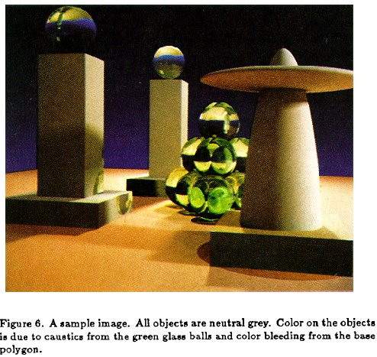
Rendering Equation (Kajiya 86)

Slide 15
Outline
Reflectance Equation (review)
Global Illumination
Rendering Equation
As a general Integral Equation and Operator
Approximations (Ray Tracing, Radiosity)
Surface Parameterization (Standard Form)

Slide 16
Rendering Equation as Integral Equation
Reflected Light
(Output Image)
Emission
Reflected
Light
BRDF
Cosine of
Incident angle
UNKNOWN
KNOWN
UNKNOWN
KNOWN
KNOWN
Is a Fredholm Integral Equation of second kind
[extensively studied numerically] with canonical form
Kernel of equation

Slide 17
Linear Operator Theory
Linear operators act on functions like matrices act on vectors or discrete representations
Basic linearity relations hold
Examples include integration and differentiation
M is a linear operator.
f and h are functions of u
a and b are scalars
f and g are functions

Slide 18
Linear Operator Equation
Kernel of equation
Light Transport Operator
Can also be discretized to simple matrix equation
[or system of simultaneous linear equations]
(L, E are vectors, K is the light transport matrix)

Slide 19
Solving the Rendering Equation
Binomial Theorem
Term n corresponds to n bounces of light

Slide 20
Solving the Rendering Equation
Too hard for analytic solution, numerical methods
Approximations, that compute different terms, accuracies of the rendering equation
Two basic approaches are ray tracing, radiosity. More formally, Monte Carlo and Finite Element
Monte Carlo techniques sample light paths, form statistical estimate (example, path tracing)
Finite Element methods discretize to matrix equation

Slide 21
Ray Tracing
Emission directly
From light sources
Direct Illumination
on surfaces
Global Illumination
(One bounce indirect)
[Mirrors, Refraction]
(Two bounce indirect)
[Caustics etc]

Slide 22
Ray Tracing
Emission directly
From light sources
Direct Illumination
on surfaces
Global Illumination
(One bounce indirect)
[Mirrors, Refraction]
OpenGL Shading
(Two bounce indirect)
[Caustics etc]

Slide 24
Outline
Reflectance Equation (review)
Global Illumination
Rendering Equation
As a general Integral Equation and Operator
Approximations (Ray Tracing, Radiosity)
Surface Parameterization (Standard Form)

Slide 25
Rendering Equation
Surfaces (interreflection)
Reflected Light
(Output Image)
Emission
Reflected
Light
BRDF
Cosine of
Incident angle
UNKNOWN
KNOWN
UNKNOWN
KNOWN
KNOWN

Slide 26
Change of Variables
Integral over angles sometimes insufficient. Write integral in terms of surface radiance only (change of variables)

Slide 27
Change of Variables
Integral over angles sometimes insufficient. Write integral in terms of surface radiance only (change of variables)

Slide 28
Rendering Equation: Standard Form
Integral over angles sometimes insufficient. Write integral in terms of surface radiance only (change of variables)
Domain integral awkward. Introduce binary visibility fn V
Same as equation 2.52 Cohen Wallace. It swaps primed
And unprimed, omits angular args of BRDF, - sign.
Same as equation above 19.3 in Shirley, except he has
no emission, slightly diff. notation

Slide 29
Radiosity Equation
Drop angular dependence (diffuse Lambertian surfaces)
Change variables to radiosity (B) and albedo (ρ)
Expresses conservation of light energy at all points in space
Same as equation 2.54 in Cohen Wallace handout (read sec 2.6.3)
Ignore factors of π which can be absorbed.

Slide 30
Discretization and Form Factors
F is the form factor. It is dimensionless and is the fraction of energy leaving the entirety of patch j (multiply by area of j to get total energy) that arrives anywhere in the entirety of patch i (divide by area of i to get energy per unit area or radiosity).

Slide 31
Form Factors

Slide 32
Matrix Equation

Slide 33
Summary
Theory for all global illumination methods (ray tracing, path tracing, radiosity)
We derive Rendering Equation [Kajiya 86]
Major theoretical development in field
Unifying framework for all global illumination
Discuss existing approaches as special cases
Next: Practical solution using Monte Carlo methods

