Slide 1
CS61A Lecture 7 Complexity and Orders of Growth
Jon Kotker and Tom Magrino UC Berkeley EECS
June 27, 2012

Slide 2
Computer Science in the News
Bot With Boyish Personality Wins Biggest Turing Test
Eugene Goostman, a chatbot with the personality of a 13-year-old boy, won the biggest Turing test ever staged, on 23 June.
Turing test: Measure of machine intelligence proposed by Alan Turing. A human talks via a text interface to either a bot or a human: the human has to determine which (s)he is talking to.
Turing suggested that if a machine could fool the human 30% of the time, it passed the test. Eugene passed 29% of the time.
Eugene was programmed to have a “consistent and specific” personality.
http://www.newscientist.com/blogs/onepercent/2012/06/bot-with-boyish-personality-wi.html

Slide 3
Today
Time complexity of functions.
Recursion review.

Slide 4
Problem Solving: Algorithms
An algorithm is a step-by-step description of how to perform a certain task.
For example, how do we bake a cake?
Step 1: Buy cake mix, eggs, water, and oil.
Step 2: Add the cake mix to a mixing bowl.
… and so on.
Image: http://pixelperfectmag.com/wp-content/uploads/2012/05/portal-cake.jpg

Slide 5
Problem Solving: Algorithms
The functions we write in Python implement algorithms for computational problems.
For a lot of problems, there are many different algorithms to find a solution.
How do we know which algorithm is better?

Slide 6
Comparison of Algorithms
How do we know which algorithm
(and the function that implements it) is better?
Amount of time taken.
Size of the code.
Amount of non-code space used.
Precision of the solution.
Ease of implementation.
… among other metrics.
We will focus on this.

Slide 7
Comparison of Algorithms
Which function is better?
Which function takes lesser time?
ITERATIVE
def fib(n):
if n == 0:
return 0
prev, curr, k = 0, 1, 1
while k < n:
prev, curr = curr, curr + prev
k = k + 1
return curr
RECURSIVE
def fib(n):
if n == 0:
return 0
elif n == 1:
return 1
return fib(n – 1) + fib(n – 2)

Slide 8
Comparison of Algorithms
The iterative version of fib is quicker than the (naïve) recursive version of fib.
Difference is only visible for larger inputs.
Idea:
Measure the runtime of a function for large inputs. Computers are already quick for small inputs.
In module 2, we will see that we can make the two equally efficient.

Slide 9
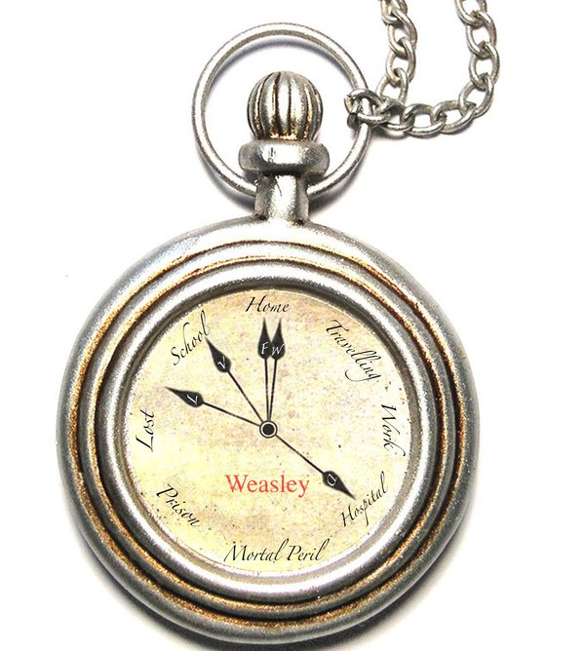
Runtime Analysis
How do we measure the runtime of a function?
Simplest way: Measure with a stopwatch.
Is this the best way?
http://fc00.deviantart.net/fs46/i/2009/187/0/a/Bill_Weasley__s_pocket_watch_by_Remus_Chocolade.jpg

Slide 10
Runtime Analysis
Measuring raw runtime depends on many factors:
Different computers can have different runtimes.
Same computer can have different runtimes on the same input.
Other processes can be running at the same time.
Algorithm needs to be implemented first!
Can be tricky to get right.
Function can take prohibitively long time to run.

Slide 11
Runtime Analysis
Problem:
How do we abstract the computer away?
Can we compare runtimes without implementing the algorithms?

Slide 12
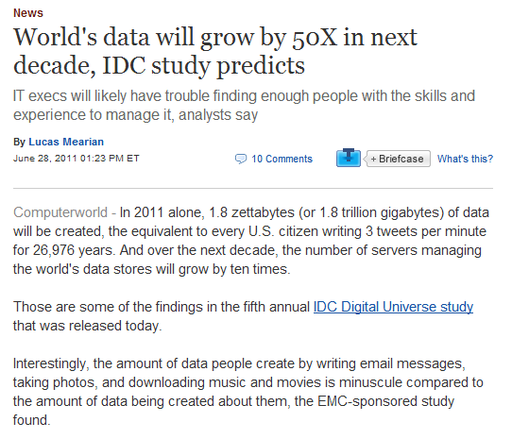
Runtime Analysis: Big Data
Humans are producing a lot of data really quickly.
http://www.computerworld.com/s/article/9217988/World_s_data_will_grow_by_50X_in_next_decade_IDC_study_predicts

Slide 13
Runtime Analysis
Big Idea:
Determine how the worst-case runtime of an algorithm scales as we scale the input.
The less the runtime scales as the input scales, the better the algorithm.
It can handle more data quicker.

Slide 14
Announcements
Waitlist is cleared. If you’re still on the waitlist by the end of this week, please let us know!
Next week, we will move to 105 Stanley for the rest of the summer.
Midterm 1 is on July 9.
We will have a review session closer to the date.
If you need accommodations for the midterm, please notify DSP by the end of this week.
HW1 grade should be available on glookup.

Slide 15
Beware: Approximations Ahead
http://www.gamesdash.com/limg/1/283/beware-of-the-sign.jpg

Slide 16
Orders of Growth
def add_one(n):
return n + 1
def mul_64(n):
return n * 64
def square(n):
return n * n
Time taken by these functions is roughly independent of the input size.
These functions run in constant time.

Slide 17
Orders of Growth
def add_one(n):
return n + 1
def mul_64(n):
return n * 64
def square(n):
return n * n
Approximation:
Arithmetic operations and assignments take constant time.

Slide 18
Orders of Growth
def fact(n):
k, prod = 1, 1
while k <= n:
prod = prod * k
k = k + 1
return prod
Constant-time operations
This loop runs $n$ times.
Constant-time operations
Total time for all operations is proportional to $n$.

Slide 19
Orders of Growth
def fact(n):
k, prod = 1, 1
while k <= n:
prod = prod * k
k = k + 1
return prod
Time taken by this function scales roughly linearly as the input size scales.
This function runs in linear time.

Slide 20
Orders of Growth
def sum_facts(n):
‘‘‘Adds factorials of
integers from 1 to n.’’’
sum, k = 0, 1
while k <= n:
sum += fact(k)
k = k + 1
return sum
Constant-time operations
This loop runs $n$ times.
For the $k$th loop, fact runs in time proportional to $k$.
Constant-time operations

Slide 21
Orders of Growth
Time taken by sum_facts is proportional to
$$1+2+ … +n+an+b$$
$$=\frac{1}{2}n⋅\left(n+1\right)+an+b$$
$$=\frac{1}{2}n^{2}+\left(a+1/2\right)n+b$$
Call to fact inside loop
Constant time operations per loop
$$k=1$$
$$k=2$$
$$k=n$$
Constant time operations outside loop

Slide 22
Orders of Growth
The constants $a$ and $b$ do not actually matter.
For really large values of $n$, $n^{2}$ suppresses $n$.
For really large values of $n$,
$\frac{1}{2}n^{2}+\left(a+1/2\right)n+b≈\frac{1}{2}n^{2}$.
$$n$$ | 1 | 10 | 100 | 1000 | 10000
$$n^{2}$$ | 1 | 100 | 10000 | 1000000 | 100000000

Slide 23
Orders of Growth
One more approximation:
We only care about how the runtime scales as the input size scales, so the constant factor is irrelevant.
$\frac{1}{2}n^{2}$ scales similarly to $n^{2}$.
For example, if the input size doubles, both functions quadruple.

Slide 24
Orders of Growth
def sum_facts(n):
‘‘‘Adds factorials of
integers from 1 to n.’’’
sum, k = 0, 1
while k <= n:
sum += fact(k)
k = k + 1
return sum
Time taken by this function scales roughly quadratically as the input size scales.
This function runs in quadratic time.

Slide 25
Orders of Growth
A few important observations:
We only care about really large input values, since computers can deal with small values really quickly.
We can ignore any constant factors in front of polynomial terms, since we want to know how the runtime scales.
We care about the worst-case runtime. If the function can be linear on some inputs and quadratic on other inputs, it runs in quadratic time overall. This can happen if your code has an if statement, for example.
How do we communicate the worst-case asymptotic runtime to other computer scientists?
“For large input values”

Slide 26
Big-O Notation
Let $f\left(n\right)$ be the runtime of a function.
It depends on the input size $n$.
We can then say
$$f\left(n\right)∈\text{O}(g\left(n\right))$$
“Belongs to”
Set of functions

Slide 27
Big-O Notation
Intuitively, $g(n)$ is an “upper bound” on $f(n)$.
$$f\left(n\right)∈\text{O}\left(g\left(n\right)\right)$$
if there are two integers $c$, $N$such that
for all $n>N$,
$f\left(n\right)<c⋅g(n)$.
“For large input values”
“Ignore the constant factors”

Slide 28
Big-O Notation: Example
Once $n^{2}$ surpasses $n$ after $N$, $n$ can never catch up to $n^{2}$, and $n^{2}$ grows much faster.
$$N$$

Slide 29
Big-O Notation: Example
$$f\left(n\right)∈\text{O}\left(g\left(n\right)\right)$$
if there are two integers $c$, $N$such that
for all $n>N$,
$f\left(n\right)<c⋅g(n)$.
$$n$$
$$n^{2}$$
$$1$$
$$1$$

Slide 30
Big-O Notation
In this class, we are not going to worry about finding the values of $c$ and $N$.
We would like you to get a basic intuition for how the function behaves for large inputs.
CS61B, CS70 and CS170 will cover this topic in much more detail.

Slide 31
Big-O Notation
Remember:
Constant factors do not matter.
Larger powered polynomial terms suppress smaller powered polynomial terms.
We care about the worst-case runtime.

Slide 32
Big-O Notation
Constant factors do not matter.
Size of input ($N$) | $$t_{1}\left(n\right)=3n^{3}$$ | $$t_{2}\left(n\right)=19,500,000n$$
10 | 3.10 microseconds | 200 milliseconds
100 | 3.0 milliseconds | 2.0 seconds
1000 | 3.0 seconds | 20 seconds
10000 | 49 minutes | 3.2 minutes
100000 | 35 days (est.) | 32 minutes
1000000 | 95 years (est.) | 5.4 hours
Jon Bentley ran two different programs to solve the same problem. The cubic algorithm was run on a Cray supercomputer, while the linear algorithm was run on a Radio Shack microcomputer. The microcomputer beat out the super computer for large $n$.
From Programming Pearls (Addison-Wesley, 1986)

Slide 33
Big-O Notation
Which of these are correct?
$\frac{1}{2}n^{2}∈\text{O}(n^{2})$
$n^{2}∈\text{O}(n)$
$15000n+3∈\text{O}(n)$
$5n^{2}+6n+3∈\text{O}(n^{2})$

Slide 34
Big-O Notation
Which of these are correct?
$\frac{1}{2}n^{2}∈\text{O}(n^{2})$ Correct
$n^{2}∈\text{O}(n)$ Incorrect
$15000n+3∈\text{O}(n)$ Correct
$5n^{2}+6n+3∈\text{O}\left(n^{2}\right)$ Correct

Slide 35
Big-O Notation
How does this relate to asymptotic runtime?
If a function runs in constant time, its runtime is in $\text{O}\left(1\right)$.
(“Its runtime is bounded above by a constant multiple of 1.”)
If a function runs in linear time, its runtime is in $\text{O}\left(n\right)$.
(“Its runtime is bounded above by a constant multiple of $n$.”)
If a function runs in quadratic time, its runtime is in $\text{O}\left(n^{2}\right)$.
(“Its runtime is bounded above by a constant multiple of$n^{2}$.”)

Slide 36
Common Runtimes
Class of Functions | Common Name | Commonly found in
$$\text{O}(1)$$ | Constant | Searching and arithmetic
$$\text{O}(\log{n})$$ | Logarithmic | Searching
$$\text{O}(\sqrt{n})$$ | Root-$n$ | Primality checks
$$\text{O}(n)$$ | Linear | Searching, sorting
$$\text{O}(n\log{n)}$$ | Linearithmic/loglinear | Sorting
$$\text{O}(n^{2})$$ | Quadratic | Sorting
$$\text{O}(n^{3})$$ | Cubic | Matrix multiplication
$$\text{O}(2^{n})$$ | Exponential | Enumeration
“POLYNOMIAL”
There are many problems for which the worst-case runtime is exponential. There has yet been no proof that these problems have polynomial solutions, and there has been no proof that a polynomial solution does not exist.
One example is the problem of finding the shortest tour through a set of cities.

Slide 37
Common Runtimes
Generally, “efficient” code is code that has a polynomial asymptotic runtime. The lower the power on the polynomial, the better.

Slide 38
Big-Theta and Big-Omega Notation
We defined earlier $f\left(n\right)∈\text{O}\left(g\left(n\right)\right)$
$g\left(n\right)$ is an upper bound on $f\left(n\right).$
If $f\left(n\right)=\text{O}\left(g\left(n\right)\right)$, then $g\left(n\right)∈Ω\left(f\left(n\right)\right)$.
$f(n)$ is a lower bound on $g(n)$.
If $f\left(n\right)=\text{O}\left(g\left(n\right)\right)$ and $g\left(n\right)=\text{O}(f\left(n\right))$, then $f\left(n\right)=Θ\left(g\left(n\right)\right)$.
$g\left(n\right)$ is a tight bound on $f(n)$.

Slide 39
Which Algorithm is Better?
def sum1(n):
''' Adds all numbers from 1 to n. '''
sum, k = 0, 1
while k <= n:
sum += k
k += 1
return sum
def sum2(n):
''' Adds all numbers from 1 to n. '''
return (n * (n+1))/2

Slide 40
Which Algorithm is Better?
def sum1(n):
''' Adds all numbers from 1 to n. '''
sum, k = 0, 1
while k <= n:
sum += k
k += 1
return sum
#The second one is better
def sum2(n):
''' Adds all numbers from 1 to n. '''
return (n * (n+1))/2

Slide 41
Conclusion
One measure of efficiency of an algorithm and the function that implements it is to measure its runtime.
In asymptotic runtime analysis, we determine how the runtime of a program scales as the size of the input scales.
Big-O, Big-Omega and Big-Theta notations are used to establish relationships between functions for large input sizes.
Preview: The other computational player: data.

