Slide 1
CS61A Lecture 12 Immutable Trees
Jom Magrotker UC Berkeley EECS
July 9, 2012

Slide 2
Computer Science in the News
http://www.bbc.com/news/technology-18671061

Slide 3
Today
Review: Immutable Trees
Binary Trees and Binary Search Trees
Extra: Tuples versus IRLists

Slide 4
Review: Hierarchical Data
Often, we find that information is nicely organized into hierarchies.
Example: Writing!
Book
Chapter
Chapter
Chapter
Paragraph
Paragraph
Paragraph
Sentence
Sentence
Sentence
Word
Word
Word

Slide 5
Review: Trees
A tree data structure traditionally has two parts:
A datum: Information stored at the top.
Some children: Trees that appear below this tree.
Datum
Children

Slide 6
Review: Trees
Notice that trees are also recursively defined.
A tree is made from other trees –
these trees are its subtrees.

Slide 7
Review: Trees
Nodes
A is a parent to B and C
A
B
C
Branches
B and C are children of A

Slide 8
Review: Trees
Root
fib(4)
fib(3)
fib(2)
fib(2)
fib(1)
fib(1)
fib(0)
fib(1)
fib(0)
Leaves

Slide 9
Review: Immutable Trees
1
make_itree(1,
(make_itree(2),
make_itree(3,
(make_itree(4),
make_itree(5))),
make_itree(6,
(make_itree(7),))))
Root
2
3
6
No children
Tuple of children
(each is an ITree!)
4
7
5
Only one child

Slide 10
Review: Immutable Trees
fir =
1
itree_datum(fir) is 1
itree_children(fir) is the tuple
2
3
6
4
7
(
)
5
2
,
3
,
6
4
This is not what is printed!
The expression evaluates to a tuple of ITrees, which are the children of fir.
7
5
A group of trees is called a forest.

Slide 11
Review: ITrees
def make_itree(datum, children=()):
return (datum, children)
def itree_datum(t):
return t[0]
def itree_children(t):
return t[1]
Constructor
Selectors

Slide 12
Review: Operating on ITrees
Write the function itree_prod, which takes an ITree of numbers and returns the product of all the numbers in the ITree.
>>> t = make_itree(1, (make_itree(2),
make_itree(3),
make_itree(4)))
>>> itree_prod(t)
24

Slide 13
Example: Operating on ITrees
Idea: Split the problem into two different parts: one that handles a single tree and one that handles a forest.
def itree_prod(t):
return itree_datum(t) * forest_prod(itree_children(t))
def forest_prod(f):
if len(f) == 0:
return 1
return itree_prod(f[0]) * forest_prod(f[1:])
Returns the product of numbers in an ITree.
Datum, multiplied by…
… the product of all the numbers in all the ITrees in the forest.
These ITrees are the children.
Product of numbers in the first ITree, multiplied by…
… the product of all the numbers in all the other ITrees of the forest.

Slide 14
Example: Operating on ITrees
Idea: Split the problem into two different parts: one that handles a single tree and one that handles a forest.
def itree_prod(t):
return itree_datum(t) * forest_prod(itree_children(t))
def forest_prod(f):
if len(f) == 0:
return 1
return itree_prod(f[0]) * forest_prod(f[1:])
Not a data abstraction violation.
We know that f is a tuple of ITrees.

Slide 15
Example: Operating on ITrees
Idea: Split the problem into two different parts: one that handles a single tree and one that handles a forest.
def itree_prod(t):
return itree_datum(t) * forest_prod(itree_children(t))
def forest_prod(f):
if len(f) == 0:
return 1
return itree_prod(f[0]) * forest_prod(f[1:])
This is called mutual recursion because it involves two functions recursively calling each other!

Slide 16
Mutual Recursion
To find the product of the whole ITree in itree_prod, we need to apply itree_prod itself to the smaller subtrees that are the children of the provided itree.
forest_prod does this for us.

Slide 17
Example: Operating on ITrees
An alternate definition for itree_prod does not need two separate and smaller functions:
from operator import mul
def itree_prod(t):
return itree_datum(t) * \
reduce(mul,
map(itree_prod,
itree_children(t)),
1)
Applies itree_prod recursively on the children.
Multiplies all the results of applying itree_prod on the children.

Slide 18
Practice: Operating on ITrees
Write a function scale_itree that takes an ITree of numbers and a scaling factor, and returns a new ITree that results from scaling each number in the original ITree.
1
2
scale_itree
2
3
6
, 2
=
4
6
12
4
7
8
14
5
10

Slide 19
Practice: Operating on ITrees
def scale_itree(itree, factor):
return make_itree(___________________________,
scale_forest(_____________________,
______))
def scale_forest(forest, factor):
results = ()
for itree in forest:
results = results + __________________________
return results

Slide 20
Practice: Operating on ITrees
def scale_itree(itree, factor):
return make_itree(itree_datum(itree) * factor,
scale_forest(itree_children(itree),
factor))
def scale_forest(forest, factor):
results = ()
for itree in forest:
results = results + scale_itree(itree, factor)
return results

Slide 21
Practice: Operating on ITrees
Alternative solution:
def scale_itree(itree, factor):
return make_itree(itree_datum(itree) * factor,
scale_forest(itree_children(itree),
factor))
def scale_forest(forest, factor):
if len(forest) == 0:
return ()
return (scale_itree(forest[0], factor),) + \
scale_forest(forest[1:], factor)
Tuple of one tree

Slide 22
Practice: Operating on ITrees
def scale_itree(itree, factor):
return make_itree(___________________________,
tuple(map(__________,
_____________________)))

Slide 23
Practice: Operating on ITrees
def scale_itree(itree, factor):
return make_itree(itree_datum(itree) * factor,
tuple(map(scale_itree,
itree_children(itree))))

Slide 24
Practice: Operating on ITrees
Write a function count_leaves that counts the number of leaves in the ITree provided.
1
count_leaves
2
3
6
=
4
4
7
5

Slide 25
Practice: Operating on ITrees
def count_leaves(itree):
if ______________:
return 1
return cl_forest(_____________________)
def cl_forest(f):
if len(f) == 0:
return _
return _____________________________________

Slide 26
Practice: Operating on ITrees
def count_leaves(itree):
if is_leaf(itree):
return 1
return cl_forest(itree_children(itree))
def cl_forest(f):
if len(f) == 0:
return 0
return count_leaves(f[0]) + cl_forest(f[1:])
def is_leaf(itree):
return len(itree_children(itree)) == 0

Slide 27
Practice: Operating on ITrees
def count_leaves(itree):
if ______________:
return 1
return reduce(___,
map(____________,
_____________________),
_)

Slide 28
Practice: Operating on ITrees
def count_leaves(itree):
if is_leaf(itree):
return 1
return reduce(add,
map(count_leaves,
itree_children(itree)),
0)

Slide 29
Announcements
Homework 6 is due tomorrow, July 10.
Starting with the next homework, we will mark questions as core and reinforcement.
The core questions are ones that we suggest you work on to understand the idea better.
The reinforcement questions are extra problems that you can practice with, but are not as critical.
Project 2 is due on Friday, July 13.
Homework 0 for the staff is now available.

Slide 30
Announcements
Midterm 1 is tonight.
Where? 2050 VLSB.
When? 7PM to 9PM.
Closed book and closed electronic devices.
One 8.5” x 11” ‘cheat sheet’ allowed.
Group portion is 15 minutes long.
Post-midterm potluck on Wednesday, July 11 in the Wozniak Lounge from 6:30pm to 10pm.
Bring food, drinks and board games!
Drop by if and when you can.

Slide 31
Announcements
http://berkeley.edu/map/maps/ABCD345.html
Campanile

Slide 32
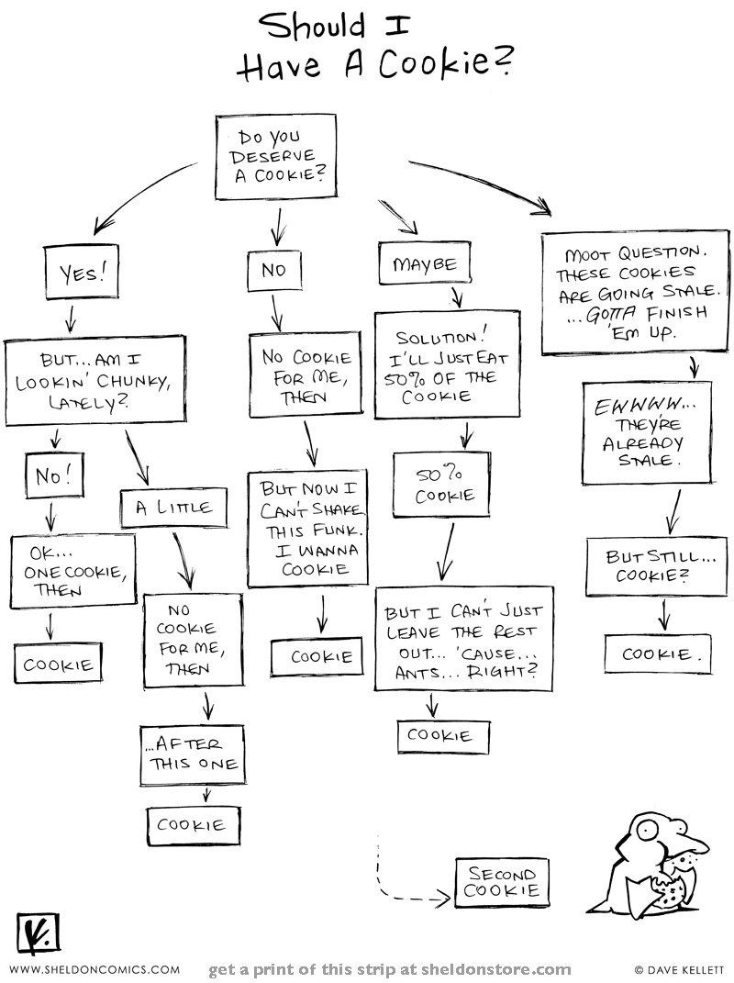
Break
http://www.sheldoncomics.com/archive/101026.html/

Slide 33
Problem Solving: Searching
Searching is a problem that shows up frequently in many different (and daily!) settings.
Problem: We have a collection of data and we need to find a certain datum.
Examples:
Searching for a person in a phone book.
Searching for a webpage on the Internet.
… and so on.
http://www.spacepub.com/wp-content/uploads/2011/06/The-Truth-Is-Out-There.jpg

Slide 34
Problem Solving: Searching
Write a predicate function has_num that determines if a number is in a tuple of numbers.
def has_num(tup, num_to_find):
for item in tup:
if ___________:
return ____
return _____

Slide 35
Problem Solving: Searching
Write a predicate function has_num that determines if a number is in a tuple of numbers.
def has_num(tup, num_to_find):
for item in tup:
if item == num:
return True
return False

Slide 36
Problem Solving: Searching
How does the running time of has_item scale as $n$, the length of the tuple, scales?
Can we do better?
http://i2.kym-cdn.com/photos/images/original/000/221/792/cute-puppy-pictures-anything-you-can-do-i-can-do-better.jpg

Slide 37
Trees in Real Life: Binary Trees
Trees where each node has at most two children are known as binary trees.
1
2
5
3
4
6

Slide 38
Trees in Real Life: Binary Search Trees
Binary search trees are binary trees where all of the items to the left of a node are smaller, and the items to the right are larger.
Why the term “search trees”?
They speed up the search for an item in a sequence.
10
How?
4
12
2
6
14

Slide 39
Trees in Real Life: Binary Search Trees
Let us try to find 4 in this binary search tree:
10
4
12
It could be anywhere here.
2
6
14

Slide 40
Trees in Real Life: Binary Search Trees
Let us try to find 4 in this binary search tree:
10
4
12
Discard this half of the data.
It can’t be here!
They’re too big.
It could be anywhere here.
2
6
14

Slide 41
Trees in Real Life: Binary Search Trees
Let us try to find 4 in this binary search tree:
10
4
12
It is present in the BST. ☺
2
6
14

Slide 42
Trees in Real Life: Binary Search Trees
Let us try to find 14 in this binary search tree:
10
4
12
It could be anywhere here.
2
6
14

Slide 43
Trees in Real Life: Binary Search Trees
Let us try to find 14 in this binary search tree:
10
4
12
Discard this half of the data.
It can’t be here!
They’re too small.
It could be anywhere here.
2
6
14

Slide 44
Trees in Real Life: Binary Search Trees
Let us try to find 14 in this binary search tree:
10
4
12
It could be anywhere here.
2
6
14

Slide 45
Trees in Real Life: Binary Search Trees
Let us try to find 14 in this binary search tree:
10
4
12
It is present in the BST. ☺
2
6
14

Slide 46
Trees in Real Life: Binary Search Trees
Let us try to find 11 in this binary search tree:
10
4
12
It could be anywhere here.
2
6
14

Slide 47
Trees in Real Life: Binary Search Trees
Let us try to find 11 in this binary search tree:
10
4
12
Discard this half of the data.
It can’t be here!
They’re too small.
It could be anywhere here.
2
6
14

Slide 48
Trees in Real Life: Binary Search Trees
Let us try to find 11 in this binary search tree:
10
4
12
Discard this half of the data.
It can’t be here!
They’re too big.
2
6
14

Slide 49
Trees in Real Life: Binary Search Trees
Let us try to find 11 in this binary search tree:
10
4
12
It isn’t present in the BST. ☹
2
6
14

Slide 50
Trees in Real Life: Binary Search Trees
Two important things when searching for an item in a binary search tree (BST):
As we go down the tree, from one level to another, from parent to child, we discard approximately half the data each time.
In the worst case, we go down all the way to the leaves.

Slide 51
Trees in Real Life: Binary Search Trees
The height of a tree is the length of the longest path from the root to any leaf.
If there are $n$ nodes in a binary search tree, and if the binary search tree is balanced, then the height of the tree is approximately $\log_{2}{n}$.
Approximately as many nodes on the left of any node as there are on the right of that node.

Slide 52
Logarithmic Algorithm
Why approximately $\log_{2}n$?
1
2
4
8
…

Slide 53
Logarithmic Algorithm
Why approximately $\log_{2}n$?
For a tree of height $h$(or $h+1$ levels), the total number of nodes is
$$1 + 2 + 4 + 8 + … +2^{h}=n$$
or, $2^{h+1}– 1=n$
or, $h≈\log_{2}(n)$

Slide 54
Logarithmic Algorithm
Why approximately $\log_{2}n$?
Alternatively, notice that when we go down one level, we are discarding approximately half the data.

Slide 55
Trees in Real Life: Binary Search Trees
In the worst case, we go down to the leaves, visiting each level of nodes once.
There are approximately $\log_{2}n$ levels.
The runtime to find an item in a binary search tree (BST) with $n$ nodes is $O(log⁡n)$.
Exponentially faster than $O(n)$!

Slide 56
BST ADT
empty_bst = None
def make_bst(datum, left=empty_bst,
right=empty_bst):
return (left, datum, right)
def bst_datum(b):
return b[1]
def bst_left(b):
return b[0]
def bst_right(b):
return b[2]
Constructor
Selectors

Slide 57
BST ADT
bst_is_leaf(b) returns True if the BST is a leaf:
def bst_is_leaf(b):
return bst_left(b) == empty_bst and
bst_right(b) == empty_bst

Slide 58
BST ADT
def has_num(b, num):
if b == empty_bst:
return False
elif bst_datum(b) == item:
return ____
elif bst_datum(b) > item:
return has_num(___________,
num)
return has_num(____________,
num)

Slide 59
BST ADT
def has_num(b, num):
if b == empty_bst:
return False
elif bst_datum(b) == item:
return True
elif bst_datum(b) > item:
return has_num(bst_left(b),
num)
return has_num(bst_right(b),
num)

Slide 60
Conclusion
ITrees are useful for representing general tree-structures.
Binary search trees allow us to search through data faster.
Preview: Object-oriented programming: a brand new paradigm.

Slide 61
Good Luck Tonight!
http://www.whosawesome.com/images/awesome.jpg

Slide 62
Extra: Tuples versus IRLists
Tuples and IRLists are two different ways of representing lists of items: they are two different data structures, each with their own advantages and disadvantages.
You will compare them further in CS61B, but here is a preview.

Slide 63
Extra: Tuples versus IRLists
IRLists are recursively defined, tuples are not.
This gives IRLists an advantage when you want to perform a naturally recursive task, such as mapping a function on a sequence.

Slide 64
Extra: Tuples versus IRLists
Which of the following methods is better?
def map_irlist(fn, irl):
return make_irlist(fn(irlist_first(irl)),
map_irlist(fn,
irlist_rest(irl)))
def map_tuple(fn, tup):
results = ()
for item in tup:
results = results + (fn(item),)
return results

Slide 65
Extra: Tuples versus IRLists
map_irlist is better than map_tuple.
map_tuple creates and discards temporary tuples, since tuples are immutable.
map_irlist “tacks on” new items to the front of an existing (and growing) IRList.

Slide 66
Extra: Tuples versus IRLists
Tuples are unchanging sequences of data, which gives them an advantage when all you want to do is grab information from a sequence.

Slide 67
Extra: Tuples versus IRLists
Which of the following methods is better?
def getitem_tuple(tup, pos):
return tup[pos]
def getitem_irlist(irl, pos):
if pos == 0:
return irlist_first(irl)
return getitem_irlist(irlist_rest(irl), pos-1)

Slide 68
Extra: Tuples versus IRLists
getitem_tuple is better than getitem_irlist.
Indexing into a tuple takes (on average) constant time, but indexing into an IRList takes linear time.

