Slide 1
CS61A Lecture 16 Mutable Data Structures
Jom Magrotker UC Berkeley EECS
July 16, 2012

Slide 2
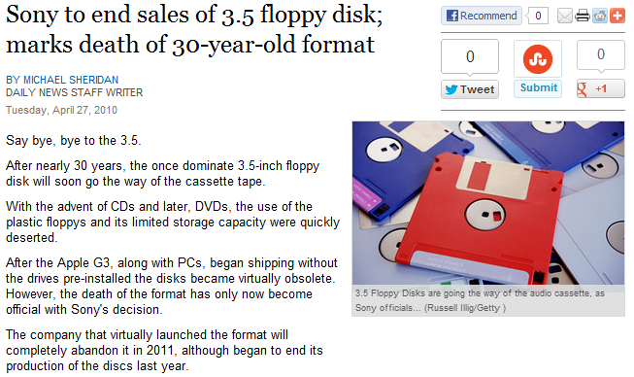
Computer Science in the News (Two Years Ago)
http://articles.nydailynews.com/2010-04-27/news/27062899_1_marks-death-format-floppy-disk

Slide 3
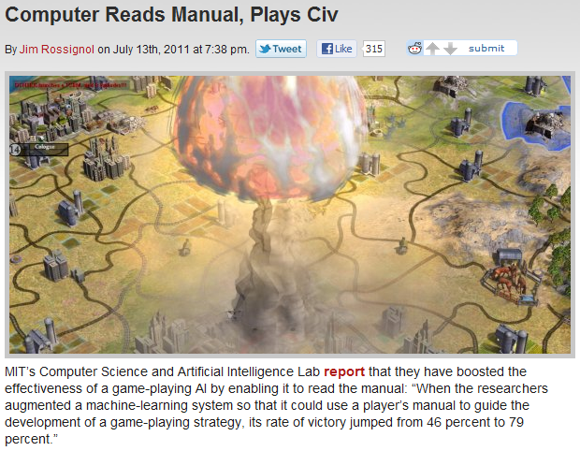
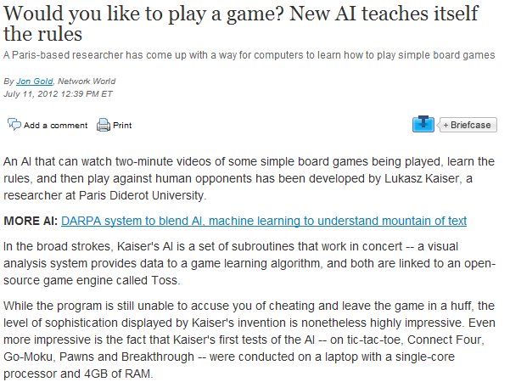
Computer Science in the News
http://www.networkworld.com/news/2012/071112-ai-games-260821.html
http://www.rockpapershotgun.com/2011/07/13/computer-reads-manual-plays-civ/

Slide 4
Today
Review: Object-Oriented Programming
Mutable Lists
Identity and Equality
Mutable Dictionaries

Slide 5
Review: OOP Class Design
At Hogwarts, we want to write a class to store information about potions. How would you represent the following attributes?
Name of the potion.
Ingredients of the potion.
How it interacts with another potion.
Collection of all potions ever.
CHOICES
Instance Variable
Class Variable
Method
http://images2.fanpop.com/image/photos/13700000/Severus-Snape-rip-severus-snape-13701634-1024-669.jpg

Slide 6
Review: OOP Class Design
At Hogwarts, we want to write a class to store information about potions. How would you represent the following attributes?
Name of the potion: Instance variable
Ingredients of the potion: Instance variable
How it interacts with another potion: Method
Collection of all potions ever: Class variable

Slide 7
Review: Mutable Data Structures
We have seen that objects possess state: they can change over time. Objects are thus mutable.
The IRLists and IDicts we saw earlier were immutable, which means that once created, they could not be modified.
Python has built-in list and dictionary data structures that are mutable.

Slide 8
Mutable Lists: A Primer
>>> a = [3, 4, 5]
>>> a[0]
3
>>> a[1:]
[4, 5]
>>> a[0] = 7
>>> a
[7, 4, 5]
Slicing makes a new list.
Could not have done this with tuples!

Slide 9
Mutable Lists: A Primer
>>> a
[7, 4, 5]
>>> a.append(10)
>>> a
[7, 4, 5, 10]
>>> a.extend([2, 3])
>>> a
[7, 4, 5, 10, 2, 3]
>>> a[2:4] = [6, 8]
[7, 4, 6, 8, 2, 3]
>>> a.pop()
3
>>> a
[7, 4, 6, 8, 2]
>>> a.remove(8)
[7, 4, 6, 2]
None of these operations create new lists. They all update the same list.
The slicing operator here does not make a new list. It refers to elements and positions in the original list.

Slide 10
Mutable Lists: A Primer
>>> a
[7, 4, 6, 2]
>>> a[3] = a[0]
>>> a
[7, 4, 6, 7]
>>> a.count(7)
2
>>> a.index(4)
1
>>> a.reverse()
>>> a
[7, 6, 4, 7]
>>> a.sort()
>>> a
[4, 6, 7, 7]
>>> a.insert(1, 3)
>>> a
[4, 3, 6, 7, 7]
>>> del a[2]
>>> a
[4, 3, 7, 7]
None of these operations create new lists. They all update the same list.

Slide 11
List Comprehensions
List comprehensions allow us to create new lists in the style of generator expressions.
>>> a = [2, 4, 6]
>>> b = [2*item for item in a]
>>> b
[4, 8, 12]
3. Add twice the element to the new list.
2. Call each element item.
1. Take the list a.

Slide 12
List Comprehensions
List comprehensions allow us to create new lists in the style of generator expressions.
>>> a = [2, 4, 6]
>>> b = [2*item for item in a if item > 3]
>>> b
[8, 12]
3. Add twice the item to the new list…
2. Evaluate one element and call the result item.
1. Take the list a.
4. … but only if item is greater than 3.

Slide 13
Working with Mutable Lists
Write a function called square_list that squares the items in a list. The function does not create a new list: it mutates the original list. (Assume the list is not deep.)
>>> my_list = [2, 7, 1, 8, 2]
>>> square_list(my_list)
>>> my_list[1]
49
We are not creating a new list.
We are not using the statement
my_list = square_list(my_list)

Slide 14
Working with Mutable Lists
Write a function called square_list that squares the items in a list. The function does not create a new list: it mutates the original list. (Assume the list is not deep.)
def square_list(l):
pos = 0
while pos < len(l):
l[pos] = l[pos] * l[pos]
pos += 1
1. Initialize a variable that keeps track of the current position in the list.
2. As long as there are elements…
No return statement!
3. Update the current position in the list with the new value.
4. Move to the next position in the list.

Slide 15
Comparing Lists and Tuples
def square_tuple(tup):
results = ()
for val in tup:
results = results + (val*val,)
return results
def square_list(l):
pos = 0
while pos < len(l):
l[pos] = l[pos] * l[pos]
pos += 1
A new tuple is created.
Items are added to the new tuple.
The new tuple is returned.
(Actually, new tuples are created in each iteration.)
The original list is modified.

Slide 16
Working with Mutable Lists
Write a function called map_list that maps the function provided to the items of a list. The function does not create a new list: it mutates the original list.
>>> my_list = [2, 7, 1, 8, 2]
>>> map_list(lambda x: x**3, my_list)
>>> my_list[3]
512

Slide 17
Working with Mutable Lists
Write a function called map_list that maps the function provided to the items of a list. The function does not create a new list: it mutates the original list.
def map_list(fn, l):
pos = 0
while pos < len(l):
l[pos] = __________
pos += 1

Slide 18
Working with Mutable Lists
Write a function called map_list that maps the function provided to the items of a list. The function does not create a new list: it mutates the original list.
def map_list(fn, l):
pos = 0
while pos < len(l):
l[pos] = fn(l[pos])
pos += 1

Slide 19
Announcements: Midterm 2
Midterm 2 is on Wednesday, July 25.
Where? 2050 VLSB.
When? 7PM to 9PM.
How much? Material covered from July 4 until, and including, July 19 (from immutable trees until environment diagrams). You will also need to know material from Midterm 1.
Closed book and closed electronic devices.
One 8.5” x 11” ‘cheat sheet’ allowed.
Group portion is 15 minutes long.
Midterm review session on Friday, July 20.

Slide 20
Announcements: Midterm 1
Midterm 1 solutions will be released tonight.
Midterm 1 regrade request protocol:
Attach, to the front, a sheet of paper describing the questions that you would like to be regraded, and the reasons why.
We reserve the right to regrade the entire midterm.
Regrade request deadline is end of day, Thursday, July 26.

Slide 21
Announcements
Homework 8 is due Tuesday, July 17.
Homework 9 is due Friday, July 20.
Project 3 is due Tuesday, July 24.
Please ask for help if you need to. There is a lot of work in the weeks ahead, so if you are ever confused, consult (in order of preference) your study group and Piazza, your TAs, and Jom.
Don’t be confused!

Slide 22
Box-and-Pointer Diagrams
my_list = [2, 7, 1, 8, 2]
The boxes point to the elements of the list.
The name of the list, which points to the list.
my_list
This arrow shows the start of the list.
2
7
1
8
2
Element 1
Element 3
Element 5
Element 2
Element 4

Slide 23
Box-and-Pointer Diagrams
my_list = [2, [3, 1], 1, 8, 2]
my_list
2
1
8
2
3
1

Slide 24
Identity and Equality
>>> my_list = [2, 7, 1, 8, 2]
>>> other_list = [2, 7, 1, 8, 2]
>>> my_list == other_list
True
>>> my_list is other_list
False
my_list and other_list have the same values: they are equal.
my_list and other_list are different lists: they are not identical.
my_list
other_list
2
7
1
8
2
2
7
1
8
2

Slide 25
Identity and Equality
>>> my_list = [2, 7, 1, 8, 2]
>>> other_list = my_list
>>> my_list == other_list
True
>>> my_list is other_list
True
my_list and other_list have the same values: they are equal.
my_list and other_list are the same lists: they are identical.
my_list
other_list
2
7
1
8
2

Slide 26
Identity and Equality
>>> kaushik = Person(...)
>>> kaushy = kaushik
>>> kaushik is kaushy
True
>>> kaushik == kaushy
True
kaushik and kaushy are different names for the same object: they are identical.
Since kaushik and kaushy are different names for the same object, they have the same value, and are equal.
Identity implies equality.

Slide 27
Identity and Equality
>>> kaushik = Person(...)
>>> shrivats = Person(...)
>>> shrivats is kaushik
False
>>> shrivats == kaushik
True
kaushik and shrivats are names for different objects: they are not identical.
kaushik and shrivats are names for different objects that have the “same value”, and are thus equal.
Equality does not necessarily imply identity.

Slide 28
Identity and Equality: Caveat
By default, in Python, == acts the same as is.
a == b
is converted to
a.__eq__(b)
The Person class in the previous slide should implement the __eq__ method, or else
shrivats == kaushik
would have also evaluated to False.
Classes can define what the “equality” of their instances means.

Slide 29
Identity and Equality
The classes for the native data types in Python (numbers, Booleans, strings, tuples, lists, dictionaries) implement the __eq__ method.
>>> 3 == 4
False
>>> [1, 2, 3] == [1, 2, 3]
True
>>> True.__eq__(False)
False

Slide 30
Identity and Equality: Practice
With the following expressions
>>> a = [2, 7, 1, 8]
>>> b = [3, 1, 4]
>>> a[2] = b
>>> c = [2, 7, [3, 1, 4], 8]
what do the following expressions evaluate to?
(A box-and-pointer diagram may be useful here.)
>>> a[2][0]
>>> a[2] is b
>>> a is c
>>> a == c

Slide 31
Identity and Equality: Practice
With the following expressions
>>> a = [2, 7, 1, 8]
>>> b = [3, 1, 4]
>>> a[2] = b
>>> c = [2, 7, [3, 1, 4], 8]
what do the following expressions evaluate to?
(A box-and-pointer diagram may be useful here.)
>>> a[2][0] 2
>>> a[2] is b True
>>> a is c False
>>> a == c True

Slide 32
Identity and Equality: Practice
With the following expressions
>>> a = [2, 7, 1, 8]
>>> b = [3, 1, 4]
>>> a[2] = b
>>> c = [2, 7, [3, 1, 4], 8]
>>> a[2][1] = 3
what do the following expressions evaluate to?
(A box-and-pointer diagram may be useful here.)
>>> a[2][1]
>>> b[1]
>>> c[2][1]

Slide 33
Identity and Equality: Practice
With the following expressions
>>> a = [2, 7, 1, 8]
>>> b = [3, 1, 4]
>>> a[2] = b
>>> c = [2, 7, [3, 1, 4], 8]
>>> a[2][1] = 3
what do the following expressions evaluate to?
(A box-and-pointer diagram may be useful here.)
>>> a[2][1] 3
>>> b[1] 3
>>> c[2][1] 1

Slide 34
Identity and Equality: Practice
Implement the method __eq__ for the Pokemon class that will allow us to check if one Pokémon is “equal” to another, which means that it has the same HP as the other.
>>> ashs_pikachu = Pokemon(‘Pikachu’, ‘Ash’, 300)
>>> brocks_pikachu = Pokemon(‘Pikachu’, ‘Brock’, 300)
>>> ashs_pikachu is brocks_pikachu
False
>>> ashs_pikachu == brocks_pikachu
True

Slide 35
Identity and Equality: Practice
Implement the method __eq__ for the Pokemon class that will allow us to check if one Pokémon is “equal” to another, which means that it has the same HP as the other.
class Pokemon:
...
def __eq__(self, other):
return _________________________________________

Slide 36
Identity and Equality: Practice
Implement the method __eq__ for the Pokemon class that will allow us to check if one Pokémon is “equal” to another, which means that it has the same HP as the other.
class Pokemon:
...
def __eq__(self, other):
return self.get_hit_pts() == other.get_hit_pts()

Slide 37
Survey Responses
Survey responses are generally very positive.
“They have great pictures to help me learn.”
“Love the breaks: come back attentive.”
“Tom and Jon create a comfortable environment that invites questions.”
“I actually look forward to coming to lecture.”
“Needs more ponies.”
http://www.gametrailers.com/side-mission/files/2012/06/my-little-pony-friendship-is-magic.jpg

Slide 38
Survey Responses
“Homework is more difficult than questions presented in lecture.”
This is intentional! Lectures describe and explain the ideas; discussions and labs reinforce the ideas; homework and projects allow you to wrestle with, and learn, the material.
“Please post the lecture slides earlier.”
We will try and get them online by 9am, so that you have time to look over them if you need to. The answers to the questions will also be available soon after lecture.

Slide 39
Survey Responses
“Class goes too fast.”
Again, we apologize, but summer courses tend to go faster than normal. Please don’t hesitate to talk to your study group and the staff whenever you are stuck. Don’t be confused!
“More practical examples in lecture.”
We will try to include more practical examples.
“Lectures are behind the homework.”
Yes, but we have now caught up!

Slide 40
Survey Responses
“Too many questions being asked in class.”
We will try to address as many questions as we can without compromising on pace. Your questions are our constant feedback regarding whether the concept makes sense. So, keep asking questions!
However, if the question is tangential, or relates to other languages like Java or C, we may defer the question to after class, or office hours, or Piazza.
Don’t be afraid to ask questions! We will definitely address your question, even if not in lecture. However, you must re-ask it, on Piazza, so we remember to answer it.

Slide 41
Haiku Break
“I love comp science,
Bring on the problem, baby
This is what we do.”
“CS not that hard.
But sometimes it no make sense.”
“Computer science,
Solutions are ecstasy,
Debugging is hell.”
“This is a haiku.
I do not want to write this.
But now I am done.”
“Class is good.
I am learning lots.
Keep it up.”
“To describe CS
With a short, succinct haiku.
Out of syllables.”

Slide 42
Mutable Dictionaries
Lists allow us to index elements by integers; dictionaries allow us to index elements by keys that are not necessarily integers.
This is particularly useful when we want to establish a correspondence between a descriptive key and a value.

Slide 43
Mutable Dictionaries
Keys
Values
>>> roman_numerals = { ‘I’ : 1,
‘V’ : 5,
‘X’ : 10 }
>>> roman_numerals[‘V’]
5
>>> roman_numerals.__getitem__(‘V’)
5
>>> list(roman_numerals.keys())
[‘I’, ‘V’, ‘X’]
>>> ‘C’ in roman_numerals
False

Slide 44
Mutable Dictionaries
Write the function count_words, which returns a dictionary that maps a word to the number of times it occurs in a list of words.
>>> word_list = [‘the’, ‘rain’, ‘in’,
‘spain’, ‘falls’,
‘mainly’, ‘in’, ‘the’,
‘plain’]
>>> word_counts = count_words(word_list)
>>> word_counts[‘the’]
2

Slide 45
Mutable Dictionaries
def count_words(l):
count_dict = {}
for word in l:
if word not in count_dict:
count_dict[word] = 1
else:
count_dict[word] += 1
return count_dict
1. Create a new dictionary for the counts.
2. For each word in the list of words...
3. If the word is not already in the dictionary...
4. Make a new entry for it.
5. Otherwise, update the existing entry.

Slide 46
Comparing Dictionaries and IDicts
def count_words_idict(l):
counts = make_idict()
for word in l:
count = idict_select(counts, word)
if count is not None:
counts = idict_update(counts, word, count+1)
else:
counts = idict_update(counts, word, 1)
return counts
New immutable dictionaries are created in each iteration.

Slide 47
Mutable Dictionaries: Practice
Write a function tally_votes that takes in a list of tuples, each of which has two elements: a candidate for an election, and number of votes received by that candidate in a particular state. tally_votes will return a dictionary that maps a candidate to the number of votes received by the candidate.
>>> votes = [(‘louis’, 30), (‘eva’, 45), (‘ben’, 4),
(‘eva’, 30), (‘ben’, 6), (‘louis’, 15)]
>>> total_votes = tally_votes(votes)
>>> total_votes[‘ben’]
10

Slide 48
Mutable Dictionaries: Practice
def tally_votes(votes):
vote_dict = {}
for vote in votes:
candidate = _______
vote_count = _______
if ___________________________:
_________________________________
else:
__________________________________
return vote_dict

Slide 49
Mutable Dictionaries: Practice
def tally_votes(votes):
vote_dict = {}
for vote in votes:
candidate = vote[0]
vote_count = vote[1]
if candidate not in vote_dict:
vote_dict[candidate] = vote_count
else:
vote_dict[candidate] += vote_count
return vote_dict

Slide 50
OOP: Class Methods
Class variables are variables shared by all instances of a class: they are not specific to a particular instance.
Methods are specific to a particular instance.
Occasionally, it would be useful to have a method that is independent of any instance, but relevant to the class as a whole.

Slide 51
OOP: Class Methods
Suppose that we want to maintain a trainer directory in our Pokemon class, which would allow us to find the list of trainers that own a certain Pokémon.
This is not specific to a particular Pokemon object. As with total_pokemon, this is relevant to the Pokemon class as a whole.

Slide 52
OOP: Class Methods
class Pokemon:
total_pokemon = 0
trainer_dir = {}
def __init__(self, name, owner, hp):
...
if name not in Pokemon.trainer_dir:
Pokemon.trainer_dir[name] = [owner]
else:
Pokemon.trainer_dir[name].append(owner)

Slide 53
OOP: Class Methods
We define a class method (or a static method) that takes in the name of a Pokémon and returns a list of the trainers that own that Pokémon. We use the staticmethod decorator.
class Pokemon:
...
@staticmethod
def trainers(name):
if name in Pokemon.trainer_dir:
return Pokemon.trainer_dir[name]
return None

Slide 54
OOP: Class Methods
>>> mistys_togepi = Pokemon('Togepi',
'Misty', 245)
>>> ashs_pikachu = ElectricPokemon('Pikachu',
'Ash', 300)
>>> brocks_pikachu = ElectricPokemon('Pikachu',
'Brock', 300)
>>> Pokemon.trainers('Pikachu')
['Ash', 'Brock']
>>> Pokemon.trainers('Charmander')

Slide 55
Conclusion
Python has built-in mutable lists and dictionaries. These can be mutated, which means that the original lists and dictionaries are modified.
There are two different kinds of equality: one that checks if two objects are the same (identical), and one that checks if two objects have the same characteristics or values (equal).
The second kind of equality can be defined by the class.
OOP allows us to have methods that are relevant to the whole class, not just to specific instances.
Preview: Mutable recursive lists and environment diagrams.

