Slide 1
CS61A Lecture 27 Logic Programming
Jom Magrotker UC Berkeley EECS
August 2, 2012

Slide 2
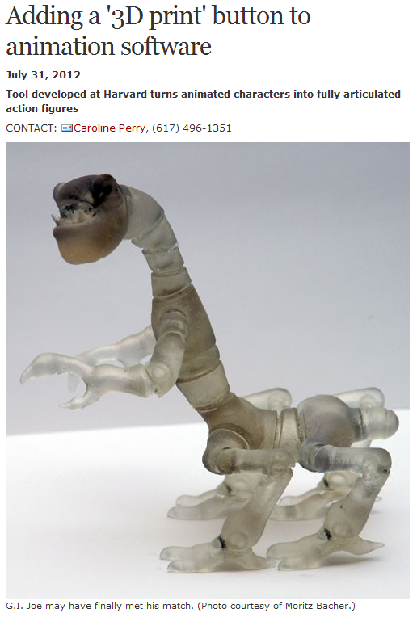
Computer Science in the News
http://www.seas.harvard.edu/news-events/press-releases/adding-a-3d-print-button-to-animation-software

Slide 3
Today
Review: PyGic
Unification

Slide 4
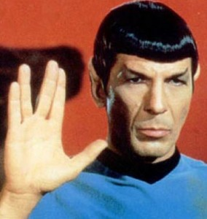
Declarative Programming
New paradigm!
In declarative programming, we describe what the properties of the required solution are, and the computer discovers how to find the solution.
Logic programming is a type of declarative programming that uses mathematical logic and logical inference to solve a problem.
http://www.5buckreview.com/wp-content/uploads/2011/03/Nimoy_Spock-284x300.jpg

Slide 5
Review: PyGic
Suppose we asserted the following fact:
P?> fact doctor(<christopher, david, matt>)
What would the interpreter print in response to the following queries?
P?> doctor(?who)
P?> doctor(<?who>)
P?> doctor(<?ninth, ?tenth, ?eleventh>)
P?> doctor(<?ninth | ?rest>)
P?> doctor(<christopher, ?tenth | ?eleventh>)

Slide 6
Review: PyGic
Suppose we asserted the following fact:
P?> fact doctor(<christopher, david, matt>)
What would the interpreter print in response to the following queries?
P?> doctor(?who)
?who = <christopher, david, matt>
P?> doctor(<?who>)
No.
P?> doctor(<?ninth, ?tenth, ?eleventh>)
?ninth = christopher, ?tenth = david, ?eleventh = matt
P?> doctor(<?ninth | ?rest>)
?ninth = christopher, ?rest = <david, matt>
P?> doctor(<christopher, ?tenth | ?eleventh>)
?tenth = david, ?eleventh = <matt>

Slide 7
PyGic: Rules
Conclusion
P?> rule grandfather(?person, ?grandson):
... father(?person, ?son)
... father(?son, ?grandson)
The conclusion is true only if the hypotheses are true.
=
Can variables be replaced with values such that the hypotheses are true? If so, the conclusion is true too.
Hypotheses

Slide 8
PyGic: Rules for Lists
We can also define rules for lists.
For example, say we want to check if two (flat) lists are equal.
What are some facts we know about equal lists?

Slide 9
PyGic: Rules for Lists
Fact 1:
The empty list is only equal to itself.
P?> fact equal_lists(<>, <>)
A fact, by the way, is equivalent to a rule with True in the body:
P?> rule equal_lists(<>, <>):
... True
True is a PyGic keyword that is, well, true.

Slide 10
PyGic: Rules for Lists
Conclusion
Fact 2:
Two lists are equal if
their first elements are equal, and if
the rest of their elements are equal.
P?> rule equal_lists(<?x | ?rest1>, <?x | ?rest2>):
... equal_lists(?rest1, ?rest2)
Hypotheses
The same variable is used in two places.
A list can therefore only match if the first elements have the same value.

Slide 11
PyGic: Rules for Lists
We want to append one list to another:
P?> append(<1, 2, 3>, <4, 5>, <1, 2, 3, 4, 5>)
Yes.
P?> append(<1, 2, 3>, <4, 5>, ?what)
Yes.
?what = <1, 2, 3, 4, 5>

Slide 12
PyGic: Rules for Lists
What are some facts we know about the problem?
Fact 1: Appending the empty list to any other list gives us the other list.
Fact 2: Appending one list to another is equivalent to adding the first element of the first list to the result of
appending the second list to the rest of the first list.
What facts or rules should we then define?

Slide 13
PyGic: Rules for Lists
P?> fact append(<>, ?z, ?z)
P?> rule append(<?x | ?u>, ?v, <?x | ?w>):
... append(?u, ?v, ?w)
We indicate that the first element of the first list and of the result must be the same.

Slide 14
PyGic: Rules for Lists
P?> fact append(<>, ?z, ?z)
P?> rule append(<?x | ?u>, ?v, <?x | ?w>):
... append(?u, ?v, ?w)
What about the rest of the first list, the second list, and the result?
The result is the second list appended to the rest of the first list.

Slide 15
PyGic: Rules for Lists (Practice)
We can now run append “backwards”.
P?> append(<1, 2, 3>, ?what, <1, 2, 3, 4, 5>)
Yes.
?what = <4, 5>
P?> append(?what, ?other, <1, 2, 3, 4, 5>)
Yes.
?what = <>
?other = <1, 2, 3, 4, 5>
P?> more?
Yes.
?what = <1>
?other = <2, 3, 4, 5>

Slide 16
PyGic: Rules for Lists (Practice)
Write the rule(s) reverse that will match only if the second list has elements in the reverse order as the first.
P?> reverse(<1, 2, 3>, <3, 2, 1>)
Yes.
P?> reverse(<1, 2, 3>, <1, 2>)
No.
P?> reverse(<1, 2, 3>, ?what)
Yes.
?what = <3, 2, 1>
(Hint: You may find append useful here.)

Slide 17
PyGic: Rules for Lists (Practice)
P?> fact reverse(<>, <>)
P?> rule reverse(<?first | ?rest>, ?rev):
... reverse(?rest, ?rest_rev)
... append(?rest_rev, <?first>, ?rev)

Slide 18
PyGic: Rules for Lists (Practice)
Write the rule(s) palindrome that will match only if the list is a palindrome, where the list reads the same forwards and backwards.
P?> palindrome(<1, 2, 3>)
No.
P?> palindrome(<1, 2, 3, 2, 1>)
Yes.
(Hint: You have defined reverse and equal_lists.)

Slide 19
PyGic: Rules for Lists (Practice)
P?> rule palindrome(?list):
... reverse(?list, ?list_rev)
... equal_lists(?list, ?list_rev)

Slide 20
Announcements
Homework 13 due Saturday, August 4.
Includes Py, streams, iterators, and generators
Also includes the Project 4 contest.
Project 4 due Tuesday, August 7.
Partnered project, in two parts.
Twelve questions, so please start early!
Two extra credit questions.
De-stress potluck tonight from 7pm to 10pm in the Wozniak Lounge (Soda, 4th floor).
Food and games.
Come and leave when you want.

Slide 21
Announcements: Final
Final is Thursday, August 9.
Where? 1 Pimentel.
When? 6PM to 9PM.
How much? All of the material in the course, from June 18 to August 8, will be tested.
Closed book and closed electronic devices.
One 8.5” x 11” ‘cheat sheet’ allowed.
No group portion.
We have emailed you if you have conflicts and have told us. If you haven’t told us yet, please let us know by toda
Final review sessions on Monday, August 6 and Tuesday, August 7, from 8pm to 9:30pm in the HP Auditorium (306 Soda).

Slide 22
How PyGic Works
Assume that we have asserted these facts:
P?> fact father(james, harry)
Yes.
P?> fact father(harry, albus_severus)
Yes.
P?> fact father(harry, james_sirius)
Yes.
What happens in response to the query:
P?> father(?who, ?child)

Slide 23
How PyGic Works
PyGic starts off with a “global” empty frame.
There are no bindings in this frame yet.

Slide 24
How PyGic Works
PyGic first searches for the facts that match the query and the rules whose conclusions match the query.
There are three such facts:
father(james, harry)
father(harry, albus_severus)
father(harry, james_sirius)

Slide 25
How PyGic Works
PyGic picks a fact:
father(james, harry)
father(harry, albus_severus)
father(harry, james_sirius)

Slide 26
How PyGic Works
PyGic prepares an empty frame that extends the global frame.
It makes a new empty frame for every query.
The current frame

Slide 27
How PyGic Works
PyGic attempts to unify the query with the fact.
Unification is a generalized form of pattern matching, where either or both of the patterns being matched may contain variables.

Slide 28
How PyGic Works: Unification
To match the query
father(?who, ?child)
with the fact
father(james, harry),
PyGic must check if
?who = james, ?child = harry.

Slide 29
How PyGic Works: Unification
PyGic checks if the variables
?who or ?child
have any values in the current frame.

Slide 30
How PyGic Works: Unification
There are none!
So, PyGic binds the variables to these values in the current frame.
Now, trivially, we know that
?who = james, ?child = harry
is true.
?who
james
?child
harry

Slide 31
How PyGic Works: Unification
PyGic is done with the query, since it successfully matched the query to a fact.
PyGic returns the frame and its bindings to be printed back to the user.

Slide 32
How PyGic Works: Backtracking
What happens if the user asks for more?
PyGic returns to the last point at which it made a choice (a choice point), and ignores all the frames that it made as a result of that choice.
There, it tries to make another choice, if it can. If not, it goes to the choice point before that, and attempts to make another choice.

Slide 33
How PyGic Works: Backtracking
In this example, it made a choice when it chose which fact to unify. As a result, a new frame is created with possibly new bindings.
If it cannot choose another fact or rule to unify, and if there are no more choice points, then there are no more ways to satisfy the rules.

Slide 34
How PyGic Works: Backtracking
This is known as chronological backtracking.
PyGic backtracks to the last point at which it made a choice and attempts to make another one to find another solution.

Slide 35
How PyGic Works
Now, say that we have the following rule:
P?> rule grandfather(?who, ?grandson):
... father(?who, ?son)
... father(?son, ?grandson)
What happens in response to the query:
P?> grandfather(james, ?grandson)

Slide 36
How PyGic Works
PyGic first searches for the facts that match the query and the rules whose conclusions match the query.
There is only one such rule:
grandfather(?who, ?grandson)
PyGic picks this rule.

Slide 37
How PyGic Works
PyGic will rename the variables to avoid confusion with other rules that may have the same variable names.
The rule is now
grandfather(?who#1, ?grandson#2):
father(?who#1, ?son#3)
father(?son#3, ?grandson#2)

Slide 38
How PyGic Works
PyGic prepares an empty frame, where no variables have yet been bound to any value.

Slide 39
How PyGic Works: Unification
To match the query
grandfather(james, ?grandson)
with the rule conclusion
grandfather(?who#1, ?grandson#2),
PyGic must check if
?who#1 = james,
?grandson#2 = ?grandson.

Slide 40
How PyGic Works: Unification
PyGic checks if the variables
?who#1, ?grandson#2, ?grandson
have any values in the current frame.

Slide 41
How PyGic Works: Unification
There are none!
So, PyGic makes the proper bindings in the current frame.
?who#1
james
?grandson#2
?grandson

Slide 42
How PyGic Works: Hypotheses
However, this is a rule!
PyGic needs to determine if the hypotheses are true to infer that the conclusion is true.
PyGic will consider each hypothesis as a new query, and determine if each hypothesis is true.

Slide 43
How PyGic Works
The new query is
father(?who#1, ?son#3)
PyGic searches for facts and rule conclusions that match this query. There are three such facts:
father(james, harry)
father(harry, albus_severus)
father(harry, james_sirius)

Slide 44
How PyGic Works
PyGic picks a fact:
father(james, harry)
father(harry, albus_severus)
father(harry, james_sirius)

Slide 45
How PyGic Works
PyGic prepares an empty frame, which extends the previous frame.
?who#1
james
?grandson#2
?grandson
This is very different from the environment diagrams we studied earlier.
Variables could not be assigned to variables!

Slide 46
How PyGic Works: Unification
To match the query
father(?who#1, ?son#3)
with the fact
father(james, harry),
PyGic must check if
?who#1 = james, ?son#3 = harry.

Slide 47
How PyGic Works: Unification
PyGic checks if the variables
?who#1 or ?son#3
have any values in the current frame or its parent.
?who#1
james
?grandson#2
?grandson

Slide 48
How PyGic Works: Unification
?who#1 has a value, but that value matches james.
There are no bindings for ?son#3.
PyGic binds ?son#3 with harry.
The query has been successfully unified with a fact.
?who#1
james
?son#3
harry
?grandson#2
?grandson

Slide 49
How PyGic Works
The first hypothesis in the body of the grandfather rule is true. Now, we check the second hypothesis
father(?son#3, ?grandson#2)
PyGic searches for facts and rule conclusions that match this query. There are three such facts:
father(james, harry)
father(harry, albus_severus)
father(harry, james_sirius)

Slide 50
How PyGic Works
PyGic picks a fact:
father(james, harry)
father(harry, albus_severus)
father(harry, james_sirius)

Slide 51
How PyGic Works
PyGic prepares another empty frame, which extends the previous frame.
?who#1
james
?son#3
harry
?grandson#2
?grandson

Slide 52
How PyGic Works: Unification
To match the query
father(?son#3, ?grandson#2)
with the fact
father(james, harry),
PyGic must check if
?son#3 = james, ?grandson#2 = harry.

Slide 53
How PyGic Works: Unification
PyGic checks if the variables
?son#3 or ?grandson#2
have any values in the current frame or its parents.
?who#1
james
?son#3
harry
?grandson#2
?grandson

Slide 54
How PyGic Works: Unification
?son#3 has a value, which does not match james.
The query is not true, given the existing bindings.
?who#1
james
?son#3
harry
?grandson#2
?grandson

Slide 55
How PyGic Works
PyGic then backtracks and picks another fact:
father(james, harry)
father(harry, albus_severus)
father(harry, james_sirius)

Slide 56
How PyGic Works
PyGic prepares another empty frame, which extends the previous frame.
Notice that the “previous frame” is the frame before the last choice point.
?who#1
james
?son#3
harry
?grandson#2
?grandson

Slide 57
How PyGic Works: Unification
To match the query
father(?son#3, ?grandson#2)
with the fact
father(harry, albus_severus),
PyGic must check if
?son#3 = harry,
?grandson#2 = albus_severus.

Slide 58
How PyGic Works: Unification
PyGic checks if the variables
?son#3 or ?grandson#2
have any values in the current frame or its parents.
?who#1
james
?son#3
harry
?grandson#2
?grandson

Slide 59
How PyGic Works: Unification
?son#3 has a value, but that value matches harry.
?grandson#2 has a value ?grandson.
PyGic binds ?grandson with albus_severus.
The query has been unified with the fact.
?who#1
james
?son#3
harry
?grandson
albus_severus
?grandson#2
?grandson

Slide 60
How PyGic Works
Both the hypotheses of the grandson rule are true, so the conclusion must also be true.
The values for the variables in the original query (?grandson) are looked up in the environment and printed.

Slide 61
How PyGic Works: Code (Simplified)
To prove a query in the given environment and with a given rule database...
def prove_query(query, env, ruledb):
if is_true_expr(query):
yield env
else:
matching_rules = ruledb.find_rules_matching(query)
for rule in matching_rules:
rule = rule.rename()
newenv = pygic.environments.Environment(env)
if unify_expr_lists(query, rule.conclusion, new_env):
for result in prove_queries(rule.hypotheses, newenv, ruledb):
yield result
If the query is the true expression, yield the current environment.
Find all the rules in the database whose conclusions match the query.
Remember that facts are also rules, each with a body of True.

Slide 62
How PyGic Works: Code (Simplified)
def prove_query(query, env, ruledb):
if is_true_expr(query):
yield env
else:
matching_rules = ruledb.find_rules_matching(query)
for rule in matching_rules:
rule = rule.rename()
newenv = pygic.environments.Environment(env)
if unify_expr_lists(query, rule.conclusion, new_env):
for result in prove_queries(rule.hypotheses, newenv, ruledb):
yield result
For every rule that matches...
... returned a renamed rule.

Slide 63
How PyGic Works: Code (Simplified)
def prove_query(query, env, ruledb):
if is_true_expr(query):
yield env
else:
matching_rules = ruledb.find_rules_matching(query)
for rule in matching_rules:
rule = rule.rename()
newenv = pygic.environments.Environment(env)
if unify_expr_lists(query, rule.conclusion, new_env):
for result in prove_queries(rule.hypotheses, newenv, ruledb):
yield result
Extend the environment.
Try to unify the query with the conclusion of the rule, which may add bindings in the frames.
If the hypotheses in the query can be proved, yield the environment that results from the proof.

Slide 64
How PyGic Works: Code (Simplified)
def prove_query(query, env, ruledb):
if is_true_expr(query):
yield env
else:
matching_rules = ruledb.find_rules_matching(query)
for rule in matching_rules:
rule = rule.rename()
newenv = pygic.environments.Environment(env)
if unify_expr_lists(query, rule.conclusion, new_env):
for result in prove_queries(rule.hypotheses, newenv, ruledb):
yield result
yield allows us to continue where we left off, or to “backtrack” to a choice point.

Slide 65
How PyGic Works: Code (Simplified)
def prove_queries(queries, env, ruledb):
if len(queries) == 0:
yield env
else:
for new_env in prove_query(queries[0], env, ruledb):
for result in prove_queries(queries[1:], new_env, ruledb):
yield result
If there are no more queries to check, we successfully yield the current environment.

Slide 66
How PyGic Works: Code (Simplified)
def prove_queries(queries, env, ruledb):
if len(queries) == 0:
yield env
else:
for new_env in prove_query(queries[0], env, ruledb):
for result in prove_queries(queries[1:], new_env, ruledb):
yield result
Prove the first query and obtain a resulting new environment.
Prove the rest of the queries in the new environment.

Slide 67
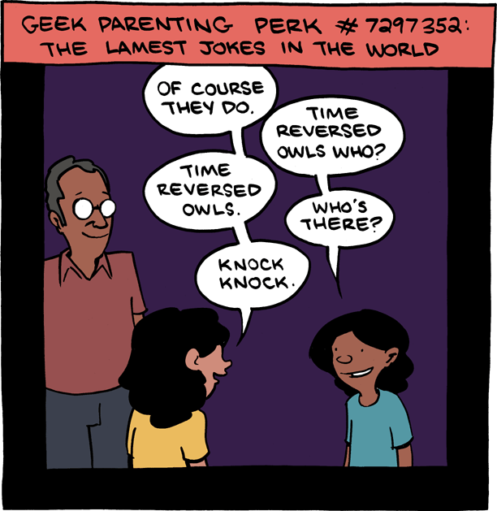
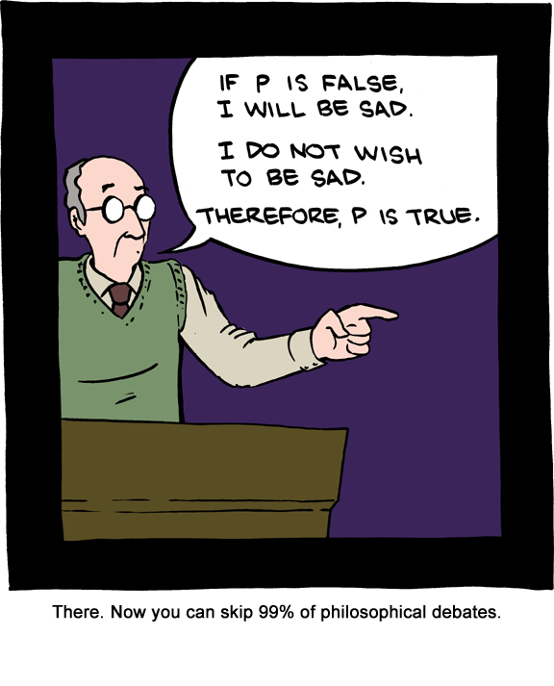
Break
http://www.smbc-comics.com/index.php?db=comics&id=2673
http://www.smbc-comics.com/index.php?db=comics&id=2684

Slide 68
Applications
Declarative programming is useful in database applications.
For example, if we have a database of student records, and want to get all the records of sophomore year students, we run the query
SELECT * FROM STUDENT_DB WHERE YEAR = 2

Slide 69
Applications
Notice that in the query
SELECT * FROM STUDENT_DB WHERE YEAR = 2
all that we have specified are the properties we expect from our output.
We could, of course, iterate through all the records and filter out the ones we need, but it is a common enough operation that it is better to specify what we want from the output, rather than how we want to get it.

Slide 70
Conclusion
Under the hood, PyGic matches the query against all of its rules and facts. It then picks one, and attempts to unify the query with the fact (or rule conclusion) by finding a consistent assignment to the variables in either.
Declarative programming is useful in situations where we know what we expect of the output.
Preview: Write your own chat client.

