Slide 1
CS61A Lecture 31
Fin
Jom Magrotker
UC Berkeley EECS
August 9, 2012

Slide 2
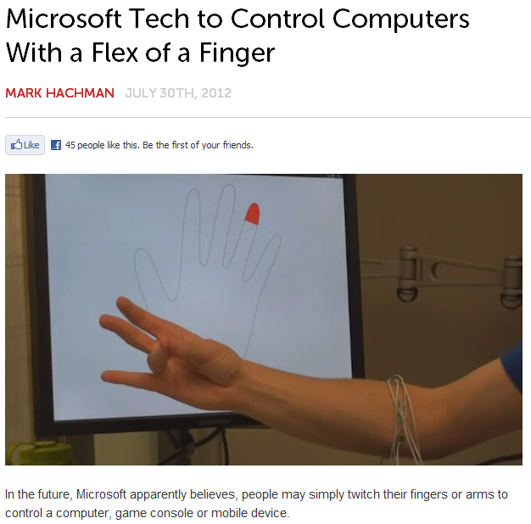
Computer Science in the News
http://www.readwriteweb.com/archives/microsoft-tech-to-control-computers-with-a-flex-of-a-finger.php

Slide 3
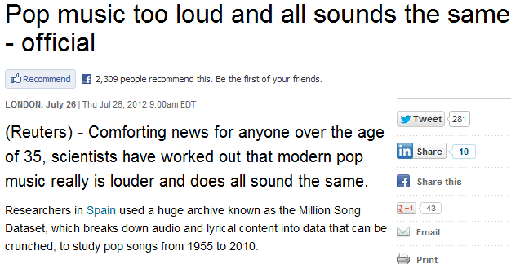
Computer Science in the News
http://www.reuters.com/article/2012/07/26/science-music-idUSL6E8IOE3320120726

Slide 4
Today
Parting Thoughts
  Where do you go from here?
  Life Lessons
  Advice
Computational Biology
Artificial Intelligence
Thanks and Credits

Slide 5
Contest Winners
Congratulations, everyone!
All submissions were amazing!
If you see your art up here,
come up and claim your prize.
Drumroll, please!

Slide 6
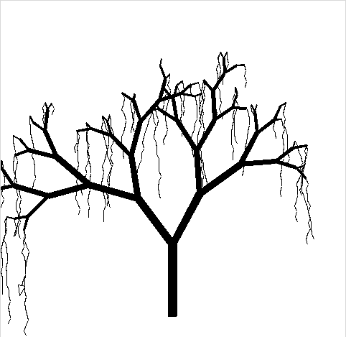
Contest Winners:
Tied for 2nd / 3rd Place Featherweight
Tangled Tree
by David Friedman
Vines trembling in the breeze
Lulling, calm all at ease
Bones littered beneath.

Slide 7

Contest Winners:
Tied for 2nd / 3rd Place Featherweight
Recursive Rainbow Roses
by Stephen Pretto
and Lu Chen
Rainbows and Roses
Colors that leave you smiling
Now please vote for us

Slide 8

Contest Winners:
1st Place Featherweight
Chagrin
by Neil Thomas
and Rahul Nadkarni
Down the rabbit hole
Into a chesire typhoon
(Re)cursed by Carroll

Slide 9
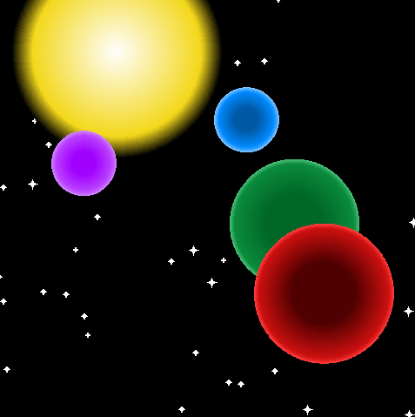
Contest Winners:
3rd Place Heavyweight
Universe Generator
by Tom Selvi
and Iris Wang
I come to Soda
In the day I come out and
Great! It’s now night time.

Slide 10
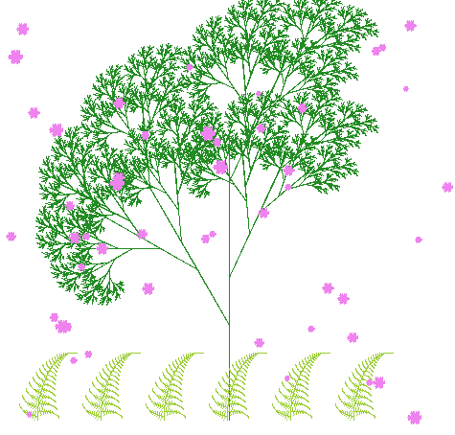
Contest Winners:
2nd Place Heavyweight
Spring Bloom
by Chien-yi Chang
and Jiajia Jing
Spring cherry blossoms
Surrounds exuberant greeneries
Sounds of nature

Slide 11

Contest Winners:
1st Place Heavyweight
Ring Around the Logo, a Pocketful of Medals...
by Hannah Chu
and Michael Zhu
Olympic turtles,
Slow and steady wins the race
And maybe contest? :D

Slide 12
... What Happened?
So, what did we learn?
  A way to understand computation.
  Ways to effectively organize our programs.
  Fundamentals!
Two big points we don’t want you to forget:
  Nothing is Magic!
  A lot of being a good programmer and computer scientist has to do with the way you think about what you are doing, or about to do.

Slide 13

How Far You’ve Come
Let’s take a moment to think about how far you’ve come since the beginning of the course.

Slide 14
Don’t Forget What You Learned!
All of what you have learned are the foundations of basically everything you will see in computer science!
The language you use does not really matter so long as you understand the fundamentals from this course!

Slide 15
Moving Forward
You’re (almost) done! Great!
Now what?

Slide 16
Moving Forward:
Lower Division Courses
Abstract Theoretical Ideas
CS61A
CS61B
CS61C
Programming Paradigms
Data Structures
Algorithms
Machine Structure
Parallelism
CS70
(Doesn’t really lead into CS61A)
Basics of Theory and Probability
EE**
The Math and Physics Making Your CPU Go!
More Specifics and Applications
Physics
Abstraction Barriers!

Slide 17
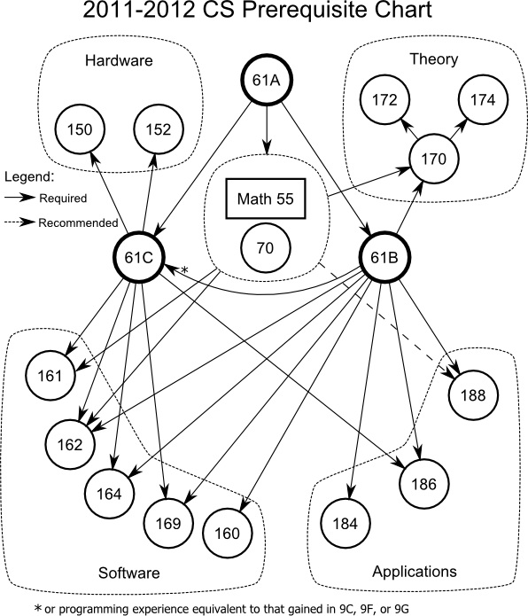
Moving Forward:
Upper Division Courses
There isn’t exactly a “recommended order” or “must-take” set of classes.
We recommend, however, that you take a little of each “area.”

Slide 18
Moving Forward:
Stay Involved with the Course!
If you can, please lab assist for future semesters of CS61A.
Often, readers and TAs are chosen based on how involved they’ve been with the course, in addition to grades and other factors.
You can apply to be a reader or TA here: https://willow.coe.berkeley.edu/PHP/gsiapp/menu.php?&dept=eecs

Slide 19
Announcements
You are now done with all projects and homework assignments! Congratulations! ☺
Grades Discrepancy
  You might have noticed we’re missing 10 points.
  We scaled each project up so the total project points is 90.
Accounts get deactivated on the 15th
  If you want to keep your files, copy them from the account now!
You’re nearly done. Thank you so much for sticking with us!

Slide 20
Announcements: Final
Final is TODAY!
  Where? 1 Pimentel.
  When? 6PM to 9PM.
  How much? All of the material in the course, from June 18 to August 8, will be tested.
Closed book and closed electronic devices.
One 8.5” x 11” ‘cheat sheet’ allowed.
No group portion.

Slide 21
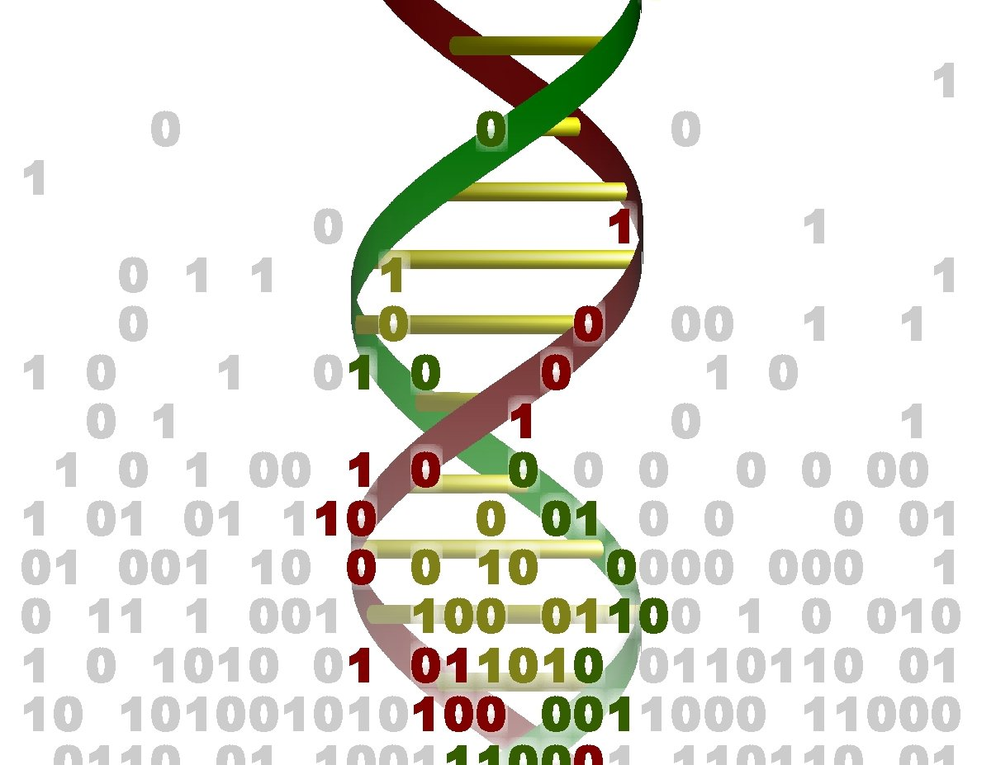
Computational Biology
Use computer science concepts to help understand biological data or to model biological systems.
http://seis.bris.ac.uk/~enfbm/MCB/dna2.jpg

Slide 22
Computational Biology
There is a lot of data in biology.
Understanding, and inferring from, this data are interesting problems that computer science can have answers for, or learn answers from.
Example problem:
Compressing the large amount of data available.
Example solution: Burrows-Wheeler transform, used when compressing files using .tar.gz.

Slide 23
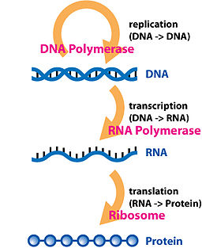
Computational Biology
Copying a file
Opening a file; converting it to machine code
Interpretation
http://en.wikipedia.org/wiki/Central_dogma_of_molecular_biology

Slide 24
Computational Biology
What patterns can we infer from the data?
What gene sequences correspond to what function?
What form will a protein fold into?
How can we model an organism as an object that interacts with other organisms?
Can we use these models to make better predictions?
… and oh so much more.

Slide 25
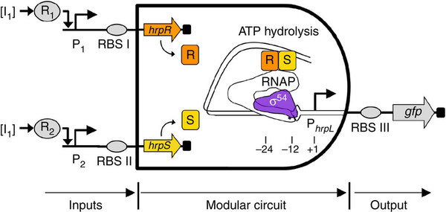
Biological Logic Gates
http://www.nature.com/ncomms/journal/v2/n10/full/ncomms1516.html

Slide 26
Artificial Intelligence
Attempts to study and design intelligent agents that can sense their environments and make decisions.
Machine learning
Robotic manipulation
Image and voice recognition
Natural language processing
Social intelligence
… and, oh so much more.

Slide 27
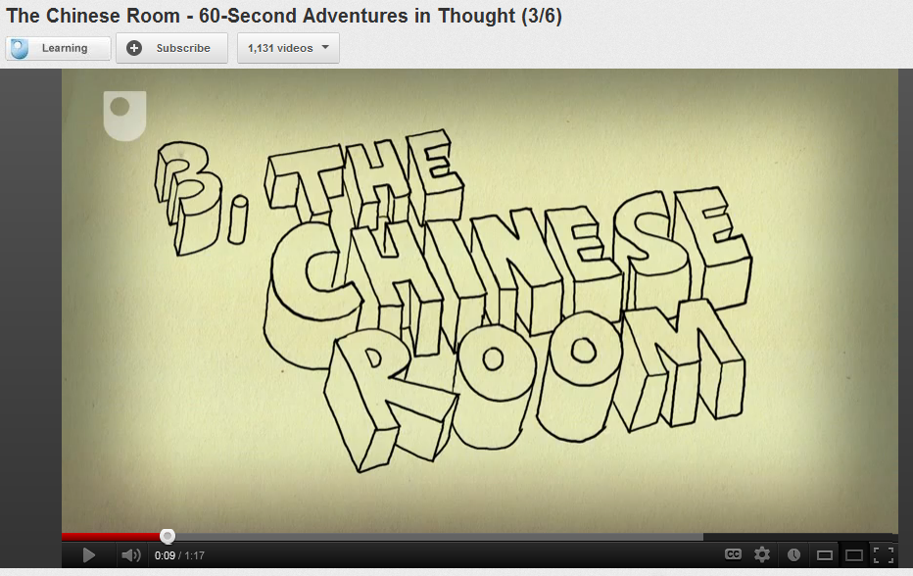
Artificial Intelligence
http://www.youtube.com/watch?v=TryOC83PH1g

Slide 28
Artificial Intelligence
Much of it is based on probabilities: given the data that is available:
Can a machine determine the probability of an event happening?
Can a machine determine the probability of an object being of a particular type?
Can a machine determine what happened “under-the-hood”, when only data about what has happened “over-the-hood” is available?

Slide 29
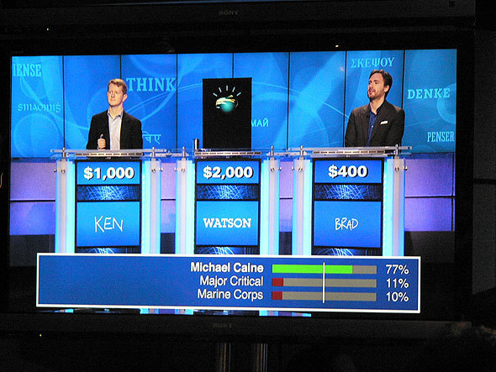
Artificial Intelligence
http://i.cmpnet.com/informationweek/galleries/automated/570/jeopardy12_full.jpg

Slide 30
Machine Learning: Supervised Learning
Idea: Provide the machine with a lot of data and associated human-generated “tags”.
The machine should learn what tags most likely correspond to different features in the input.
This allows us to construct classifiers, which tell us what tags belong to a certain piece of data.

Slide 31
Machine Learning: Supervised Learning
Usually done in at least two phases:
Training Phase: Take a large fraction of the available data – the training set – and let the machine learn using this data.
Testing Phase: Test how often the machine is correct, by asking it to predict the tags on the rest of the available data – the test set. Improve the machine accordingly.
Iterative improvement!

Slide 32
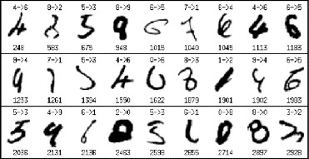
Machine Learning: Supervised Learning
Postal service dgit recognition:
93% accurate.
http://www.sciencedirect.com/science/article/pii/S0031320306004250

Slide 33
Machine Learning: Supervised Learning
Features
Aspects of the data that the machine looks for when computing its probabilities.
For digits: Curvature, amount of whitespace in image, rotation, edges, ...
For birds: Beak, color, general shape, ...
For faces: Eyes, nose, mouth, relative positions, …

Slide 34
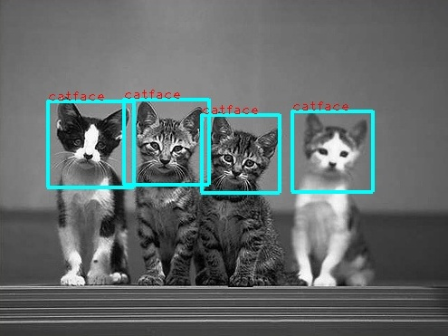
Machine Learning: Supervised Learning
http://www.di.ens.fr/~laptev/objectdetection/detsample_catfaces.jpg

Slide 35
Machine Learning
Unsupervised Learning
No data is provided:
Machine has to learn what it needs to find, and has to detect patterns in data.
Reinforcement Learning
There are now consequences to decisions: machine learns what to do and what not to do.

Slide 36
Natural Language Processing
Can a computer understand human language?
Early attempts involved giving the rules of a language to a computer; the current trend, however, is to give the computer the data.
The computer learns the rules by itself.

Slide 37
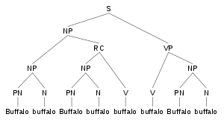
Natural Language Processing
http://upload.wikimedia.org/wikipedia/commons/thumb/2/2c/Buffalo_sentence_1_parse_tree.svg/300px-Buffalo_sentence_1_parse_tree.svg.png

Slide 38
Computational Humor and Storytelling
From the 1977 program TALE-SPIN:
“Once upon a time, George Ant lived near a patch of ground. There was a nest in an ash tree. Wilma Bird lived in the nest. There was some water in a river. Wilma knew that the water was in the river. George knew that the water was in the river. One day, Wilma was very thirsty. Wilma wanted to get near some water. Wilma flew from her nest across a meadow through a valley to the river. Wilma drank the water. Wilma was not thirsty any more.
George was very thirsty. George wanted to get near some water. George walked from his patch of ground across the meadow through the valley to a river bank. George fell into the water. George wanted to get near the valley. George couldn’t get near the valley. George wanted to get near the meadow. George couldn’t get near the meadow. Wilma wanted George to get near the meadow. Wilma wanted to get near George. Wilma grabbed George with her claw. Wilma took George from the river through the valley to the meadow. George was devoted to Wilma. George owed everything to Wilma. Wilma let go of George. George fell to the meadow. The end.”
http://www.j-paine.org/dobbs/lisp_joke_generator.html

Slide 39
Computational Humor and Storytelling
Knock, knock.
Who’s there?
Ammonia.
Ammonia who?
Ammonia trying to be funny.
http://www.slideserve.com/duy/opening-computational-door-on-knock-knock-jokes

Slide 40
Computer Science is Huge
There are so many subfields in computer science; many of these are interdisciplinary with other sciences and social sciences.
Experiment and find which one suits you!

Slide 41
Our Biggest Secret
“Computer science is not about computers, nor is it really a science.”
– Prof. Brian Harvey

Slide 42
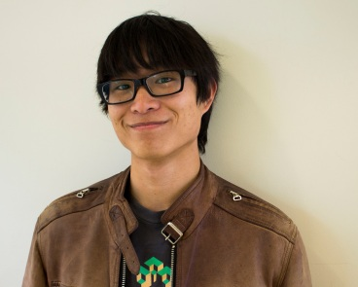
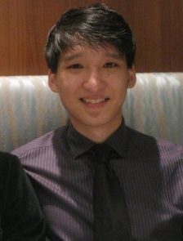
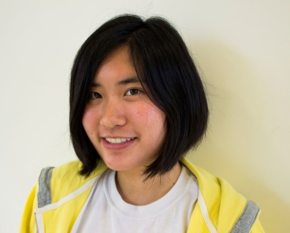
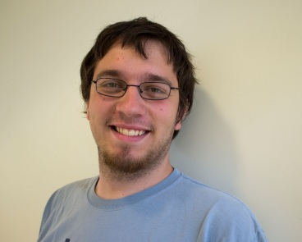
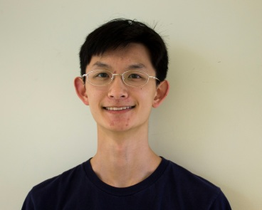
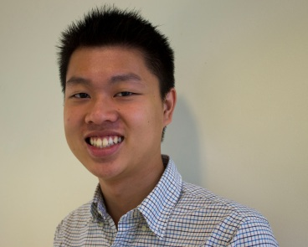
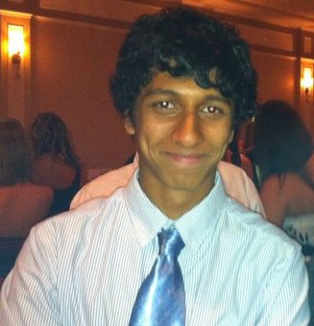
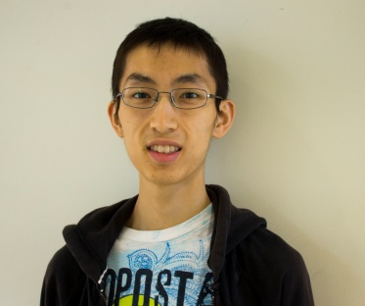
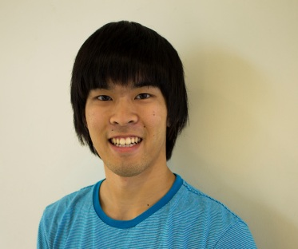
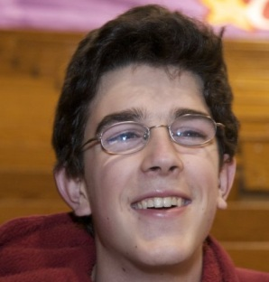
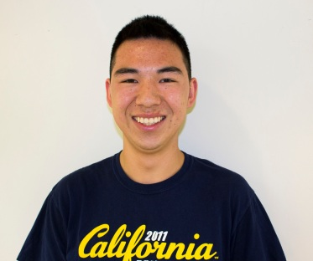
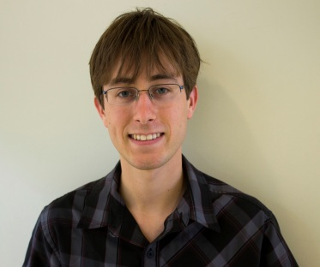
Thank You!
Teaching Assistants
Eric Kim
Steven Tang
Joy Jeng
Stephen Martinis
Albert Wu
Allen Nguyen
Readers
Sagar Karandikar
Jack Long
Mark Miyashita
Michael Ball
Robert Huang
Keegan Mann
Lab Assistants

Slide 43
From the Both of Us…
Thank you for being a huge part of a great summer!
You – yes, you – are CS61Awesome.

Slide 44

Conclusion
You’re CS61Awesome!
Good luck on the final tonight!
http://1.bp.blogspot.com/-7mqzeXpy1tU/Tjf8M4OAK6I/AAAAAAAAA0o/YTo2eUbWW0c/s1600/21213201012601Y.jpg

