Slide 1
CS 61B Data Structures and Programming Methodology
Aug 6, 2008
David Sun

Slide 2
Breadth-first Search
Starts at an arbitrary source vertex s then visits every vertex that is reachable from it.
During this systematic traversal we can compute the distance (in terms of the smallest number of edges) and the shortest path from s to each reachable vertex v.
Called Breadth-first because it:
Visits all vertices whose distance from the starting vertex is one, then all vertices whose distance from the starting vertex is two, and so on.

Slide 3
BFS(Graph G) {
Queue<Vertex> fringe;
fringe = queue containing {v};
v.dist() = 0;
v.parent() = null;
while (! fringe.isEmpty()) {
Vertex v = fringe.dequeue ();
For each edge (v,w) {
if (! marked (w))
mark(w);
w.dist() = v.dist() + 1;
w.parent() = v;
fringe.enqueue(w);
}
}
}

Slide 4
Correctness of BFS
The starting vertex is enqueued first, then all the vertices at a distance of 1 from the start, then all the vertices at a distance of 2, and so on.
Why?
When the starting vertex is dequeued, all the vertices at a distance of 1 are enqueued, but no other vertex is.
When the depth-1 vertices are dequeued and processed, all the vertices at a distance of 2 are enqueued, because every vertex at a distance of 2 must be reachable by a single edge from some vertex at a distance of 1.
When the depth-1 vertices are dequeued and processed no vertex at a depth other than 2 will be enqueued, because every vertex at a distance greater than 2 is not reachable by a single edge from some vertex at depth of 1.

Slide 5
Running Time of BFS
Observations:
Each of the |V| vertices is enqueued at most once, and hence dequeued at most once.
Enqueuing and dequeuing take O(1) time – total time devoted to queue operations O(|V|).
If adjacency list representation is used:
each adjacency list is scanned at most once.
the sum of the length of all adjacency lists is Theta(|E|).
time spent scanning the adjacency list is O(|E|)
Running time:
O(|V|+|E|) if using adjacency list.
O(|V|²) if using adjacency matrix.

Slide 6
Problem:
You want to wire the pins of of some circuit component. With n pins, you can interconnect them using n-1 wires. Of all possible arrangements, we’d like to find the one that uses the least amount of wire.

Slide 7
Minimum Spanning Tree
We can model the problem using using a connected, undirected graph G = (V, E) as follows:
V is the set of pins,
E is the set of possible interconnections (between pairs of pins),
For each edge (u,v) in E, there is a weight(u, v) specifying the cost (amount of wires) needed to connect u to v.
Now, find an acyclic, subset T connects all the vertices and whose total weight is minimized.

Slide 8
Minimum Spanning Tree
T is acyclic and connects all of the vertices,
it must form a tree, which we call a spanning tree since it “spans” the vertices of the graph G.
we are not minimizing the number of edges in T, since all spanning trees have exactly |V|-1 edges.
the problem of determining T given a graph is called the minimum-spanning-tree problem.

Slide 9
Generic Algorithm
Generic Algorithm for finding the minimum spanning tree:
A iterative algorithm that uses a greedy strategy, which means that at each iteration, we “grow” the current spanning tree by picking an edge with the least weight.
Generic-MST(Graph G)
Set<Vertex>A;
while A does not form a spanning tree
find an edge (u,v) in E of G such that after adding (u,v) to A, A is a subset of a minimum spanning tree.
Add (u,v) to A

Slide 10
Kruskal’s Algorithm
Based directly on the generic minimum-spanning-tree algorithm:
At each iteration we find the edge of the least weight and that does not create a cycle.
The set of edges found so far forms a forest.
MST-Kruskal(Graph G)
Create a new tree T with the same vertex set as G.
Sort the edges of G in nondecreasing order by weight.
Iterate through the sorted edges, for each edge (u,v):
If u and v are not connected by an edge in T
add (u,v) to T

Slide 11
Example

Slide 12
Running Time of Kruskal’s Algorithm
Step 1 Creating a new graph with the same vertex set:
Takes O(|V|) time.
Step 2 Sorting |E| edges:
Using one of the logarithmic-time sorting algorithms, e.g., mergesort, heapsort or quicksort, we can do this in O(|E| log |E|) time.
Step 3 Determining whether u and w are already connected by a path.
A simple way is to do a depth-first traversal on T starting at u, and see if we visit w, however, potentially taking Theta(|V|²) time.
We can do better using Disjoint Sets, which takes O(|E| log |E|) time.
Hence, the running time is in O(|V| + |E| log |E|).
If |E| < |V|², then log |E| < 2 log |V|. Therefore, Kruskal's algorithm runs in O(|E| log |V|) time.

Slide 13
Correctness of Kruskal’s Algorithm
Suppose the algorithm is considering adding an edge (u, w) to T, and there is not yet a path connecting u to w.
Let U be the set of vertices in T that are connected (so far) to u, and let W be a set containing all the other vertices, including w.
Let the bridge edges be any edges in G that have one end vertex in U and one end vertex in W.
Argument: Any spanning tree must contain at least one of these bridge edges. As long as we choose a bridge edge with the lowest weight, we are safe.

Slide 14
Prime’s Algorithm
Operates much like Dijkstra’s algorithm for finding shortest paths in a graph.
The set of edges found so-far always forms a tree.
Start at some root and grow the tree until it spans the all the vertices in V.
At each iteration, we add to the tree the edge of least weight that does not create a cycle.

Slide 15
Prime’s Algorithm
MST-Prime(Graph G)
PriorityQueue fringe;
For each vertex v {
v.dist() = ∞;
v.parent() = null;
}
Choose an arbitrary starting vertex, s;
s.dist() = 0;
fringe = priority queue ordered by smallest .dist();
add all vertices to fringe;
while (! fringe.isEmpty()) {
Vertex v = fringe.removeMin();
For each edge (v,w) {
if (w ∈ fringe && weight(v,w) < w.dist()) {
w.dist() = weight (v, w); w.parent() = v;
}
}
}

Slide 16
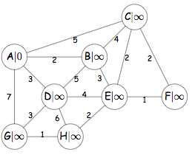
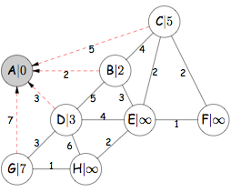
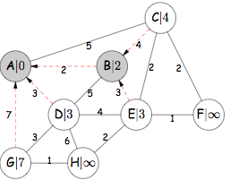
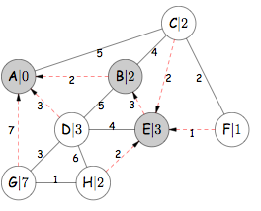
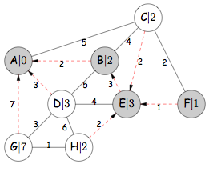
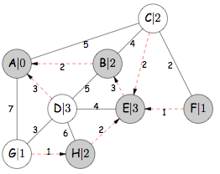
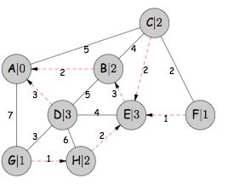
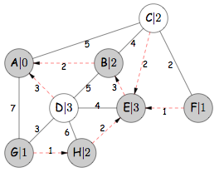
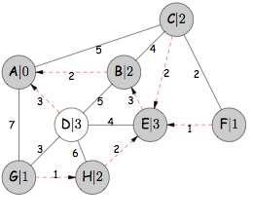

Slide 17
Running Time of Prime’s Algorithm
Initialization and putting all the vertices into the priority queue: O(|V|) time.
Removing the minimum element from the priority queue in each iteration: O(log |V|) time. This is executed |V| times: O(|V| log |V|).
The body of the for-loop takes O(log |V|) since by updating .dist() of a vertex, we are effectively reinserting the vertex into the priority queue. The body of the for-loop is executed |E| times: O(|E|log|V|).
Hence the running time of Prime’s algorithm is O(|E|log|V| + |V|log|V|) = O(|E| log |V|), which is asymptotically the same as the implementation of Kruskal’s algorithm using Disjoint Sets.

