Slide 1
CS 61C: Great Ideas in Computer Architecture (Machine Structures) Thread Level Parallelism
Instructors: Randy H. Katz David A. Patterson
http://inst.eecs.Berkeley.edu/~cs61c/fa10

Slide 2
Review
Intel SSE SIMD Instructions
One instruction fetch that operates on multiple operands simultaneously
SSE Instructions in C
Can embed the SEE machine instructions directly into C programs through the use of intrinsics

Slide 3
Review: Flynn Taxonomy
SISD and MIMD most commonly encountered
Most common parallel processing programming style: Single Program Multiple Data
Single program that runs on all processors of an MIMD

Slide 4
Agenda
Multiprocessor
Cache Coherence
Administrivia
Technology Break
Synchronization
OpenMP (if there is time)

Slide 5
Parallel Processing: Multiprocessor Systems (MIMD)
Multiprocessor (MIMD): a computer system with at least 2 processors
Deliver high throughput for independent jobs via job-level parallelism
Improve the run time of a single program that has been specially crafted to run on a multiprocessor - a parallel processing program
Now Use term core for processor (“Multicore”) because “Multiprocessor Microprocessor” too redundant
Processor
Processor
Processor
Cache
Cache
Cache
Interconnection Network
Memory
I/O
Notes:
Power has become the overriding issue for both data centers and microprocessors. Power efficiency has joined scalable performance making the case for multiprocessors. Multiprocessors also improve availability.

Slide 6
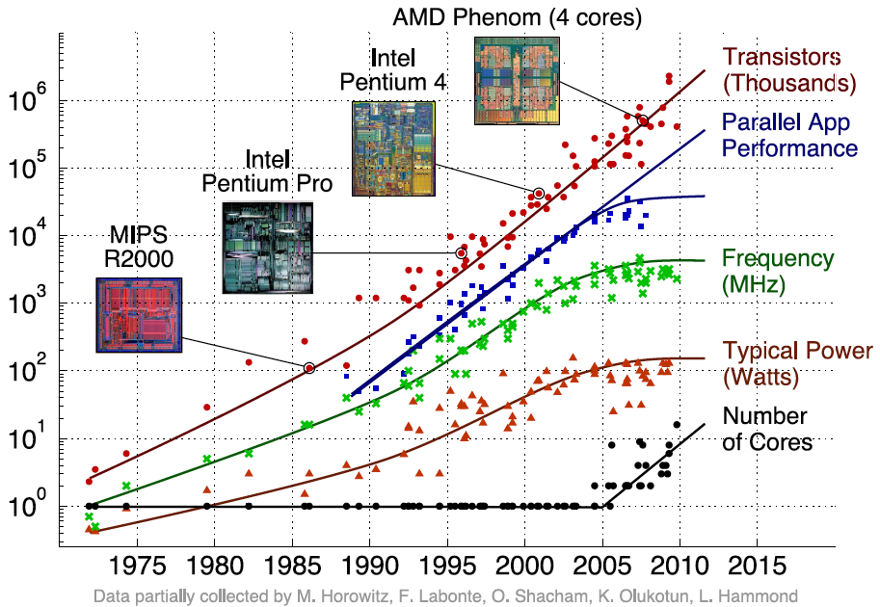
Transition to Multicore
Sequential App Performance

Slide 7
Multiprocessors and You
Only path to performance is parallelism
Clock rates flat or declining
SIMD: 2X width every 3-4 years
128b wide now, 256b 2011, 512b in 2014?, 1024b in 2018?
MIMD: Add 2 cores every 2 years: 2, 4, 6, 8, 10, …
A key challenge is to craft parallel programs that have high performance on multiprocessors as the number of processors increase – i.e., that scale
Scheduling, load balancing, time for synchronization, overhead for communication
Project 4: fastest code on 8 processor computers
2 chips/computer, 4 cores/chip

Slide 8
Parallel Performance Over Time
Year | Cores | SIMD bits /Core | Core * SIMD bits | Peak DP FLOPs
2003 | 2 | 128 | 256 | 4
2005 | 4 | 128 | 512 | 8
2007 | 6 | 128 | 768 | 12
2009 | 8 | 128 | 1024 | 16
2011 | 10 | 256 | 2560 | 40
2013 | 12 | 256 | 3072 | 48
2015 | 14 | 512 | 7168 | 112
2017 | 16 | 512 | 8192 | 128
2019 | 18 | 1024 | 18432 | 288
2021 | 20 | 1024 | 20480 | 320

Slide 9
Multiprocessor Key Questions
Q1 – How do they share data?
Q2 – How do they coordinate?
Q3 – How many processors can be supported?

Slide 10
Shared Memory Multiprocessor (SMP)
Q1 – Single address space shared by all processors/cores
Q2 – Processors coordinate/communicate through shared variables in memory (via loads and stores)
Use of shared data must be coordinated via synchronization primitives (locks) that allow access to data to only one processor at a time
All multicore computers today are SMP

Slide 11
Example: Sum Reduction
Sum 100,000 numbers on 100 processor SMP
Each processor has ID: 0 ≤ Pn ≤ 99
Partition 1000 numbers per processor
Initial summation on each processor
sum[Pn] = 0; for (i = 1000*Pn; i < 1000*(Pn+1); i = i + 1) sum[Pn] = sum[Pn] + A[i];
Now need to add these partial sums
Reduction: divide and conquer
Half the processors add pairs, then quarter, …
Need to synchronize between reduction steps

Slide 12
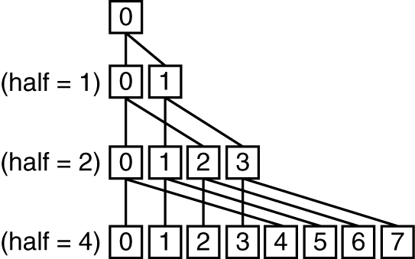
Example: Sum Reduction
half = 100;
repeat
synch();
if (half%2 != 0 && Pn == 0)
sum[0] = sum[0] + sum[half-1];
/* Conditional sum needed when half is odd;
Processor0 gets missing element */
half = half/2; /* dividing line on who sums */
if (Pn < half) sum[Pn] = sum[Pn] + sum[Pn+half];
until (half == 1);

Slide 13
An Example with 10 Processors
sum[P0]
sum[P1]
sum[P2]
sum[P3]
sum[P4]
sum[P5]
sum[P6]
sum[P7]
sum[P8]
sum[P9]
P0
P1
P2
P3
P4
P5
P6
P7
P8
P9
half = 10
Notes:
For class handout

Slide 14
An Example with 10 Processors
sum[P0]
sum[P1]
sum[P2]
sum[P3]
sum[P4]
sum[P5]
sum[P6]
sum[P7]
sum[P8]
sum[P9]
P0
P1
P2
P3
P4
P5
P6
P7
P8
P9
half = 10
P0
P1
P2
P3
P4
half = 5
P0
P1
half = 2
P0
half = 1
Notes:
For lecture
So load balancing issue at second reduction (when half = 2)

Slide 15
Shared Memory and Caches
What if?
Processors 1 and 2 read Memory[1000] (value 20)
0
1
2
Processor
Processor
1000
Processor
1000
Cache
1000
1000
Cache
Cache
Interconnection Network
20
Memory
20
I/O

Slide 16
Shared Memory and Caches
What if?
Processors 1 and 2 read Memory[1000]
Processor 0 writes Memory[1000] with 40
0
Processor 0
Write
Invalidates
Other Copies
Processor
1
2
1000
Processor
Processor
1000 40
1000 20
1000 20
Cache
Cache
Cache
Interconnection Network
1000 40
Memory
I/O

Slide 17
Keeping Multiple Caches Coherent
Architect’s job: shared memory => keep cache values coherent
Idea: When any processor has cache miss or writes, notify other processors via interconnection network
If only reading, many processors can have copies
If a processor writes, invalidate all other copies
Shared written result can “ping-pong” between caches

Slide 18
How Does HW Keep $ Coherent?
Each cache tracks state of each block in cache:
Shared: up-to-date data, other caches may have a copy
Modified: up-to-date data, changed (dirty), no other cache has a copy, OK to write, memory out-of-date

Slide 19
2 Optional Performance Optimizations of Cache Coherency via new States
Each cache tracks state of each block in cache:
Exclusive: up-to-date data, no other cache has a copy, OK to write, memory up-to-date
Avoids writing to memory if block replaced
Supplies data on read instead of going to memory
Owner: up-to-date data, other caches may have a copy (they must be in Shared state)
Only cache that supplies data on read instead of going to memory

Slide 20
Name of Common Cache Coherency Protocol: MOESI
Memory access to cache is either
Modified (in cache)
Owned (in cache)
Exclusive (in cache)
Shared (in cache)
Invalid (not in cache)

Slide 21
Agenda
Multiprocessor
Cache Coherence
Administrivia
Synchronization
OpenMP (if there is time)

Slide 22
Administrivia
Midterm answers and grading ruberic online
Turn in your written regrade petitions with your exam to your TA by next Tuesday Oct 19
Final Exam 8-11AM (TBD) Monday Dec 13
Make sure all grades are correct but Project 4, Final by December 1

Slide 23
Computers in the News
“Intel Tries Anonymity, for a Change” By ASHLEE VANCE, NY Times, October 12, 2010
Japanese Game Maker on a Buying Spree By HIROKO TABUCHI, NY Times, October 12, 2010
TOKYO — DeNA, a Japanese social game company, said on Tuesday that it would acquire Ngmoco, a Silicon Valley iPhone game developer, for $400 million — one of the largest deals involving an iPhone software company and another sign that Apple’s products are fast becoming the hottest mobile game devices on the market.

Slide 24
Survey
Too much reading?
To midterm - K&R: 97 pg; WSC: 33; P&H: 143 = 273 total pages
Midterm to end - P&H: 186 pg, Handouts: 39 pages = 225 total pages
1st 7 weeks: average is 39 pages / week
Last 8 weeks: average is 28 pages / week
~10% don’t read book or look at slides
Highest rated assignment (learned the most): Project 1 42% “I enjoyed it and learned a lot” + 40% “it was a satisfactory assignment and I learned some”

Slide 25
Cache Coherency and Block Size
Suppose block size is 32 bytes
Suppose Processor 0 reading and writing variable X, Processor 1 reading and writing variable Y
Suppose in X location 4000, Y in 4012
What will happen?
Effect called false sharing
How can you prevent it?

Slide 26
Threads
thread of execution: smallest unit of processing scheduled by operating system
On 1 processor, multithreading occurs by time-division multiplexing:
Processor switched between different threads
Context switching happens frequently enough user perceives threads as running at the same time
On a multiprocessor, threads run at the same time, with each processor running a thread

Slide 27
Data Races and Synchronization
2 memory accesses form a data race if from different threads to same location, and at least one is a write, and they occur one after another
If there is a data race, result of program can vary depending on chance (which thread first?)
Avoid data races by synchronizing writing and reading to get deterministic behavior
Synchronization done by user-level routines that rely on hardware synchronization instructions

Slide 28
Lock and Unlock Synchronization
Lock used to create region (“critical section”) where only 1 processor can operate
Given shared memory, use memory location to act synchronization point: “lock”
Processors read it to see if must wait, or OK to go into critical section (and set to locked)
0 => lock is free / open / unlocked
1 => lock is taken / closed / locked

Slide 29
Peer Instruction: What Happens?
addiu $t1,$zero, 1 ; t1 = Locked value
Tryagain: lw $t0, lock($s0) ; load lock
beq $t0, $zero, Trygain ; loop if 0
HaveLock: sw $t1, lock($s0) ; Lock must be 1?
Implements lock correctly
Infinite Loop, since no change to lock before beq
Doesn’t work because another core could read lock in memory before sw changes it to 1, go to critical section
Doesn’t work because OS could schedule another thread on this core between lw and sw, and the other thread could go into critical section
A)(red) I only B)(orange) II only C)(green) III only D)(yellow) IV only
E)(pink) III and IV
Notes:
2: 104 10 5 10 then 104 11 5 11 …because ints in this system are 4-bytes long and the actual address increments by 4 even though it appears to only incrememt 1.

Slide 30
Hardware Synchronization
Hardware support required to prevent interloper (either thread on other core or thread on same core) from changing the value
Atomic read/write memory operation
No other access to the location allowed between the read and write
Could be a single instruction
E.g., atomic swap of register ↔ memory
Or an atomic pair of instructions

Slide 31
Synchronization in MIPS
Load linked: ll rt, offset(rs)
Store conditional: sc rt, offset(rs)
Succeeds if location not changed since the ll
Returns 1 in rt
Fails if location is changed
Returns 0 in rt
Example: atomic swap (to test/set lock variable)
try: add $t0,$zero,$s4 ;copy exchange value
ll $t1,0($s1) ;load linked
sc $t0,0($s1) ;store conditional
beq $t0,$zero,try ;branch store fails
add $s4,$zero,$t1 ;put load value in $s4

Slide 32
OpenMP
OpenMP is an API used for multi-threaded, shared memory parallelism
Compiler Directives
Runtime Library Routines
Environment Variables
Portable
Standardized

Slide 33
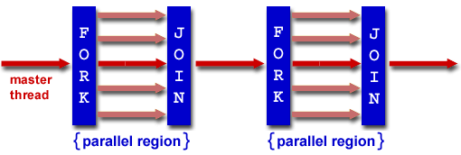
Fork/Join Parallelism
Start out executing the program with one master thread
Master thread forks worker threads
Worker threads die or suspend at end of parallel code
Image courtesy of http://www.llnl.gov/computing/tutorials/openMP/

Slide 34
Simple Parallelization
for (i=0; i<max; i++) zero[i] = 0;
For loop must have canonical shape for OpenMP to parallelize it
Necessary for run-time system to determine loop iterations
No premature exits from the loop allowed
i.e., No break, return, exit, goto statements

Slide 35
OpenMP Extends C with Pragmas
Pragmas are a mechanism C provides for language extensions
Commonly implemented pragmas: structure packing, symbol aliasing, floating point exception modes
Good mechanism for OpenMP because compilers that don't recognize a pragma are supposed to ignore them
Runs on sequential computer even with embedded pragmas

Slide 36
The parallel for pragma
#pragma omp parallel for
for (i=0; i<max; i++) zero[i] = 0;
Master thread creates additional threads, each with a separate execution context
All variables declared outside for loop are shared by default, except for loop index

Slide 37
Thread Creation
How many threads will OpenMP create?
Defined by OMP_NUM_THREADS environment variable
Set this variable to the maximum number of threads you want OpenMP to use
Presumably = number of processors in computer running program

Slide 38
Summary
Sequential software is slow software
SIMD and MIMD only path to higher performance
Multiprocessor (Multicore) uses Shared Memory (single address space)
Cache coherency implements shared memory even with multiple copies in multiple caches
False sharing a concern
Synchronization via hardware primitives:
MIPS does it with Load Linked + Store Conditional
OpenMP as simple parallel extension to C

