Slide 1
CS 61C: Great Ideas in Computer Architecture Lecture 14 –Cache Performance (Cache III)
Instructors:
Mike Franklin
Dan Garcia
http://inst.eecs.berkeley.edu/~cs61c/fa11

Slide 2
In the News… Major Expansion of World’s Data Centers
The next great expansion of the world’s digital infrastructure is under way in developing markets like those of China, Brazil and Argentina.
Growth expected to match levels from economy’s “boom years” despite global slowdown
http://www.nytimes.com/2011/09/28/technology/worlds-data-centers-expected-to-grow-survey-says.html

Slide 3
Agenda
Review – Direct Mapped Caches
Measuring Performance
Multi-Level Caches
Associative Caches
Cache Wrap Up

Slide 4
Review: Multiword Block Direct Mapped Cache
Four words/block, cache size = 1K words (256 blocks) (4KB Total data)
Byte offset
Hit
31 30 . . . 13 12 11 . . . 4 3 2 1 0
Data
Tag
20
8
Block offset
Index
Index
Valid
Tag
Data
0
1
2
.
.
.
253
254
255
20
32
Notes:
to take advantage for spatial locality want a cache block that is larger than word word in size.

Slide 5
Measuring Performance
Computers use a clock to determine when events takes place within hardware
Clock cycles – discrete time intervals
a.k.a. clocks, cycles, clock periods, clock ticks
Clock rate or clock frequency – clock cycles per second (inverse of clock cycle time)
3 GigaHertz clock rate => clock cycle time = 1/3x10⁹ seconds clock cycle time = 333 picoseconds (ps)

Slide 6
CPU Performance Factors
But a program executes instructions
1st term called Instruction Count
3rd term is Clock Cycle Time (1 / Clock rate)
2nd term abbreviated CPI for average Clock cycles Per Instruction
Why CPI = 1? Why CP1 > 1? Can CPI be < 1?
Time = Seconds Program Instructions Clock cycles Seconds Program Instruction Clock Cycle
=
×
×

Slide 7
Average Memory Access Time (AMAT)
Average Memory Access Time (AMAT) is the average to access memory considering both hits and misses
AMAT = Time for a hit + Miss rate x Miss penalty
What is the AMAT for a processor with a 200 psec clock, a miss penalty of 50 clock cycles, a miss rate of 0.02 misses per instruction and a cache access time of 1 clock cycle?
Potential impact of much larger cache on AMAT?
1 + 0.02 x 50 = 2 clock cycles
Or 2 x 200 = 400 psecs
1) Lower Miss rate
2) Longer Access time (Hit time): smaller is faster
Increase in hit time will likely add another stage to the pipeline
At some point, increase in hit time for a larger cache may overcome the improvement in hit rate, yielding a decrease in performance
Notes:
AMAT = 1 + 0.02x50 = 2

Slide 8
Measuring Cache Performance – Effect on CPI
Assuming cache hit costs are included as part of the normal CPU execution cycle, then
CPU time = IC × CPI × CC
= IC × (CPI_{ideal} + Average Memory-stall cycles) × CC
CPI_{stall}
A simple model for Memory-stall cycles
Memory-stall cycles = accesses/instruction × miss rate × miss penalty
This ignores extra costs of write misses – which were described previously
Notes:
Reasonable write buffer depth (e.g., four or more words) and a memory capable of accepting writes at a rate that significantly exceeds the average write frequency means write buffer stalls are small

Slide 9
Impacts of Cache Performance
Relative $ penalty increases as processor performance improves (faster clock rate and/or lower CPI)
Memory speed unlikely to improve as fast as processor cycle time. When calculating CPI_{stall}, cache miss penalty is measured in processor clock cycles needed to handle a miss
Lower the CPI_{ideal}, more pronounced impact of stalls
Processor with a CPI_{ideal} of 2, a 100 cycle miss penalty, 36% load/store instr’s, and 2% I$ and 4% D$ miss rates
Memory-stall cycles = 2% × 100 + 36% × 4% × 100 = 3.44
So CPI_{stalls} = 2 + 3.44 = 5.44
More than twice the CPI_{ideal} !
What if the CPI_{ideal} is reduced to 1?
What if the D$ miss rate went up by 1%?
Notes:
For ideal CPI = 1, then CPIstall = 4.44 and the amount of execution time spent on memory stalls would have risen from 3.44/5.44 = 63% to 3.44/4.44 = 77%
For miss penalty of 200, memory stall cycles = 2% 200 + 36% x 4% x 200 = 6.88 so that CPIstall = 8.88
This assumes that hit time (so hit time is 1 cycle) is not a factor in determining cache performance. A larger cache would have a longer access time (if a lower miss rate), meaning either a slower clock cycle or more stages in the pipeline for memory access.

Slide 10
Multiple Cache Levels
Main Memory
L2$
L1$
CPU
Mem
Access
.
.
.
Miss
Hit
Miss
Hit
Path of Data Back to CPU

Slide 11
Multiple Cache Levels
With advancing technology, have more room on die for bigger L1 caches and for second level cache – normally a unified L2 cache (i.e., it holds both instructions and data,) and in some cases even a unified L3 cache
New AMAT Calculation: AMAT = L1 Hit Time + L1 Miss Rate * L1 Miss Penalty L1 Miss Penalty = L2 Hit Time + L2 Miss Rate * L2 Miss Penalty and so forth (final miss penalty is Main Memory access time)
Notes:
Also reduces cache miss penalty

Slide 12
New AMAT Example
1 cycle L1 Hit Time, 2% L1 Miss Rate, 5 cycle L2 Hit Time, 5% L2 Miss Rate.
100 cycle Main Memory access time
No L2 Cache: AMAT = 1 + .02*100 = 3
With L2 Cache: AMAT = 1 + .02*(5 + .05*100) = 1.2!

Slide 13
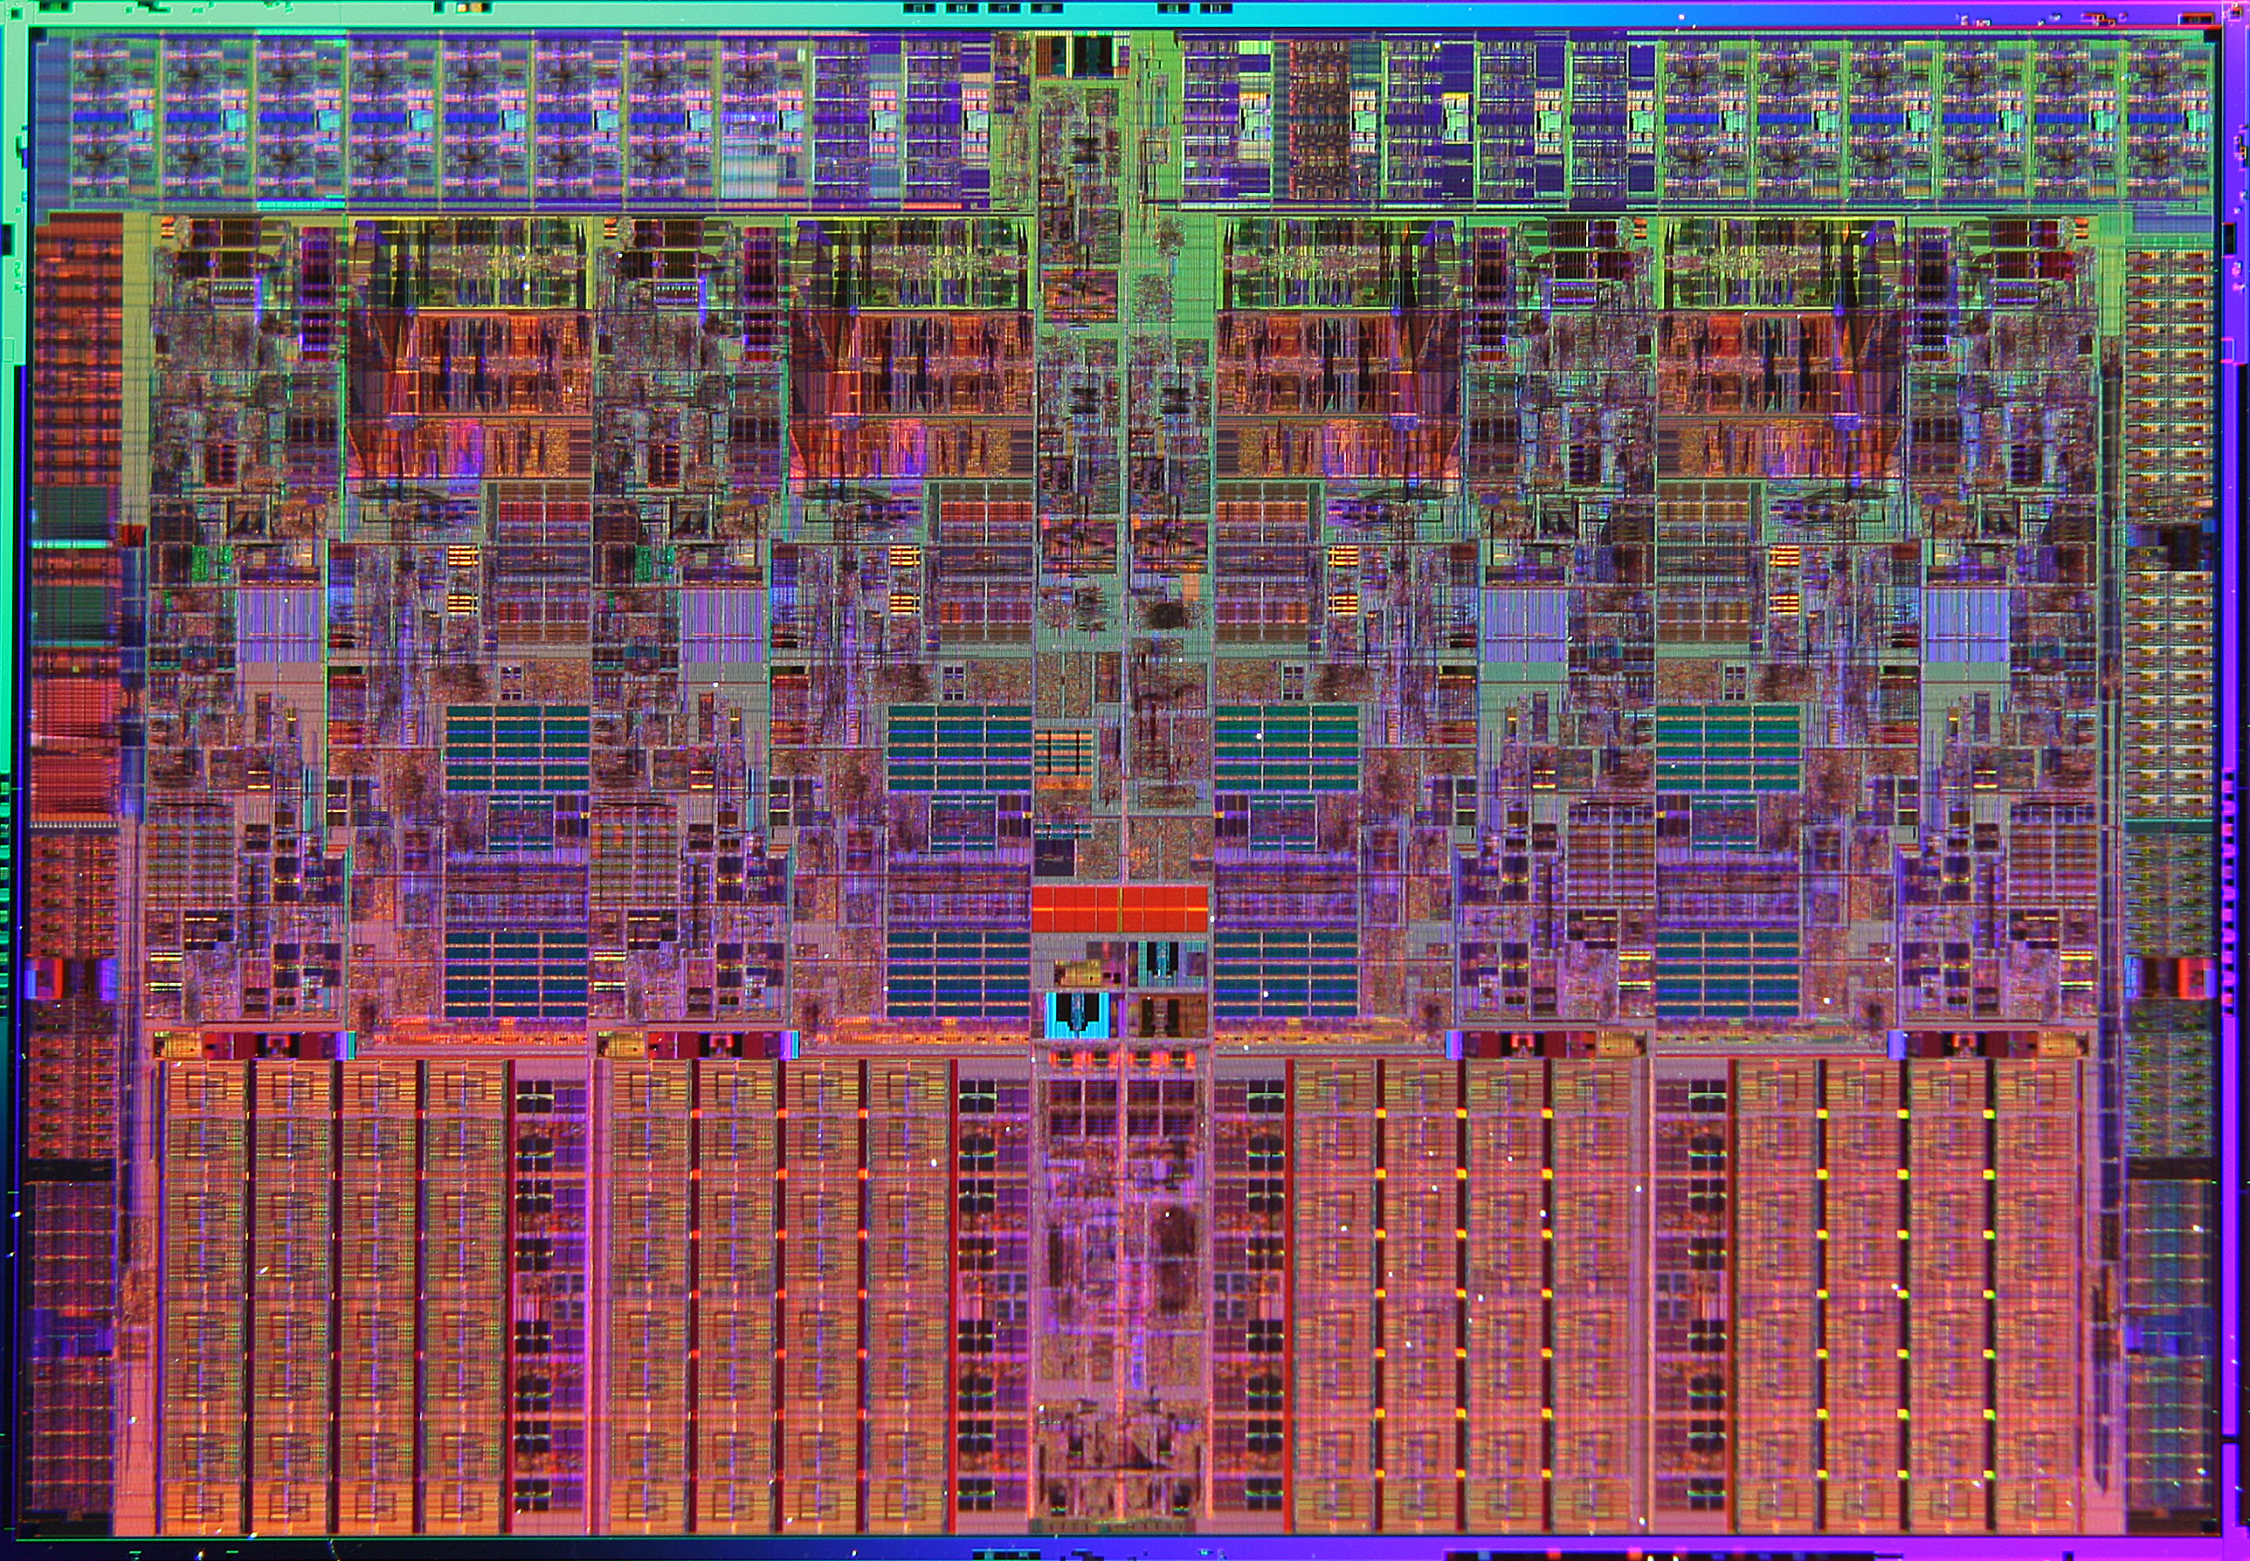
Nehalem Die Photo
Memory Controller
Misc IO
Misc IO
13.6 mm (0.54 inch)
Core
Core
Core
Core
Memory
Queue
QPI
QPI
Shared L3 Cache
18.9 mm (0.75 inch)

Slide 14
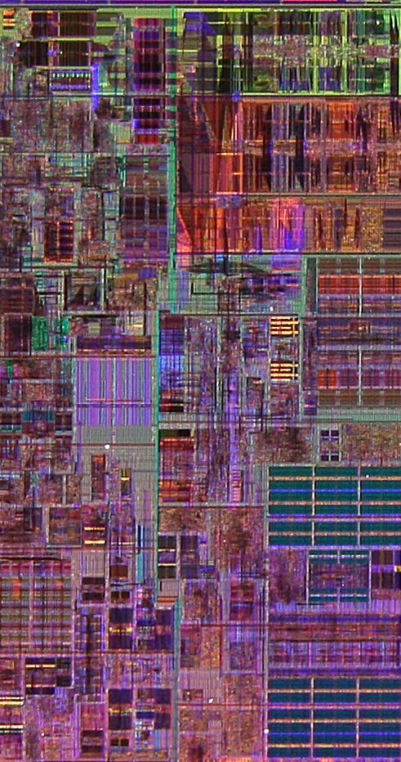
Core Area Breakdown
Memory Controller
Execution Units
32KB I$ per core
32KB D$ per core
512KB L2$ per core
Share one 8-MB L3$
L1 Data cache
L2 Cache & Interrupt Servicing
L1 Inst cache & Inst Fetch
L3 Cache
Load Store Queue

Slide 15
Sources of Cache Misses: The 3Cs
Compulsory (cold start or process migration, 1st reference):
First access to block impossible to avoid; small effect for long running programs
Solution: increase block size (increases miss penalty; very large blocks could increase miss rate)
Capacity:
Cache cannot contain all blocks accessed by the program
Solution: increase cache size (may increase access time)
Conflict (collision):
Multiple memory locations mapped to the same cache location
Solution 1: increase cache size
Solution 2: increase associativity (may increase access time)
Notes:
(Capacity miss) That is the cache misses are due to the fact that the cache is simply not large enough to contain all the blocks that are accessed by the program.
The solution to reduce the Capacity miss rate is simple: increase the cache size.
Here is a summary of other types of cache miss we talked about.
First is the Compulsory misses. These are the misses that we cannot avoid. They are caused when we first start the program.
Then we talked about the conflict misses. They are the misses that caused by multiple memory locations being mapped to the same cache location.
There are two solutions to reduce conflict misses. The first one is, once again, increase the cache size. The second one is to increase the associativity.
For example, say using a 2-way set associative cache instead of directed mapped cache.
But keep in mind that cache miss rate is only one part of the equation. You also have to worry about cache access time and miss penalty. Do NOT optimize miss rate alone.
Finally, there is another source of cache miss we will not cover today. Those are referred to as invalidation misses caused by another process, such as IO , update the main memory so you have to flush the cache to avoid inconsistency between memory and cache.
+2 = 43 min. (Y:23)

Slide 16
Reducing Cache Misses
Allow more flexible block placement in cache
Direct mapped $: memory block maps to exactly one cache block
Fully associative $: allow a memory block to be mapped to any cache block
Compromise: divide $ into sets, each of which consists of n “ways” (n-way set associative) to place memory block
Memory block maps to unique set determined by index field and is placed in any of the n-ways of that set
Calculation: (block address) modulo (# sets in the cache)
Notes:
All of the tags of all of the elements of the set must be searched for a match.

Slide 17
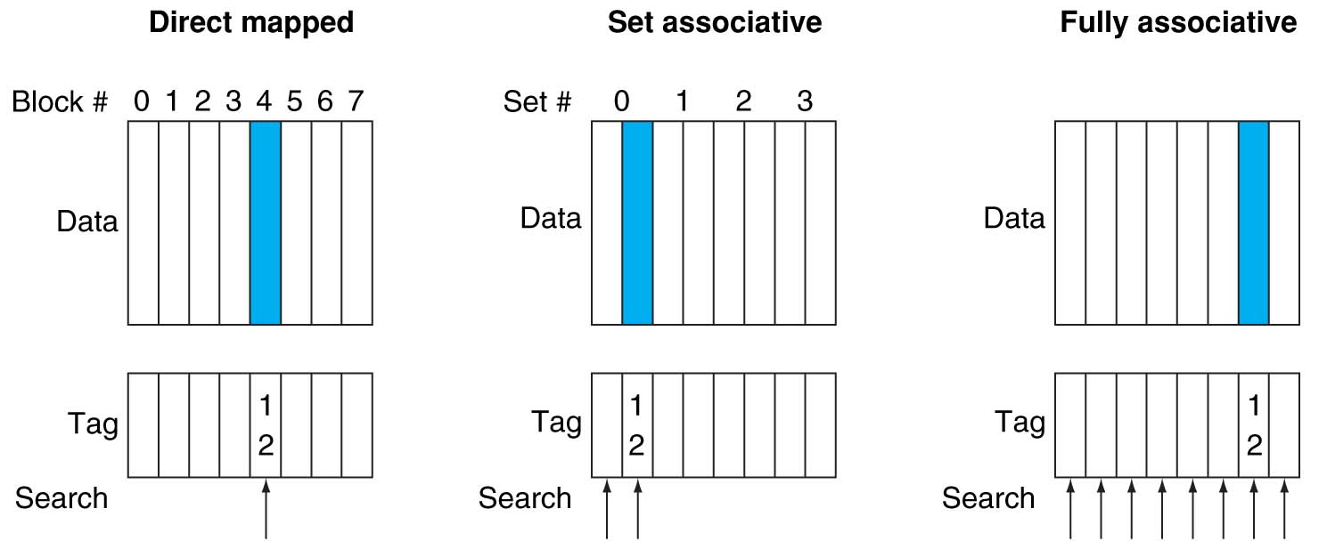
Alternative Block Placement Schemes
DM placement: mem block 12 in 8 block cache: only one cache block where mem block 12 can be found—(12 modulo 8) = 4
SA placement: four sets x 2-ways (8 cache blocks), memory block 12 in set (12 mod 4) = 0; either element of the set
FA placement: mem block 12 can appear in any cache blocks

Slide 18
Example: 4-Word Direct-Mapped $ Worst-Case Reference String
Consider the sequence of memory accesses
0 4 0 4 0 4 0 4
Start with an empty cache - all blocks initially marked as not valid
0
miss
01
4
miss
00
0
miss
01
4
miss
4
4
0
00 Mem(0)
00 Mem(0)
01 Mem(4)
00 Mem(0)
00
0
miss
0
01
4
miss
4
00
0
miss
0
01
4
miss
4
01 Mem(4)
00 Mem(0)
01 Mem(4)
00 Mem(0)
8 requests, 8 misses
Ping pong effect due to conflict misses - two memory locations that map into the same cache block
Notes:
For class handout

Slide 19
Example: 2-Way Set Associative $ (4 words = 2 sets x 2 ways per set)
Main Memory
0000xx
0001xx
0010xx
0011xx
0100xx
0101xx
0110xx
0111xx
1000xx
1001xx
1010xx
1011xx
1100xx
1101xx
1110xx
1111xx
One word blocks
Two low order bits define the byte in the word (32b words)
Cache
Set
Way
V
Tag
Data
0
0
1
0
1
1
Q: How do we find it?
Use next 1 low order memory address bit to determine which cache set (i.e., modulo the number of sets in the cache)
Q: Is it there?
Compare all the cache tags in the set to the high order 3 memory address bits to tell if the memory block is in the cache
Notes:
For lecture
This picture is as opposed to
Way 0
both red Set 0
Way 1
------------------------------------
Way 0
both green Set 1
Way 1

Slide 20
Example: 4-Word 2-Way SA $ Same Reference String
Consider the sequence of memory accesses
0 4 0 4 0 4 0 4
Start with an empty cache - all blocks initially marked as not valid
0
miss
4
miss
0
hit
4
hit
000 Mem(0)
000 Mem(0)
000 Mem(0)
000 Mem(0)
010 Mem(4)
010 Mem(4)
010 Mem(4)
8 requests, 2 misses
Solves the ping pong effect in a direct mapped cache due to conflict misses since now two memory locations that map into the same cache set can co-exist!
Notes:
For lecture
Another sample string to try 0 1 2 3 0 8 11 0 3

Slide 21
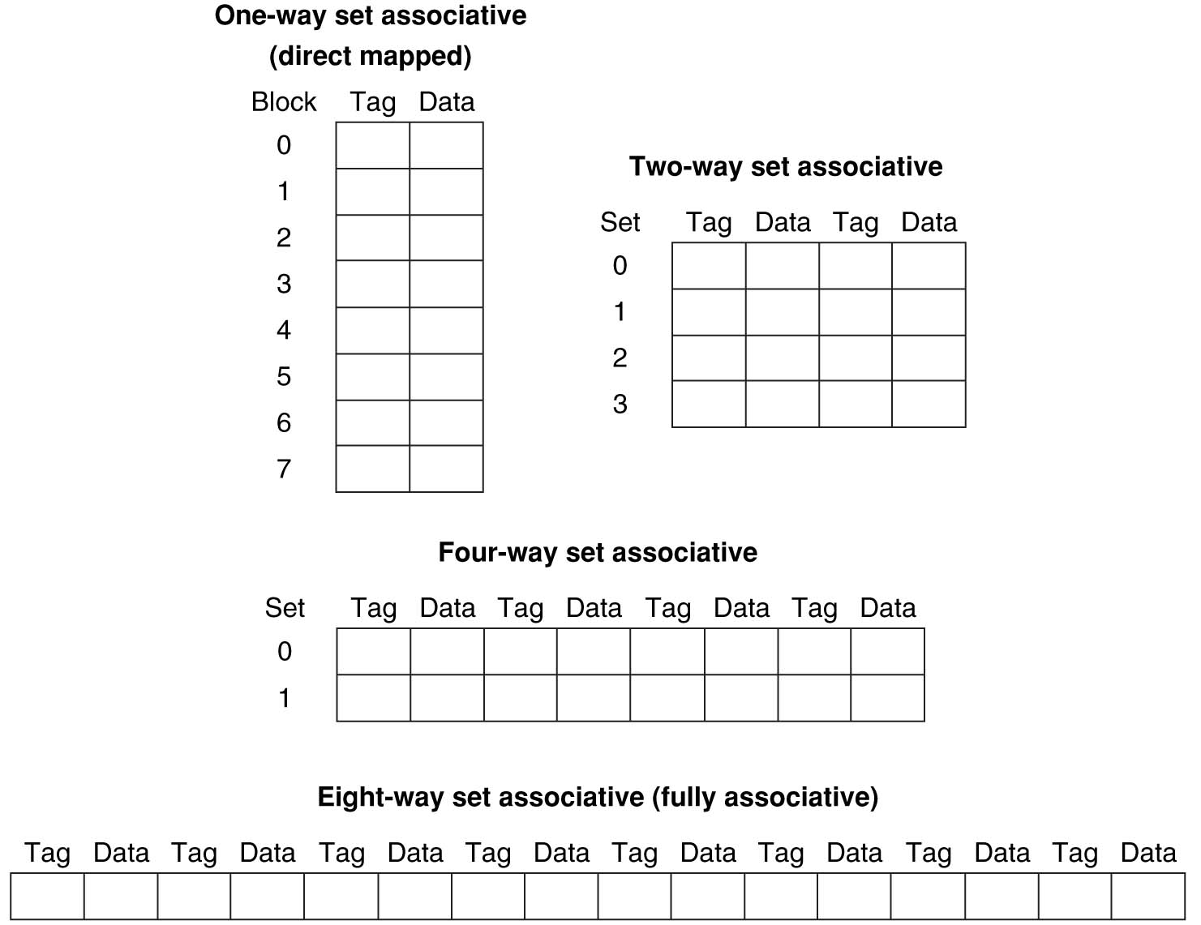
Example: Eight-Block Cache with Different Organizations
Total size of $ in blocks is equal to number of sets x associativity. For fixed $ size, increasing associativity decreases number of sets while increasing number of elements per set. With eight blocks, an 8-way set-associative $ is same as a fully associative $.

Slide 22
Four-Way Set-Associative Cache
2⁸ = 256 sets each with four ways (each with one block)
31 30 . . . 13 12 11 . . . 2 1 0
Byte offset
Tag
22
8
Index
Index
V
Tag
Data
V
Tag
Data
V
Tag
Data
V
Tag
Data
0
1
2
.
.
.
253
254
255
0
1
2
.
.
.
253
254
255
0
1
2
.
.
.
253
254
255
0
1
2
.
.
.
253
254
255
Way 0
Way 1
Way 2
Way 3
32
4x1 select
Hit
Data
Notes:
This is called a 4-way set associative cache because there are four cache entries for each cache index. Essentially, you have four direct mapped cache working in parallel.
This is how it works: the cache index selects a set from the cache. The four tags in the set are compared in parallel with the upper bits of the memory address.
If no tags match the incoming address tag, we have a cache miss.
Otherwise, we have a cache hit and we will select the data from the way where the tag matches occur.
This is simple enough. What is its disadvantages?
+1 = 36 min. (Y:16)

Slide 23
Range of Set-Associative Caches
For a fixed-size cache, each increase by a factor of two in associativity doubles the number of blocks per set (i.e., the number or ways) and halves the number of sets – decreases the size of the index by 1 bit and increases the size of the tag by 1 bit
Used for tag compare
Selects the set
Selects the word in the block
Tag
Index
Block offset
Byte offset
Increasing associativity
Decreasing associativity
Fully associative
(only one set)
Tag is all the bits except
block and byte offset
Direct mapped
(only one way)
Smaller tags, only a single comparator
Notes:
For lecture
In 2008, the greater size and power consumption of CAMs generally leads to 2-way and 4-way set associativity being built from standard SRAMs with comparators with 8-way and above being built using CAMs

Slide 24
Costs of Set-Associative Caches
N-way set-associative cache costs
N comparators for tag comparisons
Must choose appropriate set (multiplexer) before data is available
When miss occurs, which way’s block selected for replacement?
Random Replacement: Hardware randomly selects a cache item and throw it out
Least Recently Used (LRU): one that has been unused the longest
Notes:
First of all, a N-way set associative cache will need N comparators instead of just one comparator (use the right side of the diagram for direct mapped cache).
A N-way set associative cache will also be slower than a direct mapped cache because of this extra multiplexer delay.
Finally, for a N-way set associative cache, the data will be available AFTER the hit/miss signal becomes valid because the hit/mis is needed to control the data MUX.
For a direct mapped cache, that is everything before the MUX on the right or left side, the cache block will be available BEFORE the hit/miss signal (AND gate output) because the data does not have to go through the comparator.
This can be an important consideration because the processor can now go ahead and use the data without knowing if it is a Hit or Miss. Just assume it is a hit.
Since cache hit rate is in the upper 90% range, you will be ahead of the game 90% of the time and for those 10% of the time that you are wrong, just make sure you can recover.
You cannot play this speculation game with a N-way set-associative cache because as I said earlier, the data will not be available to you until the hit/miss signal is valid.
+2 = 38 min. (Y:18)

Slide 25
LRU Cache Block Replacement
Least Recently Used
Hardware keeps track of access history
Replace the entry that has not been used for the longest time
For 2-way set-associative cache, need one bit for LRU replacement
On access set access bit for used block, clear other one
Example of a Simple “Pseudo” LRU Implementation
Assume 64 Fully Associative entries in a set.
Hardware replacement pointer points to one cache entry
Whenever access is made to the entry the pointer points to:
Move the pointer to the next entry
Otherwise: do not move the pointer
Entry 0
Entry 1
Replacement
:
Pointer
Entry 63

Slide 26
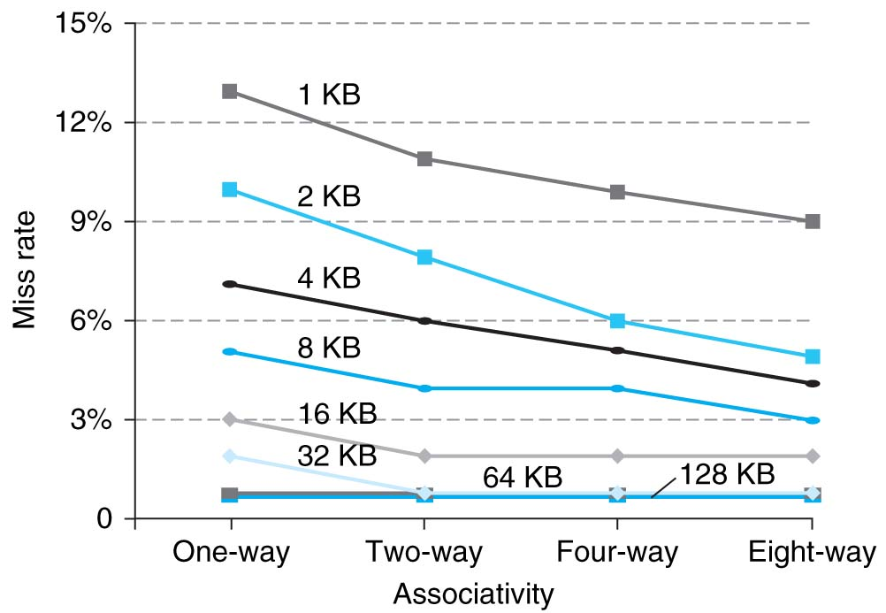
Benefits of Set-Associative Caches
Largest gains are in going from direct mapped to 2-way (20%+ reduction in miss rate)
Notes:
As cache sizes grow, the relative improvement from associativity increases only slightly; since the overall miss rate of a larger cache is lower, the opportunity for improving the miss rate decreases and the absolute improvement in miss rate from associativity shrinks significantly.

Slide 27
The Cache Design Space
Several interacting dimensions
Cache size
Block size
Write-through vs. write-back
Write allocation
Associativity
Replacement policy
Optimal choice is a compromise
Depends on access characteristics
Workload
Use (I-cache, D-cache)
Depends on technology / cost
Simplicity often wins
Cache Size
(Associativity)
Block Size
Bad
Good
Factor A
Factor B
Less
More
Notes:
No fancy replacement policy is needed for the direct mapped cache.
As a matter of fact, that is what cause direct mapped trouble to begin with: only one place to go in the cache--causes conflict misses.
No fancy replacement policy is needed for the direct mapped cache.
As a matter of fact, that is what cause direct mapped trouble to begin with: only one place to go in the cache--causes conflict misses.
Besides working at Sun, I also teach people how to fly whenever I have time.
Statistic have shown that if a pilot crashed after an engine failure, he or she is more likely to get killed in a multi-engine light airplane than a single engine airplane.
The joke among us flight instructors is that: sure, when the engine quit in a single engine stops, you have one option: sooner or later, you land. Probably sooner.
But in a multi-engine airplane with one engine stops, you have a lot of options. It is the need to make a decision that kills those people.

Slide 28
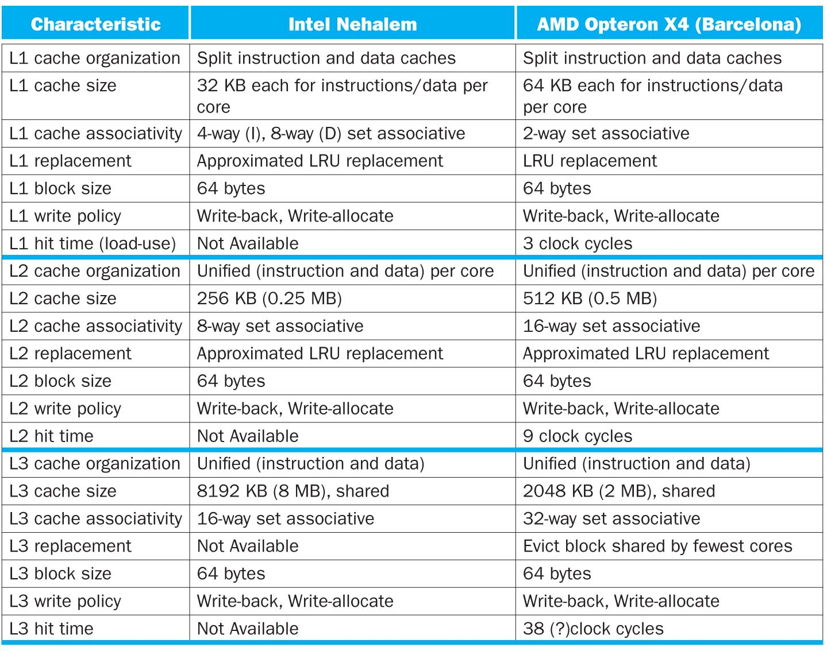

Slide 29
Summary
AMAT to measure cache performance
Cache can have major impact on CPI
Multi-level caches - Reduce Cache Miss Penalty
Optimize first level to be fast!
Optimize 2nd and 3rd levels to minimize the memory access penalty
Set-associativity - Reduce Cache Miss Rate
Memory block maps into more than 1 cache block
N-way: n possible places in cache to hold a memory block
Lots and lots of cache parameters!
Write-back vs. write through, write allocation, block size, cache size, associativity, etc.

