Slide 1
61C In the News
Initially, when the iPhone 4S went on sale Oct. 14, many users couldn't get Siri to work because so many people were trying at the same time. Siri needs to go through Apple's cloud-based servers to work, and Siri's popularity caused a bit of a traffic jam.

Slide 2
CS 61C: Great Ideas in Computer Architecture (Machine Structures) Lecture 31: Pipeline Parallelism 2
Instructors: Mike Franklin
Dan Garcia
http://inst.eecs.Berkeley.edu/~cs61c/fa11

Slide 3
Instruction Level Parallelism (ILP)
Another parallelism form to go with Request Level Parallelism and Data Level Parallelism
RLP – e.g., Warehouse Scale Computing
DLP – e.g., SIMD, Map Reduce
ILP – e.g., Pipelined instruction Execution
5 stage pipeline => 5 instructions executing simultaneously, one at each pipeline stage

Slide 4
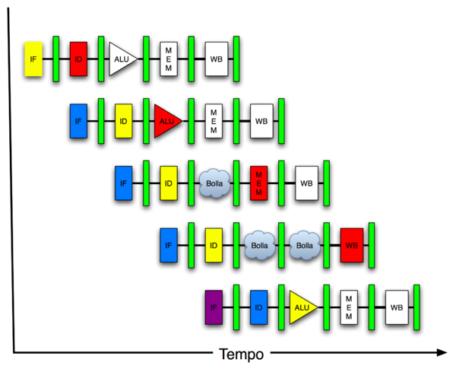
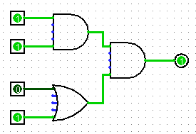
You Are Here!
Software Hardware
Parallel Requests
Assigned to computer
e.g., Search “Katz”
Parallel Threads
Assigned to core
e.g., Lookup, Ads
Parallel Instructions
>1 instruction @ one time
e.g., 5 pipelined instructions
Parallel Data
>1 data item @ one time
e.g., Add of 4 pairs of words
Hardware descriptions
All gates functioning in parallel at same time
Warehouse Scale Computer
Smart Phone
Harness Parallelism &
Achieve High Performance
Computer
Core
…
Core
Memory (Cache)
Input/Output
Core
Today’s Lecture
Instruction Unit(s)
Functional
Unit(s)
A₀+B₀
A₁+B₁
A₂+B₂
A₃+B₃
Main Memory
Logic Gates

Slide 5
Pipelined Execution Representation
Time
IFtch
Dcd
Exec
Mem
WB
IFtch
Dcd
Exec
Mem
WB
IFtch
Dcd
Exec
Mem
WB
IFtch
Dcd
Exec
Mem
WB
IFtch
Dcd
Exec
Mem
WB
IFtch
Dcd
Exec
Mem
WB
Every instruction must take same number of steps, also called pipeline “stages”, so some will go idle sometimes

Slide 6
Graphical Pipeline Diagrams
rd
PC
instruction
memory
registers
rs
Data
memory
rt
ALU
+4
imm
2. Decode/
Register Read
1. Instruction
Fetch
5. Write Back
3. Execute
4. Memory
Use datapath figure below to represent pipeline
IFtch
Dcd
Exec
Mem
WB
I$
Reg
ALU
D$
Reg

Slide 7
Graphical Pipeline Representation
(In Reg, right half highlight read, left half write)
Time (clock cycles)
I
n
s
t
r.
O
r
d
e
r
Load
I$
Reg
ALU
D$
Reg
Add
I$
Reg
ALU
D$
Reg
Store
I$
Reg
ALU
D$
Reg
Sub
I$
Reg
ALU
D$
Reg
Or
I$
Reg
ALU
D$
Reg

Slide 8
Pipeline Performance
Assume time for stages is
100ps for register read or write
200ps for other stages
What is pipelined clock rate?
Compare pipelined datapath with single-cycle datapath
Instr | Instr fetch | Register read | ALU op | Memory access | Register write | Total time
lw | 200ps | 100 ps | 200ps | 200ps | 100 ps | 800ps
sw | 200ps | 100 ps | 200ps | 200ps |  | 700ps
R-format | 200ps | 100 ps | 200ps |  | 100 ps | 600ps
beq | 200ps | 100 ps | 200ps |  |  | 500ps

Slide 9
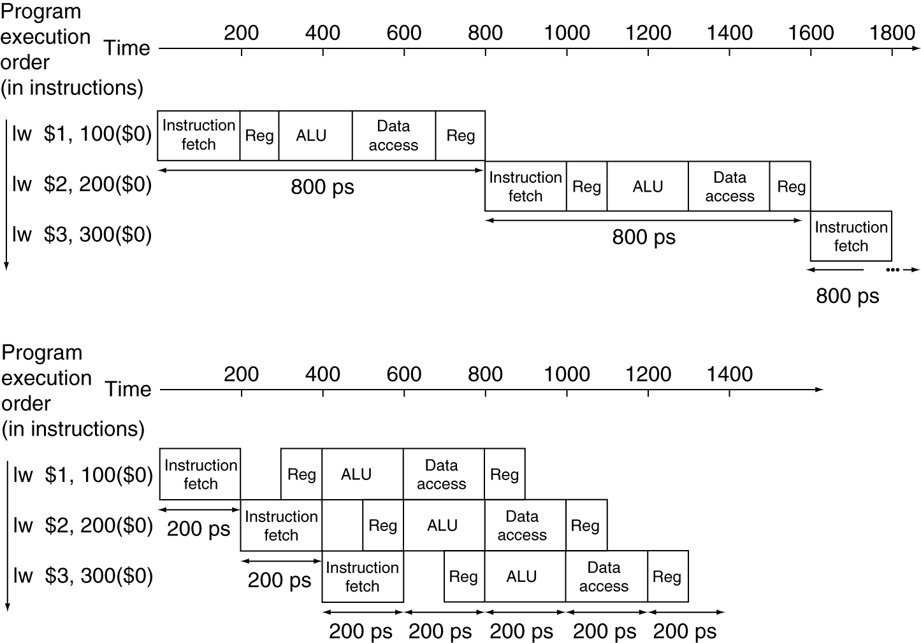
Pipeline Performance
Single-cycle (T_{c}= 800ps)
Pipelined (T_{c}= 200ps)

Slide 10
Pipeline Speedup
If all stages are balanced
i.e., all take the same time
Time between instructions_{pipelined} = Time between instructions_{nonpipelined} Number of stages
If not balanced, speedup is less
Speedup due to increased throughput
Latency (time for each instruction) does not decrease

Slide 11
Hazards
Situations that prevent starting the next logical instruction in the next clock cycle
Structural hazards
Required resource is busy (e.g., roommate studying)
Data hazard
Need to wait for previous instruction to complete its data read/write (e.g., pair of socks in different loads)
Control hazard
Deciding on control action depends on previous instruction (e.g., how much detergent based on how clean prior load turns out)

Slide 12
1. Structural Hazards
Conflict for use of a resource
In MIPS pipeline with a single memory
Load/Store requires memory access for data
Instruction fetch would have to stall for that cycle
Causes a pipeline “bubble”
Hence, pipelined datapaths require separate instruction/data memories
In reality, provide separate L1 I$ and L1 D$

Slide 13
1. Structural Hazard #1: Single Memory
Time (clock cycles)
I
n
s
t
r.
O
r
d
e
r
Load
I$
Reg
ALU
D$
Reg
Instr 1
I$
Reg
ALU
D$
Reg
Instr 2
I$
Reg
ALU
D$
Reg
Instr 3
I$
Reg
ALU
D$
Reg
Instr 4
I$
Reg
ALU
D$
Reg
Read same memory twice in same clock cycle

Slide 14
1. Structural Hazard #2: Registers (1/2)
I
n
s
t
r.
O
r
d
e
r
Time (clock cycles)
sw
I$
Reg
ALU
D$
Reg
Instr 1
I$
Reg
ALU
D$
Reg
Instr 2
I$
Reg
ALU
D$
Reg
Instr 3
I$
Reg
ALU
D$
Reg
Instr 4
I$
Reg
ALU
D$
Reg
Can we read and write to registers simultaneously?

Slide 15
1. Structural Hazard #2: Registers (2/2)
Two different solutions have been used:
1) RegFile access is VERY fast: takes less than half the time of ALU stage
Write to Registers during first half of each clock cycle
Read from Registers during second half of each clock cycle
2) Build RegFile with independent read and write ports
Result: can perform Read and Write during same clock cycle

Slide 16
Data Hazards (1/2)
Consider the following sequence of instructions
add $t0, $t1, $t2
sub $t4, $t0 ,$t3
and $t5, $t0 ,$t6
or $t7, $t0 ,$t8
xor $t9, $t0 ,$t10

Slide 17
Data Hazards (2/2)
Data-flow backward in time are hazards
I
n
s
t
r.
O
r
d
e
r
Time (clock cycles)
IF
ID/RF
EX
MEM
WB
add $t0,$t1,$t2
I$
Reg
ALU
D$
Reg
sub $t4,$t0,$t3
I$
Reg
ALU
D$
Reg
and $t5,$t0,$t6
I$
Reg
ALU
D$
Reg
or $t7,$t0,$t8
I$
Reg
ALU
D$
Reg
xor $t9,$t0,$t10
I$
Reg
ALU
D$
Reg

Slide 18
Data Hazard Solution: Forwarding
Forward result from one stage to another
IF
ID/RF
EX
MEM
WB
add $t0,$t1,$t2
I$
Reg
ALU
D$
Reg
sub $t4,$t0,$t3
I$
Reg
ALU
D$
Reg
and $t5,$t0,$t6
I$
Reg
ALU
D$
Reg
or $t7,$t0,$t8
I$
Reg
ALU
D$
Reg
xor $t9,$t0,$t10
I$
Reg
ALU
D$
Reg
“or” hazard solved by register hardware

Slide 19
Data Hazard: Load/Use (1/4)
Dataflow backwards in time are hazards
Can’t solve all cases with forwarding
Must stall instruction dependent on load, then forward (more hardware)
IF
ID/RF
EX
MEM
WB
lw $t0,0($t1)
I$
Reg
ALU
D$
Reg
sub $t3,$t0,$t2
I$
Reg
ALU
D$
Reg

Slide 20
Data Hazard: Load/Use (2/4)
Hardware stalls pipeline (Called “interlock”)
lw $t0, 0($t1)
IF
ID/RF
EX
MEM
WB
I$
Reg
ALU
D$
Reg
sub $t3,$t0,$t2
bubble
I$
Reg
ALU
D$
Reg
and $t5,$t0,$t4
I$
bubble
Reg
ALU
D$
Reg
or $t7,$t0,$t6
bubble
I$
D$
Reg
ALU
Not in MIPS: (MIPS = Microprocessor without Interlocked Pipeline Stages)

Slide 21
Data Hazard: Load/Use (3/4)
Instruction slot after a load is called “load delay slot”
If that instruction uses the result of the load, then the hardware interlock will stall it for one cycle.
Alternative: If the compiler puts an unrelated instruction in that slot, then no stall
Letting the hardware stall the instruction in the delay slot is equivalent to putting a nop in the slot (except the latter uses more code space)

Slide 22
Data Hazard: Load/Use (4/4)
Stall is equivalent to nop
lw $t0, 0($t1)
I$
Reg
ALU
D$
Reg
nop
bubble
bubble
bubble
bubble
bubble
sub $t3,$t0,$t2
I$
Reg
ALU
D$
Reg
and $t5,$t0,$t4
I$
Reg
ALU
Reg
D$
or $t7,$t0,$t6
I$
Reg
ALU
D$

Slide 23
Pipelining and ISA Design
MIPS Instruction Set designed for pipelining
All instructions are 32-bits
Easier to fetch and decode in one cycle
x86: 1- to 17-byte instructions
(x86 HW actually translates to internal RISC instructions!)
Few and regular instruction formats, 2 source register fields always in same place
Can decode and read registers in one step
Memory operands only in Loads and Stores
Can calculate address 3rd stage, access memory 4th stage
Alignment of memory operands
Memory access takes only one cycle

Slide 24
3. Control Hazards
Branch determines flow of control
Fetching next instruction depends on branch outcome
Pipeline can’t always fetch correct instruction
Still working on ID stage of branch
BEQ, BNE in MIPS pipeline
Simple solution Option 1: Stall on every branch until have new PC value
Would add 2 bubbles/clock cycles for every Branch! (~ 20% of instructions executed)

Slide 25
Stall => 2 Bubbles/Clocks
Time (clock cycles)
I
n
s
t
r.
O
r
d
e
r
beq
I$
Reg
ALU
D$
Reg
Instr 1
I$
Reg
ALU
D$
Reg
Instr 2
I$
Reg
ALU
D$
Reg
Instr 3
I$
Reg
ALU
D$
Reg
Instr 4
I$
Reg
ALU
D$
Reg
Where do we do the compare for the branch?

Slide 26
Until next time …
The BIG Picture
Pipelining improves performance by increasing instruction throughput: exploits ILP
Executes multiple instructions in parallel
Each instruction has the same latency
Subject to hazards
Structure, data, control
Stalls reduce performance
But are required to get correct results
Compiler can arrange code to avoid hazards and stalls
Requires knowledge of the pipeline structure

