Slide 1
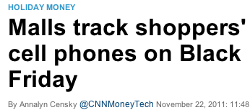
61C In the News
Starting on Black Friday and running through New Year's Day, two U.S. malls -- Promenade Temecula in southern California and Short Pump Town Center in Richmond, Va. -- will track guests' movements by monitoring the signals from their cell phones.
While the data that's collected is anonymous, it can follow shoppers' paths from store to store.
The goal is for stores to answer questions like: How many Nordstrom shoppers also stop at Starbucks? How long do most customers linger in Victoria's Secret? Are there unpopular spots in the mall that aren't being visited?
Consumers can opt out by turning off their phones.

Slide 2
CS 61C: Great Ideas in Computer Architecture (Machine Structures) Lecture 38: IO, Networking & Disks
Instructors: Mike Franklin
Dan Garcia
http://inst.eecs.Berkeley.edu/~cs61c/Fa11

Slide 3
Review
Exceptions are “Unexpected” events
Interrupts are asynchronous
can be used for interacting with I/O devices
Need to handle in presence of pipelining, etc.
Logic similar to that of Branch mis-prediction
Networks are another form of I/O
Internet – 1962
Started with 4 hosts, growing exponentially since
WWW – 1986
“Vague but Exciting” proposal at CERN
Shared vs. Switched networks

Slide 4
What makes networks work?
links connecting switches and/or routers to each other and to computers or devices
Computer
switch
switch
switch
network
interface
ability to name the components and to route packets of information - messages - from a source to a destination
Layering, redundancy, protocols, and encapsulation as means of abstraction (61C big idea)
Notes:
Computer has Network Interface Card (NIC)
Sends message through the series of switches, which get the message to recipient
Usually draw the series of switches as the “Internet Cloud”
- Represents an abstraction, “don’t know” implementation
- Send the message through the network, and it will get to where it needs to go
Switches use routing tables to know how to get the message to the recipient

Slide 5
Software Protocol to Send and Receive
SW Send steps
1: Application copies data to OS buffer
2: OS calculates checksum, starts timer
3: OS sends data to network interface HW and says start
SW Receive steps
3: OS copies data from network interface HW to OS buffer
2: OS calculates checksum, if OK, send ACK; if not, delete message (sender resends when timer expires)
1: If OK, OS copies data to user address space, & signals application to continue
Dest
Src
Checksum
Net ID
Net ID
Len
ACK
INFO
CMD/ Address /Data
Header
Payload
Trailer
Notes:
Timer is counting down on Time To Live (TTL)
- You can see this in Pings

Slide 6
Protocol for Networks of Networks?
Abstraction to cope with complexity of communication
Networks are like onions
Hierarchy of layers:
Application (chat client, game, etc.)
Transport (TCP, UDP)
Network (IP)
Physical Link (wired, wireless, etc.)
Networks are like onions.
They stink?
Yes. No!
Oh, they make you cry.
No!… Layers. Onions have layers. Networks have layers.
Notes:
WS companies used TCP/IP even over LAN
Because early Ethernet controllers were cheap, but not reliable

Slide 7
Protocol Family Concept
Key to protocol families is that communication occurs logically at the same level of the protocol, called peer-to-peer… …but is implemented via services at the next lower level
Encapsulation: carry higher level information within lower level “envelope”
Fragmentation: break packet into multiple smaller packets and reassemble

Slide 8
Protocol Family Concept
Message
Logical
Message
Actual
Actual
Logical
H
Message
T
H
Message
T
Actual
Actual
H
H
Message
T
T
H
H
Message
T
T
Physical

Slide 9
Protocol for Network of Networks
Transmission Control Protocol/Internet Protocol (TCP/IP) (TCP :: a Transport Layer)
This protocol family is the basis of the Internet, a WAN protocol
IP makes best effort to deliver
Packets can be lost, corrupted
TCP guarantees delivery
TCP/IP so popular it is used even when communicating locally: even across homogeneous LAN
Notes:
WS companies used TCP/IP even over LAN
Because early Ethernet controllers were cheap, but not reliable
TCP and IP fundamentally different but very connected
TCP hires IP guys
- GO!
- IP guy falls into a hole
- TCP hires another IP guy
- GO!
-IP gus falls into a hole
- Hire another!

Slide 10
TCP/IP packet, Ethernet packet, protocols
Application sends message
Ethernet Hdr
TCP breaks into 64KiB segments, adds 20B header
IP Header
TCP Header
EH
IP Data
IP adds 20B header, sends to network
TCP data
If Ethernet, broken into 1500B packets with headers, trailers (24B)
Message
Ethernet Hdr
.

Slide 11
disks

Slide 12
Magnetic Disk – common I/O device
A kind of computer memory
Information stored by magnetizing ferrite material on surface of rotating disk
similar to tape recorder except digital rather than analog data
Nonvolatile storage
retains its value without applying power to disk.
Two Types
Floppy disks – slower, less dense, removable.
Hard Disk Drives (HDD) – faster, more dense, non-removable.
Purpose in computer systems (Hard Drive):
Long-term, inexpensive storage for files
“Backup” for main-memory. Large, inexpensive, slow level in the memory hierarchy (virtual memory)

Slide 13
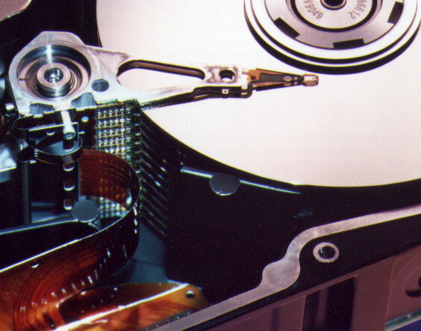
Photo of Disk Head, Arm, Actuator
Arm
Spindle
Head
Actuator
{
Platters (1-12)

Slide 14
Disk Device Terminology
Inner
Track
Arm
Head
Sector
Outer
Track
Several platters, with information recorded magnetically on both surfaces (usually)
Bits recorded in tracks, which in turn divided into sectors (e.g., 512 Bytes)
Actuator moves head (end of arm) over track (“seek”), wait for sector rotate under head, then read or write
Platter
Actuator

Slide 15
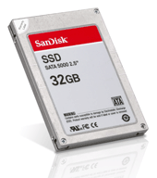
Where does Flash memory come in?
Microdrives and Flash memory (e.g., CompactFlash) are going head-to-head
Both non-volatile (no power, data ok)
Flash benefits: durable & lower power (no moving parts, need to spin µdrives up/down)
Flash limitations: finite number of write cycles (wear on the insulating oxide layer around the charge storage mechanism). Most ≥ 100K, some ≥ 1M W/erase cycles.
How does Flash memory work?
NMOS transistor with an additional conductor between gate and source/drain which “traps” electrons. The presence/absence is a 1 or 0.
en.wikipedia.org/wiki/Flash_memory

Slide 16
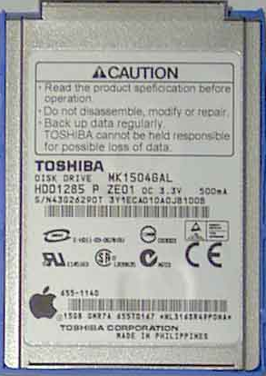
What does Apple put in its iPods?
en.wikipedia.org/wiki/Ipod www.apple.com/ipod
Toshiba flash 2GB
Samsung flash 8, 16 GB
Toshiba 1.8-inch HDD 80, 160GB
Toshiba flash 8, 32, 64 GB
shuffle, nano, classic, touch

Slide 17
Use Arrays of Small Disks…
Katz and Patterson asked in 1987:
Can smaller disks be used to close gap in performance between disks and CPUs?
Conventional: 4 disk designs
3.5”
5.25”
10”
14”
Low End
High End
Disk Array: 1 disk design
3.5”

Slide 18
Replace Small # of Large Disks with Large # of Small!
(1988 Disks)
IBM 3390K
20 GBytes
97 cu. ft.
3 KW
15 MB/s
600 I/Os/s
250 KHrs
$250K
IBM 3.5" 0061
320 MBytes
0.1 cu. ft.
11 W
1.5 MB/s
55 I/Os/s
50 KHrs
$2K
x70
23 GBytes
11 cu. ft.
1 KW
120 MB/s
3900 I/Os/s
??? Hrs
$150K
Capacity
Volume
Power
Data Rate
I/O Rate
MTTF
Cost
9X
3X
8X
6X
Disk Arrays potentially high performance, high MB per cu. ft., high MB per KW, but what about reliability?

Slide 19
Replace Small # of Large Disks with Large # of Small!
(1988 Disks)
IBM 3390K
20 GBytes
97 cu. ft.
3 KW
15 MB/s
600 I/Os/s
250 KHrs
$250K
IBM 3.5" 0061
320 MBytes
0.1 cu. ft.
11 W
1.5 MB/s
55 I/Os/s
50 KHrs
$2K
x70
23 GBytes
11 cu. ft.
1 KW
120 MB/s
3900 I/Os/s
??? Hrs
$150K
Capacity
Volume
Power
Data Rate
I/O Rate
MTTF
Cost
9X
3X
8X
6X
Disk Arrays potentially high performance, high MB per cu. ft., high MB per KW, but what about reliability?

Slide 20
Array Reliability
Reliability - whether or not a component has failed
measured as Mean Time To Failure (MTTF)
Reliability of N disks = Reliability of 1 Disk ÷ N (assuming failures independent)
50,000 Hours ÷ 70 disks = 700 hour
Disk system MTTF: Drops from 6 years to 1 month!
Disk arrays too unreliable to be useful!

Slide 21
Redundant Arrays of (Inexpensive) Disks
Files are “striped” across multiple disks
Redundancy yields high data availability
Availability: service still provided to user, even if some components failed
Disks will still fail
Contents reconstructed from data redundantly stored in the array
⇒ Capacity penalty to store redundant info
⇒ Bandwidth penalty to update redundant info

Slide 22
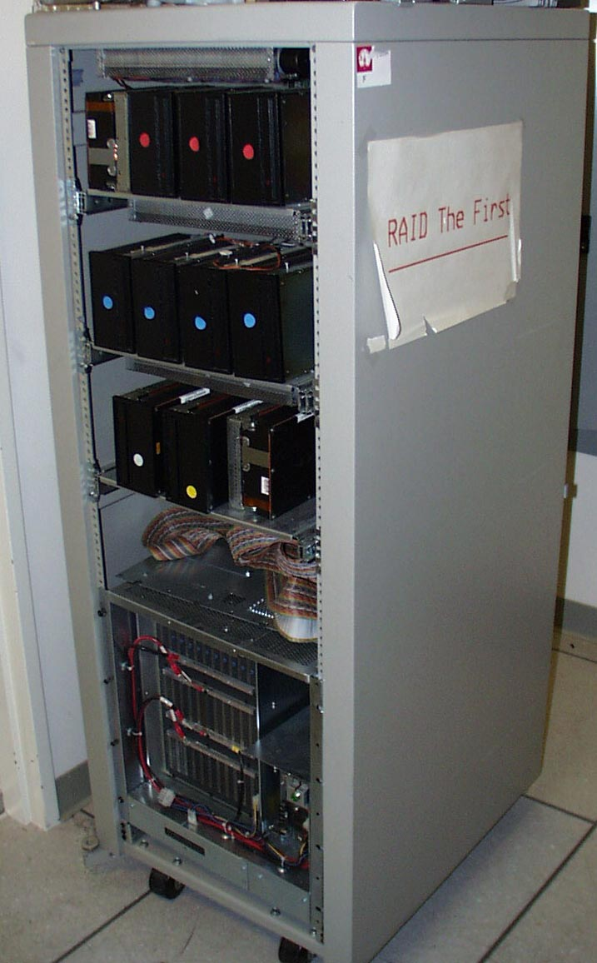
RAID : Redundant Array of Inexpensive Disks
Invented @ Berkeley (1989)
A multi-billion industry 80% non-PC disks sold in RAIDs
Idea:
Files are “striped” across multiple disks
Redundancy yields high data availability
Disks will still fail
Contents reconstructed from data redundantly stored in the array
⇒ Capacity penalty to store redundant info
⇒ Bandwidth penalty to update redundant info

Slide 23
“RAID 0”: No redundancy = “AID”
Assume have 4 disks of data for this example, organized in blocks
Large accesses faster since transfer from several disks at once
This and next 5 slides from RAID.edu, http://www.acnc.com/04_01_00.html http://www.raid.com/04_00.html also has a great tutorial

Slide 24
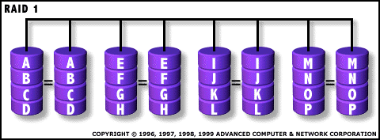
RAID 1: Mirror data
Each disk is fully duplicated onto its “mirror”
Very high availability can be achieved
Bandwidth reduced on write:
1 Logical write = 2 physical writes
Most expensive solution: 100% capacity overhead

Slide 25
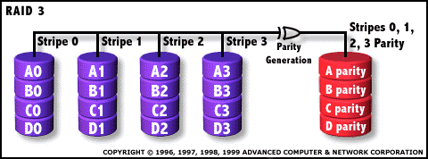
RAID 3: Parity
Spindles synchronized, each sequential byte on a diff. drive
Parity computed across group to protect against hard disk failures, stored in P disk
Logically, a single high capacity, high transfer rate disk
25% capacity cost for parity in this example vs. 100% for RAID 1 (5 disks vs. 8 disks)
Q: How many drive failures can be tolerated?

Slide 26
Inspiration for RAID 5 (RAID 4 block-striping)
Small writes (write to one disk):
Option 1: read other data disks, create new sum and write to Parity Disk (access all disks)
Option 2: since P has old sum, compare old data to new data, add the difference to P: 1 logical write = 2 physical reads + 2 physical writes to 2 disks
Parity Disk is bottleneck for Small writes: Write to A0, B1 ➔ both write to P disk
A0
B0
C0
D0
P
(RAID 4 block-striping)
A1
B1
C1
D1
P

Slide 27
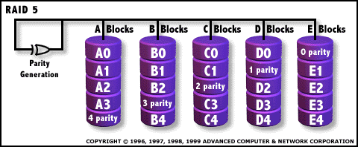
RAID 5: Rotated Parity, faster small writes
Independent writes possible because of interleaved parity
Example: write to A0, B1 uses disks 0, 1, 4, 5, so can proceed in parallel
Still 1 small write = 4 physical disk accesses
en.wikipedia.org/wiki/Redundant_array_of_independent_disks

Slide 28
“And in conclusion…”
I/O gives computers their 5 senses
I/O speed range is 100-million to one
Processor speed means must synchronize with I/O devices before use: Polling vs. Interrupts
Networks are another form of I/O
Protocol suites allow networking of heterogeneous components
Another form of principle of abstraction
RAID
Higher performance with more disk arms per $
More disks == More disk failures
Different RAID levels provide different cost/speed/reliability tradeoffs

Slide 29
Peer Instruction
ABC
0: FFF
1: FFT
2: FTF
3: FTT
4: TFF
5: TFT
6: TTF
7: TTT
RAID 1 (mirror) and 5 (rotated parity) help with performance and availability
RAID 1 has higher cost than RAID 5
Small writes on RAID 5 are slower than on RAID 1

Slide 30
Bonus Slides

Slide 31
Bonus: Disk Device Performance (1/2)
Disk Latency = Seek Time + Rotation Time + Transfer Time + Controller Overhead
Seek Time? depends on no. tracks to move arm, speed of actuator
Rotation Time? depends on speed disk rotates, how far sector is from head
Transfer Time? depends on data rate (bandwidth) of disk (f(bit density,rpm)), size of request
Outer
Track
Inner
Track
Sector
Head
Arm
Controller
Spindle
Platter
Actuator
Notes:
Use analogy to records

Slide 32
Bonus: Disk Device Performance (2/2)
Average distance of sector from head?
1/2 time of a rotation
7200 Revolutions Per Minute ⇒ 120 Rev/sec
1 revolution = 1/120 sec ⇒ 8.33 milliseconds
1/2 rotation (revolution) ⇒ 4.17 ms
Average no. tracks to move arm?
Disk industry standard benchmark:
Sum all time for all possible seek distances from all possible tracks / # possible
Assumes average seek distance is random
Size of Disk cache can strongly affect perf!
Cache built into disk system, OS knows nothing

Slide 33
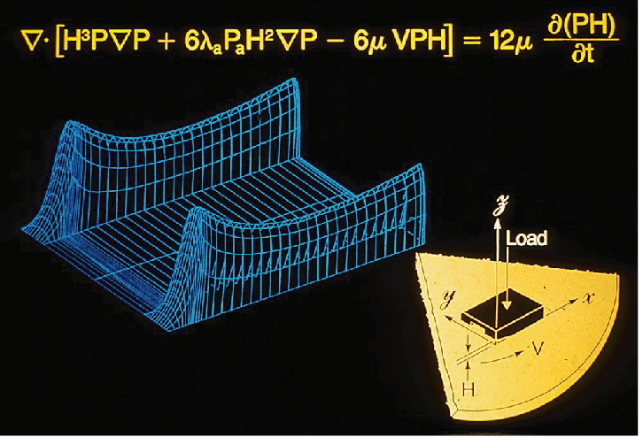
BONUS : Hard Drives are Sealed. Why?
The closer the head to the disk, the smaller the “spot size” and thus the denser the recording.
Measured in Gbit/in2. ~60 is state of the art.
Disks are sealed to keep the dust out.
Heads are designed to “fly” at around 5-20nm above the surface of the disk.
99.999% of the head/arm weight is supported by the air bearing force (air cushion) developed between the disk and the head.

