Slide 1
CS 61C: Great Ideas in Computer Architecture Strings and Functions
Instructor:
Krste Asanovic, Randy H. Katz
http://inst.eecs.Berkeley.edu/~cs61c/sp12

Slide 2
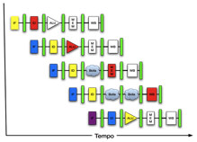
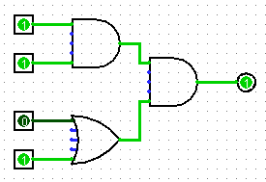
New-School Machine Structures (It’s a bit more complicated!)
Software Hardware
Parallel Requests
Assigned to computer
e.g., Search “Katz”
Parallel Threads
Assigned to core
e.g., Lookup, Ads
Parallel Instructions
>1 instruction @ one time
e.g., 5 pipelined instructions
Parallel Data
>1 data item @ one time
e.g., Add of 4 pairs of words
Hardware descriptions
All gates @ one time
Programming Languages
Warehouse Scale Computer
Smart Phone
Harness Parallelism &
Achieve High Performance
Computer
Core
…
Core
Memory (Cache)
Input/Output
Core
Instruction Unit(s)
Functional
Unit(s)
A₀+B₀
A₁+B₁
A₂+B₂
A₃+B₃
Cache Memory
Today’s Lecture
Logic Gates

Slide 3
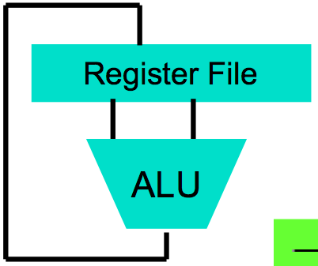
Big Idea #1: Levels of Representation/Interpretation
High Level Language Program (e.g., C)
temp = v[k];
v[k] = v[k+1];
v[k+1] = temp;
Compiler
Anything can be represented as a number, i.e., data or instructions
lw $t0, 0($2)
lw $t1, 4($2)
sw $t1, 0($2)
sw $t0, 4($2)
Assembly Language Program (e.g., MIPS)
Assembler
0000 1001 1100 0110 1010 1111 0101 1000
1010 1111 0101 1000 0000 1001 1100 0110
1100 0110 1010 1111 0101 1000 0000 1001
0101 1000 0000 1001 1100 0110 1010 1111
Machine Language Program (MIPS)
Machine Interpretation
Hardware Architecture Description (e.g., block diagrams)
Architecture Implementation
Logic Circuit Description (Circuit Schematic Diagrams)

Slide 4
Agenda
Review
Strings in C and MIPS
Administrivia
Functions
And in Conclusion, …

Slide 5
Strings: C vs. Java
Recall: a string is just a long sequence of characters (i.e., array of chars)
C: 8-bit ASCII, define strings with end of string character NUL (0 in ASCII)
Java: 16-bit Unicode, first entry gives length of string

Slide 6
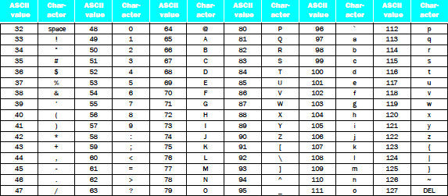
Strings
“Cal” in ASCII in C; How many bytes?
Using 1 integer per byte, what does it look like?
Notes:
Thus, the
string “Cal” is represented in C by the following 4 bytes, shown as decimal numbers:
67, 97, 108, 0.

Slide 7
Strings
“Cal” in Unicode in Java; How many bytes?
Using 1 integer per byte, what does it look like? (For Latin alphabet, 1st byte is 0, 2nd byte is ASCII)
Notes:
Thus, the
string “Cal” is represented in C by the following 10 bytes, shown as decimal numbers:
0, 0, 0, 3, 0, 67, 0, 97, 0, 108
(32 bit word contains string length)

Slide 8
Pointers and Strings in C
char *p; # p is a pointer to a character
char x[] = “Randy Katz”; # x points to a literal string
p = x; # p points to the same place as x
p = &x[0]; # same as p = x
Cannot write x = “Randy Katz”;
Strings are not a primitive type in C (but character arrays are)
Element/character at a time processing possible, but whole string processing requires special routines
P
R A N D Y sp K A T Z 0
0 1 2 3 4 5 6 7 8 9 10
X
Notes:
a[b] – Array subscript
*a -- Indirection ("object pointed to by a")
&a -- Reference ("address of a")
p = &x[0] is the same as “p gets the address of the 0th element pointed to by x

Slide 9
Support for Characters and Strings
Load a word, use andi to isolate byte
lw $s0,0($s1)
andi $s0,$s0,255 # Zero everything but last 8 bits
RISC Design Principle: “Make the Common Case Fast”—Many programs use text: MIPS has load byte instruction (lb)
lb $s0,0($s1)
Also store byte instruction (sb)

Slide 10
Support for Characters and Strings
Load a word, use andi to isolate half of word
lw $s0,0($s1)
andi $s0,$s0,65535 # Zero everything but last 16 bits
RISC Design Principle #3: “Make the Common Case Fast”—Many programs use text, MIPS has load halfword instruction (lh)
lh $s0,0($s1)
Also store halfword instruction (sh)

Slide 11
Fast String Copy Code in C
Copy x[] to y[]
char *p, *q;
p = &x[0]; /* p = x */
/* set p to address of 1st char of x */
q = &y[0]; /* q = y also OK */
/* set q to address of 1st char of y */
while((*q++ = *p++) != ‘\0’) ;

Slide 12
Fast String Copy in MIPS Assembly
Get addresses of x and y into $s1, $s2
p and q are assigned to these registers
# $t1 = &p (BA), q @ &p + 4
# $s1 = p
# $s2 = q
Loop: # $t2 = *p
# *q = $t2
# p = p + 1
# q = q + 1
# if *p == 0, go to Exit
j Loop # go to Loop
Exit: # N characters => N*6 + 3 instructions
BA+4
Q
BA
P

Slide 13
Fast String Copy in MIPS Assembly
Get addresses of x and y into $s1, $s2
p and q are assigned to these registers
lw $t1, Base Address (e.g., BA)
lw $s1,0($t1) # $s1 = p
lw $s2,4($t1) # $s2 = q
Loop: lb $t2,0($s1) # $t2 = *p
sb $t2,0($s2) # *q = $t2
addi $s1,$s1,1 # p = p + 1
addi $s2,$s2,1 # q = q + 1
# if *p == 0, go to Exit
j Loop # go to Loop
Exit: # N characters => N*6 + 3 instructions
BA+4
Q
BA
P
Student Roulette?

Slide 14
Fast String Copy in MIPS Assembly
Get addresses of x and y into $s1, $s2
p and q are assigned to these registers
lw $t1, Base Address (e.g., BA)
lw $s1,0($t1) # $s1 = p
lw $s2,4($t1) # $s2 = q
Loop: lb $t2,0($s1) # $t2 = *p
sb $t2,0($s2) # *q = $t2
addi $s1,$s1,1 # p = p + 1
addi $s2,$s2,1 # q = q + 1
beq $t2,$zero,Exit # if *p == 0, go to Exit
j Loop # go to Loop
Exit: # N characters => N*6 + 3 instructions
BA+4
Q
BA
P
Student Roulette?

Slide 15
Which statement is TRUE?
char *p, *q;
p = &x[0]; q = &y[0];
while((*q++ = *p++) != ‘\0’) ;
lw $t1, Base Address (e.g., BA)
lw $s1,0($t1) # $s1 = p
lw $s2,4($t1) # $s2 = q
Loop: lb $t2,0($s1) # $t2 = *p
sb $t2,0($s2) # *q = $t2
addi $s1,$s1,1 # p = p + 1
addi $s2,$s2,1 # q = q + 1
beq $t2,$zero,Exit # if *p == 0, go to Exit
j Loop # go to Loop
Exit:
☐
$t1 corresponds to p
☐
$s1 corresponds to p
☐
$s1 corresponds to q
☐
$s1 corresponds to *p
Notes:
VertLeftWhiteCheck1
Answer: B s1 corresponds to p,
($s2 corresponds to q)
($t1 corresponds to &x[0])
*p lb/sb $t2,0($s1) = value in $t2 at right point …because ints in this system are 4-bytes long and the actual address increments by 4 even though it appears to only incrememt 1.

Slide 16
Agenda
Review
Strings in C and MIPS
Administrivia
Functions
And in Conclusion, …

Slide 17
Administrivia
Map-Reduce Project #1
Two Parts, first part due Sunday
Write-up posted last night (thanks Alan!)
Lab #3
Hands on EC2, needed for Project #1, Part 2
HW #3
C practice/numbers and strings
… Midterm is coming in < one month!
Let us know special accommodation now …
CS 188 students, ask your instructors to return my emails!

Slide 18
Agenda
Review
Strings in C and MIPS
Administrivia
Functions
And in Conclusion, …

Slide 19
Six Fundamental Steps in Calling a Function
Put parameters in a place where function can access them
Transfer control to function
Acquire (local) storage resources needed for function
Perform desired task of the function
Put result value in a place where calling program can access it and restore any registers you used
Return control to point of origin, since a function can be called from several points in a program

Slide 20
MIPS Function Call Conventions
Registers faster than memory, so use them
$a0–$a3: four argument registers to pass parameters
$v0–$v1: two value registers to return values
$ra: one return address register to return to the point of origin
(7 + $zero +$at of 32, 23 left!)
Notes:
$at – assembler temporary register, used for pseudo instructions

Slide 21
MIPS Registers Assembly Language Conventions
$t0-$t9: 10 x temporaries (intermediates)
$s0-$s7: 8 x “saved” temporaries (program variables)
18 registers
32 – (18 + 9) = 5 left

Slide 22
MIPS Function Call Instructions
Invoke function: jump and link instruction (jal)
“link” means form an address or link that points to calling site to allow function to return to proper address
Jumps to address and simultaneously saves the address of following instruction in register $ra
jal ProcedureAddress
Return from function: jump register instruction (jr)
Unconditional jump to address specified in register
jr $ra

Slide 23
Notes on Functions
Calling program (caller) puts parameters into registers $a0-$a3 and uses jal X to invoke X (callee)
Must have register in computer with address of currently executing instruction
Instead of Instruction Address Register (better name), historically called Program Counter (PC)
It’s a program’s counter; it doesn’t count programs!
jr $ra puts address inside $ra into PC
What value does jal X place into $ra? ????
Student Roulette?

Slide 24
Notes on Functions
Calling program (caller) puts parameters into registers $a0-$a3 and uses jal X to invoke X (callee)
Must have register in computer with address of currently executing instruction
Instead of Instruction Address Register (better name), historically called Program Counter (PC)
It’s a program’s counter, it doesn’t count programs!
jr $ra puts address inside $ra into PC
What value does jal X place into $ra? Next PC
PC + 4

Slide 25
Where Are Old Register Values Saved to Restore Them After Function Call
Need a place to save old values before call function, restore them when return, and delete
Ideal is stack: last-in-first-out queue (e.g., stack of plates)
Push: placing data onto stack
Pop: removing data from stack
Stack in memory, so need register to point to it
$sp is the stack pointer in MIPS
Convention is grow from high to low addresses
Push decrements $sp, Pop increments $sp
(28 out of 32, 4 left!)

Slide 26
Example
int leaf_example (int g, int h, int i, int j)
{
int f;
f = (g + h) – (i + j);
return f;
}
Parameter variables g, h, i, and j in argument registers $a0, $a1, $a2, and $a3, and f in $s0
Assume need one temporary register $t0

Slide 27
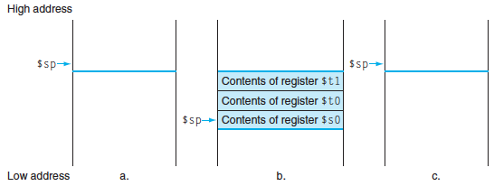
Stack Before, During, After Function
Need to save old values of $s0 and $t0
Contents of $t0
Contents of $s0

Slide 28
MIPS Code for leaf_example
leaf_example:
# adjust stack for 2 int items
# save $t0 for use afterwards
# save $s0 for use afterwards
# f = g + h
# t0 = i + j
# return value (g + h) – (i + j)
# restore $s0 for caller
# restore $t0 for caller
# delete 2 items from stack
# jump back to calling routine
Student Roulette?
Notes:
addi $sp,$sp,-8 # adjust stack for 2 items
sw $t0, 4($sp) # save $t0 for use afterwards
sw $s0, 0($sp) # save $s0 for use afterwards
add $s0,$a0,$a1 # f = g + h
add $t0,$a2,$a3 # t0 = i + j
sub $v0,$s0,$t0 # return value (g + h) – (i + j)
lw $s0, 0($sp) # restore register $s0 for caller
lw $t0, 4($sp) # restore register $t0 for caller
addi $sp,$sp,8 # adjust stack to delete 2 items
jr $ra # jump back to calling routine

Slide 29
What will the printf output?
static int *p;
int leaf (int g, int h, int i, int j)
{
int f; p = &f;
f = (g + h) – (i + j);
return f;
}
int main(void) { int x;
x = leaf(1,2,3,4);
x = leaf(3,4,1,2);
…
printf(”%d\n”,*p);
}
☐
Print -4
☐
Print 4
☐
a.out will crash
☐
None of the above
Notes:
VertLeftWhiteCheck1
B: Print 4 …because ints in this system are 4-bytes long and the actual address increments by 4 even though it appears to only incrememt 1.

Slide 30
What If a Function Calls a Function? Recursive Function Calls?
Would clobber values in $a0 to $a3 and $ra
What is the solution?
Student Roulette?
Notes:
Save $ra on the stack

Slide 31
Allocating Space on Stack
C has two storage classes: automatic and static
Automatic variables are local to function and discarded when function exits
Static variables exist across exits from and entries to procedures
Use stack for automatic (local) variables that don’t fit in registers
Procedure frame or activation record: segment of stack with saved registers and local variables
Some MIPS compilers use a frame pointer ($fp) to point to first word of frame
(29 of 32, 3 left!)

Slide 32
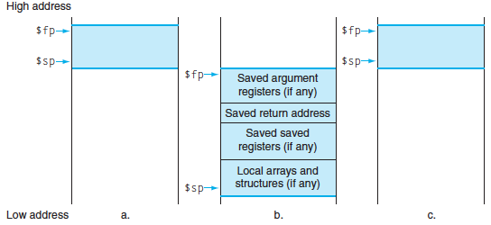
Stack Before, During, After Call

Slide 33
Recursive Function Factorial
int fact (int n)
{
if (n < 1) return (1);
else return (n * fact(n-1));
}

Slide 34
Recursive Function Factorial
Fact: # adjust stack for 2 items
addi $sp,$sp,-8
# save return address
sw $ra, 4($sp) # save argument n
sw $a0, 0($sp) # test for n < 1
slti $t0,$a0,1
# if n >= 1, go to L1
beq $t0,$zero,L1 # Then part (n==1) return 1
addi $v0,$zero,1 # pop 2 items off stack
addi $sp,$sp,8 # return to caller
jr $ra
L1:
# Else part (n >= 1) # arg. gets (n – 1)
addi $a0,$a0,-1 # call fact with (n – 1)
jal fact
# return from jal: restore n
lw $a0, 0($sp) # restore return address
lw $ra, 4($sp) # adjust sp to pop 2 items
addi $sp, $sp,8 # return n * fact (n – 1)
mul $v0,$a0,$v0 # return to the caller
jr $ra
mul is a pseudo instruction
Notes:
Slti: set dst to 1 if src is less than imm (signed immediate)

Slide 35
Optimized Function Convention
To reduce expensive loads and stores from spilling and restoring registers, MIPS divides registers into two categories:
Preserved across function call
Caller can rely on values being unchanged
$ra, $sp, $gp, $fp, “saved registers” $s0- $s7
Not preserved across function call
Caller cannot rely on values being unchanged
Return value registers $v0,$v1, Argument registers $a0-$a3, “temporary registers” $t0-$t9

Slide 36
Where is the Stack in Memory?
MIPS convention
Stack starts in high memory and grows down
Hexadecimal (base 16) : 7fff fffc_{hex}
MIPS programs (text segment) in low end
0040 0000_{hex}
static data segment (constants and other static variables) above text for static variables
MIPS convention global pointer ($gp) points to static
(30 of 32, 2 left! – will see when talk about OS)
Heap above static for data structures that grow and shrink ; grows up to high addresses

Slide 37
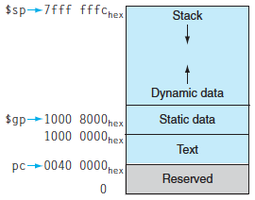
MIPS Memory Allocation

Slide 38
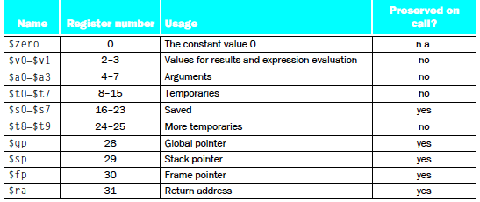
Register Allocation and Numbering

Slide 39
Which statement is FALSE?
☐
MIPS uses jal to invoke a function and jr to return from a function
☐
jal saves PC+1 in %ra
☐
The callee can use temporary registers (%ti) without saving and restoring them
☐
The caller can rely on save registers (%si) without fear of callee changing them
Notes:
VertLeftWhiteCheck1
B: Print It saves PC+4 …because ints in this system are 4-bytes long and the actual address increments by 4 even though it appears to only incrememt 1.

Slide 40
And in Conclusion, …
C strings are char arrays, byte per character, null terminated
Distinguish pointers and the memory they point to
* for dereference, & for address
C is function oriented; code reuse via functions
Jump and link (jal) invokes, jump register (jr $ra) returns
Registers $a0-$a3 for arguments, $v0-$v1 for return values
Stack for spilling registers, nested function calls, C local (automatic) variables

