Slide 1
CS 61C: Great Ideas in Computer Architecture Thread-Level Parallelism (TLP)
Instructor:
Krste Asanovic, Randy H. Katz
http://inst.eecs.Berkeley.edu/~cs61c/fa12

Slide 2
Review
SIMD Parallelism via Intel SSE Instructions
Use of SSE intrinsics to get access to assembly instructions from C code
Restructuring data to provide aligned access for SSE loads and stores

Slide 3
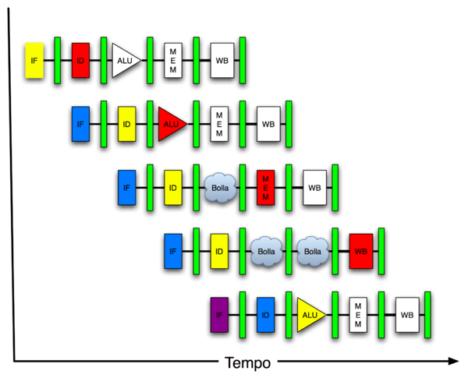
New-School Machine Structures (It’s a bit more complicated!)
Software Hardware
Parallel Requests
Assigned to computer
e.g., Search “Katz”
Parallel Threads
Assigned to core
e.g., Lookup, Ads
Parallel Instructions
>1 instruction @ one time
e.g., 5 pipelined instructions
Parallel Data
>1 data item @ one time
e.g., Add of 4 pairs of words
Hardware descriptions
All gates @ one time
Programming Languages
Warehouse Scale Computer
Smart Phone
Harness Parallelism &
Achieve High Performance
Computer
Core
…
Core
Memory (Cache)
Project 3
Input/Output
Core
Instruction Unit(s)
Functional
Unit(s)
A₀+B₀
A₁+B₁
A₂+B₂
A₃+B₃
Cache Memory
Logic Gates

Slide 4
Simple Multiprocessor
Processor 0
Control
Memory
Processor 0 Memory Accesses
Input
Datapath
PC
Registers
(ALU)
Bytes
Processor 1
Control
Processor 1 Memory Accesses
Datapath
Output
PC
Registers
(ALU)
I/O-Memory Interfaces

Slide 5
Multiprocessor Execution Model
Each processor has its own PC and executes an independent stream of instructions (MIMD)
Different processors can access the same memory space
Processors can communicate via shared memory by storing/loading to/from common locations
Two ways to use a multiprocessor:
Deliver high throughput for independent jobs via job-level parallelism
Improve the run time of a single program that has been specially crafted to run on a multiprocessor - a parallel-processing program
Now Use term core for processor (“Multicore”) because “Multiprocessor Microprocessor” too redundant

Slide 6
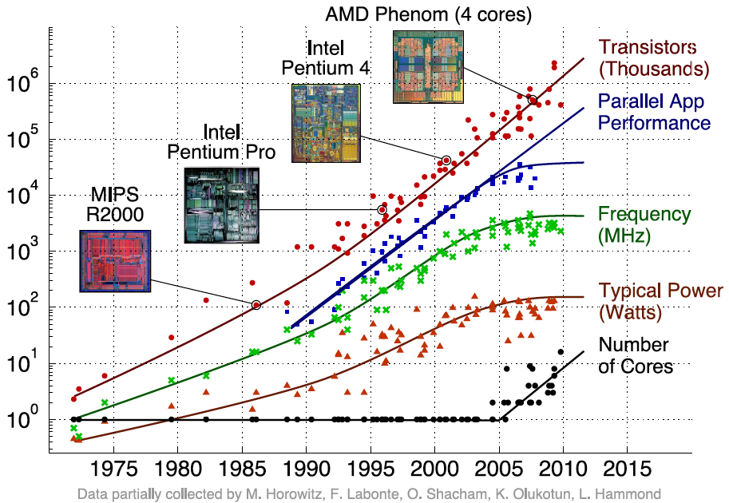
Transition to Multicore
Sequential App Performance

Slide 7
Parallelism Only Path to Higher Performance
Sequential processor performance not expected to increase much, and might go down
If want apps with more capability, have to embrace parallel processing (SIMD and MIMD)
In mobile systems, use multiple cores and GPUs
In warehouse-scale computers, use multiple nodes, and all the MIMD/SIMD capability of each node

Slide 8
Multiprocessors and You
Only path to performance is parallelism
Clock rates flat or declining
SIMD: 2X width every 3-4 years
128b wide now, 256b 2011, 512b in 2014?, 1024b in 2018?
MIMD: Add 2 cores every 2 years: 2, 4, 6, 8, 10, …
A key challenge is to craft parallel programs that have high performance on multiprocessors as the number of processors increase – i.e., that scale
Scheduling, load balancing, time for synchronization, overhead for communication
Project 3: fastest code on 8-core computers
2 chips/computer, 4 cores/chip

Slide 9
Potential Parallel Performance (assuming SW can use it)
Year | Cores | SIMD bits /Core | Core * SIMD bits | Peak DP FLOPs/Cycle
2003 | 2 | 128 | 256 | 4
2005 | 4 | 128 | 512 | 8
2007 | 6 | 128 | 768 | 12
2009 | 8 | 128 | 1024 | 16
2011 | 10 | 256 | 2560 | 40
2013 | 12 | 256 | 3072 | 48
2015 | 14 | 512 | 7168 | 112
2017 | 16 | 512 | 8192 | 128
2019 | 18 | 1024 | 18432 | 288
2021 | 20 | 1024 | 20480 | 320
MIMD
SIMD
MIMD *SIMD
+2/
2yrs
2X/
4yrs
2.5X
8X
20X

Slide 10
Multiprocessor Caches
Memory is a performance bottleneck even with one processor
Use caches to reduce bandwidth demands on main memory
Each core has a local private cache holding data it has accessed recently
Only cache misses have to access the shared common memory
Processor
Processor
Processor
Cache
Cache
Cache
Interconnection Network
Memory
I/O
Notes:
Power has become the overriding issue for both data centers and microprocessors. Power efficiency has joined scalable performance making the case for multiprocessors. Multiprocessors also improve availability.

Slide 11
Shared Memory and Caches
What if?
Processors 1 and 2 read Memory[1000] (value 20)
0
1
2
Processor
Processor
1000
Processor
1000
Cache
1000
1000
Cache
Cache
Interconnection Network
20
Memory
20
I/O

Slide 12
Shared Memory and Caches
Now:
Processor 0 writes Memory[1000] with 40
0
1
2
1000
Processor
Processor
Processor
1000 40
1000 20
1000 20
Cache
Cache
Cache
Interconnection Network
1000 40
Memory
I/O
Problem?

Slide 13
Keeping Multiple Caches Coherent
Architect’s job: shared memory => keep cache values coherent
Idea: When any processor has cache miss or writes, notify other processors via interconnection network
If only reading, many processors can have copies
If a processor writes, invalidate any other copies
Write transactions from one processor “snoop” tags of other caches using common interconnect
Invalidate any “hits” to same address in other caches
If hit is to dirty line, other cache has to write back first!

Slide 14
Shared Memory and Caches
Example, now with cache coherence
Processors 1 and 2 read Memory[1000]
Processor 0 writes Memory[1000] with 40
0
Processor 0
Write
Invalidates
Other Copies
Processor
1
2
1000
Processor
Processor
1000 40
1000 20
1000 20
Cache
Cache
Cache
Interconnection Network
1000 40
Memory
I/O

Slide 15
Flashcard Quiz: Which statement is true?
Using write-through caches removes the need for cache coherence
Every processor store instruction must check contents of other caches
Most processor load and store accesses only need to check in local private cache
Only one processor can cache any memory location at one time

Slide 16
Administrivia
Midterm Tuesday Oct 9, 8PM:
Two rooms: 1 Pimentel and 2050 LSB
Check your room assignment!
Covers everything through lecture Wednesday 10/3
Closed book, can bring one sheet notes, both sides
Copy of Green card will be supplied
No phones, calculators, …; just bring pencils & eraser
TA Review: Sun. Oct. 7, 3-5pm, 2050 VLSB
NO LECTURE ON WEDNESDAY OCTOBER 10!!!

Slide 17
Midterm Room Assignment by Login
1 Pimentel = logins ab – mk
2050 VLSB = logins mm - xm

Slide 18
Cache Coherency Tracked by Block
Processor 0
Processor 1
Cache 0
Cache 1
4000
4000
4004
4008
4012
4016
4028
Tag
32-Byte Data Block
Memory
Suppose block size is 32 bytes
Suppose Processor 0 reading and writing variable X, Processor 1 reading and writing variable Y
Suppose in X location 4000, Y in 4012
What will happen?

Slide 19
Coherency tracked by cache line
Block ping-pongs between two caches even though processors are accessing disjoint variables
Effect called false sharing
How can you prevent it?

Slide 20
Fourth “C” of Cache Misses: Coherence Misses
Misses caused by coherence traffic with other processor
Also known as communication misses because represents data moving between processors working together on a parallel program
For some parallel programs, coherence misses can dominate total misses

Slide 21
Threads
A thread is a unit of work described by a sequential flow of instructions
Each thread has a program counter and processor registers, and accesses the shared memory
Each processor provides one (or more) hardware threads that actively execute instructions
An operating system can multiplex multiple software threads onto the available hardware threads

Slide 22
Operating System Threads
Give the illusion of many active threads by time-multiplexing hardware threads among software threads
Remove a software thread from a hardware thread by interrupting its execution and saving its registers and PC into memory
Also if one thread is blocked waiting for network access or user input
Can make a different software thread active by loading its registers into processor and jumping to its saved PC

Slide 23
Hardware Multithreading
Basic idea: Processor resources are expensive and should not be left idle
Long memory latency to memory on cache miss?
Hardware switches threads to bring in other useful work while waiting for cache miss
Cost of thread context switch must be much less than cache miss latency
Put in redundant hardware so don’t have to save context on every thread switch:
PC, Registers
Attractive for apps with abundant TLP
Commercial multi-user workloads

Slide 24
Hardware Multithreading
Processor
Memory
Control
Input
Datapath
PC 0
PC 1
Registers 0
Registers 1
(ALU)
Bytes
Two copies of PC and Registers inside processor hardware
Looks like two processors to software (hardware thread 0, hardware thread 1)
Control logic decides which thread to execute an instruction from next
Output
I/O-Memory Interfaces

Slide 25
Multithreading vs. Multicore
Multithreading => Better Utilization
≈1% more hardware, 1.10X better performance?
Share integer adders, floating-point adders, caches (L1 I $, L1 D$, L2 cache, L3 cache), Memory Controller
Multicore => Duplicate Processors
≈50% more hardware, ≈2X better performance?
Share outer caches (L2 cache, L3 cache), Memory Controller

Slide 26
Machines in (old) 61C Lab
/usr/sbin/sysctl -a | grep hw\.
hw.model = MacPro4,1
…
hw.physicalcpu: 8
hw.logicalcpu: 16
…
hw.cpufrequency = 2,260,000,000
hw.physmem = 2,147,483,648
hw.cachelinesize = 64
hw.l1icachesize: 32,768
hw.l1dcachesize: 32,768
hw.l2cachesize: 262,144
hw.l3cachesize: 8,388,608
Therefore, should try up to 16 threads to see if performance gain even though only 8 cores

Slide 27
And in Conclusion, …
Sequential software is slow software
SIMD and MIMD only path to higher performance
Multiprocessor/Multicore uses Shared Memory
Cache coherency implements shared memory even with multiple copies in multiple caches
False sharing a concern; watch block size!
Multithreading increases utilization, Multicore more processors (MIMD)

