Slide 1
CS 61C:
Great Ideas in Computer Architecture
Switches, Transistors, Gates, and Boolean Logic
Instructors:
Krste Asanovic, Randy H. Katz
http://inst.eecs.Berkeley.edu/~cs61c/fa12

Slide 2





You are Here!
Software Hardware
Parallel Requests
  Assigned to computer
  e.g., Search “Katz”
Parallel Threads
  Assigned to core
  e.g., Lookup, Ads
Parallel Instructions
  >1 instruction @ one time
  e.g., 5 pipelined instructions
Parallel Data
  >1 data item @ one time
  e.g., Add of 4 pairs of words
Hardware descriptions
  All gates @ one time
Programming Languages
Warehouse Scale Computer
Smart
Phone
Harness
Parallelism &
Achieve High
Performance
Computer
Core
…
Core
Memory (Cache)
Input/Output
Core
Instruction Unit(s)
Functional
Unit(s)
A₀+B₀
A₁+B₁
A₂+B₂
A₃+B₃
Cache Memory
Today
Logic Gates

Slide 3
Agenda
Switching Networks, Transistors
Gates and Truth Tables for Circuits
Boolean Algebra
(Logisim if there is time)
And in Conclusion, …

Slide 4
Agenda
Switching Networks, Transistors
Gates and Truth Tables for Circuits
Boolean Algebra
(Logisim if there is time)
And in Conclusion, …

Slide 5
Hardware Design
Next several weeks: how a modern processor is built, starting with basic elements as building blocks
Why study hardware design?
  Understand capabilities and limitations of hw in general and processors in particular
  What processors can do fast and what they can’t do fast
  (avoid slow things if you want your code to run fast!)
  Background for more in depth hw courses (CS 152)
  Hard to know what will need for next 30 years
  There is just so much you can do with standard processors: you may need to design own custom hw for extra performance
    Even some commercial processors today have customizable hardware!

Slide 6
Synchronous Digital Systems
Hardware of a processor, such as the MIPS, is an example of a Synchronous Digital System
Synchronous:
  All operations coordinated by a central clock
    “Heartbeat” of the system!
Digital:
  Represent all values by two discrete values
  Electrical signals are treated as 1’s and 0’s
    1 and 0 are complements of each other
  High /low voltage for true / false, 1 / 0

Slide 7
Switches: Basic Element of Physical Implementations
Implementing a simple circuit (arrow shows action if wire changes to “1” or is asserted):
A
Z
Close switch (if A is “1” or asserted)
and turn on light bulb (Z)
Z
A
Open switch (if A is “0” or
unasserted) and turn off light
bulb (Z)
Z ≡ A

Slide 8
Switches (cont’d)
Compose switches into more complex ones (Boolean functions):
A
B
AND
Z ≡ A and B
A
OR
Z ≡ A or B
B

Slide 9
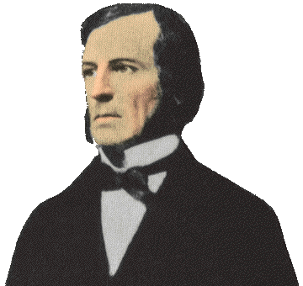
Historical Note
Early computer designers built ad hoc circuits from switches
Began to notice common patterns in their work: ANDs, ORs, …
Master’s thesis (by Claude Shannon) made link between work and 19th Century
Mathematician George Boole
  Called it “Boolean” in his honor
Could apply math to give theory to
hardware design, minimization, …

Slide 10
Transistors
High voltage (V_{dd}) represents 1, or true
Low voltage (0 volts or Ground) represents 0, or false
Let threshold voltage (V_{th}) decide if a 0 or a 1
If switches control whether voltages can propagate through a circuit, can build a computer
Our switches: CMOS transistors

Slide 11
CMOS Transistor Networks
Modern digital systems designed in CMOS
  MOS: Metal-Oxide on Semiconductor
  C for complementary: use pairs of normally-open and normally-closed switches
    Used to be called COS-MOS for complementary-symmetry -MOS
CMOS transistors act as voltage-controlled switches
  Similar, though easier to work with, than relay switches from earlier era
  Use energy primarily when switching
Notes:
Wikipedia: The phrase "metal–oxide–semiconductor" is a reference to the physical structure of certain field-effect transistors, having a metal gate electrode placed on top of an oxide insulator, which in turn is on top of a semiconductor material.
CMOS circuits use a combination of p-type and n-type metal–oxide–semiconductor field-effect transistors (MOSFETs)

Slide 12
CMOS Transistors
Gate
Source
Drain
Three terminals: source, gate, and drain
  Switch action:
  if voltage on gate terminal is (some amount) higher/lower than source terminal then conducting path established between drain and source terminals (switch is closed)
Note circle symbol to indicate “NOT” or “complement”
Gate
Gate
Source
Drain
Source
Drain
n-channel transitor
open when voltage at Gate is low
closes when:
voltage(Gate) > voltage (Threshold)
(High resistance when gate voltage Low,
Low resistance when gate voltage High)
p-channel transistor
closed when voltage at Gate is low
opens when:
voltage(Gate) > voltage (Threshold)
(Low resistance when gate voltage Low,
High resistance when gate voltage High)
Notes:
From wikipedia:
The field-effect transistor (FET) relies on an electric field to control the shape and hence the conductivity of a channel of one type of charge carrier in a semiconductor material.
The most commonly used FET is the MOSFET. The CMOS (complementary-symmetry metal oxide semiconductor) process technology is the basis for modern digital integrated circuits. This process technology uses an arrangement where the (usually "enhancement-mode") p-channel MOSFET and n-channel MOSFET are connected in series such that when one is on, the other is off.
CMOS circuits are constructed in such a way that all PMOS transistors must have either an input from the voltage source or from another PMOS transistor. Similarly, all NMOS transistors must have either an input from ground or from another NMOS transistor. The composition of a PMOS transistor creates low resistance between its source and drain contacts when a low gate voltage is applied and high resistance when a high gate voltage is applied.
On the other hand, the composition of an NMOS transistor creates high resistance between source and drain when a low gate voltage is applied and low resistance when a high gate voltage is applied.

Slide 13
CMOS Circuit Rules
Don’t pass weak values => Use Complementary Pairs
  N-type transistors pass weak 1’s (V_{dd} - V_{th})
  N-type transistors pass strong 0’s (ground)
  Use N-type transistors only to pass 0’s (N for negative)
  Converse for P-type transistors: Pass weak 0s, strong 1s
    Pass weak 0’s (V_{th}), strong 1’s (V_{dd})
    Use P-type transistors only to pass 1’s (P for positive)
  Use pairs of N-type and P-type to get strong values
Never leave a wire undriven
  Make sure there’s always a path to V_{dd} or gnd
Never create a path from V_{dd} to gnd (ground)
Notes:
Wikipedia: CMOS accomplishes current reduction by complementing every nMOSFET with a pMOSFET and connecting both gates and both drains together. A high voltage on the gates will cause the nMOSFET to conduct and the pMOSFET not to conduct while a low voltage on the gates causes the reverse. This arrangement greatly reduces power consumption and heat generation. However, during the switching time both MOSFETs conduct briefly as the gate voltage goes from one state to another. This induces a brief spike in power consumption and becomes a serious issue at high frequencies.

Slide 14
Administrivia
Regrade window opens today and closes by next Wednesday’s lecture
  Best to return to your lab/discussion TA (parallel processing!)
Coming labs and HWs: build up for Project #3
  Last week’s lab: Cache blocking
  This week’s lab: SIMD instruction set
  This week’s HW: Cache blocking and SIMD practice
  Next week’s lab: OpenMP thread programming

Slide 15
EECS Grading Policy
http://www.eecs.berkeley.edu/Policies/ugrad.grading.shtml
“A typical GPA for courses in the lower division is 2.7. This GPA would result, for example, from 17% A's, 50% B's, 20% C's, 10% D's, and 3% F's. A class whose GPA falls outside the range 2.5 - 2.9 should be considered atypical.”
Spring 2011: GPA 2.85
24% A's, 49% B's, 18% C's,
6% D's, 3% F's
Job/Intern Interviews: They grill
you with technical questions, so
it’s what you say, not your GPA
(61c gives you good stuff to say)
 | Fall | Spring
2011 | 2.72 | 2.85
2010 | 2.81 | 2.81
2009 | 2.71 | 2.81
2008 | 2.95 | 2.74
2007 | 2.67 | 2.76

Slide 16

CS61c in the News
Computers meet Cameras
http://gigaplan.com
http://mlb.mlb.com/photos/gigapan/?gpId=a2be33bf9acd8730e8a086e8c1f26d8d&ps=1

Slide 17
Agenda
Switching Networks, Transistors
Gates and Truth Tables for Circuits
Boolean Algebra
(Logisim if there is time)
And in Conclusion, …

Slide 18
MOS Networks
p-channel transistor
closed when voltage at Gate is low
opens when:
voltage(Gate) > voltage (Threshold)
X
what is the
relationship
between x and y?
3v
x
y
Y
0 volts
(gnd)
0v
3 volts
(Vdd)
n-channel transitor
open when voltage at Gate is low
closes when:
voltage(Gate) > voltage (Threshold)
Called an invertor or not gate
Notes:
X = 0 implies top switch is closed, so 3V sent Y
X = 0 implies bottom switch is open, so nothing sent to Y
X = 3v implies Top switch is open, so nothing sent to Y
X = 3v implies Bottom switch is closed, so 0V sent Y
Wikipedia:
The image shows what happens when an input is connected to both a PMOS transistor (top of diagram) and an NMOS transistor (bottom of diagram). When the voltage of input X is low, the NMOS transistor's channel is in a high resistance state. This limits the current that can flow from Y to ground.
The PMOS transistor's channel is in a low resistance state and much more current can flow from the supply to the output. Because the resistance between the supply voltage and Y is low, the voltage drop between the supply voltage and Y due to a current drawn from Y is small. The output therefore registers a high voltage.
On the other hand, when the voltage of input X is high, the PMOS transistor is in an OFF (high resistance) state so it would limit the current flowing from the positive supply to the output, while the NMOS transistor is in an ON (low resistance) state, allowing the output to drain to ground.
Because the resistance between Y and ground is low, the voltage drop due to a current drawn into Y placing Y above ground is small. This low drop results in the output registering a low voltage.
In short, the outputs of the PMOS and NMOS transistors are complementary such that when the input is low, the output is high, and when the input is high, the output is low. Because of this behavour of input and output, the CMOS circuits' output is the inverse of the input.

Slide 19
MOS Networks
n-channel transitor
open when voltage at Gate is low
closes when voltage(Gate) > voltage (Source) + ε
X
what is the
relationship
between x and y?
3v
x
y
Y
0 volts
(gnd)
3 volts (Vdd)
0v
3 volts
(Vdd)
0 volts (gnd)
p-channel transistor
closed when voltage at Gate is low
opens when voltage(Gate) < voltage (Source) – ε
Called an invertor or not gate
Notes:
X = 0 implies top switch is closed, so 3V sent Y
X = 0 implies bottom switch is open, so nothing sent to Y
X = 3v implies Top switch is open, so nothing sent to Y
X = 3v implies Bottom switch is closed, so 0V sent Y
The most commonly used FET is the MOSFET. The CMOS (complementary-symmetry metal oxide semiconductor) process technology is the basis for modern digital integrated circuits. This process technology uses an arrangement where the (usually "enhancement-mode") p-channel MOSFET and n-channel MOSFET are connected in series such that when one is on, the other is off.

Slide 20
P = ½ C V² f
Dynamic Energy (when switching) is proportional to Capacitance * Voltage²
Since pulse is 0 -> 1 -> 0 or 1 -> 0 -> 1,
Energy of a single transition is proportional to
½ *Capacitance * Voltage²
Power is just energy per transition times frequency of transitions: proportional to
½ * Capacitance * Voltage² * Frequency

Slide 21
Two Input Networks
Student Roulette
what is the
relationship between x, y and z?
X
Y
x
y
z
3v
0 volts
0 volts
0 volts
3 volts
Z
3 volts
0 volts
0v
3 volts
3 volts
X
Y
x
y
z
0 volts
0 volts
3v
0 volts
3 volts
Z
3 volts
0 volts
3 volts
3 volts
0v
Notes:
Top
X = 0v Y = 0V both closed on top, so Z = 3v
X = 0v Y = 0V both open bottom
X = 0v Y = 3V 2nd closed on top, so Z = 3v
X = 0v Y = 3V 2nd in series open
X = 3v Y = 0V 1st closed on top, so Z = 3v
X = 3v Y = 0V 1st in series open
X = 3v Y = 3V both open on top
X = 3v Y = 0V both closed, so Z = 0v

Slide 22
Two Input Networks: Peer Instruction
what is the
relationship between x, y and z?
X
Y
x
y
z
Called NAND gate (NOT AND)
3v
0 volts
3 volts
0 volts
0 volts
3 volts
3 volts
Z
3 volts
3 volts
0 volts
0v
3 volts
3 volts
0 volts
X
Y
x
y
z
A B C D
0 volts
0 volts
0 0 3 3
volts
3v
0 volts
3 volts
0 3 0 3
volts
Z
3 volts
0 volts
0 3 0 3
volts
3 volts
3 volts
3 3 0 0
volts
0v
Notes:
Top
X = 0v Y = 0V both closed on top, so Z = 3v
X = 0v Y = 0V both open bottom
X = 0v Y = 3V 2nd closed on top, so Z = 3v
X = 0v Y = 3V 2nd in series open
X = 3v Y = 0V 1st closed on top, so Z = 3v
X = 3v Y = 0V 1st in series open
X = 3v Y = 3V both open on top
X = 3v Y = 0V both closed, so Z = 0v

Slide 23
Two Input Networks
what is the
relationship between x, y and z?
X
Y
x
y
z
Called NAND gate (NOT AND)
3v
0 volts
3 volts
0 volts
0 volts
3 volts
3 volts
Z
3 volts
3 volts
0 volts
0v
3 volts
3 volts
0 volts
X
Y
Called NOR gate (NOT OR)
x
y
z
3v
0 volts
0 volts
3 volts
0 volts
3 volts
0 volts
Z
3 volts
0 volts
0 volts
3 volts
3 volts
0 volts
0v
Notes:
Bottom
X = 0v Y = 0V both closed on top in series, so Z = 3v
X = 0v Y = 0V both open bottom
X = 0v Y = 3V 1st open on top,
X = 0v Y = 3V 2nd in series closed, so Z = 0v
X = 3v Y = 0V 2nd open on top
X = 3v Y = 0V 2nd in series closed, so Z = 0v
X = 3v Y = 3V both open on top
X = 3v Y = 3V both closed, so Z = 0v

Slide 24
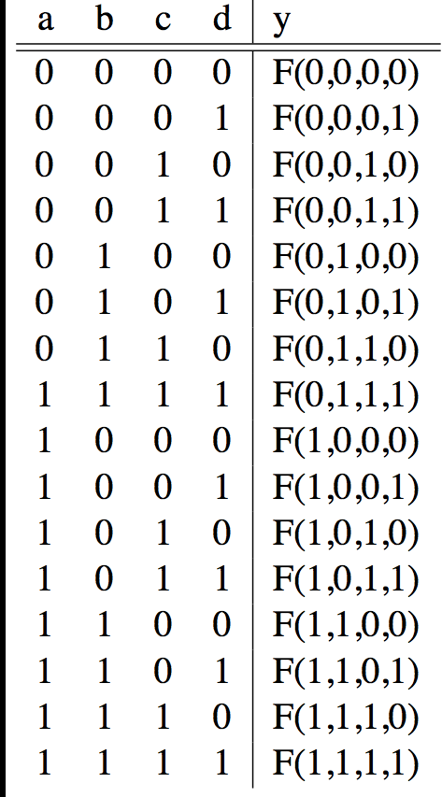
Truth Tables
List outputs for all possible inputs
A
F
B
Y
C
0
D

Slide 25
Truth Table Example #1: y= F(a,b): 1 iff a ≠ b
a | b | y
0 | 0 | 0
0 | 1 | 1
1 | 0 | 1
1 | 1 | 0
Y = A B + A B
Y = A + B
XOR

Slide 26
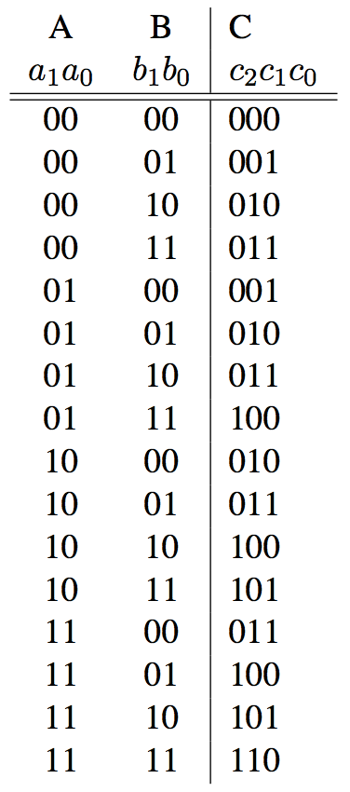
Truth Table Example #2:
2-bit Adder
How
Many
Rows?
A1
+
C2
A0
C1
B1
C0
B0

Slide 27
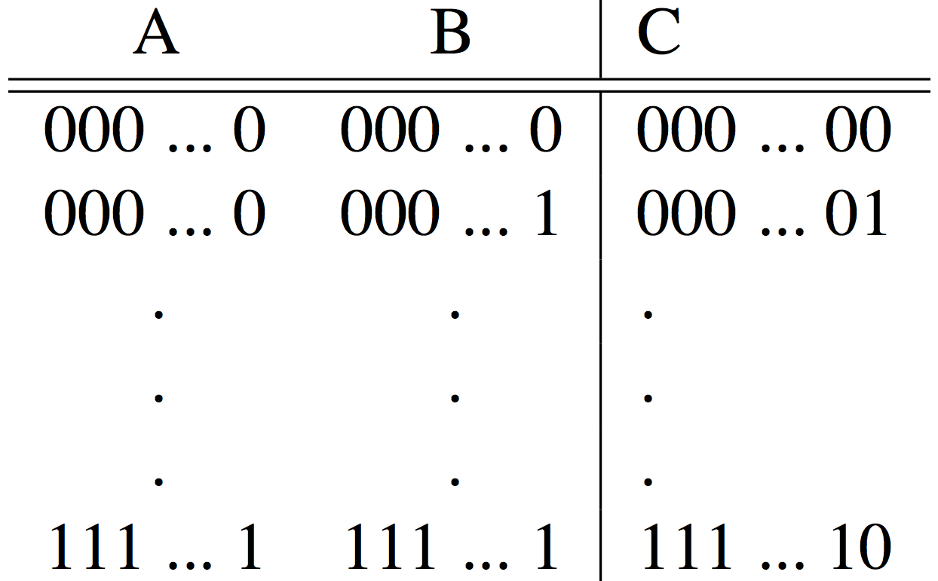
Truth Table Example #3:
32-bit Unsigned Adder
How
Many
Rows?

Slide 28
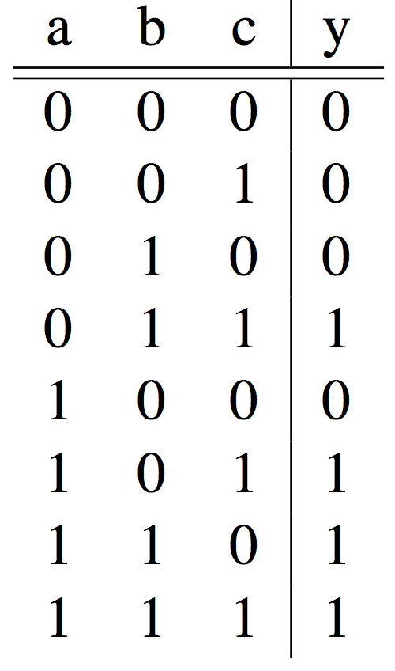
Truth Table Example #4:
3-input Majority Circuit
Y = A B C + A B C + A B C + A B C
This is called Sum of Products form;
Just another way to represent the TT
as a logical expression
Y = B C + A (B C + B C)
Y = B C + A (B + C)
More simplified forms
(fewer gates and wires)

Slide 29
Combinational Logic Symbols
Common combinational logic systems have standard symbols called logic gates
  Buffer, NOT
  AND, NAND
  OR, NOR
A
Z
A
Z
Easy to implement
with CMOS transistors
(the switches we have
available and use most)
B
A
Z
B

Slide 30
Agenda
Switching Networks, Transistors
Gates and Truth Tables for Circuits
Boolean Algebra
(Logisim if there is time)
And in Conclusion, …

Slide 31
Boolean Algebra
Use plus for OR
  “logical sum”
Use product for AND (a•b or implied via ab)
  “logical product”
“Hat” to mean complement (NOT)
Thus
ab + a + c
= a•b + a + c
= (a AND b) OR a OR (NOT c )

Slide 32
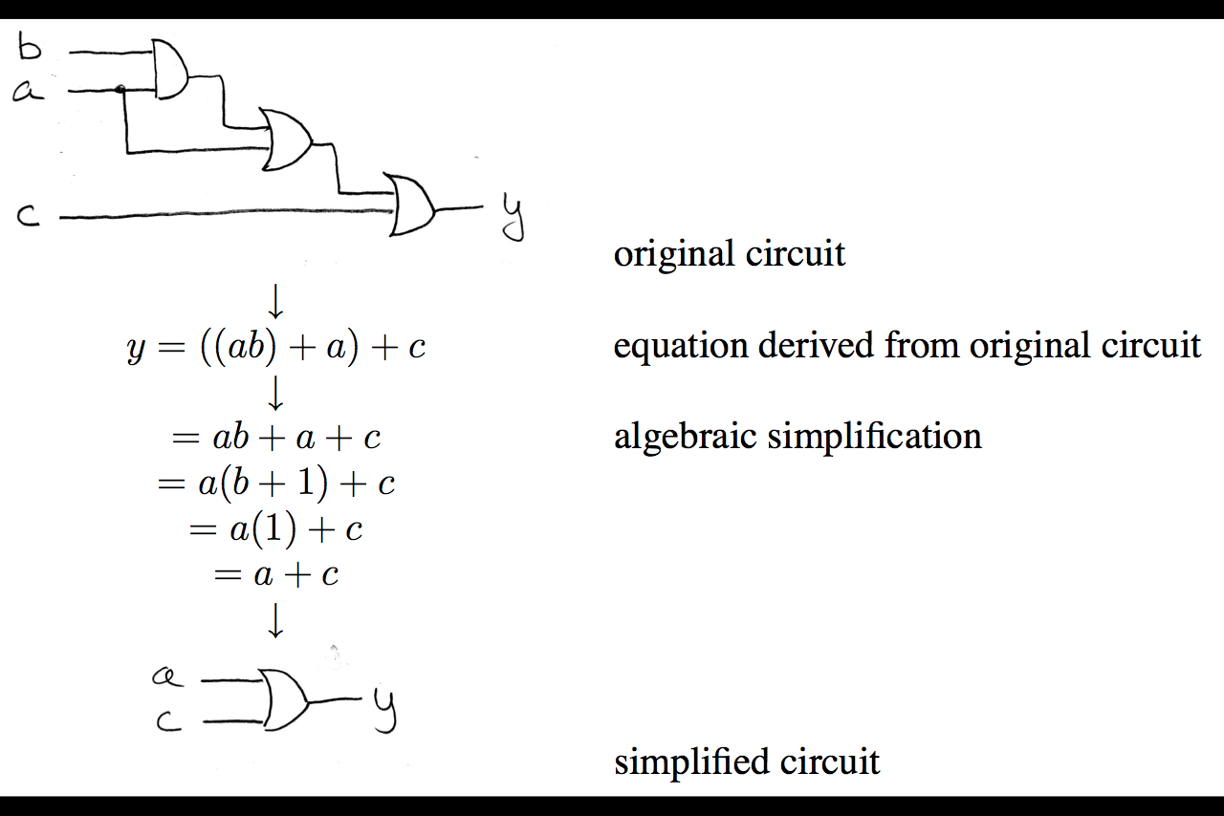
Boolean Algebra: Circuit & Algebraic Simplification

Slide 33
Laws of Boolean Algebra
X X = 0
X 0 = 0
X 1 = X
X X = X
X Y = Y X
(X Y) Z = Z (Y Z)
X (Y + Z) = X Y + X Z
X Y + X = X
X Y + X = X + Y
X Y = X + Y
X + X = 1
X + 1 = 1
X + 0 = X
X + X = X
X + Y = Y + X
(X + Y) + Z = Z + (Y + Z)
X + Y Z = (X + Y) (X + Z)
(X + Y) X = X
(X + Y) X = X Y
X + Y = X Y
Complementarity
Laws of 0’s and 1’s
Identities
Idempotent Laws
Commutativity
Associativity
Distribution
Uniting Theorem
United Theorem v. 2
DeMorgan’s Law

Slide 34
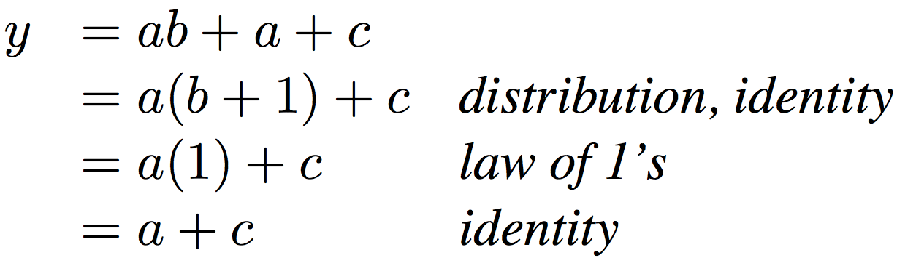
Boolean Algebraic Simplification Example
Notes:
Do on black board
First write truth table
Then minimize and check truth table
From distribution: a(b +1) + c
Froms laws of 0s and 1s: b+1 = 1
= a + c
Truth Table
a b c y
0 0 0 0
0 0 1 1
0 0 1 1

Slide 35
Boolean Algebraic Simplification Example
a b c y
0 0 0 0
0 0 1 1
0 1 0 0
0 1 1 1
1 0 0 1
1 0 1 1
1 1 0 1
1 1 1 1
Notes:
Do on black board
From distribution: a(b +1) + c
Froms laws of 0s and 1s: b+1 = 1
= a + c
Truth Table
a b c y
0 0 0 0
0 0 1 1
0 1 0 0
0 1 1 1
1 0 0 1
1 0 1 1
1 1 0 1
1 1 1 1

Slide 36
Agenda
Switching Networks, Transistors
Gates and Truth Tables for Circuits
Boolean Algebra
And in Conclusion, …

Slide 37
Agenda
Switching Networks, Transistors
Gates and Truth Tables for Circuits
Boolean Algebra
(Logisim if there is time)
And in Conclusion, …

Slide 38
Logisim
Free schematic capture/logic simulation program in Java
  “A graphical tool for designing and simulating logic circuits”
  Search and download version 2.7.1, online tutorial
  ozark.hendrix.edu/~burch/logisim/
Drawing interface based on toolbar
  Color-coded wires aid in simulating and debugging a circuit
  Wiring tool draws horizontal and vertical wires, automatically connecting to components and to other wires.
Circuit layouts used as "subcircuits" of other circuits, allowing hierarchical circuit design
Included circuit components: inputs and outputs, gates, multiplexers, arithmetic circuits, flip-flops, RAM memory

Slide 39
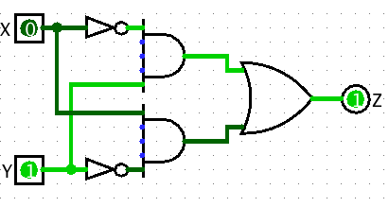
Logisim Wires
Blue wires: value at that point is "unknown”
Gray wires: not connected to anything
OK when in process of building a circuit
When finished => wires not be blue or gray
If connected, all wires should be green
  Bright green a 1
  Dark green a 0

Slide 40
Common Mistakes in Logisim
Connecting wires together
Using input for output
Connecting to edge without connecting to actual input
  Unexpected direction of input
Notes:
1. XOR Logic with Bug.circ
Works for 00, 10, 11, breaks for 01
(xor connected to input of gate – 2 wires with different values)
2. AndBug.circ
Works for 00, 10, 01, fails for 11
(its not unconnected inputs to And gate – change inputs to see)
(its using west facing input as an output)
3. counter without bug.circ
FSM not working as change input!
(facing wrong way)

Slide 41
And in Conclusion, …
Real world voltages are analog, but are quantized to represent logic 0 and logic 1
Transistors are just switches, combined to form gates: AND, OR, NOT, NAND, NOR
Truth table can be mapped to gates for combinational logic design
Boolean algebra allows minimization of gates

