Slide 1
CS 61C: Great Ideas in Computer Architecture Timing and State
Instructors:
Krste Asanovic, Randy H. Katz
http://inst.eecs.Berkeley.edu/~cs61c/fa12

Slide 2
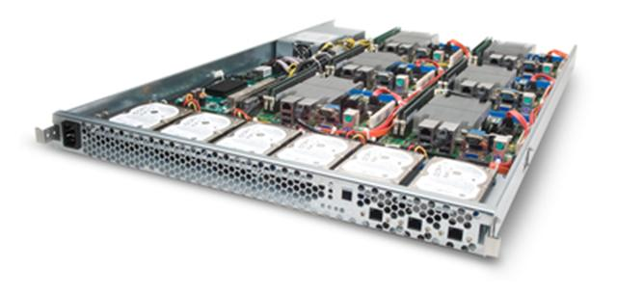
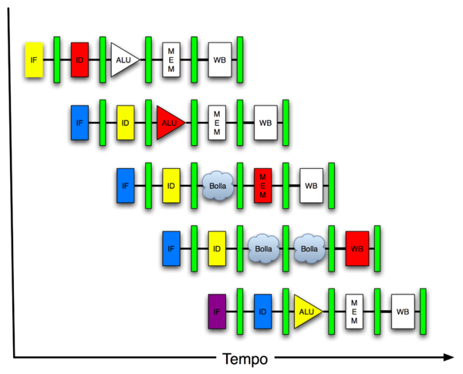
You are Here!
Software Hardware
Parallel Requests
Assigned to computer
e.g., Search “Katz”
Parallel Threads
Assigned to core
e.g., Lookup, Ads
Parallel Instructions
>1 instruction @ one time
e.g., 5 pipelined instructions
Parallel Data
>1 data item @ one time
e.g., Add of 4 pairs of words
Hardware descriptions
All gates @ one time
Programming Languages
Warehouse Scale Computer
Smart Phone
Harness Parallelism &
Achieve High Performance
Computer
Core
…
Core
Memory (Cache)
Input/Output
Core
Instruction Unit(s)
Functional
Unit(s)
A₀+B₀
A₁+B₁
A₂+B₂
A₃+B₃
Cache Memory
Today
Logic Gates

Slide 3
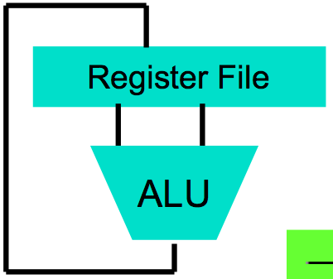
Levels of Representation/Interpretation
High Level Language Program (e.g., C)
temp = v[k];
v[k] = v[k+1];
v[k+1] = temp;
Compiler
Anything can be represented as a number, i.e., data or instructions
lw $t0, 0($2)
lw $t1, 4($2)
sw $t1, 0($2)
sw $t0, 4($2)
Assembly Language Program (e.g., MIPS)
Assembler
0000 1001 1100 0110 1010 1111 0101 1000
1010 1111 0101 1000 0000 1001 1100 0110
1100 0110 1010 1111 0101 1000 0000 1001
0101 1000 0000 1001 1100 0110 1010 1111
Machine Language Program (MIPS)
Machine Interpretation
Hardware Architecture Description (e.g., block diagrams)
Architecture Implementation
Logic Circuit Description (Circuit Schematic Diagrams)

Slide 4
Review
Real world voltages are analog, but are quantized to represent logic 0 and logic 1
Transistors are just switches, combined to form gates: AND, OR, NOT, NAND, NOR
Truth table can be mapped to gates for combinational logic design
Boolean algebra allows minimization of gates

Slide 5
Agenda
State Elements
Finite State Machines
And in Conclusion, …

Slide 6
Agenda
State Elements
Finite State Machines
And in Conclusion, …

Slide 7
Type of Circuits
Synchronous Digital Systems consist of two basic types of circuits:
Combinational Logic (CL) circuits
Output is a function of the inputs only, not the history of its execution
E.g., circuits to add A, B (ALUs)
Last lecture was CL
Sequential Logic (SL)
Circuits that “remember” or store information
aka “State Elements”
E.g., memories and registers (Registers)
Today’s lecture is SL

Slide 8
Design Hierarchy
system
datapath
control
code registers
state registers
combinational logic
multiplexer
comparator
register
logic
switching networks

Slide 9
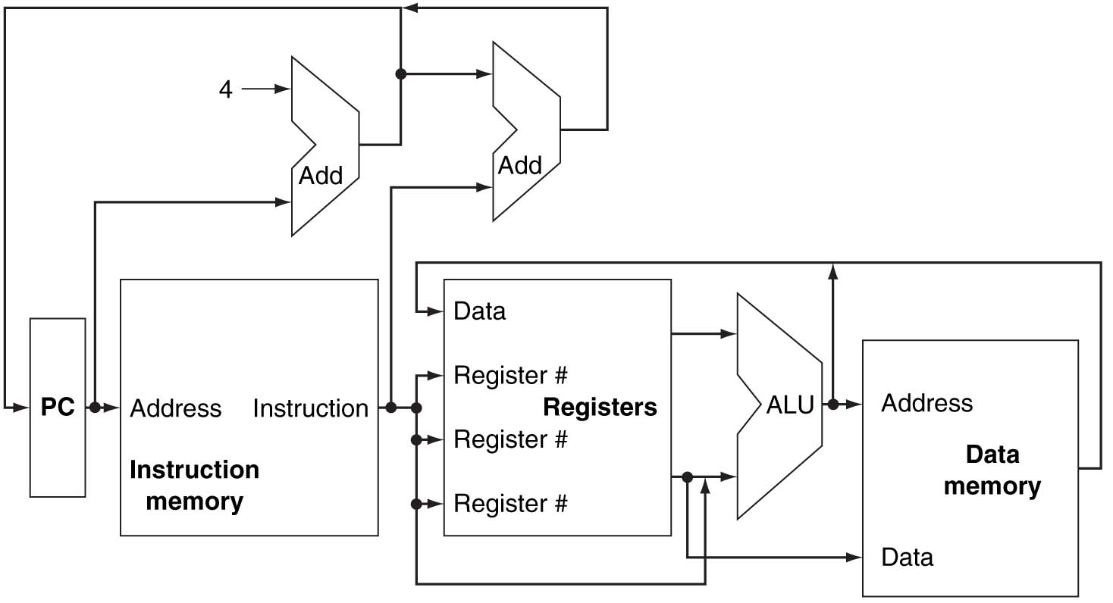
A Conceptual MIPS Datapath

Slide 10
Uses for State Elements
Place to store values for later re-use:
Register files (like $1-$31 on the MIPS)
Memory (caches, and main memory)
Help control flow of information between combinational logic blocks
State elements hold up the movement of information at input to combinational logic blocks to allow for orderly passage

Slide 11
Accumulator Example
Why do we need to control the flow of information?
SUM
X_{i}
S
Want: S=0;
for (i=0;i<n;i++)
S = S + X_{i}
Assume:
Each X value is applied in succession, one per cycle
After n cycles the sum is present on S

Slide 12
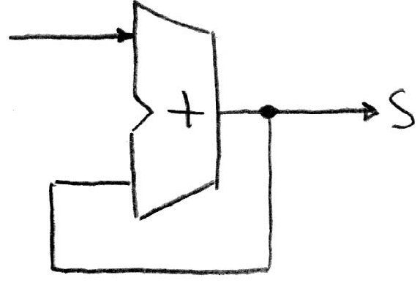
First Try: Does this work?
Feedback
No!
Reason #1: How to control the next iteration of the ‘for’ loop?
Reason #2: How do we say: ‘S=0’?

Slide 13
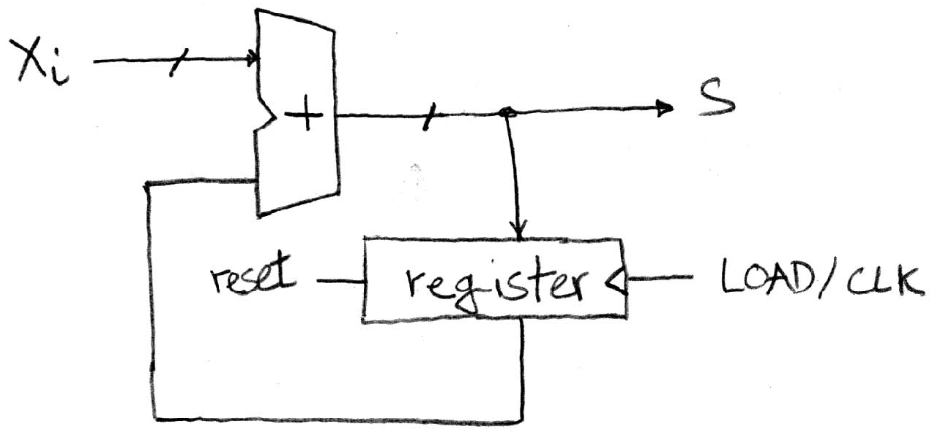
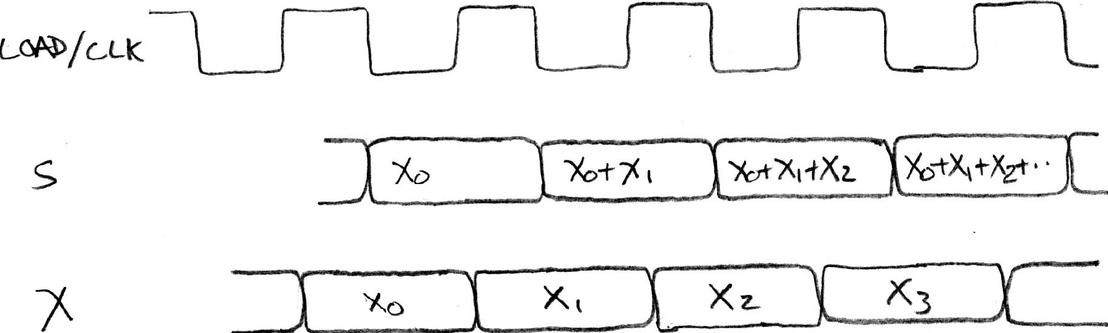
Second Try: How About This?
Register is used to hold up the transfer of data to adder
Square wave clock sets when things change
High (1)
Low (0)
Rough timing …
Rounded Rectangle per clock means could be 1 or 0
High (1)
Low (0)
Xi must be ready before clock edge due to adder delay
High (1)
Low (0)
Time

Slide 14
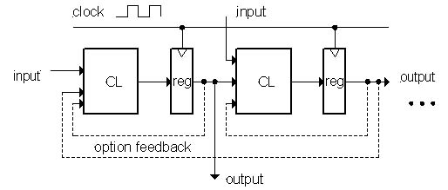
Model for Synchronous Systems
Collection of Combinational Logic blocks separated by registers
Feedback is optional
Clock signal(s) connects only to clock input of registers
Clock (CLK): steady square wave that synchronizes the system
Register: several bits of state that samples on rising edge of CLK (positive edge-triggered) or falling edge (negative edge-triggered)

Slide 15
Register Internals
n instances of a “Flip-Flop”
Flip-flop name because the output flips and flops between 0 and 1
D is “data input”, Q is “data output”
Also called “D-type Flip-Flop”

Slide 16
Camera Analogy Timing Terms
Want to take a portrait – timing right before and after taking picture
Set up time – don’t move since about to take picture (open camera shutter)
Hold time – need to hold still after shutter opens until camera shutter closes
Time click to data – time from open shutter until can see image on output (viewfinder)

Slide 17
Hardware Timing Terms
Setup Time: when the input must be stable before the edge of the CLK
Hold Time: when the input must be stable after the edge of the CLK
“CLK-to-Q” Delay: how long it takes the output to change, measured from the edge of the CLK

Slide 18
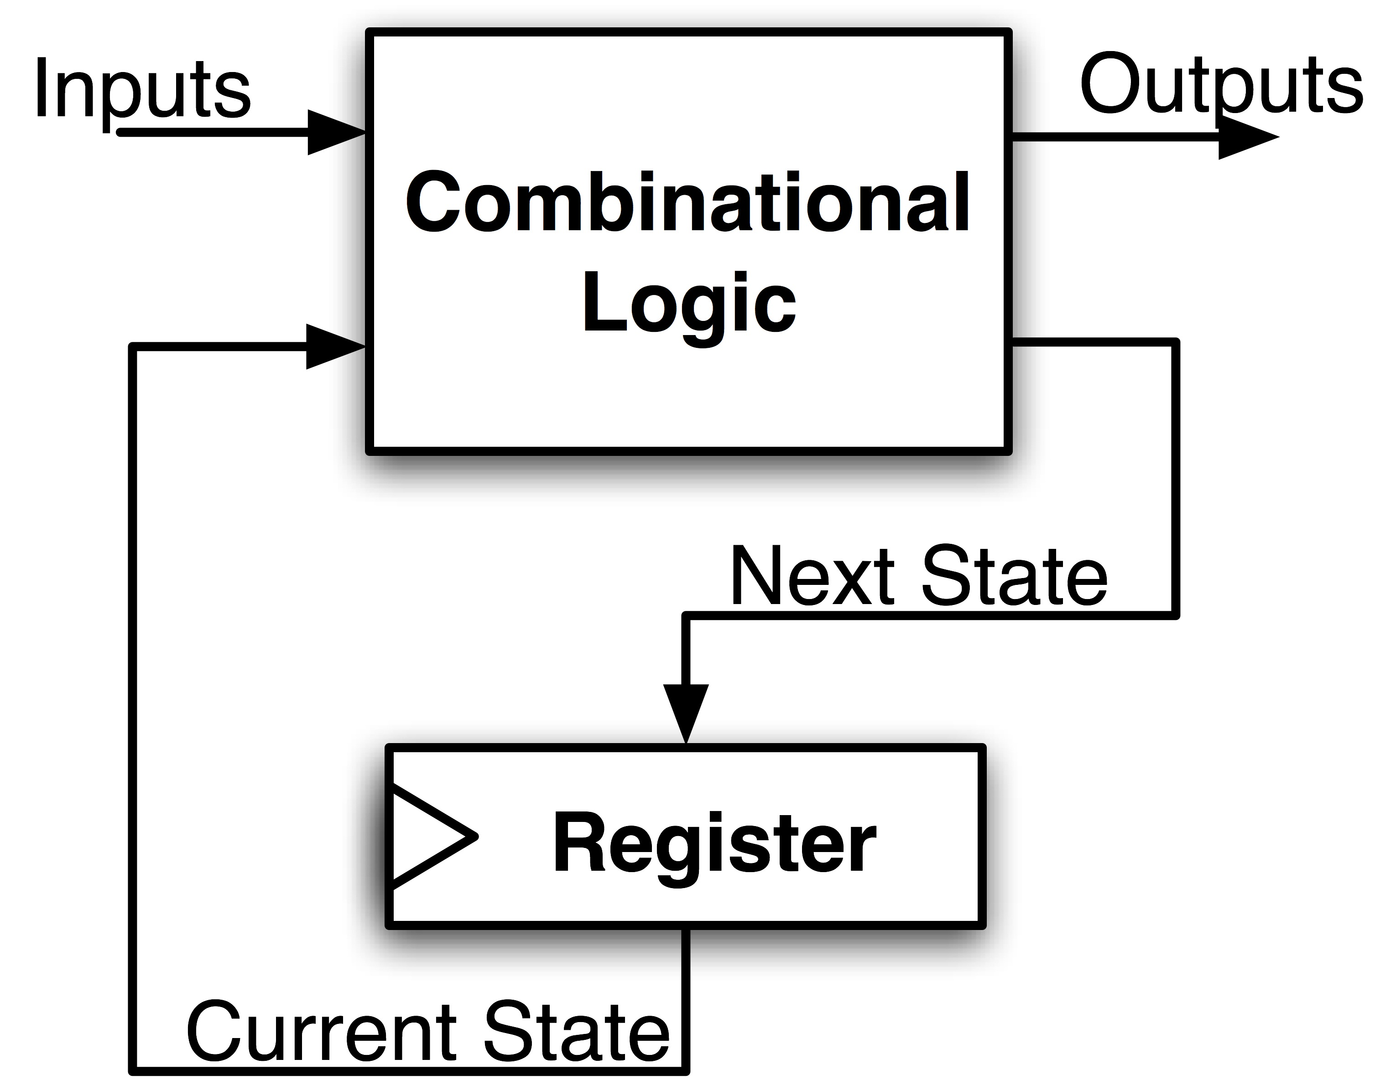
FSM Maximum Clock Frequency
What is the maximum frequency of this circuit?
Hint:
Frequency = 1/Period
Max Delay = Setup Time + CLK-to-Q Delay + CL Delay

Slide 19
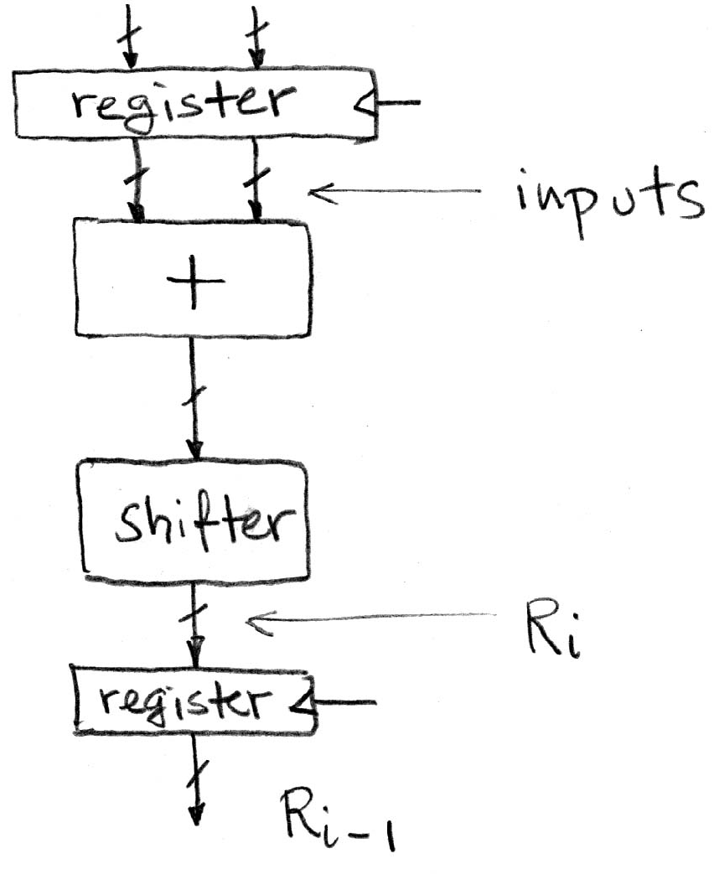
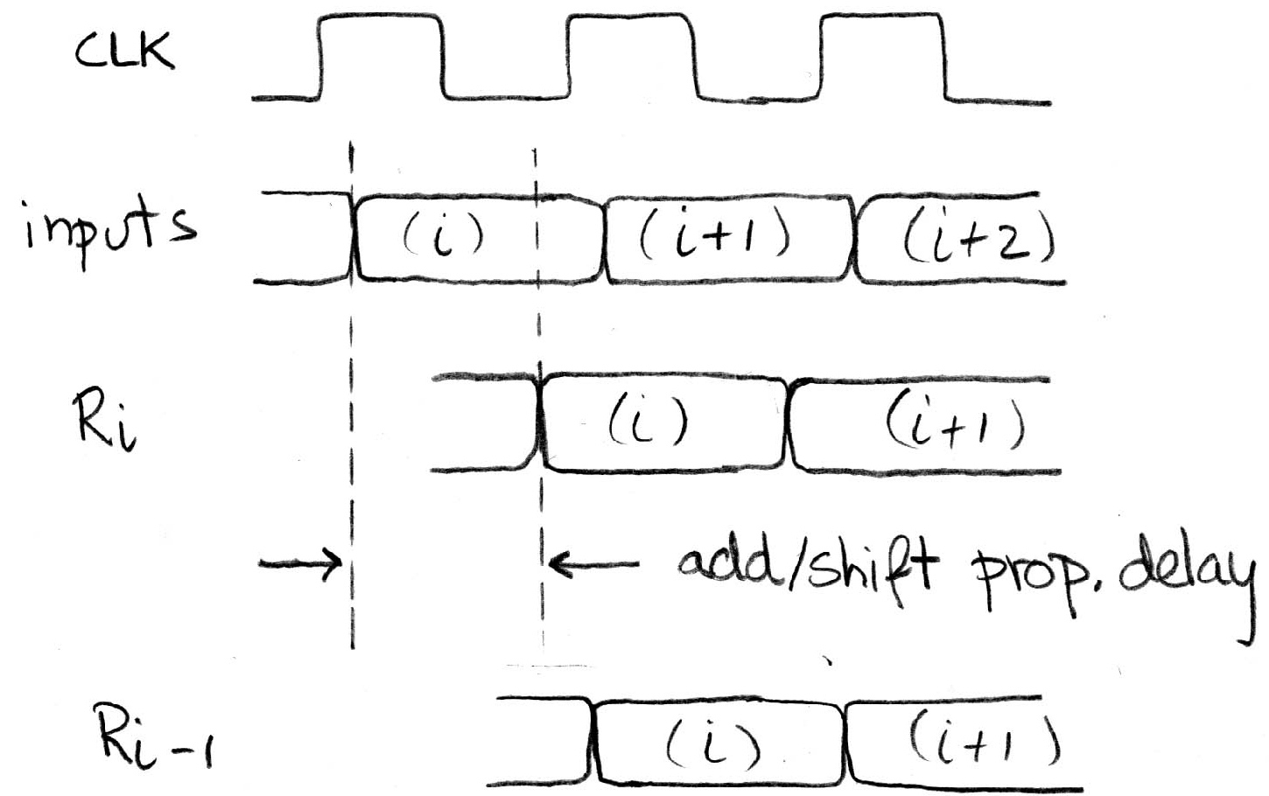
Pipelining to Improve Performance: BEFORE (1/2)
Timing…
High (1)
Low (0)
High (1)
Low (0)
High (1)
Low (0)
High (1)
Low (0)
Note: delay of 1 clock cycle from input to output.
Clock period limited by propagation delay of adder/shifter

Slide 20
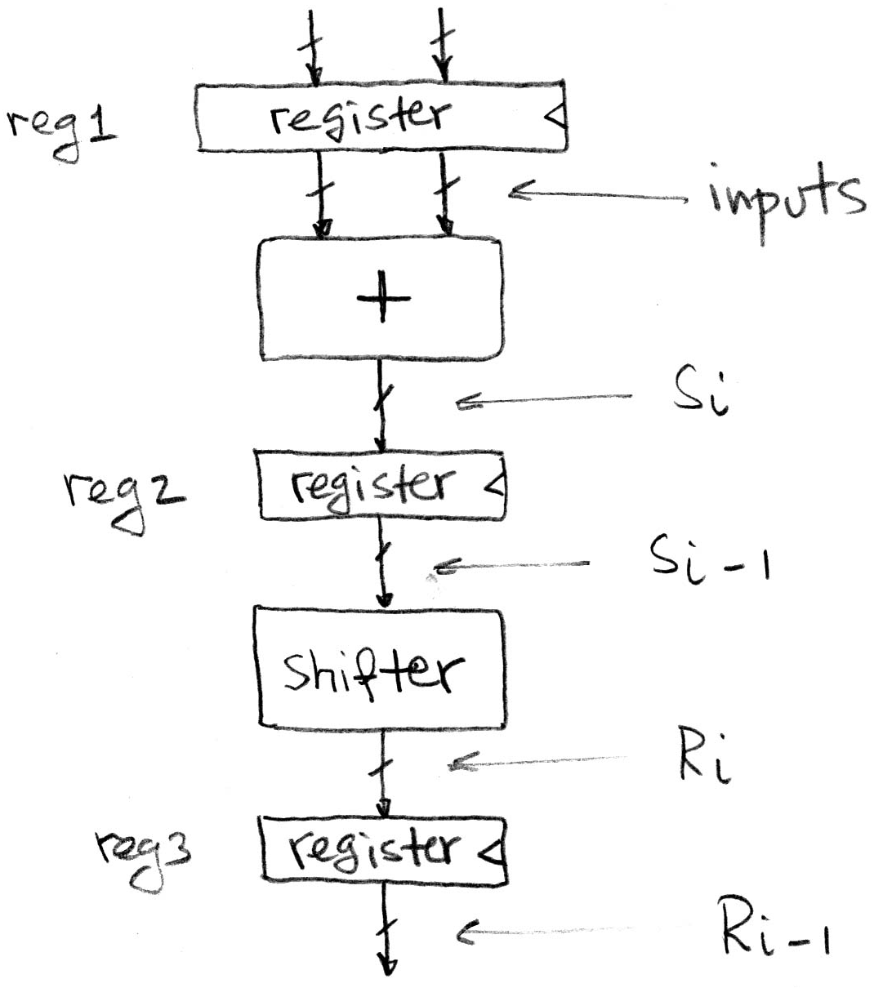
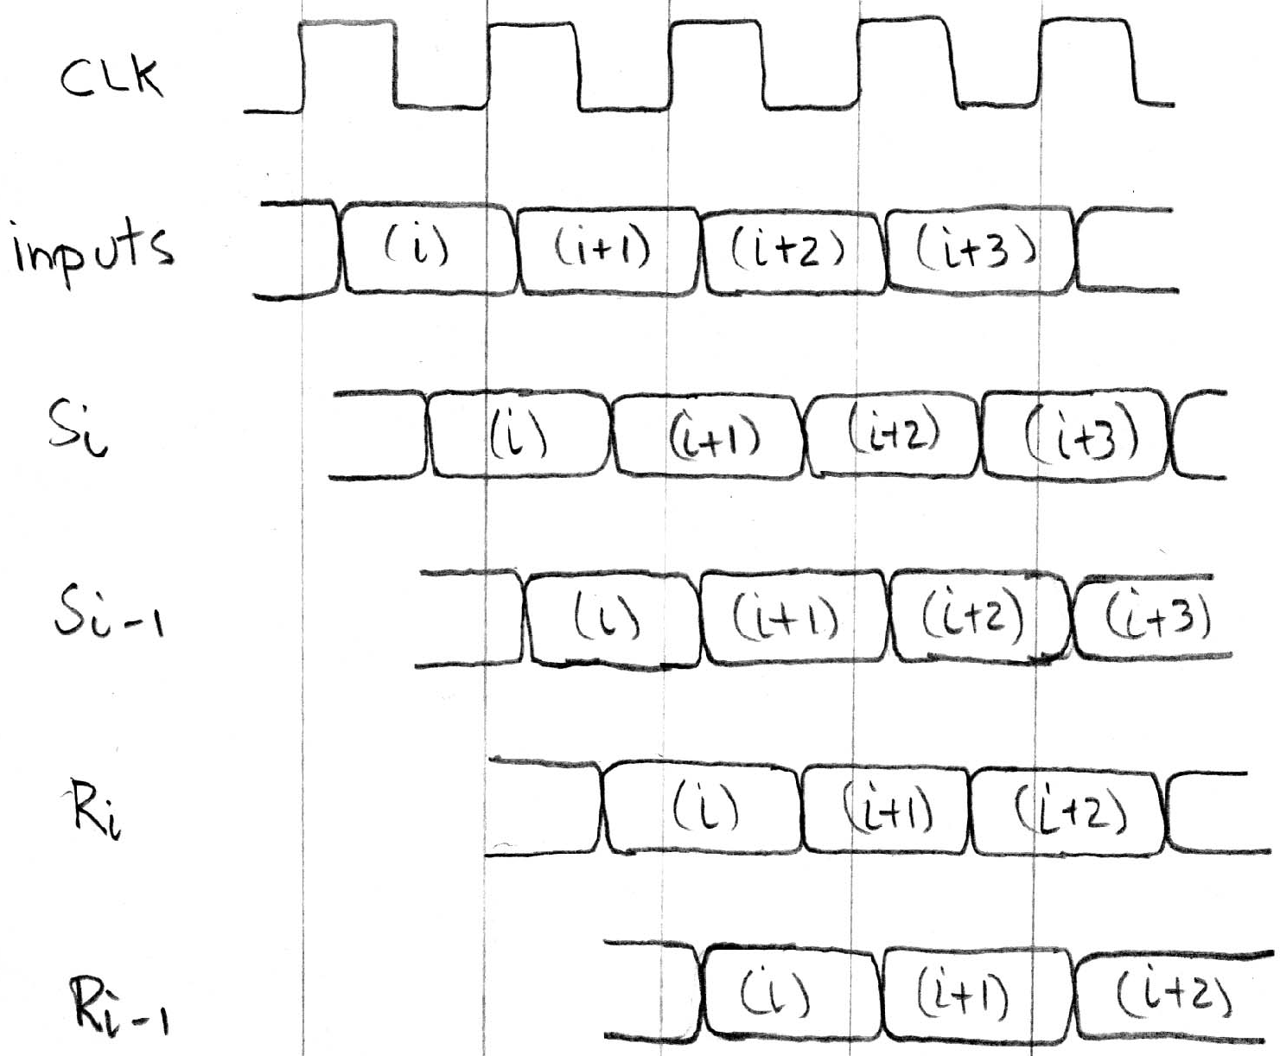
Pipelining to Improve Performance (2/2)
Insertion of register allows higher clock frequency
More outputs per second
Timing…
Ready before clock edge: setup time
Delay for Adder Combinational Logic
Delay for Setup + Clk to Q
Delay for Shifter Combinational Logic
Delay for Setup + Clk to Q

Slide 21
Agenda
State Elements
Finite State Machines
And, in Conclusion, …

Slide 22
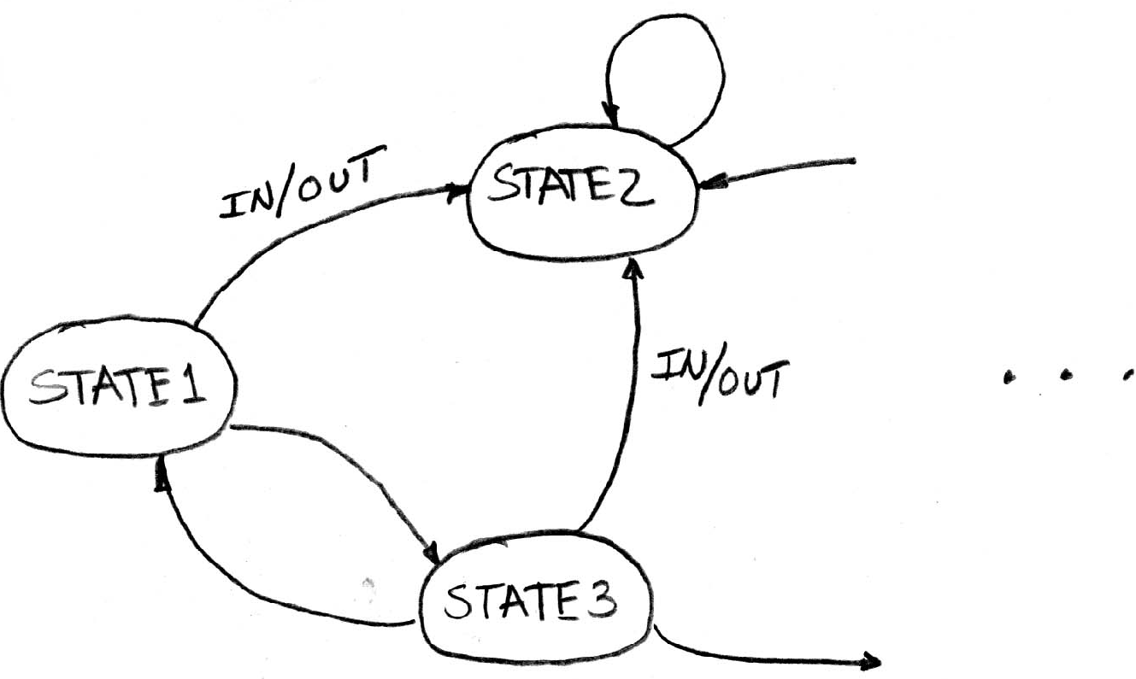
Another Great (Theory) Idea: Finite State Machines (FSM)
You may have seen FSMs in other classes
Same basic idea
Function can be represented with a “state transition diagram”
With combinational logic and registers, any FSM can be implemented in hardware

Slide 23
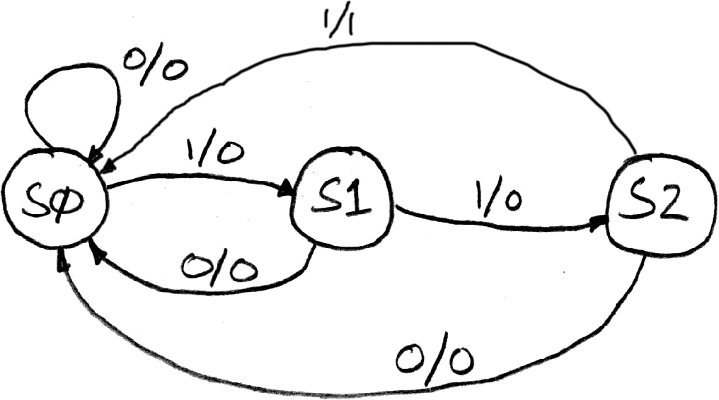
Example: 3 Ones FSM
FSM to detect the occurrence of 3 consecutive 1’s in the Input
Draw the FSM …
Assume state transitions are controlled by the clock: On each clock cycle the machine checks the inputs and moves to a new state and produces a new output …

Slide 24
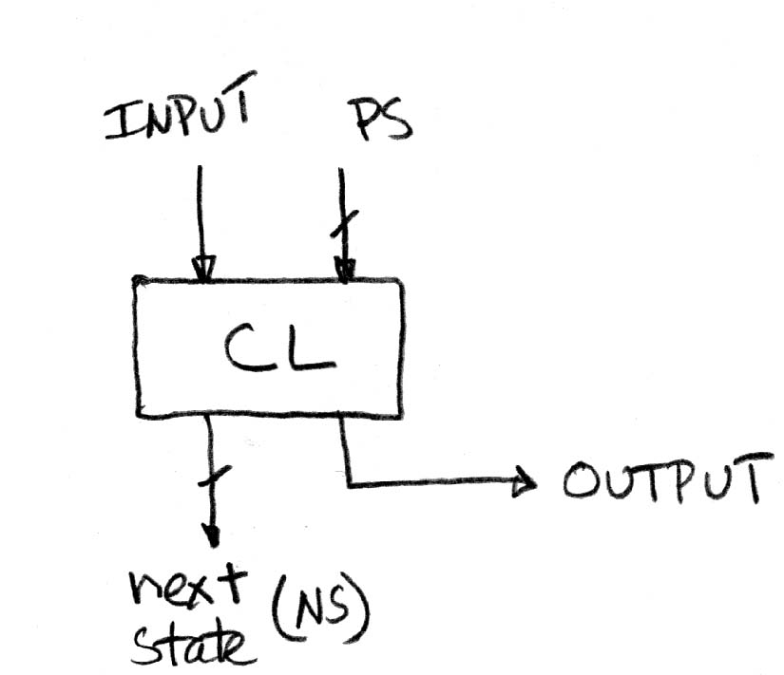
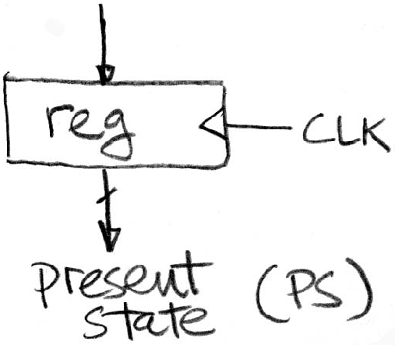
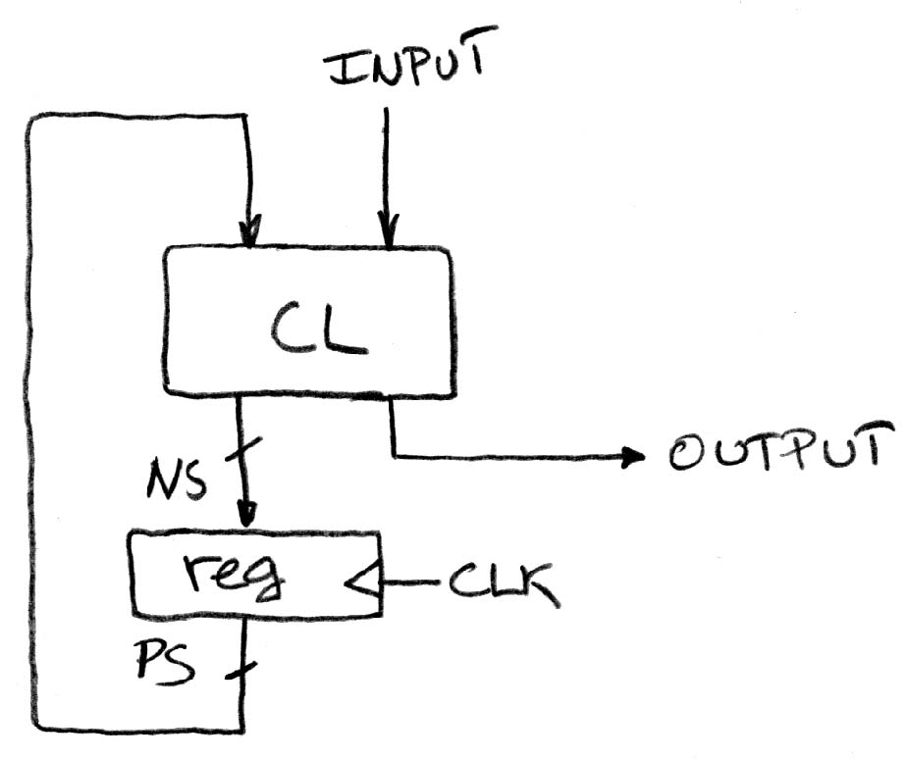
Hardware Implementation of FSM
Register needed to hold a representation of the machine’s state. Unique bit pattern for each state.
+
Combinational logic circuit is used to implement a function maps from present state (PS) and input to next state (NS) and output.
=
The register is used to break the feedback path between Next State (NS) and Prior State (PS), controlled by the clock

Slide 25
Hardware for FSM: Combinational Logic
Can look at its functional specification, truth table form
Truth table …
PS
Input
NS
Output
00
0
00
0
00
1
01
0
01
0
00
0
01
1
10
0
10
0
00
0
10
1
00
1

Slide 26
Hardware for FSM: Combinational Logic
Truth table …
PS
Input
NS
Output
00
0
00
0
00
1
01
0
01
0
00
0
01
1
10
0
10
0
00
0
10
1
00
1

Slide 27
Hardware for FSM: Combinational Logic
Alternative Truth Table format: list only cases where value is a 1.Then restate as logic equations using PS1, PS0, Input
Truth table …
PS
Input
NS
Output
00
0
00
0
00
1
01
0
01
0
00
0
01
1
10
0
10
0
00
0
10
1
00
1

Slide 28
Hardware for FSM: Combinational Logic
Alternative Truth Table format: list only cases where value is a 1.Then restate as logic equations using PS1, PS0, Input
NS bit 0 is 1
PS
Input
Truth table …
00
1
PS
Input
NS
Output
NS bit 1 is 1
00
0
00
0
PS
Input
00
1
01
0
01
1
01
0
00
0
01
1
10
0
Output is 1
10
0
00
0
PS
Input
10
1
00
1
10
1

Slide 29
Hardware for FSM: Combinational Logic
Alternative Truth Table format: list only cases where value is a 1.Then restate as logic equations using PS1, PS0, Input
NS0 = PS1•PS0•Input
NS0 = ~PS1•~PS0•Input
NS1 = PS1•PS0•Input
NS1 = ~PS1•PS0•Input
Output= PS1•PS0•Input
Output= PS1•~PS0•Input
NS bit 0 is 1
PS
Input
Truth table …
00
1
PS
Input
NS
Output
NS bit 1 is 1
00
0
00
0
PS
Input
00
1
01
0
01
1
01
0
00
0
01
1
10
0
Output is 1
10
0
00
0
PS
Input
10
1
00
1
10
1

Slide 30
And, in Conclusion, …
Hardware systems made from Stateless Combinational Logic and Stateful “Memory” Logic (Registers)
Clocks tell us when D-flip-flops change
Setup and Hold times important
We pipeline long-delay CL for faster clock cycle
Split up the critical path
Finite State Machines extremely useful
Can implement FSM with register + logic

