Slide 1
CS 61C: Great Ideas in Computer Architecture Virtual Memory
Instructors:
Krste Asanovic, Randy H. Katz
http://inst.eecs.Berkeley.edu/~cs61c/fa12

Slide 2
Review
Implementing precise interrupts in in-order pipelines:
Save exceptions in pipeline until commit point
Check for traps and interrupts before commit
No architectural state overwritten before commit
Support multiprogramming with translation and protection
Base and bound, simple scheme, suffers from memory fragmentation
Paged systems remove external fragmentation but add indirection through page table

Slide 3
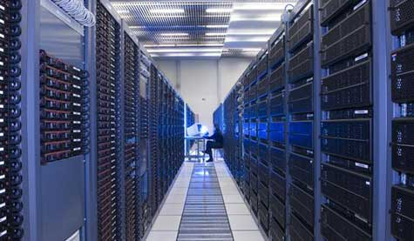
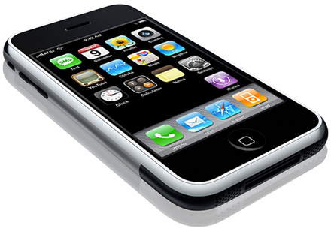
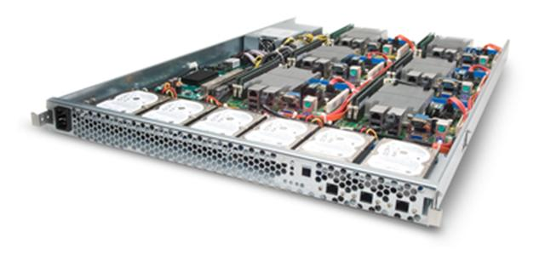
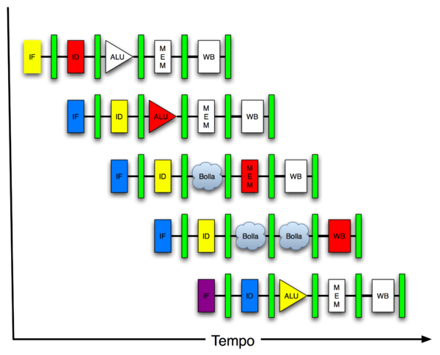
You Are Here!
Software Hardware
Parallel Requests
Assigned to computer
e.g., Search “Katz”
Parallel Threads
Assigned to core
e.g., Lookup, Ads
Parallel Instructions
>1 instruction @ one time
e.g., 5 pipelined instructions
Parallel Data
>1 data item @ one time
e.g., Add of 4 pairs of words
Hardware descriptions
All gates @ one time
Programming Languages
Warehouse Scale Computer
Smart Phone
Harness Parallelism &
Achieve High Performance
Today’s
Lecture
Computer
Core
…
Core
Memory (Cache)
Input/Output
Core
Instruction Unit(s)
Functional
Unit(s)
A₀+B₀
A₁+B₁
A₂+B₂
A₃+B₃
Main Memory
Logic Gates

Slide 4
Private Address Space per User
User 1
OS
pages
VA1
Page Table
User 2
VA1
Page Table
Physical Memory
User 3
VA1
Page Table
free
Each user has a page table
Page table contains an entry for each user page
Notes:
OS ensures that the page tables are disjoint.

Slide 5
A Problem in the Early Sixties
There were many applications whose data could not fit in the main memory, e.g., payroll
Paged memory system reduced fragmentation but still required the whole program to be resident in the main memory

Slide 6
Manual Overlays
Assume an instruction can address all the storage on the drum
Method 1: programmer keeps track of addresses in the main memory and initiates an I/O transfer when required
Difficult, error-prone!
Method 2: automatic initiation of I/O transfers by software address translation
Brooker’s interpretive coding, 1960
Inefficient!
40k bits
main
640k bits
drum
Central Store
Ferranti Mercury
1956
Not just an ancient black art, e.g., IBM Cell microprocessor used in Playstation-3 has explicitly managed local store!
Notes:
British Firm Ferranti, did Mercury and then Atlas
Method 1 too difficult for users
Method 2 too slow.

Slide 7
Demand Paging in Atlas (1962)
“A page from secondary
storage is brought into the primary storage whenever it is (implicitly) demanded by the processor.”
Tom Kilburn
Primary
32 Pages
512 words/page
Primary memory as a cache
for secondary memory
Secondary
(Drum)
32x6 pages
Central
Memory
User sees 32 x 6 x 512 words
of storage
Notes:
Single-level Store

Slide 8
Hardware Organization of Atlas
Effective
Address
16 ROM pages
0.4 ~1 μsec
system code
(not swapped)
system data
(not swapped)
Initial
Address
Decode
2 subsidiary pages
1.4 μsec
PARs
48-bit words
512-word pages
1 Page Address Register (PAR) per page frame
0
Main
32 pages
1.4 μsec
Drum (4)
192 pages
8 Tape decks
88 sec/word
31
<effective PN , status>
Compare the effective page address against all 32 PARs
match ⇒ normal access
no match ⇒ page fault
save the state of the partially executed
instruction

Slide 9
Atlas Demand Paging Scheme
On a page fault:
Input transfer into a free page is initiated
The Page Address Register (PAR) is updated
If no free page is left, a page is selected to be replaced (based on usage)
The replaced page is written on the drum
to minimize drum latency effect, the first empty page on the drum was selected
The page table is updated to point to the new location of the page on the drum

Slide 10
Recap: Typical Memory Hierarchy
Take advantage of the principle of locality to present the user with as much memory as is available in the cheapest technology at the speed offered by the fastest technology
On-Chip Components
Control
Instr
Cache
Second
Level
Cache
(SRAM)
Secondary
Memory
(Disk)
Main
Memory
(DRAM)
Datapath
Data
Cache
RegFile
Speed (cycles): ½’s 1’s 10’s 100’s 10,000’s
Size (bytes): 100’s 10K’s M’s G’s T’s
Cost: highest lowest
Notes:
Instead, the memory system of a modern computer consists of a series of black boxes ranging from the fastest to the slowest.
Besides variation in speed, these boxes also varies in size (smallest to biggest) and cost.
What makes this kind of arrangement work is one of the most important principle in computer design. The principle of locality. The principle of locality states that programs access a relatively small portion of the address space at any instant of time.
The design goal is to present the user with as much memory as is available in the cheapest technology (points to the disk).
While by taking advantage of the principle of locality, we like to provide the user an average access speed that is very close to the speed that is offered by the fastest technology.
(We will go over this slide in detail in the next lectures on caches).

Slide 11
Modern Virtual Memory Systems Illusion of a large, private, uniform store
Protection & Privacy
several users, each with their private address space and one or more shared address spaces
page table ≡ name space
Demand Paging
Provides the ability to run programs larger than the primary memory
Hides differences in machine configurations
The price is address translation on
each memory reference
OS
user_{i}
Swapping
Store
Primary
Memory
VA
mapping
PA
TLB
Notes:
Portability on machines with different memory configurations.

Slide 12
Administrivia
Regrade request deadline Monday Nov 26
For everything up to Project 4

Slide 13
CS61C in the News “World's oldest digital computer successfully reboots”
Iain Thomson
The Register, 11/20/2012
“After three years of restoration by the National Museum of Computing (TNMOC) and staff at Bletchley Park, the world's oldest functioning digital computer has been successfully rebooted at a ceremony attended by two of its original developers. The 2.5 ton Harwell Dekatron, later renamed the Wolverhampton Instrument for Teaching Computation from Harwell (WITCH), was first constructed in 1949 and from 1951 ran at the USK's Harwell Atomic Energy Research Establishment, where it was used to process mathematical calculations for Britain's nuclear program.
The system uses 828 flashing Dekatron valves, each capable of holding a single digit, for volatile memory, plus 480 GPO 3000 type relays to shift calculations and six paper tape readers. It was very slow, taking a couple of seconds for each addition or subtraction, five seconds for multiplication and up to 15 for division.”

Slide 14
Hierarchical Page Table
Virtual Address
31
22
21
12
11
0
p1 p2 offset
10-bit
L1 index
10-bit
L2 index
offset
Root of the Current
Page Table
p2
p1
Physical Memory
(Processor
Register)
Level 1
Page Table
Level 2
Page Tables
page in primary memory
page in secondary memory
PTE of a nonexistent page
Data Pages

Slide 15
Two-Level Page Tables in Physical Memory
Physical Memory
Virtual Address Spaces
Level 1 PT User 1
VA1
Level 1 PT User 2
User 1
User2/VA1
VA1
User1/VA1
User 2
Level 2 PT User 2

Slide 16
Address Translation & Protection
Virtual Address
Virtual Page No. (VPN)
offset
Kernel/User Mode
Read/Write
Protection
Check
Address
Translation
Exception?
Physical Address
Physical Page No. (PPN)
offset
Every instruction and data access needs address
translation and protection checks
A good VM design needs to be fast (~ one cycle) and space efficient

Slide 17
Translation Lookaside Buffers (TLB)(really an Address Translation Cache!)
Address translation is very expensive!
In a two-level page table, each reference becomes several memory accesses
Solution: Cache translations in TLB
TLB hit ⇒ Single-Cycle Translation
TLB miss ⇒ Page-Table Walk to refill
virtual address
VPN offset
V R W D tag PPN
(VPN = virtual page number)
(PPN = physical page number)
hit?
physical address
PPN offset
Notes:
3 memory references
2 page faults (disk accesses) + ..
Actually used in IBM before paged memory.

Slide 18
TLB Designs
Typically 32-128 entries, usually fully associative
Each entry maps a large page, hence less spatial locality across pages ➔ more likely that two entries conflict
Sometimes larger TLBs (256-512 entries) are 4-8 way set-associative
Larger systems sometimes have multi-level (L1 and L2) TLBs
Random or FIFO replacement policy
No process information in TLB?
TLB Reach: Size of largest virtual address space that can be simultaneously mapped by TLB
Example: 64 TLB entries, 4KB pages, one page per entry
TLB Reach = _____________________________________________?

Slide 19
TLB Designs
Typically 32-128 entries, usually fully associative
Each entry maps a large page, hence less spatial locality across pages ➔ more likely that two entries conflict
Sometimes larger TLBs (256-512 entries) are 4-8 way set-associative
Larger systems sometimes have multi-level (L1 and L2) TLBs
Random or FIFO replacement policy
No process information in TLB?
TLB Reach: Size of largest virtual address space that can be simultaneously mapped by TLB
Example: 64 TLB entries, 4KB pages, one page per entry
TLB Reach = _____________________________________________?
64 entries * 4 KB = 256 KB (if contiguous)

Slide 20
Handling a TLB Miss
Software (MIPS, Alpha)
TLB miss causes an exception and the operating system walks the page tables and reloads TLB. A privileged “untranslated” addressing mode used for walk
Hardware (SPARC v8, x86, PowerPC, RISC-V)
A memory management unit (MMU) walks the page tables and reloads the TLB
If a missing (data or PT) page is encountered during the TLB reloading, MMU gives up and signals a Page-Fault exception for the original instruction

Slide 21
Flashcard Quiz: Which statement is false?
TLB miss is much faster than page fault
TLB exploits spatial locality
TLB hardware grows with larger page size
TLB exploits temporal locality

Slide 22
Hierarchical Page Table Walk: SPARC v8
Virtual Address
Index 1 Index 2 Index 3 Offset
31 23 17 11 0
Context
Table
Register
Context Table
L1 Table
root ptr
Context
Register
L2 Table
PTP
L3 Table
PTP
PTE
31 11 0
Physical Address
PPN Offset
MMU does this table walk in hardware on a TLB miss

Slide 23
Page-Based Virtual-Memory Machine (Hardware Page-Table Walk)
Page Fault?
Protection violation?
Page Fault?
Protection violation?
Virtual Address
Virtual Address
Physical Address
Physical Address
PC
Inst. TLB
D
Decode
E
M
Data TLB
W
Inst. Cache
Data Cache
+
Miss?
Miss?
Page-Table Base Register
Hardware Page Table Walker
Physical Address
Memory Controller
Physical Address
Physical Address
Main Memory (DRAM)
Assumes page tables held in untranslated physical memory

Slide 24
Address Translation: putting it all together
Virtual Address
hardware
hardware or software
software
TLB
Lookup
miss
hit
Page Table
Walk
Protection
Check
the page is
∉ memory ∈ memory
denied
permitted
Page Fault
(OS loads page)
Update TLB
Protection
Fault
Physical
Address
(to cache)
Where?
SEGFAULT
Notes:
Need to restart instruction.
Soft and hard page faults.

Slide 25
Handling VM-related traps
PC
Inst TLB
Inst. Cache
D
Decode
E
M
Data TLB
Data Cache
W
+
TLB miss? Page Fault?
Protection violation?
TLB miss? Page Fault?
Protection violation?
Handling a TLB miss needs a hardware or software mechanism to refill TLB
Handling a page fault (e.g., page is on disk) needs a restartable trap so software handler can resume after retrieving page
Precise exceptions are easy to restart
Can be imprecise but restartable, but this complicates OS software
Handling protection violation may abort process

Slide 26
Address Translation in CPU Pipeline
PC
Inst TLB
Inst. Cache
D
Decode
E
M
Data TLB
Data Cache
W
+
TLB miss? Page Fault?
Protection violation?
TLB miss? Page Fault?
Protection violation?
Need to cope with additional latency of TLB:
slow down the clock?
pipeline the TLB and cache access?
virtual address caches (see CS152)
parallel TLB/cache access

Slide 27
Concurrent Access to TLB & Cache (Virtual Index/Physical Tag)
Virtual
Index
VA
VPN L b
TLB
Direct-map Cache
2^{L} blocks
2^{b}-byte block
k
PA
PPN Page Offset
Tag
=
Physical Tag
Data
hit?
Index L is available without consulting the TLB
⇒ cache and TLB accesses can begin simultaneously!
Tag comparison is made after both accesses are completed
Cases: L + b = k, L + b < k, L + b > k

Slide 28
Virtual-Index Physical-Tag Caches: Associative Organization
Virtual
Index
VA
VPN a L = k-b b
2ª
TLB
Direct-map
2^{L} blocks
Direct-map
2^{L} blocks
k
Phy.
Tag
PA
PPN Page Offset
=
=
Tag
hit?
2ª
Data
After the PPN is known, 2ª physical tags are compared
How does this scheme scale to larger caches?
Notes:
Consider 4-Kbyte pages and caches with 32-byte blocks
32-Kbyte cache ⇒ 2ª = 8
4-Mbyte cache ⇒ 2ª =1024 No !

Slide 29
VM features track historical uses:
Bare machine, only physical addresses
One program owned entire machine
Batch-style multiprogramming
Several programs sharing CPU while waiting for I/O
Base & bound: translation and protection between programs (not virtual memory)
Problem with external fragmentation (holes in memory), needed occasional memory defragmentation as new jobs arrived
Time sharing
More interactive programs, waiting for user. Also, more jobs/second.
Motivated move to fixed-size page translation and protection, no external fragmentation (but now internal fragmentation, wasted bytes in page)
Motivated adoption of virtual memory to allow more jobs to share limited physical memory resources while holding working set in memory
Virtual Machine Monitors
Run multiple operating systems on one machine
Idea from 1970s IBM mainframes, now common on laptops
e.g., run Windows on top of Mac OS X
Hardware support for two levels of translation/protection
Guest OS virtual -> Guest OS physical -> Host machine physical
Also basis of Cloud Computing
Virtual machine instances for Project 1

Slide 30
Acknowledgements
These slides contain material developed and copyright by:
Arvind (MIT)
Krste Asanovic (MIT/UCB)
Joel Emer (Intel/MIT)
James Hoe (CMU)
John Kubiatowicz (UCB)
David Patterson (UCB)
MIT material derived from course 6.823
UCB material derived from course CS252

