Slide 1
Matrix Multiplication Results Projects 3 and 5 (EC)
Loc Do and Anirudh Garg
CS61c Fall 2012

Slide 2
Project 3-1: Average

Slide 3
Project 3-1: 60x60

Slide 4
Proj3-1: Performance vs Lines of Codes

Slide 5
Project 3-2: Benchmark

Slide 6
Project 3-2: Performance vs Lines of Codes

Slide 7
Project 5: Benchmark

Slide 8
Project 5: Performance vs. Lines of Codes

Slide 9
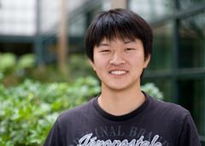
Third Place
Richie Zeng and Paroma Varma
90.505 Gflop/s
153 lines of codes

Slide 10
Third Place

Slide 11
Second Place
Vaisahaal Shankar and Nikita Kitaev:
90.594 Gflop/s
277 lines of codes

Slide 12
Second Place

Slide 13
First Place
Daniel Chin and Parker Schuh
95.143 Gflop/s
453 lines of codes

Slide 14
First Place

