Slide 1
CS 61C: Great Ideas in Computer Architecture SIMD
Instructor:
Randy H. Katz
http://inst.eecs.Berkeley.edu/~cs61c/fa13

Slide 2
Agenda
Review
SIMD
Administrivia
Midterm “Review”
And in Conclusion, …

Slide 3
Agenda
Review
SIMD
Administrivia
Midterm “Review”
And in Conclusion, …

Slide 4
Review
Three C’s of cache misses
Compulsory
Capacity
Conflict
Amdahl’s Law: Speedup = 1/((1-F)+F/S)
Flynn’s Taxonomy: SISD/SIMD/MISD/MIMD

Slide 5
Agenda
Review
SIMD
Administrivia
Midterm “Review”

Slide 6
SIMD Architectures
Data parallelism: executing one operation on multiple data streams
Example to provide context:
Multiplying a coefficient vector by a data vector (e.g., in filtering)
y[i] := c[i] × x[i], 0 ≤ i < n
Sources of performance improvement:
One instruction is fetched & decoded for entire operation
Multiplications are known to be independent
Pipelining/concurrency in memory access as well

Slide 7
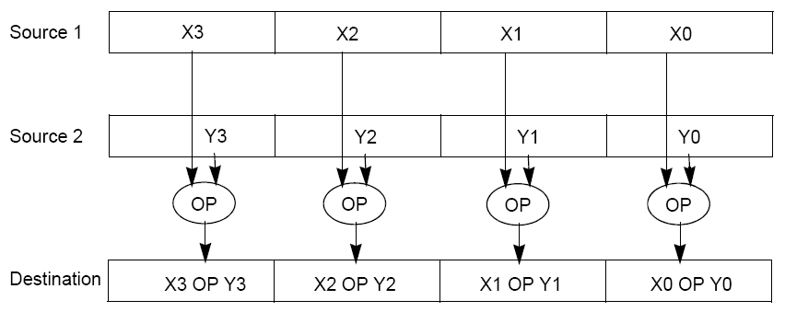
“Advanced Digital Media Boost”
To improve performance, Intel’s SIMD instructions
Fetch one instruction, do the work of multiple instructions
MMX (MultiMedia eXtension, Pentium II processor family)
SSE (Streaming SIMD Extension, Pentium III and beyond)

Slide 8
Example: SIMD Array Processing
for each f in array
f = sqrt(f)
for each f in array
{
load f to the floating-point register
calculate the square root
write the result from the register to memory
}
for each 4 members in array
{
load 4 members to the SSE register
calculate 4 square roots in one operation
store the 4 results from the register to memory
}
SIMD style

Slide 9
Data-Level Parallelism and SIMD
SIMD wants adjacent values in memory that can be operated in parallel
Usually specified in programs as loops
for(i=1000; i>0; i=i-1)
x[i] = x[i] + s;
How can reveal more data-level parallelism than available in a single iteration of a loop?
Unroll loop and adjust iteration rate

Slide 10
Looping in MIPS
Assumptions:
$t1 is initially the address of the element in the array with the highest address
$f0 contains the scalar value s
8($t2) is the address of the last element to operate on
CODE:
Loop: 1. l.d $f2,0($t1) ; $f2=array element
2. add.d $f10,$f2,$f0 ; add s to $f2
3. s.d $f10,0($t1) ; store result
4. addui $t1,$t1,#-8 ; decrement pointer 8 byte
5. bne $t1,$t2,Loop ;repeat loop if $t1 != $t2

Slide 11
Loop Unrolled
Loop: l.d $f2,0($t1)
add.d $f10,$f2,$f0
s.d $f10,0($t1)
l.d $f4,-8($t1)
add.d $f12,$f4,$f0
s.d $f12,-8($t1)
l.d $f6,-16($t1)
add.d $f14,$f6,$f0
s.d $f14,-16($t1)
l.d $f8,-24($t1)
add.d $f16,$f8,$f0
s.d $f16,-24($t1)
addui $t1,$t1,#-32
bne $t1,$t2,Loop
NOTE:
Only 1 Loop Overhead every 4 iterations
This unrolling works if
loop_limit(mod 4) = 0
3. (Different Registers eliminate stalls in pipeline; we’ll see later in course)

Slide 12
Loop Unrolled Scheduled
Loop:l.d $f2,0($t1)
l.d $f4,-8($t1)
l.d $f6,-16($t1)
l.d $f8,-24($t1)
add.d $f10,$f2,$f0
add.d $f12,$f4,$f0
add.d $f14,$f6,$f0
add.d $f16,$f8,$f0
s.d $f10,0($t1)
s.d $f12,-8($t1)
s.d $f14,-16($t1)
s.d $f16,-24($t1)
addui $t1,$t1,#-32
bne $t1,$t2,Loop
4 Loads side-by-side: Could replace with 4-wide SIMD Load
4 Adds side-by-side: Could replace with 4-wide SIMD Add
4 Stores side-by-side: Could replace with 4-wide SIMD Store

Slide 13
Loop Unrolling in C
Instead of compiler doing loop unrolling, could do it yourself in C
for(i=1000; i>0; i=i-1)
x[i] = x[i] + s;
Could be rewritten
for(i=1000; i>0; i=i-4) {
x[i] = x[i] + s;
x[i-1] = x[i-1] + s;
x[i-2] = x[i-2] + s;
x[i-3] = x[i-3] + s;
}
What is downside of doing it in C?

Slide 14
Generalizing Loop Unrolling
A loop of n iterations
k copies of the body of the loop
Assuming (n mod k) ≠ 0
Then we will run the loop with 1 copy of the body (n mod k) times and with k copies of the body floor(n/k) times
(Will revisit loop unrolling again when get to pipelining later in semester)

Slide 15
Intel SIMD Extensions
MMX 64-bit registers, reusing floating-point registers [1992]
SSE2/3/4, new 128-bit registers [1999]
AVX, new 256-bit registers [2011]
Space for expansion to 1024-bit registers

Slide 16
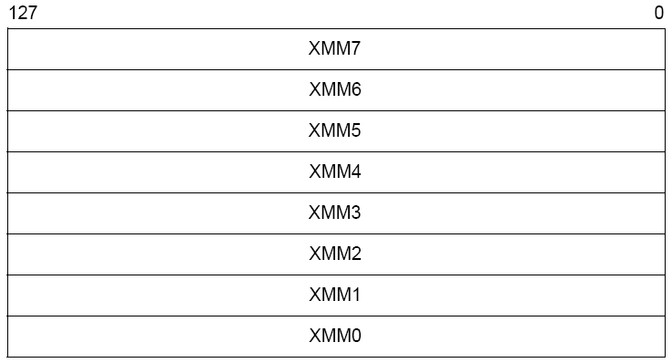
XMM Registers
Architecture extended with eight 128-bit data registers: XMM registers
x86 64-bit address architecture adds 8 additional registers (XMM8 – XMM15)

Slide 17
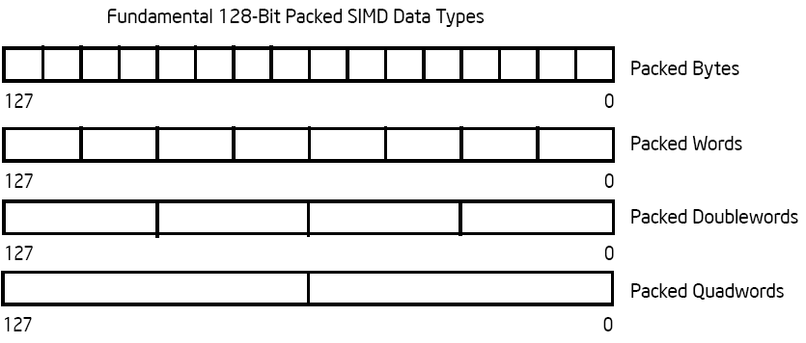
Intel Architecture SSE2+ 128-Bit SIMD Data Types
Note: in Intel Architecture (unlike MIPS) a word is 16 bits
Single-precision FP: Double word (32 bits)
Double-precision FP: Quad word (64 bits)
122 121
96 95
80 79
64 63
48 47
32 31
16 15
16 / 128 bits
122 121
96 95
80 79
64 63
48 47
32 31
16 15
8 / 128 bits
96 95
64 63
32 31
4 / 128 bits
64 63
2 / 128 bits

Slide 18
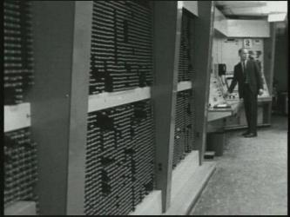
First SIMD Extensions: MIT Lincoln Labs TX-2, 1957

Slide 19
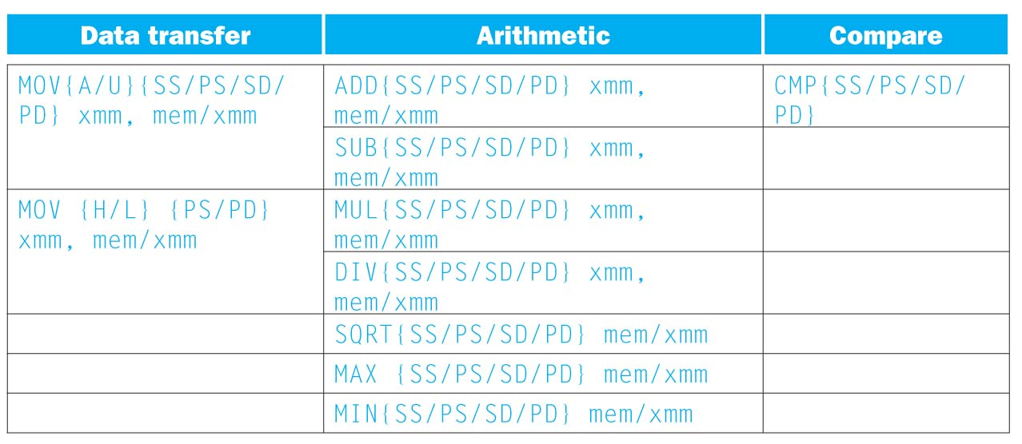
SSE/SSE2 Floating Point Instructions
Move does both load and store
xmm: one operand is a 128-bit SSE2 register
mem/xmm: other operand is in memory or an SSE2 register
{SS} Scalar Single precision FP: one 32-bit operand in a 128-bit register
{PS} Packed Single precision FP: four 32-bit operands in a 128-bit register
{SD} Scalar Double precision FP: one 64-bit operand in a 128-bit register
{PD} Packed Double precision FP, or two 64-bit operands in a 128-bit register
{A} 128-bit operand is aligned in memory
{U} means the 128-bit operand is unaligned in memory
{H} means move the high half of the 128-bit operand
{L} means move the low half of the 128-bit operand

Slide 20
Example: Add Two Single-Precision Floating-Point Vectors
Computation to be performed:
vec_res.x = v1.x + v2.x;
vec_res.y = v1.y + v2.y;
vec_res.z = v1.z + v2.z;
vec_res.w = v1.w + v2.w;
SSE Instruction Sequence:
(Note: Destination on the right in x86 assembly)
movaps address-of-v1, %xmm0
// v1.w | v1.z | v1.y | v1.x -> xmm0
addps address-of-v2, %xmm0
// v1.w+v2.w | v1.z+v2.z | v1.y+v2.y | v1.x+v2.x -> xmm0
movaps %xmm0, address-of-vec_res
mov a ps : move from mem to XMM register, memory aligned, packed single precision
add ps : add from mem to XMM register, packed single precision
mov a ps : move from XMM register to mem, memory aligned, packed single precision

Slide 21
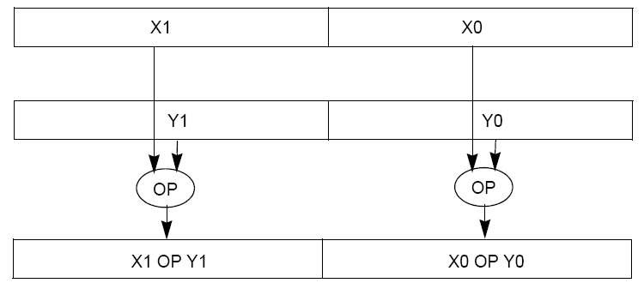
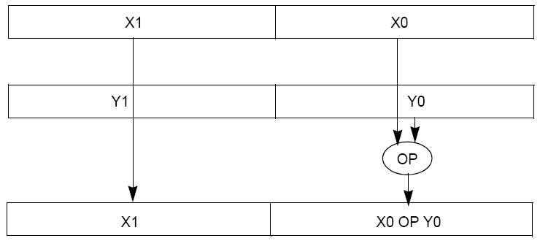
Packed and Scalar Double-Precision Floating-Point Operations
Packed
Scalar

Slide 22
Intel SSE Intrinsics
Intrinsics are C functions and procedures for inserting assembly language into C code, including SSE instructions
With intrinsics, can program using these instructions indirectly
One-to-one correspondence between SSE instructions and intrinsics

Slide 23
Example SSE Intrinsics
Instrinsics:
Corresponding SSE instructions:
Vector data type:
_m128d
Load and store operations:
_mm_load_pd MOVAPD/aligned, packed double
_mm_store_pd MOVAPD/aligned, packed double
_mm_loadu_pd MOVUPD/unaligned, packed double
_mm_storeu_pd MOVUPD/unaligned, packed double
Load and broadcast across vector
_mm_load1_pd MOVSD + shuffling/duplicating
Arithmetic:
_mm_add_pd ADDPD/add, packed double
_mm_mul_pd MULPD/multiple, packed double
Notes:
CS267 Lecture 2
23

Slide 24
Example: 2 x 2 Matrix Multiply
Definition of Matrix Multiply:
2
C_{i,j} = (A×B)_{i,j} = ∑ A_{i,k}× B_{k,j}
k = 1
A_{1,1}
A_{1,2}
B_{1,1}
B_{1,2}
C_{1,1}=A_{1,1}B_{1,1} + A_{1,2}B_{2,1}
C_{1,2}=A_{1,1}B_{1,2}+A_{1,2}B_{2,2}
x
=
A_{2,1}
A_{2,2}
B_{2,1}
B_{2,2}
C_{2,1}=A_{2,1}B_{1,1} + A_{2,2}B_{2,1}
C_{2,2}=A_{2,1}B_{1,2}+A_{2,2}B_{2,2}

Slide 25
Example: 2 x 2 Matrix Multiply
Using the XMM registers
Two 64-bit doubles per XMM reg
C₁
C_{1,1}
C_{2,1}
Stored in memory in Column-major order
C₂
C_{1,2}
C_{2,2}
A
A_{1,i}
A_{2,i}
B₁
B_{i,1}
B_{i,1}
B₂
B_{i,2}
B_{i,2}

Slide 26
Example: 2 x 2 Matrix Multiply
Initialization
I = 1
C₁
0
0
C₂
0
0
A
A_{1,1}
A_{2,1}
_mm_load_pd: Stored in memory in Column order
B₁
B_{1,1}
B_{1,1}
_mm_load1_pd: SSE instruction that loads a double word and stores it in the high and low double words of the XMM register
B₂
B_{1,2}
B_{1,2}

Slide 27
Example: 2 x 2 Matrix Multiply
Initialization
I = 1
C₁
0
0
C₂
0
0
A
A_{1,1}
A_{2,1}
_mm_load_pd: Load 2 doubles into XMM reg, Stored in memory in Column-major order
B₁
B_{1,1}
B_{1,1}
_mm_load1_pd: SSE instruction that loads a double word and stores it in the high and low double words of the XMM register (duplicates value in both halves of XMM)
B₂
B_{1,2}
B_{1,2}

Slide 28
Example: 2 x 2 Matrix Multiply
First iteration intermediate result
I = 1
C₁
0+A_{1,1}B_{1,1}
0+A_{2,1}B_{1,1}
c1 = _mm_add_pd(c1,_mm_mul_pd(a,b1));
c2 = _mm_add_pd(c2,_mm_mul_pd(a,b2));
SSE instructions first do parallel multiplies and then parallel adds in XMM registers
C₂
0+A_{1,1}B_{1,2}
0+A_{2,1}B_{1,2}
A
A_{1,1}
A_{2,1}
_mm_load_pd: Stored in memory in Column order
B₁
B_{1,1}
B_{1,1}
_mm_load1_pd: SSE instruction that loads a double word and stores it in the high and low double words of the XMM register (duplicates value in both halves of XMM)
B₂
B_{1,2}
B_{1,2}

Slide 29
Example: 2 x 2 Matrix Multiply
First iteration intermediate result
I = 2
C₁
0+A_{1,1}B_{1,1}
0+A_{2,1}B_{1,1}
c1 = _mm_add_pd(c1,_mm_mul_pd(a,b1));
c2 = _mm_add_pd(c2,_mm_mul_pd(a,b2));
SSE instructions first do parallel multiplies and then parallel adds in XMM registers
C₂
0+A_{1,1}B_{1,2}
0+A_{2,1}B_{1,2}
A
A_{1,2}
A_{2,2}
_mm_load_pd: Stored in memory in Column order
B₁
B_{2,1}
B_{2,1}
_mm_load1_pd: SSE instruction that loads a double word and stores it in the high and low double words of the XMM register (duplicates value in both halves of XMM)
B₂
B_{2,2}
B_{2,2}

Slide 30
Example: 2 x 2 Matrix Multiply
Second iteration intermediate result
I = 2
C_{1,1}
C_{2,1}
C₁
A_{1,1}B_{1,1}+A_{1,2}B_{2,1}
A_{2,1}B_{1,1}+A_{2,2}B_{2,1}
c1 = _mm_add_pd(c1,_mm_mul_pd(a,b1));
c2 = _mm_add_pd(c2,_mm_mul_pd(a,b2));
SSE instructions first do parallel multiplies and then parallel adds in XMM registers
C₂
A_{1,1}B_{1,2}+A_{1,2}B_{2,2}
A_{2,1}B_{1,2}+A_{2,2}B_{2,2}
C_{1,2}
C_{2,2}
A
A_{1,2}
A_{2,2}
_mm_load_pd: Stored in memory in Column order
B₁
B_{2,1}
B_{2,1}
_mm_load1_pd: SSE instruction that loads a double word and stores it in the high and low double words of the XMM register (duplicates value in both halves of XMM)
B₂
B_{2,2}
B_{2,2}

Slide 31
Live Example: 2 x 2 Matrix Multiply
Definition of Matrix Multiply:
2
C_{i,j} = (A×B)_{i,j} = ∑ A_{i,k}× B_{k,j}
k = 1
A_{1,1}
A_{1,2}
B_{1,1}
B_{1,2}
C_{1,1}=A_{1,1}B_{1,1} + A_{1,2}B_{2,1}
C_{1,2}=A_{1,1}B_{1,2}+A_{1,2}B_{2,2}
x
=
A_{2,1}
A_{2,2}
B_{2,1}
B_{2,2}
C_{2,1}=A_{2,1}B_{1,1} + A_{2,2}B_{2,1}
C_{2,2}=A_{2,1}B_{1,2}+A_{2,2}B_{2,2}
1
0
1
3
C_{1,1}= 1*1 + 0*2 = 1
C_{1,2}= 1*3 + 0*4 = 3
x
=
0
1
2
4
C_{2,1}= 0*1 + 1*2 = 2
C_{2,2}= 0*3 + 1*4 = 4

Slide 32
Example: 2 x 2 Matrix Multiply (Part 1 of 2)
#include <stdio.h>
// header file for SSE compiler intrinsics
#include <emmintrin.h>
// NOTE: vector registers will be represented in comments as v1 = [ a | b]
// where v1 is a variable of type __m128d and a, b are doubles
int main(void) {
// allocate A,B,C aligned on 16-byte boundaries
double A[4] __attribute__ ((aligned (16)));
double B[4] __attribute__ ((aligned (16)));
double C[4] __attribute__ ((aligned (16)));
int lda = 2;
int i = 0;
// declare several 128-bit vector variables
__m128d c1,c2,a,b1,b2;
// Initialize A, B, C for example
/* A = (note column order!)
1 0
0 1
*/
A[0] = 1.0; A[1] = 0.0; A[2] = 0.0; A[3] = 1.0;
/* B = (note column order!)
1 3
2 4
*/
B[0] = 1.0; B[1] = 2.0; B[2] = 3.0; B[3] = 4.0;
/* C = (note column order!)
0 0
0 0
*/
C[0] = 0.0; C[1] = 0.0; C[2] = 0.0; C[3] = 0.0;

Slide 33
Example: 2 x 2 Matrix Multiply (Part 2 of 2)
// used aligned loads to set
// c1 = [c_11 | c_21]
c1 = _mm_load_pd(C+0*lda);
// c2 = [c_12 | c_22]
c2 = _mm_load_pd(C+1*lda);
for (i = 0; i < 2; i++) {
/* a =
i = 0: [a_11 | a_21]
i = 1: [a_12 | a_22]
*/
a = _mm_load_pd(A+i*lda);
/* b1 =
i = 0: [b_11 | b_11]
i = 1: [b_21 | b_21]
*/
b1 = _mm_load1_pd(B+i+0*lda);
/* b2 =
i = 0: [b_12 | b_12]
i = 1: [b_22 | b_22]
*/
b2 = _mm_load1_pd(B+i+1*lda);
/* c1 =
i = 0: [c_11 + a_11*b_11 | c_21 + a_21*b_11]
i = 1: [c_11 + a_21*b_21 | c_21 + a_22*b_21]
*/
c1 = _mm_add_pd(c1,_mm_mul_pd(a,b1));
/* c2 =
i = 0: [c_12 + a_11*b_12 | c_22 + a_21*b_12]
i = 1: [c_12 + a_21*b_22 | c_22 + a_22*b_22]
*/
c2 = _mm_add_pd(c2,_mm_mul_pd(a,b2));
}
// store c1,c2 back into C for completion
_mm_store_pd(C+0*lda,c1);
_mm_store_pd(C+1*lda,c2);
// print C
printf("%g,%g\n%g,%g\n",C[0],C[2],C[1],C[3]);
return 0;
}

Slide 34
Inner loop from gcc –O -S
L2: movapd (%rax,%rsi), %xmm1 //Load aligned A[i,i+1]->m1
movddup (%rdx), %xmm0 //Load B[j], duplicate->m0
mulpd %xmm1, %xmm0 //Multiply m0*m1->m0
addpd %xmm0, %xmm3 //Add m0+m3->m3
movddup 16(%rdx), %xmm0 //Load B[j+1], duplicate->m0
mulpd %xmm0, %xmm1 //Multiply m0*m1->m1
addpd %xmm1, %xmm2 //Add m1+m2->m2
addq $16, %rax // rax+16 -> rax (i+=2)
addq $8, %rdx // rdx+8 -> rdx (j+=1)
cmpq $32, %rax // rax == 32?
jne L2 // jump to L2 if not equal
movapd %xmm3, (%rcx) //store aligned m3 into C[k,k+1]
movapd %xmm2, (%rdi) //store aligned m2 into C[l,l+1]

Slide 35
Performance-Driven ISA Extensions
Subword parallelism, used primarily for multimedia applications
Intel MMX: multimedia extension
64-bit registers can hold multiple integer operands
Intel SSE: Streaming SIMD extension
128-bit registers can hold several floating-point operands
Adding instructions that do more work per cycle
Shift-add: replace two instructions with one (e.g., multiply by 5)
Multiply-add: replace two instructions with one (x := c + a  b)
Multiply-accumulate: reduce round-off error (s := s + a  b)
Conditional copy: to avoid some branches (e.g., in if-then-else)

Slide 36
Agenda
Review
SIMD
Administrivia
Midterm “Review”
And in Conclusion, …

Slide 37
Administrivia
Midterm Thursday 17 October 6-9 PM
10 Evans (cs61c-1a – dz)
155 Dwinelle (cs61c-ea – of)
1 Pimentel (cs61c-og – zz)
Closed book/notes, open 2-sided crib sheet, no calculator, multiple choice, BRING PENCIL AND ERASER
Discussion sections generally, except if TA wishes to hold review or extra office hours—See piazza

Slide 38
Agenda
Review
SIMD
Administrivia
Midterm “Review”
And in Conclusion, …

Slide 39
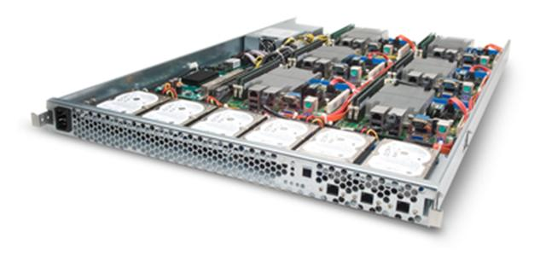
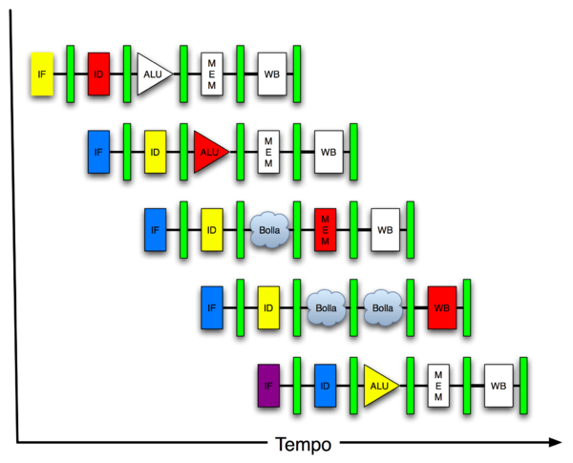
New-School Machine Structures (It’s a bit more complicated!)
Software Hardware
Parallel Requests
Assigned to computer
e.g., Search “Katz”
Parallel Threads
Assigned to core
e.g., Lookup, Ads
Parallel Instructions
>1 instruction @ one time
e.g., 5 pipelined instructions
Parallel Data
>1 data item @ one time
e.g., Add of 4 pairs of words
Hardware descriptions
All gates functioning in parallel at same time
Warehouse Scale Computer
Smart Phone
Harness Parallelism &
Achieve High Performance
Computer
Core
…
Core
Memory (Cache)
Input/Output
Core
Instruction Unit(s)
Functional
Unit(s)
A₀+B₀
A₁+B₁
A₂+B₂
A₃+B₃
Main Memory
Logic Gates

Slide 40
Great Ideas in Computer Architecture
Design for Moore’s Law
Abstraction to Simplify Design
Make the Common Case Fast
Dependability via Redundancy
Memory Hierarchy
Performance via Parallelism/Pipelining/Prediction

Slide 41
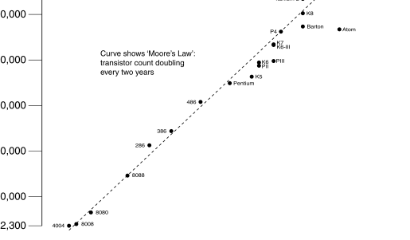
Moore’s Law
Predicts: 2X Transistors / chip every 2 years
# of transistors on an integrated circuit (IC)
Gordon Moore, Intel Cofounder B.S. Cal 1950 Cal Alumni of Year 1997
Year

Slide 42
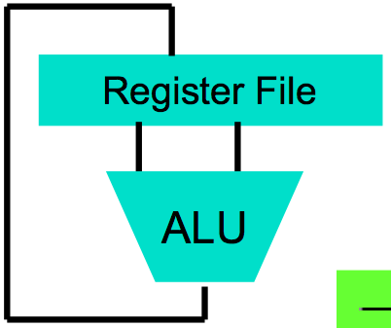
Abstraction via Layers of Representation
High Level Language Program (e.g., C)
temp = v[k];
v[k] = v[k+1];
v[k+1] = temp;
Compiler
Anything can be represented as a number, i.e., data or instructions
Assembly Language Program (e.g., MIPS)
lw $t0, 0($2)
lw $t1, 4($2)
sw $t1, 0($2)
sw $t0, 4($2)
Assembler
Machine Language Program (MIPS)
0000 1001 1100 0110 1010 1111 0101 1000
1010 1111 0101 1000 0000 1001 1100 0110
1100 0110 1010 1111 0101 1000 0000 1001
0101 1000 0000 1001 1100 0110 1010 1111
Machine Interpretation
Hardware Architecture Description (e.g., block diagrams)
Architecture Implementation
Logic Circuit Description (Circuit Schematic Diagrams)

Slide 43
Make the Common Case Fast
In making a design tradeoff, favor the common over the infrequent case
Don’t spend time optimizing code that is run infrequently
Choose your performance metric and use measurement to determine the common case
Capability
Capacity
Notes:
Capability computing vs. capacity computing

Slide 44
Dependability via Redundancy
Redundancy so that a failing piece doesn’t make the whole system fail
1+1=2
2 of 3 agree
1+1=2
1+1=2
1+1=1
FAIL!
Increasing transistor density reduces the cost of redundancy

Slide 45
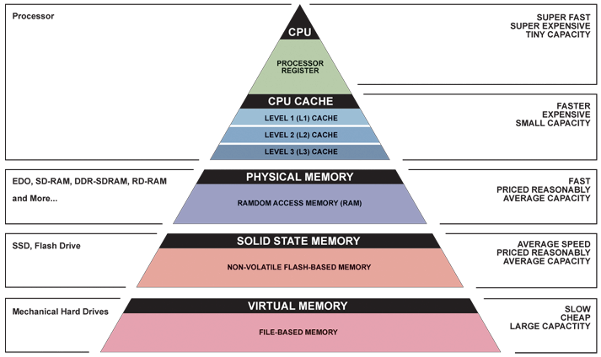
Memory Hierarchy
Fast, Expensive,
but Small
Cheap, Large, but Small

Slide 46
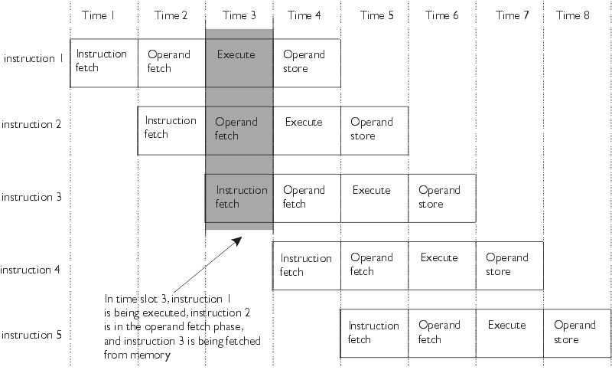
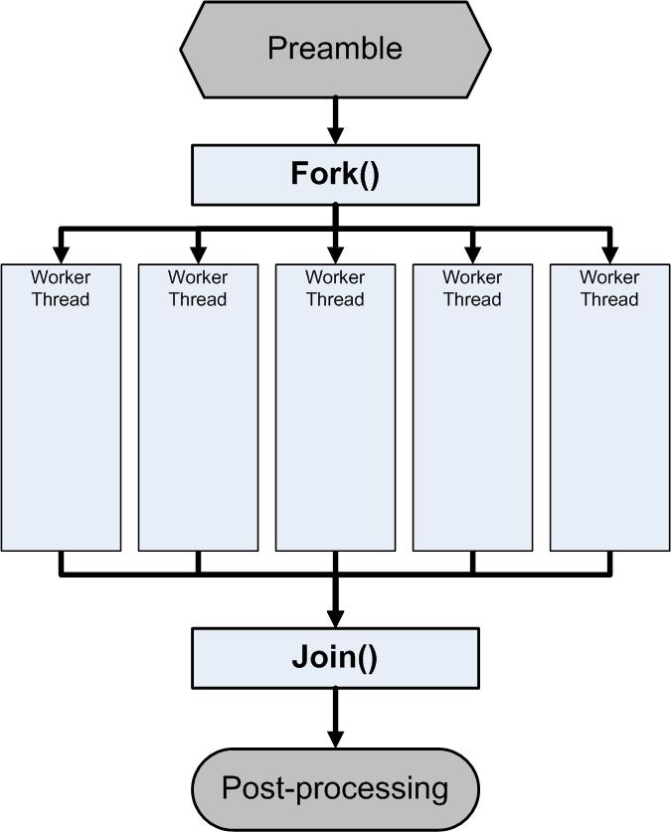
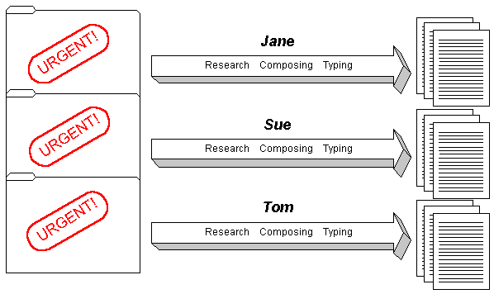
Parallelism/Pipelining/Prediction

Slide 47
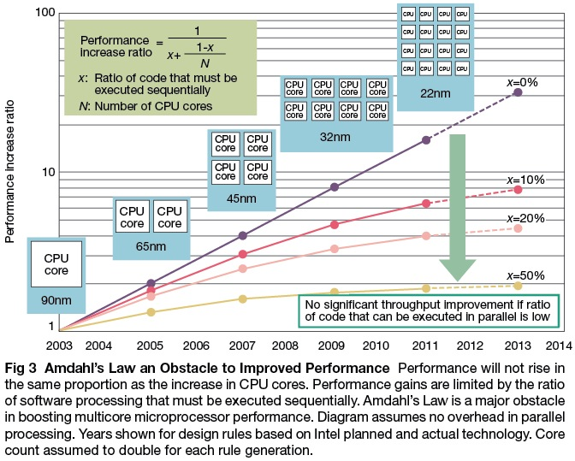
XBOX One
Theoretic vs. Real Performance

Slide 48
Warehouse-Scale Computers
Power Usage Effectiveness
Request-Level Parallelism
MapReduce
Handling failures
Costs of WSC

Slide 49
C Language and Compilation
C Types, including Structs, Consts, Enums
Arrays and strings
C Pointers
C functions and parameter passing

Slide 50
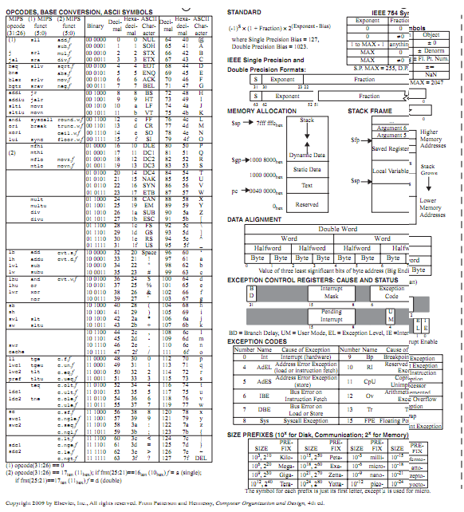
MIPS Instruction Set
ALU operations
Loads/Stores
Branches/Jumps
Registers
Memory
Function calling conventions
Stack

Slide 51
Everything is a Number
Binary
Signed versus Unsigned
One’s Complement/Two’s Complement
Floating-Point numbers
Character Strings
Instruction Encoding

Slide 52
Components of a Computer
Memory
Processor
Input
Enable?
Read/Write
Control
Datapath
Address
Bytes
PC
Registers
Write Data
Arithmetic & Logic Unit
(ALU)
ReadData
Output
Processor-Memory Interface
I/O-Memory Interfaces

Slide 53
Caches
Spatial/Temporal Locality
Instruction versus Data
Block size, capacity
Direct-Mapped cache
3 C’s
Cache-aware performance programming

Slide 54
Parallelism
SIMD/MIMD/MISD/SISD
Amdahl’s Law
Strong vs. weak scaling
Data-Parallel execution

Slide 55
Agenda
Review
SIMD
Administrivia
Midterm “Review”
And in Conclusion, …

Slide 56
And in Conclusion, …
Intel SSE SIMD Instructions
Exploit data-level parallelism in loops
One instruction fetch that operates on multiple operands simultaneously
128-bit XMM registers
SSE Instructions in C
Embed the SSE machine instructions directly into C programs through use of intrinsics
Achieve efficiency beyond that of optimizing compiler
Good luck on the Midterm!

