Slide 1
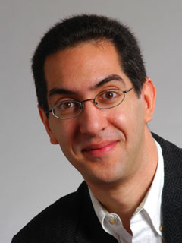
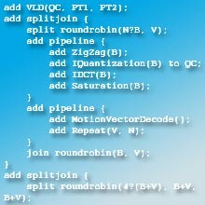
Simple multicore API
inst.eecs.berkeley.edu/~cs61c UCB CS61C : Machine Structures Lecture 43 – Summary & Goodbye 2008-05-12
Hello to Ivan Budiselic from Belmont, CA Dan Collins from Wisconsin Rapids, WI
Christian Engels from Saarbrücken, GERMANY Pablo Varela from Argentina
Lecturer SOE Dan Garcia
Bill Thies, outstanding MIT PhD student may have discovered a simple way to do parallel programming: StreamIt, based on data flow. A smart compiler splits across cores. We gave him offer!!
technologyreview.com/Infotech/18597/

Slide 2
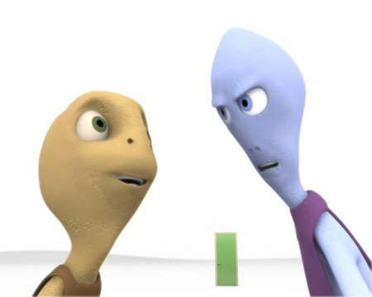
Cool Stuff…the videos before lecture
SIGGRAPH Electronic Theatre
www.siggraph.org/publications/video-review/SVR.html
$40/video for ACM Members
SIGGRAPH Conference in Los Angeles!
2008-08-11 ⇒ 2008-08-15 www.siggraph.org/s2008/

Slide 3
Review : Parallelism
Above the line (inter-computer, many machines) & below the line (intra-computer, multiple cores & CPUs) both critical for future.
Hard to write code that fully takes advantage of all available resources to get optimal speedup.
Amdahl’s Law: MaxSpeedup = 1/s (s = % of serial code)
Inter-computing ||ism : Distributed & Supercomputing
Grid (usu remote, heterogeneous) & Cluster computing
Synchronization hard, APIs help (MapReduce, MPI)
Intra-computing ||ism : pthreads, OpenMP
Cache coherence makes it difficult! Manycore, not multicore!
Berkeley EECS & PAR lab taking initative to make 1000+ core HW, put in researchers hands!

Slide 4
We learned about “Machine Structures”
Application (ex: browser)
CS61C
Operating
Compiler
System
(Mac OSX)
Software
Assembler
Instruction Set
Architecture
Hardware
Processor
Memory
I/O system
Datapath & Control
Digital Design
Circuit Design
transistors
Coordination of many levels (layers) of abstraction

Slide 5
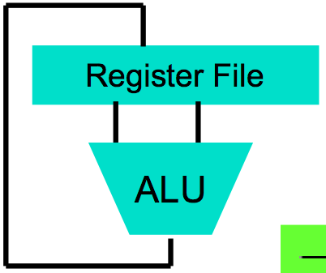
We made HW/SW contact!
High Level Language Program (e.g., C)
temp = v[k];
v[k] = v[k+1];
v[k+1] = temp;
Compiler
Assembly Language Program (e.g.,MIPS)
lw $t0, 0($2)
lw $t1, 4($2)
sw $t1, 0($2)
sw $t0, 4($2)
Assembler
Machine Language Program (MIPS)
0000 1001 1100 0110 1010 1111 0101 1000
1010 1111 0101 1000 0000 1001 1100 0110
1100 0110 1010 1111 0101 1000 0000 1001
0101 1000 0000 1001 1100 0110 1010 1111
Machine Interpretation
Hardware Architecture Description (e.g., block diagrams)
Architecture Implementation
Logic Circuit Description (Circuit Schematic Diagrams)

Slide 6
CS61C: So what did you learn? (1st lecture)
Learn some of the big ideas in CS & Engineering:
5 classic components of a Computer
Principle of abstraction, systems built as layers
Data can be anything (integers, floating point, characters): a program determines what it is
Stored program concept: instructions just data
Compilation v. interpretation thru system layers
Principle of Locality, exploited via memory hierarchy (caches)
Benefits of a layer of indirection (VM)
Greater performance by exploiting parallelism
Pipelining, superscaler, ILP, MPI, MapReduce, OpenMP, pthreads
Principles/Pitfalls of Performance Measurement
Notes:
We will take a break and talk about class philosophy.

Slide 7
Life: So what did you learn? (all yr)
Use ISO 8601
YYYY-MM-DD
Don’t be afraid
…to ask questions, sit in front, dance in the aisles
Find your partner
Find the Yin to your Yang (project & life partners)
Enjoy your youth
E.g., Travel while you aren’t tied down in your life
Love your job
Love what you do; do what you love

Slide 8
20th vs. 21st Century IT Targets
20th Century Measure of Success
Performance (peak vs. delivered)
Cost (purchase cost vs. ownership cost, power)
21st Century Measure of Success? “SPUR”
Security
Privacy
Usability
Reliability
Massive parallelism greater chance (this time) if
Measure of success is SPUR vs. only cost-perf
Uniprocessor performance improvement decelerates

Slide 9
Other Implications
Need to revisit chronic unsolved problem
Parallel programming!!
Implications for applications:
Computing power >>> CDC6600, Cray XMP (choose your favorite supercomputer) on an economical die inside your watch, cell phone or PDA
On your body health monitoring
Google + library of congress on your PDA
As devices continue to shrink…
The need for great HCI critical as ever!

Slide 10
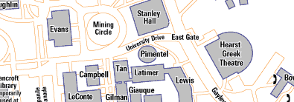
Upcoming Calendar
Week # | Mon | Wed | Fri
#17 This week | LAST CLASS Summary, Review, & HKN Evals Performance comp due @ 11:59pm
#18 FINAL REVIEW Sun @ 2-5pm 10 Evans | FINAL EXAM 5-8pm @ 1 Pimentel Only bring pen{,cil}s, two 8.5”x11” handwritten sheets + green sheet. Leave backpacks, books, calculators, cells & pagers home! Everyone must take ALL of the final!

Slide 11
Administrivia: Become active!
If you did well in CS3 or 61[ABC] (A- or above) and want to be on staff?
Usual path: Lab Assistant  Reader  TA
Contact Jenny Jones in 395 Soda before first week of semester for LA signup…
Reader/TA forms: www.cs/~juliea/
I strongly encourage anyone who gets an A- or above in the class to follow this path…
I’ll be teaching CS61C in 2009Sp. Why?

Slide 12
Survey Results

Slide 13
Survey Results

Slide 14
Survey Results

Slide 15
Survey Results

Slide 16
Survey Results

Slide 17
Survey Results

Slide 18
Survey Results

Slide 19
Survey Results

Slide 20
Survey Results

Slide 21
Survey Results

Slide 22
Survey Results

Slide 23
Survey Results

Slide 24
Survey Results

Slide 25
Survey Results

Slide 26
Survey Results

Slide 27
Survey Results

Slide 28
Taking advantage of Cal Opportunities
“The Godfather answers all of life’s questions” – Heard in “You’ve got Mail”
Why were we the #2 Univ in the WORLD?
Research, reseach, research!
Whether you want to go to grad school or industry, you need someone to vouch for you!
…as is the case with the Mob
Techniques
Find out what you like, do lots of web research (read published papers), hit OH of Prof, show enthusiasm & initiative
http://research.berkeley.edu/
So says the 2004 ranking from the “Times Higher Education Supplement”

Slide 29
CS98/198 Opportunities Fall 2008
GamesCrafters (Game Theory R & D)
Develop SW, analysis on 2-person games of no chance. (e.g., go, chess, connect-4, nim, etc.)
Req: ≥ A- in CS61C, Game Theory / SW Interest
MS-DOS X (Mac Student Developers)
Learn to program Macintoshes.
Req: Interest. Owning a mac helps, not required.
Taught as a DeCal by MS-DOS X veterans
UCBUGG (Recreational Graphics)
Develop computer-generated images, animations.
Req: 3D experience, portfolio
Taught as a DeCal by UCBUGG veterans

Slide 30
Peer Instruction
Strong AI
1: Control
2: Datapath
3: Memory
4: Input
5: Output Weak AI
6: Control
7: Datapath
8: Memory
9: Input
0: Output
Strong or Weak AI? Strong AI: Machines that act intelligently have real, conscious minds...sapience Weak AI: Machines can be made to act as if they were intelligent, but won’t be sapient.
In the future, what’ll be the most important computer component?
Computer
Processor
Memory
(where
programs,
data
live when
running)
Devices
Control
(“brain”)
Input
Datapath
(“brawn”)
Output

Slide 31
Peer Instruction Answer
Star Trek’s Data will exist. Strong AI!
“Forget cloning. Forget TVs on your wrist watch. The biggest invention of the next 100 years will be the ability to directly connect your brain to a machine, aka wet computing.” – Dan Garcia
A macaque monkey at Duke University can already control a robotic arm with thought.
In 2005, EECS hired Prof Jose Carmena, a “wet computing” ace!
DARPA interested for mind-control robots & flying
Virtual Reality achieved with proper I/O interfacing…
www.popsci.com/popsci/medicine/article/0,12543,576464,00.html

Slide 32
Penultimate slide: Thanks to the staff!
TAs
Head TA David Jacobs
Omar Akkawi
Matt Johnson
Keaton Mowery
Casey Rodarmor
Ben Sussman
Brian Zimmer
Readers
Hongcheng Chang
Timothy Wu
Andrew Toulouse
James Liao
TAs-in-Training
Andrew Toulouse
James Liao
George Chen
Thanks to all the former CS61C instructors who have added to these notes…

Slide 33
The Future for Future Cal Alumni
What’s The Future?
New Millennium
Ubiquitous & Quantum Computing, Nanotechnology, 10 M “volunteer” CPUs, the Parallel revolution...
Rapid Changes in Technology
World’s 2nd Best Education
Never Give Up!
“The best way to predict the future is to invent it” – Alan Kay
The Future is up to you!

