Slide 1
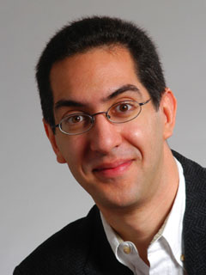
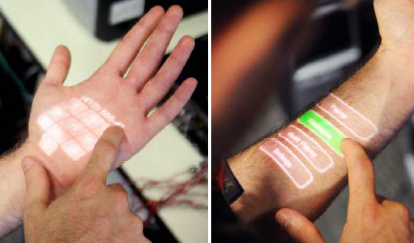
Skinput … use your body as input!!
inst.eecs.berkeley.edu/~cs61c UCB CS61C : Machine Structures Lecture 35 – Input / Output 2010-04-21
We’ve merged 3 lectures into 1… See 2008Sp for full slides (few Qs plz)
Lecturer SOE Dan Garcia
Chris Harrison has developed a system that allows you to touch your skin and control a computer. He shows examples, combined with a pico projector, of dialing a phone number on your hand, etc.
www.chrisharrison.net/projects/skinput/

Slide 2
i/o basics

Slide 3
Recall : 5 components of any Computer
Earlier Lectures
Current Lecture
Keyboard, Mouse
Computer
Processor
(active)
Memory
(passive)
(where
programs,
data live
when
running)
Devices
Input
Control
(“brain”)
Disk,
Network
Output
Datapath
(“brawn”)
Display, Printer
Notes:
That is, any computer, no matter how primitive or advance, can be divided into five parts:
1. The input devices bring the data from the outside world into the computer.
2. These data are kept in the computer’s memory until ...
3. The datapath request and process them.
4. The operation of the datapath is controlled by the computer’s controller.
All the work done by the computer will NOT do us any good unless we can get the data back to the outside world.
5. Getting the data back to the outside world is the job of the output devices.
The most COMMON way to connect these 5 components together is to use a network of busses.

Slide 4
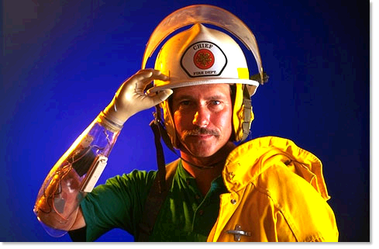
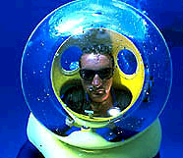
Motivation for Input/Output
I/O is how humans interact with computers
I/O gives computers long-term memory.
I/O lets computers do amazing things:
Read pressure of synthetic hand and control synthetic arm and hand of fireman
Control propellers, fins, communicate in BOB (Breathable Observable Bubble)
Computer without I/O like a car w/no wheels; great technology, but gets you nowhere

Slide 5
I/O Device Examples and Speeds
I/O Speed: bytes transferred per second (from mouse to Gigabit LAN: 7 orders of mag!)
Device Behavior Partner Data Rate (KB/s)
Keyboard Input Human 0.01
Mouse Input Human 0.02
Voice output Output Human 5.00
Floppy disk Storage Machine 50.00
Laser Printer Output Human 100.00
Magnetic Disk Storage Machine 10,000.00
Wireless Network I or O Machine 10,000.00
Graphics Display Output Human 30,000.00
Wired LAN Network I or O Machine 125,000.00
When discussing transfer rates, use 10^{x}
Notes:
Here are some examples of the various I/O devices you are probably familiar with.
Notice that most I/O devices that has human as their partner usually has relatively low peak data rates because human in general are slow relatively to the computer system.
The exceptions are the laser printer and the graphic displays.
Laser printer requires a high data rate because it takes a lot of bits to describe high resolution image you like to print by the laser writer.
The graphic display requires a high data rate because as I will show you later in today’s lecture, all the color objects we see in the real world and taken for granted is very hard to replicate on a graphic display.
Let’s take a closer look at one of the most popular storage device, magnetic disks.
+2 = 28 min. (Y:08)

Slide 6
Instruction Set Architecture for I/O
What must the processor do for I/O?
Input: reads a sequence of bytes
Output: writes a sequence of bytes
Some processors have special input and output instructions
Alternative model (used by MIPS):
Use loads for input, stores for output
Called “Memory Mapped Input/Output”
A portion of the address space dedicated to communication paths to I/O devices (no mem there)
Instead, they correspond to registers in I/O devices
address
0xFFFFFFFF
0xFFFF0000
cntrl reg.
data reg.
0

Slide 7
Processor-I/O Speed Mismatch
1GHz microprocessor can execute 1 billion load or store instructions per second, or 4,000,000 KB/s data rate
I/O devices data rates range from 0.01 KB/s to 125,000 KB/s
Input: device may not be ready to send data as fast as the processor loads it
Also, might be waiting for human to act
Output: device not be ready to accept data as fast as processor stores it
What to do?

Slide 8
Processor Checks Status before Acting
Path to device generally has 2 registers:
Control Register, says it’s OK to read/write (I/O ready) [think of a flagman on a road]
Data Register, contains data
Processor reads from Control Register in loop, spins while waiting for device to set Ready bit in Control reg (0 ⇒ 1) to say its OK
Processor then loads from (input) or writes to (output) data register
Load from or Store into Data Register resets Ready bit (1 ⇒ 0) of Control Register
This is called “Polling”

Slide 9
What is the alternative to polling?
Wasteful to have processor spend most of its time “spin-waiting” for I/O to be ready
Would like an unplanned procedure call that would be invoked only when I/O device is ready
Solution: use exception mechanism to help I/O. Interrupt program when I/O ready, return when done with data transfer

Slide 10
I/O Interrupt
An I/O interrupt is like overflow exceptions except:
An I/O interrupt is “asynchronous”
More information needs to be conveyed
An I/O interrupt is asynchronous with respect to instruction execution:
I/O interrupt is not associated with any instruction, but it can happen in the middle of any given instruction
I/O interrupt does not prevent any instruction from completion
Notes:
How does an I/O interrupt different from the exception you already learned?
Well, an I/O interrupt is asynchronous with respect to the instruction execution while exception such as overflow or page fault are always associated with a certain instruction.
Also for exception, the only information needs to be conveyed is the fact that an exceptional condition has occurred but for interrupt, there is more information to be conveyed.
Let me elaborate on each of these two points.
Unlike exception, which is always associated with an instruction, interrupt is not associated with any instruction. The user program is just doing its things when an I/O interrupt occurs.
So I/O interrupt does not prevent any instruction from completing so you can pick your own convenient point to take the interrupt.
As far as conveying more information is concerned, the interrupt detection hardware must somehow let the OS know who is causing the interrupt.
Furthermore, interrupt requests needs to be prioritized. The hardware that can do all these looks like this.
+2 = 64 min. (Y:44)

Slide 11
Interrupt-Driven Data Transfer
Memory
(1) I/O
interrupt
add
sub
and
or
user
program
(2) save PC
(3) jump to interrupt
service routine
(5)
read
store
...
jr
interrupt
service
routine
(4) perform transfer
Notes:
That is, whenever an I/O device needs attention from the processor, it interrupts the processor from what it is currently doing.
This is how an I/O interrupt looks in the overall scheme of things. The processor is minding its business when one of the I/O device wants its attention and causes an I/O interrupt.
The processor then save the current PC, branch to the address where the interrupt service routine resides, and start executing the interrupt service routine.
When it finishes executing the interrupt service routine, it branches back to the point of the original program where we stop and continue.
The advantage of this approach is efficiency. The user program’s progress is halted only during actual transfer.
The disadvantage is that it require special hardware in the I/O device to generate the interrupt. And on the processor side, we need special hardware to detect the interrupt and then to save the proper states so we can resume after the interrupt.
+2 = 62 min. (Y:42)

Slide 12
Administrivia
Project 2 graded face-to-face, check web page for scheduling
Project 3 (Cache simulator) out
You may work in pairs for this project
Try the performance competition!
You may work in pairs for this too
Do it for fun!
Do it to shine!
Do it to test your metttle!
Do it for EPA!

Slide 13
Upcoming Calendar
Week # | Mon | Wed | Thu Lab | Fri
#13 This week |  | I/O P3 out | VM | Performance
#14 Last week o’ classes | Inter-machine Parallelism | Summary, Review, Evaluation | Parallel | Intra-machine Parallelism(Scott) P3 due
#15 RRR Week |  |  |  | Perf comp due 11:59pm
#16 Finals Week Review Sun May 9 3-6pm 10 Evans |  |  |  | Final Exam 8-11am in Hearst Gym

Slide 14
Networks

Slide 15
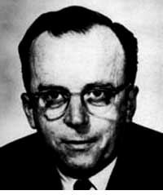
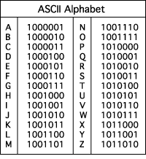
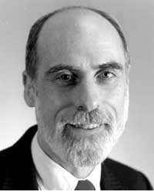
The Internet (1962)
www.computerhistory.org/internet_history
Founders
JCR Licklider, as head of ARPA, writes on “intergalactic network”
1963 : ASCII becomes first universal computer standard
1969 : Defense Advanced Research Projects Agency (DARPA) deploys 4 “nodes” @ UCLA, SRI, Utah, & UCSB
1973 Robert Kahn & Vint Cerf invent TCP, now part of the Internet Protocol Suite
Internet growth rates
Exponential since start!
“Lick”
Revolutions like this don't come along very often
Vint Cerf
www.greatachievements.org/?id=3736 en.wikipedia.org/wiki/Internet_Protocol_Suite

Slide 16
Why Networks?
Originally sharing I/O devices between computers
E.g., printers
Then communicating between computers
E.g., file transfer protocol
Then communicating between people
E.g., e-mail
Then communicating between networks of computers
E.g., file sharing, www, …
Notes:
Original printers were the size of bathrooms - HAD to share
FTP was the first time file sharing happened
Communicating between people has become dominant, pervasive, ubiquitous
- Also IM
Last bullet is where a lot of research is happening

Slide 17
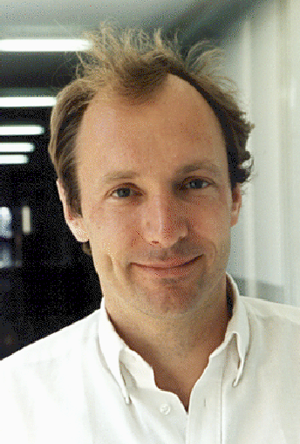
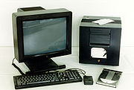
The World Wide Web (1989)
en.wikipedia.org/wiki/History_of_the_World_Wide_Web
“System of interlinked hypertext documents on the Internet”
History
1945: Vannevar Bush describes hypertext system called “memex” in article
1989: Tim Berners-Lee proposes, gets system up ’90
~2000 Dot-com entrepreneurs rushed in, 2001 bubble burst
Wayback Machine
Snapshots of web over time
Today : Access anywhere!
World’s First web server in 1990
Tim Berners-Lee
www.archive.org

Slide 18
Shared vs. Switched Based Networks
Shared
Shared vs. Switched:
Switched: pairs (“point-to-point” connections) communicate at same time
Shared: 1 at a time (CSMA/CD)
Aggregate bandwidth (BW) in switched network is many times shared:
point-to-point faster since no arbitration, simpler interface
Node
Node
Node
Node
Crossbar
Switch
Node
Node
Node
Notes:
Analogy for shared:
“It’s like naked students running between dorm rooms -- many can look (read common bus) but only 1 in hall (drives bus) at a time”
CSMA/CD = Carrier Sense Multiple Access / Collision Detection
Bus: On collision, have to wait random amount of time
Buses not used very much, inefficient.
Switches are much more efficient
Bandwidth is like throughput

Slide 19
What makes networks work?
links connecting switches to each other and to computers or devices
Computer
switch
switch
switch
network
interface
ability to name the components and to route packets of information - messages - from a source to a destination
Layering, redundancy, protocols, and encapsulation as means of abstraction (61C big idea)
Notes:
Computer has Network Interface Card (NIC)
Sends message through the series of switches, which get the message to recipient
Usually draw the series of switches as the “Internet Cloud”
- Represents an abstraction, “don’t know” implementation
- Send the message through the network, and it will get to where it needs to go
Switches use routing tables to know how to get the message to the recipient

Slide 20
disks

Slide 21
Magnetic Disk – common I/O device
A kind of computer memory
Information stored by magnetizing ferrite material on surface of rotating disk
similar to tape recorder except digital rather than analog data
Nonvolatile storage
retains its value without applying power to disk.
Two Types
Floppy disks – slower, less dense, removable.
Hard Disk Drives (HDD) – faster, more dense, non-removable.
Purpose in computer systems (Hard Drive):
Long-term, inexpensive storage for files
“Backup” for main-memory. Large, inexpensive, slow level in the memory hierarchy (virtual memory)

Slide 22
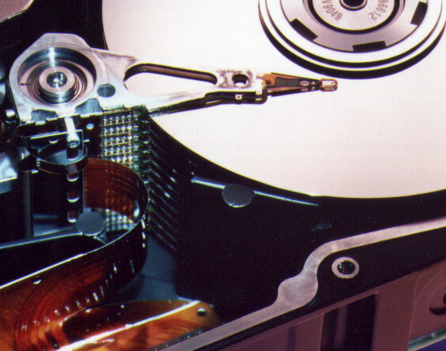
Photo of Disk Head, Arm, Actuator
Arm
Spindle
Head
Actuator
{
Platters (1-12)

Slide 23
Disk Device Terminology
Several platters, with information recorded magnetically on both surfaces (usually)
Bits recorded in tracks, which in turn divided into sectors (e.g., 512 Bytes)
Actuator moves head (end of arm) over track (“seek”), wait for sector rotate under head, then read or write
Inner
Track
Arm
Head
Sector
Outer
Track
Platter
Actuator

Slide 24
Disk Device Performance (1/2)
Disk Latency = Seek Time + Rotation Time + Transfer Time + Controller Overhead
Seek Time? depends on no. tracks to move arm, speed of actuator
Rotation Time? depends on speed disk rotates, how far sector is from head
Transfer Time? depends on data rate (bandwidth) of disk (f(bit density,rpm)), size of request
Outer
Track
Inner
Track
Sector
Head
Arm
Controller
Spindle
Platter
Actuator
Notes:
Use analogy to records

Slide 25
Disk Device Performance (2/2)
Average distance of sector from head?
1/2 time of a rotation
7200 Revolutions Per Minute ⇒ 120 Rev/sec
1 revolution = 1/120 sec ⇒ 8.33 milliseconds
1/2 rotation (revolution) ⇒ 4.17 ms
Average no. tracks to move arm?
Disk industry standard benchmark:
Sum all time for all possible seek distances from all possible tracks / # possible
Assumes average seek distance is random
Size of Disk cache can strongly affect perf!
Cache built into disk system, OS knows nothing

Slide 26
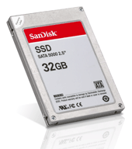
Where does Flash memory come in?
Microdrives and Flash memory (e.g., CompactFlash) are going head-to-head
Both non-volatile (no power, data ok)
Flash benefits: durable & lower power (no moving parts, need to spin µdrives up/down)
Flash limitations: finite number of write cycles (wear on the insulating oxide layer around the charge storage mechanism). Most ≥ 100K, some ≥ 1M W/erase cycles.
How does Flash memory work?
NMOS transistor with an additional conductor between gate and source/drain which “traps” electrons. The presence/absence is a 1 or 0.
en.wikipedia.org/wiki/Flash_memory

Slide 27
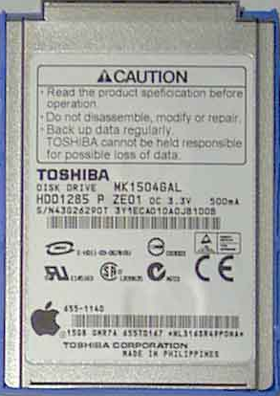
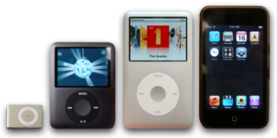
What does Apple put in its iPods?
en.wikipedia.org/wiki/Ipod www.apple.com/ipod
Toshiba flash 1, 2GB
Samsung flash 4, 8GB
Toshiba 1.8-inch HDD 80, 160GB
Toshiba flash 8, 16, 32GB
shuffle, nano, classic, touch

Slide 28
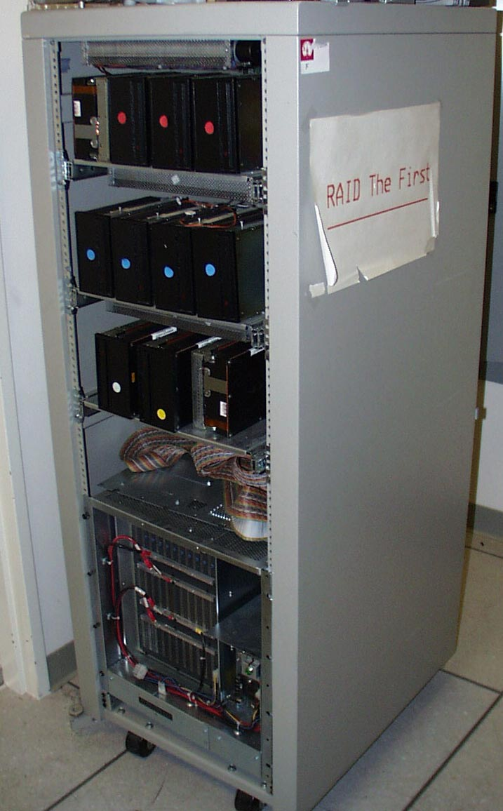
RAID : Redundant Array of Inexpensive Disks
Invented @ Berkeley (1989)
A multi-billion industry 80% non-PC disks sold in RAIDs
Idea:
Files are “striped” across multiple disks
Redundancy yields high data availability
Disks will still fail
Contents reconstructed from data redundantly stored in the array
⇒ Capacity penalty to store redundant info
⇒ Bandwidth penalty to update redundant info

Slide 29
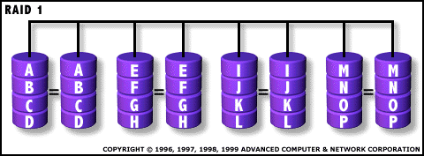
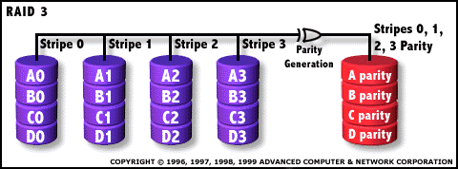
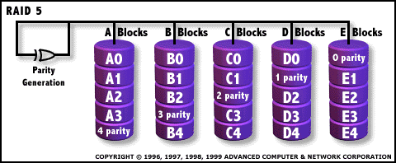
Common RAID configurations
RAID 0 No redundancy, Fast access
RAID 1
Mirror Data, most expensive sol’n
RAID 3
Parity drive protects against 1 failure
RAID 5
Rotated parity across all drives

Slide 30
“And in conclusion…”
I/O gives computers their 5 senses
I/O speed range is 100-million to one
Processor speed means must synchronize with I/O devices before use
Polling works, but expensive
processor repeatedly queries devices
Interrupts works, more complex
devices causes an exception, causing OS to run and deal with the device
I/O control leads to Operating Systems

