Slide 1
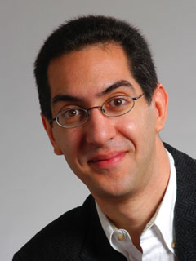
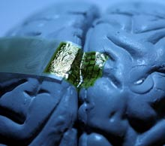
Brain interfaces made of silk
inst.eecs.berkeley.edu/~cs61c UCB CS61C : Machine Structures Lecture 38 – Summary & Goodbye 2010-04-28
…please exit via upper doors today…
Lecturer SOE Dan Garcia
Traditionally, surgeons have implanted devices into brains for neural interfaces, but that is irritating and causes scarring. Now, doctors are investigating “gentler, softer, biocompatible electrodes on thin, flexible substrates”. Inserted through small hole in the skull, mechanically strong silk films measure high-res brain activity.
www.technologyreview.com/biomedicine/25154

Slide 2
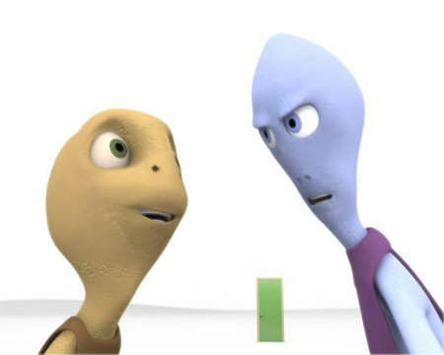
Cool Stuff…the videos before lecture
SIGGRAPH Electronic Theatre
www.siggraph.org/publications/video-review
$40/video for ACM Members
SIGGRAPH Conference in Los Angeles!
2010-07-25 ⇒ 2010-07-29 www.siggraph.org/s2010/

Slide 3
Review : Parallelism
Above the line (inter-computer, many machines) & below the line (intra-computer, multiple cores & CPUs) both critical for future.
Hard to write code that fully takes advantage of all available resources to get optimal speedup.
Amdahl’s Law: MaxSpeedup = 1/s (s = % of serial code)
Inter-computing ||ism : Distributed & Supercomputing
Grid (usu remote, heterogeneous) & Cluster computing
Synchronization hard, APIs help (MapReduce, MPI)
Intra-computing ||ism : pthreads, OpenMP
Cache coherence makes it difficult! Manycore, not multicore!
Berkeley EECS & PAR lab on cutting edge!!

Slide 4
We learned about “Machine Structures”
Application (ex: browser)
CS61C
Operating
Compiler
System
(Mac OSX)
Software
Assembler
Instruction Set
Architecture
Hardware
Processor
Memory
I/O system
Datapath & Control
Digital Design
Circuit Design
transistors
Coordination of many levels (layers) of abstraction

Slide 5
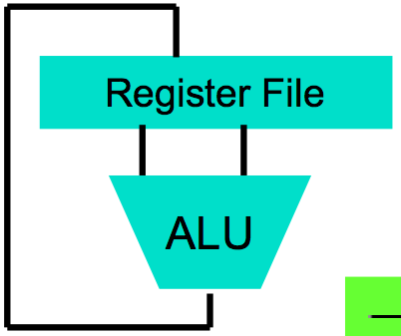
We made HW/SW contact!
High Level Language Program (e.g., C)
temp = v[k];
v[k] = v[k+1];
v[k+1] = temp;
Compiler
Assembly Language Program (e.g.,MIPS)
lw $t0, 0($2)
lw $t1, 4($2)
sw $t1, 0($2)
sw $t0, 4($2)
Assembler
Machine Language Program (MIPS)
0000 1001 1100 0110 1010 1111 0101 1000
1010 1111 0101 1000 0000 1001 1100 0110
1100 0110 1010 1111 0101 1000 0000 1001
0101 1000 0000 1001 1100 0110 1010 1111
Machine Interpretation
Hardware Architecture Description (e.g., block diagrams)
Architecture Implementation
Logic Circuit Description (Circuit Schematic Diagrams)

Slide 6
CS61C: So what did you learn? (1st lecture)
Learn some of the big ideas in CS & Engineering:
5 classic components of a Computer
Principle of abstraction, systems built as layers
Data can be anything (integers, floating point, characters): a program determines what it is
Stored program concept: instructions just data
Compilation v. interpretation thru system layers
Principle of Locality, exploited via memory hierarchy (caches)
Benefits of a layer of indirection (VM)
Greater performance by exploiting parallelism
Pipelining, superscaler, MPI, MapReduce, OpenMP, pthreads
Principles/Pitfalls of Performance Measurement
Notes:
We will take a break and talk about class philosophy.

Slide 7
Life: So what did you learn? (all yr)
Use ISO 8601
YYYY-MM-DD
Don’t be afraid
…to ask questions, sit in front, dance in the aisles
Find your partner
Find the Yin to your Yang (project & life partners)
Enjoy your youth
E.g., Travel while you aren’t tied down in your life
Love your job
Love what you do; do what you love

Slide 8
20th vs. 21st Century IT Targets
20th Century Measure of Success
Performance (peak vs. delivered)
Cost (purchase cost vs. ownership cost, power)
21st Century Measure of Success? “SPUR”
Security
Privacy
Usability
Reliability
Massive parallelism greater chance (this time) if
Measure of success is SPUR vs. only cost-perf
Uniprocessor performance improvement decelerates

Slide 9
Other Implications
Need to revisit chronic unsolved problem
Parallel programming!!
Implications for applications:
Computing power >>> CDC6600, Cray XMP (choose your favorite supercomputer) on an economical die inside your watch, cell phone or PDA
On your body health monitoring
Google + library of congress on your PDA
As devices continue to shrink…
The need for great HCI (human-computer interfaces) is as critical as ever!

Slide 10
Upcoming Calendar
Week # | Mon | Wed | Thu Lab | Fri
#14 Last week o’ classes | Inter-machine Parallelism | Summary, Review, Evaluation | Parallel | Intra-machine Parallelism(Scott) P3 due
#15 RRR Week |  |  |  | Perf comp due 11:59pm
#16 Finals Week Review Sun May 9 3-6pm 10 Evans |  |  |  | Final Exam 8-11am in 230 Hearst Gym

Slide 11
Administrivia: Become active!
Final Exam details
Only bring pen{,cil}s, two 8.5”x11” handwritten sheets (writing on both sides) + green sheet.
Leave backpacks, books, calculators, cells & pagers home!
Everyone must take ALL of the final!
If you did well in CS3 or 61[ABC] (A- or above) and want to be on staff?
Usual path: Lab Assistant  Reader  TA
LA: sign up w/Jenny Jones in 395 Soda before 1st week of semester
Reader/TA forms: www.cs/~juliea/
I strongly encourage anyone who gets an A- or above in the class to follow this path…

Slide 12
Taking advantage of Cal Opportunities
“The Godfather answers all of life’s questions” – Heard in “You’ve got Mail”
Why were we the #2 Univ in the WORLD?
Research, reseach, research!
Whether you want to go to grad school or industry, you need someone to vouch for you!
…as is the case with the Mob
Techniques
Find out what you like, do lots of web research (read published papers), hit OH of Prof, show enthusiasm & initiative
http://research.berkeley.edu/
So says the 2004 ranking from the “Times Higher Education Supplement”

Slide 13
Dan’s Opportunities Fall 2010
GamesCrafters (Game Theory R & D)
Develop SW, analysis on 2-person games of no chance. (e.g., go, chess, connect-4, nim, etc.)
Req: ≥ A- in CS61C, Game Theory / SW Interest
MS-DOS X (Mac Student Developers)
Learn to program Macintoshes.
Req: Interest. Owning a mac helps, not required.
Taught as a DeCal by MS-DOS X veterans
UCBUGG (Recreational Graphics)
Develop computer-generated images, animations.
Req: 3D interest
Taught as a DeCal by UCBUGG veterans
CNM190/CS194-8 (Advanced Digital Animation)
Learn how the experts make 3D computer animations
Req: 3D Experience; we’ll choose students by experience
This is a ONE-YEAR course… (Fall 2010 + Spring 2011)

Slide 14
Anatomy: 5 components of any Computer
In the future, what’ll be the most important computer component?
Computer
Processor
Devices
Control
(“brain”)
Memory
Input
Control
Datapath
Memory
Input
Output
Datapath (“brawn”)
Output
Notes:
That is, any computer, no matter how primitive or advance, can be divided into five parts:
1. The input devices bring the data from the outside world into the computer.
2. These data are kept in the computer’s memory until ...
3. The datapath request and process them.
4. The operation of the datapath is controlled by the computer’s controller.
All the work done by the computer will NOT do us any good unless we can get the data back to the outside world.
5. Getting the data back to the outside world is the job of the output devices.
The most COMMON way to connect these 5 components together is to use a network of busses.

Slide 15
Peer Instruction Opinion
“Forget cloning. Forget TVs on your wrist watch. The biggest invention of the next 100 years will be the ability to directly connect your brain to a machine, aka wet computing.” – Dan Garcia
A macaque monkey at Duke University can already control a robotic arm with thought.
DARPA interested for mind-control robots & flying
Virtual Reality achieved with proper I/O interfacing…
Jose Carmena, UCB EECS Prof Research: Brain-Machine Interface www.eecs.berkeley.edu/~carmena/

Slide 16
Penultimate slide: Thanks to the staff!
TAs
Head TA Scott Beamer
Eric Chang
Michael Greenbaum
Long Wei
Bing Xia
Readers
Anurag Jain
Rohit Poddar
Ibrahim Awwal
Myo Nyi Nyi
Andy Horng
Thanks to all the former CS61C instructors who have added to these notes…

Slide 17
The Future for Future Cal Alumni
What’s The Future?
New Millennium
Ubiquitous & Quantum Computing, Nanotechnology, 10 M “volunteer” CPUs, the Parallel revolution...
Rapid Changes in Technology
World’s 2nd Best Education
Never Give Up!
“The best way to predict the future is to invent it” – Alan Kay
The Future is up to you!
Please exit via upper doors…

