Slide 1
inst.eecs.berkeley.edu/~cs61c UC Berkeley CS61C : Machine Structures Lecture 39 – Intra-machine Parallelism 2010-04-30
Head TA Scott Beamer
www.cs.berkeley.edu/~sbeamer
Old-Fashioned Mud-Slinging with Flash
Apple, Adobe, and Microsoft all pointing fingers at each other for Flash’s crashes. Apple and Microsoft will back HTML5.
Notes:
Greet class

Slide 2
Review
Parallelism is necessary for performance
It looks like it’s the future of computing
It is unlikely that serial computing will ever catch up with parallel computing
Software Parallelism
Grids and clusters, networked computers
MPI & MapReduce – two common ways to program
Parallelism is often difficult
Speedup is limited by serial portion of the code and communication overhead

Slide 3
Today
Superscalars
Power, Energy & Parallelism
Multicores
Vector Processors
Challenges for Parallelism

Slide 4
Disclaimers
Please don’t let today’s material confuse what you have already learned about CPU’s and pipelining
When programmer is mentioned today, it means whoever is generating the assembly code (so it is probably a compiler)
Many of the concepts described today are difficult to implement, so if it sounds easy, think of possible hazards

Slide 5
Superscalar
Add more functional units or pipelines to the CPU
Directly reduces CPI by doing more per cycle
Consider what if we:
Added another ALU
Added 2 more read ports to the RegFile
Added 1 more write port to the RegFile

Slide 6
Simple Superscalar MIPS CPU
Instruction
Memory
Can now do 2 instructions in 1 cycle!
Inst1
Inst0
Rd
Rs
Rt
Rd
Rs
Rt
Instruction
Address
5
5
5
5
5
5
A
Data
Addr
W0
Ra
Rb
W1
Rc
Rd
32
32
Data
Memory
PC
Register
File
ALU
Next Address
B
Data In
clk
clk
32
clk
32
C
32
32
ALU
D

Slide 7
Simple Superscalar MIPS CPU (cont.)
Considerations
ISA now has to be changed
Forwarding for pipelining now harder
Limitations of our example
Programmer must explicitly generate instruction parallel code
Improvement only if other instructions can fill slots
Doesn’t scale well

Slide 8
Superscalars in Practice
Modern superscalar processors often hide behind a scalar ISA
Gives the illusion of a scalar processor
Dynamically schedules instructions
Tries to fill all slots with useful instructions
Detects hazards and avoids them
Instruction Level Parallelism (ILP)
Multiple instructions from same instruction stream in flight at the same time
Examples: pipelining and superscalars

Slide 9
Scaling

Slide 10
Scaling

Slide 11
Energy & Power Considerations
Courtesy: Chris Batten

Slide 12
Energy & Power Considerations
Courtesy: Chris Batten

Slide 13
Parallel Helps Energy Efficiency
Power ~ CV²f
Circuit delay is roughly linear with V
William Holt, HOT Chips 2005

Slide 14
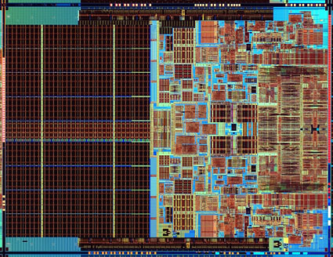
Multicore
Put multiple CPU’s on the same die
Cost of multicore: complexity and slower single-thread execution
Task/Thread Level Parallelism (TLP)
Multiple instructions streams in flight at the same time

Slide 15
Cache Coherence Problem
CPU0:
CPU0
CPU1
LW R2, 16(R0)
CPU1:
LW R2, 16(R0)
Cache
Addr | Value
Cache
Addr | Value
CPU1:
SW R0,16(R0)
16
5
16
5
0
View of memory no longer “coherent”.
Loads of location 16 from CPU0 and CPU1 see different values!
Shared Main Memory
Addr | Value
16
5
0
From: John Lazzaro

Slide 16
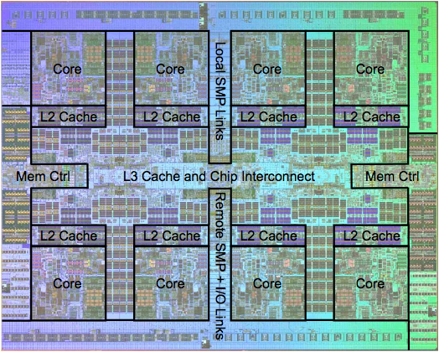
Real World Example: IBM POWER7

Slide 17
Administrivia
Proj3 due tonight at 11:59p
Performance Contest posted tonight
Office Hours Next Week
Watch website for announcements
Final Exam Review – 5/9, 3-6p, 10 Evans
Final Exam – 5/14, 8-11a, 230 Hearst Gym
You get to bring: two 8.5”x11” sheets of handwritten notes + MIPS Green sheet

Slide 18
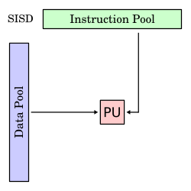
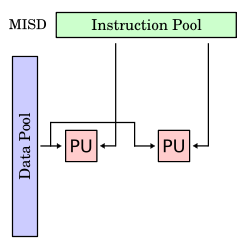
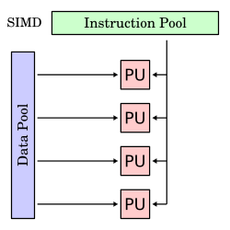
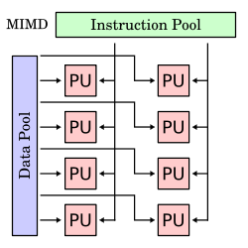
Flynn’s Taxonomy
Classification of Parallel Architectures
Single Instruction
Multiple Instruction
Single Data
Multiple Data
wwww.wikipedia.org

Slide 19
Vector Processors
Vector Processors implement SIMD
One operation applied to whole vector
Not all program can easily fit into this
Can get high performance and energy efficiency by amortizing instruction fetch
Spends more silicon and power on ALUs
Data Level Parallelism (DLP)
Compute on multiple pieces of data with the same instruction stream

Slide 20
Vectors (continued)
Vector Extensions
Extra instructions added to a scalar ISA to provide short vectors
Examples: MMX, SSE, AltiVec
Graphics Processing Units (GPU)
Also leverage SIMD
Initially very fixed function for graphics, but now becoming more flexible to support general purpose computation

Slide 21
Parallelism at Different Levels
Intra-Processor (within the core)
Pipelining & superscalar (ILP)
Vector extensions & GPU (DLP)
Intra-System (within the box)
Multicore – multiple cores per socket (TLP)
Multisocket – multiple sockets per system
Intra-Cluster (within the room)
Multiple systems per rack and multiple racks per cluster

Slide 22
Conventional Wisdom (CW) in Computer Architecture
Old CW: Power is free, but transistors expensive
New CW: Power wall Power expensive, transistors “free”
Can put more transistors on a chip than have power to turn on
Old CW: Multiplies slow, but loads fast
New CW: Memory wall Loads slow, multiplies fast
200 clocks to DRAM, but even FP multiplies only 4 clocks
Old CW: More ILP via compiler / architecture innovation
Branch prediction, speculation, Out-of-order execution, VLIW, …
New CW: ILP wall Diminishing returns on more ILP
Old CW: 2X CPU Performance every 18 months
New CW is Power Wall + Memory Wall + ILP Wall = Brick Wall
Implication: We must go parallel!

Slide 23
Parallelism again? What’s different this time?
“This shift toward increasing parallelism is not a triumphant stride forward based on breakthroughs in novel software and architectures for parallelism; instead, this plunge into parallelism is actually a retreat from even greater challenges that thwart efficient silicon implementation of traditional uniprocessor architectures.”
– Berkeley View, December 2006
HW/SW Industry bet its future that breakthroughs will appear before it’s too late
view.eecs.berkeley.edu

Slide 24
Peer Instruction
All energy efficient systems are low power
My GPU at peak can do more FLOP/s than my CPU
12
a) FF
b) FT
c) TF
d) TT

Slide 25
Peer Instruction Answer
An energy efficient system could peak with high power to get work done and then go to sleep … FALSE
Current GPUs tend to have more FPUs than current CPUs, they just aren’t as programmable … TRUE
All energy efficient systems are low power
My GPU at peak can do more FLOP/s than my CPU
12
a) FF
b) FT
c) TF
d) TT
Notes:
False (explained above)
True

Slide 26
“And In conclusion…”
Parallelism is all about energy efficiency
Types of Parallelism: ILP, TLP, DLP
Parallelism already at many levels
Great opportunity for change

