Slide 1
CS 61C: Great Ideas in Computer Architecture (Machine Structures) Introduction to C (Part I)
Instructors: Randy H. Katz
David A. Patterson
http://inst.eecs.Berkeley.edu/~cs61c/sp11

Slide 2
Agenda
Scheme vs. Java vs. C
Administrivia
Quick Start Introduction to C
Technology Break
Pointers
Summary

Slide 3
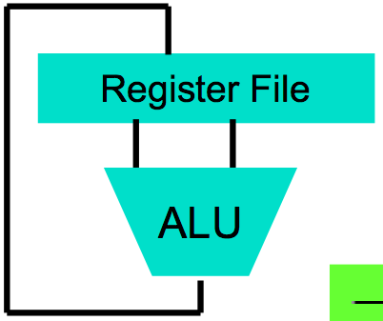
Levels of Representation/Interpretation
High Level Language Program (e.g., C)
temp = v[k];
v[k] = v[k+1];
v[k+1] = temp;
We are here!
Compiler
Anything can be represented as a number, i.e., data or instructions
lw $t0, 0($2)
lw $t1, 4($2)
sw $t1, 0($2)
sw $t0, 4($2)
Assembly Language Program (e.g., MIPS)
Assembler
0000 1001 1100 0110 1010 1111 0101 1000
1010 1111 0101 1000 0000 1001 1100 0110
1100 0110 1010 1111 0101 1000 0000 1001
0101 1000 0000 1001 1100 0110 1010 1111
Machine Language Program (MIPS)
Machine Interpretation
Hardware Architecture Description (e.g., block diagrams)
Architecture Implementation
Logic Circuit Description (Circuit Schematic Diagrams)

Slide 4
Agenda
Scheme vs. Java vs. C
Administrivia
Quick Start Introduction to C
Technology Break
Pointers
Summary

Slide 5
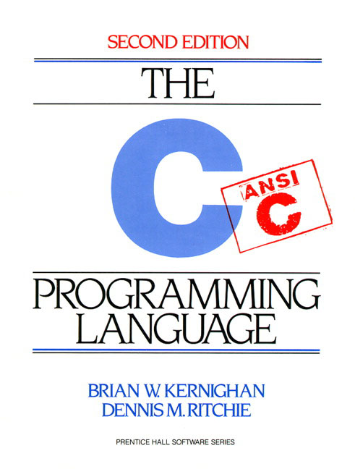
Introduction to C “the Universal Assembly Language”
“Some” C experience is required before CS61C
C++ or Java OK
Based on pre-semester survey:
83% already know JAVA
54% already know C++
34% already know C
7% already know C#
About 10% have not taken 61B or equivalent
If you have no experience in these languages, then start early and ask a lot of questions in discussion!

Slide 6
Disclaimer
You will not learn how to fully code in C in these lectures! You’ll still need your C reference for this course
K&R is a must-have
Check online for more sources
“JAVA in a Nutshell,” O’Reilly
Chapter 2, “How Java Differs from C”
http://oreilly.com/catalog/javanut/excerpt/
Brian Harvey’s helpful transition notes
On CS61C class website
http://inst.eecs.berkeley.edu/~cs61c/resources/HarveyNotesC1-3.pdf
Key C concepts: Pointers, Arrays, Implications for Memory management

Slide 7
C vs. Java
 | C | Java
Type of Language | Function Oriented | Object Oriented
Program-ming Unit | Function | Class = Abstract Data Type
Compilation | gcc hello.c creates machine language code | javac Hello.java creates Java virtual machine language bytecode
Execution | a.out loads and executes program | java Hello interprets bytecode
hello, world | #include<stdio.h> int main(void) { printf("Hello\n"); return 0; } | public class HelloWorld { public static void main(String[] args) { System.out.printl("Hello"); } }
Storage | Manual (malloc, free) | Automatic (garbage collection)
From http://www.cs.princeton.edu/introcs/faq/c2java.html

Slide 8
Basic C Concepts
Compiler
Typed variables
Typed functions
Header files (.h)
Structs
Enums
Pointers
Creates useable programs from C source
Kind of data that a variable contains
The kind of data returned from a function
Declare functions and variables in a separate file
Groups of related values
Lists of predefined values
Aliases to other variables
These concepts distinguish C from other languages you may know

Slide 9
Compilation: Overview
C compilers map C programs into architecture-specific machine code (string of 1s and 0s)
Unlike Java, which converts to architecture independent bytecode
Unlike most Scheme environments, which interpret the code
These differ mainly in exactly when your program is converted to low-level machine instructions (“levels of interpretation”)
For C, generally a two part process of compiling .c files to .o files, then linking the .o files into executables; Assembling is also done (but is hidden, i.e., done automatically, by default)

Slide 10
Compilation: Advantages
Excellent run-time performance: generally much faster than Scheme or Java for comparable code (because it optimizes for a given architecture)
Fair compilation time: enhancements in compilation procedure (Makefiles) allow only modified files to be recompiled
Why C?: we can write programs that allow us to exploit underlying features of the architecture – memory management, special instructions, parallelism

Slide 11
Compilation: Disadvantages
Compiled files, including the executable, are architecture-specific, depending on CPU type and the operating system
Executable must be rebuilt on each new system
I.e., “porting your code” to a new architecture
“Change → Compile → Run [repeat]” iteration cycle can be slow, during the development cycle

Slide 12
Typed Variables in C
int variable1 = 2;
float variable2 = 1.618;
char variable3 = 'A';
You have to declare the type of data a variable will hold
Types can't change
Type Description Examples
int integer numbers, including negatives 0, 78, -1400
unsigned int integer numbers (no negatives) 0, 46, 900
float floating point decimal numbers 0.0, 1.618, -1.4
char single text character or symbol 'a', 'D', '?’
double greater precision FP number long larger signed integer

Slide 13
Typed Functions in C
int numberOfPeople ()
{
return 3;
}
float dollarsAndCents ()
{
return 10.33;
}
char firstLetter ()
{
return 'A';
}
You have to declare the type of data you plan to return from a function
Return type can be any C variable type, and is placed to the left of the function name
You can also specify the return type as void
Just think of this as saying that no value will be returned
Also necessary to define types for values passed into a function
Variables and functions MUST be defined before they are used

Slide 14
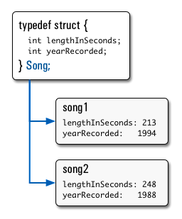
Structs in C
Structs are structured groups of variables, e.g.,
typedef struct {
int lengthInSeconds;
int yearRecorded;
} Song;
Song song1;
song1.lengthInSeconds = 213;
song1.yearRecorded = 1994;
Song song2;
song2.lengthInSeconds = 248;
song2.yearRecorded = 1988;
Dot notation: x.y = value

Slide 15
Consts and Enums in C
Constant is assigned a value once in the declaration; value can't change until the program is restarted
const float goldenRatio = 1.618;
const int daysInWeek = 7;
You can have a constant version of any of the standard C variable types
Enums: a group of related constants used to parameterize libraries

Slide 16
Agenda
Scheme vs. Java vs. C
Administrivia
Quick Start Introduction to C
Technology Break
Pointers

Slide 17
Administrivia
We promised you that CS61c would be relentless!
This week: Lab #2, HW #2
Lab #2, Amazon EC2, will soon be posted
HW #2 will soon be posted
TAs have their office hours late in the week – don’t wait for last minute to get questions answered on HWs and Labs
Take a quick look when posted and come to discussion with questions
We are amazed that there students who still haven’t signed up for the class discussion/announcements group!
Wonderful to see the valuable discussion and help going on there!

Slide 18
Agenda
Scheme vs. Java vs. C
Administrivia
Quick Start Introduction to C
Technology Break
Pointers

Slide 19
A First C Program: Hello World
Original C:
main()
{
printf("\nHello World\n");
}
ANSI Standard C:
#include <stdio.h>
int main(void)
{
printf("\nHello World\n");
return (0);
}

Slide 20
A Second C Program: Compute Table of Sines
#include <stdio.h>
#include <math.h>
void main()
{
int angle_degree;
double angle_radian, pi, value;
/* Print a header */
printf("\nCompute a table of the sine function\n\n");
/* obtain pi once for all */
/* or just use pi = M_PI, where */
/* M_PI is defined in math.h */
pi = 4.0*atan(1.0);
printf("Value of PI = %f \n\n", pi);
printf("angle Sine \n");
angle_degree = 0;
/* initial angle value */
/* scan over angle */
while (angle_degree <= 360)
/* loop until angle_degree > 360 */
{
angle_radian = pi*angle_degree/180.0;
value = sin(angle_radian);
printf (" %3d %f \n ", angle_degree, value);
angle_degree = angle_degree + 10;
/* increment the loop index */
}
}

Slide 21
Second C Program Sample Output
Compute a table of the sine function
Value of PI = 3.141593
angle Sine
0 0.000000
10 0.173648
20 0.342020
30 0.500000
40 0.642788
50 0.766044
60 0.866025
70 0.939693
80 0.984808
90 1.000000
100 0.984808
110 0.939693
120 0.866025
130 0.766044
140 0.642788
150 0.500000
160 0.342020
170 0.173648
180 0.000000
190 -0.173648
200 -0.342020
210 -0.500000
220 -0.642788
230 -0.766044
240 -0.866025
250 -0.939693
260 -0.984808
270 -1.000000
280 -0.984808
290 -0.939693
300 -0.866025
310 -0.766044
320 -0.642788
330 -0.500000
340 -0.342020
350 -0.173648
360 -0.000000

Slide 22
C Syntax: main
To get arguments to the main function, use:
int main (int argc, char *argv[])
What does this mean?
argc contains the number of strings on the command line (the executable counts as one, plus one for each argument). Here argc is 2:
unix% sort myFile
argv is a pointer to an array containing the arguments as strings (more on pointers later)

Slide 23
C Syntax: Variable Declarations
Similar to Java, but with a few minor but important differences
All variable declarations must appear before they are used (e.g., at the beginning of the block)
A variable may be initialized in its declaration; if not, it holds garbage!
Examples of declarations:
Correct: {
int a = 0, b = 10;
...
Incorrect: for (int i = 0; i < 10; i++)
}

Slide 24
C Syntax : Flow Control (1/2)
Within a function, remarkably close to Java constructs in methods (shows its legacy) in terms of flow control
if-else
if (expression) statement
if (expression) statement1
else statement2
while
while (expression)
statement
do
statement
while (expression);

Slide 25
C Syntax : Flow Control (2/2)
Within a function, remarkably close to Java constructs in methods (shows its legacy) in terms of flow control
for
for (initialize; check; update) statement
switch
switch (expression){
case const1: statements
case const2: statements
default: statements
}
break

Slide 26
C Syntax: True or False
What evaluates to FALSE in C?
0 (integer)
NULL (a special kind of pointer: more on this later)
No explicit Boolean type
What evaluates to TRUE in C?
Anything that isn’t false is true
Same idea as in scheme: only #f is false, anything else is true!

Slide 27
Agenda
Scheme vs. Java vs. C
Administrivia
Quick Start Introduction to C
Technology Break
Pointers

Slide 28
Agenda
Scheme vs. Java vs. C
Administrivia
Quick Start Introduction to C
Technology Break
Pointers

Slide 29
Address vs. Value
Consider memory to be a single huge array
Each cell of the array has an address associated with it
Each cell also stores some value
Do you think they use signed or unsigned numbers? Negative address?!
Don’t confuse the address referring to a memory location with the value stored there
...
101 102 103 104 105 ...
...
23
42

Slide 30
Pointers
An address refers to a particular memory location; e.g., it points to a memory location
Pointer: A variable that contains the address of a variable
Location (address)
...
101 102 103 104 105 ...
104
...
23
42
p
x
y
name

Slide 31
Pointers
How to create a pointer:
& operator: get address of a variable
int *p, x;
Note the “*” gets used 2 different ways in this example. In the declaration to indicate that p is going to be a pointer, and in the printf to get the value pointed to by p.
p
?
x
?
x = 3;
p
?
x
3
p = &x;
p
x
3
How get a value pointed to?
* “dereference operator”: get the value that the pointer points to
printf(“p points to %d\n”,*p);

Slide 32
Pointers
How to change a variable pointed to?
Use the dereference operator * on left of assignment operator =
p
x
3
*p = 5;
p
x
5

Slide 33
Pointers and Parameter Passing
Java and C pass parameters “by value”
Procedure/function/method gets a copy of the parameter, so changing the copy cannot change the original
void addOne (int x) { x = x + 1; }
int y = 3;
addOne(y);
y remains equal to 3

Slide 34
Pointers and Parameter Passing
How can we get a function to change a value?
void addOne (int *p) { *p = *p + 1; }
int y = 3;
addOne(&y);
y is now equal to 4

Slide 35
Pointers
Pointers are used to point to any kind of data (int, char, a struct, etc.)
Normally a pointer only points to one type (int, char, a struct, etc.).
void * is a type that can point to anything (generic pointer)
Use sparingly to help avoid program bugs, and security issues, and other bad things!

Slide 36
Peer Instruction Question
void main(); { int *p, x=5, y; // init y = *(p = &x) + 1; int z; flip-sign(p); printf("x=%d,y=%d,p=%d\n",x,y,p); } flip-sign(int *n){*n = -(*n)}
How many syntax + logic errors in this C code?
#Errors
Red: 1
Orange: 2
Green: 3
Yellow: 4
Pink: 5
Notes:
See following answer slide

Slide 37
Peer Instruction Answer
void main(); { int *p, x=5, y; // init y = *(p = &x) + 1; int z; flip-sign(p); printf("x=%d,y=%d,p=%d\n",x,y,*p); } flip-sign(int *n){*n = -(*n);}
How many syntax + logic errors in this C code?
I get 5 … (signed ptr print is logical err)
#Errors
Red: 1
Orange: 2
Green: 3
Yellow: 4
Pink: 5
#Errors
a)1
b)2
c)3
d)4
e)5
Notes:
See following answer slide

Slide 38
More C Pointer Dangers
Declaring a pointer just allocates space to hold the pointer – it does not allocate the thing being pointed to!
Local variables in C are not initialized, they may contain anything (aka “garbage”)
What does the following code do?
void f()
{
int *ptr;
*ptr = 5;
}

Slide 39
Pointers in C
Why use pointers?
If we want to pass a large struct or array, it’s easier / faster / etc. to pass a pointer than the whole thing
In general, pointers allow cleaner, more compact code
So what are the drawbacks?
Pointers are probably the single largest source of bugs in C, so be careful anytime you deal with them
Most problematic with dynamic memory management—which you will to know by the end of the semester, but not for the projects (there will be a lab later in the semester)
Dangling references and memory leaks

Slide 40
Why Pointers in C?
At time C was invented (early 1970s), compilers often didn’t produce efficient code
Computers 25,000 times faster today, compilers better
C designed to let programmer say what they want code to do without compiler getting in way
Even give compilers hints which registers to use!
Today’s compilers produce much better code, so may not need to use pointers
Compilers even ignore hints since they do it better!

Slide 41
FYI—Update to ANSI C
“C99” or “C9x” standard
gcc -std=c99 to compile
References
http://en.wikipedia.org/wiki/C99
http://home.tiscalinet.ch/t_wolf/tw/c/c9x_changes.html
Highlights
Declarations in for loops, like Java
Java-like // comments (to end of line)
Variable-length non-global arrays
<inttypes.h>: explicit integer types
<stdbool.h>: for boolean logic types and definitions

Slide 42
And In Conclusion, …
All data is in memory
Each memory location has an address to use to refer to it and a value stored in it
Pointer is a C version (abstraction) of a data address
* “follows” a pointer to its value
& gets the address of a value
Arrays and strings are implemented as variations on pointers
C is an efficient language, but leaves safety to the programmer
Array bounds not checked
Variables not automatically initialized
Use pointers with care: they are a common source of bugs in programs

