Slide 1
CS 61C: Great Ideas in Computer Architecture (Machine Structures) Introduction to Machine Language
Instructors: Randy H. Katz
David A. Patterson
http://inst.eecs.Berkeley.edu/~cs61c/sp11

Slide 3
Agenda
Machine Language
Administrivia
Operands
Technology Break
Strings
Summary

Slide 4
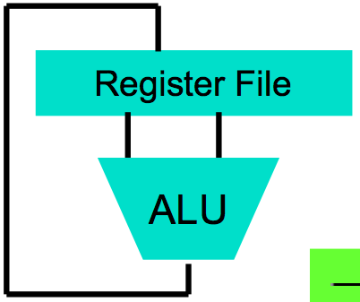
Levels of Representation/Interpretation
High Level Language Program (e.g., C)
temp = v[k];
v[k] = v[k+1];
v[k+1] = temp;
Compiler
Anything can be represented as a number, i.e., data or instructions
lw $t0, 0($2)
lw $t1, 4($2)
sw $t1, 0($2)
sw $t0, 4($2)
Assembly Language Program (e.g., MIPS)
Assembler
0000 1001 1100 0110 1010 1111 0101 1000
1010 1111 0101 1000 0000 1001 1100 0110
1100 0110 1010 1111 0101 1000 0000 1001
0101 1000 0000 1001 1100 0110 1010 1111
Machine Language Program (MIPS)
Machine Interpretation
Hardware Architecture Description (e.g., block diagrams)
Architecture Implementation
Logic Circuit Description (Circuit Schematic Diagrams)

Slide 5
Agenda
Machine Language
Administrivia
Operands
Technology Break
Strings
Summary

Slide 6
The Language a Computer Understands
Word a computer understands: instruction
Vocabulary of all words a computer understands: instruction set (aka instruction set architecture or ISA)
Different computers may have different vocabularies (i.e., different ISAs)
iPhone not same as Macbook
Or the same vocabulary (i.e., same ISA)
iPhone and iPad computers have same instruction set

Slide 7
The Language a Computer Understands
Why not all the same? Why not all different? What might be pros and cons?

Slide 8
The Language a Computer Understands
Why not all the same? Why not all different? What might be pros and cons?
Single ISA (to rule them all):
Leverage common compilers, operating systems, etc.
BUT fairly easy to retarget these for different ISAs (e.g., Linux, gcc)
Multiple ISAs:
Specialized instructions for specialized applications
Different tradeoffs in resources used (e.g., functionality, memory demands, complexity, power consumption, etc.)
Competition and innovation is good, especially in emerging environments (e.g., mobile devices)

Slide 9
Instruction Set in CS61c
MIPS
Invented by John Hennessy @ Stanford
(Why not Berkeley/Sun RISC invented by Dave Patterson? Ask him!)
MIPS is a real world ISA
Standard instruction set for networking equipment
Elegant example of Reduced Instruction Set Computer (RISC) instruction set

Slide 10
RISC Design Principles
Basic RISC principle: “A simpler CPU (the hardware that interprets machine language) is a faster CPU” (CPU → Core)
Focus of the RISC design is reduction of the number and complexity of instructions in the ISA
A number of the more common strategies include:
Fixed instruction length, generally a single word; Simplifies process of fetching instructions from memory
Simplified addressing modes; Simplifies process of fetching operands from memory
Fewer and simpler instructions in the instruction set; Simplifies process of executing instructions
Only load and store instructions access memory; E.g., no add memory to register, add memory to memory, etc.
Let the compiler do it. Use a good compiler to break complex high-level language statements into a number of simple assembly language statements

Slide 11
CS61c’s Instruction Set
Most popular RISC is ARM (Advanced RISC Machine)
In every smart phone-like device |(e.g., iPhone, iPad, iPod, …)
Another popular Instruction Set is used in Macbook and PCs: Intel 80x86 in Core i3, Core i5, Core i7, …
20x ARM versus 80x86 (i.e., 05 billion vs. .3 billion)

Slide 12
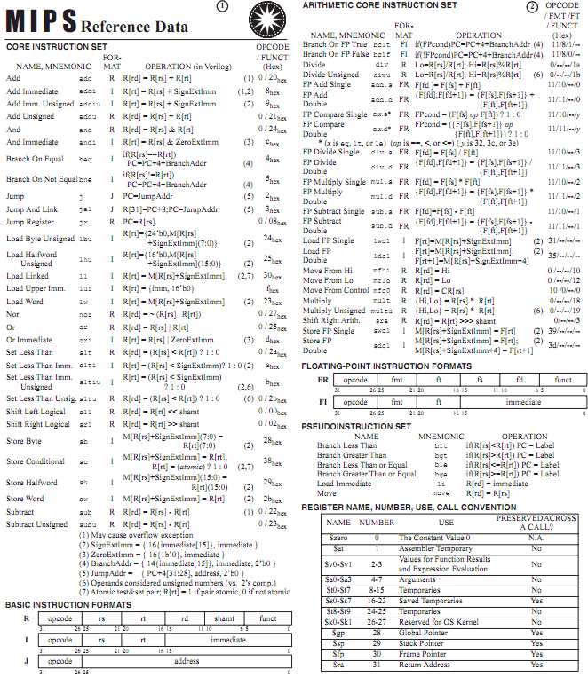
MIPS Green Card

Slide 13
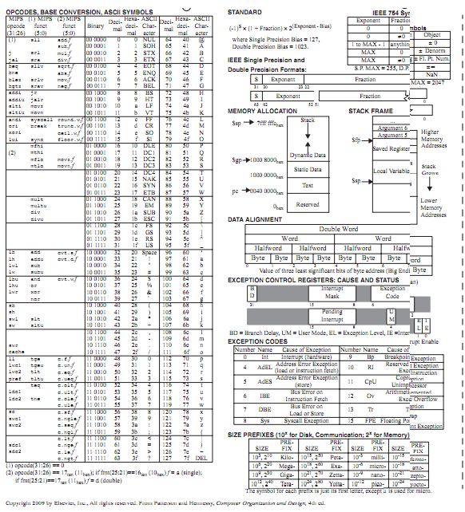
MIPS Green Card

Slide 14
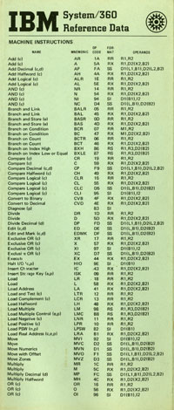
Inspired by the IBM 360 “Green Card”

Slide 15
MIPS Instructions
Every computer does arithmetic
Instruct a computer to do addition:
add a, b, c
Add b to c and put sum into a
3 operands: 2 sources + 1 destination for sum
One operation per MIPS instruction
How do you write the same operation in C?

Slide 16
Guess More MIPS instructions
Subtract c from b and put difference in a?
Multiply b by c and put product in a?
Divide b by c and put quotient in a?

Slide 17
Guess More MIPS instructions
Subtract c from b and put difference in a?
sub a, b, c
Multiply b by c and put product in a?
mul a, b, c
Divide b by c and put quotient in a? div a, b, c

Slide 18
Guess More MIPS instructions
C operator &: c & b with result in a?
C operator |: c | b with result in a?
C operator <<: c << b with result in a?
C operator >>: c >> b with result in a?

Slide 19
Guess More MIPS instructions
C operator &: c & b with result in a?
and a, b, c
C operator |: c | b with result in a?
or a, b, c
C operator <<: c << b with result in a?
sll a, b, c
C operator >>: c >> b with result in a? srl a, b, c

Slide 20
Example Instructions
MIPS instructions are inflexible, rigid:
Just one arithmetic operation per instruction
Always with three operands
How write this C expression in MIPS?
a = b + c + d + e

Slide 21
Example Instructions
How write this C expression in MIPS?
a = b + c + d + e
add t1, d, e
add t2, c, t1
add a, b, t2

Slide 22
Comments in MIPS
Can add comments to MIPS instruction by putting # that continues to end of line of text
add a, b, c # b + c is placed in a
add a, a, d # b + c + d is now in a
add a, a, e # b + c + d + e is in a

Slide 23
C to MIPS
Operators almost identical
What is MIPS code that performs same as?
a = b + c;
d = a – e;
What is MIPS code that performs same as?
f = (g + h) – (i + j);
Notes:
add a, b, c
sub d, a, e
add t0,g,h # temporary variable t0 contains g + h
# Although the next operation is subtract, we need to calculate the sum of i and j before we can subtract.
add t1,i,j # temporary variable t1 contains i + j
# Thus, the second instruction places the sum of i and j in another temporary variable created by the compiler, called t1:
code:sub f,t0,t1 # f gets t0 – t1, which is (g + h) – (i + j)
# Finally, the subtract instruction subtracts the second sum from the first and places the difference in the variable f, completing the compiled

Slide 24
C to MIPS
What is MIPS code that performs same as?
a = b + c; add a, b, c
d = a – e; sub d, a, e
What is MIPS code that performs same as?
f = (g + h) – (i + j);
add t1, i, j
add t2, g, h
sub f, t2, t1
Notes:
add a, b, c
sub d, a, e
add t0,g,h # temporary variable t0 contains g + h
# Although the next operation is subtract, we need to calculate the sum of i and j before we can subtract.
add t1,i,j # temporary variable t1 contains i + j
# Thus, the second instruction places the sum of i and j in another temporary variable created by the compiler, called t1:
code:sub f,t0,t1 # f gets t0 – t1, which is (g + h) – (i + j)
# Finally, the subtract instruction subtracts the second sum from the first and places the difference in the variable f, completing the compiled

Slide 25
Peer Instruction
For a given function, which programming language likely takes the most lines of code?
Scheme
C
MIPS instructions
Put the three representations in order:
Red. Most to least: I, II, III Orange. I, III, II
Green. II, III, I Yellow. II, I, III
Pink. III, II, I Blue. III, I, II

Slide 26
Peer Instruction
For a given function, which programming language likely takes the most lines of code?
Scheme
C
MIPS instructions
Put the three representations in order:
Red. Most to least: I, II, III Orange. I, III, II
Green. II, III, I Yellow. II, I, III
Pink. III, II, I Blue. III, I, II

Slide 27
Agenda
Machine Language
Administrivia
Operands
Technology Break
Strings
Summary

Slide 28
Administrivia
This week in lab and homework:
Lab #3 EC2 posted (TAs say it is more doable than last week)
Note: labs graded on a scale of 0 to 2
HW #3 Posted
Note: HWs graded on a scale from 0 to 3
Project #1 posted
Note: intermediate checkpoint due Sunday!
HKN Announcements/Tutoring

Slide 29
Agenda
Machine Language
Administrivia
Operands
Technology Break
Strings
Summary

Slide 30
Computer Hardware Operands
High-Level Programming languages: could have millions of variables
Instruction sets have fixed, smaller number
Called registers
“Bricks” of computer hardware
Used to construct computer hardware
Visible to (the “assembly language”) programmer
MIPS Instruction Set has 32 registers

Slide 31
Why Just 32 Registers?
RISC Design Principle: Smaller is faster
But you can be too small …
Hardware would likely be slower with 64, 128, or 256 registers
32 is enough for compiler to translate typical C programs, and not run out of registers very often
ARM instruction set has only 16 registers
May be faster, but compiler may run out of registers too often (aka “spilling registers to memory”)

Slide 32
Names of MIPS Registers
For registers that hold programmer variables:
$s0, $s1, $s2, …
For registers that hold temporary variables:
$t0, $t1, $t2, …
Suppose variables f, g, h, i, and j are assigned to the registers $s0, $s1, $s2, $s3, and $s4, respectively. What is MIPS for
f = (g + h) – (i + j);
Notes:
add $so, $s1, $s2
add $t0, $s3, $s4
sub $s0, $s0, $t0

Slide 33
Names of MIPS Registers
Suppose variables f, g, h, i, and j are assigned to the registers $s0, $s1, $s2, $s3, and $s4, respectively. What is MIPS for
f = (g + h) – (i + j);
add $t1, $s3, $s4
add $t2, $s1, $s2
sub $s0, $t2, $t1
Notes:
add $so, $s1, $s2
add $t0, $s3, $s4
sub $s0, $s0, $t0

Slide 34
Size of Registers
Bit is the atom of Computer Hardware: contains either 0 or 1
True “alphabet” of computer hardware is 0, 1
Will eventually express MIPS instructions as combinations of 0s and 1s
MIPS registers are 32 bits wide
MIPS calls this quantity a word
Some computers use 16-bit wide words
E.g., Intel 80x86

Slide 35
Data Structures vs. Simple Variables
In addition to registers, a computer also has memory that holds millions / billions of words
Memory is a single dimension array, starting at 0
To access memory, need an address (like an array index)
But MIPS instructions only operate on registers!
Solution: instructions specialized to transfer words (data) between memory and registers
Called data transfer instructions
…
3
2
1
0

Slide 36
Transfer from Memory to Register
MIPS instruction: Load Word, abbreviated lw
Assume A is an array of 100 words, variables g and h map to registers $s1 and $s2, the starting address/base address of the array A is in $s3
int A[100];
g = h + A[3];
Becomes:
lw $t0,3($s3) # Temp reg $t0 gets A[3]
add $s1,$s2,$t0 # g = h + A[3]

Slide 37
Memory Addresses are in Bytes
Lots of data is smaller than 32 bits, but rarely smaller than 8 bits – works fine if everything is a multiple of 8 bits
8 bit item is called a byte
(1 word = 4 bytes)
Memory addresses are really in bytes, not words
Word addresses are 4 bytes apart
Word address is same as leftmost byte
Addr of lowest byte in word is addr of word
…
…
…
…
…
12
13
14
15
3
8
9
10
11
2
4
5
6
7
1
0
1
2
3
0

Slide 38
Transfer from Memory to Register
MIPS instruction: Load Word, abbreviated lw
Assume A is an array of 100 words, variables g and h map to registers $s1 and $s2, the starting address/base address of the array A is in $s3
g = h + A[3];
Becomes:
lw $t0, 3($s3) # Temp reg $t0 gets A[3]
add $s1,$s2,$t0 # g = h + A[3]
12
Notes:
Re]lace 8 with 32 on lw

Slide 39
Transfer from Register to Memory
MIPS instruction: Store Word, abbreviated sw
Assume A is an array of 100 words, variables g and h map to registers $s1 and $s2, the starting address, or base address, of the array A is in $s3
A[10] = h + A[3];
Turns into
lw $t0,12($s3) # Temp reg $t0 gets A[3]
add $t0,$s2,$t0 # t0 = h + A[3]
# A[10] = h + A[3]
Notes:
Add
sw $t0, 40($s3) # Stores h+A[3] into A[10]

Slide 40
Transfer from Register to Memory
MIPS instruction: Store Word, abbreviated sw
Assume A is an array of 100 words, variables g and h map to registers $s1 and $s2, the starting address, or base address, of the array A is in $s3
A[10] = h + A[3];
Turns into
lw $t0,12($s3) # Temp reg $t0 gets A[3]
add $t0,$s2,$t0 # t0 = h + A[3]
sw $t0,40($s3) # A[10] = h + A[3]
Notes:
Add
sw $t0, 40($s3) # Stores h+A[3] into A[10]

Slide 41
Speed of Registers vs. Memory
Given that
Registers: 32 words (128 Bytes)
Memory: Billions of bytes (2 GB to 8 GB on laptop)
and the RISC principle is
Smaller is faster
How much faster are registers than memory??
About 100-500 times faster!

Slide 42
Agenda
Machine Language
Administrivia
Operands
Technology Break
Strings
Summary

Slide 43
Agenda
Machine Language
Administrivia
Operands
Technology Break
Strings
Summary

Slide 45
Strings: C vs. Java
Recall: a string is just a long sequence of characters (i.e., array of chars)
C: 8-bit ASCII, define strings with end of string character NUL (0 in ASCII)
Java: 16-bit UNICODE, first entry gives length of string

Slide 46
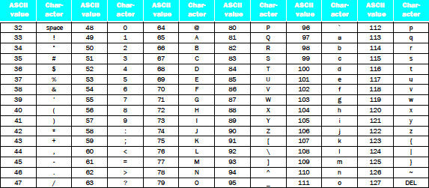
Strings
“Cal” in ASCII in C; How many bytes?
Using 1 integer per byte, what does it look like?
Notes:
Thus, the
string “Cal” is represented in C by the following 4 bytes, shown as decimal numbers:
67, 97, 108, 0.

Slide 47
Strings
“Cal” in ASCII in C; How many bytes?
Using 1 integer per byte, what does it look like?
Notes:
Thus, the
string “Cal” is represented in C by the following 4 bytes, shown as decimal numbers:
67, 97, 108, 0.

Slide 48
Strings
“Cal” in Unicode in Java; How many bytes?
Using 1 integer per byte, what does it look like? (For Latin alphabet, 1st byte is 0, 2nd byte is ASCII)
Notes:
Thus, the
string “Cal” is represented in C by the following 10 bytes, shown as decimal numbers:
0, 0, 0, 3, 0, 67, 0, 97, 0, 108
(32 bit word contains string length)

Slide 49
Strings
“Cal” in Unicode in Java; How many bytes?
Using 1 integer per byte, what does it look like? (For Latin alphabet, 1st byte is 0, 2nd byte is ASCII)
Notes:
Thus, the
string “Cal” is represented in C by the following 10 bytes, shown as decimal numbers:
0, 0, 0, 3, 0, 67, 0, 97, 0, 108
(32 bit word contains string length)

Slide 50
Support for Characters and Strings
Load a word, use andi to isolate byte
lw $s0,0($s1)
andi $s0,$s0,255 # Zero everything but last 8 bits
RISC Design Principle: “Make the Common Case Fast”—Many programs use text: MIPS has load byte instruction (lb)
lb $s0,0($s1)
Also store byte instruction (sb)

Slide 51
Support for Characters and Strings
Load a word, use andi to isolate half of word
lw $s0,0($s1)
andi $s0,$s0,65535 # Zero everything but last 16 bits
RISC Design Principle #3: “Make the Common Case Fast”—Many programs use text, MIPS has load halfword instruction (lh)
lh $s0,0($s1)
Also store halfword instruction (sh)

Slide 52
Computer Decision Making
Based on computation, do something different
In programming languages: if-statement
Sometimes combined with gotos and labels
MIPS: if-statement instruction is
beq register1,register2,L1
means go to statement labeled L1 if value in register1 = value in register2
beq stands for branch if equal
Other instruction: bne for branch if not equal

Slide 53
Making Decisions in C or Java
if (i == j) f = g + h; else f = g – h;
If false, skip over “then” part to “else” part => use conditional branch bne
Otherwise, (its true) do “then” part and skip over “else” part => need an always branch instruction (“unconditional branch”)
MIPS name for this instruction: jump (j)

Slide 54
Making Decisions in MIPS
if (i == j) f = g + h; else f = g – h;
f => $s0, g => $s1, h => $s2, i => $s3, j => $s4
If false, skip “then” part to “else” part
Otherwise, (its true) do “then” part and skip over “else” part
Notes:
bne $s3,$s4,Else # go to Else part if i ≠ j
add $s0,$s1,$s2 # f = g + h (Then part)
j Exit # go to Exit
Else: sub $s0,$s1,$s2 # f = g – h (Else part)
Exit:

Slide 55
Making Decisions in MIPS
if (i == j) f = g + h; else f = g – h;
f => $s0, g => $s1, h => $s2, i => $s3, j => $s4
If false, skip “then” part to “else” part
Otherwise, (its true) do “then” part and skip over “else” part
bne $s3,$s4,Else # go to Else part if i ≠ j
add $s0,$s1,$s2 # f = g + h (Then part)
j Exit # go to Exit
Else: sub $s0,$s1,$s # f = g – h (Else part)
Exit:

Slide 56
And In Conclusion …
Computer words and vocabulary are called instructions and instruction set respectively
MIPS is example RISC instruction set in this class
Rigid format: 1 operation, 2 source operands, 1 destination
add, sub, mul, div, and, or, sll, srl
lw, sw to move data to/from registers from/to memory
Simple mappings from arithmetic expressions, array access, if-then-else in C to MIPS instructions

