Slide 1
CS 61C: Great Ideas in Computer Architecture (Machine Structures) Caches
Instructors: Randy H. Katz David A. Patterson
http://inst.eecs.Berkeley.edu/~cs61c/sp11

Slide 3
Review
Time (seconds/program) is performance measure Instructions Clock cycles Seconds Program Instruction Clock Cycle
Benchmarks stand in for real workloads to as standardized measure of relative performance
Power of increasing concern, and being added to benchmarks
Time measurement via clock cycles, machine specific
Profiling tools as way to see where spending time in your program
=
×
×

Slide 4
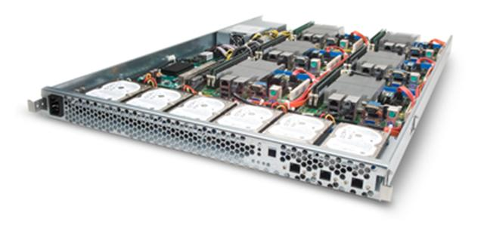
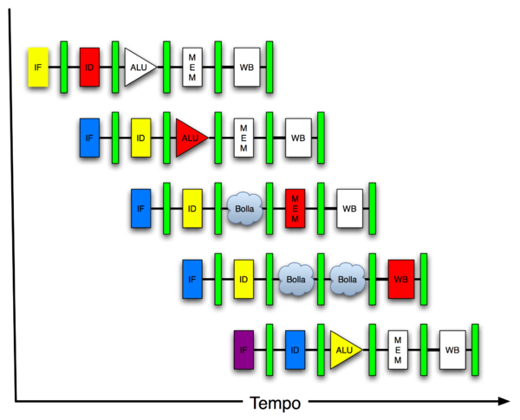
New-School Machine Structures (It’s a bit more complicated!)
Software Hardware
Parallel Requests
Assigned to computer
e.g., Search “Katz”
Parallel Threads
Assigned to core
e.g., Lookup, Ads
Parallel Instructions
>1 instruction @ one time
e.g., 5 pipelined instructions
Parallel Data
>1 data item @ one time
e.g., Add of 4 pairs of words
Hardware descriptions
All gates @ one time
Warehouse Scale Computer
Smart Phone
Harness Parallelism &
Achieve High Performance
Computer
Today’s
Lecture
Core
…
Core
Memory (Cache)
Input/Output
Core
Instruction Unit(s)
Functional
Unit(s)
A₀+B₀
A₁+B₁
A₂+B₂
A₃+B₃
Main Memory
Logic Gates

Slide 5
Agenda
Memory Hierarchy Analogy
Memory Hierarchy Overview
Administrivia
Caches
Direct Mapped Cache
Technology Break
(Cache Performance: If time permits)

Slide 6
Library Analogy
Writing a report based on books on reserve
E.g., works of J.D. Salinger
Go to library to get reserved book and place on desk in library
If need more, check them out and keep on desk
But don’t return earlier books since might need them
You hope this collection of ~10 books on desk enough to write report, despite 10 being only 0.00001% of books in UC Berkeley libraries

Slide 7
Big Idea: Locality
Temporal Locality (locality in time)
Go back to same book on desktop multiple times
If a memory location is referenced then it will tend to be referenced again soon
Spatial Locality (locality in space)
When go to book shelf, pick up multiple books on J.D. Salinger since library stores related books together
If a memory location is referenced, the locations with nearby addresses will tend to be referenced soon
Notes:
How does the memory hierarchy work? Well it is rather simple, at least in principle.
In order to take advantage of the temporal locality, that is the locality in time, the memory hierarchy will keep those more recently accessed data items closer to the processor because chances are (points to the principle), the processor will access them again soon.
In order to take advantage of the spatial locality, not ONLY do we move the item that has just been accessed to the upper level, but we ALSO move the data items that are adjacent to it.
+1 = 15 min. (X:55)

Slide 8
Principle of Locality
Principle of Locality: Programs access small portion of address space at any instant of time
What program structures lead to temporal and spatial locality in code?
In data?
Student Roulette

Slide 9
How does hardware exploit principle of locality?
Offer a hierarchy of memories where
closest to processor is fastest (and most expensive per bit so smallest)
furthest from processor is largest (and least expensive per bit so slowest)
Goal is to create illusion of memory almost as fast as fastest memory and almost as large as biggest memory of the hierarchy

Slide 10
Big Idea: Memory Hierarchy
Processor
Higher
Increasing distance from processor, decreasing speed
Levels in memory hierarchy
Level 1
Level 2
Level 3
Lower
. . .
Level n
Size of memory at each level
Student Roulette
As we move to deeper levels the latency goes up and price per bit goes down. Why?

Slide 11
Cache Concept
Processor and memory speed mismatch leads us to add a new level: a memory cache
Implemented with same integrated circuit processing technology as processor, integrated on-chip: faster but more expensive than DRAM memory
Cache is a copy of a subset of main memory
Modern processors have separate caches for instructions and data, as well as several levels of caches implemented in different sizes
As a pun, often use $ (“cash”) to abbreviate cache, e.g. D$ = Data Cache, I$ = Instruction Cache

Slide 12
Memory Hierarchy Technologies
Caches use SRAM (Static RAM) for speed and technology compatibility
Fast (typical access times of 0.5 to 2.5 ns)
Low density (6 transistor cells), higher power, expensive ($2000 to $4000 per GB in 2011)
Static: content will last as long as power is on
Main memory uses DRAM (Dynamic RAM) for size (density)
Slower (typical access times of 50 to 70 ns)
High density (1 transistor cells), lower power, cheaper ($20 to $40 per GB in 2011)
Dynamic: needs to be “refreshed” regularly (~ every 8 ms)
Consumes 1% to 2% of the active cycles of the DRAM
Notes:
Size comparison: DRAM/SRAM is 4 to 8 times
Cost/cycle time comparison SRAM/DRAM is 8 to 16 times
http://parts.digikey.com/1/parts/1211303-ic-sram-1mbit-10ns-32soj-cy7c109d-10vxi.html
Quantity discount 10ns 1MBit SRAM $2.24, $17/Mbyte, $1700/100 Mbyte, $17000/GByte
http://www.frys.com/template/harddrives
DRAM: 4GB @ $70 or $17.50 per GB
24GB@$800 = $33/Gbyte
http://www.frys.com/category/Outpost/Hard+Drives+&+Memory/Memory/Notebook+Memory/Apple+-+Mac++Memory/
DDR2 1GB @ $25 per
DDR3 1 GB @ $37.5 per
FLASH Media
Approx. $2 per Gbyte

Slide 13
Characteristics of the Memory Hierarchy
Processor
Inclusive– what is in L1$ is a subset of what is in L2$ is a subset of what is in MM that is a subset of is in SM
4-8 bytes (word)
Increasing distance from the processor in access time
L1$
8-32 bytes (block)
L2$
16-128 bytes (block)
Main Memory
4,096+ bytes (page)
Secondary Memory
(Relative) size of the memory at each level
Notes:
Because the upper level is smaller and built using faster memory parts, its hit time will be much smaller than the time to access the next level in the hierarchy (which is the major component of the miss penalty).

Slide 14
How is the Hierarchy Managed?
registers ↔ memory
By compiler (or assembly level programmer)
cache ↔ main memory
By the cache controller hardware
main memory ↔ disks (secondary storage)
By the operating system (virtual memory)
(Talk about later in the semester)
Virtual to physical address mapping assisted by the hardware (TLB)
By the programmer (files)

Slide 15
Typical Memory Hierarchy
On-Chip Components
Control
Instr
Cache
Second
Level
Cache
(SRAM)
Secondary
Memory
(Disk
Or Flash)
Main
Memory
(DRAM)
Datapath
RegFile
Data
Cache
Speed (cycles): ½’s 1’s 10’s 100’s 1,000,000’s
Size (bytes): 100’s 10K’s M’s G’s T’s
Cost/bit: highest lowest
Principle of locality + memory hierarchy presents programmer with ≈ as much memory as is available in the cheapest technology at the ≈ speed offered by the fastest technology
Notes:
Instead, the memory system of a modern computer consists of a series of black boxes ranging from the fastest to the slowest.
Besides variation in speed, these boxes also varies in size (smallest to biggest) and cost.
What makes this kind of arrangement work is one of the most important principle in computer design. The principle of locality. The principle of locality states that programs access a relatively small portion of the address space at any instant of time.
The design goal is to present the user with as much memory as is available in the cheapest technology (points to the disk).
While by taking advantage of the principle of locality, we like to provide the user an average access speed that is very close to the speed that is offered by the fastest technology.
(We will go over this slide in detail in the next lectures on caches).

Slide 16
Review so far
Wanted: effect of a large, cheap, fast memory
Approach: Memory Hierarchy
Successively lower levels contain “most used” data from next higher level
Exploits temporal & spatial locality
Memory hierarchy follows 2 Design Principles: Smaller is faster and Do common the case fast

Slide 17
Agenda
Memory Hierarchy Overview
Administrivia
Caches
Direct Mapped Cache
Technology Break
(Cache Performance: If time permits)

Slide 18
Administrivia
Everyone off wait lists
Lab #6 posted
Project #2, Part 2 Due Sunday @ 11:59:59
No Homework this week!
Midterm in 2 weeks:
Exam: Tu, Mar 8, 6-9 PM, 145/155 Dwinelle
Split: A-Lew in 145, Li-Z in 155
No discussion during exam week; no lecture that day
TA Review: Su, Mar 6, 2-5 PM, 2050 VLSB
Small number of special consideration cases, due to class conflicts, etc.—contact Dave or Randy

Slide 19
Project 2, Part 1
>10,
< 12
48%
≤10 27%
≥ 12 26%
12 new tests
57 passed all tests
Max score 15
218 fail 4 to 6 tests
Most code does not properly sign-extend immediate field
4 failed initial 2 tests
3 didn’t compile

Slide 20
61C in the News
“South Korean homes now have greater Internet access than we do,” President Obama said in his State of the Union address. Last week, Mr. Obama unveiled an $18.7 billion broadband spending program. (Use WiMax to beam broadband from where Internet providers' systems currently end to rural areas. )
By the end of 2012, South Korea intends to connect every home in the country to the Internet at one gigabit per second. That would be a tenfold increase from the already blazing national standard and more than 200 times as fast as the average household setup in the United States.
“Home Internet May Get Even Faster in South Korea,”
By Mark McDonald, New York Times, February 21, 2011

Slide 21
What Conference?
Will be held in charming San Francisco April 3-5?
Is sponsored by Google, Intel, Microsoft, Cisco, NetAp, …
Includes a past National Academy of Engineering President , past IBM Academy of Technology Chair, past ACM President, past Computing Research Association Chair, members of NAE, Technology Review’s Young Innovators (TR35), and Google’s Executive VP of Research & Engineering?
Has attendance that averages 50% female, 40% African American, and 30% Hispanic?

Slide 22
in beautiful
San Francisco
Inclusive: all welcome, it works!
82%: reaffirms CS major, will finish degree
Luminiaries: Deborah Estrin UCLA, Blaise Aguera y Arcas Microsoft, Alan Eustace Google, Bill Wulf UVA, Irving Wladawsky-Berger IBM, John Kubiatowicz UC Berkeley
Rising Stars: Illya Hicks Rice, Ayanna Howard Georgia Tech, Patty Lopez Intel
General Chair: Dave Patterson
tapiaconference.org/2011
CDC is a joint org. of ACM,IEEE/CS,CRA
If you care, come!
Volunteer poster for student opportunities (work remote or import student)
Encourage grad students to apply doctoral consortium
8 great speakers
Workshops on Grad School Success, Early Career Success, Resume Preparation + BOFs
Banquet and Dance
San Francisco Activity: Alcatraz Tour, Chinatown, Bike over Golden Gate Bridge, …
If interested, email Sheila Humphrys with name, year, topic interest + 2 to 3 sentences why want to go to Tapia humphrys@EECS.Berkeley.EDU
http://tapiaconference.org/2011/participate.html

Slide 23
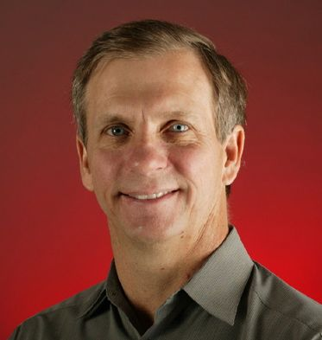
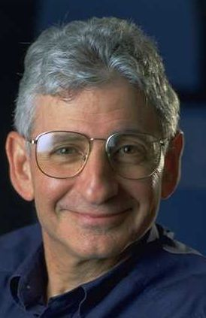
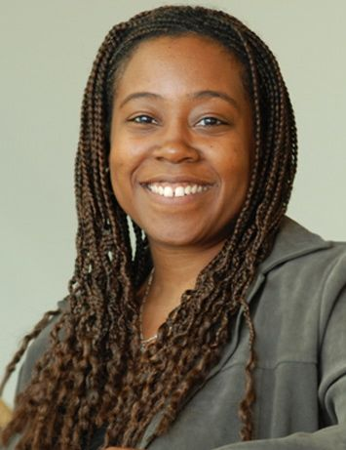
Aguera y Arcas
Estrin
Eustace
Kubiatowicz
Speakers
Tapia Awardee
Lopez
Hicks
Wladawsky
Howard
Wulf
Organizers
Patterson
Taylor
Tapia
Lanius
Vargas
Perez-Quinones
Notes:
Top Row, L-R: Blaise Aguera y Arcas Microsoft (TR35), Deborah Estrin UCLA (NAE), Alan Eustace Google, John Kubiatowicz UC Berkeley
Middle Row, L-R: Patty Lopez Intel, Illya Hicks Rice, Irving Wladawsky-Berger IBM, Ayanna Howard Georgia Tech (TR35). Bill Wulf Virgina (Tapia Award winner, NAE)
Bottom Row, L-R: Dave Patterson UC Berkeley (General Chair,NAE, NAS, CRA, ACM), Valerie Taylor Texas A&M, Richard Tapia Rice (NAE), Cynthia Lanius Rice, Juan Vargas Microsoft (Vice-Chair), Manuel A. Perez-Quinones (CDC chair)

Slide 24
Cache Design Questions
How best to organize the memory blocks of the cache?
To which block of the cache does a given main memory address map?
Since the cache is a subset of memory, multiple memory addresses can map to the same cache location
How do we know which blocks of main memory currently have a copy in cache?
How do we find these copies quickly?

Slide 25
Cache Basics: Direct Mapped
Direct mapped
Each memory block is mapped to exactly one block in the cache
Many lower level blocks share a given cache block
Block is also called a line
Address mapping:
(block address) modulo (# of blocks in the cache)
Tag associated with each cache block containing the address information (the upper portion of the address) required to identify the block (to answer Q1)
(Later in semester we’ll cover alternatives to direct mapped)

Slide 26
Mapping a 6-bit Memory Address
5
4
3
2
1
0
Mem Block Within $ Block
Tag
Block Within $
Index
Byte Offset Within Block (e.g., Word)
Note: $ = Cache
In example, block size is 4 bytes/1 word (it could be multi-word)
Memory and cache blocks are the same size, unit of transfer between memory and cache
# Memory blocks >> # Cache blocks
16 Memory blocks/16 words/64 bytes/6 bits to address all bytes
4 Cache blocks, 4 bytes (1 word) per block
4 Memory blocks map to each cache block
Byte within block: low order two bits, ignore! (nothing smaller than a block)
Memory block to cache block, aka index: middle two bits
Which memory block is in a given cache block, aka tag: top two bits

Slide 27
Direct Mapped Cache Example
One word blocks, cache size = 1K words (or 4KB)
Byte offset
31 30 . . . 13 12 11 . . . 2 1 0
Hit
Tag
20
10
Data
Valid bit ensures something useful in cache for this index
Index
Read data from cache instead of memory if a Hit
Index
Valid
Tag
Data
0
1
2
.
.
.
1021
1022
1023
Compare Tag with upper part of Address to see if a Hit
20
32
Student Roulette
What kind of locality are we taking advantage of?
Notes:
Let’s use a specific example with realistic numbers: assume we have a 1 K word (4Kbyte) direct mapped cache with block size equals to 4 bytes (1 word).
In other words, each block associated with the cache tag will have 4 bytes in it (Row 1).
With Block Size equals to 4 bytes, the 2 least significant bits of the address will be used as byte select within the cache block.
Since the cache size is 1K word, the upper 32 minus 10+2 bits, or 20 bits of the address will be stored as cache tag.
The rest of the (10) address bits in the middle, that is bit 2 through 11, will be used as Cache Index to select the proper cache entry
Temporal!

Slide 28
Caching: A Simple First Example
Cache
Main Memory
0000xx
0001xx
0010xx
0011xx
0100xx
0101xx
0110xx
0111xx
1000xx
1001xx
1010xx
1011xx
1100xx
1101xx
1110xx
1111xx
Index
Valid
Tag
Data
One word blocks
Two low order bits define the byte in the word (32b words)
00
01
10
11
Q: Where in the cache is the mem block?
Use next 2 low order memory address bits – the index – to determine which cache block (i.e., modulo the number of blocks in the cache)
Q: Is the mem block in cache?
Compare the cache tag to the high order 2 memory address bits to tell if the memory block is in the cache
Student Roulette
(block address) modulo (# of blocks in the cache)
Notes:
For class handout

Slide 29
Caching: A Simple First Example
Main Memory
0000xx
0001xx
0010xx
0011xx
0100xx
0101xx
0110xx
0111xx
1000xx
1001xx
1010xx
1011xx
1100xx
1101xx
1110xx
1111xx
One word blocks
Two low order bits define the byte in the word (32b words)
Cache
Index
Valid
Tag
Data
00
01
10
11
Q: Where in the cache is the mem block?
Use next 2 low order memory address bits – the index – to determine which cache block (i.e., modulo the number of blocks in the cache)
Q: Is the mem block in cache?
Compare the cache tag to the high order 2 memory address bits to tell if the memory block is in the cache
(block address) modulo (# of blocks in the cache)
Notes:
For lecture
Valid bit indicates whether an entry contains valid information – if the bit is not set, there cannot be a match for this block

Slide 30
Direct Mapped Cache
Consider the main memory word reference string
0 1 2 3 4 3 4 15
Start with an empty cache - all blocks initially marked as not valid
0000 0001 0010 0011 0100 0011 0100 1111
Address 0
Notes:
For class handout

Slide 31
Direct Mapped Cache
Consider the main memory word reference string
0 1 2 3 4 3 4 15
Start with an empty 4-word cache - all blocks initially marked as not valid
0000 0001 0010 0011 0100 0011 0100 1111
0
miss
00 Mem(0)
1 requests, 1 miss
Notes:
For lecture
Reference string is word addresses (or block number since we are using one word blocks) – i.e., the low order two bits used to selected the byte in the 32-bit word are ignored

Slide 32
Direct Mapped Cache
Consider the main memory word reference string
0 1 2 3 4 3 4 15
Start with an empty cache - all blocks initially marked as not valid
Student Roulette
0
miss
1
2
3
00 Mem(0)
00 Mem(0)
Time
4
3
4
15
Time
Notes:
For class handout

Slide 33
Direct Mapped Cache
Consider the main memory word reference string
0 1 2 3 4 3 4 15
Start with an empty cache - all blocks initially marked as not valid
0000 0001 0010 0011 0100 0011 0100 1111
0
miss
1
miss
2
miss
3
miss
00 Mem(0)
00 Mem(0)
00 Mem(0)
00 Mem(1)
00 Mem(0)
00 Mem(1)
00 Mem(2)
00 Mem(1)
00 Mem(2)
00 Mem(3)
4
miss
3
hit
4
hit
15
miss
01
4
00 Mem(0)
00 Mem(1)
00 Mem(2)
00 Mem(3)
01 Mem(4)
00 Mem(1)
00 Mem(2)
00 Mem(3)
01 Mem(4)
00 Mem(1)
00 Mem(2)
00 Mem(3)
01 Mem(4)
00 Mem(1)
00 Mem(2)
00 Mem(3)
11
15
8 requests, 6 misses
Notes:
For lecture
Reference string is word addresses (or block number since we are using one word blocks) – i.e., the low order two bits used to selected the byte in the 32-bit word are ignored

Slide 34
Multiword Block Direct Mapped Cache
Four words/block, cache size = 1K words
Byte offset
Hit
31 30 . . . 13 12 11 . . . 4 3 2 1 0
Data
Tag
20
8
Block offset
Index
Index
Valid
Tag
Data
0
1
2
.
.
.
253
254
255
20
32
What kind of locality are we taking advantage of?
Student Roulette
Notes:
to take advantage for spatial locality want a cache block that is larger than word word in size.

Slide 35
Taking Advantage of Spatial Locality
Let cache block hold more than one word
0 1 2 3 4 3 4 15
Start with an empty cache - all blocks initially marked as not valid
0000 0001 0010 0011 0100 0011 0100 1111
0
1
2
3
4
3
4
15
Notes:
For class handout

Slide 36
Taking Advantage of Spatial Locality
Let cache block hold more than one word
0 1 2 3 4 3 4 15
Start with an empty cache - all blocks initially marked as not valid
0000 0001 0010 0011 0100 0011 0100 1111
0
miss
Student Roulette
1
2
00 Mem(1) Mem(0)
3
4
3
4
15
Notes:
For class handout

Slide 37
Taking Advantage of Spatial Locality
Let cache block hold more than one word
0 1 2 3 4 3 4 15
Start with an empty cache - all blocks initially marked as not valid
0
miss
1
hit
2
miss
00 Mem(1) Mem(0)
00 Mem(1) Mem(0)
00 Mem(1) Mem(0)
00 Mem(3) Mem(2)
3
hit
4
miss
3
hit
01
5
4
00 Mem(1) Mem(0)
00 Mem(1) Mem(0)
01 Mem(5) Mem(4)
00 Mem(3) Mem(2)
00 Mem(3) Mem(2)
00 Mem(3) Mem(2)
4
hit
15
miss
01 Mem(5) Mem(4)
01 Mem(5) Mem(4)
11
00 Mem(3) Mem(2)
00 Mem(3) Mem(2)
15
14
8 requests, 4 misses
Notes:
For lecture
Show the 4-bit address mapping – 2-bits of tag, 1-bit of set address (index), 1-bit of word-in-block select

Slide 38
Miss Rate vs Block Size vs Cache Size
Miss rate goes up if the block size becomes a significant fraction of the cache size because the number of blocks that can be held in the same size cache is smaller (increasing capacity misses)
Notes:
Increasing the block size usually decreases the miss rate.
A more serious problem is that the miss penalty goes up since it is primarily determined by the time to fetch the block from the next lower level of the hierarchy and load it into the cache.

Slide 39
Measuring Cache Performance
Assuming cache hit costs are included as part of the normal CPU execution cycle, then
CPU time = IC × CPI × CC
= IC × (CPI_{ideal} + Memory-stall cycles) × CC
CPI_{stall}
A simple model for Memory-stall cycles
Memory-stall cycles = accesses/program × miss rate × miss penalty
Will talk about writes and write misses next lecture, where its a little more complicated
Notes:
Reasonable write buffer depth (e.g., four or more words) and a memory capable of accepting writes at a rate that significantly exceeds the average write frequency means write buffer stalls are small

Slide 40
Impacts of Cache Performance
Relative $ penalty increases as processor performance improves (faster clock rate and/or lower CPI)
Memory speed unlikely to improve as fast as processor cycle time. When calculating CPI_{stall}, cache miss penalty is measured in processor clock cycles needed to handle a miss
Lower the CPI_{ideal}, more pronounced impact of stalls
Processor with a CPI_{ideal} of 2, a 100 cycle miss penalty, 36% load/store instr’s, and 2% I$ and 4% D$ miss rates
Memory-stall cycles = 2% × 100 + 36% × 4% × 100 = 3.44
So CPI_{stalls} = 2 + 3.44 = 5.44
More than twice the CPIideal !
What if the CPI_{ideal} is reduced to 1?
What if the D$ miss rate went up by 1%?
Student Roulette
Notes:
For ideal CPI = 1, then CPIstall = 4.44 and the amount of execution time spent on memory stalls would have risen from 3.44/5.44 = 63% to 3.44/4.44 = 77%
For miss penalty of 200, memory stall cycles = 2% 200 + 36% x 4% x 200 = 6.88 so that CPIstall = 8.88
This assumes that hit time (so hit time is 1 cycle) is not a factor in determining cache performance. A larger cache would have a longer access time (if a lower miss rate), meaning either a slower clock cycle or more stages in the pipeline for memory access.

Slide 41
Average Memory Access Time (AMAT)
Average Memory Access Time (AMAT) is the average to access memory considering both hits and misses
AMAT = Time for a hit + Miss rate x Miss penalty
What is the AMAT for a processor with a 200 psec clock, a miss penalty of 50 clock cycles, a miss rate of 0.02 misses per instruction and a cache access time of 1 clock cycle?
Potential impact of much larger cache on AMAT?
1 + 0.02 x 50 = 2 clock cycles
Or 2 x 200 = 400 psecs
Student Roulette
1) Lower Miss rate
2) Longer Access time (Hit time): smaller is faster
Increase in hit time will likely add another stage to the pipeline
At some point, increase in hit time for a larger cache may overcome the improvement in hit rate, yielding a decrease in performance
Notes:
AMAT = 1 + 0.02x50 = 2

Slide 42
Review so far
Principle of Locality for Libraries /Computer Memory
Hierarchy of Memories (speed/size/cost per bit) to Exploit Locality
Cache – copy of data lower level in memory hierarchy
Direct Mapped to find block in cache using Tag field and Valid bit for Hit
Larger caches reduce Miss rate via Temporal and Spatial Locality, but can increase Hit time
Larger blocks to reduces Miss rate via Spatial Locality, but increase Miss penalty
AMAT helps balance Hit time, Miss rate, Miss penalty

