Slide 1
CS 61C: Great Ideas in Computer Architecture SIMD I
Instructor:
David A. Patterson
http://inst.eecs.Berkeley.edu/~cs61c/sp12

Slide 2
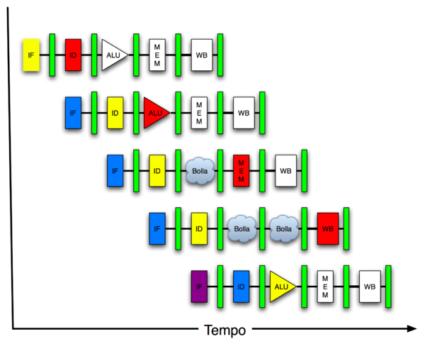
New-School Machine Structures (It’s a bit more complicated!)
Software Hardware
Parallel Requests
Assigned to computer
e.g., Search “Katz”
Parallel Threads
Assigned to core
e.g., Lookup, Ads
Parallel Instructions
>1 instruction @ one time
e.g., 5 pipelined instructions
Parallel Data
>1 data item @ one time
e.g., Add of 4 pairs of words
Hardware descriptions
All gates @ one time
Programming Languages
Warehouse Scale Computer
Smart Phone
Harness Parallelism &
Achieve High Performance
Computer
Core
…
Core
Memory (Cache)
Input/Output
Core
Today’s
Lecture
Instruction Unit(s)
Functional
Unit(s)
A₀+B₀
A₁+B₁
A₂+B₂
A₃+B₃
Cache Memory
Logic Gates

Slide 3
Review
To access cache, Memory Address divided into 3 fields: Tag, Index, Block Offset
Cache size is Data + Management (tags, valid, dirty bits)
Write misses trickier to implement than reads
Write back vs. Write through
Write allocate vs. No write allocate
Cache Performance Equations:
CPU time = IC × CPI_{stall} × CC = IC × (CPI_{ideal} + Memory-stall cycles) × CC
AMAT = Time for a hit + Miss rate x Miss penalty
If understand caches, can adapt software to improve cache performance and thus program performance

Slide 4
Agenda
Flynn Taxonomy
Administrivia
DLP and SIMD
Intel Streaming SIMD Extensions (SSE)
(Amdahl’s Law if time permits)

Slide 5
Alternative Kinds of Parallelism: The Programming Viewpoint
Job-level parallelism/process-level parallelism
Running independent programs on multiple processors simultaneously
Example?
Parallel processing program
Single program that runs on multiple processors simultaneously
Example?

Slide 6
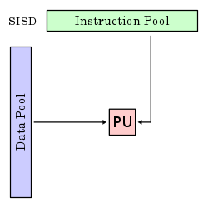
Alternative Kinds of Parallelism: Single Instruction/Single Data Stream
Single Instruction, Single Data stream (SISD)
Sequential computer that exploits no parallelism in either the instruction or data streams. Examples of SISD architecture are traditional uniprocessor machines
Processing Unit

Slide 7
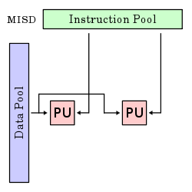
Alternative Kinds of Parallelism: Multiple Instruction/Single Data Stream
Multiple Instruction, Single Data streams (MISD)
Computer that exploits multiple instruction streams against a single data stream for data operations that can be naturally parallelized. For example, certain kinds of array processors.
No longer commonly encountered, mainly of historical interest only

Slide 8
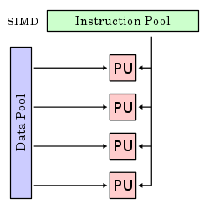
Alternative Kinds of Parallelism: Single Instruction/Multiple Data Stream
Single Instruction, Multiple Data streams (SIMD or “sim-dee”)
Computer that exploits multiple data streams against a single instruction stream to operations that may be naturally parallelized, e.g., Intel SIMD instruction extensions or NVIDIA Graphics Processing Unit (GPU)

Slide 9
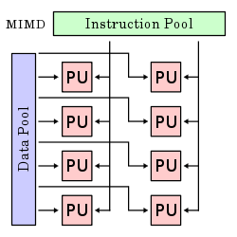
Alternative Kinds of Parallelism: Multiple Instruction/Multiple Data Streams
Multiple Instruction, Multiple Data streams (MIMD or “mim-dee”)
Multiple autonomous processors simultaneously executing different instructions on different data.
MIMD architectures include multicore and Warehouse Scale Computers
(Discuss after midterm)

Slide 10
Flynn Taxonomy
In 2012, SIMD and MIMD most common parallel computers
Most common parallel processing programming style: Single Program Multiple Data (“SPMD”)
Single program that runs on all processors of an MIMD
Cross-processor execution coordination through conditional expressions (thread parallelism after midterm )
SIMD (aka hw-level data parallelism): specialized function units, for handling lock-step calculations involving arrays
Scientific computing, signal processing, multimedia (audio/video processing)

Slide 11
Data-Level Parallelism (DLP) (from 2nd lecture, January 19)
2 kinds of DLP
Lots of data in memory that can be operated on in parallel (e.g., adding together 2 arrays)
Lots of data on many disks that can be operated on in parallel (e.g., searching for documents)
2nd lecture (and 1st project) did DLP across 10s of servers and disks using MapReduce
Today’s lecture (and 3rd project) does Data Level Parallelism (DLP) in memory

Slide 12
SIMD Architectures
Data parallelism: executing one operation on multiple data streams
Example to provide context:
Multiplying a coefficient vector by a data vector (e.g., in filtering)
y[i] := c[i] × x[i], 0 ≤ i < n
Sources of performance improvement:
One instruction is fetched & decoded for entire operation
Multiplications are known to be independent
Pipelining/concurrency in memory access as well

Slide 13
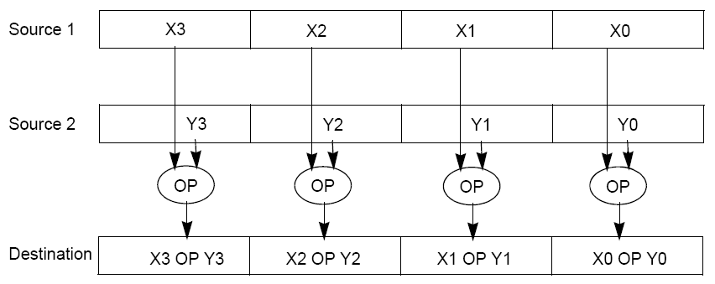
“Advanced Digital Media Boost”
To improve performance, Intel’s SIMD instructions
Fetch one instruction, do the work of multiple instructions
MMX (MultiMedia eXtension, Pentium II processor family)
SSE (Streaming SIMD Extension, Pentium III and beyond)

Slide 14
Example: SIMD Array Processing
for each f in array
f = sqrt(f)
for each f in array
{
load f to the floating-point register
calculate the square root
write the result from the register to memory
}
for each 4 members in array
{
load 4 members to the SSE register
calculate 4 square roots in one operation
store the 4 results from the register to memory
}
SIMD style

Slide 15
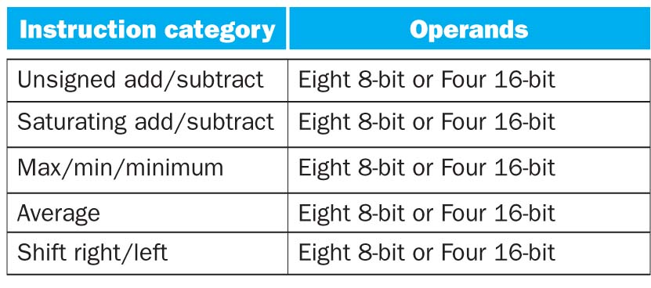
Intel SSE Instruction Categories for Multimedia Support
SSE-2+ supports wider data types to allow 16 x 8-bit and 8 x 16-bit operands

Slide 16
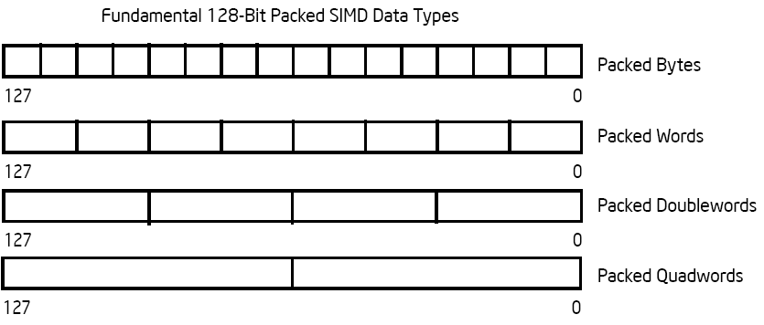
Intel Architecture SSE2+ 128-Bit SIMD Data Types
Note: in Intel Architecture (unlike MIPS) a word is 16 bits
Single precision FP: Double word (32 bits)
Double precision FP: Quad word (64 bits)
122 121
96 95
80 79
64 63
48 47
32 31
16 15
16 / 128 bits
122 121
96 95
80 79
64 63
48 47
32 31
16 15
8 / 128 bits
96 95
64 63
32 31
4 / 128 bits
64 63
2 / 128 bits

Slide 17
Administrivia
Lab #7 posted
Midterm in 1 week:
Exam: Tu, Mar 6, 6:40-9:40 PM, 2050 VLSB
Covers everything through lecture today
Closed book, can bring one sheet notes, both sides
Copy of Green card will be supplied
No phones, calculators, …; just bring pencils & eraser
TA Review: Su, Mar 4, Starting 2PM, 2050 VLSB
Will send (anonymous) 61C midway survey before Midterm

Slide 18
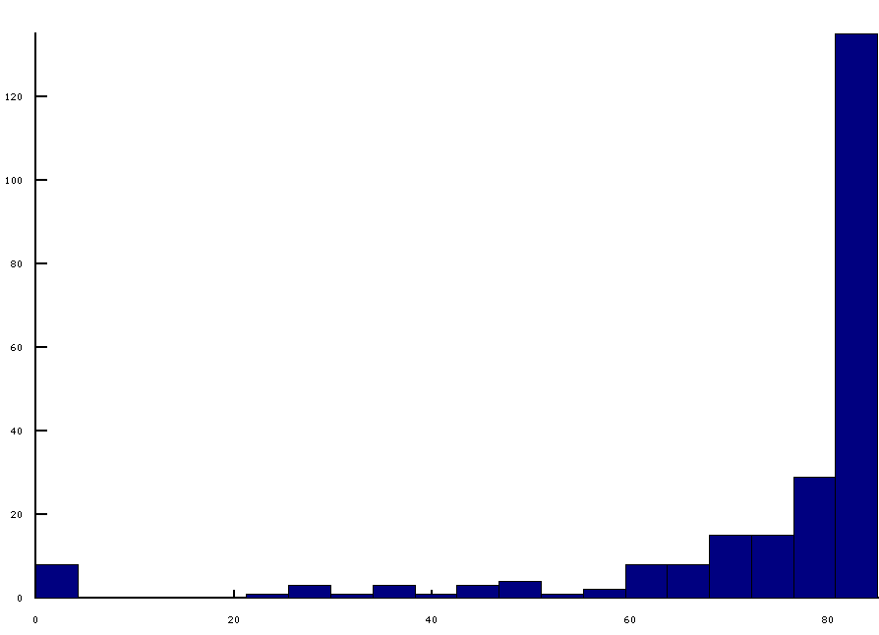
Project 2, Part 2 Grades
On-time submissions grades
Majority got perfect or near-perfect scores
Median 81.5, Mean 74.1

Slide 19
Most Common Test Failures Proj 2
85 | signed short sort (rt34)
77 | unsigned short sort (rt35)
74 | address overflow (rt37)
59 | string sort (signed chars) (rt30)
57 | string sort (unsigned chars) (rt31)
52 | signed int sort (rt32)
51 | null deref (rt38)
49 | unsigned int sort (rt33)
34 | sra (rt11)
32 | jalr (rt13)
31 | misaligned load word (rt6)
29 | out of range deref (rt36)
29 | store byte (rt7)
28 | store half (rt8)
25 | slti (rt25)
22 | sltiu (rt26)
19 | ackermann (rt1)
18 | store word (rt5)
18 | load half (rt3)
17 | load byte (rt2)
12 | slt (rt19)
8 | andi (rt27)
8 | addiu (rt24)
8 | load word (rt4)
7 | nor (rt18)
6 | srl (rt10)

Slide 20
61C in the News
“The smartphone market last year was a half billion units,” [Timothy D. Cook, the Apple chief executive] continued. “In 2015, it is projected to be a billion units. When you take it in the context of these numbers, the truth is, this is a jaw-dropping industry.” …
“I think currently the biggest trend is not the price, but the capability,” Shao Yang [marketing director for mobile devices at Huawei] said. “There is a competition in capability. The function of the phone will change very fast.”
“Apple’s Lead in Smartphones Is Not Guaranteed,”
By Kevin O’Brien, New York Times, February 27, 2012

Slide 21
Agenda
Flynn Taxonomy
Administrivia
DLP and SIMD
Technology Break
Intel Streaming SIMD Extensions (SSE)
(Amdahl’s Law if time permits)

Slide 22
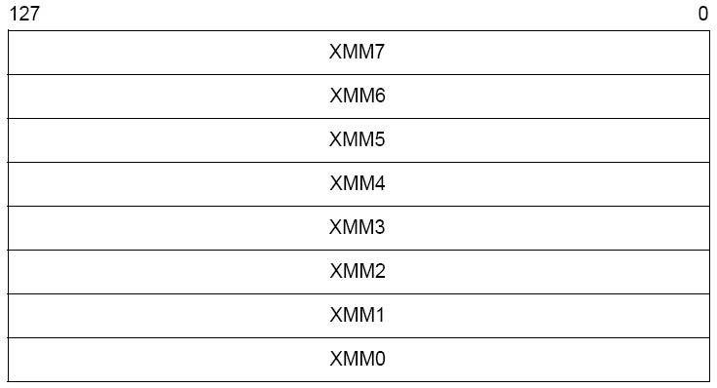
XMM Registers
Architecture extended with eight 128-bit data registers: XMM registers
IA 64-bit address architecture: available as 16 64-bit registers (XMM8 – XMM15)
E.g., 128-bit packed single-precision floating-point data type (doublewords), allows four single-precision operations to be performed simultaneously

Slide 23
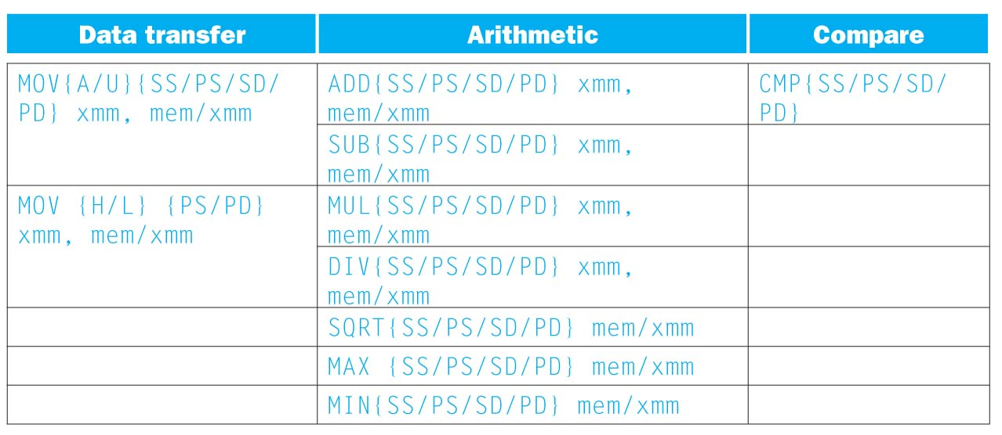
SSE/SSE2 Floating Point Instructions
Move does both load and store
xmm: one operand is a 128-bit SSE2 register
mem/xmm: other operand is in memory or an SSE2 register
{SS} Scalar Single precision FP: one 32-bit operand in a 128-bit register
{PS} Packed Single precision FP: four 32-bit operands in a 128-bit register
{SD} Scalar Double precision FP: one 64-bit operand in a 128-bit register
{PD} Packed Double precision FP, or two 64-bit operands in a 128-bit register
{A} 128-bit operand is aligned in memory
{U} means the 128-bit operand is unaligned in memory
{H} means move the high half of the 128-bit operand
{L} means move the low half of the 128-bit operand

Slide 24
Example: Add Two Single Precision FP Vectors
Computation to be performed:
vec_res.x = v1.x + v2.x;
vec_res.y = v1.y + v2.y;
vec_res.z = v1.z + v2.z;
vec_res.w = v1.w + v2.w;
SSE Instruction Sequence:
(Note: Destination on the right in x86 assembly)
movaps address-of-v1, %xmm0
// v1.w | v1.z | v1.y | v1.x -> xmm0
addps address-of-v2, %xmm0
// v1.w+v2.w | v1.z+v2.z | v1.y+v2.y | v1.x+v2.x -> xmm0
movaps %xmm0, address-of-vec_res
mov a ps : move from mem to XMM register, memory aligned, packed single precision
add ps : add from mem to XMM register, packed single precision
mov a ps : move from XMM register to mem, memory aligned, packed single precision

Slide 25
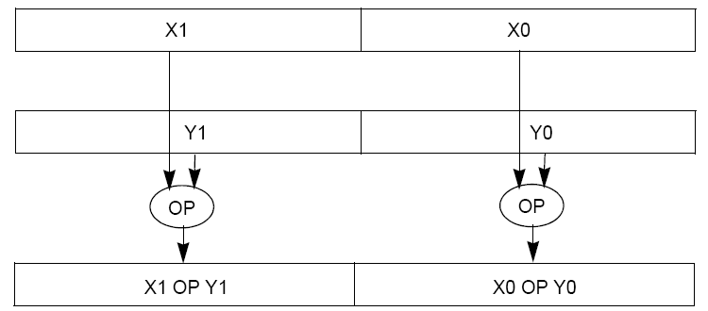
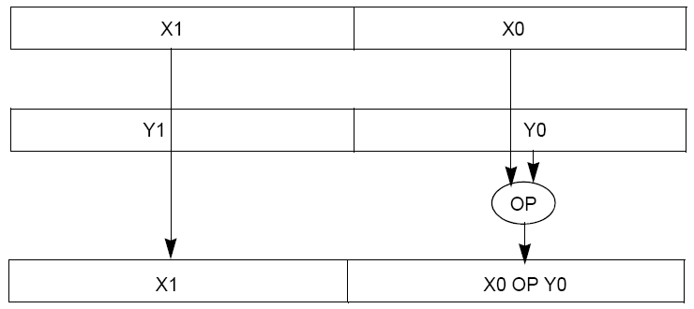
Packed and Scalar Double-Precision Floating-Point Operations

Slide 26
Example: Image Converter
Converts BMP (bitmap) image to a YUV (color space) image format:
Read individual pixels from the BMP image, convert pixels into YUV format
Can pack the pixels and operate on a set of pixels with a single instruction
E.g., bitmap image consists of 8 bit monochrome pixels
Pack these pixel values in a 128 bit register (8 bit * 16 pixels), can operate on 16 values at a time
Significant performance boost
Notes:
BMP File Format, also known as Bitmap Image File
The BMP File Format is capable of storing 2D digital images of arbitrary width, height, and resolution, both monochrome and color, in various color depths, and optionally with data compression, alpha channels, and color profiles.
YUV is a color space typically used as part of a color image pipeline.
The Y'UV model defines a color space in terms of one luma (Y') and two chrominance (UV) components.

Slide 27
Example: Image Converter
FMADDPS – Multiply and add packed single precision floating point instruction
One of the typical operations computed in transformations (e.g., DFT of FFT)
N
P = ∑ f(n) × x(n)
n = 1

Slide 28
Example: Image Converter
Floating point numbers f(n) and x(n) in src1 and src2; p in dest; C implementation for N = 4 (128 bits):
for (int i =0; i< 4; i++)
p = p + src1[i] * src2[i];
Regular x86 instructions for the inner loop:
//src1 is on the top of the stack; src1 * src2 -> src1
fmul DWORD PTR _src2$[%esp+148]
//p = ST(1), src1 = ST(0); ST(0)+ST(1) -> ST(1); ST-Stack Top
faddp %ST(0), %ST(1)
(Note: Destination on the right in x86 assembly)
Number regular x86 Fl. Pt. instructions executed: 4 * 2 = 8
Notes:
http://developer.amd.com/cpu/SSE5/Pages/default.aspx
"DE C0+i FADDP ST(i), ST(0) Add ST(0) to ST(i), store result in ST(i), and pop the register stack".
Destination on right called AT&T format

Slide 29
Example: SSE Image Converter
Floating point numbers f(n) and x(n) in src1 and src2; p in dest; C implementation for N = 4 (128 bits):
for (int i =0; i< 4; i++)
p = p + src1[i] * src2[i];
SSE2 instructions for the inner loop:
//xmm0 = p, xmm1 = src1[i], xmm2 = src2[i]
mulps %xmm1, %xmm2 // xmm2 * xmm1 -> xmm2
addps %xmm2, %xmm0 // xmm0 + xmm2 -> xmm0
Number regular instructions executed: 2 SSE2 instructions vs. 8 x86
SSE5 instruction accomplishes same in one instruction:
fmaddps %xmm0, %xmm1, %xmm2, %xmm0
// xmm2 * xmm1 + xmm0 -> xmm0
// multiply xmm1 x xmm2 paired single, // then add product paired single to sum in xmm0
Number regular instructions executed: 1 SSE5 instruction vs. 8 x86
Notes:
http://developer.amd.com/cpu/SSE5/Pages/default.aspx
In AT&T syntax, the code on the slide should look like this (note Ichanged the comments, too).
One thing that is confusing is thatmulps/addps implicitly use one of the source operands as thedestination operand, but fmaddps has a fourth explicit destination. Iverified this is true.
//xmm0 = p, xmm1 = src1[i], xmm2 = src2[i]
mulps %xmm1, %xmm2 // xmm2 * xmm1 -> xmm2
addps %xmm2, %xmm0 // xmm0 * xmm2 -> xmm0
//SSE5 accomplishes this in one instruction:
fmaddps %xmm0, %xmm1, %xmm2, %xmm0 // xmm2 * xmm1 + xmm0 -> xmm0

Slide 30
Intel SSE Intrinsics
Intrinsics are C functions and procedures for putting in assembly language, including SSE instructions
With intrinsics, can program using these instructions indirectly
One-to-one correspondence between SSE instructions and intrinsics

Slide 31
Example SSE Intrinsics
Instrinsics:
Corresponding SSE instructions:
Vector data type:
_m128d
Load and store operations:
_mm_load_pd MOVAPD/aligned, packed double
_mm_store_pd MOVAPD/aligned, packed double
_mm_loadu_pd MOVUPD/unaligned, packed double
_mm_storeu_pd MOVUPD/unaligned, packed double
Load and broadcast across vector
_mm_load1_pd MOVSD + shuffling/duplicating
Arithmetic:
_mm_add_pd ADDPD/add, packed double
_mm_mul_pd MULPD/multiple, packed double
02/09/2010
CS267 Lecture 7
31
Notes:
CS267 Lecture 2
31

Slide 32
Example: 2 x 2 Matrix Multiply
Definition of Matrix Multiply:
2
C_{i,j} = (A×B)_{i,j} = ∑ A_{i,k}× B_{k,j}
k = 1
A_{1,1}
A_{1,2}
B_{1,1}
B_{1,2}
C_{1,1}=A_{1,1}B_{1,1} + A_{1,2}B_{2,1}
C_{1,2}=A_{1,1}B_{1,2}+A_{1,2}B_{2,2}
x
=
A_{2,1}
A_{2,2}
B_{2,1}
B_{2,2}
C_{2,1}=A_{2,1}B_{1,1} + A_{2,2}B_{2,1}
C_{2,2}=A_{2,1}B_{1,2}+A_{2,2}B_{2,2}

Slide 33
Example: 2 x 2 Matrix Multiply
Using the XMM registers
64-bit/double precision/two doubles per XMM reg
C₁
C_{1,1}
C_{2,1}
Stored in memory in Column order
C₂
C_{1,2}
C_{2,2}
A
A_{1,i}
A_{2,i}
B₁
B_{i,1}
B_{i,1}
B₂
B_{i,2}
B_{i,2}

Slide 34
Example: 2 x 2 Matrix Multiply
Initialization
I = 1
C₁
0
0
C₂
0
0
A
A_{1,1}
A_{2,1}
_mm_load_pd: Stored in memory in Column order
B₁
B_{1,1}
B_{1,1}
_mm_load1_pd: SSE instruction that loads a double word and stores it in the high and low double words of the XMM register
B₂
B_{1,2}
B_{1,2}

Slide 35
Example: 2 x 2 Matrix Multiply
Initialization
I = 1
C₁
0
0
C₂
0
0
A
A_{1,1}
A_{2,1}
_mm_load_pd: Load 2 doubles into XMM reg, Stored in memory in Column order
B₁
B_{1,1}
B_{1,1}
_mm_load1_pd: SSE instruction that loads a double word and stores it in the high and low double words of the XMM register (duplicates value in both halves of XMM)
B₂
B_{1,2}
B_{1,2}

Slide 36
Example: 2 x 2 Matrix Multiply
First iteration intermediate result
I = 1
C₁
0+A_{1,1}B_{1,1}
0+A_{2,1}B_{1,1}
c1 = _mm_add_pd(c1,_mm_mul_pd(a,b1));
c2 = _mm_add_pd(c2,_mm_mul_pd(a,b2));
SSE instructions first do parallel multiplies and then parallel adds in XMM registers
C₂
0+A_{1,1}B_{1,2}
0+A_{2,1}B_{1,2}
A
A_{1,1}
A_{2,1}
_mm_load_pd: Stored in memory in Column order
B₁
B_{1,1}
B_{1,1}
_mm_load1_pd: SSE instruction that loads a double word and stores it in the high and low double words of the XMM register (duplicates value in both halves of XMM)
B₂
B_{1,2}
B_{1,2}

Slide 37
Example: 2 x 2 Matrix Multiply
First iteration intermediate result
I = 2
C₁
0+A_{1,1}B_{1,1}
0+A_{2,1}B_{1,1}
c1 = _mm_add_pd(c1,_mm_mul_pd(a,b1));
c2 = _mm_add_pd(c2,_mm_mul_pd(a,b2));
SSE instructions first do parallel multiplies and then parallel adds in XMM registers
C₂
0+A_{1,1}B_{1,2}
0+A_{2,1}B_{1,2}
A
A_{1,2}
A_{2,2}
_mm_load_pd: Stored in memory in Column order
B₁
B_{2,1}
B_{2,1}
_mm_load1_pd: SSE instruction that loads a double word and stores it in the high and low double words of the XMM register (duplicates value in both halves of XMM)
B₂
B_{2,2}
B_{2,2}

Slide 38
Example: 2 x 2 Matrix Multiply
Second iteration intermediate result
I = 2
C_{1,1}
C_{2,1}
C₁
A_{1,1}B_{1,1}+A_{1,2}B_{2,1}
A_{2,1}B_{1,1}+A_{2,2}B_{2,1}
c1 = _mm_add_pd(c1,_mm_mul_pd(a,b1));
c2 = _mm_add_pd(c2,_mm_mul_pd(a,b2));
SSE instructions first do parallel multiplies and then parallel adds in XMM registers
C₂
A_{1,1}B_{1,2}+A_{1,2}B_{2,2}
A_{2,1}B_{1,2}+A_{2,2}B_{2,2}
C_{1,2}
C_{2,2}
A
A_{1,2}
A_{2,2}
_mm_load_pd: Stored in memory in Column order
B₁
B_{2,1}
B_{2,1}
_mm_load1_pd: SSE instruction that loads a double word and stores it in the high and low double words of the XMM register (duplicates value in both halves of XMM)
B₂
B_{2,2}
B_{2,2}

Slide 39
Live Example: 2 x 2 Matrix Multiply
Definition of Matrix Multiply:
2
C_{i,j} = (A×B)_{i,j} = ∑ A_{i,k}× B_{k,j}
k = 1
A_{1,1}
A_{1,2}
B_{1,1}
B_{1,2}
C_{1,1}=A_{1,1}B_{1,1} + A_{1,2}B_{2,1}
C_{1,2}=A_{1,1}B_{1,2}+A_{1,2}B_{2,2}
x
=
A_{2,1}
A_{2,2}
B_{2,1}
B_{2,2}
C_{2,1}=A_{2,1}B_{1,1} + A_{2,2}B_{2,1}
C_{2,2}=A_{2,1}B_{1,2}+A_{2,2}B_{2,2}
1
0
1
3
C_{1,1}= 1*1 + 0*2 = 1
C_{1,2}= 1*3 + 0*4 = 3
x
=
0
1
2
4
C_{2,1}= 0*1 + 1*2 = 2
C_{2,2}= 0*3 + 1*4 = 4

Slide 40
Example: 2 x 2 Matrix Multiply (Part 1 of 2)
#include <stdio.h>
// header file for SSE compiler intrinsics
#include <emmintrin.h>
// NOTE: vector registers will be represented in comments as v1 = [ a | b]
// where v1 is a variable of type __m128d and a, b are doubles
int main(void) {
// allocate A,B,C aligned on 16-byte boundaries
double A[4] __attribute__ ((aligned (16)));
double B[4] __attribute__ ((aligned (16)));
double C[4] __attribute__ ((aligned (16)));
int lda = 2;
int i = 0;
// declare several 128-bit vector variables
__m128d c1,c2,a,b1,b2;
// Initialize A, B, C for example
/* A = (note column order!)
1 0
0 1
*/
A[0] = 1.0; A[1] = 0.0; A[2] = 0.0; A[3] = 1.0;
/* B = (note column order!)
1 3
2 4
*/
B[0] = 1.0; B[1] = 2.0; B[2] = 3.0; B[3] = 4.0;
/* C = (note column order!)
0 0
0 0
*/
C[0] = 0.0; C[1] = 0.0; C[2] = 0.0; C[3] = 0.0;

Slide 41
Example: 2 x 2 Matrix Multiply (Part 2 of 2)
// used aligned loads to set
// c1 = [c_11 | c_21]
c1 = _mm_load_pd(C+0*lda);
// c2 = [c_12 | c_22]
c2 = _mm_load_pd(C+1*lda);
for (i = 0; i < 2; i++) {
/* a =
i = 0: [a_11 | a_21]
i = 1: [a_12 | a_22]
*/
a = _mm_load_pd(A+i*lda);
/* b1 =
i = 0: [b_11 | b_11]
i = 1: [b_21 | b_21]
*/
b1 = _mm_load1_pd(B+i+0*lda);
/* b2 =
i = 0: [b_12 | b_12]
i = 1: [b_22 | b_22]
*/
b2 = _mm_load1_pd(B+i+1*lda);
/* c1 =
i = 0: [c_11 + a_11*b_11 | c_21 + a_21*b_11]
i = 1: [c_11 + a_21*b_21 | c_21 + a_22*b_21]
*/
c1 = _mm_add_pd(c1,_mm_mul_pd(a,b1));
/* c2 =
i = 0: [c_12 + a_11*b_12 | c_22 + a_21*b_12]
i = 1: [c_12 + a_21*b_22 | c_22 + a_22*b_22]
*/
c2 = _mm_add_pd(c2,_mm_mul_pd(a,b2));
}
// store c1,c2 back into C for completion
_mm_store_pd(C+0*lda,c1);
_mm_store_pd(C+1*lda,c2);
// print C
printf("%g,%g\n%g,%g\n",C[0],C[2],C[1],C[3]);
return 0;
}

Slide 42
Inner loop from gcc –O -S
L2: movapd (%rax,%rsi), %xmm1 //Load aligned A[i,i+1]->m1
movddup (%rdx), %xmm0 //Load B[j], duplicate->m0
mulpd %xmm1, %xmm0 //Multiply m0*m1->m0
addpd %xmm0, %xmm3 //Add m0+m3->m3
movddup 16(%rdx), %xmm0 //Load B[j+1], duplicate->m0
mulpd %xmm0, %xmm1 //Multiply m0*m1->m1
addpd %xmm1, %xmm2 //Add m1+m2->m2
addq $16, %rax // rax+16 -> rax (i+=2)
addq $8, %rdx // rdx+8 -> rdx (j+=1)
cmpq $32, %rax // rax == 32?
jne L2 // jump to L2 if not equal
movapd %xmm3, (%rcx) //store aligned m3 into C[k,k+1]
movapd %xmm2, (%rdi) //store aligned m2 into C[l,l+1]

Slide 43
Performance-Driven ISA Extensions
Subword parallelism, used primarily for multimedia applications
Intel MMX: multimedia extension
64-bit registers can hold multiple integer operands
Intel SSE: Streaming SIMD extension
128-bit registers can hold several floating-point operands
Adding instructions that do more work per cycle
Shift-add: replace two instructions with one (e.g., multiply by 5)
Multiply-add: replace two instructions with one (x := c + a  b)
Multiply-accumulate: reduce round-off error (s := s + a  b)
Conditional copy: to avoid some branches (e.g., in if-then-else)

Slide 44
Big Idea: Amdahl’s (Heartbreaking) Law
Speedup due to enhancement E is
Exec time w/o E
Speedup w/ E = ----------------------
Exec time w/ E
Suppose that enhancement E accelerates a fraction F (F <1) of the task by a factor S (S>1) and the remainder of the task is unaffected
Execution Time w/o E × [ (1-F) + F/S]
Execution Time w/ E =
1 / [ (1-F) + F/S ]
Speedup w/ E =

Slide 45
Big Idea: Amdahl’s Law
Speedup =
Example: the execution time of half of the program can be accelerated by a factor of 2. What is the program speed-up overall?

Slide 46
Big Idea: Amdahl’s Law
Speedup = 1
Example: the execution time of half of the program can be accelerated by a factor of 2. What is the program speed-up overall?
(1 - F) + F
Non-speed-up part
S
Speed-up part
1
1
=
=
1.33
0.5 + 0.5
0.5 + 0.25
2

Slide 47
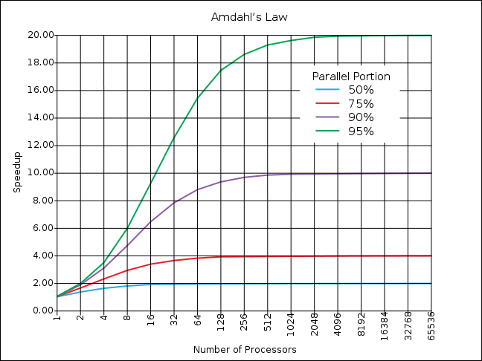
Big Idea: Amdahl’s Law
If the portion of the program that can be parallelized is small, then the speedup is limited
The non-parallel portion limits the performance

Slide 48
Example #1: Amdahl’s Law
Speedup w/ E =
Consider an enhancement which runs 20 times faster but which is only usable 25% of the time.
Speedup w/ E =
What if its usable only 15% of the time?
Speedup w/ E =
Amdahl’s Law tells us that to achieve linear speedup with 100 processors, none of the original computation can be scalar!
To get a speedup of 90 from 100 processors, the percentage of the original program that could be scalar would have to be 0.1% or less
Speedup w/ E =
Notes:
For class handout

Slide 49
Example #1: Amdahl’s Law
Speedup w/ E = 1 / [ (1-F) + F/S ]
Consider an enhancement which runs 20 times faster but which is only usable 25% of the time
Speedup w/ E = 1/(.75 + .25/20) = 1.31
What if its usable only 15% of the time?
Speedup w/ E = 1/(.85 + .15/20) = 1.17
Amdahl’s Law tells us that to achieve linear speedup with 100 processors, none of the original computation can be scalar!
To get a speedup of 90 from 100 processors, the percentage of the original program that could be scalar would have to be 0.1% or less
Speedup w/ E = 1/(.001 + .999/100) = 90.99

Slide 50
Parallel Speed-up Example
Z₀ + Z₁ + … + Z₁₀
X_{1,1}
X_{1,10}
Y_{1,1}
Y_{1,10}
Partition 10 ways and perform on 10 parallel processing units
+
X_{10,1}
X_{10,10}
Y_{10,1}
Y_{10,10}
Non-parallel part
Parallel part
10 “scalar” operations (non-parallelizable)
100 parallelizable operations
110 operations

Slide 51
Example #2: Amdahl’s Law
Speedup w/ E = 1 / [ (1-F) + F/S]
Consider summing 10 scalar variables and two 10 by 10 matrices (matrix sum) on 10 processors
Speedup w/ E =
What if there are 100 processors ?
Speedup w/ E =
What if the matrices are 100 by 100 (or 10,010 adds in total) on 10 processors?
Speedup w/ E =
What if there are 100 processors ?
Speedup w/ E =
Notes:
For class handout

Slide 52
Example #2: Amdahl’s Law
Speedup w/ E = 1 / [ (1-F) + F/S ]
Consider summing 10 scalar variables and two 10 by 10 matrices (matrix sum) on 10 processors
Speedup w/ E = 1/(.091 + .909/10) = 1/0.1819 = 5.5
What if there are 100 processors ?
Speedup w/ E = 1/(.091 + .909/100) = 1/0.10009 = 10.0
What if the matrices are 100 by 100 (or 10,010 adds in total) on 10 processors?
Speedup w/ E = 1/(.001 + .999/10) = 1/0.1009 = 9.9
What if there are 100 processors ?
Speedup w/ E = 1/(.001 + .999/100) = 1/0.01099 = 91
Notes:
For lecture
10/110 operations = 0.091
10/10010 operations = 0.000999

Slide 53
Strong and Weak Scaling
To get good speedup on a multiprocessor while keeping the problem size fixed is harder than getting good speedup by increasing the size of the problem.
Strong scaling: when speedup can be achieved on a parallel processor without increasing the size of the problem
Weak scaling: when speedup is achieved on a parallel processor by increasing the size of the problem proportionally to the increase in the number of processors
Load balancing is another important factor: every processor doing same amount of work
Just 1 unit with twice the load of others cuts speedup almost in half
Notes:
Add load balancing example here – page 638

Slide 54
Review
Flynn Taxonomy of Parallel Architectures
SIMD: Single Instruction Multiple Data
MIMD: Multiple Instruction Multiple Data
SISD: Single Instruction Single Data (unused)
MISD: Multiple Instruction Single Data
Intel SSE SIMD Instructions
One instruction fetch that operates on multiple operands simultaneously
128/64 bit XMM registers
SSE Instructions in C
Embed the SSE machine instructions directly into C programs through use of intrinsics
Achieve efficiency beyond that of optimizing compiler

