Slide 1
CS 61C: Great Ideas in Computer Architecture Virtual Machines 2
Instructor:
David A. Patterson
http://inst.eecs.Berkeley.edu/~cs61c/sp12

Slide 2
Review
Virtual Memory, Paging for Isolation and Protection, help Virtual Machines share memory
Can think of as another level of memory hierarchy, but not really used like caches are today
Not really routinely paging to disk today
Virtual Machines as even greater level of protection to allow greater level of sharing
Enables fine control, allocation, software distribution, multiple price points for Cloud Computing
Even on laptops (e.g., Windows on Mac using Parallels)

Slide 3
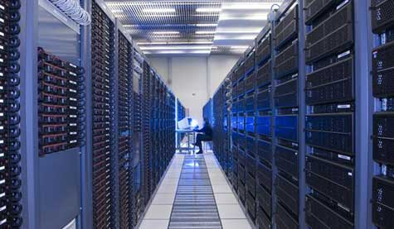
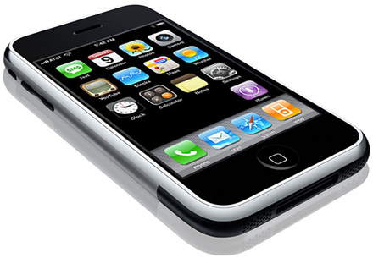
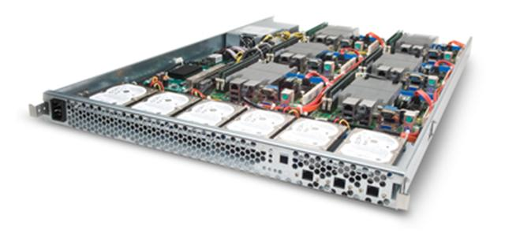
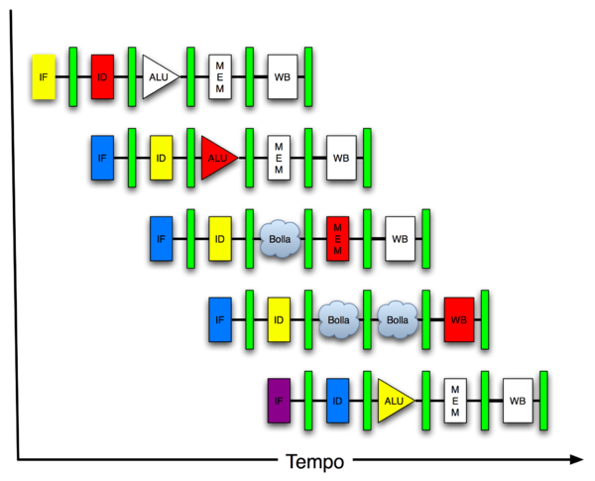
You Are Here!
Today’s
Lecture
Software Hardware
Parallel Requests
Assigned to computer
e.g., Search “Katz”
Parallel Threads
Assigned to core
e.g., Lookup, Ads
Parallel Instructions
>1 instruction @ one time
e.g., 5 pipelined instructions
Parallel Data
>1 data item @ one time
e.g., Add of 4 pairs of words
Hardware descriptions
All gates @ one time
Programming Languages
Warehouse Scale Computer
Smart Phone
Harness Parallelism &
Achieve High Performance
Virtual Machines/Memory
Computer
Core
…
Core
Memory (Cache)
Input/Output
Core
Instruction Unit(s)
Functional
Unit(s)
A₀+B₀
A₁+B₁
A₂+B₂
A₃+B₃
Main Memory
Logic Gates

Slide 4
Agenda
Virtual Memory, Pass 2
Translation Lookaside Buffer (TLB)
A day in the life of an instruction with TLB
Administrivia
TLB Performance Impact and Nehalem
Matrix Multiply: Inside Edition!
Peer Instructions
Reduced Instruction Set Computers (if time is available)
Summary

Slide 5
Paged Memory Systems
Processor-generated address is split into:
page number offset
32-bit byte address
4096 byte pages
20 bits
12 bits
Page table contains the physical address of the base of each page:
1
0
0
0
Program consists of 4x 4K Byte pages or
16384 Bytes
Physical Memory
1
1
2
2
3
3
3
Virtual Address Space
Page Table
(think of an array of base registers or pointers)
2
Page tables make it possible to store the pages of a program non-contiguously.
Notes:
Relaxes the contiguous allocation requirement.

Slide 6
Library Analogy
Book title like virtual address
Library of Congress call number like physical address
Card catalogue like page table, mapping from book title to call #
On card, available for 2-hour in library use (vs. 2-week checkout) like access rights

Slide 7
Separate Address Space per Virtual Machine
VM1
VA1
Page Table
VM2
VA1
Page Table
Physical Memory
VM3
VA1
Page Table
free
Each virtual machine has own page table
Page table contains an entry for each page
Notes:
OS ensures that the page tables are disjoint.

Slide 8
Paging Terminology
Program addresses called virtual addresses
Space of all virtual addresses called virtual memory
Memory addresses called physical addresses
Space of all physical addresses called physical memory

Slide 9
Notes on Page Table
Solves the fragmentation problem: all chunks same size, so any holes can be used
OS must reserve Swap Space on disk for each virtual machine
To grow a virtual machine, ask Op. System
If unused pages available, OS uses them first
If not, OS swaps some old pages to disk
(Least Recently Used to pick pages to swap)
How/Why grow a process?

Slide 10
Address Translation & Protection
Virtual Address
Virtual Page No. (VPN)
offset
Kernel/User Mode
Read/Write
Protection
Check
Address
Translation
Exception?
Physical Address
Physical Page No. (PPN)
offset
Every instruction and data access needs address translation and protection checks

Slide 11
Protection via Page Table
Access Rights checked on every access to see if allowed
Read: can read, but not write page
Read/Write: read or write data on page
Execute: Can fetch instructions from page
Valid = Valid page table entry
Invalid means it’s on the disk, not in physical memory

Slide 12
More Depth on Page Tables
Virtual Address:
page no.
offset
20 bits
12 bits
Page Table
Page Table
Base Reg
...
V
A.R.
P. P. A.
index
into
page
table
Access
Rights
Physical
Page
Address
+
Val
-id
Physical
Memory
Address
.
...
Page Table located in physical memory

Slide 13
Virtual Memory Without Doubling Memory Accesses
Caches suggest that there is temporal and spatial locality of data
Locality really means locality of addresses of data
What about locality of translations of virtual page addresses into physical page addresses?
Why not a Page Table Address Translation Cache?
For historical reasons, called Translation Lookaside Buffer (TLB)

Slide 14
Translation Lookaside Buffers (TLB): Another Layer of Indirection!
Address translation is very expensive!
Each reference becomes 2 memory accesses
Solution: Cache address translations in TLB!
TLB hit  Single Cycle Translation
TLB miss  Access Page-Table to refill
virtual address
VPN offset
V R W X tag PPN
(VPN = virtual page number)
(PPN = physical page number)
hit?
physical address
PPN offset
Notes:
3 memory references
2 page faults (disk accesses) + ..
Actually used in IBM before paged memory.

Slide 15
Address Translation: Putting it all Together
Virtual Address
hardware
hardware or software
software
Restart instruction
TLB
Lookup
miss
hit
Page Table
Walk
Protection
Check
the page is
∉ Memory ∈ memory
denied
permitted
Page Fault
(OS loads page)
Update TLB
Protection
Fault
Physical
Address
(to cache)
SEGFAULT
Notes:
Need to restart instruction.
Soft and hard page faults.

Slide 16
TLB Design
Typically 32-128 entries
Usually fully associative
Each entry maps a large page, hence less spatial locality across pages
A memory management unit (MMU) is hardware that walks the page tables and reloads the TLB

Slide 17
Address Translation in CPU Pipeline
PC
Inst TLB
Inst. Cache
D
Decode
E
M
Data TLB
Data Cache
W
+
TLB miss? Page Fault?
Protection violation?
TLB miss? Page Fault?
Protection violation?
Handling a TLB miss needs a hardware or software mechanism to refill TLB
Need mechanisms to cope with the additional latency of a TLB:
Slow down the clock
Pipeline the TLB and cache access

Slide 18
Day in the Life of an (Instruction) Address
Physical Address (PA)
Physical Address (PA)
PC
MEM
Instruction
No Cache, No Virtual Memory

Slide 19
Day in the Life of an (Instruction) Address
Virtual Address (VA): Virtual Page Number (VPN), Offset
PC
PA (PPN, Offset)
PA
TLB
MEM
Hit
Instruction
If locality works, this is the common case!
No Cache, Virtual Memory, TLB Hit

Slide 20
Day in the Life of an (Instruction) Address
Virtual Address (VA): Virtual Page Number (VPN), Offset
PC
TLB
Miss
PTBR
VPN
Page Table Base Register
(@Page Table Entry)
PA (PPN, Offset)
PA
+
MEM
MEM
Instruction
No Cache, Virtual Memory, TLB Miss, Page Table Access

Slide 21
Day in the Life of an (Instruction) Address
Virtual Address (VA): Virtual Page Number (VPN), Offset
PC
TLB
Miss
PTBR
VPN
Page Table Base Register
(@Page Table Entry)
PA (PPN, Offset)
PA
+
D$
MEM
Hit
Instruction
Physical Data Cache, Virtual Memory, TLB Miss, Page Table Access

Slide 22
Day in the Life of an (Instruction) Address
Virtual Address (VA): Virtual Page Number (VPN), Offset
PC
TLB
Miss
PTBR
VPN
Page Table Base Register
+
(@Page Table Entry)
D$
Miss
(@Page Table Entry)
PA (PPN, Offset)
PA
MEM
MEM
Instruction
Physical Data Cache, Virtual Memory, TLB Miss, Page Table Access

Slide 23
Day in the Life of an (Instruction) Address
Virtual Address (VA): Virtual Page Number (VPN), Offset
PC
TLB
Miss
PTBR
VPN
Page Table Base Register
+
(@Page Table Entry)
D$
Miss
(@Page Table Entry)
PA
(PPN,
Offset)
Hit
MEM
I$
Instruction
Physical Data & Instruction Cache, Virtual Memory, TLB Miss, Page Table Access

Slide 24
Day in the Life of an (Instruction) Address
Virtual Address (VA): Virtual Page Number (VPN), Offset
PC
TLB
Miss
PTBR
VPN
Page Table Base Register
+
(@Page Table Entry)
D$
Miss
(@Page Table Entry)
PA
(PPN,
Offset)
Miss
MEM
I$
PA
MEM
Instruction
Day in the life of a data access is not too different
Physical Data & Instruction Cache, Virtual Memory, TLB Miss, Page Table Access

Slide 25
Administrivia
1 more Lecture: End off course Overview/Cal Culture/HKN Evaluation
film “Powers of 10”? Will show 9:31AM Th
www.powersof10.com/
Please fill out final 61C Survey:https://www.surveymonkey.com/s/61Cspr12Final
All grades but Project 4 finalized: 4/27; Proj 4 5/1
Go to lab to finalize any labs Th/Fr
Final Review: Sunday April 29, 2-5PM, 2050 VLSB
Extra office hours: Thu-Fri May 3-4 1 to 5PM
Final: Wed May 9 11:30-2:30, 1 PIMENTEL

Slide 26
Agenda
Virtual Memory, Pass 2
Translation Lookaside Buffer (TLB)
A day in the life of an instruction with TLB
Administrivia
TLB Performance Impact and Nehalem
Matrix Multiply: Inside Edition!
Peer Instructions
Reduced Instruction Set Computers (if time is available)
Summary

Slide 27
Impact of TLBs on Performance
Each TLB miss to Page Table ~ L1 Cache miss
Page sizes are 4 KB to 8 KB (4 KB on x86)
TLB has typically 128 entries
Set Associative or Fully Associative
TLB Reach: Size of largest virtual address space that can be simultaneously mapped by TLB:
128 * 4 KB = 512 KB = 0.5 MB!
What can you do to have better performance?
Student Roulette?

Slide 28
Improving TLB Performance
Add larger page size that operating system can use in situations when OS knows that object is big and protection of whole object OK
X86 has 4 KB pages + 2 MB and 4 MB “superpages”
Have 2 Levels of TLB just like 2 levels of cache instead of going directly to Page Table on L1 TLB miss

Slide 29
Impact on TLB
Page Table keeps track of whether page needs to be written back to disk if its been modified
Has a Page Table Dirty Bit
So also have “Page Dirty Bit” in TLB, set when any data in page is written
When TLB entry replaced, corresponding Page Dirty Bit is set in Page Table Entry

Slide 30
Nehalem Virtual Memory Details
48-bit virtual address space, 40-bit physical address space
Split, 2-level TLB: I L1, D L1 + U L2 per core
I-TLB (L1) has shared 128 entries 4-way associative for 4KB pages, plus 7 dedicated fully-associative entries per SMT thread for large page (2/4MB) entries
D-TLB (L1) has 64 entries for 4KB pages and 32 entries for 2/4MB pages, both 4-way associative, dynamically shared between SMT threads
Unified L2 TLB has 512 entries for 4KB pages only, also 4-way associative
Data TLB Reach (4 KB only) L1: 64*4 KB =0.25 MB, L2:512*4 KB= 2MB (superpages) L1: 32 *2-4 MB = 64-128 MB

Slide 31
Agenda
Virtual Memory, Pass 2
Administrivia
Translation Lookaside Buffer (TLB)
A day in the life of an instruction with TLB
TLB Performance Impact and Nehalem
Matrix Multiply: Inside Edition!
Peer Instructions
Reduced Instruction Set Computers (if time is available)
Summary

Slide 32
Peer Instruction: True or False
Which statements is True about Virtual Machines?
Multiple Virtual Machines can run on one computer
Multiple Virtual Machine Monitors can run on one computer
III. The Guest OS must be the same as the Host OS
A) I only
B) II only
C) III only
D) I and II
Notes:
I is true

Slide 33
Peer Instruction: True or False
Which statements is True about Virtual Machines?
Multiple Virtual Machines can run on one computer
Multiple Virtual Machine Monitors can run on one computer
III. The Guest OS must be the same as the Host OS
A) I only
B) II only
C) III only
D) I and II
Notes:
D) 1c, 2a, 3b

Slide 34
Peer Instruction: True or False
A program tries to load a word X that causes a TLB miss but not a page fault. Which are True or False:
1. A TLB miss means that the page table does not contain a valid mapping for virtual page corresponding to the address X
2. There is no need to look up in the page table because there is no page fault
3. The word that the program is trying to load is present in physical memory.
A) 1 F, 2 F, 3 F
B) 1 F, 2 F, 3 T
C) 1 F, 2 T, 3 F
D) 1 F, 2 T, 3 T
Notes:
B) Statements 1 and 2 are false; 3 is true

Slide 35
Peer Instruction: True or False
A program tries to load a word X that causes a TLB miss but not a page fault. Which are True or False:
1. A TLB miss means that the page table does not contain a valid mapping for virtual page corresponding to the address X
2. There is no need to look up in the page table because there is no page fault
3. The word that the program is trying to load is present in physical memory.
A) 1 F, 2 F, 3 F
B) 1 F, 2 F, 3 T
C) 1 F, 2 T, 3 F
D) 1 F, 2 T, 3 T
Notes:
B) Statements 1 and 2 are false; 3 is true

Slide 36
Peer Instruction: True or False
TLBs entries have valid bits and dirty bits. Data caches have them also.
A. The valid bit means the same in both: if valid = 0, it must miss in both TLBs and Caches.
B. The valid bit has different meanings. For caches, it means this entry is valid if the address requested matches the tag. For TLBs, it determines whether there is a page fault (valid=0) or not (valid=1).
C. The dirty bit means the same in both: the data in this block in the TLB or Cache has been changed.
D. The dirty bit has different meanings. For caches, it means the data block has been changed. For TLBs, it means that the page corresponding to this TLB entry has been changed.
A) 1 F, 2 T, 3 F, 4 T
B) 1 F, 2 T, 3 T, 4 F
C) 1 T, 2 F, 3 F, 4 T
D) 1 T, 2 F, 3 T, 4 F
Notes:
40\\4A: True. If valid is 1, that means that there is no block or mapping there or the block or mapping has become bad somehow. Therefore, the TLB and cache will miss.
B. False. No, an invalid bit means that the entry in the TLB is garbage.
C. False. A TLB is not in control of VA->PA mappings, therefore it could never have anything to “writeback” the dirty data to.
D. True. Yes, since a TLB is a cache of VA->PA mappings, if it is “dirty” it means that that page is dirty.

Slide 37
Peer Instruction: True or False
TLBs entries have valid bits and dirty bits. Data caches have them also.
A. The valid bit means the same in both: if valid = 0, it must miss in both TLBs and Caches.
B. The valid bit has different meanings. For caches, it means this entry is valid if the address requested matches the tag. For TLBs, it determines whether there is a page fault (valid=0) or not (valid=1).
C. The dirty bit means the same in both: the data in this block in the TLB or Cache has been changed.
D. The dirty bit has different meanings. For caches, it means the data block has been changed. For TLBs, it means that the page corresponding to this TLB entry has been changed.
A) 1 F, 2 T, 3 F, 4 T
B) 1 F, 2 T, 3 T, 4 F
C) 1 T, 2 F, 3 F, 4 T
D) 1 T, 2 F, 3 T, 4 F
Notes:
40\\4A: True. If valid is 1, that means that there is no block or mapping there or the block or mapping has become bad somehow. Therefore, the TLB and cache will miss.
B. False. No, an invalid bit means that the entry in the TLB is garbage.
C. False. A TLB is not in control of VA->PA mappings, therefore it could never have anything to “writeback” the dirty data to.
D. True. Yes, since a TLB is a cache of VA->PA mappings, if it is “dirty” it means that that page is dirty.

Slide 38
Peer Instruction: Match the Phrase
Match the memory hierarchy element on the left with the closest phrase on the right:
1. L1 cache a. A cache for page table entries
2. L2 cache b. A cache for a main memory
3. Main memory c. A cache for disks
4. TLB d. A cache for a cache
A) 1 a, 2 b, 3 c, 4 d
B) 1 a, 2 b, 3 d, 4 c
C) 1 b, 2 d, 3 a, 4 c
D) 1 d, 2 b, 3 c, 4 a
Notes:
F) Statements 2 and 4 are correct; the rest are incorrect

Slide 39
Peer Instruction: Match the Phrase
Match the memory hierarchy element on the left with the closest phrase on the right:
1. L1 cache a. A cache for page table entries
2. L2 cache b. A cache for a main memory
3. Main memory c. A cache for disks
4. TLB d. A cache for a cache
A) 1 a, 2 b, 3 c, 4 d
B) 1 a, 2 b, 3 d, 4 c
C) 1 b, 2 d, 3 a, 4 c
D) 1 d, 2 b, 3 c, 4 a
Notes:
F) Statements 2 and 4 are correct; the rest are incorrect

Slide 40
Agenda
Virtual Memory, Pass 2
Administrivia
Translation Lookaside Buffer (TLB)
A day in the life of an instruction with TLB
TLB Performance Impact and Nehalem
Matrix Multiply: Inside Edition!
Peer Instructions
Reduced Instruction Set Computers (if time is available)
Summary

Slide 41
PATTERSON’S PROJECTS
Years | Title | Profs | Students
1977-81 | X-Tree: A Tree-Structured Multiprocessor | 3 | 12
1980-84 | RISC: Reduced Instruction Set Computer | 3 | 17
1983-86 | SOAR: Smalltalk On A RISC | 2 | 12
1985-89 | SPUR: Symbolic Processing Using RISCs | 6 | 21
1988-92 | RAID: Redundant Array of Inexpensive Disks | 3 | 16
1993-98 | NOW: Network of Workstations | 4 | 25
1997-02 | IRAM: Intelligent RAM | 3 | 12
2001-05 | ROC: Recovery Oriented Computing | 2 | 11
2005-10 | RAD Lab: Reliable Adaptive Distributed Systems Laboratory | 7 | 30
2007-12 | Par Lab: Parallel Computing Laboratory | 9 | 45
2011-16 | AMP Lab: Algorithms, Machines, People | 6 | 30
*Each helped lead to a multibillion dollar industry
*Parallel Processor Projects
Notes:
Exciting Multidisciplinary Projects
I try to work with colleagues to create exciting, five-year projects that I would die to work on if I were a graduate student again. We self-assemble into teams of typically 2 to 4 faculty with the right areas of expertise to tackle a challenging and important problem, then recruit 10 to 20 graduate students to work towards building a prototype that demonstrates our proposed solution. This slide shows the ten Berkeley projects on which I participated.
The multidisciplinary nature of the project means students gain hands-on knowledge about other areas by working closely with students and faculty in other fields. The experience they gain building the common prototype helps them develop taste in research topics, which in turn helps them pick interesting research topics for their dissertations and later in the rest of their careers.
Group projects create communities where students have others with whom to interact. In particular, the more senior students can mentor the junior ones. Being a Ph.D. student can be a very lonely experience, especially when it comes time to write a dissertation; being part of a larger group can allay those feelings of isolation.

Slide 42
RISC vs. CISC
Set up: From 1965 to 1980, virtually all computers implemented instruction sets using microcode (edited wikipedia entry):
“Microcode is a layer of hardware-level instructions involved in the implementation of higher-level machine code instructions; it resides in a special high-speed memory and translates machine instructions into sequences of detailed circuit-level operations. It helps separate the machine instructions from the underlying electronics so that instructions can be designed and altered more freely. It also makes it feasible to build complex multi-step instructions while still reducing the complexity of the electronic circuitry compared to other methods. Writing microcode is often called microprogramming and the microcode in a particular processor implementation is sometimes called a microprogram.”
1980s compilers rarely generated these complex instructions

Slide 43
RISC – CISC Wars
Round 1: The Beginning of Reduced vs. Complex Instruction Set
Instruction set made up of simple or reduced instructions using easy-to-decode instruction formats and lots of registers was a better match to integrated circuits and compiler technology than the instructions sets of the 1970s that featured complex instructions and formats.
Our counterexamples were the Digital VAX-11/780, the Intel iAPX-432, and the Intel 8086 architectures, which we labeled Complex Instruction Set Computers (CISC).
“The Case for the Reduced Instruction Set Computer”, David Patterson and David Ditzel, ACM SIGARCH Computer Architecture News, October 1980
http://blogs.arm.com/software-enablement/375-risc-versus-cisc-wars-in-the-prepc-and-pc-eras-part-1/

Slide 44
RISC – CISC Wars
Round 1: The Beginning of Reduced vs. Complex Instruction Set
To implement their more sophisticated operations, CISCs relied on microcode, which is an internal interpreter with its own program memory.
RISC advocates essentially argued that these simpler internal instructions should be exposed to the compiler rather than buried inside an interpreter within a chip.
RISC architects took advantage of the simpler instruction sets to first demonstrate pipelining and later superscalar execution in microprocessors, both of which had been limited to the supercomputer realm.
http://blogs.arm.com/software-enablement/375-risc-versus-cisc-wars-in-the-prepc-and-pc-eras-part-1/

Slide 45
Original RISC Slides
See slides 1 to 16 from RISCTalk1981v6.pdf
Unedited transparencies from 1981 RISC talk + RISC I, RISC II die photos

Slide 46
RISC – CISC Wars
Round 1: The Beginning of Reduced vs. Complex Instruction Set
still amazing that was a time when graduate students could build a prototype chip that was actually faster than what Intel could build.
ARM, MIPS, and SPARC successfully demonstrated the benefits of RISC in the marketplace of the 1980s with rapidly increasing performance that kept pace with the rapid increase in transistors from Moore’s Law.
http://blogs.arm.com/software-enablement/375-risc-versus-cisc-wars-in-the-prepc-and-pc-eras-part-1/

Slide 47
RISC – CISC Wars
Round 2: Intel Responds and Dominates the PC Era
Most executed instructions simple
HW translated simple x86 instructions into internal RISC instructions, then use RISC ideas: pipelining, superscalar, ...
Intel “CISC tax”: longer pipelines, extra translation HW, and the microcode for complex operations but:
Intel’s fab line better than RISC companies, so smaller geometries hide some CISC Tax
Moore’s Law => on-chip integration of FPUs & caches, over time CISC Tax became smaller %
Increasing popularity of IBM PC + distribution of SW in binary made x86 ISA valuable, no matter what tax

Slide 48
RISC – CISC Wars
Round 2: Intel Responds and Dominates in the PC Era
Wikipedia: “While early RISC designs were significantly different than contemporary CISC designs, by 2000 the highest performing CPUs in the RISC line were almost indistinguishable from the highest performing CPUs in the CISC line.”
http://blogs.arm.com/software-enablement/375-risc-versus-cisc-wars-in-the-prepc-and-pc-eras-part-1/

Slide 49
RISC – CISC Wars
RISC vs. CISC in the PostPC Era
CISC not a good match to the smartphones and tablets of the PostPC era
It’s a new software stack and software distribution is via the “App Store model” or the browser, which lessens the conventional obsession with binary compatibility.
RISC designs are more energy efficient.
RISC designs are smaller and thus cheaper.
http://blogs.arm.com/software-enablement/377-risc-versus-cisc-wars-in-the-postpc-eras-part-2/

Slide 50
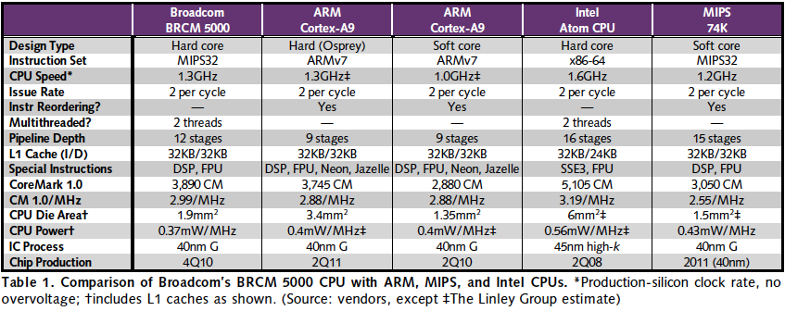
RISC vs. CISC 2010 (mobile client)
“Broadcom Shows Off New CPU,” Linley Gwennap, Microprocessor Report, November 22, 2010
X86 ≈ 1.04 – 1.08x better performance/MHz vs. MIPS, ARM
MIPS, ARM ≈ 1.4 – 1.5x better energy/MHz vs. x86
MIPS, ARM ≈ ⅓ to ¼ die area vs. x86

Slide 51
RESOLVING RISC-CISC DEBATE
Products shipped?
2010: 8.1B microprocessors
6.1B ARM, 0.3B x86 (75%+ RISC)
How USA resolves debates?
We ask celebrities!
Who is the biggest celebrity in the world?
Notes:
How do we decide important decisions in the USA?
We ask celebrities! What greater celebrity is there than Angelina Jolie?
50:42 in movie
Here is what she said in the movie Hackers in 1995
Hacker’s Part Six on Youtube, 2:27 into the movie
http://www.youtube.com/watch?v=onSQlpxpHoU

Slide 52
RESOLVING RISC-CISC Debate
Angelina Jolie as Kate Libby (aka as hacker Acid Burn) in movie “Hackers” (1995)
Notes:
How do we decide important decisions in the USA?
We ask celebrities! What greater celebrity is there than Angelina Jolie?
Here is what she said in the movie Hackers in 1995:
Stop Movie Movie via Netflix @ 50:40 - 50:55 in Hackers / 1995
This youtube video still has audio:http://www.youtube.com/watch?v=jwg4mbGL4JEAbout 50s into the clip.

Slide 53
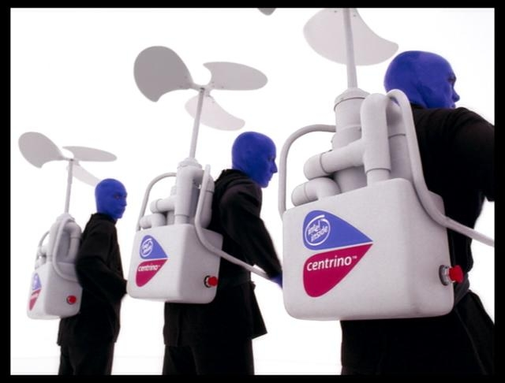
RESOLVING RISC-CISC Debate
Angelina Jolie: “RISC architecture is gonna change everything.”
Blue Man Group
“(silence)”
“Hackers” (1995)
Notes:
RISC has the endorsement of the biggest celebrity in the world.
The best Intel can do is the Blue Man group.
Who would you rather spend the weekend with talking about computer architecture?

Slide 54
And in Conclusion, …
Separate Memory Management into orthogonal functions:
Translation (mapping of virtual address to physical address)
Protection (permission to access word in memory)
But most modern systems provide support for all functions with single page-based system
All desktops/servers have full demand-paged virtual memory
Portability between machines with different memory sizes
Protection between multiple users or multiple tasks
Share small physical memory among active tasks
Simplifies implementation of some OS features
Hardware support: User/Supervisor Mode, invoke Supervisor Mode, TLB, Page Table Register

