Slide 1
CS 61C: Great Ideas in Computer Architecture Overview and Berkeley Culture
Instructor:
David A. Patterson
http://inst.eecs.Berkeley.edu/~cs61c/sp12

Slide 2
Agenda
Administrivia
Survey Results
Extra Credit Top Scores
Course Overview
Cal Culture
HKN Course Evaluation

Slide 3
Administrivia
All grades but Project 4 finalized: 4/27; Proj 4 5/1
Go to lab to finalize any labs Th/Fr
Final Review: Sun April 29, 2-5PM, 2050 VLSB
Extra office hours: Thu-Fri May 3-4 1-5PM
Final Exam: Wed May 9 11:30-2:30, 1 Pimentel
Designed for 90 minutes, you will have 3 hours
Comprehensive (particularly problem areas on midterm), but focused on course since midterm: lecture, lab, hws, and projects are fair game
8 ½ inch x 11 inch crib sheet like midterm

Slide 4
Some Survey Results
I felt the midterm was
3% Far too difficult
10% Somewhat harder than it should have been
64% Fair
20% A little too easy
2% Far too easy

Slide 5
Some Survey Results
How much time per week to you spend on average in 61C (including lecture, discussion, and labs)?
18% <10 hours per week
35% 11-12 hours per week
16% 13-14 hours per week
20% 15-16 hours per week
8% 17-20 hours per week
4% >21 hours per week
Berkeley guidelines 3 hours/unit
(EECS classes often > guidelines)

Slide 6
Some Survey Results
Rated as “Enjoyed and learned a lot”:
Project#4: Processor Design in Logisim (69%)
Logisim Labs: ALU (66%), Logisim (51%)
C memory management lab (42%)
Project#3: Matrix Multiply Performance Improvement, Part 1 (41%) & Part 2 (31%)

Slide 7
Some Survey Results
Did 61C material come up in interviews for internships or jobs? 51% Yes
“MapReduce was a hit, memory management/stack/heap questions came up, optimization questions (cache blocking, etc.) came up”
“I was simply asked how I would change one of my responses for a system that had multiple cores.”
“Interview with VMWare - Asked about experience writing parallel programs using Hadoop. Interview with Intel - Asked about using SSE intrinsics for software optimization”

Slide 8
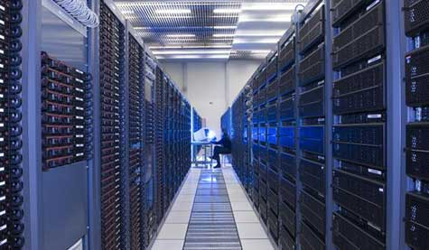
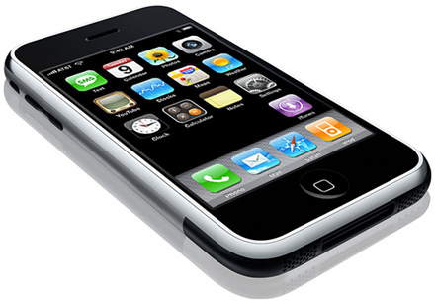
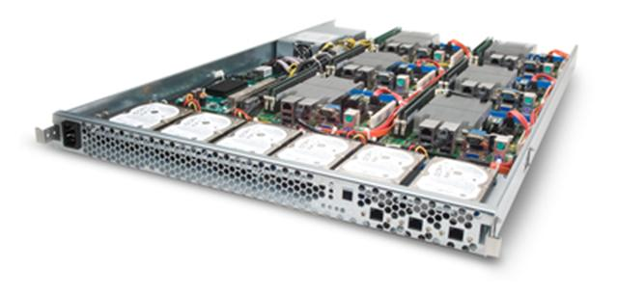
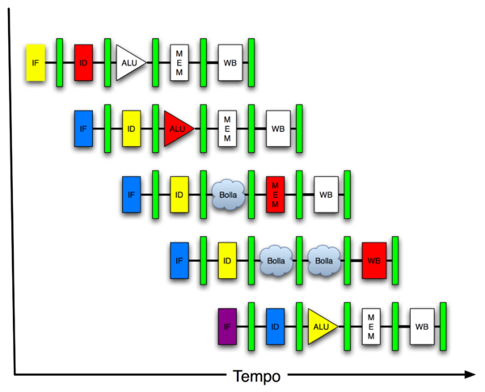
New-School Machine Structures (It’s a bit more complicated!)
Project 1
Software Hardware
Parallel Requests
Assigned to computer
e.g., Search “Katz”
Parallel Threads
Assigned to core
e.g., Lookup, Ads
Parallel Instructions
>1 instruction @ one time
e.g., 5 pipelined instructions
Parallel Data
>1 data item @ one time
e.g., Add of 4 pairs of words
Hardware descriptions
All gates functioning in parallel at same time
Programming Languages
Warehouse Scale Computer
Smart Phone
Leverage Parallelism &
Achieve High Performance
Project 2
Computer
Core
…
Core
Memory
Project 3
Input/Output
Core
Instruction Unit(s)
Functional
Unit(s)
A₀+B₀
A₁+B₁
A₂+B₂
A₃+B₃
Cache Memory
Logic Gates
Project 4

Slide 9
6 Great Ideas in Computer Architecture
Layers of Representation/Interpretation
Moore’s Law
Principle of Locality/Memory Hierarchy
Parallelism
Performance Measurement & Improvement
Dependability via Redundancy

Slide 10
Powers of Ten inspired 61C Overview
Going Top Down cover 3 Views
Architecture (when possible)
Physical Implementation of that architecture
Programming system for that architecture and implementation (when possible)
http://www.powersof10.com/film
Notes:
Start film at 5:40, lasts for 5 minutes
Google earth at steelhead way, and dam

Slide 11
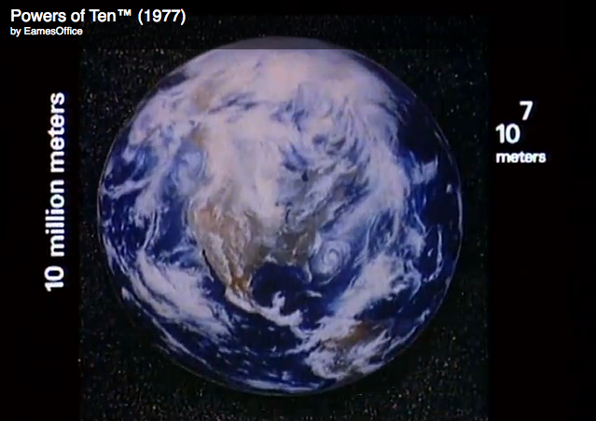
Earth
10⁷ meters
Notes:
4:55 starts coming back to earth from galaxy

Slide 12
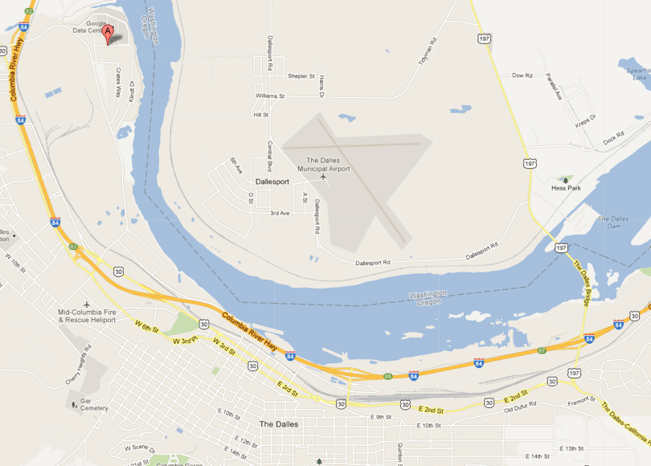
The Dalles, Oregon
10⁴ meters

Slide 13
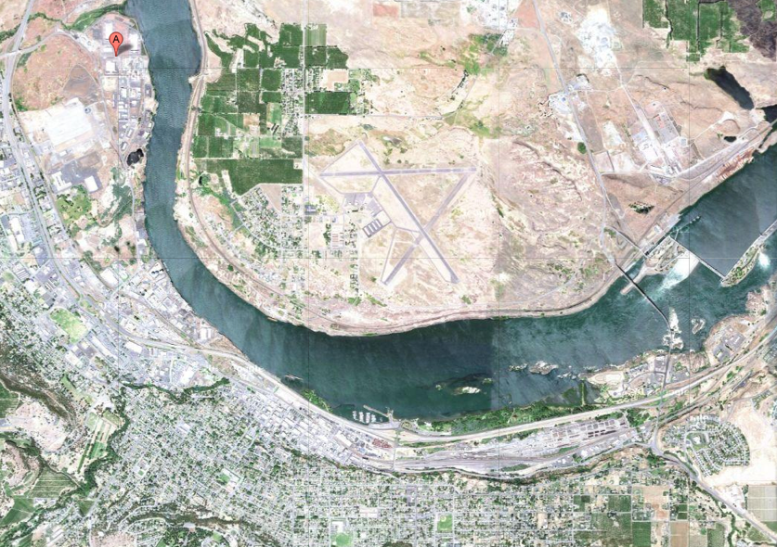
The Dalles, Oregon
10⁴ meters

Slide 14
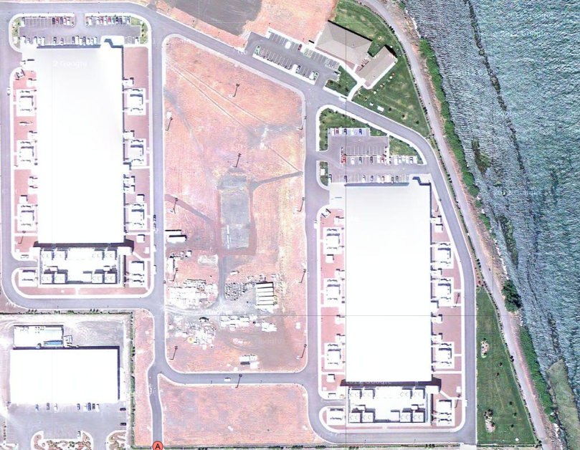
Google’s Oregon WSC
10³ meters

Slide 15
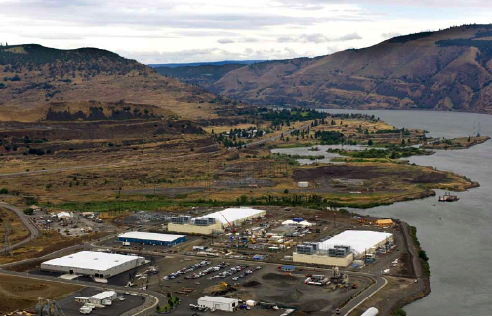
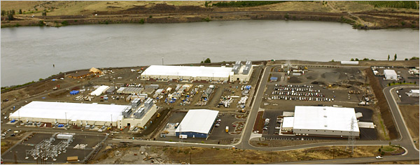
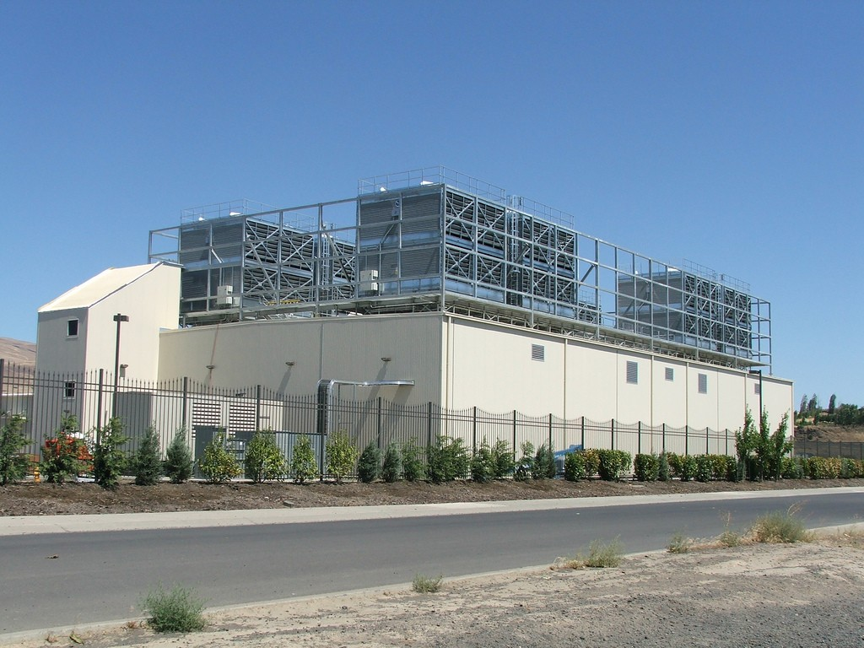
Google’s Oregon WSC
10⁴ meters
10 kilometers
10² meters
10³ meters

Slide 16
Google Warehouse
90 meters by 75 meters, 10 Megawatts
Contains 40,000 servers, 190,000 disks
Power Utilization Effectiveness: 1.23
85% of 0.23 overhead goes to cooling losses
15% of 0.23 overhead goes to power losses
Contains 45, 40-foot long containers
8 feet x 9.5 feet x 40 feet
30 stacked as double layer, 15 as single layer

Slide 17
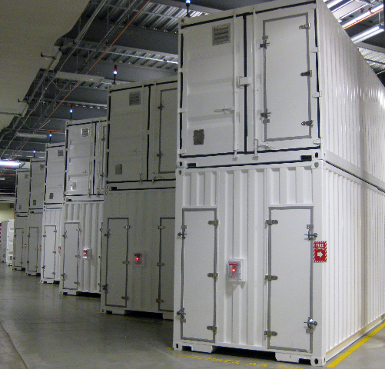
Containers in WSCs
10² meters
100 meters

Slide 18
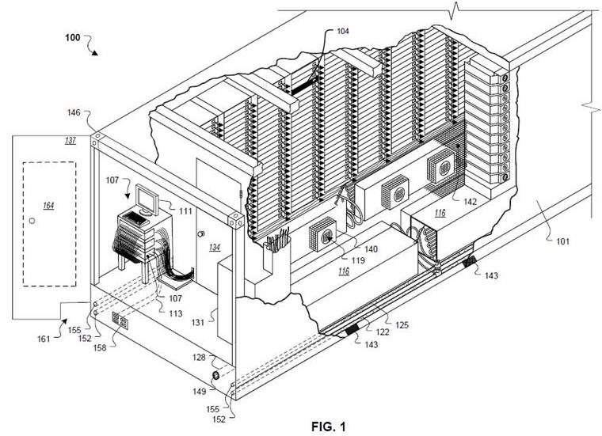
Google Container
10¹ meters

Slide 19
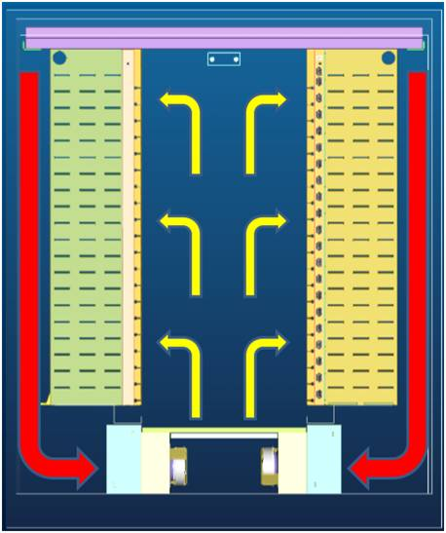
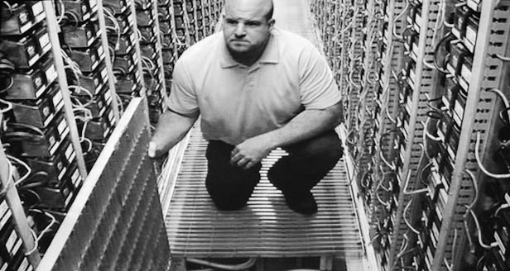
Google Container
10⁰ meters
10 meters
2 long rows, each with 29 racks
Cooling below raised floor
Hot air returned behind racks

Slide 20
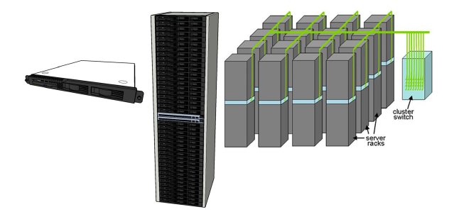
Equipment Inside a Container
Server (in rack format):
Array (aka cluster): server racks + larger local area network switch (“array switch”) 10X faster => cost 100X: cost f(N²)
7 foot Rack: servers + Ethernet local area network switch in middle (“rack switch”)

Slide 21
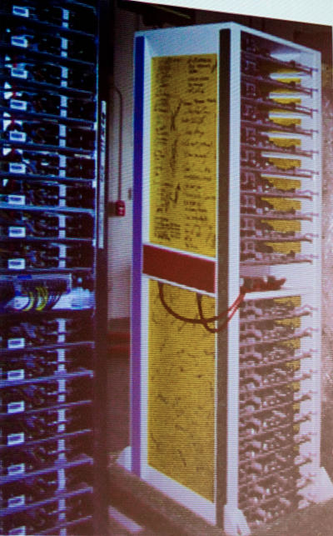
Google Rack
10⁰ meters
Google rack with 20 servers + Network Switch in the middle
48-port 1 Gigabit/sec Ethernet switch every other rack
Array switches connect to racks via multiple 1 Gbit/s links
2 datacenter routers connect to array switches over 10 Gbit/s links
1 meter

Slide 22
Programming WSC: MapReduce
public static class SumReduce extends Reducer<Text, LongWritable, Text, LongWritable> {
/** Actual reduce function.
* @param key Word.
* @param values Values for this word (partial counts).
* @param context ReducerContext object for accessing output,
* configuration information, etc.
*/
@Override
public void reduce(Text key, Iterable<LongWritable>values,
Context context) throws IOException, InterruptedException { long sum = 0L;
for (LongWritable value : values) {sum += value.get();} context.write(key, new LongWritable(sum));
}
}

Slide 23
6 Great Ideas in Computer Architecture inside the Warehouse Scale Computer
Layers of Representation/Interpretation
WSC, Container, Rack
Moore’s Law
Principle of Locality/Memory Hierarchy
Parallelism
Task Level Parallelism, Data Level Parallelism
Performance Measurement & Improvement
Measure PUE to improve PUE
Dependability via Redundancy
Multiple WSCs, Multiple Racks, Multiple Switches

Slide 24
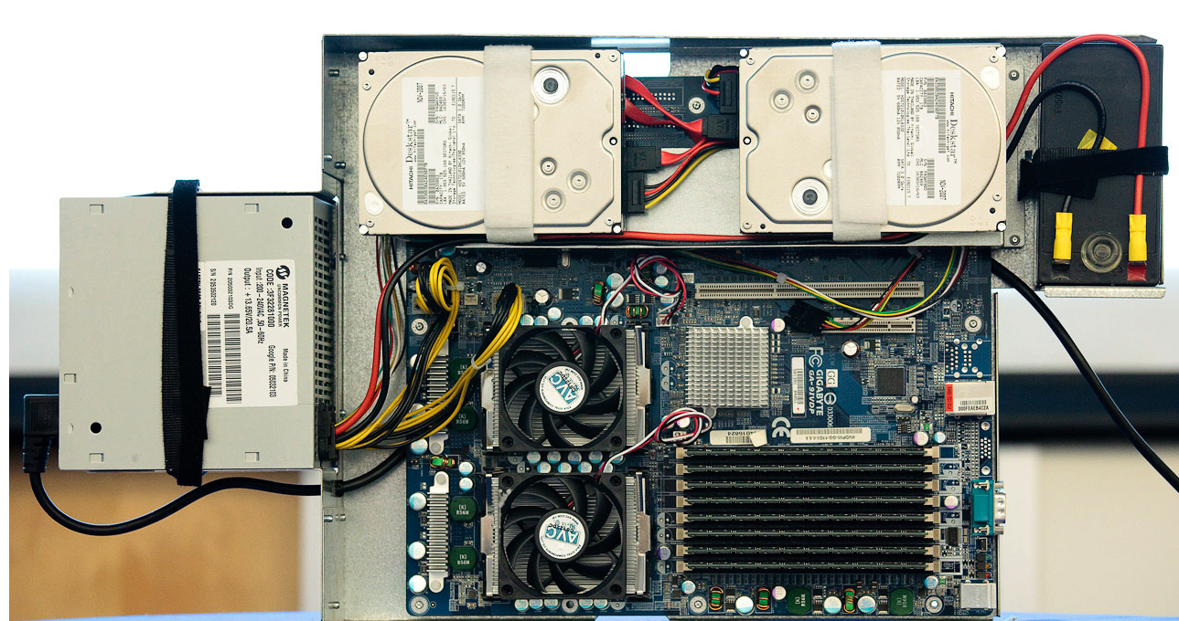
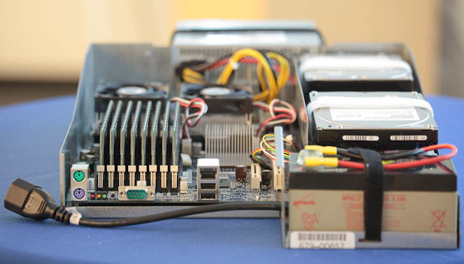
Google Server Internals
10⁻¹ meters
Google Server
10 centimeters
Notes:
Most companies buy servers from the likes of Dell, Hewlett-Packard, IBM, or Sun Microsystems. But Google, which has hundreds of thousands of servers and considers running them part of its core expertise, designs and builds its own. Ben Jai, who designed many of Google's servers, unveiled a modern Google server before the hungry eyes of a technically sophisticated audience.
Google's big surprise: each server has its own 12-volt battery to supply power if there's a problem with the main source of electricity. The company also revealed for the first time that since 2005, its data centers have been composed of standard shipping containers--each with 1,160 servers and a power consumption that can reach 250 kilowatts.
It may sound geeky, but a number of attendees--the kind of folks who run data centers packed with thousands of servers for a living--were surprised not only by Google's built-in battery approach, but by the fact that the company has kept it secret for years. Jai said in an interview that Google has been using the design since 2005 and now is in its sixth or seventh generation of design.
Read more: http://news.cnet.com/8301-1001_3-10209580-92.html#ixzz0yo8bhTOH

Slide 25
Google Board Details
Supplies only 12 volts
Battery per board vs. large battery room
Improves PUE: 99.99% efficient local battery vs 94% for battery room
2 SATA Disk Drives
1 Terabyte capacity each
3.5 inch disk drive
7200 RPM
2 AMD Opteron Microprocessors
Dual Core, 2.2 GHz
8 DIMMs
8 GB DDR2 DRAM
1 Gbit/sec Ethernet Network Interface Card

Slide 26
Programming Multicore Microprocessor: OpenMP
#include <omp.h>
#include <stdio.h>
static long num_steps = 100000;
int value[num_steps];
int reduce()
{ int i; int sum = 0;
#pragma omp parallel for private(x) reduction(+:sum)
for (i=1; i<= num_steps; i++){
sum = sum + value[i];
}
}

Slide 27
6 Great Ideas in Computer Architecture inside the Server
Layers of Representation/Interpretation
Moore’s Law
More transistors => Multicore
Principle of Locality/Memory Hierarchy
Parallelism
Thread Level Parallelism
Performance Measurement & Improvement
Timers, counters
Dependability via Redundancy

Slide 28
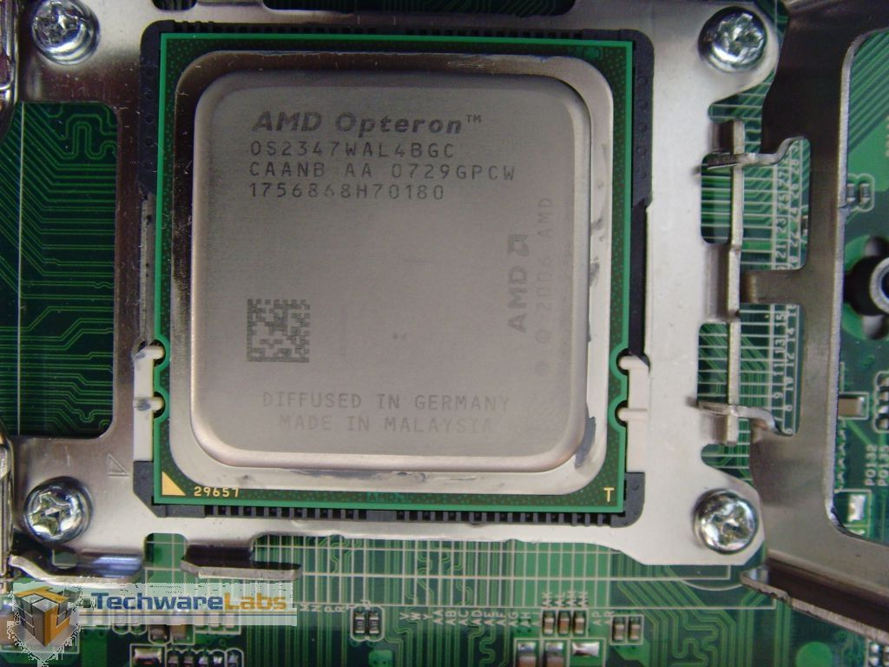
AMD Opteron Microprocessor
10⁻² meters
centimeters

Slide 29
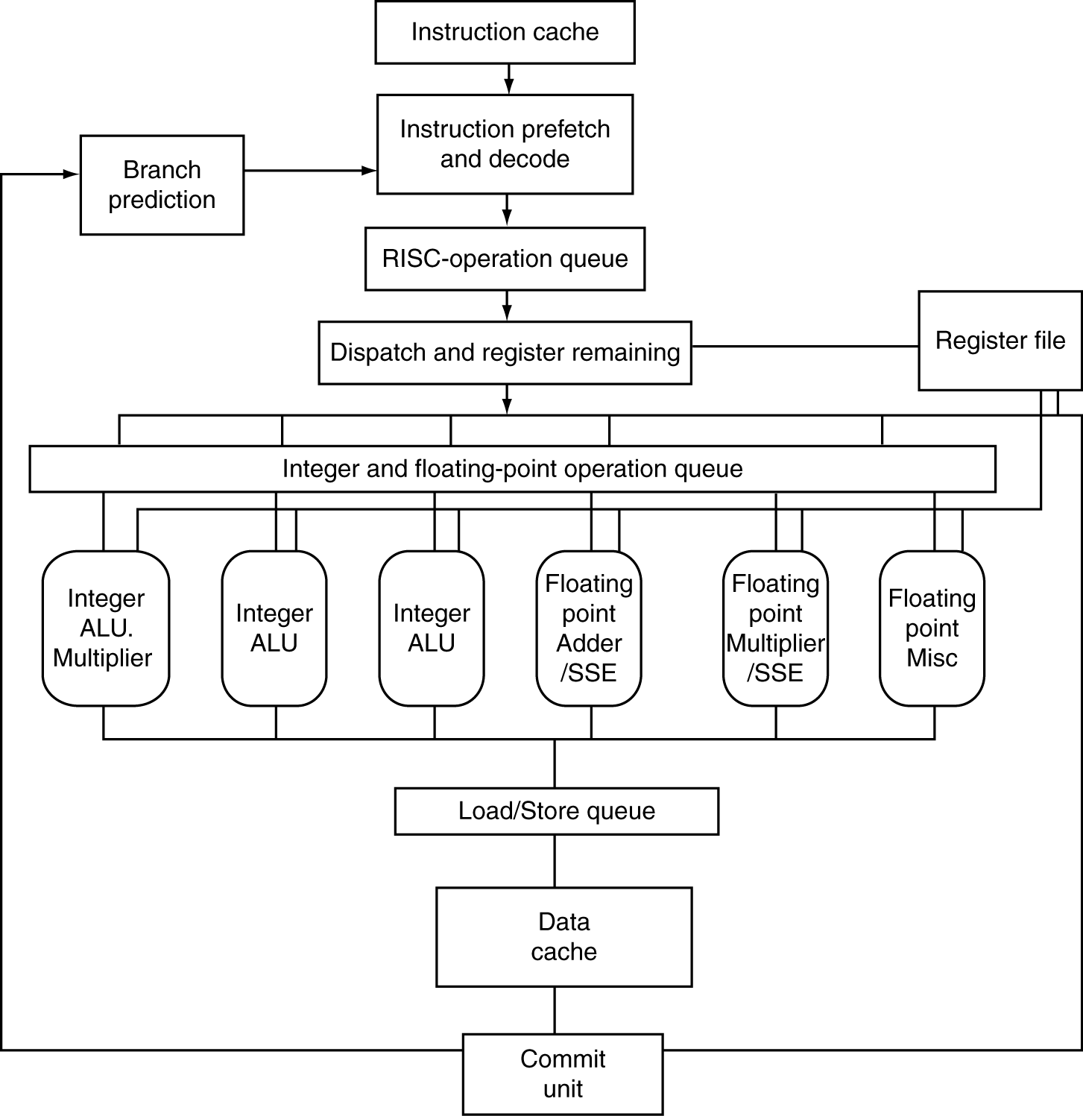
AMD Opteron Microarchitecture
72 physical registers

Slide 30
AMD Opteron Pipeline Flow
For integer operations
12 stages (Floating Point is 17 stages)
Up to 106 RISC-ops in progress

Slide 31
AMD Opteron Block Diagram
L1
Icache
64B
Fetch
Branch
Prediction
Scan/Align/Decode
Fastpath
Microcode Engine
L1
Dcache
64KB
µops
Instruction Control Unit (72 entries)
Int Decode & Rename
FP Decode & Rename
44-entry
Load/Store
Queue
Res
Res
Res
36-entry FP scheduler
AGU
AGU
AGU
FADD
FMUL
FMISC
ALU
ALU
ALU
MULT

Slide 32
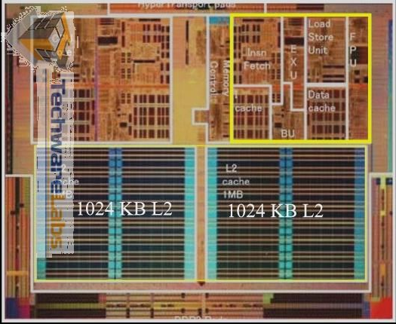
AMD Opteron Microprocessor
10⁻² meters
centimeters

Slide 33
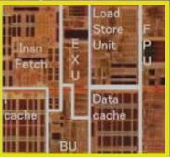
AMD Opteron Core
10⁻³ meters
millimeters

Slide 34
Programming One Core: C with Intrinsics
void mmult(int n, float *A, float *B, float *C)
{
for ( int i = 0; i < n; i+=4 )
for ( int j = 0; j < n; j++ )
{
__m128 c0 = _mm_load_ps(C+i+j*n);
for( int k = 0; k < n; k++ )
c0 = _mm_add_ps(c0, _mm_mul_ps(_mm_load_ps(A+i+k*n), _mm_load1_ps(B+k+j*n)));
_mm_store_ps(C+i+j*n, c0);
}
}

Slide 35
Inner loop from gcc –O -S
Assembly snippet from innermost loop:
movaps (%rax), %xmm9
mulps %xmm0, %xmm9
addps %xmm9, %xmm8
movaps 16(%rax), %xmm9
mulps %xmm0, %xmm9
addps %xmm9, %xmm7
movaps 32(%rax), %xmm9
mulps %xmm0, %xmm9
addps %xmm9, %xmm6
movaps 48(%rax), %xmm9
mulps %xmm0, %xmm9
addps %xmm9, %xmm5

Slide 36
6 Great Ideas in Computer Architecture inside the Microprocessor
Layers of Representation/Interpretation
Instruction Set Architecture, micro operations
Moore’s Law
Principle of Locality/Memory Hierarchy
Parallelism
Instruction Level Parallelism (superscalar, pipelining)
Data Level Parallelism
Performance Measurement & Improvement
Dependability via Redundancy

Slide 37
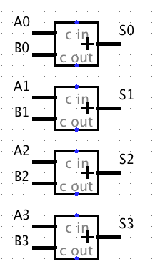
SIMD Adder
Four 32-bit adders that operate in parallel
Data Level Parallelism

Slide 38
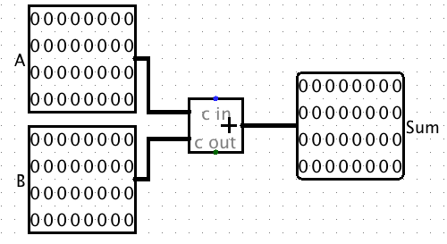
One 32-bit Adder

Slide 39
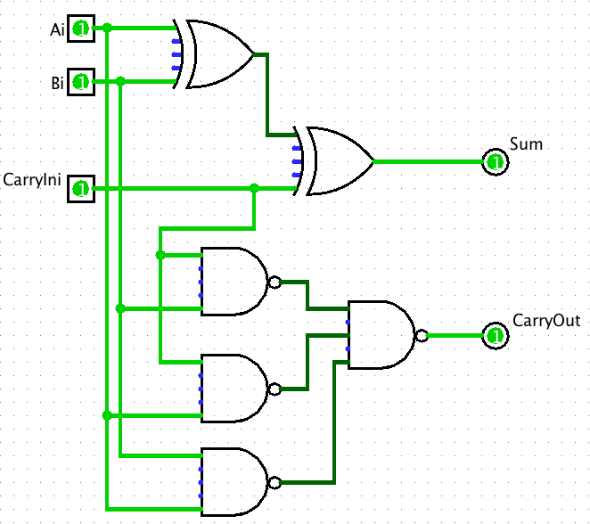
1 bit of 32-bit Adder

Slide 40
Complementary MOS Transistors (NMOS and PMOS) of NAND Gate
X
Y
x
y
z
NAND gate
3v
0 volts
3 volts
0 volts
0 volts
3 volts
3 volts
Z
3 volts
3 volts
0 volts
0v
3 volts
3 volts
0 volts
Notes:
Bottom
X = 0v Y = 0V both closed on top in series, so Z = 3v
X = 0v Y = 0V both open bottom
X = 0v Y = 3V 1st open on top,
X = 0v Y = 3V 2nd in series closed, so Z = 0v
X = 3v Y = 0V 2nd open on top
X = 3v Y = 0V 2nd in series closed, so Z = 0v
X = 3v Y = 3V both open on top
X = 3v Y = 3V both closed, so Z = 0v

Slide 41
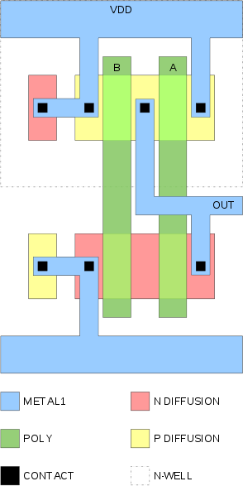
Physical Layout of NAND Gate
10⁻⁷ meters
100 nanometers

Slide 42
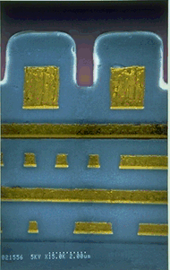
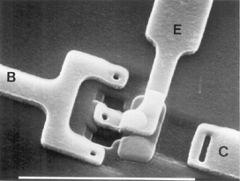
Scanning Electron Microscope
10⁻⁷ meters
100 nanometers
Top View
Cross Section

Slide 43
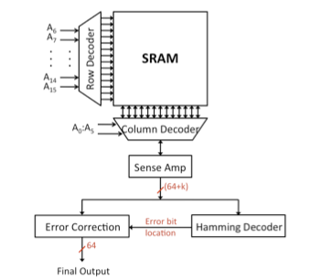
Block Diagram of Static RAM
10⁻⁶ meters

Slide 44
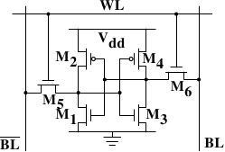
1 Bit SRAM in 6 Transistors
Notes:
The core of this cell is formed by the four transistors M₁ to M₄ which form two cross-coupled inverters. They have two stable states, representing 0 and 1 respectively. The state is stable as long as power on V_{dd} is available.
If access to the state of the cell is needed the word access line WL is raised. This makes the state of the cell immediately available for reading on BL and BL. If the cell state must be overwritten the BL and BL lines are first set to the desired values and then WL is raised. Since the outside drivers are stronger than the four transistors (M₁ through M₄) this allows the old state to be overwritten.

Slide 45
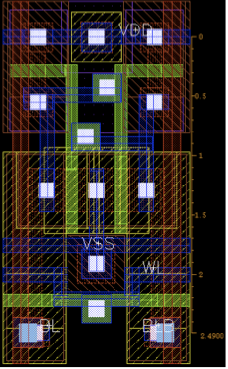
Physical Layout of SRAM Bit
10⁻⁷ meters
100 nanometers

Slide 46
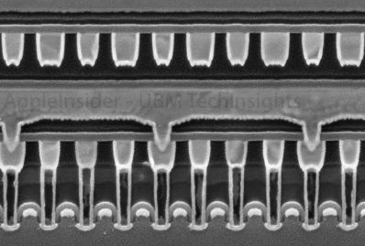
SRAM Cross Section
10⁻⁷ meters
100 nanometers

Slide 47
DIMM Module
DDR = Double Data Rate
Transfers bits on Falling AND Rising Clock Edge
Has Single Error Correcting, Double Error Detecting Redundancy (SEC/DED)
72 bits to store 64 bits of data
Uses “Chip kill” organization so that if single DRAM chip fails can still detect failure
Average server has 22,000 correctable errors and 1 uncorrectable error per year

Slide 48
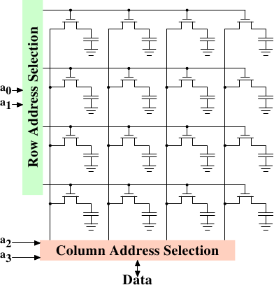
DRAM Bits
10⁻⁶ meters
1 micron

Slide 49
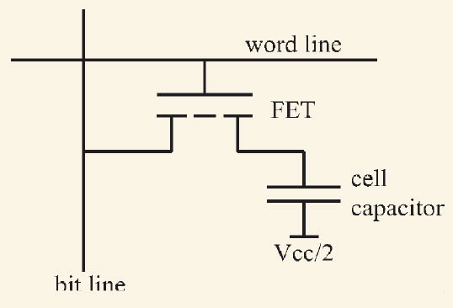
DRAM Cell in Transistors

Slide 50
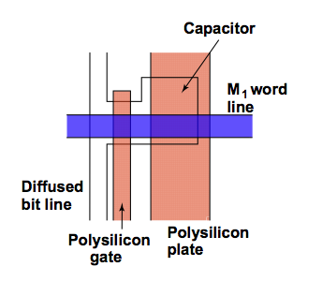
Physical Layout of DRAM Bit

Slide 51
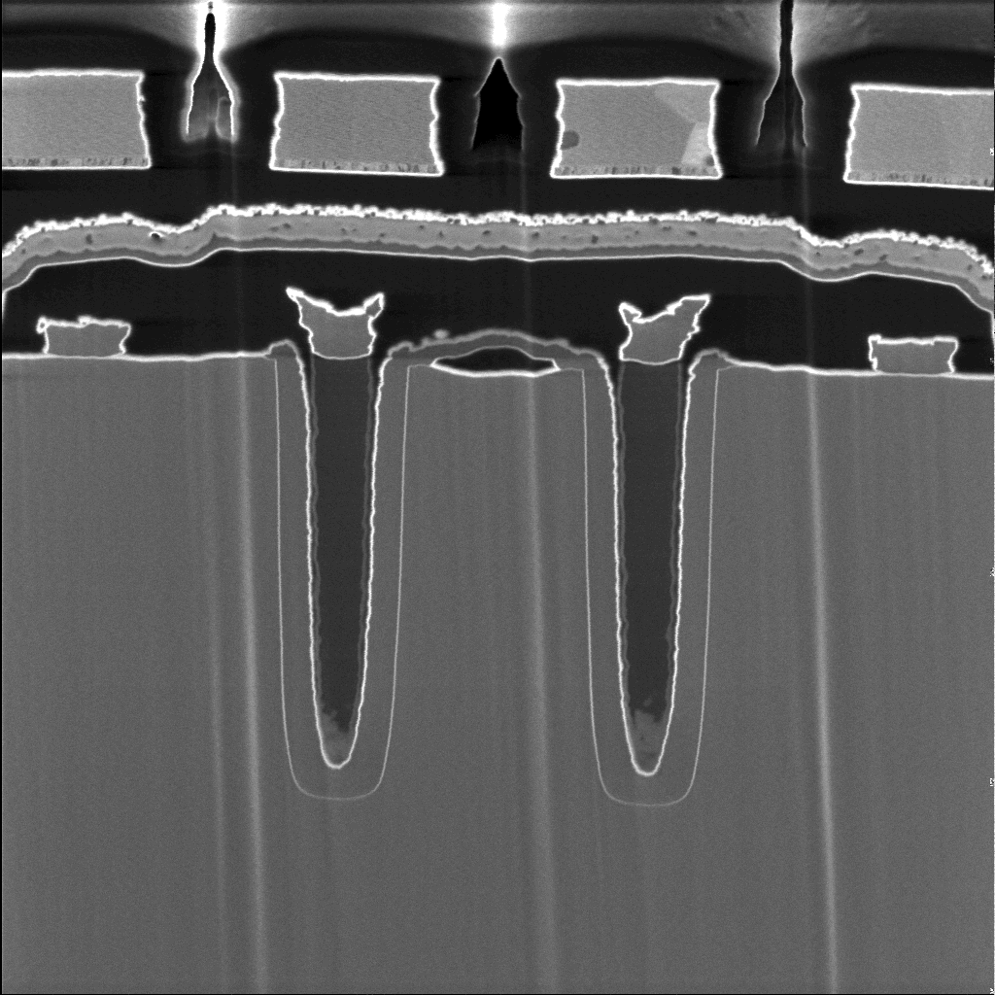
Cross Section of DRAM Bits
10⁻⁷ meters
100 nanometers

Slide 52
AMD Dependability
• L1 cache data is SEC/DED protected
• L2 cache and tags are SEC/DED protected
• DRAM is SEC/DED protected with chipkill
• On-chip and off-chip ECC protected arrays include autonomous, background hardware scrubbers
• Remaining arrays are parity protected
– Instruction cache, tags and TLBs
– Data tags and TLBs
– Generally read only data that can be recovered from lower levels

Slide 53
Programming Memory Hierarchy: Cache Blocked Algorithm
The blocked version of the i-j-k algorithm is written simply as (A,B,C are submatricies of a, b, c)
for (i=0;i<N/r;i++)
for (j=0;j<N/r;j++)
for (k=0;k<N/r;k++)
C[i][j] += A[i][k]*B[k][j]
r = block (sub-matrix) size (Assume r divides N)
X[i][j] = a sub-matrix of X, defined by block row i and block column j

Slide 54
6 Great Ideas in Computer Architecture inside the chips
Layers of Representation/Interpretation
Moore’s Law
Higher capacity caches and DRAM
Principle of Locality/Memory Hierarchy
Caches, TLBs
Parallelism
Data Level Parallelism
Performance Measurement & Improvement
Memory Traffic, Cache Misses
Dependability via Redundancy
Parity, SEC/DED

Slide 55
Course Summary
As the field changes, cs61c had to change too!
It is still about the software-hardware interface
Programming for performance!
Parallelism: Task-, Thread-, Instruction-, and Data- MapReduce, OpenMP, C, SSE instrinsics
Understanding the memory hierarchy and its impact on application performance
Interviewers ask what you did this semester!

Slide 56
Agenda
Administrivia
Survey Results
Extra Credit Top Scores
Course Overview
Cal Culture
HKN Course Evaluation

Slide 57
What to Emphasize about CS at Cal?
US News and World Report Rankings 2012
Source: http://grad-schools.usnews.rankingsandreviews.com/best-graduate-schools/top-science-schools/computer-science-rankings
Top Graduate Programs in Computer Science
4 way tie for #1: Berkeley, CMU, MIT, Stanford
4 specialties: AI, Prog. Languages, Systems, and Theory
Specialty Systems in Computer Science
1: Berkeley
2: MIT
3: CMU
4: Stanford

Slide 58
Doesn’t Reputation Lag Reality?
2007 Intel and Microsoft announced they would fund a Universal Parallel Computing Research Center (UPCRC): $10M over 5 years
Invited the 25 top Computer Science departments to submit proposals
4 finalists site visits: Berkeley, Illinois, MIT, Stanford
August 2007 Intel and Microsoft announce technical committee unanimously selected Berkeley as the top choice of the competition

Slide 59
Doesn’t Reputation Lag Reality?
Simons Foundation announced it would fund a Theory Center: $60M over 10 years
Invited many CS departments to submit proposals
3 finalists get site visits: Berkeley, Chicago, Harvard-MIT
(Shh! May 1, 2012 Simons Foundation will announce Berkeley as winner of the competition)

Slide 60
What to Emphasize about Cal overall?
Top public university (US News and World Report)
Top graduate program in the world?
35/36 programs in top 10 in 1994
48/52 programs in top 10 in 2010
University doing the most public good
Washington Monthly 2009!
Faculty Awards?
9 current Nobel Prize winners (22 all time)!
3 Turing Award winners (“Nobel of Computer Science”)!
3 Fields Medalists (“Nobel of Math”)!
32 “Genius” awards (MacArthur fellows)
91 in National Academy of Engineering!
137 in National Academy of Science!
Source: http://www.berkeley.edu/about/honors/

Slide 61
Cal Cultural History: Football!
Started with “soccer” (aka football)
11 on a team, 2 teams, 1 ball, on a field; object is to move ball into “goal”; most goals wins. No hands!
New World changes rules to increase scoring:
Make goal bigger! (full width of field)
Carry ball with hands
Can toss ball to another player backwards or laterally (called a “lateral”) anytime and forwards (“pass”) sometimes
How to stop players carrying the ball? Grab them & knock them down by making knee hit the ground (“tackle”)
In soccer tackle the ball; football tackle the person

Slide 62
ABCs of American Football
Score by...
Moving football into goal (“cross the goal line” or “into the end zone”) scoring a “touchdown”
(6 points)
Kicking football between 2 poles (“goal posts”) scoring a “field goal”
( worth 3 points, unless after touchdown, then its just 1 point: “extra point” )
Kick ball to other team after score (“kickoff”)
laterals OK
Game ends when no time left (four 15 min quarters) and person with ball is stopped
Soccer: two 45 min halves, time stops play

Slide 63
Football Field
Goal
Line
Goal
Line
End
Zone
10
20
30
40
50
40
30
20
10
End
Zone
California
Golden Bears
Cal
100 yards (91.4 meters)

Slide 64
Spectacle of American Football
Cal’s archrival is Stanford
Stereotype is Rich, Elitist Snobs
E.g, derby Man City vs. Manchester United
Play nearby archrival for last game of season
Called “The Big Game”: Cal vs. Stanford, winner gets a trophy (“The Axe”)
Oldest rivalry west of Mississippi; 100th in 1997
American college football is a spectacle
School colors (Cal Blue & Gold v. Red & White)
Nicknames (Golden Bears v. Stanford Cardinal)
School mascot (Oski the bear v. a tree(!))
Leaders of cheers (“cheerleaders”)

Slide 65
Spectacle of American Football
“Bands” (orchestras that march) from both schools at games
March & Play
Before game, at halftime, after game
Stanford Band more like a drinking club (seen the movie “Animal House”?)
Plays one song: “All Right Now” (1970)
Cannot march and play

Slide 66
1982 Big Game: “The Play”
“Top 20 favorite sports event in 20th century,” Sports Illustrated
“Greatest Football Play of All Time,” Best Damn Sports Show
“…The Play, widely considered the most dramatic ending in college football history” , AP news
“…widely considered the most famous play in college football history ,” Stanford Magazine
(“The Play” in Wikipedia en.wikipedia.org/wiki/The_Play)
Stanford
Quarterback is John Elway, who goes on to be a professional Hall of Fame football player (retired 1999)
Possibly greatest quarterback in college history?
In 1982, they had lost 4 games in last minutes
Stanford has just taken lead with 4 seconds left in game; Cal team captain yells in huddle “Don’t fall with the ball!”; watch video

Slide 67
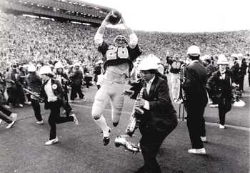
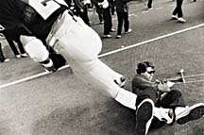
Notes About “The Play”
“Allright here we go with the kick-off. Harmon will probably try to squib it and he does. Ball comes loose and the Bears have to get out of bounds. Rogers along the sideline, another one... they're still in deep trouble at midfield, they tried to do a couple of....the ball is still loose as they get it to Rogers. They get it back to the 30, they're down to the 20...Oh the band is out on the field!! He's gonna go into the endzone!!! He got into the endzone!! … THE BEARS HAVE WON!!! THE BEARS HAVE WON!!! Oh my God, the most amazing, sensational, dramatic, heart rending... exciting thrilling finish in the history of college football!” – KGO’s Joe Starkey

Slide 68
Notes About “The Play” (1/2)
Cal only had 10 men on the field; last second another came on (170 pound Steve Dunn #3) and makes key 1st block
Kevin Moen #26: 6’1” 190 lb. safety,
laterals to Rodgers (and doesn’t give up)
Richard Rodgers #5: 6’ 200 lb. safety, Cal captain “Don’t fall with that ball.”
laterals to Garner
Dwight Garner #43: 5’9” 185 lb. running back
almost tackled, 2 legs & 1 arm pinned, laterals
Richard Rodgers #5 (again): “Give me the ball!”
laterals to Ford

Slide 69
Notes About “The Play” (1/2)
Mariet Ford #1: 5’9”, 165 pound wide receiver
Smallest player, leg cramps; overhead blind lateral to Moen and blocks 3 Stanford players
Moen (again) cuts through Stanford band into end zone (touchdown!), smashes Trombonist
On field for Stanford: 22 football players, 3 Axe committee members, 3 cheerleaders, 144 Stanford band members (172 for Stanford v. 11 for Cal)
“Weakest part of the Stanford defense was the woodwinds.” -- Cal Fan
Cal players + Stanford Trombonist (Gary Tyrrell) hold reunions; Stanford revises history (Changes score on Axe to 20-19); claims Garner’s knee was down – see video
Notes:
Start The Play at 39 seconds

Slide 70
Special Thanks to the TAs: Rimas Avizienis, Scott Beamer, Alan Christopher, Eric Liang, Paul Ruan, Ian Vonseggern

Slide 71
The Future for Future Cal Alumni
What’s The Future?
New Century, Many New Opportunties: Parallelism, Cloud, Statistics + CS, Bio + CS, Society (Health Care, 3rd world) + CS
Cal heritage as future alumni
Hard Working / Can do attitude
Never Give Up (“Don’t fall with the ball!”)
Smallest on field, 3 big guys charging you: you make a play!
“The best way to predict the future is to invent it” – Alan Kay (inventor of personal computing vision)
Future is up to you!

Slide 72
Storage System
Really 2 models: 1 Disk or 12 Disk servers
2nd tray with 10 disks, add extra 1 Gbit/s NIC
Hitachi Deskstar
1 Terabyte capacity, 7200 RPM
SATA => Serial ATA link Disk Drives
5% fail per year (AFR)
Google File System (GFS) has multiple replicas of data to protect from disk failures (like RAID 1 or mirroring)

Slide 73
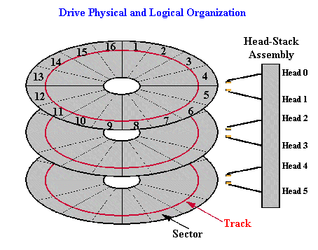
Disk Organization

Slide 74
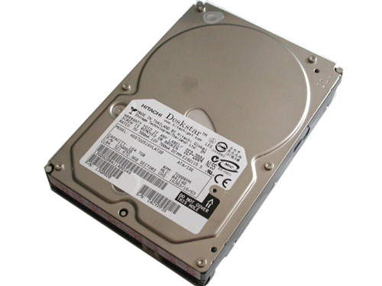
Disk
10⁻¹ meters

Slide 75
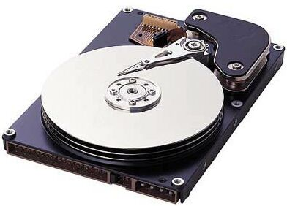
Disk Internals
10⁻¹ meters

Slide 76
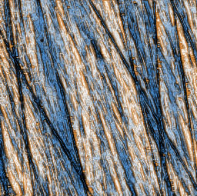
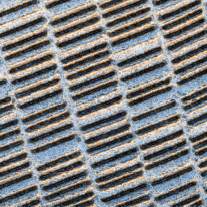
Closeup of Disk Surface
10⁻⁷ meters
Topography via Atomic Force Microscopy (AFM)
Bits visible via Magnetic Force Microscopy (MFM)
http://www.dataclinic.co.uk/data-recovery/hard-disk-microscopy-ii.htm

Slide 77
Programming Storage
Operating System calls

Slide 78
6 Great Ideas in Computer Architecture
Layers of Representation/Interpretation
Moore’s Law
Principle of Locality/Memory Hierarchy
Paging Memory
Parallelism
Task Level Parallelism (Asynchronous I/O)
Performance Measurement & Improvement
Dependability via Redundancy
Reed-Solomon ECC per disk sector, replicated files

