Slide 1
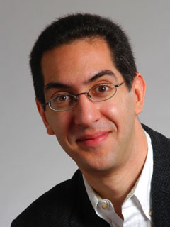
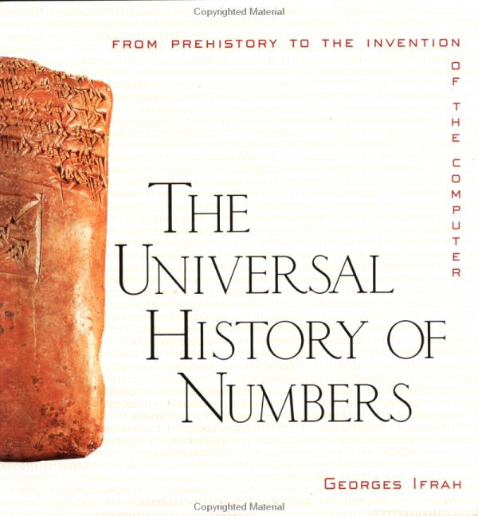
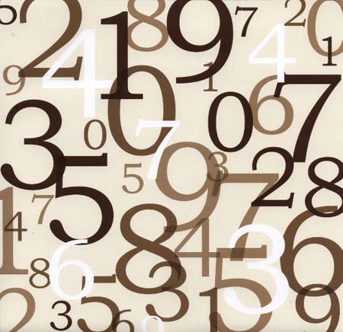
inst.eecs.berkeley.edu/~cs61c CS61C : Machine Structures Lecture #2 – Number Representation 2013-01-25
There is one handout today at the entrance!
Senior Lecturer SOE Dan Garcia
www.cs.berkeley.edu/~ddgarcia
Great book ⇒ The Universal History of Numbers by Georges Ifrah
Notes:
Greet class

Slide 2
Review
CS61C: Learn 6 great ideas in computer architecture to enable high performance programming via parallelism, not just learn C
Abstraction (Layers of Representation/Interpretation)
Moore’s Law
Principle of Locality/Memory Hierarchy
Parallelism
Performance Measurement and Improvement
Dependability via Redundancy

Slide 3
Putting it all in perspective…
“If the automobile had followed the same development cycle as the computer, a Rolls-Royce would today cost $100, get a million miles per gallon, and explode once a year, killing everyone inside.”
– Robert X. Cringely

Slide 4
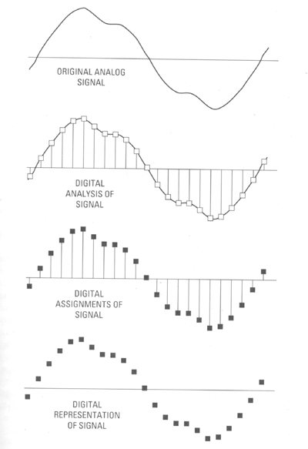
Data input: Analog ➔ Digital
Real world is analog!
To import analog information, we must do two things
Sample
E.g., for a CD, every 44,100ths of a second, we ask a music signal how loud it is.
Quantize
For every one of these samples, we figure out where, on a 16-bit (65,536 tic-mark) “yardstick”, it lies.
www.joshuadysart.com/journal/archives/digital_sampling.gif

Slide 5
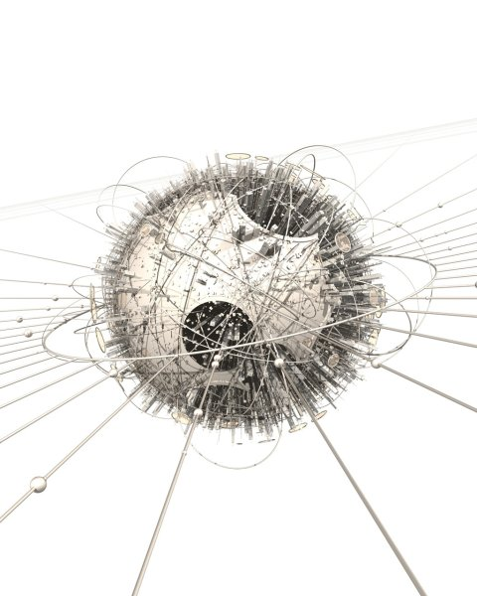
Digital data not nec born Analog…
hof.povray.org

Slide 6
BIG IDEA: Bits can represent anything!!
Characters?
26 letters  5 bits (2⁵ = 32)
upper/lower case + punctuation  7 bits (in 8) (“ASCII”)
standard code to cover all the world’s languages  8,16,32 bits (“Unicode”) www.unicode.com
Logical values?
0  False, 1  True
colors ? Ex:
locations / addresses? commands?
MEMORIZE: N bits ⇔ at most 2^{N} things
Red (00)
Green (01)
Blue (11)

Slide 7
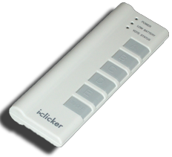
How many bits to represent π ?
1
9 (π = 3.14, so that’s 011 “.” 001 100)
64 (Since Macs are 64-bit machines)
Every bit the machine has!
∞
Notes:
Answer: 1 (since “π” is just a single concept, like “infinity”, or “on”). That bit would say “π” or “not π”. I could also hear “1/2 bit”

Slide 8
What to do with representations of numbers?
Just what we do with numbers!
Add them
Subtract them
Multiply them
Divide them
Compare them
Example: 10 + 7 = 17
…so simple to add in binary that we can build circuits to do it!
subtraction just as you would in decimal
Comparison: How do you tell if X > Y ?
1
1
1 0 1 0
+ 0 1 1 1
-------------------------
1 0 0 0 1

Slide 9
What if too big?
Binary bit patterns above are simply representatives of numbers. Abstraction! Strictly speaking they are called “numerals”.
Numbers really have an ∞ number of digits
with almost all being same (00…0 or 11…1) except for a few of the rightmost digits
Just don’t normally show leading digits
If result of add (or -, *, / ) cannot be represented by these rightmost HW bits, overflow is said to have occurred.
00000
00001
00010
11110
11111
unsigned

Slide 10
How to Represent Negative Numbers?
(C’s unsigned int, C99’s uintN_t)
So far, unsigned numbers
Obvious solution: define leftmost bit to be sign!
0 ➔ + 1 ➔ –
Rest of bits can be numerical value of number
Representation called sign and magnitude
Binary odometer
00000
00001
...
01111
10000
...
11111
Binary odometer
00000
00001
...
01111
11111
...
10001
10000
META: Ain’t no free lunch

Slide 11
Shortcomings of sign and magnitude?
Arithmetic circuit complicated
Special steps depending whether signs are the same or not
Also, two zeros
0x00000000 = +0_{ten}
0x80000000 = –0_{ten}
What would two 0s mean for programming?
Also, incrementing “binary odometer”, sometimes increases values, and sometimes decreases!
Therefore sign and magnitude abandoned

Slide 12
Administrivia
Upcoming lectures
Next few lectures: Introduction to C
Lab overcrowding
Remember, you can go to ANY discussion (none, or one that doesn’t match with lab, or even more than one if you want)
Overcrowded labs - consider finishing at home and getting checkoffs in lab, or bringing laptop to lab
If you’re checked off in 1st hour, you get an extra point on the labs!
TAs get 24x7 cardkey access (and will announce after-hours times)
Enrollment
It will work out, don’t worry
Soda locks doors @ 6:30pm & on weekends
Look at class website, piazza often!
http://inst.eecs.berkeley.edu/~cs61c/ piazza.com
Iclickerskinz.com

Slide 13
Great DeCal courses I supervise
UCBUGG (3 units, P/NP)
UC Berkeley Undergraduate Graphics Group
TuTh 7-9pm in 200 Sutardja Dai
Learn to create a short 3D animation
No prereqs (but they might have too many students, so admission not guaranteed)
http://ucbugg.berkeley.edu
MS-DOS X (2 units, P/NP)
Macintosh Software Developers for OS X
TuTh 5-7pm in 200 Sutardja Dai
Learn to program iOS devices!
No prereqs (other than interest)
http://msdosx.berkeley.edu

Slide 14
Another try: complement the bits
Example: 7₁₀ = 00111₂ –7₁₀ = 11000₂
Called One’s Complement
Note: positive numbers have leading 0s, negative numbers have leadings 1s.
Binary odometer
00000
00001
...
01111
10000
...
11110
11111
What is -00000 ? Answer: 11111
How many positive numbers in N bits?
How many negative numbers?

Slide 15
Shortcomings of One’s complement?
Arithmetic still a somewhat complicated.
Still two zeros
0x00000000 = +0_{ten}
0xFFFFFFFF = -0_{ten}
Although used for a while on some computer products, one’s complement was eventually abandoned because another solution was better.

Slide 16
Standard Negative # Representation
Problem is the negative mappings “overlap” with the positive ones (the two 0s). Want to shift the negative mappings left by one.
Solution! For negative numbers, complement, then add 1 to the result
As with sign and magnitude, & one’s compl. leading 0s  positive, leading 1s  negative
000000...xxx is ≥ 0, 111111...xxx is < 0
except 1…1111 is -1, not -0 (as in sign & mag.)
This representation is Two’s Complement
This makes the hardware simple!
(C’s int, aka a “signed integer”)
(Also C’s short, long long, …, C99’s intN_t)

Slide 17
Two’s Complement Formula
Can represent positive and negative numbers in terms of the bit value times a power of 2:
d₃₁ x -(2³¹) + d₃₀ x 2³⁰ + ... + d₂ x 2² + d₁ x 2¹ + d₀ x 2⁰
Example: 1101_{two} in a nibble?
= 1x-(2³) + 1x2² + 0x2¹ + 1x2⁰
= -2³ + 2² + 0 + 2⁰
= -8 + 4 + 0 + 1
= -8 + 5
= -3_{ten}
Example: -3 to +3 to -3 (again, in a nibble): x : 1101_{two} x’ : 0010_{two} +1 : 0011_{two} ()’: 1100_{two} +1 : 1101_{two}

Slide 18
2’s Complement Number “line”: N = 5
00000
11111
00001
2^{N-1} non-negatives
2^{N-1} negatives
one zero
how many positives?
11110
0
00010
-1
1
11101
-2
2
11100
-3
-4
.
.
.
.
.
.
-15
-16
15
Binary odometer
10001
10000
01111
00000
00001
...
01111
10000
...
11110
11111

Slide 19
Bias Encoding: N = 5 (bias = -15)
00000
11111
00001
# = unsigned + bias
Bias for N bits chosen as –(2^{N-1}-1)
one zero
how many positives?
11110
-15
00010
16
-14
11101
15
-13
11100
14
13
.
.
.
.
.
.
-1
2
0
1
01110
10001
10000
01111
01111
10000
...
11110
11111
00000
00001
...
01110
Binary odometer

Slide 20
How best to represent -12.75?
2s Complement (but shift binary pt)
Bias (but shift binary pt)
Combination of 2 encodings
Combination of 3 encodings
We can’t
Shifting binary point means “divide number by some power of 2. E.g., 11₁₀ = 1011.0₂ so (11/4)₁₀ = 2.75₁₀ = 10.110₂

Slide 21
And in summary...
META: We often make design decisions to make HW simple
We represent “things” in computers as particular bit patterns: N bits  2^{N} things
These 5 integer encodings have different benefits; 1s complement and sign/mag have most problems.
unsigned (C99’s uintN_t) :
2’s complement (C99’s intN_t) universal, learn!
Overflow: numbers ∞; computers finite,errors!
00000
00001
...
01111
10000
...
11111
00000
00001
...
01111
10000
...
11110
11111
META: Ain’t no free lunch

Slide 22
REFERENCE: Which base do we use?
Decimal: great for humans, especially when doing arithmetic
Hex: if human looking at long strings of binary numbers, its much easier to convert to hex and look 4 bits/symbol
Terrible for arithmetic on paper
Binary: what computers use; you will learn how computers do +, -, *, /
To a computer, numbers always binary
Regardless of how number is written:
32_{ten} == 32₁₀ == 0x20 == 100000₂ == 0b100000
Use subscripts “ten”, “hex”, “two” in book, slides when might be confusing

Slide 23
Two’s Complement for N=32
0000 ... 0000 0000 0000 0000_{two} = 0_{ten} 0000 ... 0000 0000 0000 0001_{two} = 1_{ten} 0000 ... 0000 0000 0000 0010_{two} = 2_{ten} . . . 0111 ... 1111 1111 1111 1101_{two} = 2,147,483,645_{ten} 0111 ... 1111 1111 1111 1110_{two} = 2,147,483,646_{ten} 0111 ... 1111 1111 1111 1111_{two} = 2,147,483,647_{ten} 1000 ... 0000 0000 0000 0000_{two} = –2,147,483,648_{ten} 1000 ... 0000 0000 0000 0001_{two} = –2,147,483,647_{ten} 1000 ... 0000 0000 0000 0010_{two} = –2,147,483,646_{ten} . . . 1111 ... 1111 1111 1111 1101_{two} = –3_{ten} 1111 ... 1111 1111 1111 1110_{two} = –2_{ten} 1111 ... 1111 1111 1111 1111_{two} = –1_{ten}
One zero; 1st bit called sign bit
1 “extra” negative:no positive 2,147,483,648_{ten}

Slide 24
Two’s comp. shortcut: Sign extension
Convert 2’s complement number rep. using n bits to more than n bits
Simply replicate the most significant bit (sign bit) of smaller to fill new bits
2’s comp. positive number has infinite 0s
2’s comp. negative number has infinite 1s
Binary representation hides leading bits; sign extension restores some of them
16-bit -4_{ten} to 32-bit:
1111 1111 1111 1100_{two}
1111 1111 1111 1111 1111 1111 1111 1100_{two}

