Slide 1
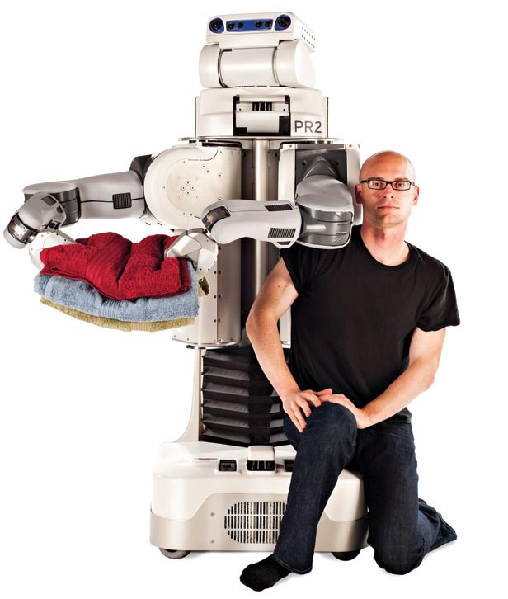
Robots that learn from us!
inst.eecs.berkeley.edu/~cs61c UCB CS61C : Machine Structures Lecture 6 – Introduction to MIPS Data Transfer & Decisions I 2013-02-04
Lecturer SOE Dan Garcia
Prof Pieter Abbeel’s recent research is in having robots learn from the way humans do tasks as apprentices. His robots have learned to perform flying acrobatics, tie surgical sutures and neatly sort socks…
www.technologyreview.com/tr35/profile.aspx?trid=1082

Slide 2
Review
In MIPS Assembly Language:
Registers replace variables
One Instruction (simple operation) per line
Simpler is Better, Smaller is Faster
New Instructions:
add, addi, sub
New Registers:
C Variables: $s0 - $s7
Temporary Variables: $t0 - $t7
Zero: $zero

Slide 3
Assembly Operands: Memory
C variables map onto registers; what about large data structures like arrays?
1 of 5 components of a computer: memory contains such data structures
But MIPS arithmetic instructions only operate on registers, never directly on memory.
Data transfer instructions transfer data between registers and memory:
Memory to register
Register to memory

Slide 4
Anatomy: 5 components of any Computer
Registers are in the datapath of the processor; if operands are in memory, we must transfer them to the processor to operate on them, and then transfer back to memory when done.
Computer
Processor
Memory
Devices
Control
(“brain”)
Input
Store (to)
Datapath
Registers
Load (from)
Output
These are “data transfer” instructions…
Notes:
That is, any computer, no matter how primitive or advance, can be divided into five parts:
1. The input devices bring the data from the outside world into the computer.
2. These data are kept in the computer’s memory until ...
3. The datapath request and process them.
4. The operation of the datapath is controlled by the computer’s controller.
All the work done by the computer will NOT do us any good unless we can get the data back to the outside world.
5. Getting the data back to the outside world is the job of the output devices.
The most COMMON way to connect these 5 components together is to use a network of busses.

Slide 5
Data Transfer: Memory to Reg (1/4)
To transfer a word of data, we need to specify two things:
Register: specify this by number ($0 - $31) or symbolic name ($s0,…,$t0,…)
Memory address: more difficult
Think of memory as a single one-dimensional array, so we can address it simply by supplying a pointer to a memory address.
Other times, we want to be able to offset from this pointer.
Remember: “Load FROM memory”

Slide 6
Data Transfer: Memory to Reg (2/4)
To specify a memory address to copy from, specify two things:
A register containing a pointer to memory
A numerical offset (in bytes)
The desired memory address is the sum of these two values.
Example: 8($t0)
specifies the memory address pointed to by the value in $t0, plus 8 bytes

Slide 7
Data Transfer: Memory to Reg (3/4)
Load Instruction Syntax:
1 2,3(4)
where
1) operation name
2) register that will receive value
3) numerical offset in bytes
4) register containing pointer to memory
MIPS Instruction Name:
lw (meaning Load Word, so 32 bits or one word are loaded at a time)

Slide 8
Data Transfer: Memory to Reg (4/4)
Data flow
Example: lw $t0,12($s0)
This instruction will take the pointer in $s0, add 12 bytes to it, and then load the value from the memory pointed to by this calculated sum into register $t0
Notes:
$s0 is called the base register
12 is called the offset
offset is generally used in accessing elements of array or structure: base reg points to beginning of array or structure (note offset must be a constant known at assembly time)

Slide 9
Data Transfer: Reg to Memory
Also want to store from register into memory
Store instruction syntax is identical to Load’s
MIPS Instruction Name:
sw (meaning Store Word, so 32 bits or one word is stored at a time)
Example: sw $t0,12($s0)
This instruction will take the pointer in $s0, add 12 bytes to it, and then store the value from register $t0 into that memory address
Remember: “Store INTO memory”
Data flow

Slide 10
Pointers v. Values
Key Concept: A register can hold any 32-bit value. That value can be a (signed) int, an unsigned int, a pointer (memory addr), and so on
E.g., If you write: add $t2,$t1,$t0 then $t0 and $t1 better contain values that can be added
E.g., If you write: lw $t2,0($t0) then $t0 better contain a pointer
Don’t mix these up!

Slide 11
Addressing: Byte vs. Word
Every word in memory has an address, similar to an index in an array
Early computers numbered words like C numbers elements of an array:
Memory[0], Memory[1], Memory[2], …
Computers needed to access 8-bit bytes as well as words (4 bytes/word)
Today machines address memory as bytes, (i.e., “Byte Addressed”) hence 32-bit (4 byte) word addresses differ by 4
Memory[0], Memory[4], Memory[8]
Called the “address” of a word

Slide 12
Compilation with Memory
What offset in lw to select A[5] in C?
4x5=20 to select A[5]: byte v. word
Compile by hand using registers: g = h + A[5];
g: $s1, h: $s2, $s3: base address of A
1st transfer from memory to register:
lw $t0,20($s3) # $t0 gets A[5]
Add 20 to $s3 to select A[5], put into $t0
Next add it to h and place in g add $s1,$s2,$t0 # $s1 = h+A[5]

Slide 13
Notes about Memory
Pitfall: Forgetting that sequential word addresses in machines with byte addressing do not differ by 1.
Many an assembly language programmer has toiled over errors made by assuming that the address of the next word can be found by incrementing the address in a register by 1 instead of by the word size in bytes.
Also, remember that for both lw and sw, the sum of the base address and the offset must be a multiple of 4 (to be word aligned)

Slide 14
More Notes about Memory: Alignment
MIPS requires that all words start at byte addresses that are multiples of 4 bytes
Called Alignment: objects fall on address that is multiple of their size
Last hex digit of address is:
3 2 1 0
Aligned
0, 4, 8, or C_{hex}
1, 5, 9, or D_{hex}
Not
Aligned
2, 6, A, or E_{hex}
3, 7, B, or F_{hex}

Slide 15
Role of Registers vs. Memory
What if more variables than registers?
Compiler tries to keep most frequently used variable in registers
Less common variables in memory: spilling
Why not keep all variables in memory?
Smaller is faster: registers are faster than memory
Registers more versatile:
MIPS arithmetic instructions can read 2, operate on them, and write 1 per instruction
MIPS data transfer only read or write 1 operand per instruction, and no operation

Slide 16
Administrivia
Midterm scheduled 2013-03-04 @ 7-9pm
Rooms TBA

Slide 17
So Far...
All instructions so far only manipulate data…we’ve built a calculator of sorts.
In order to build a computer, we need ability to make decisions…
C (and MIPS) provide labels to support “goto” jumps to places in code.
C: Horrible style; MIPS: Necessary!
Heads up: pull out some papers and pens, you’ll do an in-class exercise!

Slide 18
C Decisions: if Statements
2 kinds of if statements in C
if (condition) clause
if (condition) clause1 else clause2
Rearrange 2nd if into following:
if (condition) goto L1; clause2; goto L2;
L1: clause1;
L2:
Not as elegant as if-else, but same meaning

Slide 19
MIPS Decision Instructions
Decision instruction in MIPS:
beq register1, register2, L1
beq is “Branch if (registers are) equal” Same meaning as (using C): if (register1==register2) goto L1
Complementary MIPS decision instruction
bne register1, register2, L1
bne is “Branch if (registers are) not equal” Same meaning as (using C): if (register1!=register2) goto L1
Called conditional branches

Slide 20
MIPS Goto Instruction
In addition to conditional branches, MIPS has an unconditional branch:
j label
Called a Jump Instruction: jump (or branch) directly to the given label without needing to satisfy any condition
Same meaning as (using C): goto label
Technically, it’s the same effect as:
beq $0,$0,label
since it always satisfies the condition.

Slide 21
Compiling C if into MIPS (1/2)
Compile by hand
if (i == j) f=g+h; else f=g-h;
Use this mapping: f: $s0 g: $s1 h: $s2 i: $s3 j: $s4
(true) i == j
(false) i != j
i == j?
f=g+h
f=g-h
Exit

Slide 22
Compiling C if into MIPS (2/2)
Compile by hand
if (i == j) f=g+h; else f=g-h;
(true) i == j
(false) i != j
i == j?
f=g+h
f=g-h
Final compiled MIPS code:
beq $s3,$s4,True # branch i==j sub $s0,$s1,$s2 # f=g-h(false) j Fin # goto Fin True: add $s0,$s1,$s2 # f=g+h (true) Fin:
Note: Compiler automatically creates labels to handle decisions (branches). Generally not found in HLL code.
Exit

Slide 23
Peer Instruction
We want to translate *x = *y into MIPS
(x, y ptrs stored in: $s0 $s1)
1: add $s0, $s1, zero
2: add $s1, $s0, zero
3: lw $s0, 0($s1)
4: lw $s1, 0($s0)
5: lw $t0, 0($s1)
6: sw $t0, 0($s0)
7: lw $s0, 0($t0)
8: sw $s1, 0($t0)
a) 1 or 2
b) 3 or 4
c) 5→6
d) 6→5
e) 7→8
Notes:
Answer: [correct=c, 5->6]
We must first load the contents of y’s pointee into a temp variable [$t0], which is 5. Then we have to store $t0 back into x’s pointee, which is 6.

Slide 24
“And in Conclusion…”
Memory is byte-addressable, but lw and sw access one word at a time.
A pointer (used by lw and sw) is just a memory address, we can add to it or subtract from it (using offset).
A Decision allows us to decide what to execute at run-time rather than compile-time.
C Decisions are made using conditional statements within if, while, do while, for.
MIPS Decision making instructions are the conditional branches: beq and bne.
New Instructions:
lw, sw, beq, bne, j

