Slide 1
CS 61C: Great Ideas in Computer Architecture (Machine Structures) Lecture 17 – Datacenters and Cloud Computing
Instructor:
Dan Garcia
http://inst.eecs.Berkeley.edu/~cs61c/

Slide 2
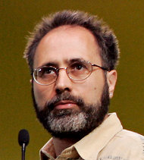
In the news
Google disclosed that it continuously uses enough electricity to power 200,000 homes, but it says that in doing so, it also makes the planet greener.
Search cost per day (per person) same as running a 60-watt bulb for 3 hours
Urs Hoelzle, Google SVP
Co-author of today’s reading
http://www.nytimes.com/2011/09/09/technology/google-details-and-defends-its-use-of-electricity.html

Slide 3
Review
Great Ideas in Computer Architecture
Layers of Representation/Interpretation
Moore’s Law
Principle of Locality/Memory Hierarchy
Parallelism
Performance Measurement and Improvement
Dependability via Redundancy

Slide 4
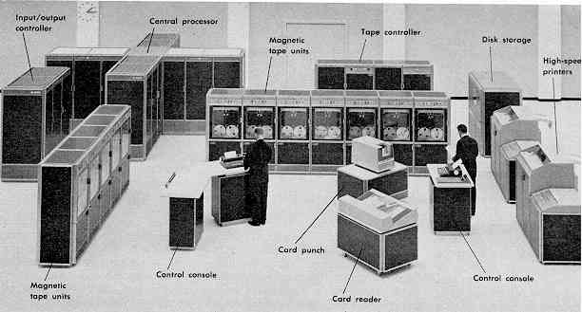
Computer Eras: Mainframe 1950s-60s
Processor (CPU)
I/O
“Big Iron”: IBM, UNIVAC, … build $1M computers for businesses ➔ COBOL, Fortran, timesharing OS

Slide 5
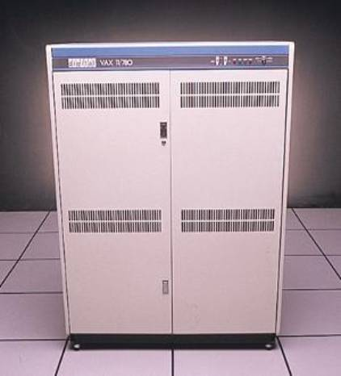
Minicomputer Eras: 1970s
Using integrated circuits, Digital, HP… build $10k computers for labs, universities ➔ C, UNIX OS

Slide 6
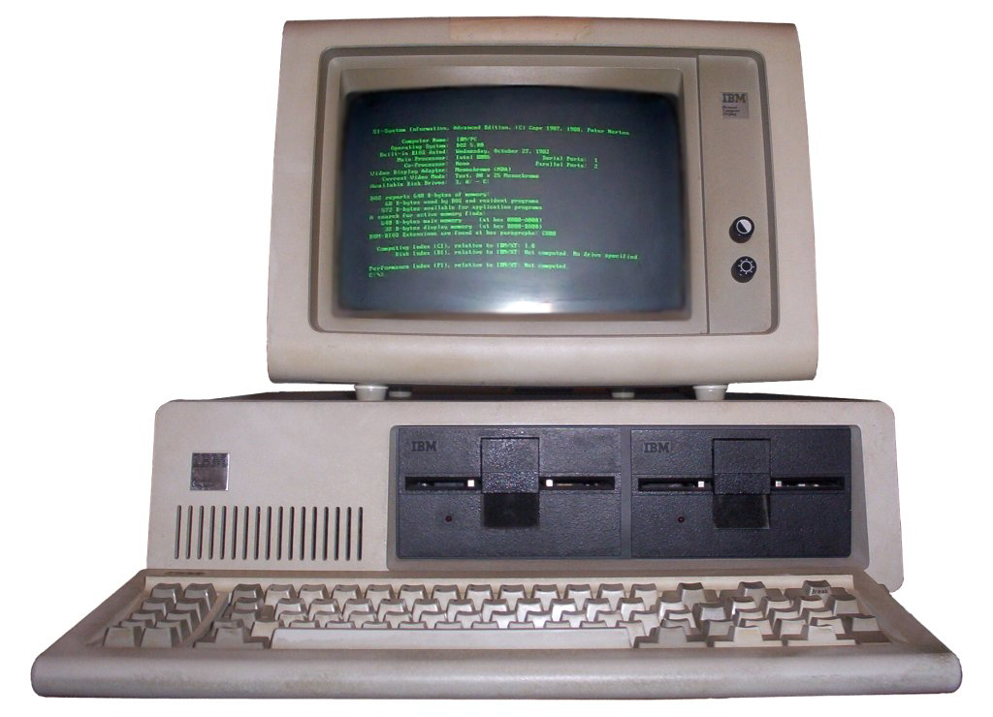
PC Era: Mid 1980s - Mid 2000s
Using microprocessors, Apple, IBM, … build $1k computer for 1 person ➔ Basic, Java, Windows OS

Slide 7
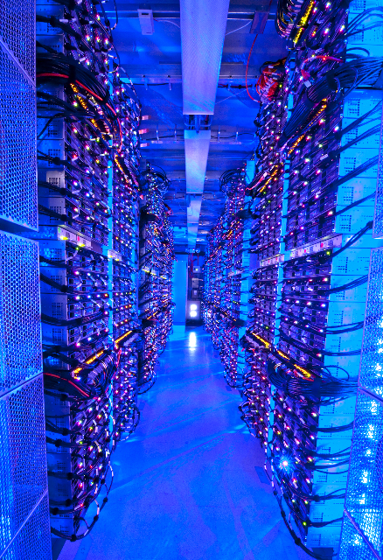
PostPC Era: Late 2000s - ??
Personal Mobile Devices (PMD): Relying on wireless networking, Apple, Nokia, … build $500 smartphone and tablet computers for individuals ➔ Objective C, Java, Android OS + iOS
Cloud Computing: Using Local Area Networks, Amazon, Google, … build $200M Warehouse Scale Computers with 100,000 servers for Internet Services for PMDs
➔ MapReduce, Ruby on Rails

Slide 8
Why Cloud Computing Now?
“The Web Space Race”: Build-out of extremely large datacenters (10,000’s of commodity PCs)
Build-out driven by growth in demand (more users)
Infrastructure software and Operational expertise
Discovered economy of scale: 5-7x cheaper than provisioning a medium-sized (1000 servers) facility
More pervasive broadband Internet so can access remote computers efficiently
Commoditization of HW & SW
Standardized software stacks

Slide 9
March 2013 AWS Instances & Prices
Instance | Per Hour | Ratio to Small | Compute Units | Virtual Cores | Compute Unit/ Core | Memory (GiB) | Disk (GiB) | Address
Standard Small | $0.065 | 1.0 | 1.0 | 1 | 1.00 | 1.7 | 160 | 32 bit
Standard Large | $0.260 | 4.0 | 4.0 | 2 | 2.00 | 7.5 | 850 | 64 bit
Standard Extra Large | $0.520 | 8.0 | 8.0 | 4 | 2.00 | 15.0 | 1690 | 64 bit
High-Memory Extra Large | $0.460 | 5.9 | 6.5 | 2 | 3.25 | 17.1 | 420 | 64 bit
High-Memory Double Extra Large | $0.920 | 11.8 | 13.0 | 4 | 3.25 | 34.2 | 850 | 64 bit
High-Memory Quadruple Extra Large | $1.840 | 23.5 | 26.0 | 8 | 3.25 | 68.4 | 1690 | 64 bit
High-CPU Medium | $0.165 | 2.0 | 5.0 | 2 | 2.50 | 1.7 | 350 | 32 bit
High-CPU Extra Large | $0.660 | 8.0 | 20.0 | 8 | 2.50 | 7.0 | 1690 | 64 bit
Closest computer in WSC example is Standard Extra Large
@ At these low rates, Amazon EC2 can make money!
even if used only 50% of time

Slide 10
Warehouse Scale Computers
Massive scale datacenters: 10,000 to 100,000 servers + networks to connect them together
Emphasize cost-efficiency
Attention to power: distribution and cooling
(relatively) homogeneous hardware/software
Offer very large applications (Internet services): search, social networking, video sharing
Very highly available: < 1 hour down/year
Must cope with failures common at scale
“…WSCs are no less worthy of the expertise of computer systems architects than any other class of machines” Barroso and Hoelzle 2009

Slide 11
Design Goals of a WSC
Unique to Warehouse-scale
Ample parallelism:
Batch apps: large number independent data sets with independent processing. Also known as Data-Level Parallelism
Scale and its Opportunities/Problems
Relatively small number of these make design cost expensive and difficult to amortize
But price breaks are possible from purchases of very large numbers of commodity servers
Must also prepare for high # of component failures
Operational Costs Count:
Cost of equipment purchases << cost of ownership

Slide 12
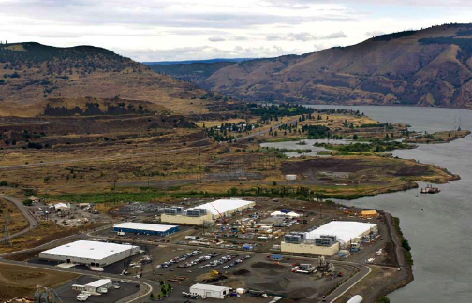
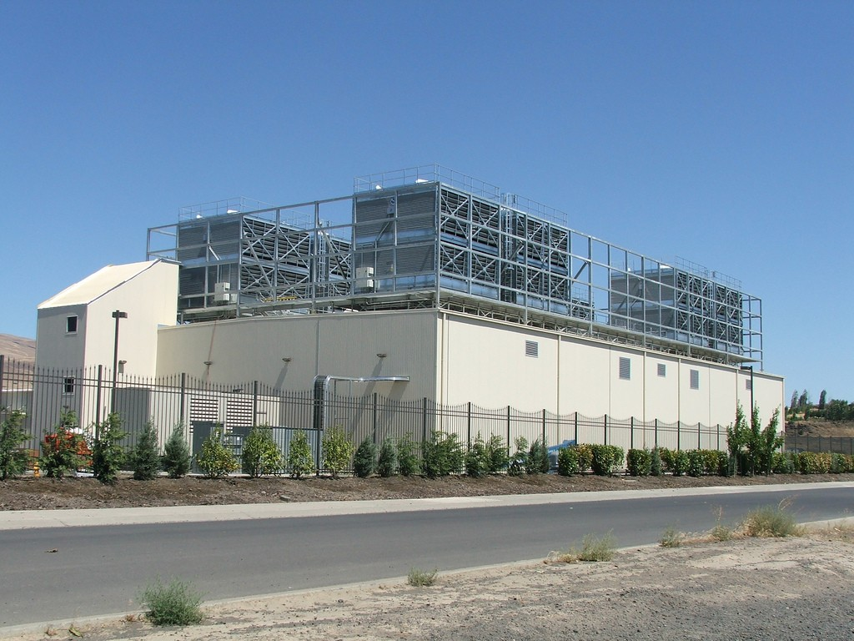
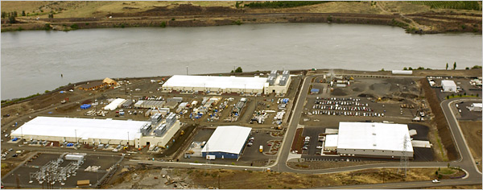
E.g., Google’s Oregon WSC

Slide 13
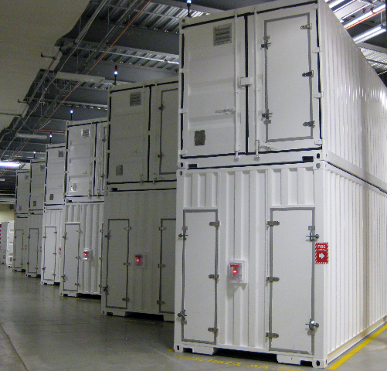
Containers in WSCs
Inside WSC
Inside Container

Slide 14
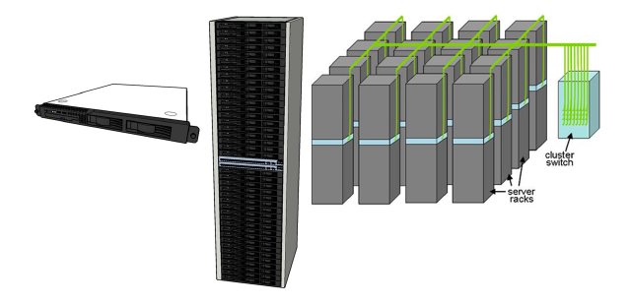
Equipment Inside a WSC
Server (in rack format):
1 ¾ inches high “1U”, x 19 inches x 16-20 inches: 8 cores, 16 GB DRAM, 4x1 TB disk
Array (aka cluster): 16-32 server racks + larger local area network switch (“array switch”) 10X faster ➔ cost 100X: cost f(N²)
7 foot Rack: 40-80 servers + Ethernet local area network (1-10 Gbps) switch in middle (“rack switch”)

Slide 15
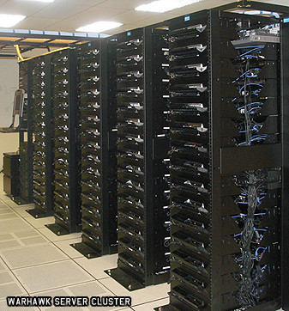
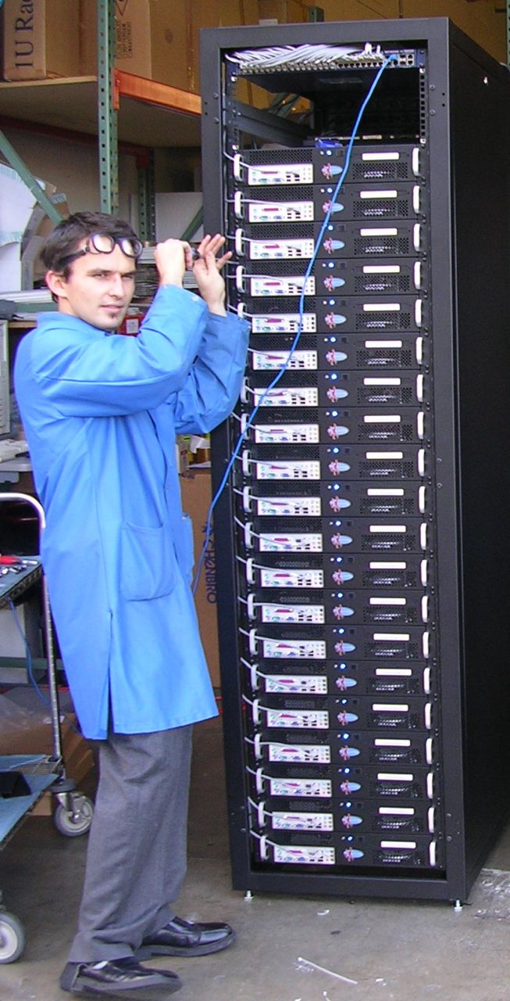
Server, Rack, Array

Slide 16
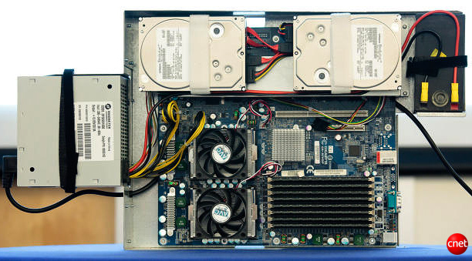
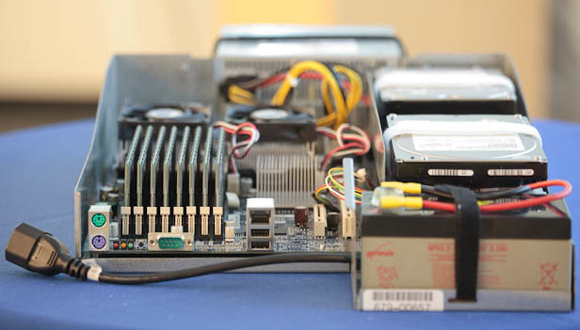
Google Server Internals
Google Server
Notes:
Most companies buy servers from the likes of Dell, Hewlett-Packard, IBM, or Sun Microsystems. But Google, which has hundreds of thousands of servers and considers running them part of its core expertise, designs and builds its own. Ben Jai, who designed many of Google's servers, unveiled a modern Google server before the hungry eyes of a technically sophisticated audience.
Google's big surprise: each server has its own 12-volt battery to supply power if there's a problem with the main source of electricity. The company also revealed for the first time that since 2005, its data centers have been composed of standard shipping containers--each with 1,160 servers and a power consumption that can reach 250 kilowatts.
It may sound geeky, but a number of attendees--the kind of folks who run data centers packed with thousands of servers for a living--were surprised not only by Google's built-in battery approach, but by the fact that the company has kept it secret for years. Jai said in an interview that Google has been using the design since 2005 and now is in its sixth or seventh generation of design.
Read more: http://news.cnet.com/8301-1001_3-10209580-92.html#ixzz0yo8bhTOH

Slide 17
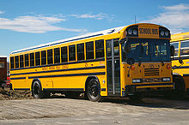
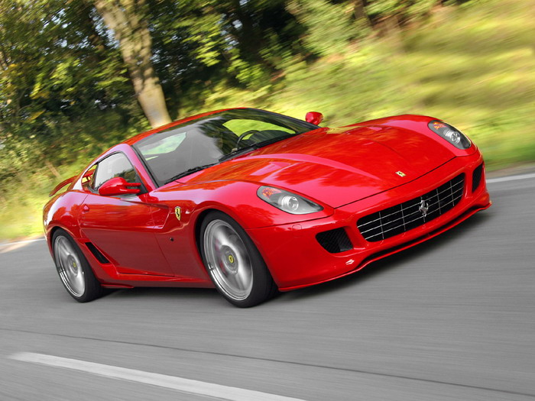
Defining Performance
What does it mean to say X is faster than Y?
2009 Ferrari 599 GTB
2 passengers, 11.1 secs for quarter mile (call it 10sec)
2009 Type D school bus
54 passengers, quarter mile time? (let’s guess 1 min)
http://www.youtube.com/watch?v=KwyCoQuhUNA
Response Time or Latency: time between start and completion of a task (time to move vehicle ¼ mile)
Throughput or Bandwidth: total amount of work in a given time (passenger-miles in 1 hour)

Slide 18
Coping with Performance in Array
Lower latency to DRAM in another server than local disk
Higher bandwidth to local disk than to DRAM in another server
 | Local | Rack | Array
Racks | -- | 1 | 30
Servers | 1 | 80 | 2400
Cores (Processors) | 8 | 640 | 19,200
DRAM Capacity (GB) | 16 | 1,280 | 38,400
Disk Capacity (TB) | 4 | 320 | 9,600
DRAM Latency (microseconds) | 0.1 | 100 | 300
Disk Latency (microseconds) | 10,000 | 11,000 | 12,000
DRAM Bandwidth (MB/sec) | 20,000 | 100 | 10
Disk Bandwidth (MB/sec) | 200 | 100 | 10

Slide 19
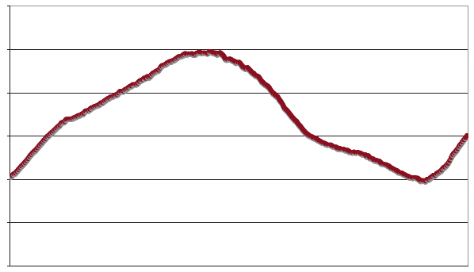
Coping with Workload Variation
Workload
2X
Midnight
Noon
Midnight
Online service: Peak usage 2X off-peak

Slide 20
Impact of latency, bandwidth, failure, varying workload on WSC software?
WSC Software must take care where it places data within an array to get good performance
WSC Software must cope with failures gracefully
WSC Software must scale up and down gracefully in response to varying demand
More elaborate hierarchy of memories, failure tolerance, workload accommodation makes WSC software development more challenging than software for single computer

Slide 21
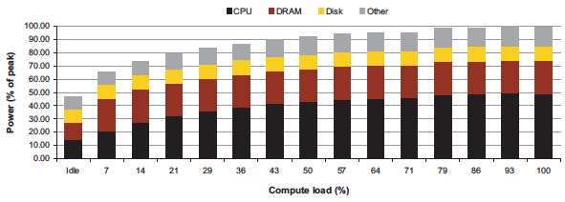
Power vs. Server Utilization
Server power usage as load varies idle to 100%
Uses ½ peak power when idle!
Uses ⅔ peak power when 10% utilized! 90%@ 50%!
Most servers in WSC utilized 10% to 50%
Goal should be Energy-Proportionality: % peak load = % peak energy

Slide 22
Power Usage Effectiveness
Overall WSC Energy Efficiency: amount of computational work performed divided by the total energy used in the process
Power Usage Effectiveness (PUE): Total building power / IT equipment power
A power efficiency measure for WSC, not including efficiency of servers, networking gear
1.0 = perfection

Slide 23
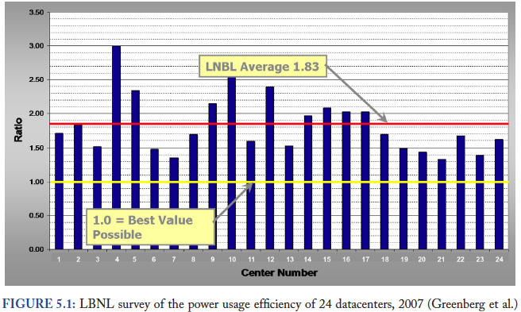
PUE in the Wild (2007)

Slide 24
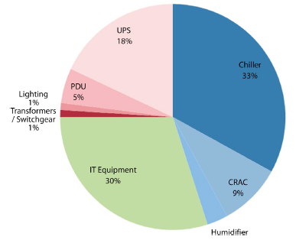
High PUE: Where Does Power Go?
Uninterruptable
Power Supply
(battery)
Chiller cools warm
water from Air
Conditioner
Power Distribution
Unit
Computer
Room
Air Conditioner
Servers + Networking

Slide 25
Google WSC A PUE: 1.24
Careful air flow handling
Don’t mix server hot air exhaust with cold air (separate warm aisle from cold aisle)
Short path to cooling so little energy spent moving cold or hot air long distances
Keeping servers inside containers helps control air flow
Elevated cold aisle temperatures
81°F instead of traditional 65°- 68°F
Found reliability OK if run servers hotter
Use of free cooling
Cool warm water outside by evaporation in cooling towers
Locate WSC in moderate climate so not too hot or too cold
Per-server 12-V DC UPS
Rather than WSC wide UPS, place single battery per server board
Increases WSC efficiency from 90% to 99%
Measure vs. estimate PUE, publish PUE, and improve operation

Slide 26
Summary
Parallelism is one of the Great Ideas
Applies at many levels of the system – from instructions to warehouse scale computers
Post PC Era: Parallel processing, smart phone to WSC
WSC SW must cope with failures, varying load, varying HW latency bandwidth
WSC HW sensitive to cost, energy efficiency
WSCs support many of the applications we have come to depend on

