Slide 1
CS 61C: Great Ideas in
Computer Architecture
MapReduce
Guest Lecturer: Justin Hsia

Slide 2
Review of Last Lecture
Performance – latency and throughput
Warehouse Scale Computing
  Example of parallel processing in the post-PC era
  Servers on a rack, rack part of cluster
  Issues to handle include load balancing, failures, power usage (sensitive to cost & energy efficiency)
  PUE = Total building power / IT equipment power

Slide 3





Great Idea #4: Parallelism
Today’s Lecture
Software Hardware
Parallel Requests
  Assigned to computer
  e.g. Search “Garcia”
Parallel Threads
  Assigned to core
  e.g. Lookup, Ads
Parallel Instructions
  > 1 instruction @ one time
  e.g. 5 pipelined instructions
Parallel Data
  > 1 data item @ one time
  e.g. add of 4 pairs of words
Hardware descriptions
  All gates functioning in parallel at same time
Warehouse Scale Computer
Smart
Phone
Leverage
Parallelism &
Achieve High
Performance
Computer
Core
…
Core
Memory
Input/Output
Core
Instruction Unit(s)
Functional
Unit(s)
A₀+B₀
A₁+B₁
A₂+B₂
A₃+B₃
Cache Memory
Logic Gates

Slide 4
Agenda
Amdahl’s Law
Request Level Parallelism
Administrivia
MapReduce
  Data Level Parallelism

Slide 5

Amdahl’s (Heartbreaking) Law
Speedup due to enhancement E:
Example: Suppose that enhancement E accelerates a fraction F (F<1) of the task by a factor S (S>1) and the remainder of the task is unaffected
Exec time w/E =
Speedup w/E =
F
Exec Time w/o E × [ (1-F) + F/S]
1 / [ (1-F) + F/S ]

Slide 6
Amdahl’s Law
Speedup = 1
Example: the execution time of half of the program can be accelerated by a factor of 2.
What is the program speed-up overall?
(1 - F) + F
Non-sped-up part
S
Sped-up part
1
1
=
=
1.33
0.5 + 0.5
0.5 + 0.25
2

Slide 7
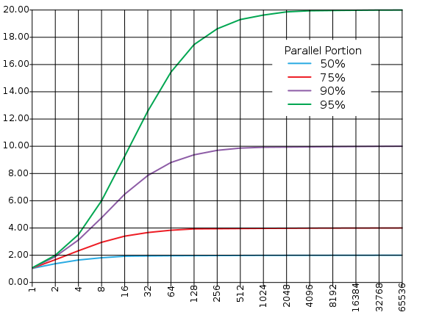
Consequence of Amdahl’s Law
The amount of speedup that can be achieved through parallelism is limited by the non-parallel portion of your program!
Time
Speedup
Parallel
portion
Serial
portion
1
2
3
4
5
Number of Processors
Number of Processors

Slide 8
Agenda
Amdahl’s Law
Request Level Parallelism
Administrivia
MapReduce
  Data Level Parallelism

Slide 9
Request-Level Parallelism (RLP)
Hundreds or thousands of requests per second
  Not your laptop or cell-phone, but popular Internet services like web search, social networking, …
  Such requests are largely independent
    Often involve read-mostly databases
    Rarely involve strict read–write data sharing or synchronization across requests
Computation easily partitioned within a request and across different requests
Notes:
On WSC, want lots going on at same time to get $ back
Easy to parallelize

Slide 10
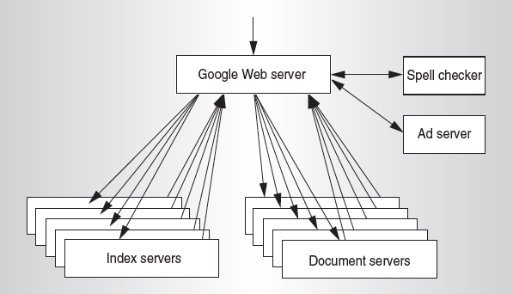
Google Query-Serving Architecture
Notes:
Example of RLP, google
Services on right
Forward requests to index servers; look up tables based on keywords that return location of relevant documents
Document servers return results
All spread across many servers -> parallelism

Slide 11

Anatomy of a Web Search
Google “Dan Garcia”
Notes:
Lets do a random search!

Slide 12
Anatomy of a Web Search (1 of 3)
Google “Dan Garcia”
  Direct request to “closest” Google Warehouse Scale Computer
  Front-end load balancer directs request to one of many arrays (cluster of servers) within WSC
  Within array, select one of many Google Web Servers (GWS) to handle the request and compose the response pages
  GWS communicates with Index Servers to find documents that contain the search words, “Dan”, “Garcia”, uses location of search as well
  Return document list with associated relevance score
Notes:
Probably/usually closest, google’s system are secret
Box routes to cluster
Lots of server processes that handle requests and put response toogether
Look up in index (does an AND)
Rank by relevance

Slide 13
Anatomy of a Web Search (2 of 3)
In parallel,
  Ad system: run ad auction for bidders on search terms
  Get images of various Dan Garcias
Use docids (document IDs) to access indexed documents
Compose the page
  Result document extracts (with keyword in context) ordered by relevance score
  Sponsored links (along the top) and advertisements (along the sides)

Slide 14
Anatomy of a Web Search (3 of 3)
Implementation strategy
  Randomly distribute the entries
  Make many copies of data (a.k.a. “replicas”)
  Load balance requests across replicas
Redundant copies of indices and documents
  Breaks up hot spots, e.g. “Gangnam Style”
  Increases opportunities for request-level parallelism
  Makes the system more tolerant of failures
Notes:
Important to return quickly (within one to a few seconds), so distribute entries.
Make replicas! (RLP!) also more fault tolerant and good to break up hot spots
Load balance

Slide 15
Agenda
Amdahl’s Law
Request Level Parallelism
Administrivia
MapReduce
  Data Level Parallelism

Slide 16
Administrivia
Midterm not graded yet
  Please don’t discuss anywhere until tomorrow!
Lab 6 is today and tomorrow
HW3 due this Sunday (3/10)
  Finish early because Proj2 is being released this week!
Twitter Tech Talk on Hadoop/MapReduce
  Thu, 3/7 at 6pm in the Woz (430 Soda)

Slide 17
Agenda
Amdahl’s Law
Request Level Parallelism
Administrivia
MapReduce
  Data Level Parallelism

Slide 18
Data-Level Parallelism (DLP)
Two kinds:
  Lots of data on many disks that can be operated on in parallel (e.g. searching for documents)
  Lots of data in memory that can be operated on in parallel (e.g. adding together 2 arrays)
Lab 6 and Project 2 do DLP across many servers and disks using MapReduce
Lab 7 and Project 3 do DLP in memory using Intel’s SIMD instructions
Notes:
Data in memory -> SIMD (at the level of one program or one instruction, on one chip), already covered
Lots of data and lots of disks -> Big stuff, using map reduce

Slide 19
What is MapReduce?
Simple data-parallel programming model designed for scalability and fault-tolerance
Pioneered by Google
  Processes > 25 petabytes of data per day
Popularized by open-source Hadoop project
  Used at Yahoo!, Facebook, Amazon, …
Notes:
Map reduce is programming model, scales and is fault tolerant (always going to be broken sutff at this scale)
Hides the complexity
*pioneered* by google sort of, been used internally in many places, break through was exposing this map and reduce externally to programmer
More than 25 petabytes of data per day
Hadoop is open source implementation (yahoo big pusher here), used all over -> Good to put on resume!

Slide 20
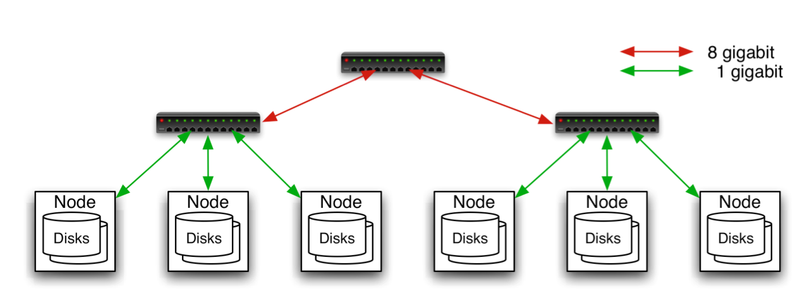
Typical Hadoop Cluster
Aggregation switch
Rack switch
40 nodes/rack, 1000-4000 nodes in cluster
1 Gbps bandwidth within rack, 8 Gbps out of rack
Node specs (Yahoo terasort):
8 x 2GHz cores, 8 GB RAM, 4 disks (= 4 TB?)
Image from http://wiki.apache.org/hadoop-data/attachments/HadoopPresentations/attachments/YahooHadoopIntro-apachecon-us-2008.pdf
Notes:
Racks, with rack switch, then aggregation switch for rack switches.
Sample set up for yahoo

Slide 21
What is MapReduce used for?
At Google:
  Index construction for Google Search
  Article clustering for Google News
  Statistical machine translation
  For computing multi-layer street maps
At Yahoo!:
  “Web map” powering Yahoo! Search
  Spam detection for Yahoo! Mail
At Facebook:
  Data mining
  Ad optimization
  Spam detection
Notes:
Lots of info and want to look through big chunks of this info at the same time (data mining)
Big Data Analytics is Big Deal™, organizations accumulate lots of data, hidden info in there too
Figure out right algorithm allows you to derive useful facts

Slide 22
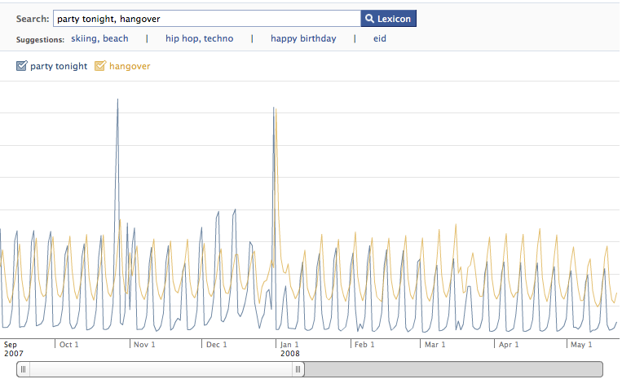
Example: Facebook Lexicon
www.facebook.com/lexicon
(no longer available)
Notes:
Example, look up number of status updates with words ‘party tonight’ and ‘hangover’ in them.
Peaks follow one another! Big spikes on new years, halloween, generally have weekend partying.

Slide 23
MapReduce Design Goals
Scalability to large data volumes:
  1000’s of machines, 10,000’s of disks
Cost-efficiency:
  Commodity machines (cheap, but unreliable)
  Commodity network
  Automatic fault-tolerance (fewer administrators)
  Easy to use (fewer programmers)
Jeffrey Dean and Sanjay Ghemawat, “MapReduce: Simplified Data Processing on Large Clusters,” Communications of the ACM, Jan 2008.
Notes:
Need to be able to churn through all this data fast; we are in essence looking at a bunch of data all at the same time

Slide 24
MapReduce Processing:
“Divide and Conquer” (1/2)
Apply Map function to user supplied record of key/value pairs
  Slice data into “shards” or “splits” and distribute to workers
  Compute set of intermediate key/value pairs
  map(in_key,in_val) ->
  list(out_key,interm_val)
Apply Reduce operation to all values that share same key in order to combine derived data properly
  Combines all intermediate values for a particular key
  Produces a set of merged output values
  reduce(out_key,list(interm_val)) ->
  list(out_val)
Notes:
Input keys and values from different domain than output keys and values.
Intermediate keys and values from same domain as output keys and values.

Slide 25
MapReduce Processing:
“Divide and Conquer” (2/2)
User supplies Map and Reduce operations in functional model
  Focus on problem, let MapReduce library deal with messy details
  Parallelization handled by framework/library
  Fault tolerance via re-execution
Notes:
Map function applies to individual records, generates intermediate set of key/value pairs
Reduce function combines all items with same intermediate key (e.g. aggregation)
Programmer supplies map and reduce functions

Slide 26
Execution Setup
Map invocations distributed by partitioning input data into M splits
  Typically 16 MB to 64 MB per piece
Input processed in parallel on different servers
Reduce invocations distributed by partitioning intermediate key space into R pieces
  e.g. hash(key) mod R
User picks M >> # servers, R > # servers
  Big M helps with load balancing, recovery from failure
  One output file per R invocation, so not too many
Notes:
- Fine granularity (more map tasks than machines)
- Each reduce task produces its own output file (so don’t want this to be too big, but still big enough so that can load balance)
Hash function decides which reducer to send to (shuffle)
Reducers collect the keys they are assigned (try to split evenly amongst reducers)

Slide 27
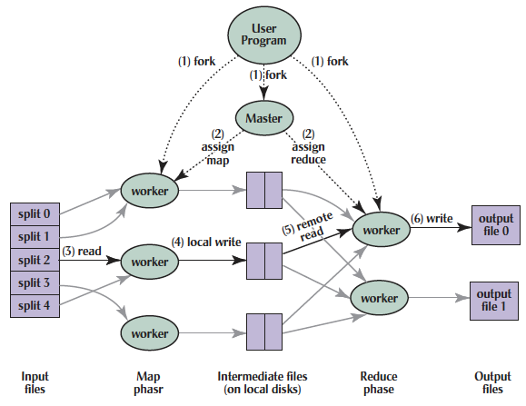
MapReduce Processing
Shuffle phase
Notes:
Here is another representation of the overall mapreduce schema

Slide 28
MapReduce Processing
1. MR 1st splits the input files into M “splits” then starts many copies of
program on servers
Shuffle phase
Notes:
When the user calls mapreduce, we first split the data into many files and replicate them across many machines (does this for you)
This is so that we can tolerate faults and also to maximize speed of execution

Slide 29
MapReduce Processing
2. One copy (the master) is special. The rest are workers. The master picks idle workers and assigns each 1 of M map tasks or 1 of R reduce tasks.
Shuffle phase
Notes:
We subdivide the map phase into M jobs and the reduce phase into R jobs as described previously. Ideally, M and R should be much larger than the number of worker machines. A special master node assigns jobs to idle workers.
Having each worker per- form many different tasks improves dynamic load balancing and also speeds up recovery when a worker fails: the many map tasks it has completed can be spread out across all the other worker machines.There are practical bounds on how large M and R can be in our imple- mentation since the master must make O(M+R) scheduling decisions and keep O(M*R) state in memory as described. (The constant factors for memory usage are small, however. The O(M*R) piece of the state consists of approximately one byte of data per map task/reduce task pair.)Furthermore, R is often constrained by users because the output of each reduce task ends up in a separate output file. In practice, we tend to choose M so that each individual task is roughly 16MB to 64MB of input data (so that the locality optimization described previously is most effective), and we make R a small multiple of the number of worker machines we expect to use. We often perform MapReduce computa- tions with M=200,000 and R=5,000, using 2,000 worker machines.

Slide 30
MapReduce Processing
3. A map worker reads the input split. It parses key/value pairs of the input data and passes each pair to the user-defined map function.
(The intermediate
key/value pairs produced by the map function are buffered in memory.)
Shuffle phase
Notes:
Map worker reads its data and applies map, buffers results in memory

Slide 31
MapReduce Processing
4. Periodically, the buffered pairs are written to local disk, partitioned
into R regions by the partitioning function.
Shuffle phase
Notes:
The locations of these
buffered pairs on the local disk are passed back to the master who is responsible for forwarding these locations to the reduce workers.
We subdivide the map phase into M pieces and the reduce phase into R pieces as described previously. Ideally, M and R should be much larger than the number of worker machines. Having each worker per- form many different tasks improves dynamic load balancing and also speeds up recovery when a worker fails: the many map tasks it has completed can be spread out across all the other worker machines.There are practical bounds on how large M and R can be in our imple- mentation since the master must make O(M+R) scheduling decisions and keep O(M*R) state in memory as described. (The constant factors for memory usage are small, however. The O(M*R) piece of the state consists of approximately one byte of data per map task/reduce task pair.)Furthermore, R is often constrained by users because the output of each reduce task ends up in a separate output file. In practice, we tend to choose M so that each individual task is roughly 16MB to 64MB of input data (so that the locality optimization described previously is most effective), and we make R a small multiple of the number of worker machines we expect to use. We often perform MapReduce computa- tions with M=200,000 and R=5,000, using 2,000 worker machines.

Slide 32
MapReduce Processing
5. When a reduce worker has read all intermediate data for its partition, it sorts it by the intermediate
keys so that all occurrences of the same key are grouped together.
(The sorting is needed because typically many different keys map to
the same reduce task )
Shuffle phase
Notes:
Shuffle, send to reducers. Reducer sorts input so that same keys are together

Slide 33
MapReduce Processing
6. Reduce worker iterates over sorted intermediate data and for each unique intermediate key, it passes key and corresponding set of values to the user’s reduce function.
The output of the reduce function is appended to a final output file for this reduce partition.
Shuffle phase
Notes:
Apply reduce to each intermediate key set, appends to job-specific output file.

Slide 34
MapReduce Processing
7. When all map and reduce tasks have been completed, the master wakes up the user program.
The MapReduce call in user program returns back to user code.
Output of MR is in R output files (1 per reduce task, with file names specified by user); often passed into another MR job.
Shuffle phase
Notes:
Once all reduce tasks done, return to user. Each reduce tasks creates a separate output file so R files. This is ok as distributed systems often deal in distributed files.

Slide 35
What Does the Master Do?
For each map task and reduce task
  State: idle, in-progress, or completed
  Identity of worker server (if not idle)
For each completed map task
  Stores location and size of R intermediate files
  Updates files and size as corresponding map tasks complete
Location and size are pushed incrementally to workers that have in-progress reduce tasks

Slide 36
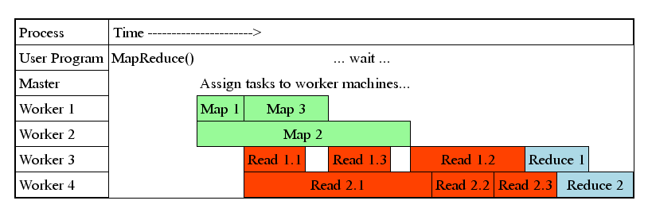
MapReduce Processing Time Line
Master assigns map + reduce tasks to “worker” servers
As soon as a map task finishes, worker server can be assigned a new map or reduce task
Data shuffle begins as soon as a given Map finishes
Reduce task begins as soon as all data shuffles finish
To tolerate faults, reassign task if a worker server “dies”
Notes:
Assign jobs to servers
Workers start new jobs when finished old ones
Send data to reducers (shuffle) as soon as map task done
Once all shuffle done, start reducing
Send heartbeats to check if workers still alive, if not, reassign tasks

Slide 37
MapReduce Processing Example: Count Word Occurrences (1/2)
Pseudo Code: for each word in input, generate <key=word, value=1>
Reduce sums all counts emitted for a particular word across all mappers
map(String input_key, String input_value):
// input_key: document name
// input_value: document contents
for each word w in input_value:
EmitIntermediate(w, "1"); // Produce count of words
reduce(String output_key, Iterator intermediate_values):
// output_key: a word
// intermediate_values: a list of counts
int result = 0;
for each v in intermediate_values:
result += ParseInt(v); // get integer from key-value
Emit(AsString(result));

Slide 38
MapReduce Processing Example: Count Word Occurrences (2/2)
Distribute
that that is is that that is not is not is that it it is
Map 1
Map 2
Map 3
Map 4
is 1, that 2
is 1, that 2
is 2, not 2
is 2, it 2, that 1
Shuffle
is 1
is 1,1
that 2
is 1,1,2,2
it 2
that 2,2
that 2,2,1
not 2
Reduce 1
Reduce 2
is 6; it 2
not 2; that 5
Collect
is 6; it 2; not 2; that 5
Notes:
Same example as before, but lets work through it…
Collect step at end to combine it all

Slide 39
MapReduce Failure Handling
On worker failure:
  Detect failure via periodic heartbeats
  Re-execute completed and in-progress map tasks
  Re-execute in progress reduce tasks
  Task completion committed through master
Master failure:
  Protocols exist to handle (master failure unlikely)
Robust: lost 1600 of 1800 machines once, but finished fine
Notes:
Must redo completed map tasks on failed node since some reducers may not have gotten the data yet
Master failure is… work in progress
But can tolerate lots of worker failures!

Slide 40
MapReduce Redundant Execution
Slow workers significantly lengthen completion time
  Other jobs consuming resources on machine
  Bad disks with soft errors transfer data very slowly
  Weird things: processor caches disabled (!!)
Solution: Near end of phase, spawn backup copies of tasks
  Whichever one finishes first "wins"
Effect: Dramatically shortens job completion time
  3% more resources, large tasks 30% faster
Notes:
If some laggards towards the end of map or reduce phase, spawn backups!
Deterministic so ok to just pick one that finishes first
Faster!

Slide 41
Question: Which statements are NOT TRUE about about MapReduce?
a)
MapReduce divides computers into 1 master and N-1 workers; masters assigns MR tasks
b)
Towards the end, the master assigns uncompleted tasks again; 1st to finish wins
c)
Reducers can start reducing as soon as they start to receive Map data
d)
Reduce worker sorts by intermediate keys to group all occurrences of same key
Notes:
VertLeftWhiteCheck1

Slide 42
Question: Which statements are NOT TRUE about about MapReduce?
a)
MapReduce divides computers into 1 master and N-1 workers; masters assigns MR tasks
b)
Towards the end, the master assigns uncompleted tasks again; 1st to finish wins
c)
Reducers can start reducing as soon as they start to receive Map data
d)
Reduce worker sorts by intermediate keys to group all occurrences of same key
Notes:
VertLeftWhiteCheck1

Slide 43
Summary
Amdahl’s Law
Request Level Parallelism
  High request volume, each largely independent
  Replication for better throughput, availability
Map Reduce Data Parallelism
  Divide large data set into pieces for independent parallel processing
  Combine and process intermediate results to obtain final result

