Slide 1
inst.eecs.berkeley.edu/~cs61c CS61C : Machine Structures Lecture 20 Thread Level Parallelism
Senior Lecturer SOE Dan Garcia
www.cs.berkeley.edu/~ddgarcia
Wireless “Matrix” device ⇒ A team at Brown University has developed a subdermal implant of a “battery, coppor coil for recharging, wireless radio, infrared transmitters, and custom ICs in a small, leak-proof, body-friendly container 2 inches long.” 100-electrode neuron-reading chip is implanted directly in the brain.
www.technologyreview.com/news/512161/a-wireless-brain-computer-interface/

Slide 2
Review
Flynn Taxonomy of Parallel Architectures
SIMD: Single Instruction Multiple Data
MIMD: Multiple Instruction Multiple Data
SISD: Single Instruction Single Data
MISD: Multiple Instruction Single Data (unused)
Intel SSE SIMD Instructions
One instruction fetch that operates on multiple operands simultaneously
64/128 bit XMM registers
(SSE = Streaming SIMD Extensions)

Slide 3
Background: Threads
A Thread stands for “thread of execution”, is a single stream of instructions
A program / process can split, or fork itself into separate threads, which can (in theory) execute simultaneously.
An easy way to describe/think about parallelism
A single CPU can execute many threads by Time Division Multipexing
Multithreading is running multiple threads through the same hardware
Thread₀
CPU
Thread₁
Time
Thread₂

Slide 4
Agenda
SSE Instructions in C
Multiprocessor
“Although threads seem to be a small step from sequential computation, in fact, they represent a huge step. They discard the most essential and appealing properties of sequential computation: understandability, predictability, and determinism. Threads, as a model of computation, are wildly non-deterministic, and the job of the programmer becomes one of pruning that nondeterminism.”
— The Problem with Threads, Edward A. Lee, UC Berkeley, 2006

Slide 5
Intel SSE Intrinsics
Intrinsics are C functions and procedures for putting in assembly language, including SSE instructions
With intrinsics, can program using these instructions indirectly
One-to-one correspondence between SSE instructions and intrinsics

Slide 6
Example SSE Intrinsics
Instrinsics:
Corresponding SSE instructions:
Vector data type:
_m128d
Load and store operations:
_mm_load_pd MOVAPD/aligned, packed double
_mm_store_pd MOVAPD/aligned, packed double
_mm_loadu_pd MOVUPD/unaligned, packed double
_mm_storeu_pd MOVUPD/unaligned, packed double
Load and broadcast across vector
_mm_load1_pd MOVSD + shuffling/duplicating
Arithmetic:
_mm_add_pd ADDPD/add, packed double
_mm_mul_pd MULPD/multiple, packed double
Notes:
CS267 Lecture 2
6

Slide 7
Example: 2 x 2 Matrix Multiply
Definition of Matrix Multiply:
2
C_{i,j} = (A×B)_{i,j} = ∑ A_{i,k}× B_{k,j}
k = 1
A_{1,1}
A_{1,2}
B_{1,1}
B_{1,2}
C_{1,1}=A_{1,1}B_{1,1} + A_{1,2}B_{2,1}
C_{1,2}=A_{1,1}B_{1,2}+A_{1,2}B_{2,2}
x
=
A_{2,1}
A_{2,2}
B_{2,1}
B_{2,2}
C_{2,1}=A_{2,1}B_{1,1} + A_{2,2}B_{2,1}
C_{2,2}=A_{2,1}B_{1,2}+A_{2,2}B_{2,2}
1
0
1
3
C_{1,1}= 1*1 + 0*2 = 1
C_{1,2}= 1*3 + 0*4 = 3
x
=
0
1
2
4
C_{2,1}= 0*1 + 1*2 = 2
C_{2,2}= 0*3 + 1*4 = 4

Slide 8
Example: 2 x 2 Matrix Multiply
Using the XMM registers
64-bit/double precision/two doubles per XMM reg
C₁
C_{1,1}
C_{2,1}
Stored in memory in Column order
C₂
C_{1,2}
C_{2,2}
A
A_{1,i}
A_{2,i}
B₁
B_{i,1}
B_{i,1}
B₂
B_{i,2}
B_{i,2}

Slide 9
Example: 2 x 2 Matrix Multiply
Initialization
I = 1
C₁
0
0
C₂
0
0
A
A_{1,1}
A_{2,1}
_mm_load_pd: Stored in memory in Column order
B₁
B_{1,1}
B_{1,1}
_mm_load1_pd: SSE instruction that loads a double word and stores it in the high and low double words of the XMM register
B₂
B_{1,2}
B_{1,2}

Slide 10
Example: 2 x 2 Matrix Multiply
Initialization
I = 1
C₁
0
0
C₂
0
0
A
A_{1,1}
A_{2,1}
_mm_load_pd: Load 2 doubles into XMM reg, Stored in memory in Column order
B₁
B_{1,1}
B_{1,1}
_mm_load1_pd: SSE instruction that loads a double word and stores it in the high and low double words of the XMM register (duplicates value in both halves of XMM)
B₂
B_{1,2}
B_{1,2}

Slide 11
Example: 2 x 2 Matrix Multiply
First iteration intermediate result
I = 1
C₁
0+A_{1,1}B_{1,1}
0+A_{2,1}B_{1,1}
c1 = _mm_add_pd(c1,_mm_mul_pd(a,b1));
c2 = _mm_add_pd(c2,_mm_mul_pd(a,b2));
SSE instructions first do parallel multiplies and then parallel adds in XMM registers
C₂
0+A_{1,1}B_{1,2}
0+A_{2,1}B_{1,2}
A
A_{1,1}
A_{2,1}
_mm_load_pd: Stored in memory in Column order
B₁
B_{1,1}
B_{1,1}
_mm_load1_pd: SSE instruction that loads a double word and stores it in the high and low double words of the XMM register (duplicates value in both halves of XMM)
B₂
B_{1,2}
B_{1,2}

Slide 12
Example: 2 x 2 Matrix Multiply
First iteration intermediate result
I = 2
C₁
0+A_{1,1}B_{1,1}
0+A_{2,1}B_{1,1}
c1 = _mm_add_pd(c1,_mm_mul_pd(a,b1));
c2 = _mm_add_pd(c2,_mm_mul_pd(a,b2));
SSE instructions first do parallel multiplies and then parallel adds in XMM registers
C₂
0+A_{1,1}B_{1,2}
0+A_{2,1}B_{1,2}
A
A_{1,2}
A_{2,2}
_mm_load_pd: Stored in memory in Column order
B₁
B_{2,1}
B_{2,1}
_mm_load1_pd: SSE instruction that loads a double word and stores it in the high and low double words of the XMM register (duplicates value in both halves of XMM)
B₂
B_{2,2}
B_{2,2}

Slide 13
Example: 2 x 2 Matrix Multiply
Second iteration intermediate result
I = 2
C_{1,1}
C_{2,1}
C₁
A_{1,1}B_{1,1}+A_{1,2}B_{2,1}
A_{2,1}B_{1,1}+A_{2,2}B_{2,1}
c1 = _mm_add_pd(c1,_mm_mul_pd(a,b1));
c2 = _mm_add_pd(c2,_mm_mul_pd(a,b2));
SSE instructions first do parallel multiplies and then parallel adds in XMM registers
C₂
A_{1,1}B_{1,2}+A_{1,2}B_{2,2}
A_{2,1}B_{1,2}+A_{2,2}B_{2,2}
C_{1,2}
C_{2,2}
A
A_{1,2}
A_{2,2}
_mm_load_pd: Stored in memory in Column order
B₁
B_{2,1}
B_{2,1}
_mm_load1_pd: SSE instruction that loads a double word and stores it in the high and low double words of the XMM register (duplicates value in both halves of XMM)
B₂
B_{2,2}
B_{2,2}

Slide 14
Example: 2 x 2 Matrix Multiply
Definition of Matrix Multiply:
2
C_{i,j} = (A×B)_{i,j} = ∑ A_{i,k}× B_{k,j}
k = 1
A_{1,1}
A_{1,2}
B_{1,1}
B_{1,2}
C_{1,1}=A_{1,1}B_{1,1} + A_{1,2}B_{2,1}
C_{1,2}=A_{1,1}B_{1,2}+A_{1,2}B_{2,2}
x
=
A_{2,1}
A_{2,2}
B_{2,1}
B_{2,2}
C_{2,1}=A_{2,1}B_{1,1} + A_{2,2}B_{2,1}
C_{2,2}=A_{2,1}B_{1,2}+A_{2,2}B_{2,2}
1
0
1
3
C_{1,1}= 1*1 + 0*2 = 1
C_{1,2}= 1*3 + 0*4 = 3
x
=
0
1
2
4
C_{2,1}= 0*1 + 1*2 = 2
C_{2,2}= 0*3 + 1*4 = 4

Slide 15
Example: 2 x 2 Matrix Multiply (Part 1 of 2)
#include <stdio.h>
// header file for SSE compiler intrinsics
#include <emmintrin.h>
// NOTE: vector registers will be represented in comments as v1 = [ a | b]
// where v1 is a variable of type __m128d and a, b are doubles
int main(void) {
// allocate A,B,C aligned on 16-byte boundaries
double A[4] __attribute__ ((aligned (16)));
double B[4] __attribute__ ((aligned (16)));
double C[4] __attribute__ ((aligned (16)));
int lda = 2;
int i = 0;
// declare several 128-bit vector variables
__m128d c1,c2,a,b1,b2;
// Initialize A, B, C for example
/* A = (note column order!)
1 0
0 1
*/
A[0] = 1.0; A[1] = 0.0; A[2] = 0.0; A[3] = 1.0;
/* B = (note column order!)
1 3
2 4
*/
B[0] = 1.0; B[1] = 2.0; B[2] = 3.0; B[3] = 4.0;
/* C = (note column order!)
0 0
0 0
*/
C[0] = 0.0; C[1] = 0.0; C[2] = 0.0; C[3] = 0.0;

Slide 16
Example: 2 x 2 Matrix Multiply (Part 2 of 2)
// used aligned loads to set
// c1 = [c_11 | c_21]
c1 = _mm_load_pd(C+0*lda);
// c2 = [c_12 | c_22]
c2 = _mm_load_pd(C+1*lda);
for (i = 0; i < 2; i++) {
/* a =
i = 0: [a_11 | a_21]
i = 1: [a_12 | a_22]
*/
a = _mm_load_pd(A+i*lda);
/* b1 =
i = 0: [b_11 | b_11]
i = 1: [b_21 | b_21]
*/
b1 = _mm_load1_pd(B+i+0*lda);
/* b2 =
i = 0: [b_12 | b_12]
i = 1: [b_22 | b_22]
*/
b2 = _mm_load1_pd(B+i+1*lda);
/* c1 =
i = 0: [c_11 + a_11*b_11 | c_21 + a_21*b_11]
i = 1: [c_11 + a_21*b_21 | c_21 + a_22*b_21]
*/
c1 = _mm_add_pd(c1,_mm_mul_pd(a,b1));
/* c2 =
i = 0: [c_12 + a_11*b_12 | c_22 + a_21*b_12]
i = 1: [c_12 + a_21*b_22 | c_22 + a_22*b_22]
*/
c2 = _mm_add_pd(c2,_mm_mul_pd(a,b2));
}
// store c1,c2 back into C for completion
_mm_store_pd(C+0*lda,c1);
_mm_store_pd(C+1*lda,c2);
// print C
printf("%g,%g\n%g,%g\n",C[0],C[2],C[1],C[3]);
return 0;
}

Slide 17
Inner loop from gcc –O -S
L2: movapd (%rax,%rsi), %xmm1 //Load aligned A[i,i+1]->m1
movddup (%rdx), %xmm0 //Load B[j], duplicate->m0
mulpd %xmm1, %xmm0 //Multiply m0*m1->m0
addpd %xmm0, %xmm3 //Add m0+m3->m3
movddup 16(%rdx), %xmm0 //Load B[j+1], duplicate->m0
mulpd %xmm0, %xmm1 //Multiply m0*m1->m1
addpd %xmm1, %xmm2 //Add m1+m2->m2
addq $16, %rax // rax+16 -> rax (i+=2)
addq $8, %rdx // rdx+8 -> rdx (j+=1)
cmpq $32, %rax // rax == 32?
jne L2 // jump to L2 if not equal
movapd %xmm3, (%rcx) //store aligned m3 into C[k,k+1]
movapd %xmm2, (%rdi) //store aligned m2 into C[l,l+1]

Slide 18
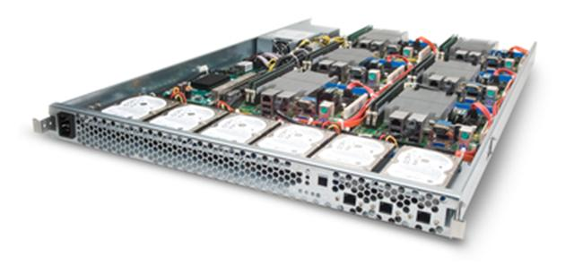
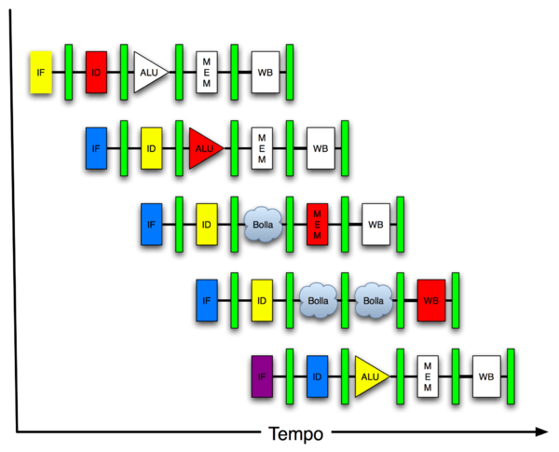
You Are Here!
Software Hardware
Parallel Requests
Assigned to computer
e.g., Search “Katz”
Parallel Threads
Assigned to core
e.g., Lookup, Ads
Parallel Instructions
>1 instruction @ one time
e.g., 5 pipelined instructions
Parallel Data
>1 data item @ one time
e.g., Add of 4 pairs of words
Hardware descriptions
All gates functioning in parallel at same time
Warehouse Scale Computer
Smart Phone
Harness Parallelism &
Achieve High Performance
Computer
Core
…
Core
Memory (Cache)
Project 3
Input/Output
Core
Instruction Unit(s)
Functional
Unit(s)
A₀+B₀
A₁+B₁
A₂+B₂
A₃+B₃
Main Memory
Logic Gates

Slide 19
Review
Intel SSE SIMD Instructions
One instruction fetch that operates on multiple operands simultaneously
SSE Instructions in C
Can embed the SEE machine instructions directly into C programs through the use of intrinsics

Slide 20
Parallel Processing: Multiprocessor Systems (MIMD)
Multiprocessor (MIMD): a computer system with at least 2 processors
Deliver high throughput for independent jobs via job-level parallelism
Improve the run time of a single program that has been specially crafted to run on a multiprocessor - a parallel processing program
Now Use term core for processor (“Multicore”) because “Multiprocessor Microprocessor” too redundant
Processor
Processor
Processor
Cache
Cache
Cache
Interconnection Network
Memory
I/O
Notes:
Power has become the overriding issue for both data centers and microprocessors. Power efficiency has joined scalable performance making the case for multiprocessors. Multiprocessors also improve availability.

Slide 21
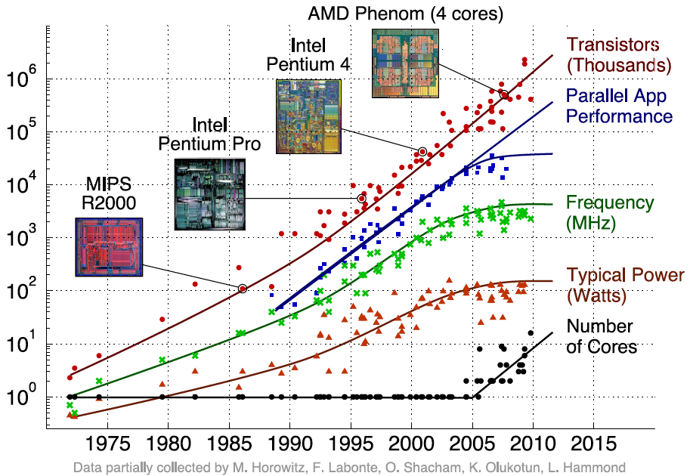
Transition to Multicore
Sequential App Performance

Slide 22
Multiprocessors and You
Only path to performance is parallelism
Clock rates flat or declining
SIMD: 2X width every 3-4 years
128b wide now, 256b 2011, 512b in 2014?, 1024b in 2018?
Advanced Vector Extensions are 256-bits wide!
MIMD: Add 2 cores every 2 years: 2, 4, 6, 8, 10, …
A key challenge is to craft parallel programs that have high performance on multiprocessors as the number of processors increase – i.e., that scale
Scheduling, load balancing, time for synchronization, overhead for communication
Will explore this further in labs and projects

Slide 23
Parallel Performance Over Time
Year | Cores | SIMD bits /Core | Core * SIMD bits | Peak DP FLOPs
2003 | 2 | 128 | 256 | 4
2005 | 4 | 128 | 512 | 8
2007 | 6 | 128 | 768 | 12
2009 | 8 | 128 | 1024 | 16
2011 | 10 | 256 | 2560 | 40
2013 | 12 | 256 | 3072 | 48
2015 | 14 | 512 | 7168 | 112
2017 | 16 | 512 | 8192 | 128
2019 | 18 | 1024 | 18432 | 288
2021 | 20 | 1024 | 20480 | 320

Slide 24
Multiprocessor Key Questions
Q1 – How do they share data?
Q2 – How do they coordinate?
Q3 – How many processors can be supported?

Slide 25
Shared Memory Multiprocessor (SMP)
Q1 – Single address space shared by all processors/cores
Q2 – Processors coordinate/communicate through shared variables in memory (via loads and stores)
Use of shared data must be coordinated via synchronization primitives (locks) that allow access to data to only one processor at a time
All multicore computers today are SMP

Slide 26
Example: Sum Reduction
Sum 100,000 numbers on 100 processor SMP
Each processor has ID: 0 ≤ Pn ≤ 99
Partition 1000 numbers per processor
Initial summation on each processor [ Phase I]
sum[Pn] = 0; for (i = 1000*Pn; i < 1000*(Pn+1); i = i + 1) sum[Pn] = sum[Pn] + A[i];
Now need to add these partial sums [Phase II]
Reduction: divide and conquer
Half the processors add pairs, then quarter, …
Need to synchronize between reduction steps

Slide 27
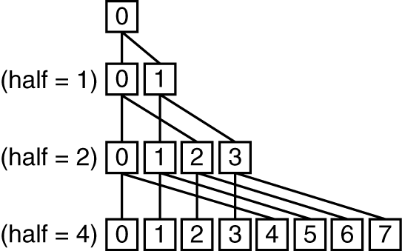
Example: Sum Reduction
Second Phase:
After each processor has computed its “local” sum
Remember, all processors are sharing the same memory.
half = 100;
repeat
synch();
if (half%2 != 0 && Pn == 0)
sum[0] = sum[0] + sum[half-1];
/* Conditional sum needed when half is odd;
Processor0 gets missing element */
half = half/2; /* dividing line on who sums */
if (Pn < half) sum[Pn] = sum[Pn] + sum[Pn+half];
until (half == 1);

Slide 28
An Example with 10 Processors
sum[P0]
sum[P1]
sum[P2]
sum[P3]
sum[P4]
sum[P5]
sum[P6]
sum[P7]
sum[P8]
sum[P9]
P0
P1
P2
P3
P4
P5
P6
P7
P8
P9
half = 10
Notes:
For class handout

Slide 29
An Example with 10 Processors
sum[P0]
sum[P1]
sum[P2]
sum[P3]
sum[P4]
sum[P5]
sum[P6]
sum[P7]
sum[P8]
sum[P9]
P0
P1
P2
P3
P4
P5
P6
P7
P8
P9
half = 10
P0
P1
P2
P3
P4
half = 5
P0
P1
half = 2
P0
half = 1
Notes:
For lecture
So load balancing issue at second reduction (when half = 2)

Slide 30
So, In Conclusion…
Sequential software is slow software
SIMD and MIMD only path to higher performance
SSE Intrinsics allow SIMD instructions to be invoked from C programs
Multiprocessor (Multicore) uses Shared Memory (single address space)

