Slide 1
CS 61C: Great Ideas in Computer Architecture (Machine Structures) Lecture 27: Single-Cycle CPU Datapath Design
Instructor: Sr Lecturer SOE Dan Garcia
http://inst.eecs.Berkeley.edu/~cs61c/sp13/

Slide 2
Technology In the News
www.technologyreview.com/news/512891/software-makes-multiple-screens-less-distracting/
Software makes multiple screens less distracting
Diff Displays from the University of St Andrews “uses eye-tracking software to sense when the user is not longer paying attention to a particular screen. It then replaces the content on that with the subtle visualization that reduces clutter and only highlights the new information”. Cool!

Slide 3
Review
Use muxes to select among inputs
S control bits selects from 2^{S} inputs
Each input can be n-bits wide, indep of S
Can implement muxes hierarchically
ALU can be implemented using a mux
Coupled with basic block elements
N-bit adder-subtractor done using N 1-bit adders with XOR gates on input
XOR serves as conditional inverter

Slide 4
Agenda
Stages of the Datapath
Datapath Instruction Walkthroughs
Datapath Design

Slide 5
Five Components of a Computer
Computer
Keyboard, Mouse
Devices
Processor
Memory
(passive)
(where
programs,
data live
when
running)
Disk (where
programs,
data live when not running)
Input
Control
Output
Datapath
Display, Printer

Slide 6
The CPU
Processor (CPU): the active part of the computer that does all the work (data manipulation and decision-making)
Datapath: portion of the processor that contains hardware necessary to perform operations required by the processor (the brawn)
Control: portion of the processor (also in hardware) that tells the datapath what needs to be done (the brain)

Slide 7
Stages of the Datapath : Overview
Problem: a single, atomic block that “executes an instruction” (performs all necessary operations beginning with fetching the instruction) would be too bulky and inefficient
Solution: break up the process of “executing an instruction” into stages, and then connect the stages to create the whole datapath
smaller stages are easier to design
easy to optimize (change) one stage without touching the others

Slide 8
Five Stages of the Datapath
Stage 1: Instruction Fetch
Stage 2: Instruction Decode
Stage 3: ALU (Arithmetic-Logic Unit)
Stage 4: Memory Access
Stage 5: Register Write

Slide 9
Stages of the Datapath (1/5)
There is a wide variety of MIPS instructions: so what general steps do they have in common?
Stage 1: Instruction Fetch
no matter what the instruction, the 32-bit instruction word must first be fetched from memory (the cache-memory hierarchy)
also, this is where we Increment PC (that is, PC = PC + 4, to point to the next instruction: byte addressing so + 4)

Slide 10
Stages of the Datapath (2/5)
Stage 2: Instruction Decode
upon fetching the instruction, we next gather data from the fields (decode all necessary instruction data)
first, read the opcode to determine instruction type and field lengths
second, read in data from all necessary registers
for add, read two registers
for addi, read one register
for jal, no reads necessary

Slide 11
Stages of the Datapath (3/5)
Stage 3: ALU (Arithmetic-Logic Unit)
the real work of most instructions is done here: arithmetic (+, -, *, /), shifting, logic (&, |), comparisons (slt)
what about loads and stores?
lw $t0, 40($t1)
the address we are accessing in memory = the value in $t1 PLUS the value 40
so we do this addition in this stage

Slide 12
Stages of the Datapath (4/5)
Stage 4: Memory Access
actually only the load and store instructions do anything during this stage; the others remain idle during this stage or skip it all together
since these instructions have a unique step, we need this extra stage to account for them
as a result of the cache system, this stage is expected to be fast

Slide 13
Stages of the Datapath (5/5)
Stage 5: Register Write
most instructions write the result of some computation into a register
examples: arithmetic, logical, shifts, loads, slt
what about stores, branches, jumps?
don’t write anything into a register at the end
these remain idle during this fifth stage or skip it all together

Slide 14
Generic Steps of Datapath
rd
PC
instruction
memory
registers
rs
Data
memory
rt
ALU
+4
imm
2. Decode/
Register
Read
1. Instruction
Fetch
5. Register
Write
3. Execute
4. Memory
Notes:
missing: multiplexors or “data selectors” – where should they be in this picture and why?
also missing – opcode for control of what operations to perform
state elements vs combinational ones – combinational given the same input will always produce the same output – out depends only on the current input

Slide 15
Datapath Walkthroughs (1/3)
add $r3,$r1,$r2 # r3 = r1+r2
Stage 1: fetch this instruction, increment PC
Stage 2: decode to determine it is an add, then read registers $r1 and $r2
Stage 3: add the two values retrieved in Stage 2
Stage 4: idle (nothing to write to memory)
Stage 5: write result of Stage 3 into register $r3

Slide 16
Example: add Instruction
reg[1]+ reg[2]
reg[1]
3
PC
instruction
memory
registers
1
Data
memory
reg[2]
ALU
2
+4
imm
add r3, r1, r2

Slide 17
Datapath Walkthroughs (2/3)
slti $r3,$r1,17 # if (r1 <17 )r3 = 1 else r3 = 0
Stage 1: fetch this instruction, increment PC
Stage 2: decode to determine it is an slti, then read register $r1
Stage 3: compare value retrieved in Stage 2 with the integer 17
Stage 4: idle
Stage 5: write the result of Stage 3 (1 if reg source was less than signed immediate, 0 otherwise) into register $r3

Slide 18
Example: slti Instruction
reg[1] <17?
reg[1]
x
instruction
memory
registers
PC
1
Data
memory
ALU
3
+4
imm
17
slti r3, r1, 17

Slide 19
Datapath Walkthroughs (3/3)
sw $r3,17($r1) # Mem[r1+17]=r3
Stage 1: fetch this instruction, increment PC
Stage 2: decode to determine it is a sw, then read registers $r1 and $r3
Stage 3: add 17 to value in register $r1 (retrieved in Stage 2) to compute address
Stage 4: write value in register $r3 (retrieved in Stage 2) into memory address computed in Stage 3
Stage 5: idle (nothing to write into a register)

Slide 20
Example: sw Instruction
reg[1] +17
reg[1]
x
instruction
memory
registers
PC
1
Data
memory
reg[3]
ALU
3
+4
imm
17
SW r3, 17(r1)
MEM[r1+17]<=r3

Slide 21
Why Five Stages? (1/2)
Could we have a different number of stages?
Yes, and other architectures do
So why does MIPS have five if instructions tend to idle for at least one stage?
Five stages are the union of all the operations needed by all the instructions.
One instruction uses all five stages: the load

Slide 22
Why Five Stages? (2/2)
lw $r3,17($r1) # r3=Mem[r1+17]
Stage 1: fetch this instruction, increment PC
Stage 2: decode to determine it is a lw, then read register $r1
Stage 3: add 17 to value in register $r1 (retrieved in Stage 2)
Stage 4: read value from memory address computed in Stage 3
Stage 5: write value read in Stage 4 into register $r3

Slide 23
Example: lw Instruction
reg[1] +17
reg[1]
x
instruction
memory
PC
1
registers
Data
memory
ALU
3
imm
MEM[r1+17]
+4
17
LW r3, 17(r1)

Slide 24
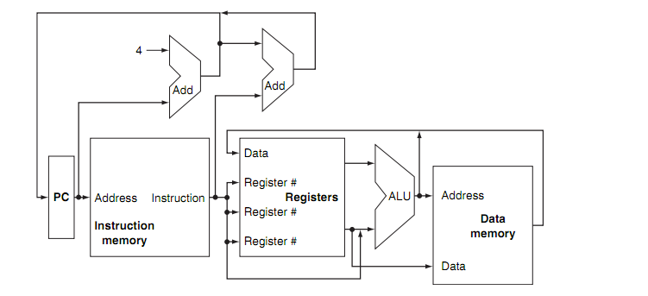
Peer Instruction
How many places in this diagram will need a multiplexor to select one from multiple inputs?
a) 0 b) 1 c) 2 d) 3 e) 4 or more

Slide 25
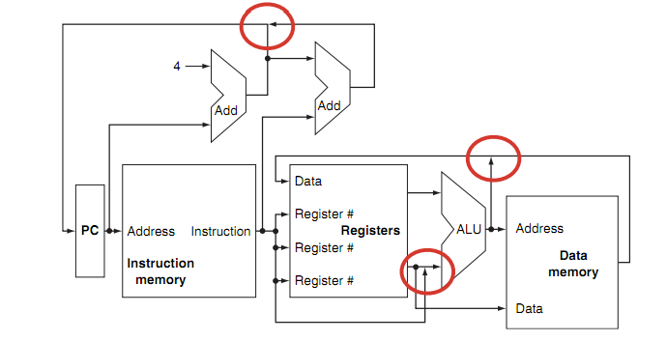
Peer Instruction
How many places in this diagram will need a multiplexor to select one from multiple inputs
a) 0 b) 1 c) 2 d) 3 e) 4 or more

Slide 26
Datapath and Control
Datapath based on data transfers required to perform instructions
Controller causes the right transfers to happen
rd
PC
instruction
memory
registers
rs
Data
memory
rt
ALU
+4
imm
opcode, funct
Controller

Slide 27
What Hardware Is Needed? (1/2)
PC: a register that keeps track of address of the next instruction to be fetched
General Purpose Registers
Used in Stages 2 (Read) and 5 (Write)
MIPS has 32 of these
Memory
Used in Stages 1 (Fetch) and 4 (R/W)
Caches makes these stages as fast as the others (on average, otherwise multicycle stall)

Slide 28
What Hardware Is Needed? (2/2)
ALU
Used in Stage 3
Performs all necessary functions: arithmetic, logicals, etc.
Miscellaneous Registers
One stage per clock cycle: Registers inserted between stages to hold intermediate data and control signals as they travel from stage to stage
Note: Register is a general purpose term meaning something that stores bits. Realize that not all registers are in the “register file”

Slide 29
CPU Clocking (1/2)
For each instruction, how do we control the flow of information though the datapath?
Single Cycle CPU: All stages of an instruction completed within one long clock cycle
Clock cycle sufficiently long to allow each instruction to complete all stages without interruption within one cycle
2. Decode/
Register
Read
1. Instruction
Fetch
5. Reg.
Write
3. Execute
4. Memory

Slide 30
CPU Clocking (2/2)
Alternative multiple-cycle CPU: only one stage of instruction per clock cycle
Clock is made as long as the slowest stage
Several significant advantages over single cycle execution: Unused stages in a particular instruction can be skipped OR instructions can be pipelined (overlapped)
2. Decode/
Register
Read
1. Instruction
Fetch
3. Execute
4. Memory
5. Register
Write

Slide 31
Processor Design
Analyze instruction set architecture (ISA) to determine datapath requirements
Meaning of each instruction is given by register transfers
Datapath must include storage element for ISA registers
Datapath must support each register transfer
Select set of datapath components and establish clocking methodology
Assemble datapath components to meet requirements
Analyze each instruction to determine sequence of control point settings to implement the register transfer
Assemble the control logic to perform this sequencing

Slide 32
Summary
CPU design involves Datapath, Control
5 Stages for MIPS Instructions
Instruction Fetch
Instruction Decode & Register Read
ALU (Execute)
Memory
Register Write
Datapath timing: single long clock cycle or one short clock cycle per stage

Slide 33
Instruction Level Parallelism
P 1
P 2
P 3
P 4
P 5
P 6
P 7
P 8
P 9
P 10
P 11
P 12
Instr 1
IF
ID
ALU
MEM
WR
IF
ID
ALU
MEM
WR
Instr 2
IF
ID
ALU
MEM
WR
Instr 2
Instr 3
IF
ID
ALU
MEM
WR
Instr 4
IF
ID
ALU
MEM
WR
Instr 5
IF
ID
ALU
MEM
WR
Instr 6
IF
ID
ALU
MEM
WR
Instr 7
IF
ID
ALU
MEM
WR
Instr 8
IF
ID
ALU
MEM
WR

