Slide 1
CS 61C: Great Ideas in Computer Architecture (Machine Structures) Lecture 37: IO Interrupts and Networks
Instructor: Sung Roa Yoon
Slides:
Mike Franklin
Dan Garcia

Slide 2
Review
I/O gives computers their 5 senses + long term memory
I/O speed range is 7 Orders of Magnitude (or more!)
Processor speed means must synchronize with I/O devices before use
Polling works, but expensive
processor repeatedly queries devices
Interrupts work, but more complex
we’ll talk about these today

Slide 3
Exceptions and Interrupts
§4.9 Exceptions
“Unexpected” events requiring change in flow of control
Different ISAs use the terms differently
Exception
Arises within the CPU
e.g., Undefined opcode, overflow, syscall, TLB Miss,…
Interrupt
From an external I/O controller
Dealing with them without sacrificing performance is difficult

Slide 4
Handling Exceptions
In MIPS, exceptions managed by a System Control Coprocessor (CP0)
Save PC of offending (or interrupted) instruction
In MIPS: save in special register called Exception Program Counter (EPC)
Save indication of the problem
In MIPS: saved in special register called Cause register
We’ll assume 1-bit
0 for undefined opcode, 1 for overflow
Jump to exception handler code at address 8000 0180_{hex}

Slide 5
Exception Properties
Restartable exceptions
Pipeline can flush the instruction
Handler executes, then returns to the instruction
Refetched and executed from scratch
PC saved in EPC register
Identifies causing instruction
Actually PC + 4 is saved because of pipelined implementation
Handler must adjust PC to get right address

Slide 6
Handler Actions
Read Cause register, and transfer to relevant handler
Determine action required
If restartable exception
Take corrective action
use EPC to return to program
Otherwise
Terminate program
Report error using EPC, cause, …

Slide 7
Exceptions in a Pipeline
Another kind of control hazard
Consider overflow on add in EX stage
add $1, $2, $1
Prevent $1 from being clobbered
Complete previous instructions
Flush add and subsequent instructions
Set Cause and EPC register values
Transfer control to handler
Similar to mispredicted branch
Use much of the same hardware

Slide 8
Exception Example
Time (clock cycles)
I
n
s
t
r.
O
r
d
e
r
and
I$
Reg
ALU
D$
Reg
or
I$
Reg
ALU
D$
Reg
add
I$
Reg
D$
Reg
ALU
slt
I$
Reg
ALU
D$
Reg
lw
I$
Reg
ALU
D$
Reg
lui
I$
Reg
ALU
D$
Reg

Slide 9
Exception Example
Time (clock cycles)
I
n
s
t
r.
O
r
d
e
r
and
I$
Reg
ALU
D$
Reg
or
I$
Reg
D$
Reg
ALU
Save PC+4 into EPC
Flush add, slt, lw
(bubble)
I$
Reg
ALU
D$
Reg
(bubble)
I$
Reg
D$
Reg
ALU
(bubble)
I$
Reg
D$
Reg
ALU
sw
I$
Reg
D$
Reg
ALU
1st instruction of handler

Slide 10
Multiple Exceptions
Pipelining overlaps multiple instructions
Could have multiple exceptions at once
E.g., Page fault in LW same clock cycle as Overflow of following instruction ADD
Simple approach: deal with exception from earliest instruction, e.g., LW exception serviced 1st
Flush subsequent instructions
Called Precise exceptions
In complex pipelines:
Multiple instructions issued per cycle
Out-of-order completion
Maintaining precise exceptions is difficult!

Slide 11
Imprecise Exceptions
Just stop pipeline and save state
Including exception cause(s)
Let the software handler work out
Which instruction(s) had exceptions
Which to complete or flush
May require “manual” completion
Simplifies hardware, but more complex handler software
Not feasible for complex multiple-issue out-of-order pipelines to always get exact instruction
All computers today offer precise exceptions—affects performance though

Slide 12
I/O Interrupt
An I/O interrupt is like an exception except:
An I/O interrupt is “asynchronous”
More information needs to be conveyed
An I/O interrupt is asynchronous with respect to instruction execution:
I/O interrupt is not associated with any instruction, but it can happen in the middle of any given instruction
I/O interrupt does not prevent any instruction from completion
Notes:
How does an I/O interrupt different from the exception you already learned?
Well, an I/O interrupt is asynchronous with respect to the instruction execution while exception such as overflow or page fault are always associated with a certain instruction.
Also for exception, the only information needs to be conveyed is the fact that an exceptional condition has occurred but for interrupt, there is more information to be conveyed.
Let me elaborate on each of these two points.
Unlike exception, which is always associated with an instruction, interrupt is not associated with any instruction. The user program is just doing its things when an I/O interrupt occurs.
So I/O interrupt does not prevent any instruction from completing so you can pick your own convenient point to take the interrupt.
As far as conveying more information is concerned, the interrupt detection hardware must somehow let the OS know who is causing the interrupt.
Furthermore, interrupt requests needs to be prioritized. The hardware that can do all these looks like this.
+2 = 64 min. (Y:44)

Slide 13
Interrupt-Driven Data Transfer
Memory
(1) I/O
interrupt
add
sub
and
or
user
program
(2) save PC
(3) jump to interrupt
service routine
read
store
...
jr
(5)
interrupt
service
routine
(4) perform transfer
Notes:
That is, whenever an I/O device needs attention from the processor, it interrupts the processor from what it is currently doing.
This is how an I/O interrupt looks in the overall scheme of things. The processor is minding its business when one of the I/O device wants its attention and causes an I/O interrupt.
The processor then save the current PC, branch to the address where the interrupt service routine resides, and start executing the interrupt service routine.
When it finishes executing the interrupt service routine, it branches back to the point of the original program where we stop and continue.
The advantage of this approach is efficiency. The user program’s progress is halted only during actual transfer.
The disadvantage is that it require special hardware in the I/O device to generate the interrupt. And on the processor side, we need special hardware to detect the interrupt and then to save the proper states so we can resume after the interrupt.
+2 = 62 min. (Y:42)

Slide 14
Benefit of Interrupt-Driven I/O
Find the % of processor consumed if the hard disk is only active 5% of the time. Assuming 500 clock cycle overhead for each transfer, including interrupt:
Disk Interrupts/s = 5% * 16 [MB/s] / 16 [B/interrupt] = 50,000 [interrupts/s]
Disk Interrupts [clocks/s] = 50,000 [interrupts/s] * 500 [clocks/interrupt] = 25,000,000 [clocks/s]
% Processor for during transfer: 2.5*10⁷ [clocks/s] / 1*10⁹ [clocks/s] = 2.5% Busy
DMA (Direct Memory Access) even better – only one interrupt for an entire page!

Slide 15
Administrivia
Project 3 part 2 grades will be released around next Monday.
Project 4 is due May 5th, but you should get started ASAP
Next week’s lab will be free section working on project 4
We will be holding normal discussions next week

Slide 16
Networks: Talking to the Outside World
Originally sharing I/O devices between computers
E.g., printers
Then communicating between computers
E.g., file transfer protocol
Then communicating between people
E.g., e-mail
Then communicating between networks of computers
E.g., file sharing, www, …
Notes:
Original printers were the size of bathrooms - HAD to share
FTP was the first time file sharing happened
Communicating between people has become dominant, pervasive, ubiquitous
- Also IM
Last bullet is where a lot of research is happening

Slide 17
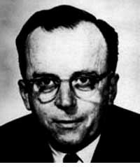
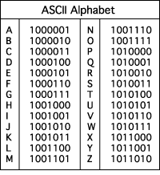
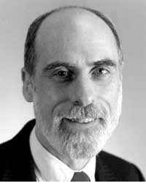
The Internet (1962)
www.computerhistory.org/internet_history
Founders
JCR Licklider, as head of ARPA, writes on “intergalactic network”
1963 : ASCII becomes first universal computer standard
1969 : Defense Advanced Research Projects Agency (DARPA) deploys 4 “nodes” @ UCLA, SRI, Utah, & UCSB
1973 Robert Kahn & Vint Cerf invent TCP, now part of the Internet Protocol Suite
Internet growth rates
Exponential since start!
“Lick”
Revolutions like this don't come along very often
Vint Cerf
www.greatachievements.org/?id=3736 en.wikipedia.org/wiki/Internet_Protocol_Suite

Slide 18
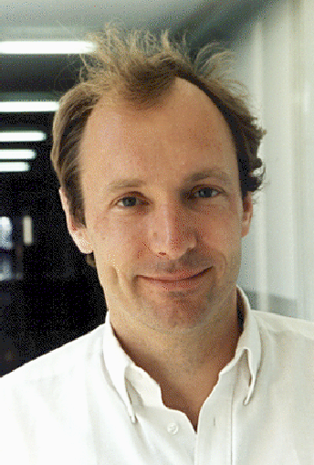
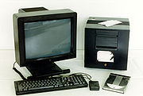
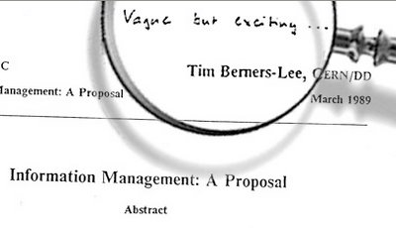
The World Wide Web (1989)
en.wikipedia.org/wiki/History_of_the_World_Wide_Web
“System of interlinked hypertext documents on the Internet”
History
1945: Vannevar Bush describes hypertext system called “memex” in article
1989: Tim Berners-Lee proposes, gets system up ’90
~2000 Dot-com entrepreneurs rushed in, 2001 bubble burst
Wayback Machine
Snapshots of web over time
Today : Access anywhere!
World’s First web server in 1990
Tim Berners-Lee

Slide 19
Shared vs. Switched Based Networks
Shared
Shared vs. Switched:
Shared: 1 at a time (CSMA/CD)
Switched: pairs (“point-to-point” connections) communicate at same time
Aggregate bandwidth (BW) in switched network is many times shared:
point-to-point faster since no arbitration, simpler interface
Node
Node
Node
Node
Crossbar
Switch
Node
Node
Node
Notes:
CSMA/CD = Carrier Sense Multiple Access / Collision Detection
Bus: On collision, have to wait random amount of time
Buses not used very much, inefficient.
Switches are much more efficient
Bandwidth is like throughput

Slide 20
What makes networks work?
links connecting switches and/or routers to each other and to computers or devices
Computer
switch
switch
switch
network
interface
ability to name the components and to route packets of information - messages - from a source to a destination
Layering, redundancy, protocols, and encapsulation as means of abstraction (61C big idea)
Notes:
Computer has Network Interface Card (NIC)
Sends message through the series of switches, which get the message to recipient
Usually draw the series of switches as the “Internet Cloud”
- Represents an abstraction, “don’t know” implementation
- Send the message through the network, and it will get to where it needs to go
Switches use routing tables to know how to get the message to the recipient

Slide 21
Software Protocol to Send and Receive
SW Send steps
1: Application copies data to OS buffer
2: OS calculates checksum, starts timer
3: OS sends data to network interface HW and says start
SW Receive steps
3: OS copies data from network interface HW to OS buffer
2: OS calculates checksum, if OK, send ACK; if not, delete message (sender resends when timer expires)
1: If OK, OS copies data to user address space, & signals application to continue
Dest
Src
Checksum
Net ID
Net ID
Len
ACK
INFO
CMD/ Address /Data
Header
Payload
Trailer
Notes:
Timer is counting down on Time To Live (TTL)
- You can see this in Pings

Slide 22
Protocol for Networks of Networks?
Abstraction to cope with complexity of communication
Networks are like onions
Hierarchy of layers:
Application (chat client, game, etc.)
Transport (TCP, UDP)
Network (IP)
Physical Link (wired, wireless, etc.)
Networks are like onions.
They stink?
Yes. No!
Oh, they make you cry.
No!… Layers. Onions have layers. Networks have layers.
Notes:
WS companies used TCP/IP even over LAN
Because early Ethernet controllers were cheap, but not reliable

Slide 23
Protocol Family Concept
Key to protocol families is that communication occurs logically at the same level of the protocol, called peer-to-peer… …but is implemented via services at the next lower level
Encapsulation: carry higher level information within lower level “envelope”
Fragmentation: break packet into multiple smaller packets and reassemble

Slide 24
Protocol Family Concept
Message
Logical
Message
Actual
Actual
Logical
H
Message
T
H
Message
T
Actual
Actual
H
H
Message
T
T
H
H
Message
T
T
Physical

Slide 25
Protocol for Network of Networks
Transmission Control Protocol/Internet Protocol (TCP/IP) (TCP :: a Transport Layer)
This protocol family is the basis of the Internet, a WAN protocol
IP makes best effort to deliver
Packets can be lost, corrupted
TCP guarantees delivery
TCP/IP so popular it is used even when communicating locally: even across homogeneous LAN
Notes:
WS companies used TCP/IP even over LAN
Because early Ethernet controllers were cheap, but not reliable
TCP and IP fundamentally different but very connected
TCP hires IP guys
- GO!
- IP guy falls into a hole
- TCP hires another IP guy
- GO!
-IP gus falls into a hole
- Hire another!

Slide 26
TCP/IP packet, Ethernet packet, protocols
Application sends message
Ethernet Hdr
TCP breaks into 64KiB segments, adds 20B header
IP Header
TCP Header
EH
IP Data
IP adds 20B header, sends to network
TCP data
If Ethernet, broken into 1500B packets with headers, trailers (24B)
Message
Ethernet Hdr
.

Slide 27
And in conclusion…
Exceptions are “Unexpected” events
Interrupts are asynchronous
can be used for interacting with I/O devices
Need to handle in presence of pipelining, etc.
Networks are another form of I/O
Protocol suites allow networking of heterogeneous components
Another form of principle of abstraction
Interested in Networking?
EE122 (CS-based in Fall, EE –based in Spring)

