Slide 1
CS 61C: Great Ideas in Computer Architecture
The Flynn Taxonomy,
Intel SIMD Instructions
Guest Lecturer: Alan Christopher

Slide 2
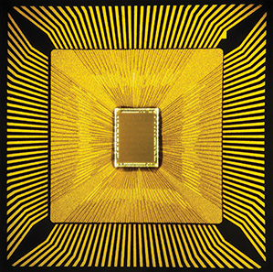
Neuromorphic Chips
Researchers at IBM and HRL laboratories are looking into building computer chips that attempt to mimic natural thought patterns in order to more effectively solve problems in AI.
http://www.technologyreview.com/featuredstory/522476/thinking-in-silicon/

Slide 3
Review of Last Lecture
Amdahl’s Law limits benefits of parallelization
Request Level Parallelism
Handle multiple requests in parallel (e.g. web search)
MapReduce Data Level Parallelism
Framework to divide up data to be processed in parallel
Mapper outputs intermediate key-value pairs
Reducer “combines” intermediate values with same key

Slide 4
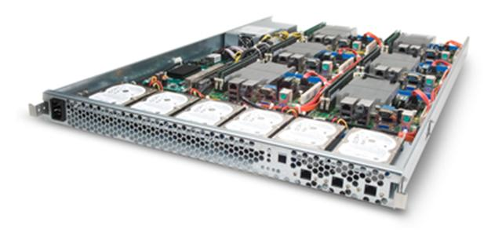
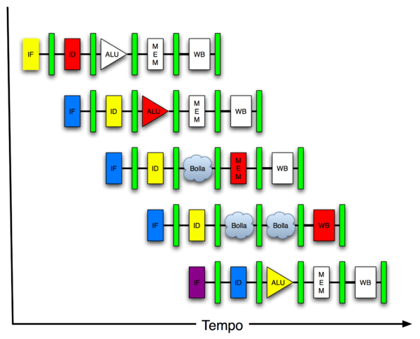
Great Idea #4: Parallelism
Software Hardware
Parallel Requests
Assigned to computer
e.g. search “Garcia”
Parallel Threads
Assigned to core
e.g. lookup, ads
Parallel Instructions
> 1 instruction @ one time
e.g. 5 pipelined instructions
Parallel Data
> 1 data item @ one time
e.g. add of 4 pairs of words
Hardware descriptions
All gates functioning in parallel at same time
Warehouse Scale Computer
Smart Phone
Leverage Parallelism &
Achieve High Performance
Computer
Core
…
Core
Memory
Input/Output
We are here
Core
Instruction Unit(s)
Functional
Unit(s)
A₀+B₀
A₁+B₁
A₂+B₂
A₃+B₃
Cache Memory
Logic Gates

Slide 5
Agenda
Flynn’s Taxonomy
Administrivia
Data Level Parallelism and SIMD
Bonus: Loop Unrolling

Slide 6
Hardware vs. Software Parallelism
Choice of hardware and software parallelism are independent
Concurrent software can also run on serial hardware
Sequential software can also run on parallel hardware
Flynn’s Taxonomy is for parallel hardware

Slide 7
Flynn’s Taxonomy
SIMD and MIMD most commonly encountered today
Most common parallel processing programming style: Single Program Multiple Data (“SPMD”)
Single program that runs on all processors of an MIMD
Cross-processor execution coordination through conditional expressions (will see later in Thread Level Parallelism)
SIMD: specialized function units (hardware), for handling lock-step calculations involving arrays
Scientific computing, signal processing, multimedia (audio/video processing)

Slide 8
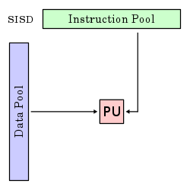
Single Instruction/Single Data Stream
Sequential computer that exploits no parallelism in either the instruction or data streams
Examples of SISD architecture are traditional uniprocessor machines
Processing Unit

Slide 9
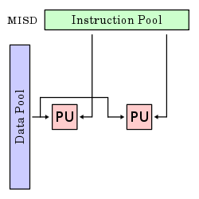
Multiple Instruction/Single Data Stream
Exploits multiple instruction streams against a single data stream for data operations that can be naturally parallelized (e.g. certain kinds of array processors)
MISD no longer commonly encountered, mainly of historical interest only

Slide 10
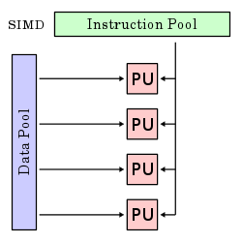
Single Instruction/Multiple Data Stream
Computer that applies a single instruction stream to multiple data streams for operations that may be naturally parallelized (e.g. SIMD instruction extensions or Graphics Processing Unit)

Slide 11
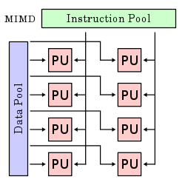
Multiple Instruction/Multiple Data Stream
Multiple autonomous processors simultaneously executing different instructions on different data
MIMD architectures include multicore and Warehouse Scale Computers

Slide 12
Agenda
Flynn’s Taxonomy
Administrivia
Data Level Parallelism and SIMD
Bonus: Loop Unrolling

Slide 13
Administrivia
Midterm next Wednesday
May have 1 double sided 8.5’’ x 11’’ sheet of hand written notes
May also bring an unedited copy of the MIPS green sheet.
We will provide a copy if you forget yours
Proj2 (MapReduce) to be released soon
Part 1 due date pushed later
Work in partners, 1 of you must know Java

Slide 14
Agenda
Flynn’s Taxonomy
Administrivia
Data Level Parallelism and SIMD
Bonus: Loop Unrolling

Slide 15
SIMD Architectures
Data-Level Parallelism (DLP): Executing one operation on multiple data streams
Example: Multiplying a coefficient vector by a data vector (e.g. in filtering)
y[i] := c[i] × x[i], 0≤i<n
Sources of performance improvement:
One instruction is fetched & decoded for entire operation
Multiplications are known to be independent
Pipelining/concurrency in memory access as well

Slide 16
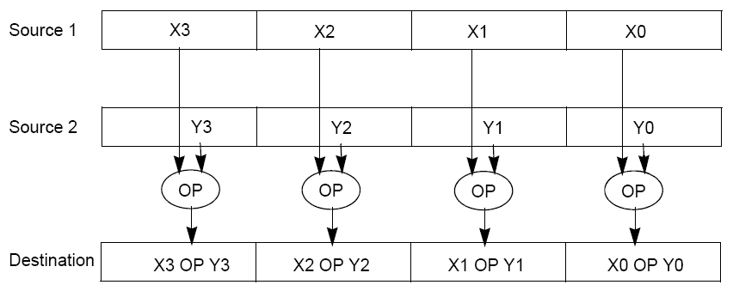
“Advanced Digital Media Boost”
To improve performance, Intel’s SIMD instructions
Fetch one instruction, do the work of multiple instructions
MMX (MultiMedia eXtension, Pentium II processor family)
SSE (Streaming SIMD Extension, Pentium III and beyond)

Slide 17
Example: SIMD Array Processing
for each f in array:
f = sqrt(f)
for each f in array {
load f to the floating-point register
calculate the square root
write the result from the register to memory
}
for every 4 members in array {
load 4 members to the SSE register
calculate 4 square roots in one operation
write the result from the register to memory
}
pseudocode
SISD
SIMD

Slide 18
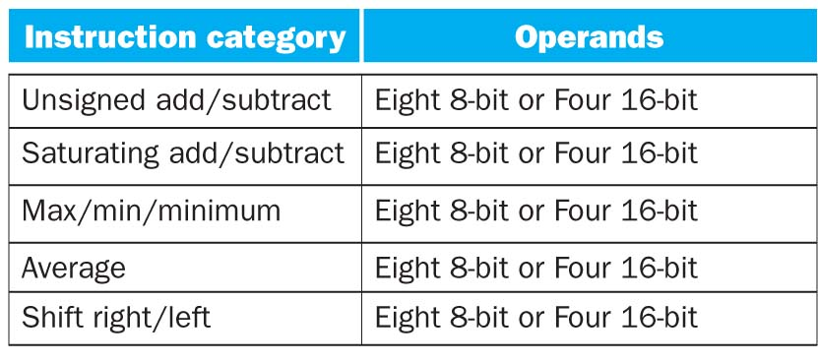
SSE Instruction Categories for Multimedia Support
Intel processors are CISC (complicated instrs)
SSE-2+ supports wider data types to allow 16 × 8-bit and 8 × 16-bit operands
Notes:
64 bits operated on simultaneously!

Slide 19
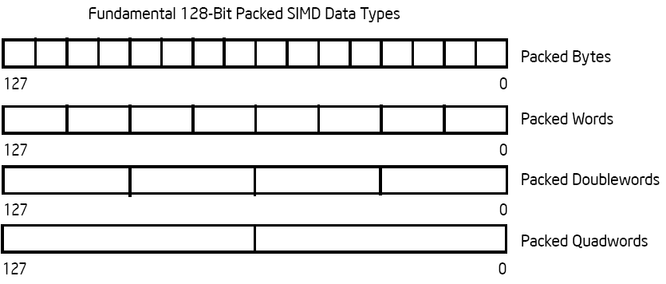
Intel Architecture SSE2+ 128-Bit SIMD Data Types
122 121
96 95
80 79
64 63
48 47
32 31
16 15
16 / 128 bits
122 121
96 95
80 79
64 63
48 47
32 31
16 15
8 / 128 bits
96 95
64 63
32 31
4 / 128 bits
64 63
2 / 128 bits
Note: in Intel Architecture (unlike MIPS) a word is 16 bits
Single precision FP: Double word (32 bits)
Double precision FP: Quad word (64 bits)

Slide 20
XMM Registers
Architecture extended with eight 128-bit data registers
64-bit address architecture: available as 16 64-bit registers (XMM8 – XMM15)
e.g. 128-bit packed single-precision floating-point data type (doublewords), allows four single-precision operations to be performed simultaneously
127
0
XMM7
XMM6
XMM5
XMM4
XMM3
XMM2
XMM1
XMM0
Notes:
Doublewords are the 32-bit chunks of data we’re used to working with.

Slide 21
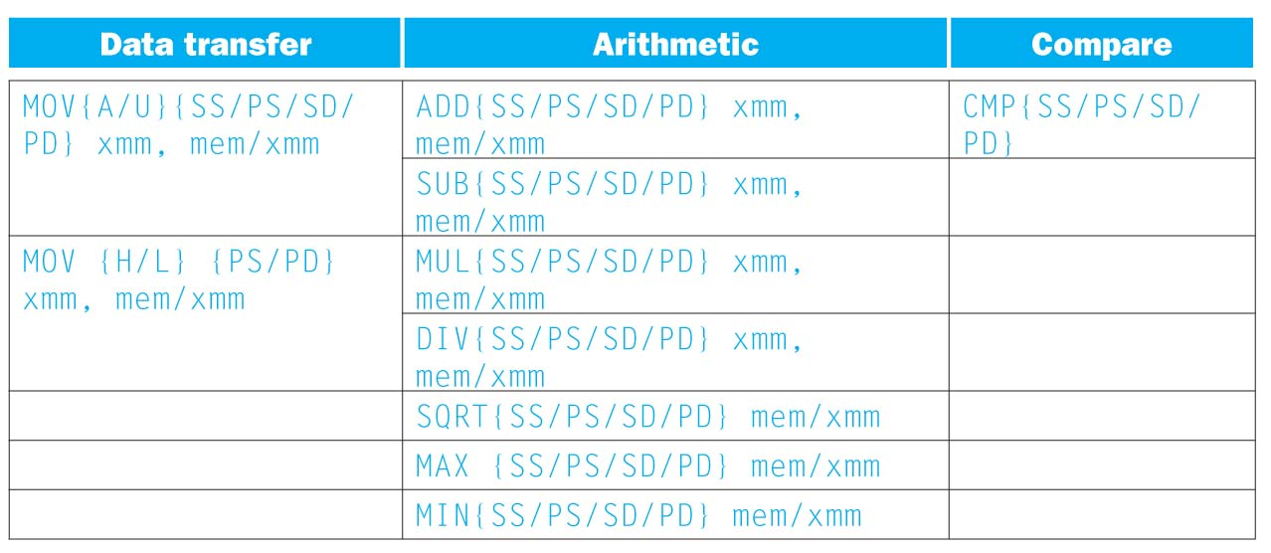
SSE/SSE2 Floating Point Instructions
{SS} Scalar Single precision FP: 1 32-bit operand in a 128-bit register
{PS} Packed Single precision FP: 4 32-bit operands in a 128-bit register
{SD} Scalar Double precision FP: 1 64-bit operand in a 128-bit register
{PD} Packed Double precision FP, or 2 64-bit operands in a 128-bit register

Slide 22
SSE/SSE2 Floating Point Instructions
xmm: one operand is a 128-bit SSE2 register
mem/xmm: other operand is in memory or an SSE2 register
{A} 128-bit operand is aligned in memory
{U} means the 128-bit operand is unaligned in memory
{H} means move the high half of the 128-bit operand
{L} means move the low half of the 128-bit operand

Slide 23
Example: Add Single Precision FP Vectors
Computation to be performed:
vec_res.x = v1.x + v2.x;
vec_res.y = v1.y + v2.y;
vec_res.z = v1.z + v2.z;
vec_res.w = v1.w + v2.w;
SSE Instruction Sequence:
movaps address-of-v1, %xmm0
// v1.w | v1.z | v1.y | v1.x -> xmm0
addps address-of-v2, %xmm0
// v1.w+v2.w | v1.z+v2.z | v1.y+v2.y | v1.x+v2.x -> xmm0
movaps %xmm0, address-of-vec_res
move from mem to XMM register, memory aligned, packed single precision
add from mem to XMM register, packed single precision
move from XMM register to mem, memory aligned, packed single precision

Slide 24
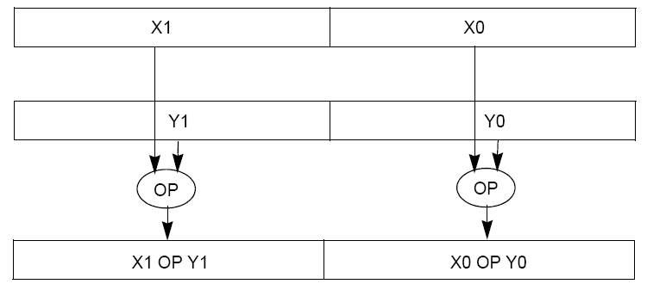
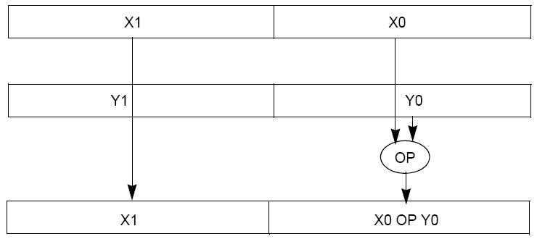
Packed and Scalar Double-Precision Floating-Point Operations
Packed Double (PD)
Scalar Double (SD)

Slide 25
Example: Image Converter (1/5)
Converts BMP (bitmap) image to a YUV (color space) image format:
Read individual pixels from the BMP image, convert pixels into YUV format
Can pack the pixels and operate on a set of pixels with a single instruction
Bitmap image consists of 8-bit monochrome pixels
By packing these pixel values in a 128-bit register, we can operate on 128/8 = 16 values at a time
Significant performance boost
Notes:
BMP File Format, also known as Bitmap Image File
The BMP File Format is capable of storing 2D digital images of arbitrary width, height, and resolution, both monochrome and color, in various color depths, and optionally with data compression, alpha channels, and color profiles.
YUV is a color space typically used as part of a color image pipeline.
The Y'UV model defines a color space in terms of one luma (Y') and two chrominance (UV) components.

Slide 26
Example: Image Converter (2/5)
FMADDPS – Multiply and add packed single precision floating point instruction
One of the typical operations computed in transformations (e.g. DFT or FFT)
CISC Instr!
N
P = ∑ f(n) × x(n)
n = 1

Slide 27
Example: Image Converter (3/5)
FP numbers f(n) and x(n) in src1 and src2; p in dest;
C implementation for N = 4 (128 bits):
for (int i = 0; i < 4; i++)
p = p + src1[i] * src2[i];
Regular x86 instructions for the inner loop:
fmul […]
faddp […]
Instructions executed: 4 * 2 = 8 (x86)
Notes:
http://developer.amd.com/cpu/SSE5/Pages/default.aspx
"DE C0+i FADDP ST(i), ST(0) Add ST(0) to ST(i), store result in ST(i), and pop the register stack".
Destination on right called AT&T format

Slide 28
Example: Image Converter (4/5)
FP numbers f(n) and x(n) in src1 and src2; p in dest;
C implementation for N = 4 (128 bits):
for (int i = 0; i < 4; i++)
p = p + src1[i] * src2[i];
SSE2 instructions for the inner loop:
//xmm0=p, xmm1=src1[i], xmm2=src2[i]
mulps %xmm1,%xmm2 // xmm2 * xmm1 -> xmm2
addps %xmm2,%xmm0 // xmm0 + xmm2 -> xmm0
Instructions executed: 2 (SSE2)
Notes:
http://developer.amd.com/cpu/SSE5/Pages/default.aspx
"DE C0+i FADDP ST(i), ST(0) Add ST(0) to ST(i), store result in ST(i), and pop the register stack".
Destination on right called AT&T format

Slide 29
Example: Image Converter (5/5)
FP numbers f(n) and x(n) in src1 and src2; p in dest;
C implementation for N = 4 (128 bits):
for (int i = 0; i < 4; i++)
p = p + src1[i] * src2[i];
SSE5 accomplishes the same in one instruction:
fmaddps %xmm0, %xmm1, %xmm2, %xmm0
// xmm2 * xmm1 + xmm0 -> xmm0
// multiply xmm1 x xmm2 packed single, // then add product packed single to sum in xmm0
Notes:
http://developer.amd.com/cpu/SSE5/Pages/default.aspx
"DE C0+i FADDP ST(i), ST(0) Add ST(0) to ST(i), store result in ST(i), and pop the register stack".
Destination on right called AT&T format

Slide 30
Summary
Flynn Taxonomy of Parallel Architectures
SIMD: Single Instruction Multiple Data
MIMD: Multiple Instruction Multiple Data
SISD: Single Instruction Single Data
MISD: Multiple Instruction Single Data (unused)
Intel SSE SIMD Instructions
One instruction fetch that operates on multiple operands simultaneously
128/64 bit XMM registers

Slide 31
BONUS SLIDES
You are responsible for the material contained on the following slides, though we may not have enough time to get to them in lecture.
They have been prepared in a way that should be easily readable and the material will be touched upon in the following lecture.

Slide 32
Agenda
Flynn’s Taxonomy
Administrivia
Data Level Parallelism and SIMD
Bonus: Loop Unrolling

Slide 33
Data Level Parallelism and SIMD
SIMD wants adjacent values in memory that can be operated in parallel
Usually specified in programs as loops
for(i=0; i<1000; i++)
x[i] = x[i] + s;
How can we reveal more data level parallelism than is available in a single iteration of a loop?
Unroll the loop and adjust iteration rate

Slide 34
Looping in MIPS
Assumptions:
$s0 → initial address (beginning of array)
$s1 → scalar value s
$s2 → termination address (end of array)
Loop:
lw $t0,0($s0)
addu $t0,$t0,$s1 # add s to array element
sw $t0,0($s0) # store result
addiu $s0,$s0,4 # move to next element
bne $s0,$s2,Loop # repeat Loop if not done

Slide 35
Loop Unrolled
Loop: lw $t0,0($s0)
addu $t0,$t0,$s1
sw $t0,0($s0)
lw $t1,4($s0)
addu $t1,$t1,$s1
sw $t1,4($s0)
lw $t2,8($s0)
addu $t2,$t2,$s1
sw $t2,8($s0)
lw $t3,12($s0)
addu $t3,$t3,$s1
sw $t3,12($s0)
addiu $s0,$s0,16
bne $s0,$s2,Loop
NOTE:
Using different registers eliminate stalls
Loop overhead encountered only once every 4 data iterations
This unrolling works if
loop_limit mod 4 = 0

Slide 36
Loop Unrolled Scheduled
Note: We just switched from integer instructions to single-precision FP instructions!
Loop: lwc1 $t0,0($s0)
lwc1 $t1,4($s0)
lwc1 $t2,8($s0)
lwc1 $t3,12($s0)
add.s $t0,$t0,$s1
add.s $t1,$t1,$s1
add.s $t2,$t2,$s1
add.s $t3,$t3,$s1
swc1 $t0,0($s0)
swc1 $t1,4($s0)
swc1 $t2,8($s0)
swc1 $t3,12($s0)
addiu $s0,$s0,16
bne $s0,$s2,Loop
4 Loads side-by-side:
Could replace with 4 wide SIMD Load
4 Adds side-by-side:
Could replace with 4 wide SIMD Add
4 Stores side-by-side:
Could replace with 4 wide SIMD Store

Slide 37
Loop Unrolling in C
Instead of compiler doing loop unrolling, could do it yourself in C:
for(i=0; i<1000; i++)
x[i] = x[i] + s;
for(i=0; i<1000; i=i+4) {
x[i] = x[i] + s;
x[i+1] = x[i+1] + s;
x[i+2] = x[i+2] + s;
x[i+3] = x[i+3] + s;
}
Loop Unroll
What is
downside of doing
this in C?

Slide 38
Generalizing Loop Unrolling
Take a loop of n iterations and perform a k-fold unrolling of the body of the loop:
First run the loop with k copies of the body floor(n/k) times
To finish leftovers, then run the loop with 1 copy of the body n mod k times
(Will revisit loop unrolling again when get to pipelining later in semester)

