Slide 1
CS 61C: Great Ideas in Computer Architecture (Machine Structures) Lecture 32: Pipeline Parallelism 3
Instructor: Dan Garcia
inst.eecs.Berkeley.edu/~cs61c

Slide 2
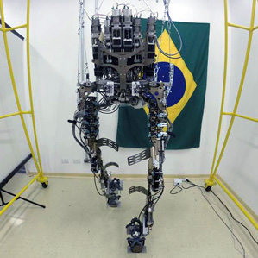
Computing in the News
“At a laboratory in São Paulo, a Duke University neuroscientist is in his own race with the World Cup clock. He is rushing to finish work on a mind-controlled exoskeleton that he says a paralyzed Brazilian volunteer will don, navigate across a soccer pitch using his or her thoughts, and use to make the ceremonial opening kick of the tournament on June 12.”
www.technologyreview.com/news/526336/world-cup-mind-control-demo-faces-deadlines-critics

Slide 3
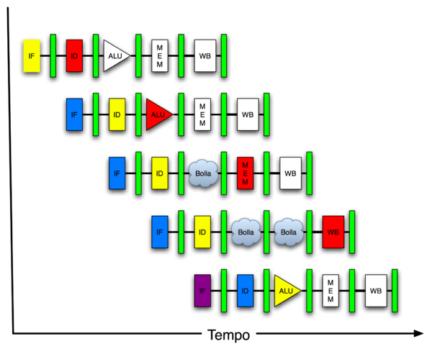
You Are Here!
Software Hardware
Parallel Requests
Assigned to computer
e.g., Search “Katz”
Parallel Threads
Assigned to core
e.g., Lookup, Ads
Parallel Instructions
>1 instruction @ one time
e.g., 5 pipelined instructions
Parallel Data
>1 data item @ one time
e.g., Add of 4 pairs of words
Hardware descriptions
All gates functioning in parallel at same time
Warehouse Scale Computer
Smart Phone
Harness Parallelism &
Achieve High Performance
Computer
Core
…
Core
Memory (Cache)
Input/Output
Core
Today’s Lecture
Instruction Unit(s)
Functional
Unit(s)
A₀+B₀
A₁+B₁
A₂+B₂
A₃+B₃
Main Memory
Logic Gates

Slide 4
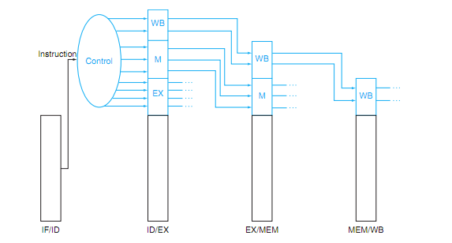
P&H Figure 4.50

Slide 5
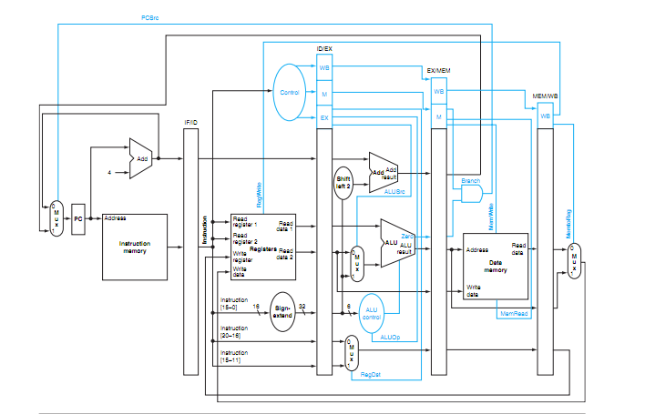
P&H 4.51 – Pipelined Control

Slide 6
Hazards
Situations that prevent starting the next logical instruction in the next clock cycle
Structural hazards
Required resource is busy (e.g., roommate studying)
Data hazard
Need to wait for previous instruction to complete its data read/write (e.g., pair of socks in different loads)
Control hazard
Deciding on control action depends on previous instruction (e.g., how much detergent based on how clean prior load turns out)

Slide 7
3. Control Hazards
Branch determines flow of control
Fetching next instruction depends on branch outcome
Pipeline can’t always fetch correct instruction
Still working on ID stage of branch
BEQ, BNE in MIPS pipeline
Simple solution Option 1: Stall on every branch until have new PC value
Would add 2 bubbles/clock cycles for every Branch! (~ 20% of instructions executed)

Slide 8
Stall => 2 Bubbles/Clocks
Time (clock cycles)
I
n
s
t
r.
O
r
d
e
r
beq
I$
Reg
ALU
D$
Reg
Instr 1
I$
Reg
ALU
D$
Reg
Instr 2
I$
Reg
ALU
D$
Reg
Instr 3
I$
Reg
ALU
D$
Reg
Instr 4
I$
Reg
ALU
D$
Reg
Where do we do the compare for the branch?

Slide 9
Control Hazard: Branching
Optimization #1:
Insert special branch comparator in Stage 2
As soon as instruction is decoded (Opcode identifies it as a branch), immediately make a decision and set the new value of the PC
Benefit: since branch is complete in Stage 2, only one unnecessary instruction is fetched, so only one no-op is needed
Side Note: means that branches are idle in Stages 3, 4 and 5
Question: What’s an efficient way to implement the equality comparison?

Slide 10
One Clock Cycle Stall
Time (clock cycles)
I
n
s
t
r.
O
r
d
e
r
beq
I$
Reg
ALU
D$
Reg
Instr 1
I$
Reg
ALU
D$
Reg
Instr 2
I$
Reg
ALU
D$
Reg
Instr 3
I$
Reg
ALU
D$
Reg
Instr 4
I$
Reg
ALU
D$
Reg
Branch comparator moved to Decode stage.

Slide 11
Control Hazards: Branching
Option 2: Predict outcome of a branch, fix up if guess wrong
Must cancel all instructions in pipeline that depended on guess that was wrong
This is called “flushing” the pipeline
Simplest hardware if we predict that all branches are NOT taken
Why?

Slide 12
Control Hazards: Branching
Option #3: Redefine branches
Old definition: if we take the branch, none of the instructions after the branch get executed by accident
New definition: whether or not we take the branch, the single instruction immediately following the branch gets executed (the branch-delay slot)
Delayed Branch means we always execute inst after branch
This optimization is used with MIPS

Slide 13
Example: Nondelayed vs. Delayed Branch
Nondelayed Branch
Delayed Branch
or $8, $9, $10
add $1, $2,$3
add $1, $2, $3
sub $4, $5, $6
sub $4, $5, $6
beq $1, $4, Exit
beq $1, $4, Exit
or $8, $9, $10
xor $10, $1, $11
xor $10, $1, $11
Exit:
Exit:

Slide 14
Control Hazards: Branching
Notes on Branch-Delay Slot
Worst-Case Scenario: put a no-op in the branch-delay slot
Better Case: place some instruction preceding the branch in the branch-delay slot—as long as the changed doesn’t affect the logic of program
Re-ordering instructions is common way to speed up programs
Compiler usually finds such an instruction 50% of time
Jumps also have a delay slot …

Slide 15
Greater Instruction-Level Parallelism (ILP)
Deeper pipeline (5 => 10 => 15 stages)
Less work per stage ⇒ shorter clock cycle
Multiple issue “superscalar”
Replicate pipeline stages ⇒ multiple pipelines
Start multiple instructions per clock cycle
CPI < 1, so use Instructions Per Cycle (IPC)
E.g., 4GHz 4-way multiple-issue
16 BIPS, peak CPI = 0.25, peak IPC = 4
But dependencies reduce this in practice
§4.10 Parallelism and Advanced Instruction Level Parallelism

Slide 16
Multiple Issue
Static multiple issue
Compiler groups instructions to be issued together
Packages them into “issue slots”
Compiler detects and avoids hazards
Dynamic multiple issue
CPU examines instruction stream and chooses instructions to issue each cycle
Compiler can help by reordering instructions
CPU resolves hazards using advanced techniques at runtime

Slide 17
Superscalar Laundry: Parallel per stage
6 PM
7
8
9
10
11
12
1
2 AM
More resources, HW to match mix of parallel tasks?
30
30
30
30
30
Time
T
a
s
k
O
r
d
e
r
A
(light clothing)
(dark clothing)
B
(very dirty clothing)
C
D
(light clothing)
(dark clothing)
E
(very dirty clothing)
F

Slide 18
Pipeline Depth and Issue Width
Intel Processors over Time
Microprocessor | Year | Clock Rate | Pipeline Stages | Issue width | Cores | Power
i486 | 1989 | 25 MHz | 5 | 1 | 1 | 5W
Pentium | 1993 | 66 MHz | 5 | 2 | 1 | 10W
Pentium Pro | 1997 | 200 MHz | 10 | 3 | 1 | 29W
P4 Willamette | 2001 | 2000 MHz | 22 | 3 | 1 | 75W
P4 Prescott | 2004 | 3600 MHz | 31 | 3 | 1 | 103W
Core 2 Conroe | 2006 | 2930 MHz | 14 | 4 | 2 | 75W
Core 2 Yorkfield | 2008 | 2930 MHz | 16 | 4 | 4 | 95W
Core i7 Gulftown | 2010 | 3460 MHz | 16 | 4 | 6 | 130W

Slide 19
Pipeline Depth and Issue Width

Slide 20
Static Multiple Issue
Compiler groups instructions into “issue packets”
Group of instructions that can be issued on a single cycle
Determined by pipeline resources required
Think of an issue packet as a very long instruction
Specifies multiple concurrent operations

Slide 21
Scheduling Static Multiple Issue
Compiler must remove some/all hazards
Reorder instructions into issue packets
No dependencies within a packet
Possibly some dependencies between packets
Varies between ISAs; compiler must know!
Pad issue packet with nop if necessary

Slide 22
MIPS with Static Dual Issue
Two-issue packets
One ALU/branch instruction
One load/store instruction
64-bit aligned
ALU/branch, then load/store
Pad an unused instruction with nop
Address | Instruction type | Pipeline Stages
n | ALU/branch | IF | ID | EX | MEM | WB
n + 4 | Load/store | IF | ID | EX | MEM | WB
n + 8 | ALU/branch |  | IF | ID | EX | MEM | WB
n + 12 | Load/store |  | IF | ID | EX | MEM | WB
n + 16 | ALU/branch |  |  | IF | ID | EX | MEM | WB
n + 20 | Load/store |  |  | IF | ID | EX | MEM | WB

Slide 23
Hazards in the Dual-Issue MIPS
More instructions executing in parallel
EX data hazard
Forwarding avoided stalls with single-issue
Now can’t use ALU result in load/store in same packet
add $t0, $s0, $s1 load $s2, 0($t0)
Split into two packets, effectively a stall
Load-use hazard
Still one cycle use latency, but now two instructions
More aggressive scheduling required

Slide 24
Scheduling Example
Schedule this for dual-issue MIPS
Loop: lw $t0, 0($s1) # $t0=array element addu $t0, $t0, $s2 # add scalar in $s2 sw $t0, 0($s1) # store result addi $s1, $s1,–4 # decrement pointer bne $s1, $zero, Loop # branch $s1!=0
 | ALU/branch | Load/store | cycle
Loop: |  |  | 1
 |  |  | 2
 |  |  | 3
 |  |  | 4

Slide 25
Scheduling Example
Schedule this for dual-issue MIPS
Loop: lw $t0, 0($s1) # $t0=array element addu $t0, $t0, $s2 # add scalar in $s2 sw $t0, 0($s1) # store result addi $s1, $s1,–4 # decrement pointer bne $s1, $zero, Loop # branch $s1!=0
 | ALU/branch | Load/store | cycle
Loop: | nop | lw $t0, 0($s1) | 1
 |  |  | 2
 |  |  | 3
 |  |  | 4

Slide 26
Scheduling Example
Schedule this for dual-issue MIPS
Loop: lw $t0, 0($s1) # $t0=array element addu $t0, $t0, $s2 # add scalar in $s2 sw $t0, 0($s1) # store result addi $s1, $s1,–4 # decrement pointer bne $s1, $zero, Loop # branch $s1!=0
 | ALU/branch | Load/store | cycle
Loop: | nop | lw $t0, 0($s1) | 1
 | addi $s1, $s1,–4 | nop | 2
 |  |  | 3
 |  |  | 4

Slide 27
Scheduling Example
Schedule this for dual-issue MIPS
Loop: lw $t0, 0($s1) # $t0=array element addu $t0, $t0, $s2 # add scalar in $s2 sw $t0, 0($s1) # store result addi $s1, $s1,–4 # decrement pointer bne $s1, $zero, Loop # branch $s1!=0
 | ALU/branch | Load/store | cycle
Loop: | nop | lw $t0, 0($s1) | 1
 | addi $s1, $s1,–4 | nop | 2
 | addu $t0, $t0, $s2 | nop | 3
 |  |  | 4

Slide 28
Scheduling Example
Schedule this for dual-issue MIPS
Loop: lw $t0, 0($s1) # $t0=array element addu $t0, $t0, $s2 # add scalar in $s2 sw $t0, 0($s1) # store result addi $s1, $s1,–4 # decrement pointer bne $s1, $zero, Loop # branch $s1!=0
 | ALU/branch | Load/store | cycle
Loop: | nop | lw $t0, 0($s1) | 1
 | addi $s1, $s1,–4 | nop | 2
 | addu $t0, $t0, $s2 | nop | 3
 | bne $s1, $zero, Loop | sw $t0, 4($s1) | 4
IPC = 5/4 = 1.25 (c.f. peak IPC = 2)

Slide 29
Loop Unrolling
Replicate loop body to expose more parallelism
Reduces loop-control overhead
Use different registers per replication
Called “register renaming”
Avoid loop-carried “anti-dependencies”
Store followed by a load of the same register
Aka “name dependence”
Reuse of a register name

Slide 30
Loop Unrolling Example
 | ALU/branch | Load/store | cycle
Loop: | addi $s1, $s1,–16 | lw $t0, 0($s1) | 1
 | nop | lw $t1, 12($s1) | 2
 | addu $t0, $t0, $s2 | lw $t2, 8($s1) | 3
 | addu $t1, $t1, $s2 | lw $t3, 4($s1) | 4
 | addu $t2, $t2, $s2 | sw $t0, 16($s1) | 5
 | addu $t3, $t4, $s2 | sw $t1, 12($s1) | 6
 | nop | sw $t2, 8($s1) | 7
 | bne $s1, $zero, Loop | sw $t3, 4($s1) | 8
IPC = 14/8 = 1.75
Closer to 2, but at cost of registers and code size

Slide 31
Dynamic Multiple Issue
“Superscalar” processors
CPU decides whether to issue 0, 1, 2, … each cycle
Avoiding structural and data hazards
Avoids the need for compiler scheduling
Though it may still help
Code semantics ensured by the CPU

Slide 32
Dynamic Pipeline Scheduling
Allow the CPU to execute instructions out of order to avoid stalls
But commit result to registers in order
Example
lw $t0, 20($s2) addu $t1, $t0, $t2 subu $s4, $s4, $t3 slti $t5, $s4, 20
Can start subu while addu is waiting for lw

Slide 33
Why Do Dynamic Scheduling?
Why not just let the compiler schedule code?
Not all stalls are predicable
e.g., cache misses
Can’t always schedule around branches
Branch outcome is dynamically determined
Different implementations of an ISA have different latencies and hazards

Slide 34
Speculation
“Guess” what to do with an instruction
Start operation as soon as possible
Check whether guess was right
If so, complete the operation
If not, roll-back and do the right thing
Common to static and dynamic multiple issue
Examples
Speculate on branch outcome (Branch Prediction)
Roll back if path taken is different
Speculate on load
Roll back if location is updated

Slide 35
Pipeline Hazard: Matching socks in later load
6 PM
7
8
9
10
11
12
1
2 AM
A depends on D; stall since folder tied up;
30
30
30
30
30
Time
T
a
s
k
O
r
d
e
r
30
30
A
bubble
B
C
D
E
F

Slide 36
Out-of-Order Laundry: Don’t Wait
6 PM
7
8
9
10
11
12
1
2 AM
A depends on D; rest continue; need more resources to allow out-of-order
30
30
30
30
30
Time
T
a
s
k
O
r
d
e
r
30
30
A
bubble
B
C
D
E
F

Slide 37
Out Of Order Intel
All use OOO since 2001
Microprocessor | Year | Clock Rate | Pipeline Stages | Issue width | Out-of-order/ Speculation | Cores | Power
i486 | 1989 | 25MHz | 5 | 1 | No | 1 | 5W
Pentium | 1993 | 66MHz | 5 | 2 | No | 1 | 10W
Pentium Pro | 1997 | 200MHz | 10 | 3 | Yes | 1 | 29W
P4 Willamette | 2001 | 2000MHz | 22 | 3 | Yes | 1 | 75W
P4 Prescott | 2004 | 3600MHz | 31 | 3 | Yes | 1 | 103W
Core | 2006 | 2930MHz | 14 | 4 | Yes | 2 | 75W
Core 2 Yorkfield | 2008 | 2930 MHz | 16 | 4 | Yes | 4 | 95W
Core i7 Gulftown | 2010 | 3460 MHz | 16 | 4 | Yes | 6 | 130W

Slide 38
Does Multiple Issue Work?
The BIG Picture
Yes, but not as much as we’d like
Programs have real dependencies that limit ILP
Some dependencies are hard to eliminate
e.g., pointer aliasing
Some parallelism is hard to expose
Limited window size during instruction issue
Memory delays and limited bandwidth
Hard to keep pipelines full
Speculation can help if done well

Slide 39
“And in Conclusion..”
Pipelining is an important form of ILP
Challenge is (are?) hazards
Forwarding helps w/many data hazards
Delayed branch helps with control hazard in 5 stage pipeline
Load delay slot / interlock necessary
More aggressive performance:
Longer pipelines
Superscalar
Out-of-order execution
Speculation

