Slide 1
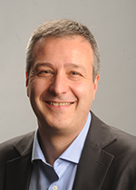
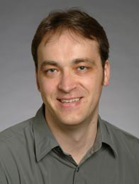
CS 61C Great Ideas in Computer Architecture (a.k.a. Machine Structures) Lecture 1: Course Introduction
Instructors:
Professor Krste Asanovic (call me “Krste”) Professor Vladimir Stojanovic (call me “Vladimir”) (lots of help from TAs, esp Head TA Sagar Karandikar)
http://inst.eecs.berkeley.edu/~cs61c/

Slide 2
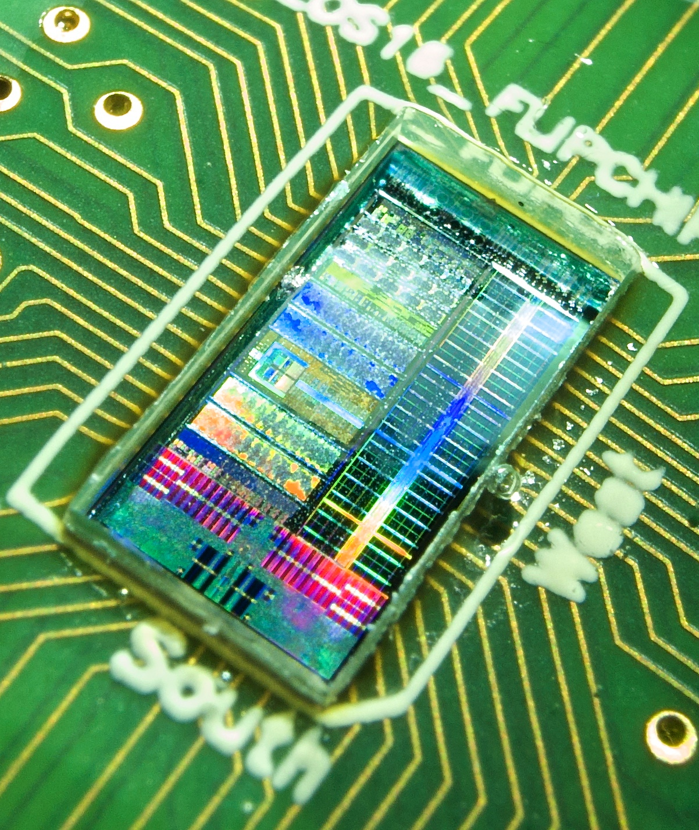
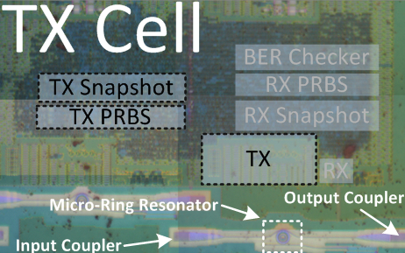
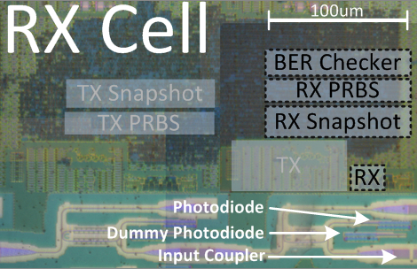
About Us, Our Joint Project: Integrated Silicon Photonics
3mm X 6mm Chip Fabricated in 45nm SOI 75m+ transistors
Dual-Core RISC-V Processor with Vector Accelerators
1MB SRAM Memory Structure for Testing
Monolithically-Integrated Silicon Photonic Links
Notes:
On the transmit cell, a resonant ring modulator is driven by an integrated driver circuit, with optical IO facilitated by two vertical grating couplers.
On the receiver cell, an input coupler being fed into an absorption-type photodetector. The receiver circuit is located nearby to minimize the wiring capacitance.

Slide 3
Agenda
Thinking about Machine Structures
Great Ideas in Computer Architecture
What you need to know about this class
Everything is a Number

Slide 4
Agenda
Thinking about Machine Structures
Great Ideas in Computer Architecture
What you need to know about this class
Everything is a Number

Slide 5
CS61C is NOT really about C Programming
It is about the hardware-software interface
What does the programmer need to know to achieve the highest possible performance
C is closer to the underlying hardware, unlike languages like Scheme, Python, Java!
Allows us to talk about key hardware features in higher level terms
Allows programmer to explicitly harness underlying hardware parallelism for high performance

Slide 6
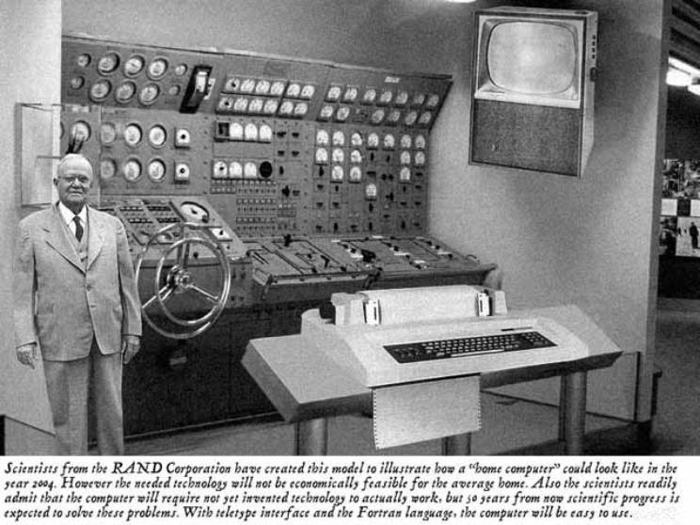
Old School CS61C
Notes:
This image is a fake!
Although the photograph displayed could represent what some people in the early 1950s contemplated a "home computer" might look like (based on the technology of the day), it isn't, as the accompanying text claims, a RAND Corporation illustration from 1954 of a prototype "home computer." The picture is actually an entry submitted to a Fark.com image modification competition, taken from an original photo of a <A HREF="http://home.att.net/~jeff1_satobserve/photo17.htm" TARGET=sub>submarine</A> submarine maneuvering room console found on the U.S. Navy web site, converted to grayscale, and modified to replace a modern display panel and TV screen with pictures of a decades-old teletype/printer and television (as well as to add the gray-suited man to the left-hand side of the photo):

Slide 7
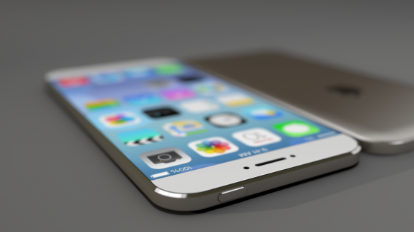
New School CS61C (1/2)
Personal Mobile Devices

Slide 8
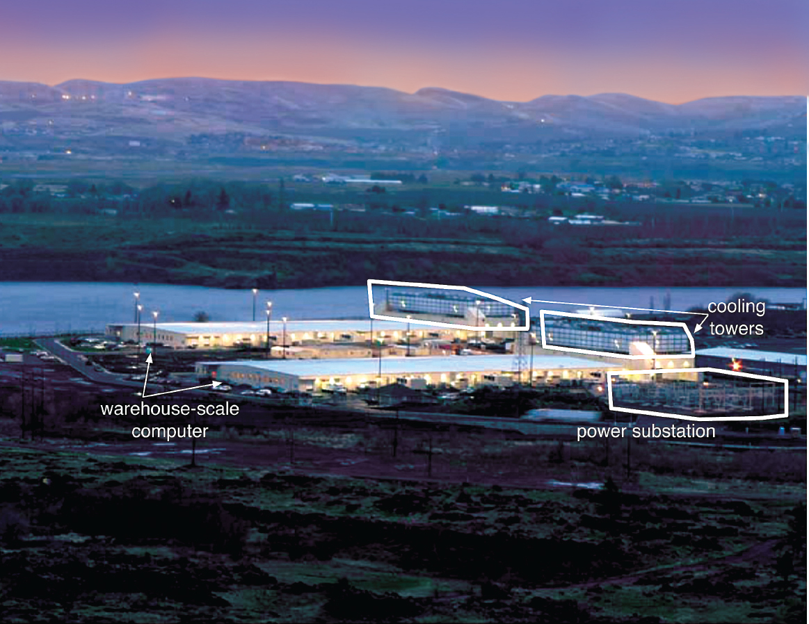
New School CS61C (2/3)

Slide 9
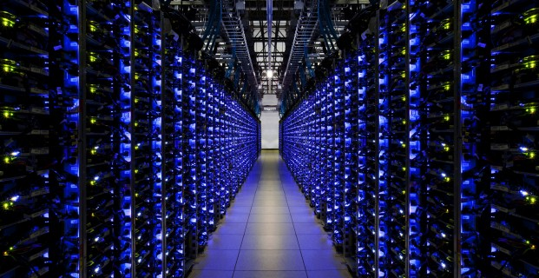
New School CS61C (3/3)

Slide 10
Old School Machine Structures
Application (ex: browser)
CS61C
Operating
Compiler
System
(Mac OSX)
Software
Assembler
Instruction Set
Architecture
Hardware
Processor
Memory
I/O system
Datapath & Control
Digital Design
Circuit Design
transistors

Slide 11
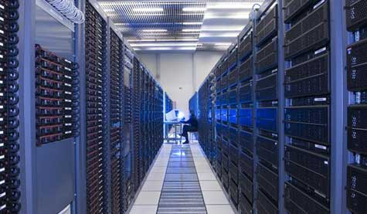
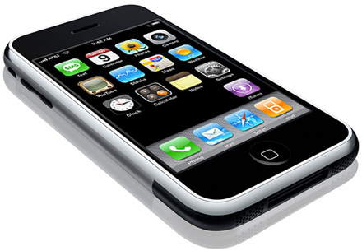
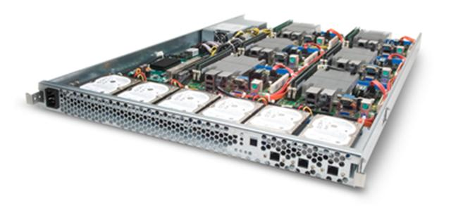
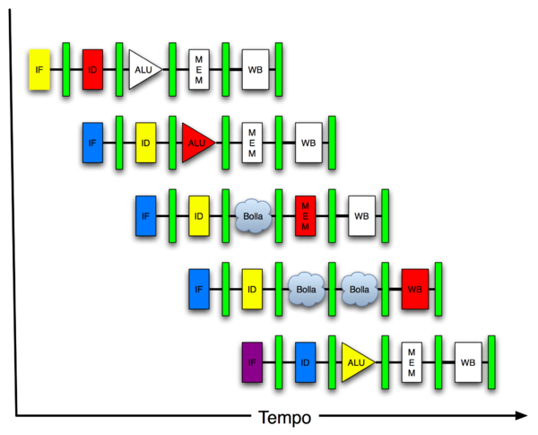
New-School Machine Structures (It’s a bit more complicated!)
Project 4
Software Hardware
Parallel Requests
Assigned to computer
e.g., Search “Katz”
Parallel Threads
Assigned to core
e.g., Lookup, Ads
Parallel Instructions
>1 instruction @ one time
e.g., 5 pipelined instructions
Parallel Data
>1 data item @ one time
e.g., Add of 4 pairs of words
Hardware descriptions
All gates functioning in parallel at same time
Warehouse-Scale Computer
Smart Phone
Harness Parallelism &
Achieve High Performance
Project 1
Computer
Core
…
Core
Memory (Cache)
Project 3
Input/Output
Core
Instruction Unit(s)
Functional
Unit(s)
A₀+B₀
A₁+B₁
A₂+B₂
A₃+B₃
Main Memory
Logic Gates
Project 2

Slide 12
Agenda
Thinking about Machine Structures
Great Ideas in Computer Architecture
What you need to know about this class
Everything is a Number

Slide 13
6 Great Ideas in Computer Architecture
Abstraction (Layers of Representation/Interpretation)
Moore’s Law (Designing through trends)
Principle of Locality (Memory Hierarchy)
Parallelism
Performance Measurement & Improvement
Dependability via Redundancy

Slide 14
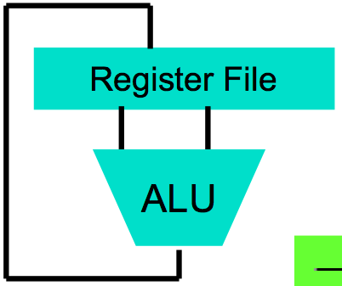
Great Idea #1: Abstraction (Levels of Representation/Interpretation)
High Level Language Program (e.g., C)
temp = v[k];
v[k] = v[k+1];
v[k+1] = temp;
Compiler
Anything can be represented as a number, i.e., data or instructions
lw $t0, 0($2)
lw $t1, 4($2)
sw $t1, 0($2)
sw $t0, 4($2)
Assembly Language Program (e.g., MIPS)
Assembler
0000 1001 1100 0110 1010 1111 0101 1000
1010 1111 0101 1000 0000 1001 1100 0110
1100 0110 1010 1111 0101 1000 0000 1001
0101 1000 0000 1001 1100 0110 1010 1111
Machine Language Program (MIPS)
Machine Interpretation
Hardware Architecture Description (e.g., block diagrams)
Architecture Implementation
Logic Circuit Description (Circuit Schematic Diagrams)

Slide 15
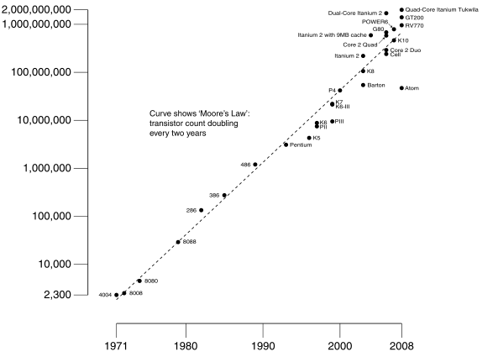
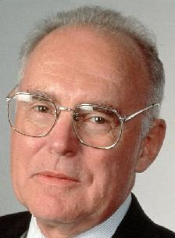
#2: Moore’s Law
Predicts:
2X Transistors / chip every 2 years
# of transistors on an integrated circuit (IC)
Gordon Moore Intel Cofounder B.S. Cal 1950!
Year

Slide 16
Interesting Times
Moore’s Law was based on how many transistors/chip at cheapest cost/transistor as technology scaled.
BUT newest, smallest fabrication processes <14nm, might have greater cost/transistor !!!!
So, why shrink????
Moore’s Law
1965-2020?

Slide 17
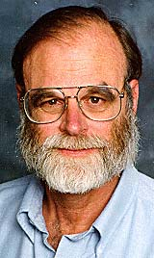
Jim Gray’s Storage Latency Analogy: How Far Away is the Data?
Andromeda
9
10
Tape /Optical
2,000 Years
Robot
Jim Gray Turing Award
B.S. Cal 1966
Ph.D. Cal 1969!
10
6
Disk
Pluto
2 Years
Sacramento
1.5 hr
100
Memory
10
On Board Cache
This Campus
10 min
2
On Chip Cache
This Room
1
Registers
My Head
1 min
(ns)

Slide 18
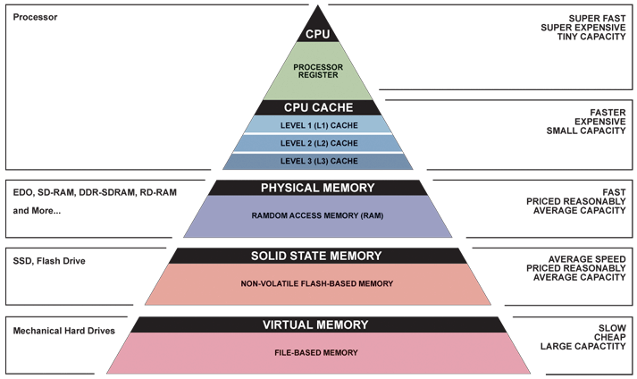
Great Idea #3: Principle of Locality/ Memory Hierarchy

Slide 19
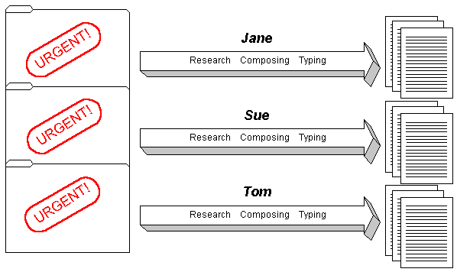
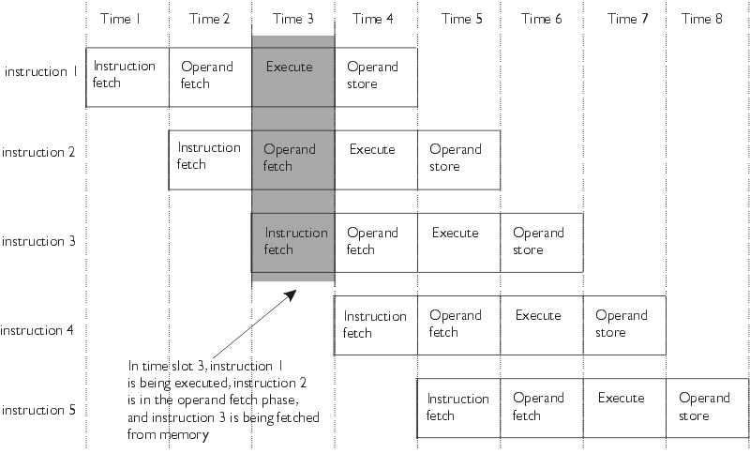
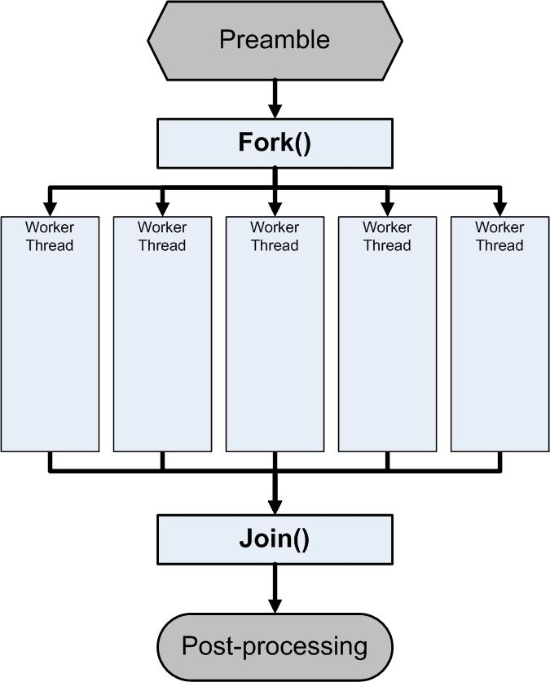
Great Idea #4: Parallelism

Slide 20
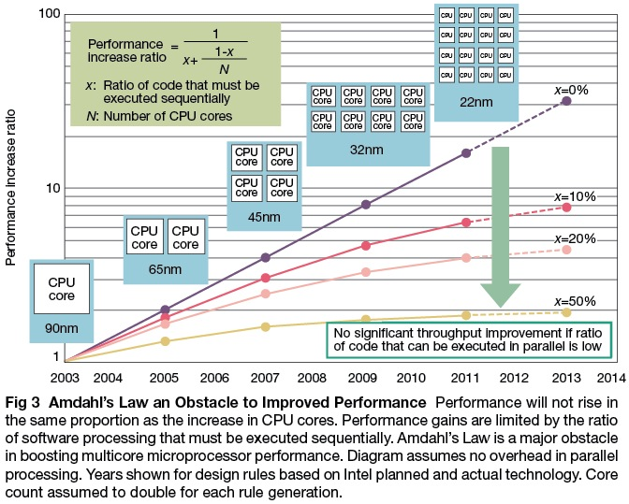
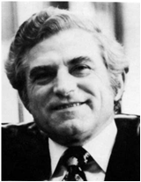
Caveat: Amdahl’s Law
Gene Amdahl
Computer Pioneer

Slide 21
Great Idea #5: Performance Measurement and Improvement
Tuning application to underlying hardware to exploit:
Locality
Parallelism
Special hardware features, like specialized instructions (e.g., matrix manipulation)
Latency
How long to set the problem up
How much faster does it execute once it gets going
It is all about time to finish

Slide 22
Coping with Failures
4 disks/server, 50,000 servers
Failure rate of disks: 2% to 10% / year
Assume 4% annual failure rate
On average, how often does a disk fail?
1 / month
1 / week
1 / day
1 / hour

Slide 23
Coping with Failures
4 disks/server, 50,000 servers
Failure rate of disks: 2% to 10% / year
Assume 4% annual failure rate
On average, how often does a disk fail?
1 / month
1 / week
1 / day
1 / hour
50,000 x 4 = 200,000 disks
200,000 x 4% = 8000 disks fail
365 days x 24 hours = 8760 hours

Slide 24
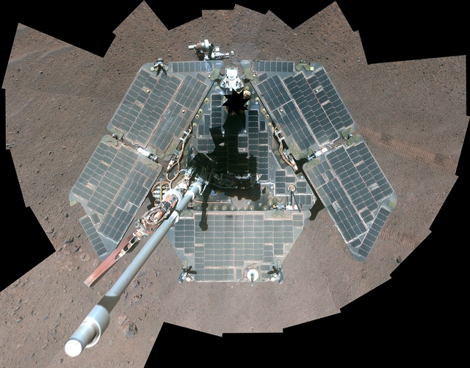
NASA Fixing Rover’s Flash Memory
Opportunity still active on Mars after >10 years
But flash memory worn out
New software update will avoid using worn out memory banks
http://www.engadget.com/2014/12/30/nasa-opportunity-rover-flash-fix/

Slide 25
Great Idea #6: Dependability via Redundancy
Redundancy so that a failing piece doesn’t make the whole system fail
1+1=2
2 of 3 agree
1+1=2
1+1=2
1+1=1
FAIL!
Increasing transistor density reduces the cost of redundancy

Slide 26
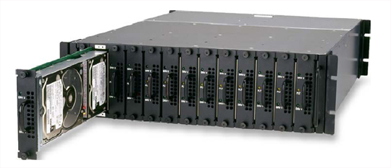
Great Idea #6: Dependability via Redundancy
Applies to everything from datacenters to storage to memory to instructors
Redundant datacenters so that can lose 1 datacenter but Internet service stays online
Redundant disks so that can lose 1 disk but not lose data (Redundant Arrays of Independent Disks/RAID)
Redundant memory bits of so that can lose 1 bit but no data (Error Correcting Code/ECC Memory)

Slide 27
Agenda
Thinking about Machine Structures
Great Ideas in Computer Architecture
What you need to know about this class
Everything is a Number

Slide 28
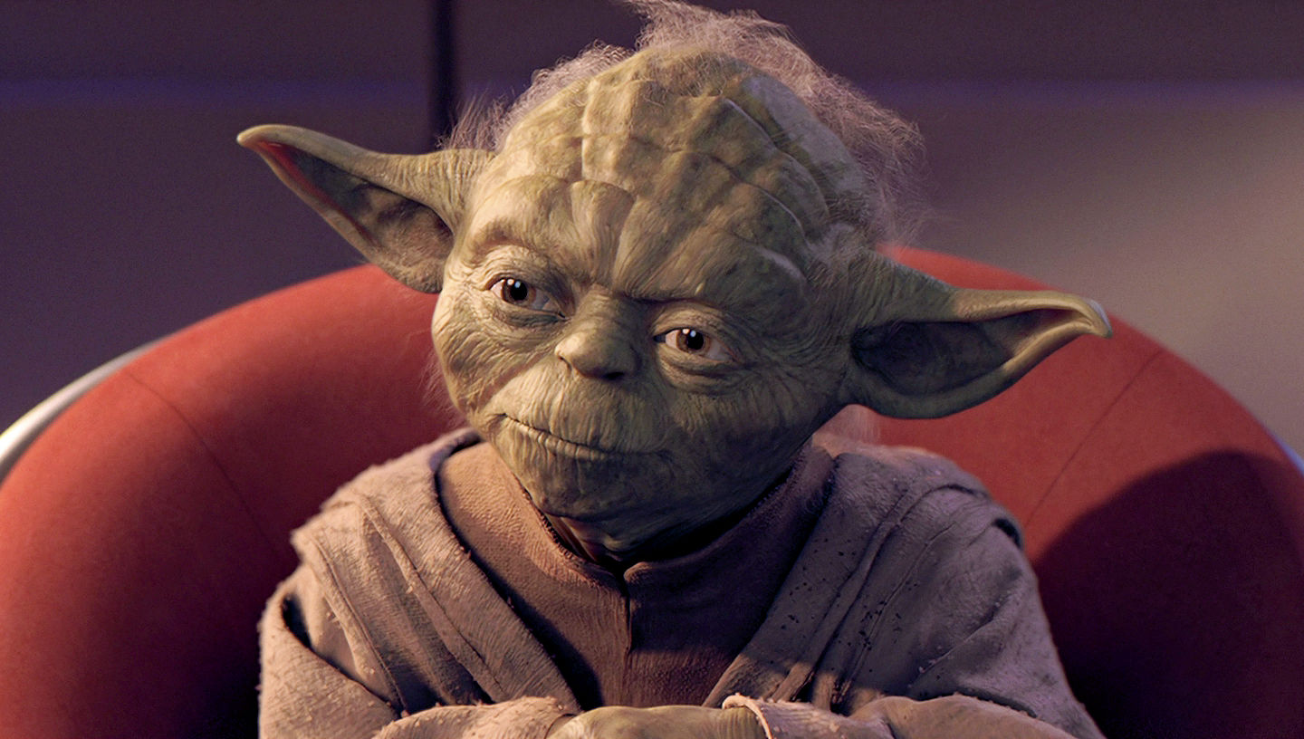
Yoda says…
“Always in motion, the future is…”
Our schedule may change slightly depending on some factors. This includes lectures, assignments & labs…

Slide 29
Weekly Schedule
Tuesday lecture starts new weekly cycle

Slide 30
Course Information
Course Web: http://inst.eecs.Berkeley.edu/~cs61c/
Instructors:
Krste Asanovic & Vladimir Stojanovic
Teaching Assistants: (see webpage)
Textbooks: Average 15 pages of reading/week (can rent!)
Patterson & Hennessey, Computer Organization and Design, 5/e (we’ll try to provide 4th Ed pages, not Asian version 4th edition)
Kernighan & Ritchie, The C Programming Language, 2nd Edition
Barroso & Holzle, The Datacenter as a Computer, 2nd Edition
Piazza:
Every announcement, discussion, clarification happens there

Slide 31
Course Grading
EPA: Effort, Participation and Altruism (5%)
Homework (10%)
Labs (5%)
Projects (20%)
Non-Parallel Application (MIPS & C)
Computer Processor Design (Logisim)
Parallelize for Performance, SIMD, MIMD
Massive Data Parallelism (Spark on Amazon EC2)
Two midterms (15% each): 6th & 12th week in class, can be clobbered!
Final (30%): 2015/5/15 @ 7-10pm
Performance Competition for honor (and EPA)

Slide 32
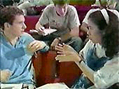
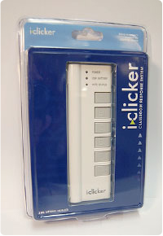
Tried-and-True Technique: Peer Instruction
Increase real-time learning in lecture, test understanding of concepts vs. details
As complete a “segment” ask multiple-choice question
1-2 minutes to decide yourself
2 minutes in pairs/triples to reach consensus.
Teach others!
2 minute discussion of answers, questions, clarifications
You can get transmitters from the ASUC bookstore
We’ll start this next week
No web-based clickers, sorry!

Slide 33
EECS Grading Policy
http://www.eecs.berkeley.edu/Policies/ugrad.grading.shtml
“A typical GPA for courses in the lower division is 2.7. This GPA would result, for example, from 17% A's, 50% B's, 20% C's, 10% D's, and 3% F's. A class whose GPA falls outside the range 2.5 - 2.9 should be considered atypical.”
Fall 2010: GPA 2.81 26% A's, 47% B's, 17% C's, 3% D's, 6% F's
Job/Intern Interviews: They grill you with technical questions, so it’s what you say, not your GPA
(New 61C gives good stuff to say)
 | Fall | Spring
2010 | 2.81 | 2.81
2009 | 2.71 | 2.81
2008 | 2.95 | 2.74
2007 | 2.67 | 2.76

Slide 34
Our goal as instructors
To make your experience in CS61C as enjoyable & informative as possible
Humor, enthusiasm & technology-in-the-news in lecture
Fun, challenging projects & HW
Pro-student policies (exam clobbering)
To maintain Cal & EECS standards of excellence
Projects & exams will be as rigorous as every year.
Score 7.0 on HKN:
Please give feedback so we can improve! Why are we not 7.0 for you? We will listen!!

Slide 35
EPA!
Effort
Attending prof and TA office hours, completing all assignments, turning in HW0, doing reading quizzes
Participation
Attending lecture and voting using the clickers
Asking great questions in discussion and lecture and making it more interactive
Altruism
Helping others in lab or on Piazza
EPA! points have the potential to bump students up to the next grade level! (but actual EPA! scores are internal)

Slide 36
Late Policy … Slip Days!
Assignments due at 11:59:59 PM
You have 3 slip day tokens (NOT hour or min)
Every day your project or homework is late (even by a minute) we deduct a token
After you’ve used up all tokens, it’s 33% deducted per day.
No credit if more than 3 days late
Save your tokens for projects, worth more!!
No need for sob stories, just use a slip day!

Slide 37
Policy on Assignments and Independent Work
ALL PROJECTS WILL BE DONE WITH A PARTNER
With the exception of laboratories and assignments that explicitly permit you to work in groups, all homework and projects are to be YOUR work and your work ALONE.
PARTNER TEAMS MAY NOT WORK WITH OTHER PARTNER TEAMS
You are encouraged to discuss your assignments with other students, and extra credit will be assigned to students who help others, particularly by answering questions on Piazza, but we expect that what you hand in is yours.
It is NOT acceptable to copy solutions from other students.
It is NOT acceptable to copy (or start your) solutions from the Web.
It is NOT acceptable to use PUBLIC github archives (giving your answers away)
We have tools and methods, developed over many years, for detecting this. You WILL be caught, and the penalties WILL be severe.
At the minimum F in the course, and a letter to your university record documenting the incidence of cheating.
(We’ve caught people in recent semesters!)
Both Giver and Receiver are equally culpable and suffer equal penalties

Slide 38
Architecture of a typical Lecture
Full
Clickers
Fun/News
“And in conclusion…”
Clickers Administrivia
Attention
10
35
60
78
90
Time (minutes)

Slide 39
Agenda
Thinking about Machine Structures
Great Ideas in Computer Architecture
What you need to know about this class
Everything is a Number

Slide 40
Key Concepts
Inside computers, everything is a number
But numbers usually stored with a fixed size
8-bit bytes, 16-bit half words, 32-bit words, 64-bit double words, …
Integer and floating-point operations can lead to results too big to store within their representations: overflow/underflow

Slide 41
Number Representation
Value of i-th digit is d × Base^{i} where i starts at 0 and increases from right to left:
123₁₀ = 1₁₀ x 10₁₀² + 2₁₀ x 10₁₀¹ + 3₁₀ x 10₁₀⁰
= 1x100₁₀ + 2x10₁₀ + 3x1₁₀ = 100₁₀ + 20₁₀ + 3₁₀
= 123₁₀
Binary (Base 2), Hexadecimal (Base 16), Decimal (Base 10) different ways to represent an integer
We use 1_{two}, 5_{ten}, 10_{hex} to be clearer (vs. 1₂, 4₈, 5₁₀, 10₁₆ )

Slide 42
Number Representation
Hexadecimal digits: 0,1,2,3,4,5,6,7,8,9,A,B,C,D,E,F
FFF_{hex} = 15_{ten}x 16_{ten}² + 15_{ten}x 16_{ten}¹ + 15_{ten}x 16_{ten}⁰ = 3840_{ten} + 240_{ten} + 15_{ten} = 4095_{ten}
1111 1111 1111_{two} = FFF_{hex} = 4095_{ten}
May put blanks every group of binary, octal, or hexadecimal digits to make it easier to parse, like commas in decimal

Slide 43
Signed and Unsigned Integers
C, C++, and Java have signed integers, e.g., 7, -255:
int x, y, z;
C, C++ also have unsigned integers, which are used for addresses
32-bit word can represent 2³² binary numbers
Unsigned integers in 32 bit word represent 0 to 2³²-1 (4,294,967,295)

Slide 44
Unsigned Integers
0000 0000 0000 0000 0000 0000 0000 0000_{two} = 0_{ten}
0000 0000 0000 0000 0000 0000 0000 0001_{two} = 1_{ten}
0000 0000 0000 0000 0000 0000 0000 0010_{two} = 2_{ten}
... ...
0111 1111 1111 1111 1111 1111 1111 1101_{two} = 2,147,483,645_{ten}
0111 1111 1111 1111 1111 1111 1111 1110_{two} = 2,147,483,646_{ten}
0111 1111 1111 1111 1111 1111 1111 1111_{two} = 2,147,483,647_{ten}
1000 0000 0000 0000 0000 0000 0000 0000_{two} = 2,147,483,648_{ten}
1000 0000 0000 0000 0000 0000 0000 0001_{two} = 2,147,483,649_{ten}
1000 0000 0000 0000 0000 0000 0000 0010_{two} = 2,147,483,650_{ten}
... ...
1111 1111 1111 1111 1111 1111 1111 1101_{two} = 4,294,967,293_{ten}
1111 1111 1111 1111 1111 1111 1111 1110_{two} = 4,294,967,294_{ten}
1111 1111 1111 1111 1111 1111 1111 1111_{two} = 4,294,967,295_{ten}

Slide 45
Signed Integers and Two’s-Complement Representation
Signed integers in C; want ½ numbers <0, want ½ numbers >0, and want one 0
Two’s complement treats 0 as positive, so 32-bit word represents 2³² integers from -2³¹ (–2,147,483,648) to 2³¹-1 (2,147,483,647)
Note: one negative number with no positive version
Book lists some other options, all of which are worse
Every computer uses two’s complement today
Most-significant bit (leftmost) is the sign bit, since 0 means positive (including 0), 1 means negative
Bit 31 is most significant, bit 0 is least significant

Slide 46
Two’s-Complement Integers
Sign Bit
0000 0000 0000 0000 0000 0000 0000 0000_{two} = 0_{ten}
0000 0000 0000 0000 0000 0000 0000 0001_{two} = 1_{ten}
0000 0000 0000 0000 0000 0000 0000 0010_{two} = 2_{ten}
... ...
0111 1111 1111 1111 1111 1111 1111 1101_{two} = 2,147,483,645_{ten}
0111 1111 1111 1111 1111 1111 1111 1110_{two} = 2,147,483,646_{ten}
0111 1111 1111 1111 1111 1111 1111 1111_{two} = 2,147,483,647_{ten}
1000 0000 0000 0000 0000 0000 0000 0000_{two} = –2,147,483,648_{ten}
1000 0000 0000 0000 0000 0000 0000 0001_{two} = –2,147,483,647_{ten}
1000 0000 0000 0000 0000 0000 0000 0010_{two} = –2,147,483,646_{ten}
... ...
1111 1111 1111 1111 1111 1111 1111 1101_{two} = –3_{ten}
1111 1111 1111 1111 1111 1111 1111 1110_{two} = –2_{ten}
1111 1111 1111 1111 1111 1111 1111 1111_{two} = –1_{ten}

Slide 47
Ways to Make Two’s Complement
For N-bit word, complement to 2_{ten}^{N}
For 4 bit number 3_{ten}=0011_{two}, two’s complement (i.e. -3_{ten}) would be 16_{ten}-3_{ten}=13_{ten} or 10000_{two} – 0011_{two} = 1101_{two}
Here is an easier way:
Invert all bits and add 1
Computers actually do it like this, too
3_{ten}
0011_{two}
1100_{two}
+ 1_{two}
Bitwise complement
-3_{ten}
1101_{two}

Slide 48
Two’s-Complement Examples
Assume for simplicity 4 bit width, -8 to +7 represented
3
+2
0011
0010
3
+ (-2)
0011
1110
-3
+ (-2)
1101
1110
5
0101
1
1 0001
-5
1 1011
7
+1
0111
0001
-8
+ (-1)
1000
1111
Carry into MSB =
Carry Out MSB
-8
1000
+7
1 0111
Overflow!
Overflow!
Carry into MSB =
Carry Out MSB

Slide 49
Suppose we had a 5-bit word. What integers can be represented in two’s complement?
☐
-32 to +31
☐
0 to +31
☐
-16 to +15
☐
-15 to +16
Notes:
VertLeftWhiteCheck1
B: Print 4 …because ints in this system are 4-bytes long and the actual address increments by 4 even though it appears to only incrememt 1.

Slide 50
Summary
CS61C: Learn 6 great ideas in computer architecture to enable high performance programming via parallelism, not just learn C
Abstraction (Layers of Representation/Interpretation)
Moore’s Law
Principle of Locality/Memory Hierarchy
Parallelism
Performance Measurement and Improvement
Dependability via Redundancy
Everything is a Number!

