Slide 1
CS 61C: Great Ideas in Computer Architecture Virtual Memory
Instructors:
Krste Asanovic & Vladimir Stojanovic
http://inst.eecs.berkeley.edu/~cs61c/

Slide 2
Review
Programmed I/O
Polling versus Interrupts
Asynchronous interrupts versus synchronous traps
Precise interrupt looks like execution stopped at exactly one instruction, every instruction before finished, no instruction after started.
Simplify software view of interrupted state

Slide 3
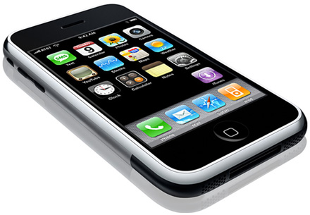
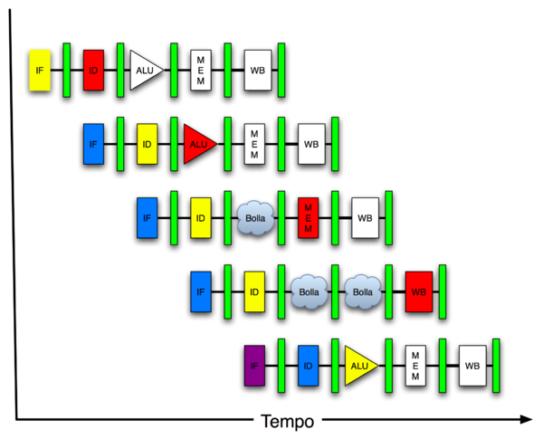
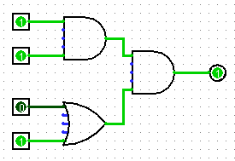
You Are Here!
Software Hardware
Parallel Requests
Assigned to computer
e.g., Search “Katz”
Parallel Threads
Assigned to core
e.g., Lookup, Ads
Parallel Instructions
>1 instruction @ one time
e.g., 5 pipelined instructions
Parallel Data
>1 data item @ one time
e.g., Add of 4 pairs of words
Hardware descriptions
All gates @ one time
Programming Languages
Warehouse Scale Computer
Smart Phone
Harness Parallelism &
Achieve High Performance
Today’s
Lecture
Computer
Core
…
Core
Memory (Cache)
Input/Output
Core
Instruction Unit(s)
Functional
Unit(s)
A₀+B₀
A₁+B₁
A₂+B₂
A₃+B₃
Main Memory
Logic Gates

Slide 4
Traps/Interrupts/Execeptions: altering the normal flow of control
I_{i-1}
HI₁
trap
handler
program
I_{i}
HI₂
I_{i+1}
HI_{n}
An external or internal event that needs to be processed by another (system) program. The event is usually unexpected or rare from program’s point of view.

Slide 5
Terminology
In CS61C (you’ll see other definitions in use elsewhere):
Interrupt – caused by an event external to current running program (e.g. key press, mouse activity)
Asynchronous to current program, can handle interrupt on any convenient instruction
Exception – caused by some event during execution of one instruction of current running program (e.g., page fault, illegal instruction)
Synchronous, must handle exception on instruction that causes exception
Trap – action of servicing interrupt or exception by hardware jump to “trap handler” code

Slide 6
Precise Traps
Trap handler’s view of machine state is that every instruction prior to the trapped one has completed, and no instruction after the trap has executed.
Implies that handler can return from an interrupt by restoring user registers and jumping to EPC
Interrupt handler software doesn’t need to understand the pipeline of the machine, or what program was doing!
More complex to handle trap caused by an exception
Providing precise traps is tricky in a pipelined superscalar out-of-order processor!
But handling imprecise interrupts in software is even worse.

Slide 7
Trap Handling in 5-Stage Pipeline
PC
Inst. Mem
D
Decode
E
M
Data Mem
W
+
PC address Exception
Illegal Opcode
Data address Exceptions
Overflow
Asynchronous Interrupts
How to handle multiple simultaneous exceptions in different pipeline stages?
How and where to handle external asynchronous interrupts?

Slide 8
Save Exceptions Until Commit
Commit Point
PC
Inst. Mem
D
Decode
E
M
Data Mem
W
+
Illegal Opcode
Overflow
Data address Exceptions
PC address Exception
Exc
D
Exc
E
Exc
M
Cause
PC
D
PC
E
PC
M
EPC
Select Handler PC
Asynchronous
Interrupts
Kill F Stage
Kill D Stage
Kill E Stage
Kill Writeback

Slide 9
Handling Traps in In-Order Pipeline
Hold exception flags in pipeline until commit point (M stage)
Exceptions in earlier pipe stages override later exceptions for a given instruction
Inject external interrupts at commit point (override others)
If exception/interrupt at commit: update Cause and EPC registers, kill all stages, inject handler PC into fetch stage

Slide 10
Trap Pipeline Diagram
time
t0 t1 t2 t3 t4 t5 t6 t7 . . . .
(I₁) 096: ADD IF₁ ID₁ EX₁ MA₁ - overflow!
(I₂) 100: XOR IF₂ ID₂ EX₂ - -
(I₃) 104: SUB IF₃ ID₃ - - -
(I₄) 108: ADD IF₄ - - - -
(I₅) Trap Handler code IF₅ ID₅ EX₅ MA₅ WB₅

Slide 11
Virtual Memory

Slide 12
“Bare” 5-Stage Pipeline
PC
Physical Address
D
E
M
Physical Address
W
Inst. Cache
Decode
Data Cache
+
Memory Controller
Physical Address
Physical Address
Physical Address
Main Memory (DRAM)
In a bare machine, the only kind of address is a physical address

Slide 13
Dynamic Address Translation
Motivation
In early machines, I/O operations were slow and each word transferred involved the CPU
Higher throughput if CPU and I/O of 2 or more programs were overlapped.
How?⇒ multiprogramming with DMA I/O devices, interrupts
Location-independent programs
Programming and storage management ease
⇒ need for a base register
Protection
Independent programs should not affect
each other inadvertently
⇒ need for a bound register
Multiprogramming drives requirement for resident supervisor (operating system) software to manage context switches between multiple programs
prog1
Physical Memory
prog2
OS

Slide 14
Simple Base and Bound Translation
Segment Length
Bound
Register
≤
Bounds
Violation?
Physical
Address
current
segment
Logical
Address
Physical Memory
Load X
+
Base
Register
Base Physical Address
Program
Address
Space
Base and bounds registers are visible/accessible only when processor is running in supervisor mode

Slide 15
Separate Areas for Program and Data
(Scheme used on all Cray vector supercomputers prior to X1, 2002)
Data Bound Register
≤
Bounds
Violation?
Logical Address
data
segment
Mem. Address Register
Load X
Data Base Register
+
Physical Address
Main Memory
Program
Address
Space
Program Bound Register
≤
Bounds
Violation?
Logical Address
program
segment
Program Counter
Program Base Register
+
Physical Address
What is an advantage of this separation?
Notes:
Permits sharing of program segments.

Slide 16
Base and Bound Machine
Prog. Bound Register
Data Bound Register
Bounds Violation?
Bounds Violation?
≤
≤
Logical Address
Logical Address
PC
D
Decode
E
M
W
Inst. Cache
Data Cache
+
+
+
Physical Address
Physical Address
Program Base Register
Data Base Register
Physical Address
Physical Address
Memory Controller
Physical Address
Main Memory (DRAM)
[ Can fold addition of base register into (register+immediate) address calculation using a carry-save adder (sums three numbers with only a few gate delays more than adding two numbers) ]

Slide 17
Memory Fragmentation
free
Users 4 & 5
arrive
Users 2 & 5
leave
OS
Space
OS
Space
OS
Space
user 1
16K
user 1
16K
user 1
16K
user 2
24K
user 2
24K
24K
user 4
16K
24K
user 4
16K
8K
8K
user 3
32K
user 3
32K
user 3
32K
24K
user 5
24K
24K
As users come and go, the storage is “fragmented”.
Therefore, at some stage programs have to be moved
around to compact the storage.
Notes:
Called Burping the memory.

Slide 18
Paged Memory Systems
Processor-generated address can be split into:
page number offset
A page table contains the physical address of the base of each page:
1
0
0
0
1
1
Physical Memory
2
2
3
3
3
Address Space
of User-1
Page Table
of User-1
2
Page tables make it possible to store the pages of a program non-contiguously.
Notes:
Relaxes the contiguous allocation requirement.

Slide 19
Private Address Space per User
User 1
OS
pages
VA1
Page Table
User 2
VA1
Page Table
Physical Memory
User 3
VA1
Page Table
free
Each user has a page table
Page table contains an entry for each user page
Notes:
OS ensures that the page tables are disjoint.

Slide 20
Where Should Page Tables Reside?
Space required by the page tables (PT) is proportional to the address space, number of users, ...
⇒ Too large to keep in registers inside CPU
Idea: Keep PTs in the main memory
needs one reference to retrieve the page base address and another to access the data word
⇒ doubles the number of memory references!

Slide 21
Page Tables in Physical Memory
PT User 1
VA1
PT User 2
User 1 Virtual Address Space
Physical Memory
VA1
User 2 Virtual Address Space

Slide 22
Administrivia
Midterm 2 scores up:
Regrade request deadline is 23:59:59 on Sunday April 26th
Clobber Policy:
Final composed of MT1, MT2, post-MT2 sections
z-scores on MT1/MT2 sections of Final compared to MT1/MT2 grades, will replace if better
Proj4-1 due date extended to Wed, April 29

Slide 23
Midterm 2 Distribution

Slide 24
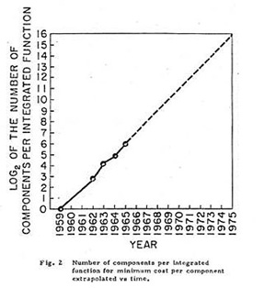
CS61C In the News: “Moore’s Law 50 Years Anniversary!”
Gordon Moore’s paper appeared in 19 April 1965 issue of Electronics.
“With unit cost falling as the number of components per circuit rises, by 1975 economics may dictate squeezing as many as 65,000 components on a single silicon chip.”

Slide 25
Demand Paging in Atlas (1962)
“A page from secondary
storage is brought into the primary storage whenever it is (implicitly) demanded by the processor.”
Tom Kilburn
Primary
32 Pages
512 words/page
Primary memory as a cache
for secondary memory
Secondary
(Drum)
32x6 pages
Central
Memory
User sees 32 x 6 x 512 words
of storage
Notes:
Single-level Store

Slide 26
Hardware Organization of Atlas
Effective
Address
16 ROM pages
0.4 ~1 μsec
system code
(not swapped)
system data
(not swapped)
Initial
Address
Decode
2 subsidiary pages
1.4 μsec
PARs
48-bit words
512-word pages
1 Page Address Register (PAR) per page frame
0
Main
32 pages
1.4 μsec
Drum (4)
192 pages
8 Tape decks
88 sec/word
31
<effective PN , status>
Compare the effective page address against all 32 PARs
match ⇒ normal access
no match ⇒ page fault
save the state of the partially executed
instruction

Slide 27
Atlas Demand Paging Scheme
On a page fault:
Input transfer into a free page is initiated
The Page Address Register (PAR) is updated
If no free page is left, a page is selected to be replaced (based on usage)
The replaced page is written on the drum
to minimize drum latency effect, the first empty page on the drum was selected
The page table is updated to point to the new location of the page on the drum

Slide 28
Linear Page Table
Page Table Entry (PTE) contains:
A bit to indicate if a page exists
PPN (physical page number) for a memory-resident page
DPN (disk page number) for a page on the disk
Status bits for protection and usage
OS sets the Page Table Base Register whenever active user process changes
Data Pages
Page Table
PPN
PPN
DPN
PPN
Data word
Offset
DPN
PPN
PPN
DPN
DPN
VPN
DPN
PPN
PPN
PT Base Register
VPN
Offset
Virtual address

Slide 29
Size of Linear Page Table
With 32-bit addresses, 4-KB pages & 4-byte PTEs:
2²⁰ PTEs, i.e, 4 MB page table per user
4 GB of swap needed to back up full virtual address space
Larger pages?
Internal fragmentation (Not all memory in page is used)
Larger page fault penalty (more time to read from disk)
What about 64-bit virtual address space???
Even 1MB pages would require 2⁴⁴ 8-byte PTEs (35 TB!)
What is the “saving grace” ?
Notes:
Virtual address space is large but only a small fraction of the
pages are populated. So we can use a sparse representation
of the table.

Slide 30
Hierarchical Page Table
Virtual Address
31
22
21
12
11
0
p1 p2 offset
10-bit
L1 index
10-bit
L2 index
offset
Root of the Current
Page Table
p2
p1
Physical Memory
(Processor
Register)
Level 1
Page Table
Level 2
Page Tables
page in primary memory
page in secondary memory
PTE of a nonexistent page
Data Pages

Slide 31
Two-Level Page Tables in Physical Memory
Physical Memory
Virtual Address Spaces
Level 1 PT User 1
VA1
Level 1 PT User 2
User 1
User2/VA1
VA1
User1/VA1
User 2
Level 2 PT User 2

Slide 32
Address Translation & Protection
Virtual Address
Virtual Page No. (VPN)
offset
Kernel/User Mode
Read/Write
Protection
Check
Address
Translation
Exception?
Physical Address
Physical Page No. (PPN)
offset
Every instruction and data access needs address
translation and protection checks
A good VM design needs to be fast (~ one cycle) and space efficient

Slide 33
Translation Lookaside Buffers (TLB)
Address translation is very expensive!
In a two-level page table, each reference becomes several memory accesses
Solution: Cache translations in TLB
TLB hit ⇒ Single-Cycle Translation
TLB miss ⇒ Page-Table Walk to refill
virtual address
VPN offset
V R W D tag PPN
(VPN = virtual page number)
(PPN = physical page number)
hit?
physical address
PPN offset
Notes:
3 memory references
2 page faults (disk accesses) + ..
Actually used in IBM before paged memory.

Slide 34
TLB Designs
Typically 32-128 entries, usually fully associative
Each entry maps a large page, hence less spatial locality across pages ➔ more likely that two entries conflict
Sometimes larger TLBs (256-512 entries) are 4-8 way set-associative
Larger systems sometimes have multi-level (L1 and L2) TLBs
Random or FIFO replacement policy
No process information in TLB?
TLB Reach: Size of largest virtual address space that can be simultaneously mapped by TLB
Example: 64 TLB entries, 4KB pages, one page per entry
TLB Reach = _____________________________________________?

Slide 35
VM-related events in pipeline
PC
Inst TLB
Inst. Cache
D
Decode
E
M
Data TLB
Data Cache
W
+
TLB miss? Page Fault?
Protection violation?
TLB miss? Page Fault?
Protection violation?
Handling a TLB miss needs a hardware or software mechanism to refill TLB
usually done in hardware now
Handling a page fault (e.g., page is on disk) needs a precise trap so software handler can easily resume after retrieving page
Handling protection violation may abort process

Slide 36
Hierarchical Page Table Walk: SPARC v8
Virtual Address
Index 1 Index 2 Index 3 Offset
31 23 17 11 0
Context
Table
Register
Context Table
L1 Table
root ptr
Context
Register
L2 Table
PTP
L3 Table
PTP
PTE
31 11 0
Physical Address
PPN Offset
MMU does this table walk in hardware on a TLB miss

Slide 37
Page-Based Virtual-Memory Machine (Hardware Page-Table Walk)
Page Fault?
Protection violation?
Page Fault?
Protection violation?
Virtual Address
Virtual Address
Physical Address
Physical Address
PC
Inst. TLB
D
Decode
E
M
Data TLB
W
Inst. Cache
Data Cache
+
Miss?
Miss?
Page-Table Base Register
Hardware Page Table Walker
Physical Address
Memory Controller
Physical Address
Physical Address
Main Memory (DRAM)
Assumes page tables held in untranslated physical memory

Slide 38
Address Translation: putting it all together
Virtual Address
hardware
hardware or software
software
TLB
Lookup
miss
hit
Page Table
Walk
Protection
Check
the page is
∉ memory ∈ memory
denied
permitted
Page Fault
(OS loads page)
Update TLB
Protection
Fault
Physical
Address
(to cache)
Where?
SEGFAULT
Notes:
Need to restart instruction.
Soft and hard page faults.

Slide 39
Modern Virtual Memory Systems Illusion of a large, private, uniform store
Protection & Privacy
several users, each with their private address space and one or more shared address spaces
page table ≡ name space
Demand Paging
Provides the ability to run programs larger than the primary memory
Hides differences in machine configurations
The price is address translation on
each memory reference
OS
user_{i}
Swapping
Store
Primary
Memory
VA
mapping
PA
TLB
Notes:
Portability on machines with different memory configurations.

Slide 40
VM features track historical uses:
Bare machine, only physical addresses
One program owned entire machine
Batch-style multiprogramming
Several programs sharing CPU while waiting for I/O
Base & bound: translation and protection between programs (not virtual memory)
Problem with external fragmentation (holes in memory), needed occasional memory defragmentation as new jobs arrived
Time sharing
More interactive programs, waiting for user. Also, more jobs/second.
Motivated move to fixed-size page translation and protection, no external fragmentation (but now internal fragmentation, wasted bytes in page)
Motivated adoption of virtual memory to allow more jobs to share limited physical memory resources while holding working set in memory
Virtual Machine Monitors
Run multiple operating systems on one machine
Idea from 1970s IBM mainframes, now common on laptops
e.g., run Windows on top of Mac OS X
Hardware support for two levels of translation/protection
Guest OS virtual -> Guest OS physical -> Host machine physical
Also basis of Cloud Computing
Virtual machine instances for Project 4

