Slide 1
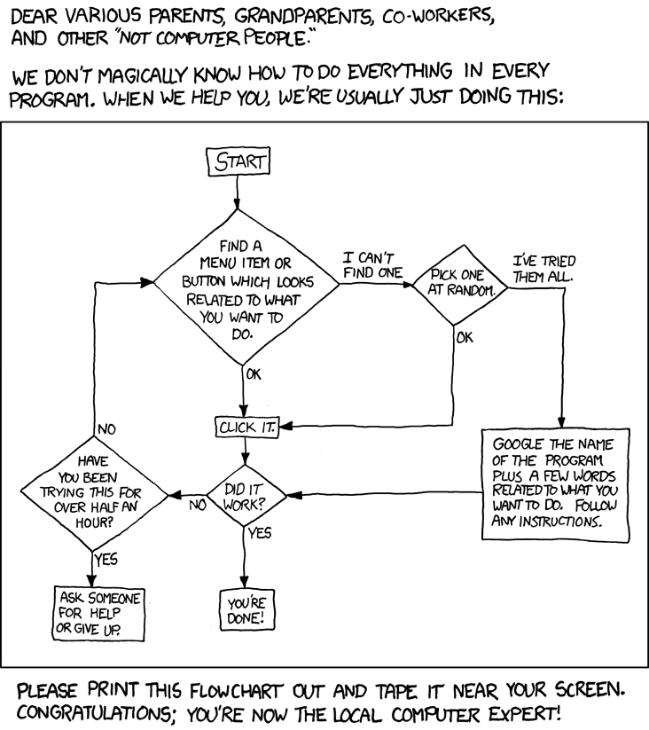
inst.eecs.berkeley.edu/~cs61c UCB CS61C : Machine Structures Lecture 8 – Decisions & and Introduction to MIPS Procedures
Instructor Paul Pearce
2010-07-01
http://www.xkcd.org/627/

Slide 2
“And in Review…”
Memory is byte-addressable, but lw and sw access one word at a time.
A pointer (used by lw and sw) is just a memory address, we can add to it or subtract from it (using offset).
A Decision allows us to decide what to execute at run-time rather than compile-time.
C Decisions are made using conditional statements within if, while, do while, for.
MIPS Decision making instructions are the conditional branches: beq and bne.
One can store and load (signed and unsigned) bytes as well as words with lb, lbu
Unsigned add/sub don’t signal overflow
Loops using beq and bne.
New Instructions:
lw, sw, beq, bne, j, lb, sb, lbu, addu, addiu, subu, srl, sll … WOW

Slide 3
Inequalities in MIPS (1/4)
Until now, we’ve only tested equalities (== and != in C). General programs need to test < and > as well.
Introduce MIPS Inequality Instruction:
“Set on Less Than”
Syntax: slt reg1,reg2,reg3
Meaning:
if (reg2 < reg3) reg1 = 1; else reg1 = 0;
“set” means “change to 1”, “reset” means “change to 0”.
reg1 = (reg2 < reg3);
Same thing…

Slide 4
Inequalities in MIPS (2/4)
How do we use this? Compile by hand: if (g < h) goto Less; #g:$s0, h:$s1
Answer: compiled MIPS code…
slt $t0,$s0,$s1 # $t0 = 1 if g<h
# $t0 = 0 if g>=h bne $t0,$0,Less # goto Less # if $t0!=0
Register $0 always contains the value 0, so bne and beq often use it for comparison after an slt instruction.
A slt ➔ bne pair means if(… < …)goto…

Slide 5
Inequalities in MIPS (3/4)
Now we can implement <, but how do we implement >, ≤ and ≥ ?
We could add 3 more instructions, but:
MIPS goal: Simpler is Better
Can we implement ≤ in one or more instructions using just slt and branches?
What about >?
What about ≥?

Slide 6
Inequalities in MIPS (4/4)
Lets compile this by hand: if (g >= h) goto Less; #g:$s0, h:$s1
Answer: compiled MIPS code…
slt $t0,$s0,$s1 # $t0 = 1 if g<h
# $t0 = 0 if g>=h beq $t0,$0,Less # goto less if g>=h
Two independent variations possible:
Use slt $t0,$s1,$s0 instead of
slt $t0,$s0,$s1
Use bne instead of beq

Slide 7
Immediates in Inequalities
There is also an immediate version of slt to test against constants: slti
Helpful in for loops
Loop: ...
if (g >= 1) goto Loop;
Loop: . . . slti $t0,$s0,1 # $t0 = 1 if g < i # $t0 = 0 if g>=1) beq $t0,$0,Loop # goto Loop if g>=1
C
M I P S
An slt ➔ beq pair means if(… ≥ …)goto…

Slide 8
What about unsigned numbers?
Also unsigned inequality instructions:
sltu, sltiu
…which sets result to 1 or 0 depending on unsigned comparisons
What is value of $t0, $t1?
($s0 = FFFF FFFA_{hex}, $s1 = 0000 FFFA_{hex})
slt $t0, $s0, $s1
sltu $t1, $s0, $s1

Slide 9
MIPS Signed vs. Unsigned – diff meanings!
MIPS terms Signed/Unsigned “overloaded”:
Do/Don't sign extend
(lb, lbu)
Do/Don't overflow
(add, addi, sub, mult, div)
(addu, addiu, subu, multu, divu)
Do signed/unsigned compare
(slt, slti/sltu, sltiu)

Slide 10
Peer Instruction
Loop:addi $s0,$s0,-1 # i = i - 1 slti $t0,$s1,2 # $t0 = (j < 2) beq $t0,$0 ,Loop # goto Loop if $t0 == 0
slt $t0,$s1,$s0 # $t0 = (j < i) bne $t0,$0 ,Loop # goto Loop if $t0 != 0
($s0=i, $s1=j)
a) j < 2 && j < i b) j ≥ 2 && j < i c) j < 2 && j ≥ i d) j ≥ 2 && j ≥ i e) j > 2 && j < i a) j < 2 || j < i b) j ≥ 2 || j < i c) j < 2 || j ≥ i d) j ≥ 2 || j ≥ i e) j > 2 || j < i
What C code properly fills in the blank in loop below?
do {i--;} while(____);
Notes:
Ans: 7
Beq is the opposite (opposite of j<2 is j≥2), bne is just the test (j<i), and you restart the loop if either is true, so it’s an or (||)

Slide 11
Peer Instruction Answer
Loop:addi $s0,$s0,-1 # i = i - 1 slti $t0,$s1,2 # $t0 = (j < 2) beq $t0,$0 ,Loop # goto Loop if $t0 == 0
slt $t0,$s1,$s0 # $t0 = (j < i) bne $t0,$0 ,Loop # goto Loop if $t0 != 0
($s0=i, $s1=j)
a) j < 2 && j < i b) j ≥ 2 && j < i c) j < 2 && j ≥ i d) j ≥ 2 && j ≥ i e) j > 2 && j < i a) j < 2 || j < i b) j ≥ 2 || j < i c) j < 2 || j ≥ i d) j ≥ 2 || j ≥ i e) j > 2 || j < i
What C code properly fills in the blank in loop below?
do {i--;} while(____);
Notes:
Ans: 7
Beq is the opposite (opposite of j<2 is j≥2), bne is just the test (j<i), and you restart the loop if either is true, so it’s an or (||)

Slide 12
Administrivia
Project 1 due Friday!
(ok, Saturday, but tell your brain it’s Friday!)
Projector bulb is dying
I tried to adjust the color scheme accordingly. I called ETS. Should be fixed soon.
HW 3 and 4 now online
Midterm:
TWO WEEKS FROM TOMORROW!
Friday, July 16th. 9:30am-12:30pm. Room: 100 Lewis
Other administrivia?

Slide 13
C functions
main() { int i,j,k,m; ... i = mult(j,k); ... m = mult(i,i); ...
}
/* really dumb mult function */
int mult (int mcand, int mlier){ int product = 0; while (mlier > 0) { product = product + mcand; mlier = mlier -1; } return product; }
What information must compiler/programmer keep track of?
What instructions can
accomplish this?

Slide 14
Function Call Bookkeeping
Registers play a major role in keeping track of information for function calls.
Register conventions:
Return address $ra
Arguments $a0, $a1, $a2, $a3
Return value $v0, $v1
Local variables $s0, $s1, … , $s7
The stack is also used; more later.

Slide 15
Instruction Support for Functions (1/6)
... sum(a,b);... /* a,b:$s0,$s1 */ } int sum(int x, int y) { return x+y; }
address (shown in decimal) 1000 1004 1008 1012 1016 … 2000 2004
C
M I P S
In MIPS, all instructions are 4 bytes, and stored in memory just like data. So here we show the addresses of where the programs are stored.

Slide 16
Instruction Support for Functions (2/6)
... sum(a,b);... /* a,b:$s0,$s1 */ } int sum(int x, int y) { return x+y; }
address (shown in decimal) 1000 add $a0,$s0,$zero # x = a 1004 add $a1,$s1,$zero # y = b 1008 addi $ra,$zero,1016 #$ra=1016 1012 j sum #jump to sum 1016 … 2000 sum: add $v0,$a0,$a1 2004 jr $ra # new instruction
C
M I P S

Slide 17
Instruction Support for Functions (3/6)
... sum(a,b);... /* a,b:$s0,$s1 */ } int sum(int x, int y) { return x+y; }
2000 sum: add $v0,$a0,$a1 2004 jr $ra # new instruction
C
Question: Why use jr here? Why not use j?
Answer: sum might be called by many places, so we can’t return to a fixed place. The calling proc to sum must be able to say “return here” somehow.
M I P S

Slide 18
Instruction Support for Functions (4/6)
Single instruction to jump and save return address: jump and link (jal)
Before: 1008 addi $ra,$zero,1016 #$ra=1016 1012 j sum #goto sum
After: 1008 jal sum # $ra=1012,goto sum
Why have a jal?
Make the common case fast: function calls very common.
Don’t have to know where code is in memory with jal!

Slide 19
Instruction Support for Functions (5/6)
Syntax for jal (jump and link) is same as for j (jump):
jal label
jal should really be called laj for “link and jump”:
Step 1 (link): Save address of next instruction into $ra
Why next instruction? Why not current one?
Step 2 (jump): Jump to the given label

Slide 20
Instruction Support for Functions (6/6)
Syntax for jr (jump register):
jr register
Instead of providing a label to jump to, the jr instruction provides a register which contains an address to jump to.
Very useful for function calls:
jal stores return address in register ($ra)
jr $ra jumps back to that address

Slide 21
Nested Procedures (1/2)
int sumSquare(int x, int y) { return mult(x,x)+ y; }
Something called sumSquare, now sumSquare is calling mult.
So there’s a value in $ra that sumSquare wants to jump back to, but this will be overwritten by the call to mult.
Need to save sumSquare return address before call to mult.

Slide 22
Nested Procedures (2/2)
In general, may need to save some other info in addition to $ra.
When a C program is run, there are 3 important memory areas allocated:
Static: Variables declared once per program, cease to exist only after execution completes. E.g., C globals
Heap: Variables declared dynamically via malloc
Stack: Space to be used by procedure during execution; this is where we can save register values

Slide 23
C memory Allocation review
Address->
∞
Space for saved procedure information
Stack
$sp
stack
pointer
Explicitly created space, i.e., malloc()
Heap
Variables declared once per program; e.g., globals
Static
Code
Program
0

Slide 24
Using the Stack (1/2)
So we have a register $sp which always points to the last used space in the stack.
To use stack, we decrement this pointer by the amount of space we need and then fill it with info.
So, how do we compile this?
int sumSquare(int x, int y) { return mult(x,x)+ y; }

Slide 25
Using the Stack (2/2)
Hand-compile sumSquare: addi $sp,$sp,-8 # space on stack sw $ra, 4($sp) # save ret addr sw $a1, 0($sp) # save y add $a1,$a0,$zero # mult(x,x) jal mult # call mult lw $a1, 0($sp) # restore y add $v0,$v0,$a1 # mult()+y lw $ra, 4($sp) # get ret addr addi $sp,$sp,8 # restore stack jr $ra mult: ...
int sumSquare(int x, int y) { return mult(x,x)+ y; }
“push”
“pop”

Slide 26
Steps for Making a Procedure Call
Save necessary values onto stack.
Assign argument(s), if any.
jal call
Restore values from stack.

Slide 27
Rules for Procedures
Called with a jal instruction, returns with a jr $ra
Accepts up to 4 arguments in $a0, $a1, $a2 and $a3
Return value is always in $v0 (and if necessary in $v1)
Must follow register conventions
So what are they? NEXT TIME

Slide 28
Basic Structure of a Function
entry_label: addi $sp,$sp, -framesize sw $ra, framesize-4($sp) # save $ra save other regs if need be
...
restore other regs if need be lw $ra, framesize-4($sp) # restore $ra addi $sp,$sp, framesize jr $ra
Prologue
ra
Body (call other functions…)
Epilogue
memory

Slide 29
MIPS Registers
The constant 0 $0 $zero Reserved for Assembler $1 $at Return Values $2-$3 $v0-$v1 Arguments $4-$7 $a0-$a3 Temporary $8-$15 $t0-$t7 Saved $16-$23 $s0-$s7 More Temporary $24-$25 $t8-$t9 Used by Kernel $26-27 $k0-$k1 Global Pointer $28 $gp Stack Pointer $29 $sp Frame Pointer $30 $fp Return Address $31 $ra
Already discussed New Not yet
(From MIPS green sheet) Use names for registers -- code is clearer!

Slide 30
Other Registers
$at: may be used by the assembler at any time; unsafe to use
$k0-$k1: may be used by the OS at any time; unsafe to use
$gp, $fp: don’t worry about them
Note: Feel free to read up on $gp and $fp in Appendix A, but you can write perfectly good MIPS code without them.

Slide 31
Peer Instruction
int fact(int n){
if(n == 0) return 1; else return(n*fact(n-1));}
When translating this to MIPS…
We COULD copy $a0 to $a1 (& then not store $a0 or $a1 on the stack) to store n across recursive calls.
We MUST save $a0 on the stack since it gets changed.
We MUST save $ra on the stack since we need to know where to return to…
123
a) FFF
b) FFT
c) FTF
c) FTT
d) TFF
d) TFT
e) TTF
e) TTT
Notes:
Answer: [correct=a, FFF]
1: False! That won’t work because it’ll be clobbered on the next recursive call
2: False! Not really because we could rewrite this iteratively in MIPS
3: False! Not really because we could rewrite this iteratively in MIPS

Slide 32
Peer Instruction Answer
int fact(int n){
if(n == 0) return 1; else return(n*fact(n-1));}
When translating this to MIPS…
We COULD copy $a0 to $a1 (& then not store $a0 or $a1 on the stack) to store n across recursive calls.
We MUST save $a0 on the stack since it gets changed.
We MUST save $ra on the stack since we need to know where to return to…
123
a) FFF
b) FFT
c) FTF
c) FTT
d) TFF
d) TFT
e) TTF
e) TTT
Notes:
Answer: [correct=a, FFF]
1: False! That won’t work because it’ll be clobbered on the next recursive call
2: False! Not really because we could rewrite this iteratively in MIPS
3: False! Not really because we could rewrite this iteratively in MIPS

Slide 33
“And in Conclusion…”
In order to help the conditional branches make decisions concerning inequalities, we introduce a single instruction: “Set on Less Than” called slt, slti, sltu, sltiu
Functions called with jal, return with jr $ra.
The stack is your friend: Use it to save anything you need. Just leave it the way you found it!
Instructions we know so far…
Arithmetic: add, addi, sub, addu, addiu, subu
Memory: lw, sw, lb, sb
Decision: beq, bne, slt, slti, sltu, sltiu
Unconditional Branches (Jumps): j, jal, jr
Registers we know so far
All of them!

Slide 34
“And in Conclusion to the conclusion…”
We are 1/4th of the way done!

Slide 35
Bonus Slides

Slide 36
Example: The C Switch Statement (1/3)
Choose among four alternatives depending on whether k has the value 0, 1, 2 or 3. Compile this C code: switch (k) { case 0: f=i+j; break; /* k=0 */ case 1: f=g+h; break; /* k=1 */ case 2: f=g–h; break; /* k=2 */ case 3: f=i–j; break; /* k=3 */ }

Slide 37
Example: The C Switch Statement (2/3)
This is complicated, so simplify.
Rewrite it as a chain of if-else statements, which we already know how to compile:
if(k==0) f=i+j; else if(k==1) f=g+h; else if(k==2) f=g–h; else if(k==3) f=i–j;
Use this mapping:
f:$s0, g:$s1, h:$s2, i:$s3, j:$s4, k:$s5

Slide 38
Example: The C Switch Statement (3/3)
Final compiled MIPS code: bne $s5,$0,L1 # branch k!=0 add $s0,$s3,$s4 #k==0 so f=i+j j Exit # end of case so Exit L1: addi $t0,$s5,-1 # $t0=k-1 bne $t0,$0,L2 # branch k!=1 add $s0,$s1,$s2 #k==1 so f=g+h j Exit # end of case so Exit L2: addi $t0,$s5,-2 # $t0=k-2 bne $t0,$0,L3 # branch k!=2 sub $s0,$s1,$s2 #k==2 so f=g-h j Exit # end of case so Exit L3: addi $t0,$s5,-3 # $t0=k-3 bne $t0,$0,Exit # branch k!=3 sub $s0,$s3,$s4 # k==3 so f=i-j Exit:

