Slide 1
CS 61C: Great Ideas in Computer Architecture (Machine Structures) Introduction to C (Part I)
Instructor: Michael Greenbaum
http://inst.eecs.Berkeley.edu/~cs61c/su11

Slide 2
Two’s Complement Review
Suppose we had 5 bits. What integers can be represented in two’s complement?
a) -32 to +31
b) -31 to +32
c) 0 to +31
d) -16 to +15
e) -15 to +15
f) -15 to +16

Slide 3
Two’s Complement Review
Suppose we had 5 bits. What integers can be represented in two’s complement?
a) -32 to +31
b) -31 to +32
c) 0 to +31
d) -16 to +15
e) -15 to +15
f) -15 to +16

Slide 4
Agenda
Scheme vs. Java vs. C
Administrivia
Quick Start Introduction to C
Break
Pointers
Summary

Slide 5
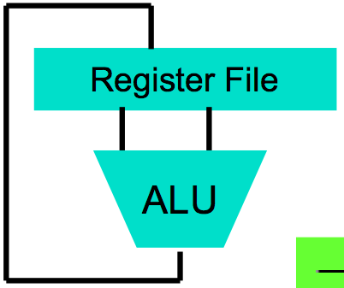
Levels of Representation/Interpretation
High Level Language Program (e.g., C)
temp = v[k];
v[k] = v[k+1];
v[k+1] = temp;
We are here!
Compiler
Anything can be represented as a number, i.e., data or instructions
lw $t0, 0($2)
lw $t1, 4($2)
sw $t1, 0($2)
sw $t0, 4($2)
Assembly Language Program (e.g., MIPS)
Assembler
0000 1001 1100 0110 1010 1111 0101 1000
1010 1111 0101 1000 0000 1001 1100 0110
1100 0110 1010 1111 0101 1000 0000 1001
0101 1000 0000 1001 1100 0110 1010 1111
Machine Language Program (MIPS)
Machine Interpretation
Hardware Architecture Description (e.g., block diagrams)
Architecture Implementation
Logic Circuit Description (Circuit Schematic Diagrams)

Slide 6
Agenda
C Language Overview
Administrivia
C Syntax and Control Flow
Break
Pointers
Summary

Slide 7
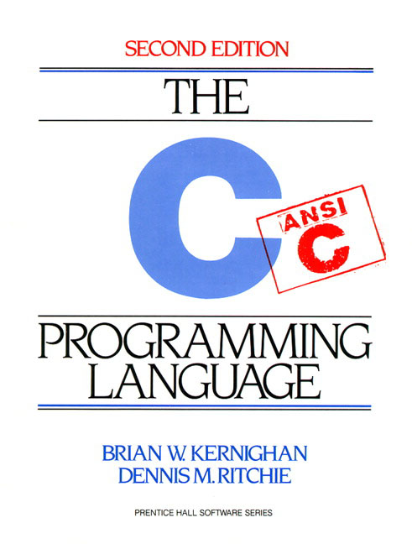
Introduction to C
Official prerequisites: “Some” C experience is required before CS61C
C++ or Java OK
Spring 2011 statistics
83% already know JAVA
54% already know C++
34% already know C
7% already know C#
About 10% have not taken 61B or equivalent
If you have no experience in these languages, then start early and ask a lot of questions in discussion!

Slide 8
Disclaimer
You will not learn how to fully code in C in these lectures! You’ll still need your C reference for this course
K&R is a must-have
Check online for more sources
“Brian Harvey’s helpful transition notes
On CS61C class website
http://inst.eecs.berkeley.edu/~cs61c/resources/HarveyNotesC1-3.pdf
Key C concepts: Pointers, Arrays, Implications for Memory management

Slide 9
C vs. Java
 | C | Java
Type of Language | Function Oriented | Object Oriented
Program-ming Unit | Function | Class / Abstract Data Types
Compilation | Machine dependant assembly | Machine independent bytecode
Execution | Loads and executes program | JVM interprets bytecode
hello, world | #include<stdio.h> int main(void) { printf("Hello\n"); return 0; } | public class HelloWorld { public static void main(String[] args) { System.out.printl("Hello"); } }
Memory management | Manual (malloc, free) | Automatic (garbage collection)
From http://www.cs.princeton.edu/introcs/faq/c2java.html

Slide 10
Compilation: Overview
C compilers map C programs into architecture-specific machine code (string of 1s and 0s)
Unlike Java, which converts to architecture independent bytecode
Unlike most Scheme environments, which interpret the code
These differ mainly in exactly when your program is mapped to low-level machine instructions
For C, generally a two part process of compiling .c files to .o files, then linking the .o files into executables; Assembling is also done (but is hidden, i.e., done automatically, by default)

Slide 11
Compilation: Advantages
Excellent run-time performance: generally much faster than Scheme or Java for comparable code (because it optimizes for a given architecture)
Fair compilation time: enhancements in compilation procedure (Makefiles) allow only modified files to be recompiled
Why C?: we can write programs that allow us to exploit underlying features of the architecture – memory management, special instructions, parallelism

Slide 12
Compilation: Disadvantages
Compiled files, including the executable, are architecture-specific, depending on CPU type and the operating system
Executable must be rebuilt on each new system
I.e., “porting your code” to a new architecture
“Change → Compile → Run [repeat]” iteration cycle can be slow, during the development cycle

Slide 13
Typed Variables in C
int x = 2;
float y = 1.618;
char z = 'A';
You have to declare the type of data a variable will hold
Type Description Examples
int signed integer 5,-12,0
short int (short) smaller signed integer
long int (long) larger signed interger
char single text character or symbol 'a', 'D', '?’
float floating point non-integer numbers 0.0, 1.618, -1.4
double greater precision FP number
Integer sizes are machine dependant!
Common size is 4 bytes, but can’t ever assume this.
Can add “unsigned” before int or char type for unsigned
eg unsigned int

Slide 14
Characters
How do we encode characters?
Relevant question: How many different characters do we want to encode?
‘a’-’z’, ‘A-Z’, ‘0-9’.
What else?

Slide 15
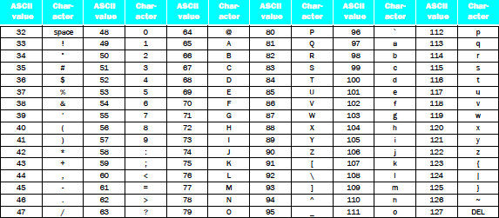
Characters
ASCII standard – 128 different characters and their numeric encodings.
A char representing the character ‘a’ contains 97.
char c = ‘a’; or char c = 97 are both valid
7 bits is enough to store a char (2⁷ = 128), round up to 1 byte since computers usually only deal with multiples of bytes.

Slide 16
Big Idea – Bits can represent anything!
Say we have 0b 0110 0011
Interpret it as a char – ‘c’
Interpret it as a (signed or unsigned) integer: 99
0b 1111 1111
Interpret it as a char: (not a valid char)
Interpret it as a signed int: -1
Interpret it as an unsigned int: 255
It all depends on how the programmer looks at them.
Just wait until Lecture 8, MIPS Instruction Formats, for an incredible example of this.

Slide 17
Types in C
C is a “weakly” typed language. You can explicitly typecast from any type to any other.
int i = -1; if(i < 0) printf(“This will print\n”); if((unsigned int) i < 0) printf(“This will not print\n”);
Can be seen as changing the “programmer’s perspective” of the variable.
Can typecast anything, even if it doesn’t really make sense:
struct node n; //We will see structs in a few slides int i = (int) n;
More freedom, but easier to shoot yourself in the foot.

Slide 18
Typed Functions in C
//Function prototypes
int multiply(int,int);
void sayHello();
int multiply(int x,int y)
{
return x*y;
}
void sayHello ()
{
printf(“Hello\n”);
}
You have to declare the type of data you plan to return from a function
Return type can be any C variable type, and is placed to the left of the function name
You can also specify the return type as void
Just think of this as saying that no value will be returned
Also necessary to define types for values passed into a function
Declaring the “prototype” of a function allows you to use it before the function’s definition.

Slide 19
C Syntax: True or False
What evaluates to FALSE in C?
0 (integer)
NULL (a special kind of pointer: more on this later)
No explicit Boolean type
What evaluates to TRUE in C?
Anything that isn’t false is true
Same idea as in scheme: only #f is false, anything else is true!

Slide 20
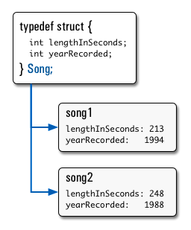
Structs in C
Way of defining compound data types.
A structured group of variables, possibly including other structs
typedef struct {
int lengthInSeconds;
int yearRecorded;
} Song;
Song song1;
song1.lengthInSeconds = 213;
song1.yearRecorded = 1994;
Song song2;
song2.lengthInSeconds = 248;
song2.yearRecorded = 1988;

Slide 21
Consts and Enums in C
Constant is assigned a value once in the declaration; value can't change until the program is restarted
const float goldenRatio = 1.618;
const int daysInWeek = 7;
You can have a constant version of any of the standard C variable types
Enums: a group of related constants used to parameterize libraries

Slide 22
Agenda
C Language Overview
Administrivia
C Syntax and Control Flow
Break
Pointers
Summary

Slide 23
Administrivia
TA office hours have been decided. For this week
Justin – Th 1-2, F 11-12. Alcoves
Sean – W 3-4, Th 11-12. Moore room – 2nd floor cory courtyard.
Alvin – MW 12-1. Alcoves
HW1 will be posted today.

Slide 24
Agenda
C Language Overview
Administrivia
C Syntax and Control Flow
Break
Pointers
Summary

Slide 25
Actual C Code
#include <stdio.h>
#define REPEAT 5
int main(int argc, char *argv[]) {
int i;
int n = 5;
for (i = 0; i < REPEAT; i = i + 1) {
printf("hello, world\n");
}
return 0;
}
Notes:
Ask about what i holds

Slide 26
C Syntax: main
To get arguments to the main function, use:
int main (int argc, char *argv[])
What does this mean?
argc contains the number of strings on the command line (the executable counts as one, plus one for each argument). Here argc is 2:
unix% sort myFile
argv is a pointer to an array containing the arguments as strings (more on pointers later)

Slide 27
C Syntax: Variable Declarations
Similar to Java, but with a few minor but important differences
All variable declarations must appear before they are used (e.g., at the beginning of the block)
A variable may be initialized in its declaration; if not, it holds garbage!
Examples of declarations:
Correct: {
int a = 0, b = 10;
...
Incorrect: for (int i = 0; i < 10; i++)
}

Slide 28
C Syntax : Flow Control (1/2)
Within a function, remarkably close to Java constructs in methods (shows its legacy) in terms of flow control
if-else
if (expression) statement
if (expression) statement1
else statement2
while
while (expression)
statement
do
statement
while (expression);

Slide 29
C Syntax : Flow Control (2/2)
for
for (initialize; check; update) statement
switch
switch (expression){
case const1: statements
case const2: statements
default: statements
}
break

Slide 30
Agenda
Scheme vs. Java vs. C
Administrivia
Quick Start Introduction to C
Technology Break
Pointers

Slide 31
Agenda
Scheme vs. Java vs. C
Administrivia
Quick Start Introduction to C
Technology Break
Pointers

Slide 32
Address vs. Value
Consider memory to be a single huge array
Each cell of the array has an address associated with it
Each cell also stores some value
Do you think they use signed or unsigned numbers? Negative address?!
Don’t confuse the address referring to a memory location with the value stored there
...
101 102 103 104 105 ...
...
23
42

Slide 33
Pointers
An address refers to a particular memory location; e.g., it points to a memory location
Pointer: A variable that contains the address of a variable
Location (address)
...
101 102 103 104 105 ...
...
23
42
104
x
y
p
name

Slide 34
Pointers
How to create a pointer:
(& operator: get address of a variable )
int *p, x;
Note the “*” gets used 2 different ways in this example. In the declaration to indicate that p is going to be a pointer, and in the printf to get the value pointed to by p.
p
?
x
?
x = 3;
p
?
x
3
p = &x;
p
x
3
How get a value pointed to?
* “dereference operator”: get the value that the pointer points to
printf(“p points to %d\n”,*p);

Slide 35
Pointers
How to change a variable pointed to?
Use the dereference operator * on left of assignment operator =
p
x
3
*p = 5;
p
x
5

Slide 36
Pointers and Parameter Passing
Java and C pass parameters “by value”
Procedure/function/method gets a copy of the parameter, so changing the copy cannot change the original
void addOne (int x) { x = x + 1;
}
int y = 3;
addOne(y);
y remains equal to 3

Slide 37
Pointers and Parameter Passing
How can we get a function to change a value?
void addOne (int *p) { *p = *p + 1; }
int y = 3;
addOne(&y);
y is now equal to 4

Slide 38
Pointers
Pointers are used to point to any kind of data (int, char, a struct, etc.)
Normally a pointer only points to one type (int, char, a struct, etc.).
void * is a type that can point to anything (generic pointer)
Use sparingly to help avoid program bugs, and security issues, and other bad things!

Slide 39
Peer Instruction Question
void main(); { int *p, x=5, y; // init y = *(p = &x) + 1; int z; flip-sign(p); printf("x=%d,y=%d,p=%d\n",x,y,p); } flip-sign(int *n){*n = -(*n)}
How many syntax + logic errors in this C code?
#Errors
a) 1
b) 2
c) 3
d) 4
e) >4
Notes:
See following answer slide

Slide 40
Peer Instruction Answer
#include <stdio.h>
void main(); { int *p, x=5, y; // init y = *(p = &x) + 1; int z; flip-sign(p); printf("x=%d,y=%d,p=%d\n",x,y,*p); } flip-sign(int *n){*n = -(*n);}
How many syntax + logic errors in this C code?
SIX
#Errors
a) 1
b) 2
c) 3
d) 4
e) >4
#Errors
a)1
b)2
c)3
d)4
e)5
Notes:
See following answer slide

Slide 41
More C Pointer Dangers
Declaring a pointer just allocates space to hold the pointer – it does not allocate the thing being pointed to!
Local variables in C are not initialized, they may contain anything (aka “garbage”)
What does the following code do?
void f()
{
int *ptr;
*ptr = 5;
}

Slide 42
Pointers in C
Why use pointers?
If we want to pass a large struct or array, it’s easier / faster / etc. to pass a pointer than the whole thing
In general, pointers allow cleaner, more compact code
So what are the drawbacks?
Pointers are probably the single largest source of bugs in C, so be careful anytime you deal with them
Most problematic with dynamic memory management—which you will to know by the end of the semester, but not for the projects (there will be a lab later in the semester)
Dangling references and memory leaks

Slide 43
Why Pointers in C?
At time C was invented (early 1970s), compilers often didn’t produce efficient code
Computers 25,000 times faster today, compilers better
C designed to let programmer say what they want code to do without compiler getting in way
Even give compilers hints which registers to use!
Today’s compilers produce much better code, so may not need to use pointers
Compilers even ignore hints since they do it better!

Slide 44
Has there been an update to ANSI C?
Yes! It’s called the “C99” or “C9x” std
You need “gcc -std=c99” to compile
References
http://en.wikipedia.org/wiki/C99
http://home.tiscalinet.ch/t_wolf/tw/c/c9x_changes.html
Highlights
Declarations in for loops, like Java (#15)
Java-like // comments (to end of line) (#10)
Variable-length non-global arrays (#33)
<inttypes.h>: explicit integer types (#38)
<stdbool.h> for boolean logic def’s (#35)

Slide 45
And In Conclusion, …
Bits can represent anything!
chars, integers, floating point, …
C is an efficient language, but leaves safety to the programmer
Weak type safety
Variables not automatically initialized
Use pointers with care: they are a common source of bugs in programs
All data is in memory
Each memory location has an address to use to refer to it and a value stored in it
Pointer is a C version (abstraction) of a data address
* “follows” a pointer to its value
& gets the address of a value
Arrays and strings are implemented as variations on pointers

