Slide 1
CS 61C: Great Ideas in Computer Architecture (Machine Structures): More MIPS Instruction Formats, Assembly, Linking
Instructors: Michael Greenbaum

Slide 2
Agenda
I and J Instruction Formats
Administrivia
The Assembler
Break
Linking
Conclusion

Slide 3
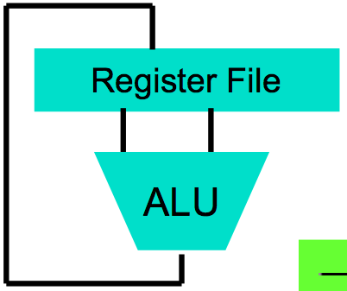
Levels of Representation/Interpretation
High Level Language Program (e.g., C)
temp = v[k];
v[k] = v[k+1];
v[k+1] = temp;
We are here!
Compiler
Anything can be represented as a number, i.e., data or instructions
lw $t0, 0($2)
lw $t1, 4($2)
sw $t1, 0($2)
sw $t0, 4($2)
Assembly Language Program (e.g., MIPS)
Assembler
0000 1001 1100 0110 1010 1111 0101 1000
1010 1111 0101 1000 0000 1001 1100 0110
1100 0110 1010 1111 0101 1000 0000 1001
0101 1000 0000 1001 1100 0110 1010 1111
Machine Language Program (MIPS)
Machine Interpretation
Hardware Architecture Description (e.g., block diagrams)
Architecture Implementation
Logic Circuit Description (Circuit Schematic Diagrams)

Slide 4
Review
MIPS Machine Language Instruction: Encode an instruction in 32 bits!
Reading an instruction starts by decoding the opcode field.
J-Format – Coming up soon…
R
opcode
rs
rt
rd
shamt
funct
I
opcode
rs
rt
immediate

Slide 5
Data Transfer Instructions
The data transfer instructions (lw,sw,lb,sb,etc.) specify two registers and a constant (the offset).
Represented with I-Format
Example:
lw $t0 -4($t1)
opcode = 35 => 100011
rs = 9 ($t1) => 01001
rt = 8 ($t0) => 01000
imm = -4 => 1111111111111100
100011
01001
01000
1111111111111100

Slide 6
16-Bit Immediate?
Unsigned # sign-extended?
addiu, sltiu, sign-extends immediates to 32 bits. Thus, # is a “signed” integer.
Rationale
addiu so that can add w/out overflow. Remember, the u means don’t signal overflow, not signed vs unsigned integers!
sltiu suffers so that we can have easy HW
Does this mean we’ll get wrong answers?
Nope, it means assembler has to handle any unsigned immediate 2¹⁵ ≤ n < 2¹⁶ (I.e., with a 1 in the 15th bit and 0s in the upper 2 bytes) as it does for numbers that are too large. ⇒

Slide 7
16-Bit Immediate?
Problem:
Chances are that addi, lw, sw and slti will use immediates small enough to fit in the immediate field.
…but what if it’s too big? What about logic operations?
Want to support up to a 32-bit immediate
Allows full bitwise logic operations
Not much point in supporting larger than processer word size

Slide 8
16-Bit Immediate?
Solution to Problem:
Handle it in software + new instruction
Don’t change the current instructions: instead, add a new instruction to help out
New instruction:
lui register, immediate
stands for Load Upper Immediate
takes 16-bit immediate and puts these bits in the upper half (high order half) of the register
sets lower half to 0s

Slide 9
16-Bit Immediate?
Solution to Problem (continued):
So how does lui help us?
Example:
addi $t0,$t0, 0xABABCDCD
…becomes
lui $at, 0xABAB
ori $at, $at, 0xCDCD
add $t0,$t0,$at
Now each I-format instruction has only a 16-bit immediate.
Wouldn’t it be nice if the assembler would this for us automatically? (later)

Slide 10
Branches: PC-Relative Addressing (1/5)
Use I-Format
opcode specifies beq versus bne
rs and rt specify registers to compare
What can immediate specify?
immediate is only 16 bits
PC (Program Counter) has byte address of current instruction being executed; 32-bit pointer to memory
So immediate cannot specify entire address to branch to.
opcode
rs
rt
immediate

Slide 11
Branches: PC-Relative Addressing (2/5)
How do we typically use branches?
Answer: if-else, while, for
Loops are generally small: usually up to 50 instructions
Function calls and unconditional jumps are done using jump instructions (j and jal), not the branches.
Conclusion: may want to branch to anywhere in memory, but a branch often changes PC by a small amount

Slide 12
Branches: PC-Relative Addressing (3/5)
Solution to branches in a 32-bit instruction: PC-Relative Addressing
Let the 16-bit immediate field be a signed two’s complement integer to be added to the PC if we take the branch.
Now we can branch ± 2¹⁵ bytes from the PC, which should be enough to cover almost any loop.
Any ideas to further optimize this?

Slide 13
Branches: PC-Relative Addressing (4/5)
Note: Instructions are words, so they’re word aligned (byte address is always a multiple of 4, which means it ends with 00 in binary).
So the number of bytes to add to the PC will always be a multiple of 4.
So specify the immediate in words.
Now, we can branch ± 2¹⁵ words from the PC (or ± 2¹⁷ bytes), so we can handle loops 4 times as large.

Slide 14
Branches: PC-Relative Addressing (5/5)
Branch Calculation:
If we don’t take the branch:
PC = PC + 4 = byte address of next instruction
If we do take the branch:
PC = (PC + 4) + (immediate * 4)
Observations
Immediate field specifies the number of words to jump, which is simply the number of instructions to jump.
Immediate field can be positive or negative.
Due to hardware, add immediate to (PC+4), not to PC; will be clearer why later in course

Slide 15
Branch Example (1/3)
MIPS Code:
Loop: beq $9,$0,End addu $8,$8,$10 addiu $9,$9,-1 j Loop End:
beq branch is I-Format:
opcode = 4 (look up in table)
rs = 9 (first operand)
rt = 0 (second operand)
immediate = ???

Slide 16
Branch Example (2/3)
MIPS Code:
Loop: beq $9,$0,End addu $8,$8,$10 addiu $9,$9,-1 j Loop End:
immediate Field:
Number of instructions to add to (or subtract from) the PC, starting at the instruction following the branch.
In beq case, immediate = 3

Slide 17
Branch Example (3/3)
MIPS Code:
Loop: beq $9,$0,End addu $8,$8,$10 addiu $9,$9,-1 j Loop End:
decimal representation:
4
9
0
3
binary representation:
000100
01001
00000
0000000000000011

Slide 18
Questions on PC-Relative addressing
Does the value in branch immediate field change if we move the code?
What do we do if destination is > 2¹⁵ instructions away from branch?

Slide 19
J-Format Instructions (1/5)
For branches, we assumed that we won’t want to branch too far, so we can specify change in PC.
For general jumps (j and jal), we may jump to anywhere in memory.
Ideally, we could specify a 32-bit memory address to jump to.
Unfortunately, we can’t fit both a 6-bit opcode and a 32-bit address into a single 32-bit word, so we compromise.

Slide 20
J-Format Instructions (2/5)
Define two “fields” of these bit widths:
As usual, each field has a name:
Key Concepts
Keep opcode field identical to R-format and I-format for consistency.
Collapse all other fields to make room for large target address.
31
0
6 bits
26 bits
opcode
target address

Slide 21
J-Format Instructions (3/5)
For now, we can specify 26 bits of the 32-bit address.
Optimization:
Note that, just like with branches, jumps will only jump to word aligned addresses, so last two bits are always 00 (in binary).
So let’s just take this for granted and not even specify them.

Slide 22
J-Format Instructions (4/5)
Now specify 28 bits of a 32-bit address
Where do we get the other 4 bits?
By definition, take the 4 highest order bits from the PC.
Technically, this means that we cannot jump to anywhere in memory, but it’s adequate 99.9999…% of the time, since programs aren’t that long
only if straddle a 256 MB boundary
If we absolutely need to specify a 32-bit address, we can always put it in a register and use the jr instruction.

Slide 23
J-Format Instructions (5/5)
Summary:
New PC = { (PC+4)[31..28], target address, 00 }
Understand where each part came from!
Note: { , , } means concatenation { 4 bits , 26 bits , 2 bits } = 32 bit address
{ 1010, 11111111111111111111111111, 00 } = 10101111111111111111111111111100
Note: Book uses ||

Slide 24
Peer Instruction Question
When combining two C files into one executable, recall we can compile and assemble them independently & then merge them together. When merging two or more binaries:
Jump insts don’t require any changes.
Branch insts don’t require any changes.
12
y) FF
p) FT
g) TF
r) TT
b)dunno
Notes:
Answer: (b)
1: False
2: True (it’s all relative)

Slide 25
Peer Instruction Question
When combining two C files into one executable, recall we can compile and assemble them independently & then merge them together. When merging two or more binaries:
Jump insts don’t require any changes.
Branch insts don’t require any changes.
12
y) FF
p) FT
g) TF
r) TT
b)dunno
What about calling function in another file? Also, absolute addresses of labels may change as multiple files are merged together.
Branch addresses are relative
Notes:
Answer: (b)
1: False
2: True (it’s all relative)

Slide 26
Agenda
I and J Instruction Formats
Administrivia
The Assembler
Break
Linking
Conclusion

Slide 27
Administrivia
Project 1 has been posted
Due Sunday at midnight
Part 2 posted today – A short but “interesting” MIPS program to run on your simulator.
How are things going?
The Midterm is next Friday.
Exact location and time still TBD.
Review session held next Monday.

Slide 28
Agenda
I and J Instruction Formats
Administrivia
The Assembler
Break
Linking
Conclusion

Slide 29
Levels of Representation/Interpretation
High Level Language Program (e.g., C)
temp = v[k];
v[k] = v[k+1];
v[k+1] = temp;
Compiler
Anything can be represented as a number, i.e., data or instructions
lw $t0, 0($2)
lw $t1, 4($2)
sw $t1, 0($2)
sw $t0, 4($2)
Assembly Language Program (e.g., MIPS)
Assembler
0000 1001 1100 0110 1010 1111 0101 1000
1010 1111 0101 1000 0000 1001 1100 0110
1100 0110 1010 1111 0101 1000 0000 1001
0101 1000 0000 1001 1100 0110 1010 1111
Machine Language Program (MIPS)
Machine Interpretation
Hardware Architecture Description (e.g., block diagrams)
Architecture Implementation
Logic Circuit Description (Circuit Schematic Diagrams)

Slide 30
Assembler
Input: Assembly Language File (e.g., foo.s for MIPS)
Outputs: Object File (e.g., foo.o for MIPS)
Produces Machine Language
Replace Pseudoinstructions
Reads and Uses Directives
Produces various information tables…

Slide 31
Pseudoinstructions (1/3)
MIPS “Instructions” that are convenient for an assembly programmer to use
Programmer meaning either a human assembly writer or a compiler.
Get translated by the assembler into real instructions.
Some examples follow…

Slide 32
Example Pseudoinstructions
Register Move move reg2,reg1
Translates to:
add reg2,$zero,reg1
Load Immediate
li reg,value
If value fits in 16 bits:
addi reg,$zero,value
else:
lui reg, upper_16_bits_of_value
ori reg,$zero, lower_16_bits

Slide 33
Example Pseudoinstructions
Load Address: How do we get the address of an instruction or global variable into a register?
la reg,label
Again if value fits in 16 bits:
addi reg,$zero,label_value
else:
lui reg, upper_16_bits_of_value
ori reg,$zero, lower_16_bits

Slide 34
Pseudoinstructions (2/3)
Problem:
When breaking up a pseudoinstruction, the assembler may need to use an extra register
If it uses any regular register, it’ll overwrite whatever the program has put into it.
Solution:
Reserve a register ($1, called $at for “assembler temporary”) that assembler will use to break up pseudo-instructions.
Since the assembler may use this at any time, it’s not safe to code with it.

Slide 35
Example Pseudoinstructions
Rotate Right Instruction
ror reg, value
Expands to:
srl $at, reg, value
sll reg, reg, 32-value
or reg, reg, $at
0
0
“No OPeration” instruction
nop
Expands to instruction = 0_{ten},
sll $0, $0, 0

Slide 36
Example Pseudoinstructions
Wrong operation for operand
addu reg,reg,value # should be addiu
If value fits in 16 bits, addu is changed to:
addiu reg,reg,value
else:
lui $at, upper 16_bits_of_value
ori $at,$at, lower_16_bits
addu reg,reg, $at
Any 32-bit immediates will get translated into an appropriate lui/ori combination!

Slide 37
Pseudoinstructions (3/3)
MAL (MIPS Assembly Language): the set of instructions that a programmer may use to code in MIPS; this includes pseudoinstructions
TAL (True Assembly Language): the set of instructions (which exist in the MIPS ISA) that can actually get directly translated into a single machine language instruction (32-bit binary string). Green sheet is TAL!
A program must be converted from MAL into TAL before translation into 1s & 0s.

Slide 38
Assembler Directives (p. B-5 to B-7)
Give directions to assembler, but do not produce machine instructions
.text: Subsequent items put in user text segment
.data: Subsequent items put in user data segment
.globl sym: declares sym global and can be referenced from other files
.asciiz str: Store the string str in memory and null-terminate it
.word w1…wn: Store the n 32-bit quantities in successive memory words

Slide 39
Producing Machine Language (1/3)
Simple Case
Arithmetic, Logical, Shifts, and so on.
All necessary info is within the instruction already.
What about Branches?
PC-Relative
So once pseudoinstructions are replaced by real ones, we know by how many instructions to branch.
So these can be handled.
Extra for experts: What about long branches?

Slide 40
Producing Machine Language (2/3)
“Forward Reference” problem
Branch instructions can refer to labels that are “forward” in the program:
Solved by taking 2 passes over the program.
First pass remembers position of labels
Second pass uses label positions to generate code
or $v0, $0, $0 L1: slt $t0, $0, $a1 beq $t0, $0, L2 addi $a1, $a1, -1 j L1 L2: add $t1, $a0, $a1

Slide 41
Producing Machine Language (3/3)
What about jumps (j and jal)?
Jumps require absolute address.
So, forward or not, still can’t generate machine instruction without knowing the position of instructions in memory.
What about references to data?
la gets broken up into lui and ori
These will require the full 32-bit address of the data.
These can’t be determined yet, so we create two tables…

Slide 42
Symbol Table
List of “items” in this file that may be used by other files.
What are they?
Labels: function calling
Data: anything in the .data section; variables which may be accessed across files

Slide 43
Relocation Table
List of “items” this file needs the address of later.
What are they?
Any label jumped to: j or jal
internal
external (including lib files)
Any piece of data that references an address
such as the la instruction

Slide 44
Object File Format
object file header: size and position of the other pieces of the object file
text segment: the machine code
data segment: binary representation of the data in the source file
relocation information: identifies lines of code that need to be “handled”
symbol table: list of this file’s labels and data that can be referenced
debugging information
A standard format is ELF (except MS, Apple) http://www.skyfree.org/linux/references/ELF_Format.pdf

Slide 45
Agenda
I and J Instruction Formats
Administrivia
The Assembler
Break
Linking
Conclusion

Slide 46
Agenda
I and J Instruction Formats
Administrivia
The Assembler
Break
Linking
Conclusion

Slide 47
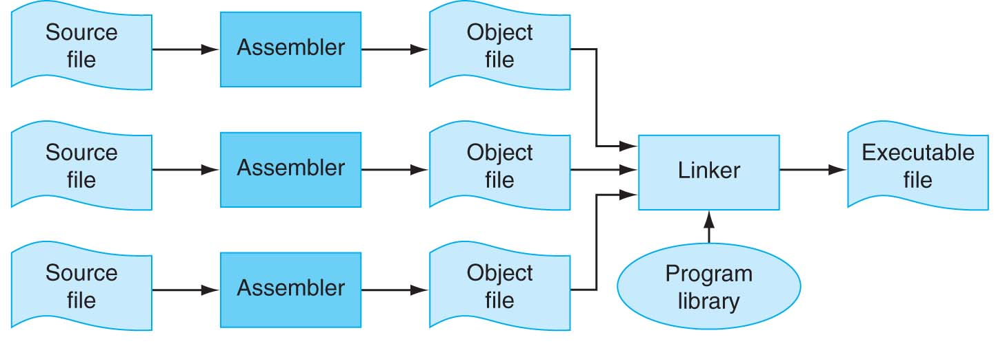
Separate Compilation and Assembly
No need to compile all code at once
How to put pieces together?
FIGURE B.1.1 The process that produces an executable file. An assembler translates a file of assembly language into an object file, which is linked with other files and libraries into an executable file. Copyright © 2009 Elsevier, Inc. All rights reserved.

Slide 48
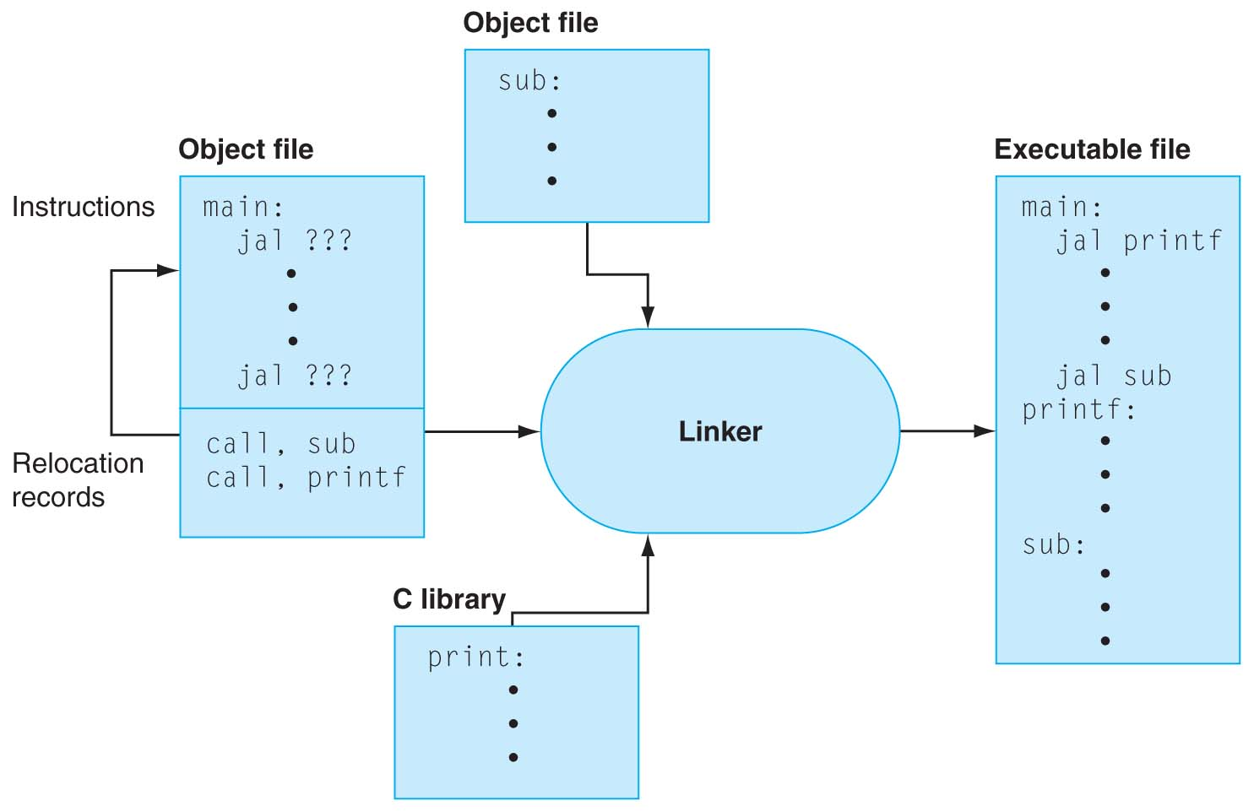
Linker Stitches Files Together
FIGURE B.3.1 The linker searches a collection of object files and program libraries to find nonlocal routines used in a program, combines them into a single executable file, and resolves references between routines in different files. Copyright © 2009 Elsevier, Inc. All rights reserved.

Slide 49
Linking Object Modules
Produces an executable image
1. Merges segments
2. Resolve labels (determine their addresses)
3. Patch location-dependent and external refs
Often a slower than compiling
all the machine code files must be read into memory and linked together

Slide 50
“And in Conclusion, …”
Everything is a (binary) number in a computer
Instructions are data; stored program concept
Different addressing schemes are needed due to the limitations of the I-Format and J-Format
Assemblers support pseudoinstructions for the assembly language programmer, keep track of labels and data locations for linker.
Linkers allow separate compilation and assembly of modules

Slide 51
Bonus slides
These are extra slides that used to be included in lecture notes, but have been moved to this, the “bonus” area to serve as a supplement.
The slides will appear in the order they would have in the normal presentation
Bonus

Slide 52
Disassembling Example (1/7)
Here are six machine language instructions in hexadecimal:
00001025_{hex} 0005402A_{hex} 11000003_{hex} 00441020_{hex} 20A5FFFF_{hex} 08100001_{hex}
Let the first instruction be at address 4,194,304_{ten} (0x00400000_{hex}).
Next step: convert hex to binary

Slide 53
Disassembling Example (2/7)
The six machine language instructions in binary:
00000000000000000001000000100101 00000000000001010100000000101010 00010001000000000000000000000011 00000000010001000001000000100000 00100000101001011111111111111111 00001000000100000000000000000001
R
0
rs
rt
rd
shamt
funct
I
1, 4-62
rs
rt
immediate
J
2 or 3
target address

Slide 54
Disassembling Example (3/7)
Select the opcode (first 6 bits) to determine the format:
00000000000000000001000000100101 00000000000001010100000000101010 00010001000000000000000000000011 00000000010001000001000000100000 00100000101001011111111111111111 00001000000100000000000000000001
Look at opcode: 0 means R-Format, 2 or 3 mean J-Format, otherwise I-Format.
Next step: separation of fields
Format:
R
R
I
R
I
J

Slide 55
Disassembling Example (4/7)
Fields separated based on format/opcode:
Format:
R
0
0
0
2
0
37
R
0
0
5
8
0
42
I
4
8
0
+3
R
0
2
4
2
0
32
I
8
5
5
-1
J
2
1,048,577
Next step: translate (“disassemble”) to MIPS assembly instructions

Slide 56
Disassembling Example (5/7)
MIPS Assembly (Part 1):
Address: Assembly instructions:
0x00400000 or $2,$0,$0 0x00400004 slt $8,$0,$5 0x00400008 beq $8,$0,3 0x0040000c add $2,$2,$4 0x00400010 addi $5,$5,-1 0x00400014 j 0x100001
0x00400018
Better solution: translate to more meaningful MIPS instructions (fix the branch/jump and add labels, registers)

Slide 57
Disassembling Example (6/7)
MIPS Assembly (Part 2):
or $v0,$0,$0 Loop: slt $t0,$0,$a1 #t0 = 1 if $0 < $a0
#t0 = 0 if $0>= $a0 beq $t0,$0,Exit # goto exit
# if $a0 <= 0 add $v0,$v0,$a0 addi $a1,$a1,-1 j Loop Exit:
Next step: translate to C code (must be creative!)

Slide 58
Disassembling Example (7/7)
Before Hex: 00001025_{hex} 0005402A_{hex} 11000003_{hex} 00441020_{hex} 20A5FFFF_{hex} 08100001_{hex}
After C code
$v0: product $a0: multiplicand $a1: multiplier
product = 0; while (multiplier > 0) { product += multiplicand; multiplier -= 1; }
or $v0,$0,$0
Loop: slt $t0,$0,$a1
beq $t0,$0,Exit
add $v0,$v0,$a0
addi $a1,$a1,-1
j Loop
Exit:
Demonstrated Big 61C Idea: Instructions are just numbers, code is treated like data

