Slide 1
CS 61C: Great Ideas in Computer Architecture (Machine Structures) MIPS Control, MIPS Pipelining Intro
Instructor: Michael Greenbaum

Slide 2
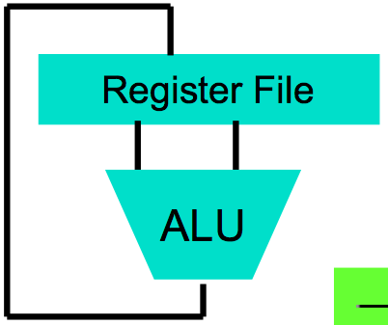
Levels of Representation/Interpretation
High Level Language Program (e.g., C)
temp = v[k];
v[k] = v[k+1];
v[k+1] = temp;
Compiler
Anything can be represented as a number, i.e., data or instructions
lw $t0, 0($2)
lw $t1, 4($2)
sw $t1, 0($2)
sw $t0, 4($2)
Assembly Language Program (e.g., MIPS)
Assembler
0000 1001 1100 0110 1010 1111 0101 1000
1010 1111 0101 1000 0000 1001 1100 0110
1100 0110 1010 1111 0101 1000 0000 1001
0101 1000 0000 1001 1100 0110 1010 1111
Machine Language Program (MIPS)
Machine Interpretation
Hardware Architecture Description (e.g., block diagrams)
Architecture Implementation
Logic Circuit Description (Circuit Schematic Diagrams)

Slide 3
Review: A Single Cycle Datapath
Inst
Memory
Instruction<31:0>
<21:25>
<16:20>
<0:15>
<11:15>
Adr
Rs
Rt
Rd
Imm16
nPC_sel
RegDst
Rd
Rt
Zero
ALUctr
MemtoReg
1
0
MemWr
4
RegWr
Rs
Rt
5
5
5
Adder
Rw
Ra
Rb
busA
32
00
busW
z
32
32
RegFile
busB
ALU
0
Mux
PC
0
clk
32
Adder
32
WrEn
Adr
PC Ext
clk
imm16
1
Data In
1
16
Extender
Data
Memory
32
clk
imm16
ExtOp
ALUSrc
Notes:
So here is the single cycle datapath we just built.
If you push into the Instruction Fetch Unit, you will see the last slide showing the PC, the next address logic, and the Instruction Memory.
Here I have shown how we can get the Rt, Rs, Rd, and Imm16 fields out of the 32-bit instruction word.
The Rt, Rs, and Rd fields will go to the register file as register specifiers while the Imm16 field will go to the Extender where it is either Zero and Sign extended to 32 bits.
The signals ExtOp, ALUSrc, ALUctr, MemWr, MemtoReg, RegDst, RegWr, Branch, and Jump are control signals.
And I will show you how to generate them on Friday.
+2 = 80 min. (Z:00)

Slide 4
Agenda
Overview of Control Signals
Administrivia
Control Implementation
Break
Pipelining Intro

Slide 5
Processor Design Process
Five steps to design a processor:
Step 1: Analyze instruction set to determine datapath requirements
Step 2: Select set of datapath components & establish clocking methodology
Step 3: Assemble datapath components to meet the requirements
Step 4: Analyze implementation of each instruction to determine setting of control signals that implements the register transfer
Step 5: Assemble the control logic

Slide 6
A Single Cycle Datapath
We have everything but the values of control signals
Instruction<31:0>
nPC_sel
instr
fetch
unit
<21:25>
<16:20>
<0:15>
clk
<11:15>
RegDst
Rd
Rt
Rs
Rt
Rd
Imm16
1
0
ALUctr
MemtoReg
RegWr
Rs
Rt
zero
5
5
5
MemWr
Rw
Ra
Rb
busA
32
Z
busW
32
32
RegFile
busB
ALU
0
0
clk
32
32
WrEn
Adr
imm16
1
Data In
1
16
Extender
Data
Memory
32
clk
ExtOp
ALUSrc
Notes:
The result of the last lecture is this single-cycle datapath.
+1 = 6 min. (X:46)

Slide 7
Values of the Control Signals
nPC_sel: “+4” 0 ⇒ PC <– PC + 4 “br” 1 ⇒ PC <– PC + 4 + {SignExt(Im16) , 00 }
“n”=next
Inst Address
nPC_sel
4
Adder
0
00
Mux
PC
Adder
1
PC Ext
clk
imm16

Slide 8
Values of the Control Signals
ExtOp: zero, sign
ALUsrc: 0 ⇒ reg; 1 ⇒ imm
ALUctr: ADD, SUB, OR
MemWr: 1 ⇒ write memory
MemtoReg: 0 ⇒ alu; 1 ⇒ mem
RegDst: 0 ⇒ rt; 1 ⇒ rd
RegWr: 1 ⇒ write register
RegDst
Rd
Rt
ALUctr
MemtoReg
1
0
MemWr
RegWr
Rs
Rt
5
5
5
Rw
Ra
Rb
busA
32
busW
32
32
RegFile
busB
ALU
0
0
clk
32
32
WrEn
Adr
imm16
Extender
1
Data In
1
16
32
Data
Memory
ALUSrc
clk
ExtOp

Slide 9
RTL: The Add Instruction
31
26
21
16
11
6
0
op
rs
rt
rd
shamt
funct
6 bits
5 bits
5 bits
5 bits
5 bits
6 bits
add rd, rs, rt
MEM[PC] Fetch the instruction from memory
R[rd] = R[rs] + R[rt] The actual operation
PC = PC + 4 Calculate the next instruction’s address
Notes:
OK, let’s get on with today’s lecture by looking at the simple add instruction.
In terms of Register Transfer Language, this is what the Add instruction need to do.
First, you need to fetch the instruction from Memory.
Then you perform the actual add operation. More specifically:
(a) You add the contents of the register specified by the Rs and Rt fields of the instruction.
(b) Then you write the results to the register specified by the Rd field.
And finally, you need to update the program counter to point to the next instruction.
Now, let’s take a detail look at the datapath during various phase of this instruction.
+2 = 10 min. (X:50)

Slide 10
Single Cycle Datapath during Add
31
26
21
16
11
6
0
op
rs
rt
rd
shamt
funct
R[rd] = R[rs] + R[rt]
Instruction<31:0>
nPC_sel=+4
instr
fetch
unit
RegDst=1
<21:25>
<16:20>
<0:15>
clk
<11:15>
rd
rt
1
0
Rs
Rt
Rd
Imm16
zero
ALUctr=ADD
RegWr=1
rs
rt
MemtoReg=0
5
5
5
busA
32
MemWr=0
busW
Rw
Ra
Rb
=
32
32
RegFile
busB
ALU
0
0
clk
32
32
WrEn
Adr
imm16
1
Data In
1
16
Extender
Data
Memory
32
clk
ExtOp=x
ALUSrc=0
Notes:
This picture shows the activities at the main datapath during the execution of the Add or Subtract instructions.
The active parts of the datapath are shown in different color as well as thicker lines.
First of all, the Rs and Rt of the instructions are fed to the Ra and Rb address ports of the register file and cause the contents of registers specified by the Rs and Rt fields to be placed on busA and busB, respectively.
With the ALUctr signals set to either Add or Subtract, the ALU will perform the proper operation and with MemtoReg set to 0, the ALU output will be placed onto busW.
The control we are going to design will also set RegWr to 1 so that the result will be written to the register file at the end of the cycle.
Notice that ExtOp is don’t care because the Extender in this case can either do a SignExt or ZeroExt. We DON’T care because ALUSrc will be equal to 0--we are using busB.
The other control signals we need to worry about are:
(a) MemWr has to be set to zero because we do not want to write the memory.
(b) And Branch and Jump, we have to set to zero. Let me show you why.
+3 = 15 min. (X:55)

Slide 11
Instruction Fetch Unit for Add
PC = PC + 4
Same for all instructions except: Branch and Jump
Inst
Memory
nPC_sel=+4
Inst Address
4
Adder
Mux
PC
Adder
00
PC Ext
clk
imm16
Notes:
This picture shows the control signals setting for the Instruction Fetch Unit at the end of the Add or Subtract instruction.
Both the Branch and Jump signals are set to 0.
Consequently, the output of the first adder, which implements PC plus 1, is selected through the two 2-to-1 mux and got placed into the input of the Program Counter register.
The Program Counter is updated to this new value at the next clock tick.
Notice that the Program Counter is updated at every cycle. Therefore it does not have a Write Enable signal to control the write.
Also, this picture is the same for or all instructions other than Branch andJjump.
Therefore I will only show this picture again for the Branch and Jump instructions and will not repeat this for all other instructions.
+2 = 17 min. (X:57)

Slide 12
Single Cycle Datapath during Or Immediate
31
26
21
16
0
op
rs
rt
immediate
R[rt] = R[rs] OR ZeroExt[Imm16]
Instruction<31:0>
nPC_sel=
instr
fetch
unit
RegDst=
<21:25>
<16:20>
<0:15>
clk
<11:15>
Rd
Rt
1
0
Rs
Rt
Rd
Imm16
zero
ALUctr=
RegWr=
Rs
Rt
MemtoReg=
5
5
5
busA
32
MemWr=
busW
Rw
Ra
Rb
=
32
32
RegFile
busB
ALU
0
0
clk
32
32
WrEn
Adr
imm16
1
Data In
1
16
Extender
Data
Memory
32
clk
ExtOp=
ALUSrc=
Notes:
Now let’s look at the control signals setting for the Or immediate instruction.
The OR immediate instruction OR the content of the register specified by the Rs field to the Zero Extended Immediate field and write the result to the register specified in Rt.
This is how it works in the datapath. The Rs field is fed to the Ra address port to cause the contents of register Rs to be placed on busA.
The other operand for the ALU will come from the immediate field. In order to do this, the controller need to set ExtOp to 0 to instruct the extender to perform a Zero Extend operation.
Furthermore, ALUSrc must set to 1 such that the MUX will block off bus B from the register file and send the zero extended version of the immediate field to the ALU.
Of course, the ALUctr has to be set to OR so the ALU can perform an OR operation.
The rest of the control signals (MemWr, MemtoReg, Branch, and Jump) are the same as theAdd and Subtract instructions.
One big difference is the RegDst signal. In this case, the destination register is specified by the instruction’s Rt field, NOT the Rd field because we do not have a Rd field here.
Consequently, RegDst must be set to 0 to place Rt onto the Register File’s Rw address port.
Finally, in order to accomplish the register write, RegWr must be set to 1.
+3 = 20 min. (X:60)

Slide 13
Single Cycle Datapath during Or Immediate
31
26
21
16
0
op
rs
rt
immediate
R[rt] = R[rs] OR ZeroExt[Imm16]
Instruction<31:0>
nPC_sel=+4
instr
fetch
unit
RegDst=0
<21:25>
<16:20>
<11:15>
<0:15>
clk
Rd
Rt
1
0
Rs
Rt
Rd
Imm16
zero
ALUctr=OR
RegWr=1
Rs
Rt
MemtoReg=0
5
5
5
busA
32
MemWr=0
busW
Rw
Ra
Rb
=
32
32
RegFile
busB
ALU
0
0
clk
32
32
WrEn
Adr
imm16
1
Data In
1
16
Extender
Data
Memory
32
clk
ExtOp=zero
ALUSrc=1
Notes:
Now let’s look at the control signals setting for the Or immediate instruction.
The OR immediate instruction OR the content of the register specified by the Rs field to the Zero Extended Immediate field and write the result to the register specified in Rt.
This is how it works in the datapath. The Rs field is fed to the Ra address port to cause the contents of register Rs to be placed on busA.
The other operand for the ALU will come from the immediate field. In order to do this, the controller need to set ExtOp to 0 to instruct the extender to perform a Zero Extend operation.
Furthermore, ALUSrc must set to 1 such that the MUX will block off bus B from the register file and send the zero extended version of the immediate field to the ALU.
Of course, the ALUctr has to be set to OR so the ALU can perform an OR operation.
The rest of the control signals (MemWr, MemtoReg, Branch, and Jump) are the same as theAdd and Subtract instructions.
One big difference is the RegDst signal. In this case, the destination register is specified by the instruction’s Rt field, NOT the Rd field because we do not have a Rd field here.
Consequently, RegDst must be set to 0 to place Rt onto the Register File’s Rw address port.
Finally, in order to accomplish the register write, RegWr must be set to 1.
+3 = 20 min. (X:60)

Slide 14
Single Cycle Datapath during Load
31
26
21
16
0
op
rs
rt
immediate
R[rt] = Data Memory {R[rs] + SignExt[imm16]}
Instruction<31:0>
nPC_sel=
instr
fetch
unit
RegDst=
<21:25>
<16:20>
<11:15>
<0:15>
clk
Rd
Rt
1
0
Rs
Rt
Rd
Imm16
zero
ALUctr=
RegWr=
Rs
Rt
MemtoReg=
5
5
5
busA
32
MemWr=
busW
Rw
Ra
Rb
=
32
32
RegFile
busB
ALU
0
0
clk
32
32
WrEn
Adr
imm16
1
Data In
1
16
Extender
Data
Memory
32
clk
ExtOp=
ALUSrc=
Notes:
Let’s continue our lecture with the load instruction. What does the load instruction do?
It first adds the contecnts of the register specified by the Rs field to the Sign Extended version of the Immediate field to form the memory address.
Then it uses this memory address to access the memory and write the data back to the register specified by the Rt field of the instruction.
Here is how the datapath works: first the Rs field is fed to the Register File’s Ra address port to place the register onto bus A.
Then the ExtOp signal is set to 1 so that the immediate field is Sign Extended and we place this value (output of Extender) onto the ALU input by setting ALUsrc to 1.
The ALU then add (ALUctr = add) the two together to form the memory address which is then placed onto the Data Memory’s address port.
In order to place the Data Memory’s output bus onto the Register File’s input bus (busW), the control needs to set MemtoReg to 1.
Similar to the OR immediate instruction I showed you earlier, the destination register here is specified by the Rt field. Therefore RegDst must be set to 0.
Finally, RegWr must be set to 1 to completer the register write operation.
Well, it should be obvious to you guys by now that we need to set Branch and Jump to 0 to make sure the Instruction Fetch Unit update the Program Counter correctly.
+3 = 28 min. (Y:08)

Slide 15
Single Cycle Datapath during Load
31
26
21
16
0
op
rs
rt
immediate
R[rt] = Data Memory {R[rs] + SignExt[imm16]}
Instruction<31:0>
nPC_sel=+4
instr
fetch
unit
RegDst=0
<21:25>
<16:20>
<0:15>
clk
<11:15>
Rd
Rt
1
0
Rs
Rt
Rd
Imm16
zero
ALUctr=ADD
RegWr=1
Rs
Rt
MemtoReg=1
5
5
5
busA
32
MemWr=0
busW
Rw
Ra
Rb
=
32
32
RegFile
busB
ALU
0
0
clk
32
32
WrEn
Adr
imm16
1
Data In
1
16
Extender
Data
Memory
32
clk
ExtOp=sign
ALUSrc=1
Notes:
Let’s continue our lecture with the load instruction. What does the load instruction do?
It first adds the contecnts of the register specified by the Rs field to the Sign Extended version of the Immediate field to form the memory address.
Then it uses this memory address to access the memory and write the data back to the register specified by the Rt field of the instruction.
Here is how the datapath works: first the Rs field is fed to the Register File’s Ra address port to place the register onto bus A.
Then the ExtOp signal is set to 1 so that the immediate field is Sign Extended and we place this value (output of Extender) onto the ALU input by setting ALUsrc to 1.
The ALU then add (ALUctr = add) the two together to form the memory address which is then placed onto the Data Memory’s address port.
In order to place the Data Memory’s output bus onto the Register File’s input bus (busW), the control needs to set MemtoReg to 1.
Similar to the OR immediate instruction I showed you earlier, the destination register here is specified by the Rt field. Therefore RegDst must be set to 0.
Finally, RegWr must be set to 1 to completer the register write operation.
Well, it should be obvious to you guys by now that we need to set Branch and Jump to 0 to make sure the Instruction Fetch Unit update the Program Counter correctly.
+3 = 28 min. (Y:08)

Slide 16
Single Cycle Datapath during Branch
31
26
21
16
0
op
rs
rt
immediate
if (R[rs] - R[rt] == 0) then Zero = 1 ; else Zero = 0
Instruction<31:0>
nPC_sel=
instr
fetch
unit
RegDst=
<21:25>
<16:20>
<0:15>
clk
<11:15>
Rd
Rt
1
0
Rs
Rt
Rd
Imm16
zero
ALUctr=
RegWr=
Rs
Rt
MemtoReg=
5
5
5
busA
32
MemWr=
busW
Rw
Ra
Rb
=
32
32
RegFile
busB
ALU
0
0
clk
32
32
WrEn
Adr
imm16
1
Data In
1
16
Extender
Data
Memory
32
clk
ExtOp=
ALUSrc=
Notes:
So how does the branch instruction work?
As far as the main datapath is concerned, it needs to calculate the branch condition. That is, it subtracts the register specified in the Rt field from the register specified in the Rs field and set the condition Zero accordingly.
In order to place the register values on busA and busB, we need to feed the Rs and Rt fields of the instruction to the Ra and Rb ports of the register file and set ALUSrc to 0.
Then we have to instruction the ALU to perform the subtract (ALUctr = sub) operation and set the Zero bit accordingly.
The Zero bit is sent to the Instruction Fetch Unit. I will show you the internal of the Instruction Fetch Unit in a second.
But before we leave this slide, I want you to notice that ExtOp, MemtoReg, and RegDst are don’t cares but RegWr and MemWr have to be ZERO to prevent any write to occur.
And finally, the controller needs to set the Branch signal to 1 so the Instruction Fetch Unit knows what to do. So now let’s take a look at the Instruction Fetch Unit.
+2 = 33 min. (Y:13)

Slide 17
Single Cycle Datapath during Branch
31
26
21
16
0
op
rs
rt
immediate
if (R[rs] - R[rt] == 0) then Zero = 1 ; else Zero = 0
Instruction<31:0>
nPC_sel=br
instr
fetch
unit
RegDst=x
<21:25>
<16:20>
<0:15>
clk
<11:15>
Rd
Rt
1
0
Rs
Rt
Rd
Imm16
zero
ALUctr=SUB
RegWr=0
Rs
Rt
MemtoReg=x
5
5
5
busA
32
MemWr=0
busW
Rw
Ra
Rb
=
32
32
RegFile
busB
ALU
0
0
clk
32
32
WrEn
Adr
imm16
1
Data In
1
16
Extender
Data
Memory
32
clk
ExtOp=x
ALUSrc=0
Notes:
So how does the branch instruction work?
As far as the main datapath is concerned, it needs to calculate the branch condition. That is, it subtracts the register specified in the Rt field from the register specified in the Rs field and set the condition Zero accordingly.
In order to place the register values on busA and busB, we need to feed the Rs and Rt fields of the instruction to the Ra and Rb ports of the register file and set ALUSrc to 0.
Then we have to instruction the ALU to perform the subtract (ALUctr = sub) operation and set the Zero bit accordingly.
The Zero bit is sent to the Instruction Fetch Unit. I will show you the internal of the Instruction Fetch Unit in a second.
But before we leave this slide, I want you to notice that ExtOp, MemtoReg, and RegDst are don’t cares but RegWr and MemWr have to be ZERO to prevent any write to occur.
And finally, the controller needs to set the Branch signal to 1 so the Instruction Fetch Unit knows what to do. So now let’s take a look at the Instruction Fetch Unit.
+2 = 33 min. (Y:13)

Slide 18
Instruction Fetch Unit at the End of Branch
31
26
21
16
0
op
rs
rt
immediate
if (Zero == 1) then PC = PC + 4 + SignExt[imm16]*4 ; else PC = PC + 4
Inst
Memory
Instruction<31:0>
nPC_sel
Adr
Zero
MUX ctrl
nPC_sel
4
Adder
0
00
(nPC_sel = 1 if branch instr.)
Mux
PC
Q: What logic gate?
Adder
1
imm16
PC Ext
clk
Notes:
Let’s look at the interesting case where the branch condition Zero is true (Zero = 1).
Well, if Zero is not asserted, we will have our boring case where PC + 1 is selected.
Anyway, with Branch = 1 and Zero = 1, the output of the second adder will be selected.
That is, we will add the seqential address, that is output of the first adder, to the sign extended version of the immediate field, to form the branch target address (output of 2nd adder).
With the control signal Jump set to zero, this branch target address will be written into the Program Counter register (PC) at the end of the clock cycle.
+2 = 35 min. (Y:15)

Slide 19
Summary: Datapath’s Control Signals
ExtOp: “zero”, “sign”
ALUsrc: 0 ⇒ regB; 1 ⇒ immed
ALUctr: “ADD”, “SUB”, “OR”
MemWr: 1 ⇒ write memory
MemtoReg: 0 ⇒ ALU; 1 ⇒ Mem
RegDst: 0 ⇒ “rt”; 1 ⇒ “rd”
RegWr: 1 ⇒ write register
RegDst
Rd
Rt
ALUctr
MemtoReg
Inst Address
1
0
MemWr
nPC_sel
RegWr
Rs
Rt
4
5
5
5
Rw
Ra
Rb
busA
32
Adder
busW
0
00
32
32
RegFile
busB
ALU
0
Mux
PC
0
clk
32
1
32
WrEn
Adr
Adder
imm16
Data In
clk
Extender
1
Data
Memory
1
PC Ext
16
32
ALUSrc
clk
ExtOp
imm16

Slide 20
Administrivia
HW3 Due Wednesday at midnight
Project 2 Part 2 due Sunday.
Slides at end of July 12 lecture contain useful info.
Project 2 Extra Credit: If you have time after finishing Part 2, try to make your program as fast as possible! Top submissions in the class get lots of extra credit, substantial improvement will get some.
Lab 12 cancelled!
Replaced with free study session where you can catch up on labs / work on project 2.
The TA’s will still be there.

Slide 21
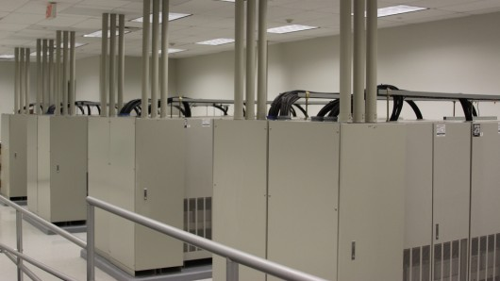
cs61c in the News
Use power dissipation from servers as source of heating?
So-called “Data Furnaces.” Sell the heat to consumers.
“Additionally, such a setup would also provide lower network latency as the storage and computation systems can be located closer to areas of high population density and therefore those using them.”
http://www.gizmag.com/data-furnaces-to-heat-the-home/19314/
http://research.microsoft.com/pubs/150265/heating.pdf

Slide 22
Processor Design Process
Five steps to design a processor:
Step 1: Analyze instruction set to determine datapath requirements
Step 2: Select set of datapath components & establish clocking methodology
Step 3: Assemble datapath components to meet the requirements
Step 4: Analyze implementation of each instruction to determine setting of control signals that implements the register transfer
Step 5: Assemble the control logic

Slide 23
Given Datapath: RTL → Control
Instruction<31:0>
Inst
Memory
<0:5>
<21:25>
<16:20>
<11:15>
<0:15>
<26:31>
Adr
Op
Fun
Rt
Rs
Rd
Imm16
Control
nPC_sel
RegWr
RegDst
ExtOp
ALUSrc
ALUctr
MemWr
MemtoReg
DATA PATH

Slide 24
Summary of the Control Signals (1/2)
inst Register Transfer
add R[rd] ← R[rs] + R[rt]; PC ← PC + 4
ALUsrc=RegB, ALUctr=“ADD”, RegDst=rd, RegWr, nPC_sel=“+4”
sub R[rd] ← R[rs] – R[rt]; PC ← PC + 4
ALUsrc=RegB, ALUctr=“SUB”, RegDst=rd, RegWr, nPC_sel=“+4”
ori R[rt] ← R[rs] + zero_ext(Imm16); PC ← PC + 4
ALUsrc=Im, Extop=“Z”, ALUctr=“OR”, RegDst=rt,RegWr, nPC_sel=“+4”
lw R[rt] ← MEM[ R[rs] + sign_ext(Imm16)]; PC ← PC + 4
ALUsrc=Im, Extop=“sn”, ALUctr=“ADD”, MemtoReg, RegDst=rt, RegWr, nPC_sel = “+4”
sw MEM[ R[rs] + sign_ext(Imm16)] ← R[rs]; PC ← PC + 4
ALUsrc=Im, Extop=“sn”, ALUctr = “ADD”, MemWr, nPC_sel = “+4”
Beq if (R[rs] == R[rt]) then PC ← PC + sign_ext(Imm16)] || 00 else PC ← PC + 4
nPC_sel = “br”, ALUctr = “SUB”

Slide 25
Summary of the Control Signals (2/2)
See
func
10 0000
10 0010
We Don’t Care :-)
Appendix A
op
00 0000
00 0000
00 1101
10 0011
10 1011
00 0100
00 0010
add
sub
ori
lw
sw
beq
jump
RegDst
1
1
0
0
x
x
x
ALUSrc
0
0
1
1
1
0
x
MemtoReg
0
0
0
1
x
x
x
RegWrite
1
1
1
1
0
0
0
MemWrite
0
0
0
0
1
0
0
nPCsel
0
0
0
0
0
1
?
Jump
0
0
0
0
0
0
1
ExtOp
x
x
0
1
1
x
x
ALUctr<2:0>
Add
Subtract
Or
Add
Add
Subtract
x
31
26
21
16
11
6
0
R-type
op
rs
rt
rd
shamt
funct
add, sub
I-type
op
rs
rt
immediate
ori, lw, sw, beq
J-type
op
target address
jump
Notes:
Here is a table summarizing the control signals setting for the seven (add, sub, ...) instructions we have looked at.
Instead of showing you the exact bit values for the ALU control (ALUctr), I have used the symbolic values here.
The first two columns are unique in the sense that they are R-type instrucions and in order to uniquely identify them, we need to look at BOTH the op field as well as the func fiels.
Ori, lw, sw, and branch on equal are I-type instructions and Jump is J-type. They all can be uniquely idetified by looking at the opcode field alone.
Now let’s take a more careful look at the first two columns. Notice that they are identical except the last row.
So we can combine these two rows here if we can “delay” the generation of ALUctr signals.
This lead us to something call “local decoding.”
+3 = 42 min. (Y:22)

Slide 26
Boolean Expressions for Controller
RegDst = add + sub ALUSrc = ori + lw + sw MemtoReg = lw RegWrite = add + sub + ori + lw MemWrite = sw nPCsel = beq Jump = jump ExtOp = lw + sw ALUctr[0] = sub + beq (assume ALUctr is 00 ADD, 01: SUB, 10: OR) ALUctr[1] = or
Where:
rtype = ~op₅ • ~op₄ • ~op₃ • ~op₂ • ~op₁ • ~op₀, ori = ~op₅ • ~op₄ • op₃ • op₂ • ~op₁ • op₀ lw = op₅ • ~op₄ • ~op₃ • ~op₂ • op₁ • op₀ sw = op₅ • ~op₄ • op₃ • ~op₂ • op₁ • op₀ beq = ~op₅ • ~op₄ • ~op₃ • op₂ • ~op₁ • ~op₀ jump = ~op₅ • ~op₄ • ~op₃ • ~op₂ • op₁ • ~op₀
add = rtype • func₅ • ~func₄ • ~func₃ • ~func₂ • ~func₁ • ~func₀ sub = rtype • func₅ • ~func₄ • ~func₃ • ~func₂ • func₁ • ~func₀
How do we implement this in gates?

Slide 27
Controller Implementation
opcode
func
add
RegDst
ALUSrc
sub
MemtoReg
ori
RegWrite
“AND” logic
lw
“OR” logic
MemWrite
sw
nPCsel
Jump
beq
ExtOp
jump
ALUctr[0]
ALUctr[1]

Slide 28
An Abstract View of the Implementation
Control
Ideal
Instruction
Memory
Instruction
Control Signals
Conditions
Rd
Rs
Rt
Instruction
Address
5
5
5
A
Data
Addr
Rw
Ra
Rb
Data
Out
32
32
32
Ideal
Data
Memory
PC
Register
File
ALU
Next Address
B
Data In
clk
clk
32
clk
Datapath
Notes:
One thing you may noticed from our last slide is that almost all instructions, except Jump, require reading some registers, do some computation, and then do something else.
Therefore our datapath will look something like this.
For example, if we have an add instruction (points to the output of Instruction Memory), we will read the registers from the register file (Ra, Rb and then busA and busB).
Add the two numbers together (ALU) and then write the result back to the register file.
On the other hand, if we have a load instruction, we will first use the ALU to calculate the memory address.
Once the address is ready, we will use it to access the Data Memory.
And once the data is available on Data Memory’s output bus, we will write the data to the register file. Well, this is simple enough.
But if it is this simple, you probably won’t need to take this class.
So in today’s lecture, I will show you how to turn this abstract datapath into a real datapath by making it slightly (JUST slightly) more complicated so it can do real work for you.
But before we do that, let’s do a quick review of the clocking methodology
+3 = 16 (X:56)

Slide 29
Call home, we’ve made HW/SW contact!
High Level Language Program (e.g., C)
temp = v[k];
v[k] = v[k+1];
v[k+1] = temp;
Compiler
Anything can be represented as a number, i.e., data or instructions
lw $t0, 0($2)
lw $t1, 4($2)
sw $t1, 0($2)
sw $t0, 4($2)
Assembly Language Program (e.g., MIPS)
Assembler
0000 1001 1100 0110 1010 1111 0101 1000
1010 1111 0101 1000 0000 1001 1100 0110
1100 0110 1010 1111 0101 1000 0000 1001
0101 1000 0000 1001 1100 0110 1010 1111
Machine Language Program (MIPS)
Machine Interpretation
Hardware Architecture Description (e.g., block diagrams)
Architecture Implementation
Logic Circuit Description (Circuit Schematic Diagrams)

Slide 30
Agenda
Overview of Control Signals
Administrivia
Control Implementation
Break
Pipelining Intro

Slide 31
Agenda
Overview of Control Signals
Administrivia
Control Implementation
Break
Pipelining Intro

Slide 32
Single Cycle Performance
Assume time for actions are
100ps for register read or write; 200ps for other events
Clock rate is?
Instr | Instr fetch | Register read | ALU op | Memory access | Register write | Total time
lw | 200ps | 100 ps | 200ps | 200ps | 100 ps | 800ps
sw | 200ps | 100 ps | 200ps | 200ps |  | 700ps
R-format | 200ps | 100 ps | 200ps |  | 100 ps | 600ps
beq | 200ps | 100 ps | 200ps |  |  | 500ps
What can we do to improve clock rate?
Will this improve performance as well?
Want increased clock rate to mean faster programs
Notes:
1.25 GHz

Slide 33
Pipeline Analogy: Doing Laundry
Ann, Brian, Cathy, Dave each have one load of clothes to wash, dry, fold, and put away
Washer takes 30 minutes
Dryer takes 30 minutes
“Folder” takes 30 minutes
“Stasher” takes 30 minutes to put clothes into drawers
A
B
C
D

Slide 34
Sequential Laundry
Sequential laundry takes 8 hours for 4 loads
6 PM
7
8
9
10
11
12
1
2 AM
T
a
s
k
O
r
d
e
r
30
30
30
30
30
30
30
30
30
30
30
30
30
30
30
30
Time
A
B
C
D

Slide 35
Pipelined Laundry
Pipelined laundry takes 3.5 hours for 4 loads!
6 PM
7
8
9
10
11
12
1
2 AM
30
30
30
30
30
Time
T
a
s
k
O
r
d
e
r
30
30
A
B
C
D

Slide 36
Pipelining Lessons (1/2)
6 PM
7
8
9
Pipelining doesn’t help latency of single task, it helps throughput of entire workload
Multiple tasks operating simultaneously using different resources
Potential speedup = Number pipe stages
Time to fill pipeline and time to drain it reduces speedup: 2.3X v. 4X in this example
T
a
s
k
O
r
d
e
r
Time
30
30
30
30
30
30
30
A
B
C
D

Slide 37
Pipelining Lessons (2/2)
6 PM
7
8
9
Suppose new Washer takes 20 minutes, new Stasher takes 20 minutes. How much faster is pipeline?
Pipeline rate limited by slowest pipeline stage
Unbalanced lengths of pipe stages reduces speedup
T
a
s
k
O
r
d
e
r
Time
30
30
30
30
30
30
30
A
B
C
D

Slide 38
Recall: Steps in Executing MIPS
1) IF: Instruction Fetch, Increment PC
2) ID: Instruction Decode, Read Registers
3) EX: Mem-ref: Calculate Address Arith-log: Perform Operation
4) Mem: Load: Read Data from Memory Store: Write Data to Memory
5) WB: Write Data Back to Register

Slide 39
Redrawn Single-Cycle Datapath
rd
PC
instruction
memory
registers
rs
Data
memory
rt
ALU
+4
imm
2. Decode/
Register Read
1. Instruction
Fetch
5. Write Back
3. Execute
4. Memory

Slide 40
Pipelined Datapath
rd
PC
instruction
memory
registers
rs
Data
memory
rt
ALU
+4
imm
2. Decode/
Register Read
1. Instruction
Fetch
5. Write Back
3. Execute
4. Memory
Add registers between stages
Hold information produced in previous cycle

Slide 41
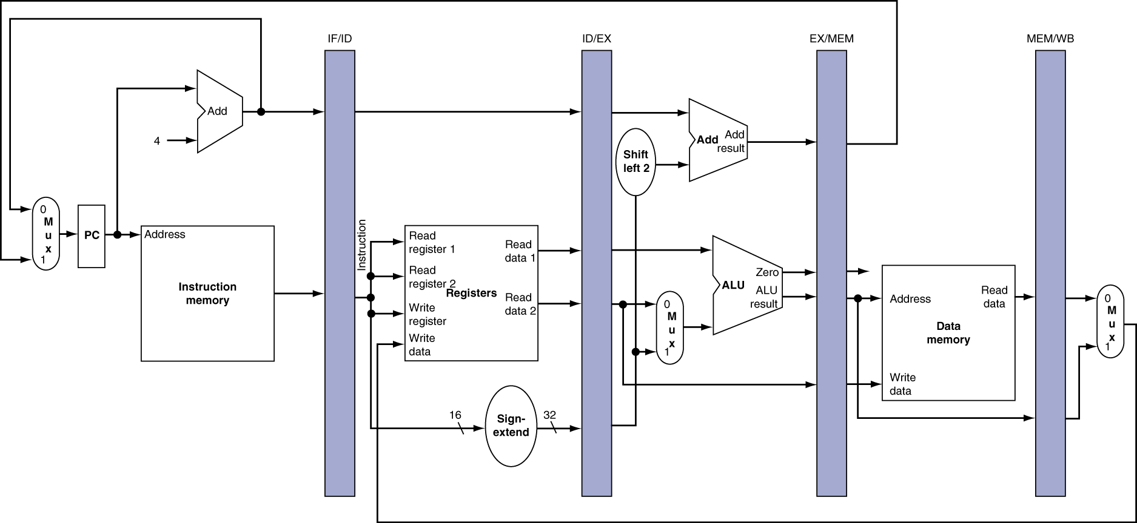
More Detailed Pipeline

Slide 42
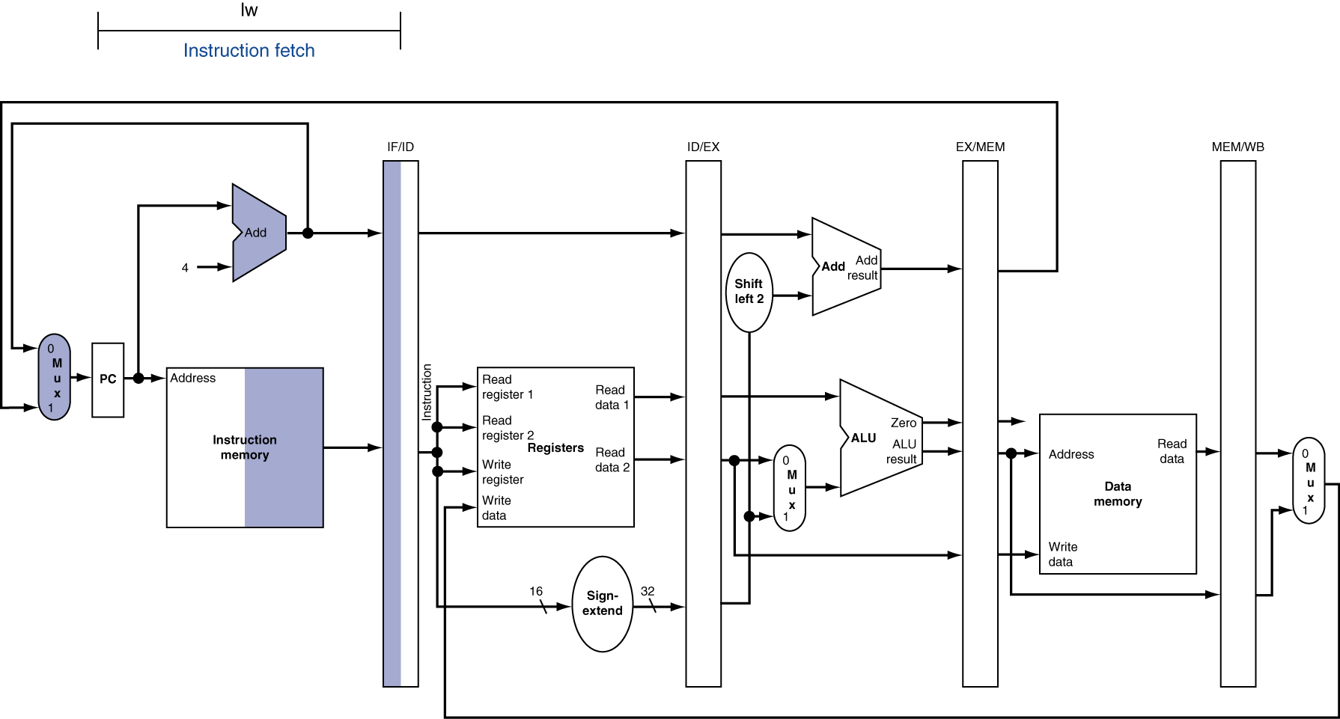
IF for Load, Store, …

Slide 43
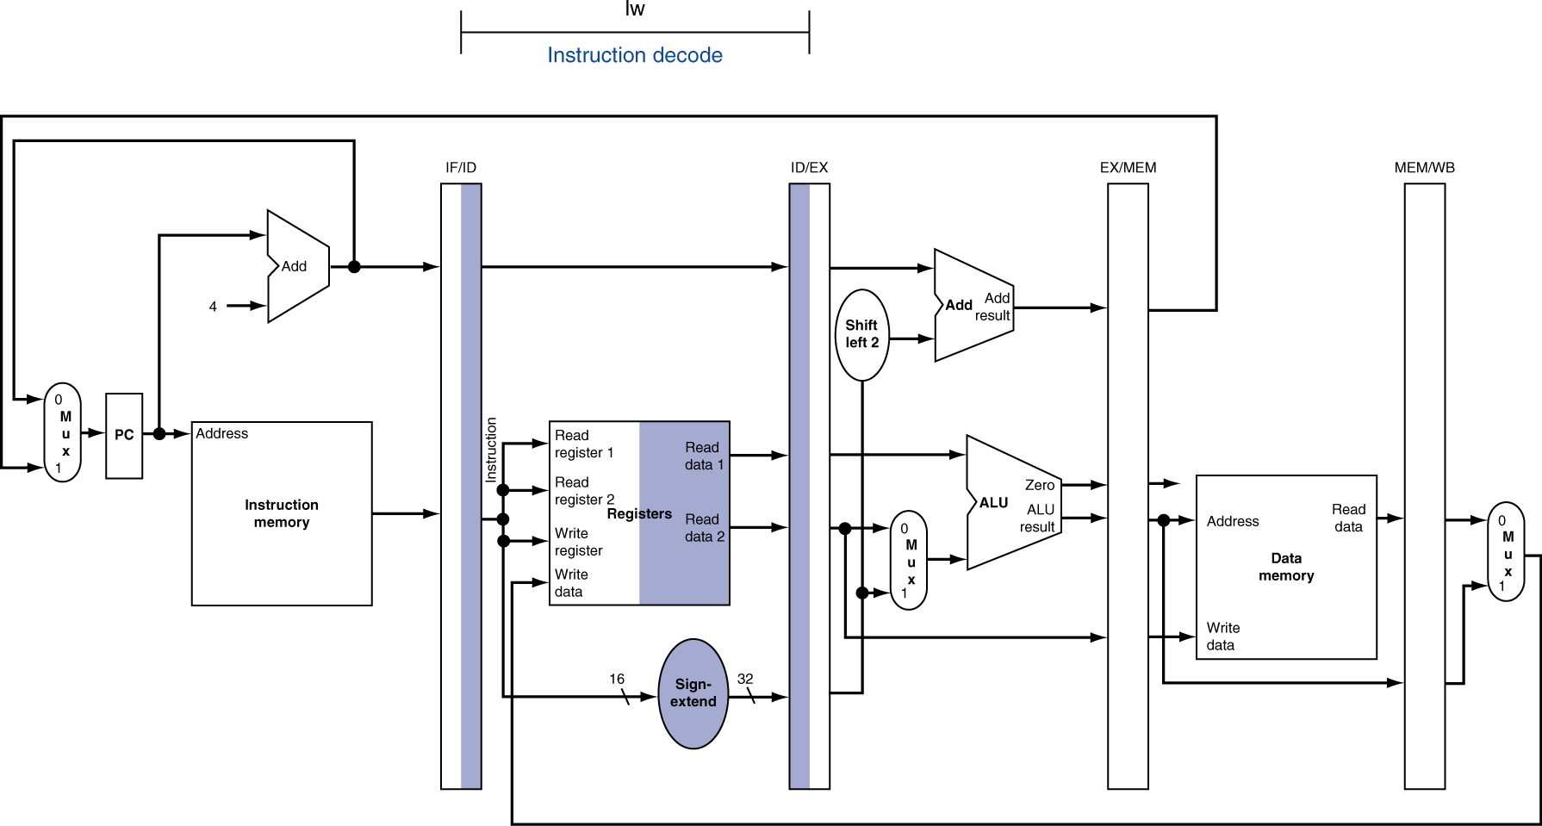
ID for Load, Store, …

Slide 44
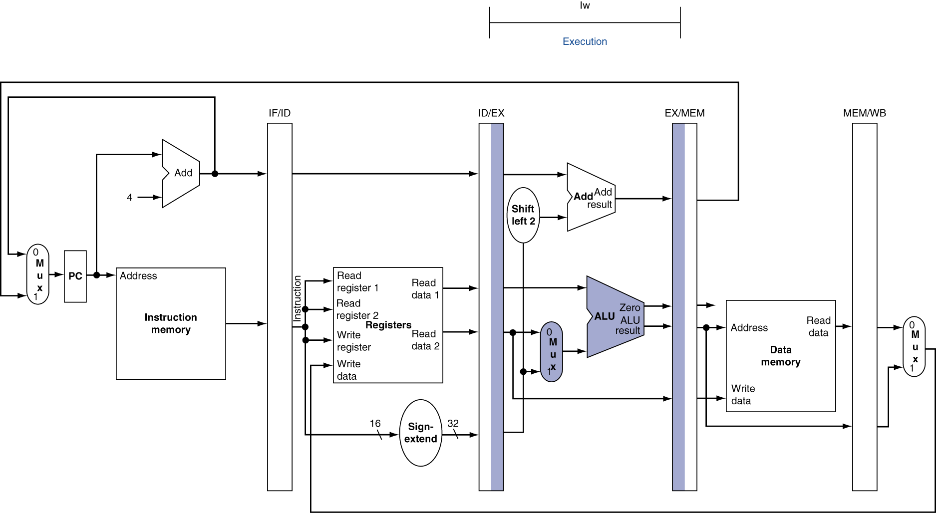
EX for Load

Slide 45
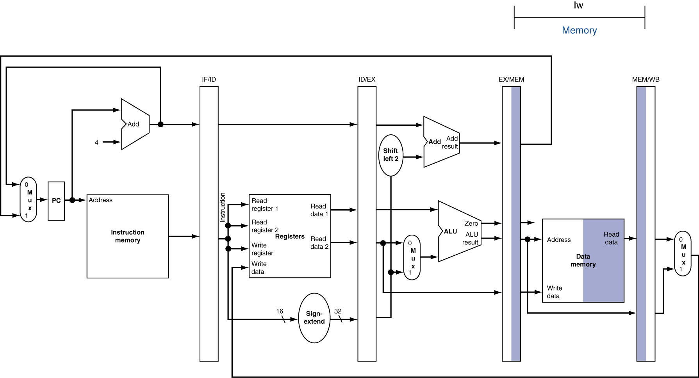
MEM for Load

Slide 46
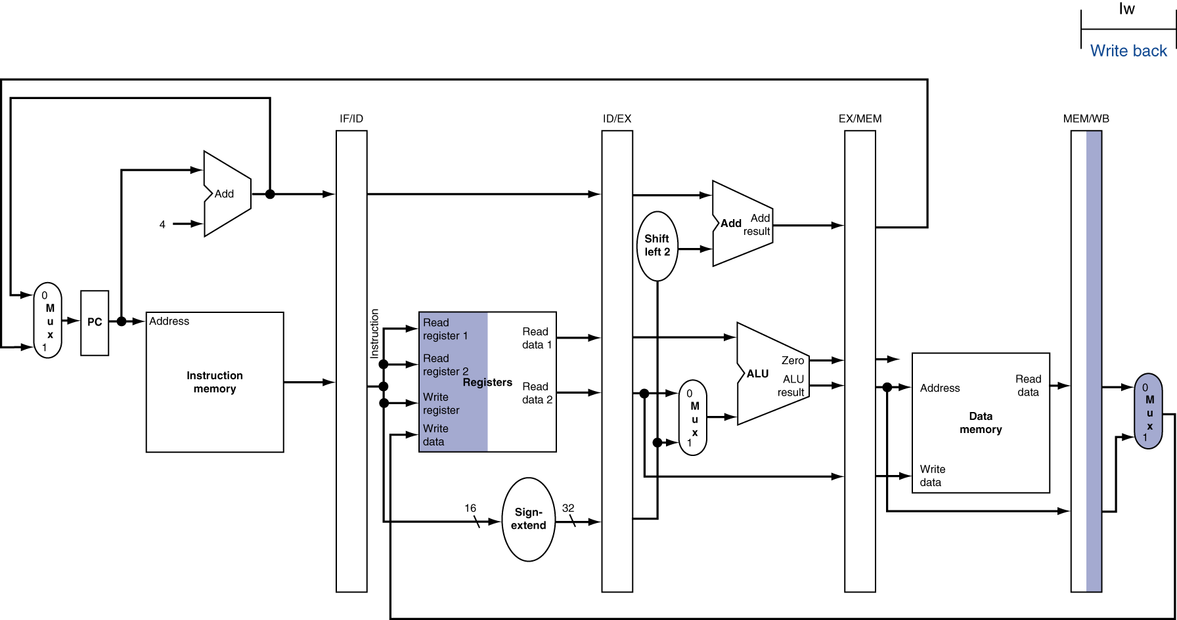
WB for Load
Wrong register number

Slide 47
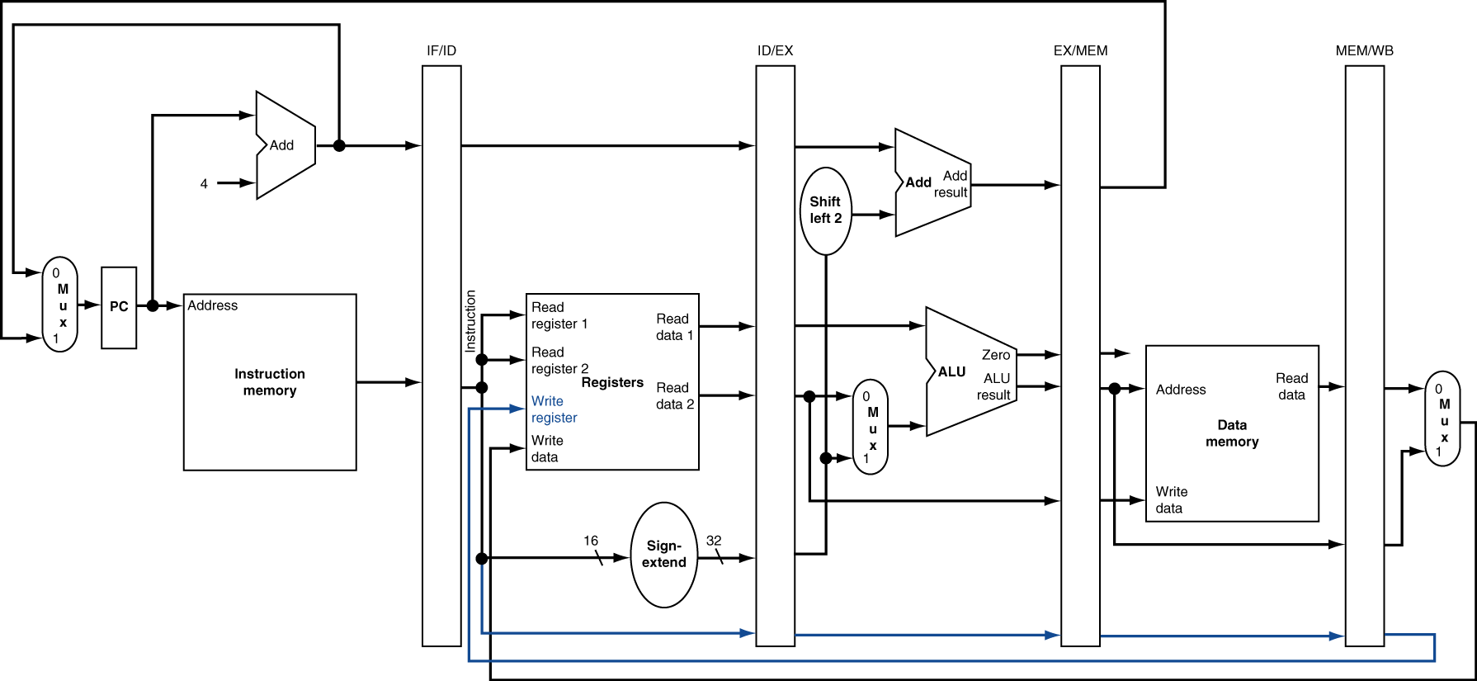
Corrected Datapath for Load

Slide 48
Pipelined Execution Representation
Time
IF
ID
EX
Mem
WB
IF
ID
EX
Mem
WB
IF
ID
EX
Mem
WB
IF
ID
EX
Mem
WB
IF
ID
EX
Mem
WB
IF
ID
EX
Mem
WB
Every instruction must take same number of steps, also called pipeline stages, so some will go idle sometimes

Slide 49
Graphical Pipeline Diagrams
rd
PC
instruction
memory
registers
rs
Data
memory
rt
ALU
+4
imm
2. Decode/
Register Read
1. Instruction
Fetch
5. Write Back
3. Execute
4. Memory
Use datapath figure below to represent pipeline
IF
ID
EX
Mem
WB
I$
Reg
ALU
D$
Reg

Slide 50
Graphical Pipeline Representation
(In Reg, right half highlight read, left half write)
Time (clock cycles)
I
n
s
t
r.
O
r
d
e
r
Load
I$
Reg
ALU
D$
Reg
Add
I$
Reg
ALU
D$
Reg
Store
I$
Reg
ALU
D$
Reg
Sub
I$
Reg
ALU
D$
Reg
Or
I$
Reg
ALU
D$
Reg

Slide 51
Pipeline Performance
Assume time for stages is
100ps for register read or write
200ps for other stages
What is pipelined clock rate?
Compare pipelined datapath with single-cycle datapath
Instr | Instr fetch | Register read | ALU op | Memory access | Register write | Total time
lw | 200ps | 100 ps | 200ps | 200ps | 100 ps | 800ps
sw | 200ps | 100 ps | 200ps | 200ps |  | 700ps
R-format | 200ps | 100 ps | 200ps |  | 100 ps | 600ps
beq | 200ps | 100 ps | 200ps |  |  | 500ps
Student Roulette?

Slide 52
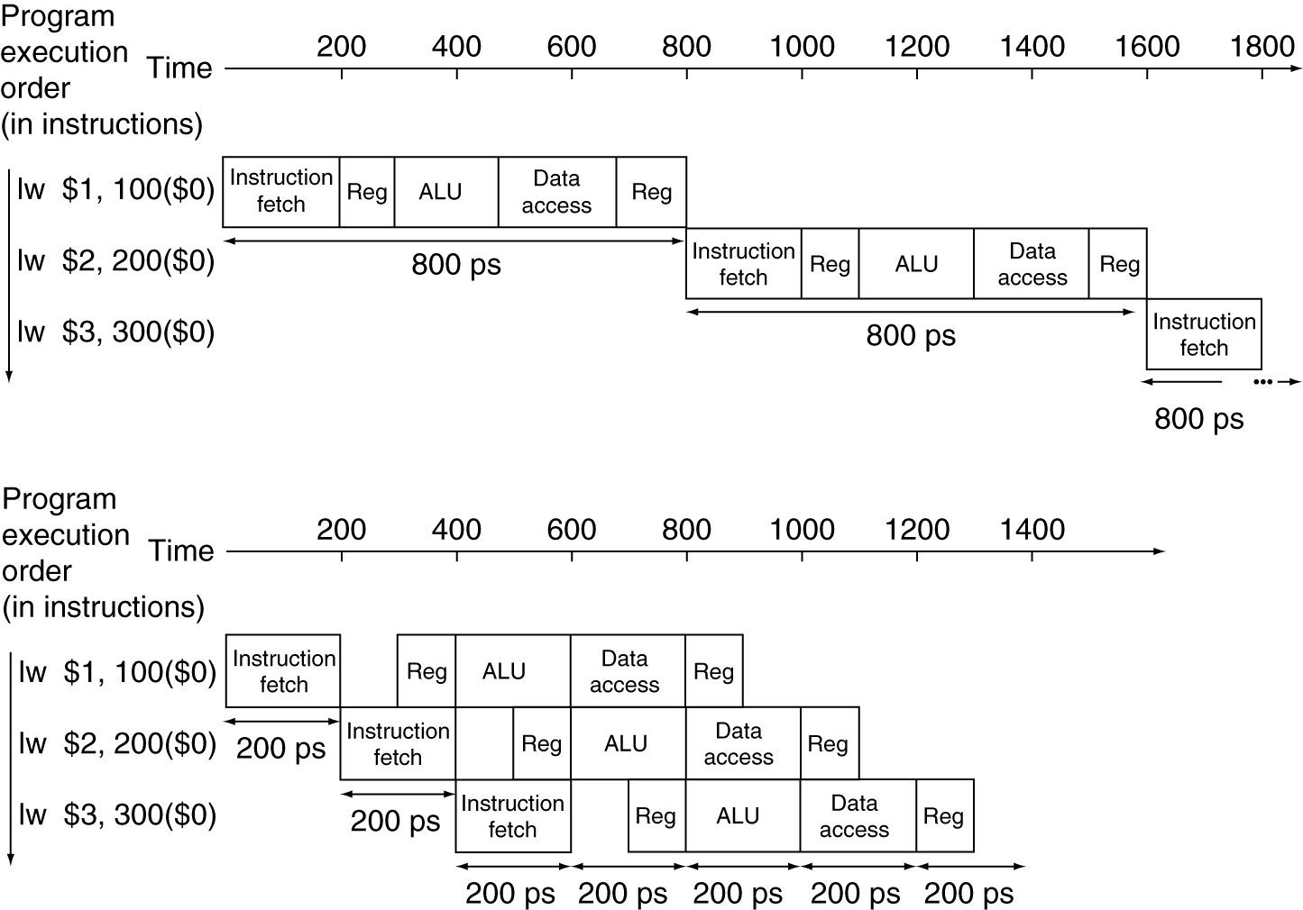
Pipeline Performance
Single-cycle (T_{c}= 800ps)
Pipelined (T_{c}= 200ps)

Slide 53
Pipeline Speedup
If all stages are balanced
i.e., all take the same time
Time between instructions_{pipelined} = Time between instructions_{nonpipelined} Number of stages
If not balanced, speedup is less
Speedup due to increased throughput
Latency (time for each instruction) does not decrease

Slide 54
Instruction Level Parallelism (ILP)
ILP – e.g., Pipelined Instruction Execution
5 stage pipeline => 5 instructions executing simultaneously, one at each pipeline stage

Slide 55
And in Conclusion, …
Can determine control signal values for each instruction.
Control implementation: Just combinational logic (at least for a single cycle CPU…)
Pipelining
Reduce critical path by inserting registers between each stage
N-stage pipeline => N operations done in parallel!

Slide 56
Bonus slides
Note: You are still responsible for knowing the material covered in these slides.
The slides will appear in the order they would have in the normal presentation
Bonus

Slide 57
Single Cycle Datapath during Store
31
26
21
16
0
op
rs
rt
immediate
Data Memory {R[rs] + SignExt[imm16]} = R[rt]
Instruction<31:0>
nPC_sel=
instr
fetch
unit
RegDst=
<21:25>
<16:20>
<0:15>
clk
<11:15>
Rd
Rt
1
0
Rs
Rt
Rd
Imm16
zero
ALUctr=
RegWr=
Rs
Rt
MemtoReg=
5
5
5
busA
32
MemWr=
busW
Rw
Ra
Rb
=
32
32
RegFile
busB
ALU
0
0
clk
32
32
WrEn
Adr
imm16
1
Data In
1
16
Extender
Data
Memory
32
clk
ExtOp=
ALUSrc=
Notes:
The store instruction performs the inverse function of the load. Instead of loading data from memory, the store instruction sends the contents of register specified by Rt to data memory.
Similar to the load instruction, the store instruction needs to read the contents of register Rs (points to Ra port) and add it to the sign extended verion of the immediate filed (Imm16, ExtOp = 1, ALUSrc = 1) to form the data memory address (ALUctr = add).
However unlike the Load instructoion where busB is not used, the store instruction will use busB to send the data to the Data memory.
Consequently, the Rt field of the instruction has to be fed to the Rb port of the register file.
In order to write the Data Memory properly, the MemWr signal has to be set to 1.
Notice that the store instruction does not update the register file. Therefore, RegWr must be set to zero and consequently control signals RegDst and MemtoReg are don’t cares.
And once again we need to set the control signals Branch and Jump to zero to ensure proper Program Counter updataing.
Well, by now, you are probably tied of these boring stuff where Branch and Jump are zero so let’s look at something different--the bracnh instruction.
+3 = 31 min. (Y:11)

Slide 58
Single Cycle Datapath during Store
31
26
21
16
0
op
rs
rt
immediate
Data Memory {R[rs] + SignExt[imm16]} = R[rt]
Instruction<31:0>
nPC_sel=+4
instr
fetch
unit
RegDst=x
<21:25>
<16:20>
<0:15>
clk
<11:15>
Rd
Rt
1
0
Rs
Rt
Rd
Imm16
zero
ALUctr=ADD
RegWr=0
Rs
Rt
MemtoReg=x
5
5
5
busA
32
MemWr=1
busW
Rw
Ra
Rb
=
32
32
RegFile
busB
ALU
0
0
clk
32
32
WrEn
Adr
imm16
1
Data In
1
16
Extender
Data
Memory
32
clk
ExtOp=sign
ALUSrc=1
Notes:
The store instruction performs the inverse function of the load. Instead of loading data from memory, the store instruction sends the contents of register specified by Rt to data memory.
Similar to the load instruction, the store instruction needs to read the contents of register Rs (points to Ra port) and add it to the sign extended verion of the immediate filed (Imm16, ExtOp = 1, ALUSrc = 1) to form the data memory address (ALUctr = add).
However unlike the Load instructoion where busB is not used, the store instruction will use busB to send the data to the Data memory.
Consequently, the Rt field of the instruction has to be fed to the Rb port of the register file.
In order to write the Data Memory properly, the MemWr signal has to be set to 1.
Notice that the store instruction does not update the register file. Therefore, RegWr must be set to zero and consequently control signals RegDst and MemtoReg are don’t cares.
And once again we need to set the control signals Branch and Jump to zero to ensure proper Program Counter updataing.
Well, by now, you are probably tied of these boring stuff where Branch and Jump are zero so let’s look at something different--the bracnh instruction.
+3 = 31 min. (Y:11)

Slide 59
Single Cycle Datapath during Jump
31
26
25
0
J-type
op
target address
jump
New PC = { PC[31..28], target address, 00 }
Jump=
Instruction<31:0>
nPC_sel=
Instruction
Fetch Unit
Rd
Rt
<21:25>
<16:20>
<11:15>
<0:15>
<0:25>
RegDst =
Clk
1
Mux
0
RegWr =
Rs
Rt
ALUctr =
Rt
Rs
Rd
Imm16
TA26
5
5
5
MemtoReg =
busA
Zero
MemWr =
Rw
Ra
Rb
busW
32
32 32-bit
Registers
0
32
busB
ALU
32
Clk
0
32
Mux
Mux
32
WrEn
Adr
1
1
Data In
32
imm16
Extender
Data
Memory
16
32
Clk
ALUSrc =
ExtOp =
Notes:
So how does the branch instruction work?
As far as the main datapath is concerned, it needs to calculate the branch condition. That is, it subtracts the register specified in the Rt field from the register specified in the Rs field and set the condition Zero accordingly.
In order to place the register values on busA and busB, we need to feed the Rs and Rt fields of the instruction to the Ra and Rb ports of the register file and set ALUSrc to 0.
Then we have to instruction the ALU to perform the subtract (ALUctr = sub) operation and set the Zero bit accordingly.
The Zero bit is sent to the Instruction Fetch Unit. I will show you the internal of the Instruction Fetch Unit in a second.
But before we leave this slide, I want you to notice that ExtOp, MemtoReg, and RegDst are don’t cares but RegWr and MemWr have to be ZERO to prevent any write to occur.
And finally, the controller needs to set the Branch signal to 1 so the Instruction Fetch Unit knows what to do. So now let’s take a look at the Instruction Fetch Unit.
+2 = 33 min. (Y:13)

Slide 60
Single Cycle Datapath during Jump
31
26
25
0
J-type
op
target address
jump
New PC = { PC[31..28], target address, 00 }
Jump=1
Instruction<31:0>
nPC_sel=?
Instruction
Fetch Unit
Rd
Rt
<21:25>
<16:20>
<11:15>
<0:15>
<0:25>
RegDst = x
Clk
1
Mux
0
RegWr = 0
Rs
Rt
ALUctr =x
Rt
Rs
Rd
Imm16
TA26
5
5
5
MemtoReg = x
busA
Zero
MemWr = 0
Rw
Ra
Rb
busW
32
32 32-bit
Registers
0
32
busB
ALU
32
Clk
0
32
Mux
Mux
32
WrEn
Adr
1
1
Data In
32
imm16
Extender
Data
Memory
16
32
Clk
ALUSrc = x
ExtOp = x
Notes:
So how does the branch instruction work?
As far as the main datapath is concerned, it needs to calculate the branch condition. That is, it subtracts the register specified in the Rt field from the register specified in the Rs field and set the condition Zero accordingly.
In order to place the register values on busA and busB, we need to feed the Rs and Rt fields of the instruction to the Ra and Rb ports of the register file and set ALUSrc to 0.
Then we have to instruction the ALU to perform the subtract (ALUctr = sub) operation and set the Zero bit accordingly.
The Zero bit is sent to the Instruction Fetch Unit. I will show you the internal of the Instruction Fetch Unit in a second.
But before we leave this slide, I want you to notice that ExtOp, MemtoReg, and RegDst are don’t cares but RegWr and MemWr have to be ZERO to prevent any write to occur.
And finally, the controller needs to set the Branch signal to 1 so the Instruction Fetch Unit knows what to do. So now let’s take a look at the Instruction Fetch Unit.
+2 = 33 min. (Y:13)

Slide 61
Instruction Fetch Unit at the End of Jump
31
26
25
0
J-type
op
target address
jump
New PC = { PC[31..28], target address, 00 }
Jump
Inst
Memory
Instruction<31:0>
nPC_sel
Adr
Zero
nPC_MUX_sel
4
How do we modify this to account for jumps?
Adder
0
00
Mux
PC
1
Adder
Clk
imm16
Notes:
Let’s look at the interesting case where the branch condition Zero is true (Zero = 1).
Well, if Zero is not asserted, we will have our boring case where PC + 1 is selected.
Anyway, with Branch = 1 and Zero = 1, the output of the second adder will be selected.
That is, we will add the seqential address, that is output of the first adder, to the sign extended version of the immediate field, to form the branch target address (output of 2nd adder).
With the control signal Jump set to zero, this branch target address will be written into the Program Counter register (PC) at the end of the clock cycle.
+2 = 35 min. (Y:15)

Slide 62
Instruction Fetch Unit at the End of Jump
31
26
25
0
J-type
op
target address
jump
New PC = { PC[31..28], target address, 00 }
Jump
Inst
Memory
Instruction<31:0>
nPC_sel
Adr
Zero
Query
Can Zero still get asserted?
Does nPC_sel need to be 0?
If not, what?
nPC_MUX_sel
26
00
4
TA
1
00
Adder
0
Mux
PC
4 (MSBs)
0
Mux
Clk
1
Adder
imm16
Notes:
Let’s look at the interesting case where the branch condition Zero is true (Zero = 1).
Well, if Zero is not asserted, we will have our boring case where PC + 1 is selected.
Anyway, with Branch = 1 and Zero = 1, the output of the second adder will be selected.
That is, we will add the seqential address, that is output of the first adder, to the sign extended version of the immediate field, to form the branch target address (output of 2nd adder).
With the control signal Jump set to zero, this branch target address will be written into the Program Counter register (PC) at the end of the clock cycle.
+2 = 35 min. (Y:15)

