Slide 1
CS 61C: Great Ideas in Computer Architecture (Machine Structures) RISC in Retrospect, Misc Topics (Fixed Point, Polling vs. Interrupts)
Instructor: Michael Greenbaum

Slide 2
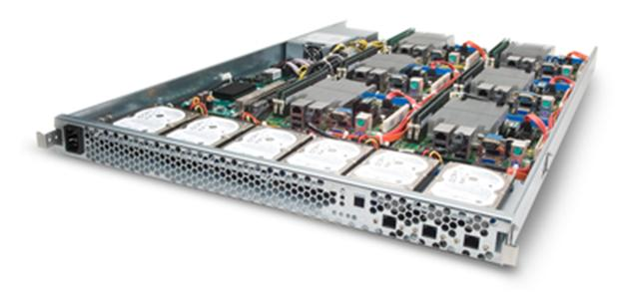
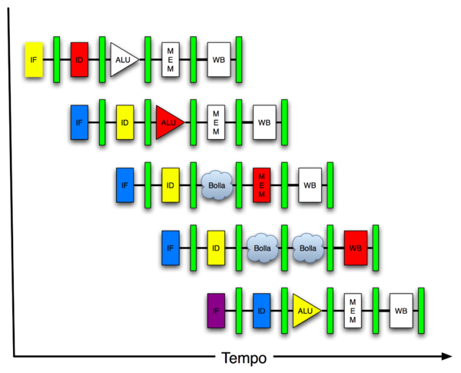
New-School Machine Structures
Today’s
Lecture
Software Hardware
Parallel Requests
Assigned to computer
e.g., Search “Katz”
Parallel Threads
Assigned to core
e.g., Lookup, Ads
Parallel Instructions
>1 instruction @ one time
e.g., 5 pipelined instructions
Parallel Data
>1 data item @ one time
e.g., Add of 4 pairs of words
Hardware descriptions
All gates @ one time
Warehouse Scale Computer
Smart Phone
Harness Parallelism &
Achieve High Performance
Computer
Core
…
Core
Memory (Cache)
Input/Output
Core
Instruction Unit(s)
Functional
Unit(s)
A₀+B₀
A₁+B₁
A₂+B₂
A₃+B₃
Main Memory
Logic Gates

Slide 3
Agenda
Modern Microprocessor: Intel Nehalem
Administrivia
RISC vs. CISC in Retrospect 30 years later
Misc: Fixed Point, Polling vs. Interrupts (If time)

Slide 4
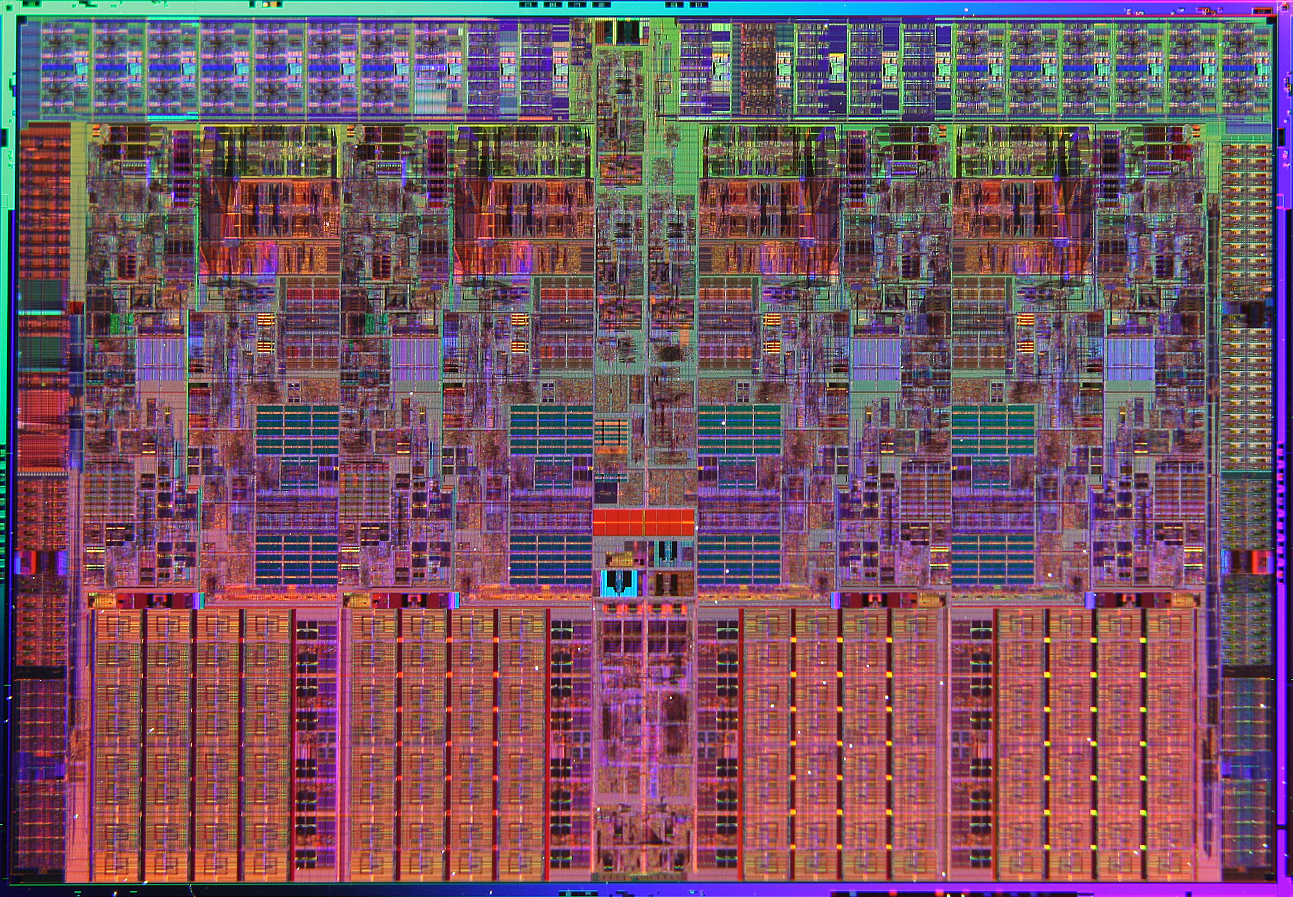
Nehalem Die Photo
Memory Controller
Misc IO
Misc IO
13.6 mm (0.54 inch)
Core
Core
Core
Core
Memory
Queue
QPI
QPI
Shared L3 Cache
18.9 mm (0.75 inch)

Slide 5
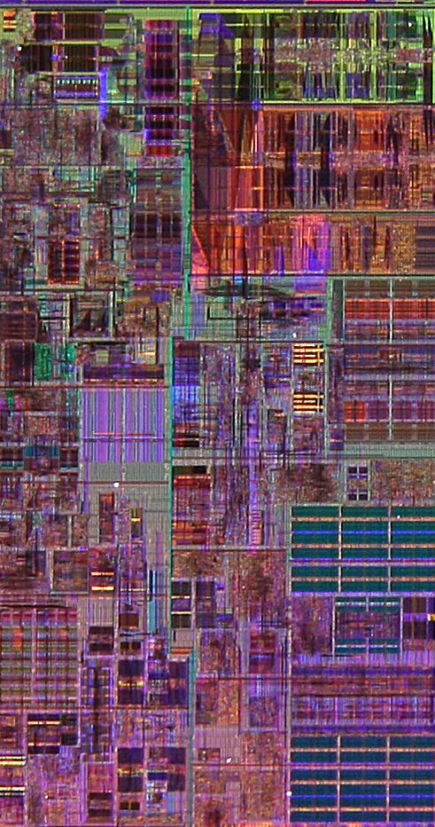
Core Area Breakdown
Memory Controller
Out-of-Order Scheduling & Instruction Commit
Execution Units
Instruction Decode,Reg Renaming & Microcode
Memory Ordering & Execution
L1 Data cache
L2 Cache & Interrupt Servicing
L1 Inst cache & Inst Fetch
Vir-tual Memory, TLB
Brnch Pre-dic-tion
L3 Cache
Load Store Queue

Slide 6
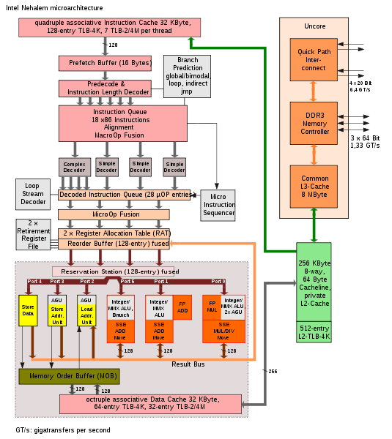
In-Order Fetch
In-Order Decode and Register Renaming
In-Order Commit
Out-of-Order Execution
2 Threads per Core
Out-of-Order Completion
Notes:
Unified Reservation Station
Schedules operations to Execution units
Single Scheduler for all Execution Units
Can be used by all integer, all FP, etc.
Execute 6 operations/cycle
3 Memory Operations
1 Load
1 Store Address
1 Store Data
3 “Computational” Operations

Slide 7
Notes:
Intel in its resolve to continue its leadership in ISA during 2008 is introducing a new set of instructions collectively called as SSE4.2.
SSE4 has been defined for Intel’s 45nm products. The first version SSE4.1 was introduced in the Penryn Arch based products. A set of 7 new instructions is being introduced in Nehalem architecture in 2008 collectively called as SSE4.2.
SSE4.2 is further divided into 2 distinct sub groups called STTNI and ATA. There are 4 instructions in STTNI and 2 ATA’s viz. POPCNT and CRC32.
STTNI is meant for accelerated string and text processing.
POPCNT is an ATA for fast pattern recognition while processing large data sets.
CRC32 is another ATA that provides hardware based CRC instruction allowing for new communication capabilities

Slide 9
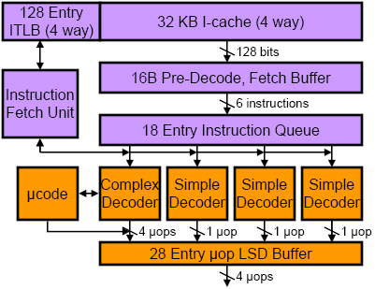
Front-End Instruction Fetch & Decode
x86 instruction bits
µOP is Intel name for internal RISC-like (MIPS) instruction, into which x86 instructions are translated
internal µOP bits
Loop Stream Detector (can run short loops out of the buffer)

Slide 10
x86 Decoding
Translate up to 4 x86 instructions into μOPS (≈MIPS or RISC instructions) each cycle
Only first x86 instruction in group can be complex (maps to 1-4 μOPS), rest must be simple (map to one μOP)
Even more complex instructions, jump into microcode engine which spits out stream of μOPS

Slide 11
Branch Prediction
Part of instruction fetch unit
Several different types of branch predictor
Details not public
Two-level Branch Table Buffer
Loop count predictor
How many backwards taken branches before loop exit

Slide 12
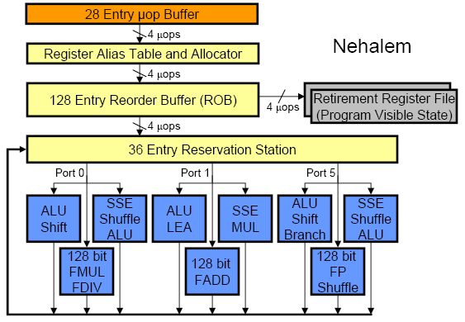
Out-of-Order Execution Engine
Renaming happens at uOP level (not original macro-x86 instructions)

Slide 13
Nehalem Memory Hierarchy Overview
32KB L1 I$
32KB L1 I$
CPU Core
4-8 Cores
CPU Core
Private L1/L2 per core
32KB L1 D$
32KB L1 D$
L3 fully inclusive of higher levels (but L2 not inclusive of L1)
256KB L2$
256KB L2$
8MB Shared L3$
3 DDR3 DRAM Memory Controllers
QuickPath System Interconnect
Other sockets’ caches kept coherent using QuickPath messages
Each DRAM Channel is 64/72b wide at up to 1.33Gb/s
Each direction is 20b@6.4Gb/s
Notes:
Integrated Memory Controller
3 DDR3 channels per socket
Massive memory bandwidth
Memory Bandwidth scales with # of processors
Very low memory latency
Intel® QuickPath Interconnect (Intel® QPI)
New point-to-point interconnect
Socket to socket connections
Socket to chipset connections
Build scalable solutions
Up to 6.4 GT/sec (12.8 GB/sec)
Bidirectional (=> 25.6 GB/sec)

Slide 14
Cache Hierarchy Latencies
L1 I & D 32KB 8-way, latency 4 cycles, 64B blocks
Note: 4KB Page (12 bits) + 8-way associativity (3 bits) means cache index doesn’t need to use virtual part of address, so L1 cache access and TLB lookup can occur in parallel, L1 cache uses physical address tags
Address Tag 6-bit Cache Index 6-bit Block Offset
20-bit Virtual Page Num 12-bit Page Offset
L2 256 KB 8-way, latency <12 cycles
L3 8 MB, 16-way, latency 30-40 cycles
DRAM, latency ~180-200 cycles

Slide 15
Optimization: Concurrent Access to TLB & Phys. Addressed Cache
Virtual
Index
VA
VPN I O
TLB
Direct-map Cache
2^{I} blocks
2^{O}-byte block
k
PA
PPN Page Offset
Tag
=
Physical Tag
Data
hit?
Index I is available without consulting the TLB
⇒ cache and TLB accesses can begin simultaneously
Tag comparison is made after both accesses are completed
Cases: I + O = k I + O < k I + O > k

Slide 17
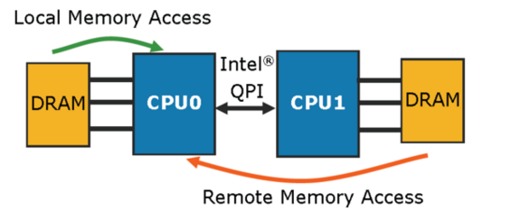
All Sockets can Access all Data
~60ns
Such systems called “NUMA” for Non Uniform Memory Access: some addresses are slower than others
~100ns

Slide 18
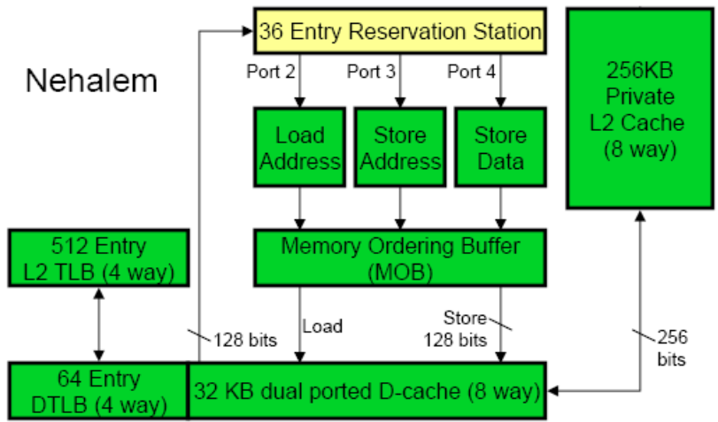
Core’s Private Memory System
Load queue 48 entries
Store queue 32 entries
Divided statically between 2 threads
Up to 16 outstanding misses in flight per core

Slide 19
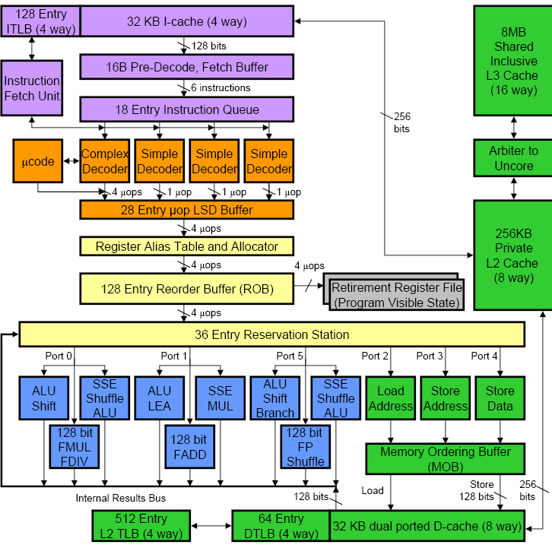

Slide 20
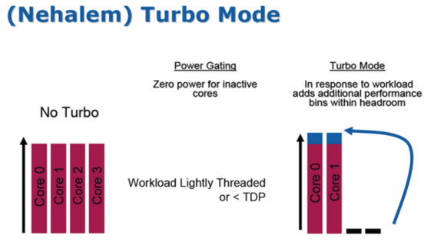

Slide 24
What to do with So Many Features?
“Introduction to Performance Analysis on Nehalem Based Processors”, 72 pages
software.intel.com/sites/products/collateral/hpc/vtune/performance_analysis_guide.pdf
“Software optimization based on performance analysis of large existing applications, in most cases, reduces to optimizing the code generation by the compiler and optimizing the memory access. Optimizing the code generation by the compiler requires inspection of the assembler of the time consuming parts of the application and verifying that the compiler generated a reasonable code stream. Optimizing the memory access is a complex issue involving the bandwidth and latency capabilities of the platform, hardware and software prefetching efficiencies and the virtual address layout of the heavily accessed variables.”

Slide 25
Administrivia
HKN surveys at end of lecture today.
Extra OH
Mine: 12-2pm today in the Soda Alcoves
Come into the SD lab tomorrow wherever there’s a blank sign-up time.
Project 3 Face-to-Face grading tomorrow, 8/10 in 200 SD lab. Don’t forget to show up!
Final Exam - Thursday, 8/11, 9am - 12pm 2050 VLSB
Two-sided handwritten cheat sheet. Green sheet provided.
Use the back side of your midterm cheat sheet!

Slide 26
Agenda
Modern Microarchitecture: Intel Nehalem
Administrivia
RISC vs. CISC in Retrospect 30 years later
Misc: Fixed Point, Polling vs. Interrupts (If time)

Slide 27
RISC vs. CISC
Set up: From 1965 to 1980, virtually all computers implemented instruction sets using microcode (edited wikipedia entry):
“Microcode is a layer of hardware-level instructions involved in the implementation of higher-level machine code instructions; it resides in a special high-speed memory and translates machine instructions into sequences of detailed circuit-level operations. It helps separate the machine instructions from the underlying electronics so that instructions can be designed and altered more freely. It also makes it feasible to build complex multi-step instructions while still reducing the complexity of the electronic circuitry compared to other methods. Writing microcode is often called microprogramming and the microcode in a particular processor implementation is sometimes called a microprogram.”
1980s compilers rarely generated these complex instructions

Slide 28
RISC – CISC Wars
Round 1: The Beginning of Reduced vs. Complex Instruction Set
Instruction set made up of simple or reduced instructions using easy-to-decode instruction formats and lots of registers was a better match to integrated circuits and compiler technology than the instruction sets of the 1970s that featured complex instructions and formats.
Counterexamples were the Digital VAX-11/780, the Intel iAPX-432, and the Intel 8086 architectures, which we labeled Complex Instruction Set Computers (CISC).
http://blogs.arm.com/software-enablement/375-risc-versus-cisc-wars-in-the-prepc-and-pc-eras-part-1/

Slide 29
RISC – CISC Wars
Round 1: The Beginning of Reduced vs. Complex Instruction Set
To implement their more sophisticated operations, CISCs relied on microcode, which is an internal interpreter with its own program memory.
RISC advocates essentially argued that these simpler internal instructions should be exposed to the compiler rather than buried inside an interpreter within a chip.
RISC architects took advantage of the simpler instruction sets to first demonstrate pipelining and later superscalar execution in microprocessors, both of which had been limited to the supercomputer realm.
http://blogs.arm.com/software-enablement/375-risc-versus-cisc-wars-in-the-prepc-and-pc-eras-part-1/

Slide 30
Original RISC Slides
See slides 1 to 16 from RISCTalk1981v6.pdf
Unedited transparencies from 1981 RISC talk + RISC I, RISC II die photos

Slide 31
RISC – CISC Wars
Round 1: The Beginning of Reduced vs. Complex Instruction Set
still amazing that was a time when graduate students could build a prototype chip that was actually faster than what Intel could build.
ARM, MIPS, and SPARC successfully demonstrated the benefits of RISC in the marketplace of the 1980s with rapidly increasing performance that kept pace with the rapid increase in transistors from Moore’s Law.
http://blogs.arm.com/software-enablement/375-risc-versus-cisc-wars-in-the-prepc-and-pc-eras-part-1/

Slide 32
RISC – CISC Wars
Round 2: Intel Responds and Dominates the PC Era
Intel “CISC tax”: longer pipelines, extra translation HW, and the microcode for complex operations but:
Intel’s fab line better than RISC companies, so smaller geometries hide some CISC Tax
Moore’s Law => on-chip integration of FPUs & caches, over time CISC Tax became smaller %
Increasing popularity of IBM PC + distribution of SW in binary made x86 ISA valuable, no matter tax

Slide 33
RISC – CISC Wars
Round 2: Intel Responds and Dominates in the PC Era
Most executed instructions simple
HW translated simple x86 instructions into internal RISC instructions, then use RISC ideas: pipelining, superscalar, ...
Wikipedia: “While early RISC designs were significantly different than contemporary CISC designs, by 2000 the highest performing CPUs in the RISC line were almost indistinguishable from the highest performing CPUs in the CISC line.”
http://blogs.arm.com/software-enablement/375-risc-versus-cisc-wars-in-the-prepc-and-pc-eras-part-1/

Slide 34
RISC – CISC Wars
RISC vs. CISC in the PostPC Era
CISC not a good match to the smartphones and tablets of the PostPC era
It’s a new software stack and software distribution is via the “App Store model” or the browser, which lessens the conventional obsession with binary compatibility.
RISC designs are more energy efficient.
RISC designs are smaller and thus cheaper.
http://blogs.arm.com/software-enablement/377-risc-versus-cisc-wars-in-the-postpc-eras-part-2/

Slide 35
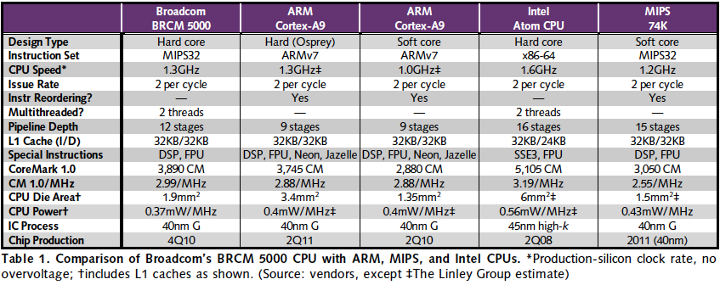
RISC vs. CISC 2010 (mobile client)
“Broadcom Shows Off New CPU,” Linley Gwennap, Microprocessor Report, November 22, 2010
X86 ≈ 1.04 – 1.08x better performance/MHz vs. MIPS, ARM
MIPS, ARM ≈ 1.4 – 1.5x better energy/MHz vs. x86
MIPS, ARM ≈ ⅓ to ¼ die area vs. x86

Slide 36
RESOLVING RISC-CISC DEBATE
Products shipped?
2010: 6.1B ARM, 0.3B x86
How USA resolves debates?
We ask celebrities!
Who is the biggest celebrity in the world?
Notes:
How do we decide important decisions in the USA?
We ask celebrities! What greater celebrity is there than Angelina Jolie?
Here is what she said in the movie Hackers in 1995
Hacker’s Part Six on Youtube, 2:27 into the movie
http://www.youtube.com/watch?v=onSQlpxpHoU

Slide 37
RESOLVING RISC-CISC Debate
Angelina Jolie as Kate Libby (aka as hacker Acid Burn) in movie “Hackers” (1995)
Notes:
How do we decide important decisions in the USA?
We ask celebrities! What greater celebrity is there than Angelina Jolie?
Here is what she said in the movie Hackers in 1995:
Movie via Netflix @ 50:55 in Hackers / 1995
This youtube video still has audio:http://www.youtube.com/watch?v=jwg4mbGL4JEAbout 50s into the clip.

Slide 38
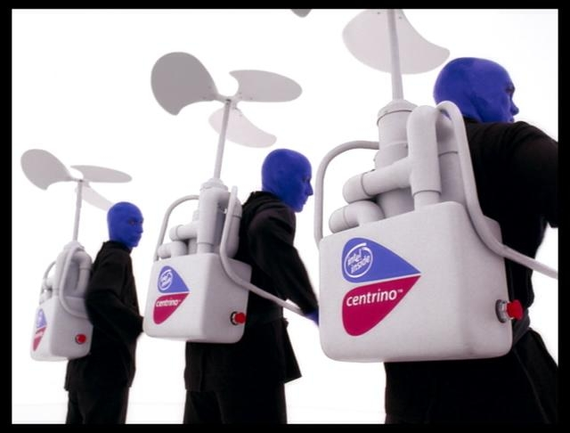
RESOLVING RISC-CISC Debate
Angelina Jolie: “RISC architecture is gonna change everything.”
Blue Man Group
“(silence)”
“Hackers” (1995)
Notes:
RISC has the endorsement of the biggest celebrity in the world.
The best Intel can do is the Blue Man group.
Who would you rather spend the weekend with talking about computer architecture?

Slide 39
Agenda
Modern Microarchitecture: Intel Nehalem
Administrivia
RISC CISC in Retrospect 30 years later
Misc: Fixed Point, Polling vs. Interrupts

Slide 40
Fixed Point
Currently, we know to use floating point to represent real numbers.
Lots of advantages - Covers wide range of numeric values, representations for +/- infinity, NaN.
When might we be unable to use Floating Point?
Embedded systems or microcontrollers (no floating point unit)
Note: Probably better to use floating point when it’s available!

Slide 41
Fixed Point
Idea: Use an integer to count by fractions of a value. Fractions determined by programmer (must be consistent).
Examples:
int seconds = 2000; //counts by milliseconds
int start = 65536; //counts by 2⁻¹⁶ths.
Addition/subtraction simple. Multiplication?
Less range than floating point, greater precision (at certain magnitudes).

Slide 42
Range of Numbers Represented
Fixed Point:
Floating Point:

Slide 43
Polling vs. Interrupts
Need to communicate asynchronously between two components.
Asynchronous - No common clock for timing
Often: CPU communicating with Peripheral Device.
Two communication options:
Polling: Repeatedly check to see if the device has sent something.
Interrupts: Have device trigger an interrupt when it’s ready.

Slide 44
Polling Advantages
No overhead of Interrupt Service routine
Steadier / more predictable performance.
Easier to support/implement.

Slide 45
Interrupt Advantages
Don’t waste time repeatedly checking device.
Could be less network bandwith, less CPU utilization overall.

Slide 46
Polling vs. Interrupts
We’ve seen examples of this so far:
Critical section implementation in MIPS - Polling.
Repeatedly check the lock to see if it’s free.
MapReduce master node checking on worker nodes - Polling.
Exceptions - Interrupt.
Other examples?

Slide 47
“And In Conclusion”
Performance, Intel chip manufacturing => x86 ISA dominates Desktops/Servers
Speculative execution: branch prediction, out of order execution, data prefetching
Hardware translation and optimization of instruction sequences
Opportunistic acceleration (Turbo Mode)
Cost, energy => RISC ISA dominates mobile personal devices, embedded computing, games
What will the future hold for client+cloud?

