Slide 1
CS 61C: Great Ideas in Computer Architecture
OpenMP, Transistors
Instructor: Justin Hsia

Slide 2
Review of Last Lecture
Amdahl’s Law limits benefits of parallelization
Multiprocessor systems uses shared memory (single address space)
Cache coherence implements shared memory even with multiple copies in multiple caches
Track state of blocks relative to other caches (e.g. MOESI protocol)
False sharing a concern
Synchronization via hardware primitives:
MIPS does it with Load Linked + Store Conditional

Slide 3
Question: Consider the following code when executed concurrently by two threads.
What possible values can result in *($s0)?
# *($s0) = 100
lw $t0,0($s0)
addi $t0,$t0,1
sw $t0,0($s0)
☐
101 or 102
☐
100, 101, or 102
☐
100 or 101
☐
102
Notes:
- 102 if one thread starts executing after the other completely finishes.
- 101 if both threads execute the lw before either thread executes the sw. One thread will see “stale data”.

Slide 4
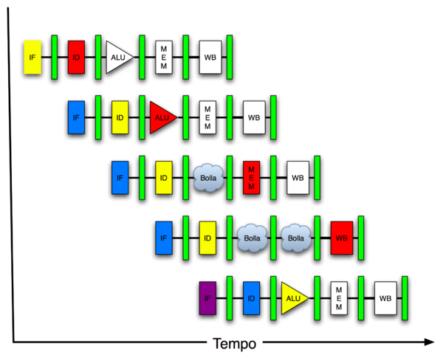
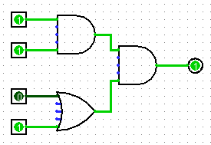
Great Idea #4: Parallelism
Software Hardware
Parallel Requests
Assigned to computer
e.g. search “Katz”
Parallel Threads
Assigned to core
e.g. lookup, ads
Parallel Instructions
> 1 instruction @ one time
e.g. 5 pipelined instructions
Parallel Data
> 1 data item @ one time
e.g. add of 4 pairs of words
Hardware descriptions
All gates functioning in parallel at same time
Warehouse Scale Computer
Smart Phone
Leverage Parallelism &
Achieve High Performance
Computer
Core
…
Core
Memory
Input/Output
Core
Instruction Unit(s)
Functional
Unit(s)
A₀+B₀
A₁+B₁
A₂+B₂
A₃+B₃
Cache Memory
Logic Gates

Slide 5
Agenda
OpenMP Introduction
Administrivia
OpenMP Directives
Workshare
Synchronization
OpenMP Common Pitfalls
Hardware: Transistors
Bonus: sections Example

Slide 6
What is OpenMP?
API used for multi-threaded, shared memory parallelism
Compiler Directives
Runtime Library Routines
Environment Variables
Portable
Standardized
Resources: http://www.openmp.org/ and http://computing.llnl.gov/tutorials/openMP/
Notes:
API: Application Programming Interface

Slide 7
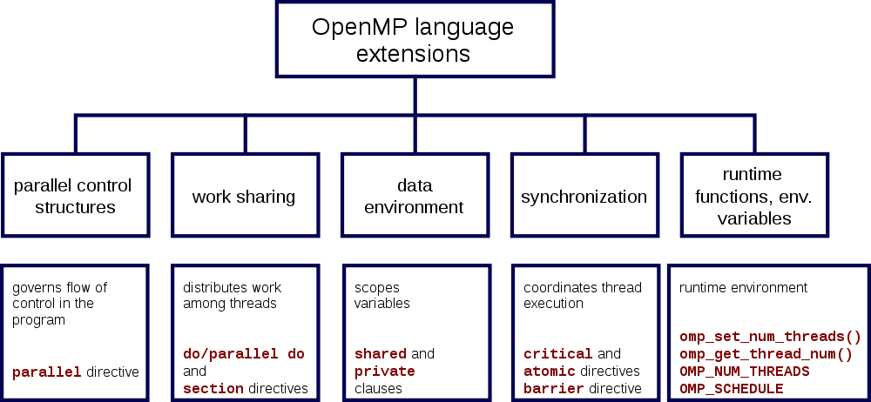
OpenMP Specification

Slide 8
Shared Memory Model with Explicit Thread-based Parallelism
Multiple threads in a shared memory environment, explicit programming model with full programmer control over parallelization
Pros:
Takes advantage of shared memory, programmer need not worry (that much) about data placement
Compiler directives are simple and easy to use
Legacy serial code does not need to be rewritten
Cons:
Code can only be run in shared memory environments
Compiler must support OpenMP (e.g. gcc 4.2)

Slide 9
OpenMP in CS61C
OpenMP is built on top of C, so you don’t have to learn a whole new programming language
Make sure to add #include <omp.h>
Compile with flag: gcc -fopenmp
Mostly just a few lines of code to learn
You will NOT become experts at OpenMP
Use slides as reference, will learn to use in lab
Key ideas:
Shared vs. Private variables
OpenMP directives for parallelization, work sharing, synchronization

Slide 10
OpenMP Programming Model
Fork - Join Model:
OpenMP programs begin as single process (master thread) and executes sequentially until the first parallel region construct is encountered
FORK: Master thread then creates a team of parallel threads
Statements in program that are enclosed by the parallel region construct are executed in parallel among the various threads
JOIN: When the team threads complete the statements in the parallel region construct, they synchronize and terminate, leaving only the master thread

Slide 11
OpenMP Extends C with Pragmas
Pragmas are a preprocessor mechanism C provides for language extensions
Commonly implemented pragmas: structure packing, symbol aliasing, floating point exception modes (not covered in 61C)
Good mechanism for OpenMP because compilers that don't recognize a pragma are supposed to ignore them
Runs on sequential computer even with embedded pragmas

Slide 12
parallel Pragma and Scope
Basic OpenMP construct for parallelization:
#pragma omp parallel
{
/* code goes here */
}
Each thread runs a copy of code within the block
Thread scheduling is non-deterministic
OpenMP default is shared variables
To make private, need to declare with pragma:
#pragma omp parallel private (x)
This is annoying, but curly brace MUST go on separate line from #pragma

Slide 13
Thread Creation
How many threads will OpenMP create?
Defined by OMP_NUM_THREADS environment variable (or code procedure call)
Set this variable to the maximum number of threads you want OpenMP to use
Usually equals the number of cores in the underlying hardware on which the program is run

Slide 14
OMP_NUM_THREADS
Shell command to set number threads:
export OMP_NUM_THREADS=x
Shell command check number threads:
echo $OMP_NUM_THREADS
OpenMP intrinsic to set number of threads:
omp_set_num_threads(x);
OpenMP intrinsic to get number of threads:
num_th = omp_get_num_threads();
OpenMP intrinsic to get Thread ID number:
th_ID = omp_get_thread_num();

Slide 15
Parallel Hello World
#include <stdio.h>
#include <omp.h>
int main () {
int nthreads, tid;
/* Fork team of threads with private var tid */
#pragma omp parallel private(tid)
{
tid = omp_get_thread_num(); /* get thread id */
printf("Hello World from thread = %d\n", tid);
/* Only master thread does this */
if (tid == 0) {
nthreads = omp_get_num_threads();
printf("Number of threads = %d\n", nthreads);
}
} /* All threads join master and terminate */
}

Slide 16
Agenda
OpenMP Introduction
Administrivia
OpenMP Directives
Workshare
Synchronization
OpenMP Common Pitfalls
Hardware: Transistors
Bonus: sections Example

Slide 17
Administrivia
Midterm re-grade requests due Thursday
Project 2: Matrix Multiply Performance Improvement
Work in groups of two!
Part 1: Due July 22 (this Sunday)
Part 2: Due July 29
HW 4 also due July 25

Slide 18
Agenda
OpenMP Introduction
Administrivia
OpenMP Directives
Workshare
Synchronization
OpenMP Common Pitfalls
Hardware: Transistors
Bonus: sections Example

Slide 19
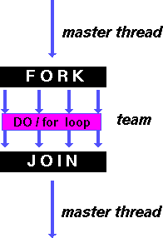
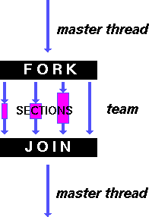
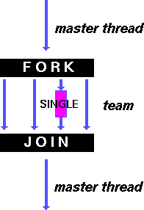
OpenMP Directives (Work-Sharing)
These are defined within a parallel section
Shares iterations of a loop across the threads
Each section is executed by a separate thread
Serializes the execution of a thread
Notes:
A work-sharing construct divides the execution of the enclosed code region among the members of the team that encounter it.

Slide 20
Parallel Statement Shorthand
#pragma omp parallel
{
#pragma omp for
for(i=0;i<len;i++) { … }
}
can be shortened to:
#pragma omp parallel for
for(i=0;i<len;i++) { … }
Also works for sections
This is the only directive in the parallel section

Slide 21
Building Block: for loop
for (i=0; i<max; i++) zero[i] = 0;
Break for loop into chunks, and allocate each to a separate thread
e.g. if max = 100 with 2 threads: assign 0-49 to thread 0, and 50-99 to thread 1
Must have relatively simple “shape” for an OpenMP-aware compiler to be able to parallelize it
Necessary for the run-time system to be able to determine how many of the loop iterations to assign to each thread
No premature exits from the loop allowed
i.e. No break, return, exit, goto statements
In general, don’t jump outside of any pragma block
Notes:
“Shape” restrictions: The FOR loop can not be a DO WHILE loop, or a loop without loop control. Also, the loop iteration variable must be an integer and the loop control parameters must be the same for all threads.

Slide 22
Parallel for pragma
#pragma omp parallel for
for (i=0; i<max; i++) zero[i] = 0;
Master thread creates additional threads, each with a separate execution context
All variables declared outside for loop are shared by default, except for loop index which is private per thread (Why?)
Implicit synchronization at end of for loop
Divide index regions sequentially per thread
Thread 0 gets 0, 1, …, (max/n)-1;
Thread 1 gets max/n, max/n+1, …, 2*(max/n)-1
Why?

Slide 23
OpenMP Timing
Elapsed wall clock time:
double omp_get_wtime(void);
Returns elapsed wall clock time in seconds
Time is measured per thread, no guarantee can be made that two distinct threads measure the same time
Time is measured from “some time in the past,” so subtract results of two calls to omp_get_wtime to get elapsed time

Slide 24
Matrix Multiply in OpenMP
start_time = omp_get_wtime();
#pragma omp parallel for private(tmp, i, j, k)
for (i=0; i<Ndim; i++){
for (j=0; j<Mdim; j++){
tmp = 0.0;
for( k=0; k<Pdim; k++){
/* C(i,j) = sum(over k) A(i,k) * B(k,j)*/
tmp += *(A+(i*Ndim+k)) * *(B+(k*Pdim+j));
}
*(C+(i*Ndim+j)) = tmp;
}
}
run_time = omp_get_wtime() - start_time;
Outer loop spread across N threads; inner loops inside a single thread

Slide 25
Notes on Matrix Multiply Example
More performance optimizations available:
Higher compiler optimization (-O2, -O3) to reduce number of instructions executed
Cache blocking to improve memory performance
Using SIMD SSE3 instructions to raise floating point computation rate (DLP)

Slide 26
OpenMP Directives (Synchronization)
These are defined within a parallel section
master
Code block executed only by the master thread (all other threads skip)
critical
Code block executed by only one thread at a time
atomic
Specific memory location must be updated atomically (like a mini-critical section for writing to memory)
Applies to single statement, not code block

Slide 27
OpenMP Reduction
Reduction specifies that one or more private variables are the subject of a reduction operation at end of parallel region
Clause reduction(operation:var)
Operation: Operator to perform on the variables at the end of the parallel region
Var: One or more variables on which to perform scalar reduction
#pragma omp for reduction(+:nSum)
for (i = START ; i <= END ; i++)
nSum += i;

Slide 28
Agenda
OpenMP Introduction
Administrivia
OpenMP Directives
Workshare
Synchronization
OpenMP Common Pitfalls
Hardware: Transistors
Bonus: sections Example

Slide 29
OpenMP Pitfall #1: Data Dependencies
Consider the following code:
a[0] = 1;
for(i=1; i<5000; i++)
a[i] = i + a[i-1];
There are dependencies between loop iterations!
Splitting this loop between threads does not guarantee in-order execution
Out of order loop execution will result in undefined behavior (i.e. likely wrong result)

Slide 30
Open MP Pitfall #2: Sharing Issues
Consider the following loop:
#pragma omp parallel for
for(i=0; i<n; i++){
temp = 2.0*a[i];
a[i] = temp;
b[i] = c[i]/temp;
}
temp is a shared variable!
#pragma omp parallel for private(temp)
for(i=0; i<n; i++){
temp = 2.0*a[i];
a[i] = temp;
b[i] = c[i]/temp;
}

Slide 31
OpenMP Pitfall #3: Updating Shared Variables Simultaneously
Now consider a global sum:
for(i=0; i<n; i++)
sum = sum + a[i];
This can be done by surrounding the summation by a critical/atomic section or reduction clause:
#pragma omp parallel for reduction(+:sum)
{
for(i=0; i<n; i++)
sum = sum + a[i];
}
Compiler can generate highly efficient code for reduction

Slide 32
OpenMP Pitfall #4: Parallel Overhead
Spawning and releasing threads results in significant overhead
Better to have fewer but larger parallel regions
Parallelize over the largest loop that you can (even though it will involve more work to declare all of the private variables and eliminate dependencies)

Slide 33
OpenMP Pitfall #4: Parallel Overhead
Too much overhead in thread generation to have this statement run this frequently.
Poor choice of loop to parallelize.
start_time = omp_get_wtime();
for (i=0; i<Ndim; i++){
for (j=0; j<Mdim; j++){
tmp = 0.0;
#pragma omp parallel for reduction(+:tmp)
for( k=0; k<Pdim; k++){
/* C(i,j) = sum(over k) A(i,k) * B(k,j)*/
tmp += *(A+(i*Ndim+k)) * *(B+(k*Pdim+j));
}
*(C+(i*Ndim+j)) = tmp;
}
}
run_time = omp_get_wtime() - start_time;

Slide 34
Get To Know Your Staff
Category: Television

Slide 35
Agenda
OpenMP Introduction
Administrivia
OpenMP Directives
Workshare
Synchronization
OpenMP Common Pitfalls
Hardware: Transistors
Bonus: sections Example

Slide 36
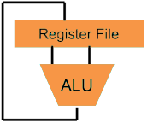
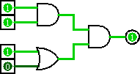
Great Idea #1: Levels of Representation/Interpretation
Higher-Level Language Program (e.g. C)
temp = v[k];
v[k] = v[k+1];
v[k+1] = temp;
Compiler
lw $t0, 0($2)
lw $t1, 4($2)
sw $t1, 0($2)
sw $t0, 4($2)
Assembly Language Program (e.g. MIPS)
Assembler
0000 1001 1100 0110 1010 1111 0101 1000
1010 1111 0101 1000 0000 1001 1100 0110
1100 0110 1010 1111 0101 1000 0000 1001
0101 1000 0000 1001 1100 0110 1010 1111
Machine Language Program (MIPS)
We are here
Machine Interpretation
Hardware Architecture Description (e.g. block diagrams)
Architecture Implementation
Logic Circuit Description (Circuit Schematic Diagrams)

Slide 37
Hardware Design
Upcoming: We’ll study how a modern processor is built, starting with basic elements as building blocks
Why study hardware design?
Understand capabilities and limitations of hardware in general and processors in particular
What processors can do fast and what they can’t do fast (avoid slow things if you want your code to run fast!)
Background for more in-depth courses (CS150, CS152)
You may need to design own custom hardware for extra performance (some commercial processors today have customizable hardware)

Slide 38
Design Hierarchy
system
Next
week
datapath
control
code registers
state registers
combinational logic
multiplexer
comparator
Later this
week
register
logic
switching networks
Today

Slide 39
Switches (1/2)
The basic element of physical implementations
Convention: if input is a “1,” the switch is asserted
A
Z
Open switch if A is “0” (unasserted)
and turn OFF light bulb (Z)
A
Z
Close switch if A is “1” (asserted) and turn ON light bulb (Z)
In this example, Z ≡ A.

Slide 40
Switches (2/2)
Can compose switches into more complex ones (Boolean functions)
Arrows show action upon assertion (1 = close)
A
B
AND:
“1”
Z ≡ A and B
A
OR:
“1”
Z ≡ A or B
B

Slide 41
Transistor Networks
Modern digital systems designed in CMOS
MOS: Metal-Oxide on Semiconductor
C for complementary: use pairs of normally-open and normally-closed switches
CMOS transistors act as voltage-controlled switches
Similar, though easier to work with, than relay switches from earlier era
Three terminals: Source, Gate, and Drain
G
S
D

Slide 42
CMOS Transistors
Switch action based on relative voltages on Gate (V_{G}) and Source (V_{S}) terminals
Threshold voltage (V_{T}) determines whether of not Source and Drain terminals are connected
When not connected, Drain left “floating”
N-channel Transistor
V_{G}–V_{S} < V_{T}: Switch OPEN
V_{G}–V_{S} > V_{T}: Switch CLOSED
P-channel Transistor
V_{G}–V_{S} < V_{T}: Switch CLOSED
V_{G}–V_{S} > V_{T}: Switch OPEN
Circle symbol means “NOT” or “complement”
Gate
Gate
Source
Drain
Source
Drain
Notes:
From wikipedia:
The field-effect transistor (FET) relies on an electric field to control the shape and hence the conductivity of a channel of one type of charge carrier in a semiconductor material.
The most commonly used FET is the MOSFET. The CMOS (complementary-symmetry metal oxide semiconductor) process technology is the basis for modern digital integrated circuits. This process technology uses an arrangement where the (usually "enhancement-mode") p-channel MOSFET and n-channel MOSFET are connected in series such that when one is on, the other is off.

Slide 43
MOS Networks
What is the relationship between X and Y?
Called an inverter or NOT gate
Voltage Source (“1”)
X
X
Y
3v
0 volts
3 volts
Y
3 volts
0 volts
0v
Ground (“0”)

Slide 44
Two Input Networks
X
Y
X
Y
Z
NAND gate (NOT AND)
3v
0 volts
3 volts
0 volts
0 volts
3 volts
3 volts
Z
3 volts
0 volts
3 volts
0v
3 volts
3 volts
0 volts
X
Y
NOR gate (NOT OR)
X
Y
Z
3v
0 volts
0 volts
3 volts
0 volts
3 volts
0 volts
Z
3 volts
0 volts
0 volts
0v
3 volts
3 volts
0 volts
Notes:
Bottom
X = 0v Y = 0V both closed on top in series, so Z = 3v
X = 0v Y = 0V both open bottom
X = 0v Y = 3V 1st open on top,
X = 0v Y = 3V 2nd in series closed, so Z = 0v
X = 3v Y = 0V 2nd open on top
X = 3v Y = 0V 2nd in series closed, so Z = 0v
X = 3v Y = 3V both open on top
X = 3v Y = 3V both closed, so Z = 0v

Slide 45
Transistors and CS61C
The internals of transistors are important, but won’t be covered in this class
Better understand Moore’s Law
Physical limitations relating to speed and power consumption
Actual physical design & implementation process
Can take EE40, EE105, and EE140
We will proceed with the abstraction of Digital Logic (0/1)

Slide 46
Block Diagrams
In reality, chips composed of just transistors and wires
Small groups of transistors form useful building blocks, which we show as blocks
Can combine to build higher-level blocks
You can build AND, OR, and NOT out of NAND!
X
Y
3v
≡
X
NAND
Z
Y
Z
0v

Slide 47
Question: Which set(s) of inputs will result in the output Z being 3 volts?
X
Y
X Y
3v
☐
0 0
☐
0 1
Z
☐
1 0
0v
☐
1 1
Notes:
Reason we need half to be private is because EVERY processor is running the “half = half/2” instruction. If Shared, would hit < 1 in one pass!

Slide 48
Summary
OpenMP as simple parallel extension to C
During parallel fork, be aware of which variables should be shared vs. private among threads
Work-sharing accomplished with for/sections
Synchronization accomplished with critical/atomic/reduction
Hardware is made up of transistors and wires
Transistors are voltage-controlled switches
Building blocks of all higher-level blocks

Slide 49
BONUS SLIDES
You are responsible for the material contained on the following slides, though we may not have enough time to get to them in lecture.
They have been prepared in a way that should be easily readable and the material will be touched upon in the following lecture.

Slide 50
Agenda
OpenMP Introduction
Administrivia
OpenMP Directives
Workshare
Synchronization
OpenMP Common Pitfalls
Hardware: Transistors
Bonus: sections Example

Slide 51
Workshare sections Example (1/4)
#include <omp.h>
#include <stdio.h>
#include <stdlib.h>
#define N 50
int main (int argc, char *argv[]) {
int i, nthreads, tid;
float a[N], b[N], c[N], d[N];
/* Initialize arrays with some data */
for (i=0; i<N; i++) {
a[i] = i * 1.5;
b[i] = i + 22.35;
c[i] = d[i] = 0.0;
}
/* main() continued on next slides... */

Slide 52
Workshare sections Example (2/4)
#pragma omp parallel private(i,tid) {
tid = omp_get_thread_num();
if (tid == 0) {
nthreads = omp_get_num_threads();
printf("Number of threads = %d\n", nthreads);
}
printf("Thread %d starting...\n",tid);
#pragma omp sections nowait {
#pragma omp section {
printf("Thread %d doing section 1\n",tid);
for (i=0; i<N; i++){
c[i] = a[i] + b[i];
printf("Thread %d: c[%d]= %f\n",tid,i,c[i]);
}
}
Declare Sections
Define individual sections

Slide 53
Workshare sections Example (3/4)
#pragma omp section {
printf("Thread %d doing section 2\n",tid);
for (i=0; i<N; i++){
d[i] = a[i] * b[i];
printf("Thread %d: d[%d]= %f\n",tid,i,d[i]);
}
}
} /* end of sections */
printf("Thread %d done.\n",tid);
} /* end of parallel section */
} /* end of main */
2nd section

Slide 54
Workshare sections Example (4/4)
Number of threads = 2
Thread 1 starting...
Thread 0 starting...
Thread 1 doing section 1
Thread 0 doing section 2
Thread 1: c[0]= 22.350000
Thread 0: d[0]= 0.000000
Thread 1: c[1]= 24.850000
Thread 0: d[1]= 35.025002
Thread 1: c[2]= 27.350000
Thread 0: d[2]= 73.050003
Thread 1: c[3]= 29.850000
Thread 0: d[3]= 114.075005
Thread 1: c[4]= 32.349998
Thread 0: d[4]= 158.100006
Thread 1: c[5]= 34.849998
Thread 0: d[5]= 205.125000
Thread 1: c[6]= 37.349998
Thread 0: d[6]= 255.150009
Thread 1: c[7]= 39.849998
Thread 0: d[7]= 308.175018
Thread 0: d[8]= 364.200012
Thread 0: d[9]= 423.225006
Thread 0: d[10]= 485.249969
Thread 0: d[11]= 550.274963
Thread 0: d[12]= 618.299988
Thread 0: d[13]= 689.324951
Thread 0: d[14]= 763.349976
Thread 0: d[15]= 840.374939
. . .
Thread 1: c[33]= 104.849998
Thread 0: d[41]= 3896.024902
Thread 1: c[34]= 107.349998
Thread 0: d[42]= 4054.049805
Thread 1: c[35]= 109.849998
Thread 0: d[43]= 4215.074707
Thread 1: c[36]= 112.349998
Thread 0: d[44]= 4379.100098
Thread 1: c[37]= 114.849998
Thread 1: c[38]= 117.349998
Thread 1: c[39]= 119.849998
Thread 1: c[40]= 122.349998
Thread 1: c[41]= 124.849998
Thread 1: c[42]= 127.349998
Thread 1: c[43]= 129.850006
Thread 1: c[44]= 132.350006
Thread 0: d[45]= 4546.125000
Thread 1: c[45]= 134.850006
Thread 0: d[46]= 4716.149902
Thread 1: c[46]= 137.350006
Thread 0: d[47]= 4889.174805
Thread 1: c[47]= 139.850006
Thread 0: d[48]= 5065.199707
Thread 0: d[49]= 5244.225098
Thread 0 done.
Thread 1: c[48]= 142.350006
Thread 1: c[49]= 144.850006
Thread 1 done.
Notice inconsistent thread scheduling!
nowait option in sections allows threads to exit “early”

