Slide 1
CS 61C: Great Ideas in Computer Architecture
Pipelining Hazards
Instructor: Justin Hsia

Slide 2
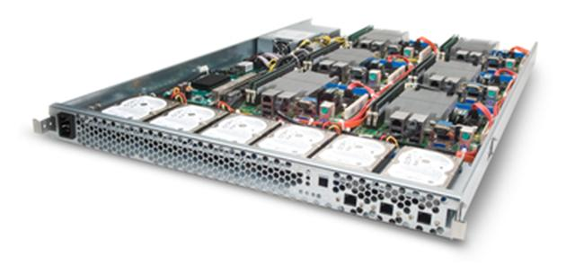
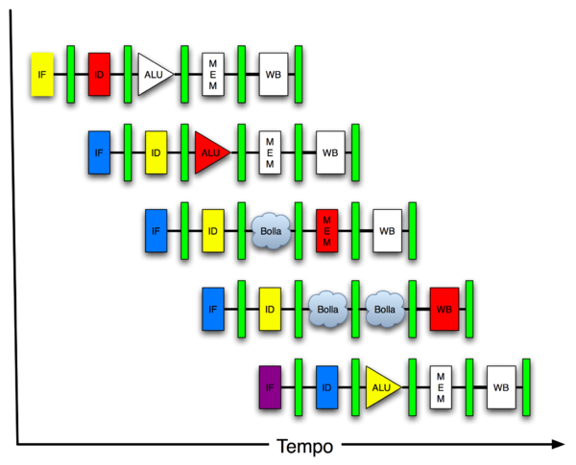
Great Idea #4: Parallelism
Software Hardware
Parallel Requests
Assigned to computer
e.g. search “Katz”
Parallel Threads
Assigned to core
e.g. lookup, ads
Parallel Instructions
> 1 instruction @ one time
e.g. 5 pipelined instructions
Parallel Data
> 1 data item @ one time
e.g. add of 4 pairs of words
Hardware descriptions
All gates functioning in parallel at same time
Warehouse Scale Computer
Smart Phone
Leverage Parallelism &
Achieve High Performance
Computer
Core
…
Core
Memory
Input/Output
Core
Instruction Unit(s)
Functional
Unit(s)
A₀+B₀
A₁+B₁
A₂+B₂
A₃+B₃
Cache Memory
Logic Gates

Slide 3
Review of Last Lecture
Implementing controller for your datapath
Take decoded signals from instruction and generate control signals
Use “AND” and “OR” Logic scheme
Pipelining improves performance by exploiting Instruction Level Parallelism
5-stage pipeline for MIPS: IF, ID, EX, MEM, WB
Executes multiple instructions in parallel
Each instruction has the same latency
What can go wrong???

Slide 4
Question: Are the following statement TRUE or FALSE?
Adding a new instruction will NOT require changing any of your existing control logic.
Adding a new control signal will NOT require changing any of your existing control logic.
1 2
☐
F F
☐
F T
☐
T F
☐
T T

Slide 5
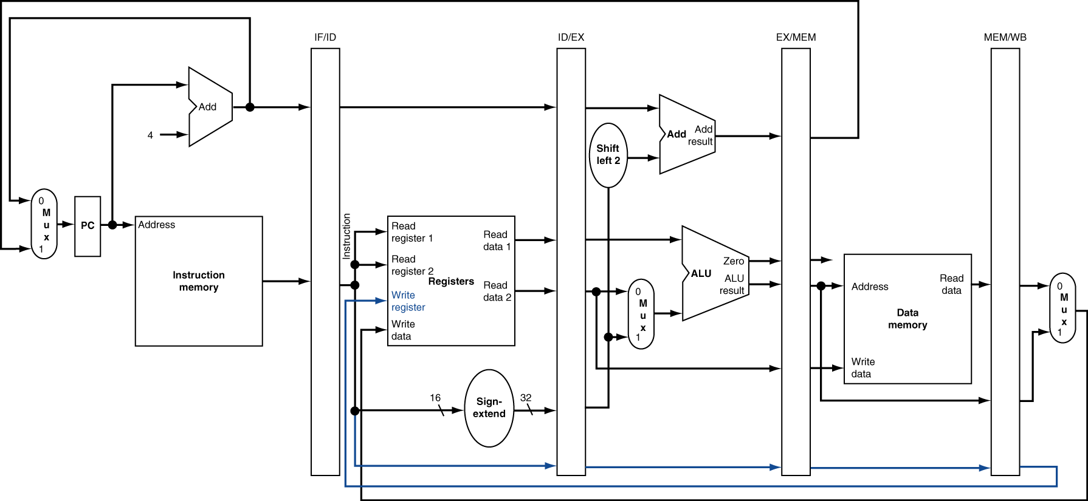
Review: Pipelined Datapath

Slide 6
Graphical Pipeline Representation
RegFile: right half is read, left half is write
Time (clock cycles)
I
n
s
t
r
O
r
d
e
r
Load
I$
Reg
ALU
D$
Reg
Add
I$
Reg
ALU
D$
Reg
Store
I$
Reg
ALU
D$
Reg
Sub
I$
Reg
ALU
D$
Reg
Or
I$
Reg
ALU
D$
Reg

Slide 7
Question: Which of the following signals (buses or control signals) for MIPS-lite does NOT need to be passed into the EX pipeline stage?
☐
PC + 4
IF
ID
EX
Mem
WB
☐
MemWr
☐
RegWr
I$
Reg
ALU
D$
Reg
☐
imm16

Slide 8
Pipelining Hazards
A hazard is a situation that prevents starting the next instruction in the next clock cycle
Structural hazard
A required resource is busy (e.g. needed in multiple stages)
Data hazard
Data dependency between instructions
Need to wait for previous instruction to complete its data read/write
Control hazard
Flow of execution depends on previous instruction

Slide 9
Agenda
Structural Hazards
Data Hazards
Forwarding
Administrivia
Data Hazards (Continued)
Load Delay Slot
Control Hazards
Branch and Jump Delay Slots
Branch Prediction

Slide 10
1. Structural Hazards
Conflict for use of a resource
MIPS pipeline with a single memory?
Load/Store requires memory access for data
Instruction fetch would have to stall for that cycle
Causes a pipeline “bubble”
Hence, pipelined datapaths require separate instruction/data memories
Separate L1 I$ and L1 D$ take care of this

Slide 11
Structural Hazard #1: Single Memory
Time (clock cycles)
I
n
s
t
r
O
r
d
e
r
Trying to read same memory twice in same clock cycle
Load
I$
Reg
ALU
D$
Reg
Instr 1
I$
Reg
ALU
D$
Reg
Instr 2
I$
Reg
ALU
D$
Reg
Instr 3
I$
Reg
ALU
D$
Reg
Instr 4
I$
Reg
ALU
D$
Reg

Slide 12
Structural Hazard #2: Registers (1/2)
Time (clock cycles)
I
n
s
t
r
O
r
d
e
r
Load
I$
Reg
ALU
D$
Reg
Can we read and write to registers simultaneously?
Instr 1
I$
Reg
ALU
D$
Reg
Instr 2
I$
Reg
ALU
D$
Reg
Instr 3
I$
Reg
ALU
D$
Reg
Instr 4
I$
Reg
ALU
D$
Reg

Slide 13
Structural Hazard #2: Registers (2/2)
Two different solutions have been used:
Split RegFile access in two: Write during 1st half and Read during 2nd half of each clock cycle
Possible because RegFile access is VERY fast (takes less than half the time of ALU stage)
Build RegFile with independent read and write ports
Conclusion: Read and Write to registers during same clock cycle is okay

Slide 14
Agenda
Structural Hazards
Data Hazards
Forwarding
Administrivia
Data Hazards (Continued)
Load Delay Slot
Control Hazards
Branch and Jump Delay Slots
Branch Prediction

Slide 15
2. Data Hazards (1/2)
Consider the following sequence of instructions:
add $t0, $t1, $t2
sub $t4, $t0, $t3
and $t5, $t0, $t6
or $t7, $t0, $t8
xor $t9, $t0, $t10

Slide 16
2. Data Hazards (2/2)
Data-flow backward in time are hazards
Time (clock cycles)
I
n
s
t
r
O
r
d
e
r
IF
ID/RF
EX
MEM
WB
add $t0,$t1,$t2
I$
Reg
ALU
D$
Reg
sub $t4,$t0,$t3
I$
Reg
ALU
D$
Reg
and $t5,$t0,$t6
I$
Reg
ALU
D$
Reg
or $t7,$t0,$t8
I$
Reg
ALU
D$
Reg
xor $t9,$t0,$t10
I$
Reg
ALU
D$
Reg

Slide 17
Data Hazard Solution: Forwarding
Forward result as soon as it is available
OK that it’s not stored in RegFile yet
IF
ID/RF
EX
MEM
WB
add $t0,$t1,$t2
I$
Reg
ALU
D$
Reg
sub $t4,$t0,$t3
I$
Reg
ALU
D$
Reg
and $t5,$t0,$t6
I$
Reg
ALU
D$
Reg
or $t7,$t0,$t8
I$
Reg
ALU
D$
Reg
xor $t9,$t0,$t10
I$
Reg
ALU
D$
Reg

Slide 18
Datapath for Forwarding (1/2)
What changes need to be made here?

Slide 19
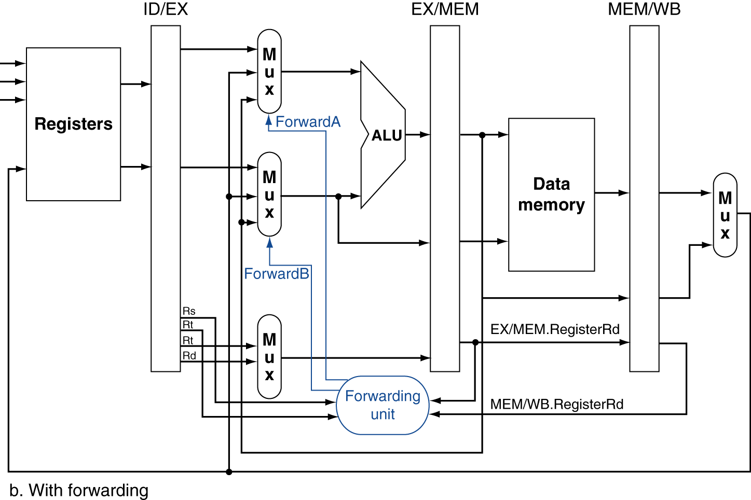
Datapath for Forwarding (2/2)
Handled by forwarding unit
Notes:
Scan figure 4.54 on p. 368.

Slide 20
Agenda
Structural Hazards
Data Hazards
Forwarding
Administrivia
Data Hazards (Continued)
Load Delay Slot
Control Hazards
Branch and Jump Delay Slots
Branch Prediction

Slide 21
Administrivia
HW 4 due tonight
Project 2 Part 2 due Sunday
Project 3 will be released Thursday or Friday

Slide 22
Agenda
Structural Hazards
Data Hazards
Forwarding
Administrivia
Data Hazards (Continued)
Load Delay Slot
Control Hazards
Branch and Jump Delay Slots
Branch Prediction

Slide 23
Data Hazard: Loads (1/4)
Recall: Dataflow backwards in time are hazards
Can’t solve all cases with forwarding
Must stall instruction dependent on load, then forward (more hardware)
IF
ID/RF
EX
MEM
WB
lw $t0,0($t1)
I$
Reg
ALU
D$
Reg
sub $t3,$t0,$t2
I$
Reg
ALU
D$
Reg

Slide 24
Data Hazard: Loads (2/4)
Schematically, this is what we want, but in reality stalls done “horizontally”
Hardware stalls pipeline
Called “hardware interlock”
IF
ID/RF
EX
MEM
WB
lw $t0, 0($t1)
I$
Reg
ALU
D$
Reg
sub $t3,$t0,$t2
bubble
I$
Reg
ALU
D$
Reg
and $t5,$t0,$t4
I$
bubble
Reg
ALU
D$
Reg
or $t7,$t0,$t6
How to stall just part of pipeline?
bubble
I$
Reg
ALU
D$

Slide 25
Data Hazard: Loads (3/4)
Stall is equivalent to nop
lw $t0, 0($t1)
I$
Reg
ALU
D$
Reg
nop
bubble
bubble
bubble
bubble
bubble
sub $t3,$t0,$t2
I$
Reg
ALU
D$
Reg
and $t5,$t0,$t4
I$
Reg
ALU
Reg
D$
or $t7,$t0,$t6
I$
Reg
ALU
D$

Slide 26
Data Hazard: Loads (4/4)
Slot after a load is called a load delay slot
If that instruction uses the result of the load, then the hardware interlock will stall it for one cycle
Letting the hardware stall the instruction in the delay slot is equivalent to putting a nop in the slot (except the latter uses more code space)
Idea: Let the compiler put an unrelated instruction in that slot → no stall!

Slide 27
Code Scheduling to Avoid Stalls
Reorder code to avoid use of load result in the next instruction!
MIPS code for A=B+E; C=B+F;
# Method 1:
lw $t1, 0($t0)
lw $t2, 4($t0)
add $t3, $t1, $t2
sw $t3, 12($t0)
lw $t4, 8($t0)
add $t5, $t1, $t4
sw $t5, 16($t0)
# Method 2:
lw $t1, 0($t0)
lw $t2, 4($t0)
lw $t4, 8($t0)
add $t3, $t1, $t2
sw $t3, 12($t0)
add $t5, $t1, $t4
sw $t5, 16($t0)
Stall!
Stall!
13 cycles
11 cycles

Slide 28
Agenda
Structural Hazards
Data Hazards
Forwarding
Administrivia
Data Hazards (Continued)
Load Delay Slot
Control Hazards
Branch and Jump Delay Slots
Branch Prediction

Slide 29
3. Control Hazards
Branch (beq, bne) determines flow of control
Fetching next instruction depends on branch outcome
Pipeline can’t always fetch correct instruction
Still working on ID stage of branch
Simple Solution: Stall on every branch until we have the new PC value
How long must we stall?

Slide 30
Branch Stall
When is comparison result available?
Time (clock cycles)
I
n
s
t
r
O
r
d
e
r
beq
I$
Reg
ALU
D$
Reg
TWO bubbles required per branch!
Instr 1
I$
Reg
ALU
D$
Reg
Instr 2
I$
Reg
ALU
D$
Reg
Instr 3
I$
Reg
ALU
D$
Reg
Instr 4
I$
Reg
ALU
D$
Reg

Slide 31
3. Control Hazard: Branching
Option #1: Insert special branch comparator in ID stage
As soon as instruction is decoded, immediately make a decision and set the new value of the PC
Benefit: Branch decision made in 2nd stage, so only one nop is needed instead of two
Side Note: This means that branches are idle in EX, MEM, and WB

Slide 32
Improved Branch Stall
When is comparison result available?
Time (clock cycles)
I
n
s
t
r
O
r
d
e
r
beq
I$
Reg
ALU
D$
Reg
Only one bubble required now
Instr 1
I$
Reg
ALU
D$
Reg
Instr 2
I$
Reg
ALU
D$
Reg
Instr 3
I$
Reg
ALU
D$
Reg
Instr 4
I$
Reg
ALU
D$
Reg

Slide 33
Datapath for ID Branch Comparator
What changes need to be made here?

Slide 34
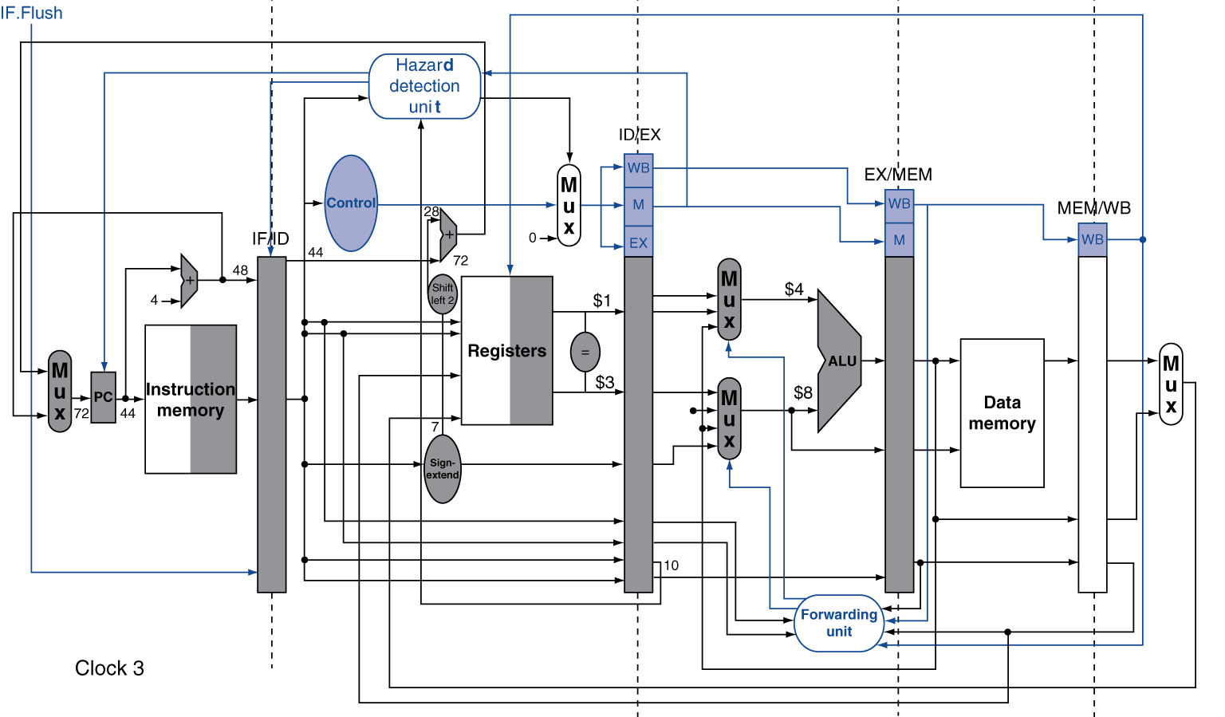
Datapath for ID Branch Comparator
Handled by hazard detection unit
Notes:
Scan figure 4.54 on p. 368.

Slide 35
3. Control Hazard: Branching
Option #2: Branch Prediction – guess outcome of a branch, fix afterwards if necessary
Must cancel (flush) all instructions in pipeline that depended on guess that was wrong
How many instructions do we end up flushing?
Achieve simplest hardware if we predict that all branches are NOT taken

Slide 36
3. Control Hazard: Branching
Option #3: Branch delay slot
Whether or not we take the branch, always execute the instruction immediately following the branch
Worst-Case: Put a nop in the branch-delay slot
Better Case: Move an instruction from before the branch into the branch-delay slot
Must not affect the logic of program

Slide 37
3. Control Hazard: Branching
MIPS uses this delayed branch concept
Re-ordering instructions is a common way to speed up programs
Compiler finds an instruction to put in the branch delay slot ≈ 50% of the time
Jumps also have a delay slot
Why is one needed?

Slide 38
Delayed Branch Example
Nondelayed Branch
Delayed Branch
or $8, $9, $10
add $1, $2,$3
add $1, $2, $3
sub $4, $5, $6
sub $4, $5, $6
beq $1, $4, Exit
beq $1, $4, Exit
or $8, $9, $10
xor $10, $1, $11
xor $10, $1, $11
Why not any of the other instructions?
Exit:
Exit:

Slide 39
Delayed Jump in MIPS
MIPS Green Sheet for jal: R[31]=PC+8; PC=JumpAddr
PC+8 because of jump delay slot!
Instruction at PC+4 always gets executed before jal jumps to label, so return to PC+8

Slide 40
Get To Know Your Staff
Category: Movies

Slide 41
Agenda
Structural Hazards
Data Hazards
Forwarding
Administrivia
Data Hazards (Continued)
Load Delay Slot
Control Hazards
Branch and Jump Delay Slots
Branch Prediction

Slide 42
Dynamic Branch Prediction
Branch penalty is more significant in deeper pipelines
Also superscalar pipelines (discussed tomorrow)
Use dynamic branch prediction
Have branch prediction buffer (a.k.a. branch history table) that stores outcomes (taken/not taken) indexed by recent branch instruction addresses
To execute a branch
Check table and predict the same outcome for next fetch
If wrong, flush pipeline and flip prediction

Slide 43
1-Bit Predictor: Shortcoming
Examine the code below, assuming both loops will be executed multiple times:
outer: … … inner: …
…
beq …, …, inner … beq …, …, outer
Inner loop branches are predicted wrong twice!
Predict as taken on last iteration of inner loop
Then predict as not taken on first iteration of inner loop next time around

Slide 44
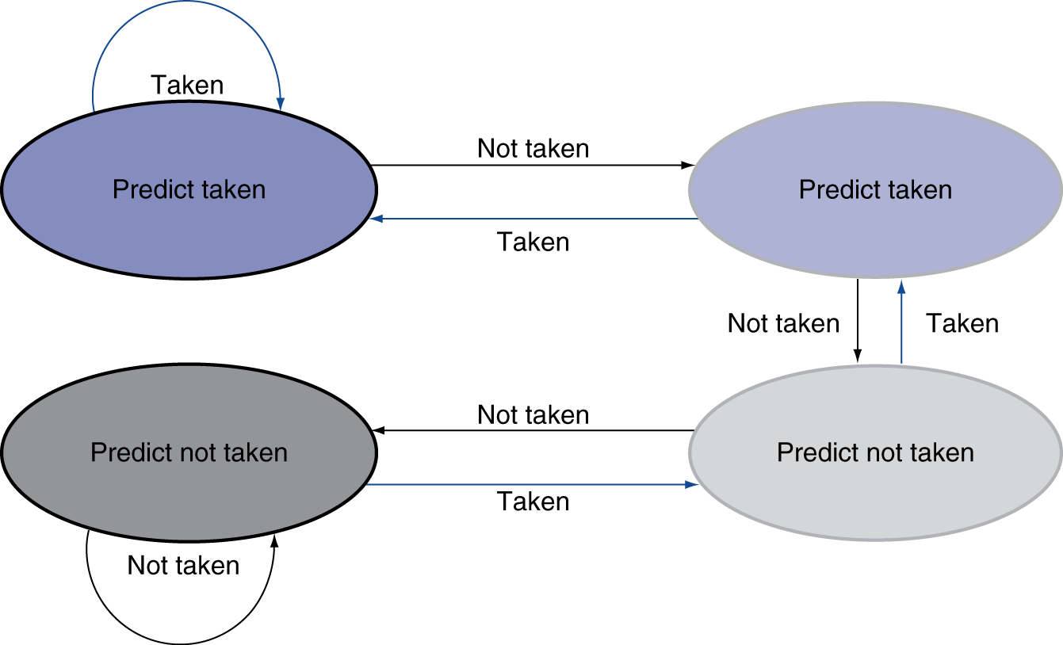
2-Bit Predictor
Only change prediction after two successive incorrect predictions

Slide 45
Question: Are the following statement TRUE or FALSE?
Thanks to pipelining, I have reduced the time it took me to wash my one shirt
Longer pipelines are always a win (since less work per stage & a faster clock)
1 2
☐
F F
☐
F T
☐
T F
☐
T T

Slide 46
Question: For each code sequences below, choose one of the statements below:
1: lw $t0,0($t0) add $t1,$t0,$t0 | 2: add $t1,$t0,$t0 addi $t2,$t0,5 addi $t4,$t1,5 | 3: addi $t1,$t0,1 addi $t2,$t0,2 addi $t3,$t0,2 addi $t3,$t0,4 addi $t5,$t1,5
☐
No stalls as is
☐
No stalls with forwarding
☐
Must stall

Slide 47
Code Sequence 1
Time (clock cycles)
I
n
s
t
r
O
r
d
e
r
lw
I$
Reg
ALU
D$
Reg
Must stall
add
I$
Reg
ALU
D$
Reg
instr
I$
Reg
ALU
D$
Reg
instr
I$
Reg
ALU
D$
Reg
instr
I$
Reg
ALU
D$
Reg

Slide 48
Code Sequence 2
Time (clock cycles)
forwarding
I
n
s
t
r
O
r
d
e
r
no forwarding
add
I$
Reg
ALU
D$
Reg
No stalls with forwarding
addi
I$
Reg
ALU
D$
Reg
addi
I$
Reg
ALU
D$
Reg
instr
I$
Reg
ALU
D$
Reg
instr
I$
Reg
ALU
D$
Reg

Slide 49
Code Sequence 3
Time (clock cycles)
I
n
s
t
r
O
r
d
e
r
I$
Reg
ALU
D$
Reg
No stalls as is
addi
addi
I$
Reg
ALU
D$
Reg
addi
I$
Reg
ALU
D$
Reg
addi
I$
Reg
ALU
D$
Reg
addi
I$
Reg
ALU
D$
Reg

Slide 50
Summary
Hazards reduce effectiveness of pipelining
Cause stalls/bubbles
Structural Hazards
Conflict in use of datapath component
Data Hazards
Need to wait for result of a previous instruction
Control Hazards
Address of next instruction uncertain/unknown
Branch and jump delay slots

